Slide 1
V
Health Information Technology Council Meeting
August 3, 2020
Notes:
Title slide
Health Information Technology Council Meeting
August 3, 2020

Slide 2
Agenda
Welcome
Undersecretary Lauren Peters
Approval of the Feb. 3, 2020 minutes (vote)
Updates from last meeting
Undersecretary Lauren Peters & Bert Ng
Clinical Gateway nodes
David Whitham
HIway strategic plan
Undersecretary Lauren Peters & Bert Ng
HIway budget
Bert Ng & David Whitham
HIway connection requirement & 2020 attestation
Chris Stuck-Girard
Conclusion
Undersecretary Lauren Peters
Notes:
Slide title: Agenda
Welcome
Undersecretary Lauren Peters
-Approval of the Feb. 3, 2020 minutes (vote)
Updates from last meeting
Bert Ng
Clinical Gateway nodes
David Whitham
HIway strategic plan
Undersecretary Lauren Peters & Bert Ng
HIway budget
Bert Ng & David Whitham
HIway connection requirement & 2020 attestation
Chris Stuck-Girard
Conclusion
Undersecretary Lauren Peters

Slide 3
Welcome
Undersecretary Lauren Peters
Notes:
Welcome
Undersecretary Lauren Peters

Slide 4
Vote: Approve minutes
MOTION: That the Health Information Technology Council hereby approves the minutes of the council meeting held on February 3, 2020 as presented/amended
Notes:
Slide title: Vote: Approve minutes
MOTION: That the Health Information Technology Council hereby approves the minutes of the council meeting held on February 3, 2020 as presented/amended

Slide 5
Updates from last meeting
Undersecretary Lauren Peters & Bert Ng
Notes:
Updates from last meeting
Lauren Peters & Bert Ng

Slide 6
Update: EHR market share by provider organization type
The top three EHRs of each provider organization type represent more than two-thirds of the market share.
n: 74
n: 38
n: 592
Epic has the largest market share among the attestation submitters (about one-third of all markets)
All named vendors are Query HIE capable and have FHIR-based APIs (albeit older release of FHIR)
Source: Mass HIway CRM Data Extract Mar 2020;
Mass HIway Attestation Data CY 2019
Notes:
Slide title: Update: EHR market share by provider organization type
Top box: The top three EHRs of each provider organization type represent more than two-thirds of the market share
Left pie chart (Hospital):
38% Meditech
38% Epic
15% Cerner
9% Other
N: 74
Middle pie chart (CHC):
32% Epic
26% Other
24% eClinicalWorks
18% NextGen
N: 38
Right pie chart (Practices):
30% Other
28% Epic
24% Athenahealth
18% eClinicalWorks
N: 592
Bottom box:
Epic has the largest market share among the attestation submitters (about one-third of all markets)
All named vendors are Query HIE capable and have FHIR-based APIs (albeit older release of FHIR)
Source: Mass HIway CRM Data Extract Mar 2020;
Mass HIway Attestation Data CY 2019

Slide 7
Update: Major provider systems shift to Epic
In 2018, Epic was the market leader with a market share of approximately 28%. Since our last meeting, Epic announced two major provider systems shifting to them.
AdventHealth
Multistate – Florida (HQ)
37 hospitals – 1,200 outpatient clinics
2/11/20
Atrium Health
Multistate – North Carolina (HQ)
40 hospitals – 900 outpatient clinics
2/20/20
Source: https://www.beckershospitalreview.com/ehrs/11-hospitals-health-systems-that-replaced-cerner-with-epic-in-the-past-5-years.html
Notes:
Slide title: Update: Major provider systems shift to Epic
Top box: In 2018, Epic was the market leader with a market share of approximately 28%. Since our last meeting, Epic announced two major provider systems shifting to them.
2nd box:
AdventHealth
Multistate – Florida (HQ); 37 hospitals – 1,200 outpatient clinics
2/11/20: Cerner ⇒ Epic
3rd box:
Atrium Health
Multistate – North Carolina (HQ); 40 hospitals – 900 outpatient clinics
2/20/20: Cerner ⇒ Epic
Source: https://www.beckershospitalreview.com/ehrs/11-hospitals-health-systems-that-replaced-cerner-with-epic-in-the-past-5-years.html

Slide 8
Clinical Gateway nodes
David Whitham
Notes:
Clinical Gateway nodes
David Whitham

Slide 9
CCG: Mass HIway Consolidated Clinical Gateway Project
Clinical Gateway nodes enable providers to submit messages through the Mass HIway to EOHHS applications, mostly supporting the DPH backend applications.
Currently there are seven (7) applications
Massachusetts Cancer Registry (MCR)
Childhood Lead Poison Prevention Program (CLPPP)
Children’s Behavioral Health Initiative (CBHI)
Electronic Lab Reporting (ELR)
Immunization (MIIS)
Intake Enrolment Assessment and Transfer Service (OTP&TB)
Syndromic Surveillance (SYNDROMIC)
This project will re-implement the current suite of Clinical Gateway nodes as a Consolidated Clinical Gateway (CCG) application running in the AWS cloud that offers submitters a choice of interface options while reducing EOHHS maintenance, operational complexity, and costs.
Key project objectives include
Migrate to AWS to reduce infrastructure costs and address scalability
Provide future alternatives to Direct messaging for public health reporting
Support Query & Retrieve functionality to align with TEFCA
Implement a FHIR interface to support enhanced the business functionality
Notes:
Slide title: CCG: Mass HIway Consolidated Clinical Gateway Project
Clinical Gateway nodes enable providers to submit messages through the Mass HIway to EOHHS applications, mostly supporting the DPH backend applications.
Currently there are seven (7) applications:
-Massachusetts Cancer Registry (MCR)
-Childhood Lead Poison Prevention Program (CLPPP)
-Children’s Behavioral Health Initiative (CBHI)
-Electronic Lab Reporting (ELR)
-Immunization (MIIS)
-Intake Enrolment Assessment and Transfer Service (OTP&TB)
-Syndromic Surveillance (SYNDROMIC)
This project will re-implement the current suite of Clinical Gateway nodes as a Consolidated Clinical Gateway (CCG) application running in the AWS cloud that offers submitters a choice of interface options while reducing EOHHS maintenance, operational complexity, and costs.
Key project objectives include:
-Migrate to AWS to reduce infrastructure costs and address scalability
-Provide future alternatives to Direct messaging for public health reporting
-Support Query & Retrieve functionality to align with TEFCA
-Implement a FHIR interface to support enhanced the business functionality

Slide 10
CCG: Business requirements
Program Business Requirements
Enhance Functionality
Migrate to AWS
3
1
2
Consolidate CG Nodes
Notes:
Slide title: CCG: Business requirements
Program Business Requirements
Flowchart
Phase 1: Migrate to AWS
Phase 2: Consolidate CG Nodes
Phase 3: Enhance Functionality

Slide 11
CCG: Migrating to AWS
Design Features
Develop, test, and deploy Consolidated CCG in AWS
Establish EOHHS support, maintenance, and release management procedures for AWS
Eliminate need for LW VG4 environments for current CG nodes
Benefits
Reduces infrastructure overhead & cost
Creates easily scalable infrastructure
Easy to manage
Reduces or eliminates downtime
Supports EOHHS IT enterprise-wide move towards AWS
Risks
Learning curve
Architecture adjustments for optimized returns
Staffing impacts as new processes evolve for support, maintenance, and release management
Unknown dependencies on EOTSS team
Migrate to AWS
3
1
2
Notes:
Slide title: CCG: Migrating to AWS
Design Features:
Develop, test, and deploy Consolidated CCG in AWS
Establish EOHHS support, maintenance, and release management procedures for AWS
Eliminate need for LW VG4 environments for current CG nodes
Benefits:
Reduces infrastructure overhead & cost
Creates easily scalable infrastructure
Easy to manage
Reduces or eliminates downtime
Supports EOHHS IT enterprise-wide move towards AWS
Risks:
Learning curve
Architecture adjustments for optimized returns
Staffing impacts as new processes evolve for support, maintenance, and release management
Unknown dependencies on EOTSS team

Slide 12
CCG: Consolidating CG nodes
Design Features
Consolidates from current 7 separate nodes
Reduces infrastructure requirements
Implements context-based routing component for clinical nodes
Benefits
Maintaining CCG will be more manageable and can be included in the general downtime windows
Deployment from Development to consolidated environments (QA, Certification, and Production) as opposed to 3 deployments for each of 7 applications
Simpler deployment of upgrades, patches, and enhancements
Reduced number of VMs and overhead will lower the operating costs
Fewer Rhapsody instances required
Simpler routing of messages with single endpoint
Easier maintenance of XML gateway
Easier to add “modules” for new use-cases than building additional nodes
Risks
New development requires significant testing and validation with each backend application
Enhance Functionality
3
1
2
Notes:
Slide title: CCG: Consolidating CG nodes
Design Features:
Consolidates from current 7 separate nodes
Reduces infrastructure requirements
Implements context-based routing component for clinical nodes
Benefits:
Maintaining CCG will be more manageable and can be included in the general downtime windows
Deployment from Development to consolidated environments (QA, Cert, and Prod) as opposed to 3 deployments for each of 7 applications
Simpler deployment of upgrades, patches, and enhancements
Reduced number of VMs and overhead will lower the operating costs
Fewer Rhapsody instances required
Simpler routing of messages with single endpoint
Easier maintenance of XML gateway
Easier to add “modules” for new use-cases than building additional nodes
Risks:
New development requires significant testing and validation with each backend application

Slide 13
CCG: Aligning with FHIR APIs
Design Features
Implement a WSDL-based web service interface solution to support synchronous operations
Support FHIR and other alternative interfaces
Design to operate in parallel with Direct messaging
Benefits
Supports synchronous Query & Retrieve in alignment with direction of TEFCA
Provides alternative to Direct messaging for public health reporting with possible native HL7 from EHRs
Provides alternative to Connect Devices; can begin program to eliminate devices and their heavy support requirements
Fewer Connect Devices and their Direct connections will reduce costs
Easy to implement – already in place for MIIS
Risks
Details of technology and schedule for TEFCA remain unspecified
Enhance Functionality
3
1
2
Notes:
Slide title: CCG: Aligning with FHIR APIs
Enhance Functionality
Design Features:
Implement a WSDL-based web service interface solution to support synchronous operations
Support FHIR and other alternative interfaces
Design to operate in parallel with Direct messaging
Benefits:
Supports synchronous Query & Retrieve in alignment with direction of TEFCA
Provides alternative to Direct messaging for public health reporting with possible native HL7 from EHRs
Provides alternative to Connect Devices; can begin program to eliminate devices and their heavy support requirements
Fewer Connect Devices and their Direct connections will reduce costs
Easy to implement – already in place for MIIS
Risks:
Details of technology and schedule for TEFCA remain unspecified

Slide 14
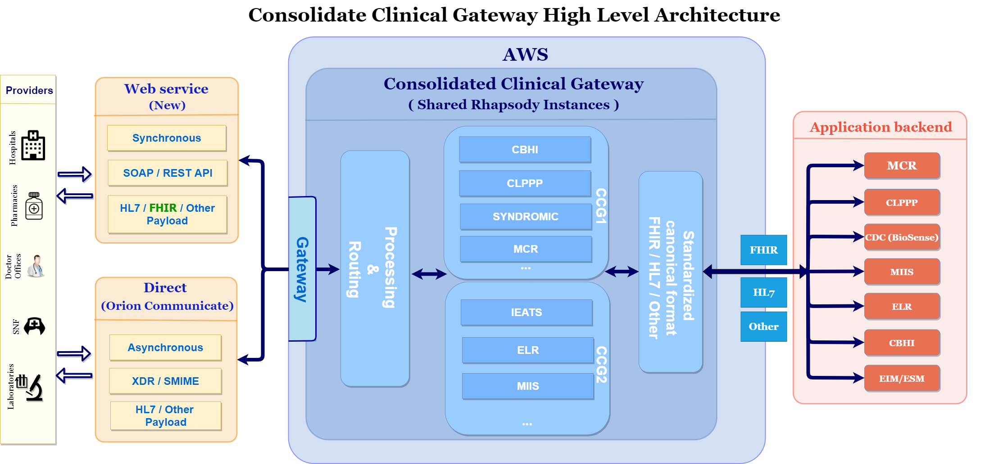
CCG: High Level Architecture
Notes:
Slide title: CCG: High Level Architecture
Far left box (arrows pointing to and from upper and lower middle left boxes): Providers
Upper middle left box (arrows pointing to/from center box): Web Service (New)
Synchronous
SOAP / REST API HL7 / FHIR / Other Payload
Lower middle left box (arrows pointing to/from center box): Direct (Orion Communicate)
Asynchronous
XDR / SMIME
HL7 / Other Payload
Center box (arrows pointing to/from right box): AWS Consolidated Clinical Gateway
Gateway
Processing & Routing
CCG1
CBHI
CLPPP
Syndromic
MCR
CCG2
IEATS
ELR
MIIS
Standardized enhanced format FHIR /HL7 / Other
Right box: Application backend
MCR
CLPPP
CDC BioSense
MIIS
ELR
CBHI
EIM/ESM

Slide 15
CCG: AWS migration timeline
Live - Sep ‘20
Live – Nov ‘20
Live – Jan ‘21
Live – Jun ‘21
Design & Dev
Internal Apps
CCG Phase 1
CCG Phase 2
FHIR & Others
Internal Apps:
Attestation Forms
Masshiway.net
Sugar CRM
Operations Tools
CCG Phase 1:
PROD Go Live
(by Order)
MCR
CBHI
CLPPP
Syndromic
CCG Phase 2:
PROD Go Live
(by Order)
IEATS
ELR
MIIS
Enhancements
FHIR Proof of Concept
Migration notes:
CG nodes in VG4 are retained until the AWS system is stabilized. In case of any issues this allows for a quick rollback to the VG4 environment
Migrations will be done on weekend nights to make sure the message flow is not interrupted during processing hours
For CCG Phase 1, the lower volume nodes will be cutover to PROD first and Syndromic will be last
For CCG Phase 2, the lower volume nodes will be cutover to PROD first and MIIS will be last
Each production cutover will have in-depth pre-production cutover activities
Notes:
Slide Title: CCG: AWS migration timeline
Timeline
Design & Dev
Internal Apps (Live – Sep ‘20)
Attestation Forms
Masshiway.net
Sugar CRM
Operations Tools
CCG Phase 1 (Live – Nov ‘20)
PROD Go Live (by Order)
MCR
CBHI
CLPPP
Syndromic
CCG Phase 2 (Live – Jan ‘21)
Prod Go Live (by Order)
IEATS
ELR
MIIS
FHIR & Others (Live – Jun ‘21)
Enhancements: FHIR Proof of Concept
Migration Notes:
CG nodes in VG4 are retained until the AWS system is stabilized. In case of any issues this allows for a quick rollback to the VG4 environment
Migrations will be done on weekend nights to make sure the message flow is not interrupted during processing hours
For CCG Phase 1, the lower volume nodes will be cutover to PROD first and Syndromic will be last
For CCG Phase 2, the lower volume nodes will be cutover to PROD first and MIIS will be last
Each production cutover will have in-depth pre-production cutover activities

Slide 16
Clinical Gateway nodes: COVID-19
As part of the daily COVID-19 reporting cycle, the Clinical Gateway (CG) nodes receive messages via the Mass HIway’s Direct Messaging System from hospital emergency departments and laboratories, transform them, and deliver them to the Massachusetts Department of Public Health’s Syndromic Surveillance and Electronic Lab Reporting applications for processing and analysis
Syndromic Surveillance
All Massachusetts hospital emergency departments participate
Highest message volume of all CG nodes with an average of 8.5 million messages per month
ED records of admissions and discharges of patients are processed by the Syndromic Surveillance CG node, which feeds the National Syndromic Surveillance Program’s BioSense Platform at the CDC
BioSense data is used by the Commonwealth’s Syndromic Surveillance program at the DPH Bureau of Infectious Disease and Laboratory Sciences for analysis of trends pertaining to COVID-19
Electronic Lab Reporting
CG node handles reports of test results from about 40% of hospital labs
Averages about 1,500 messages per month
Test results from other labs reported directly to the DPH Electronic Lab Reporting program
Notes:
Slide title: Clinical Gateway nodes: COVID-19
As part of the daily COVID-19 reporting cycle, the Clinical Gateway (CG) nodes receive messages via the Mass HIway’s Direct Messaging System from hospital emergency departments and laboratories, transform them, and deliver them to the Massachusetts Department of Public Health’s Syndromic Surveillance and Electronic Lab Reporting applications for processing and analysis
Syndromic Surveillance:
-All Massachusetts hospital emergency departments participate
-Highest message volume of all CG nodes with an average of 8.5 million messages per month
-ED records of admissions and discharges of patients are processed by the Syndromic Surveillance CG node, which feeds the National Syndromic Surveillance Program’s -BioSense Platform at the CDC
-BioSense data is used by the Commonwealth’s Syndromic Surveillance program at the DPH Bureau of Infectious Disease and Laboratory Sciences for analysis of trends pertaining to COVID-19
Electronic Lab Reporting:
-CG node handles reports of test results from about 40% of hospital labs
-Averages about 1,500 messages per month
-Test results from other labs reported directly to the DPH Electronic Lab Reporting program

Slide 17
HIway strategic plan
Undersecretary Lauren Peters & Bert Ng
Notes:
HIway strategic plan
Undersecretary Lauren Peters & Bert Ng

Slide 18
HIway Strategic Plan - Overview
The Mass HIway is the EOHHS program tasked with promoting and increasing adoption of Health Information Exchange (HIE) throughout the Commonwealth
Current frameworks
New initiatives
Direct Messaging
Direct Trust HISP
Implementation team
HIway-sponsored
Service
State-operated systems
eMOLST
HIway-facilitated
Service
Regulatory framework for market-based systems
FHIR API
Ecosystem
Notes:
Slide title: HIway Strategic Plan – Overview
Top box: The Mass HIway is the EOHHS program tasked with the promotion and increasing adoption of Health Information Exchange (HIE) throughout the Commonwealth
Left side top box: Current frameworks
Left side first title box: Direct Messaging
Left side first info box: Direct Trust HISP, Implementation team
Left side second title box: HIway-sponsored Service
Left side second info box: State-operated systems
Left side third title box: HIway-facilitated Service
Left side third info box: Regulatory framework for market-based systems
Line divides left side and right side
Right side top box: New initiatives
Right side second box: eMOLST
Arrow connects eMOLST graphic to HIway-sponsored Service graphic
Right side third box: FHIR API Ecosystem
Arrow connects FHIR API Ecosystem graphic to HIway-facilitated Service graphic

Slide 19
eMOLST: History of MOLST in Massachusetts
Medical Order for Life Sustaining Treatment (MOLST) is an advance care planning document for end of life choices.
2008 – MA legislature enacts Chapter 305 of the Acts of 2008, Sections 41–43 to “establish a pilot program to test the implementation of the physician order for life-sustaining treatment paradigm program.”
2010 – In April, the MOLST Demonstration program is implemented involving two acute care hospitals; five skilled nursing facilities, home health, and hospice providers; one primary care home-visiting program; and regional emergency medical services.
2011 – MOLST Demonstration Report recommends statewide expansion of MOLST.
2012 – MOLST statewide expansion announced in MA DPH Circular Letter: DHCQ 12-3-560 and statewide expansion of MOLST use begins.
2014 – MOLST form in use in clinical care institutions statewide.
2017 – Multiple efforts led by the Coalition on Serious Illness Care, DPH Palliative Care Advisory Committee, and Massachusetts eHealth Institute begin to scope out the transition of MOLST from paper to electronic format, including RFI for technical specifications and lessons learned from other states.
2017 – BCBS Massachusetts commits $500,000¹ to fund electronic MOLST/POLST contingent upon state match.
2018 – DPH Palliative Care Advisory Committee discusses implementation, receives input from providers, and continues to explore the transition to the National POLST Paradigm.
¹The exact amount available is $492,500 given fees paid by BCBS MA when transferring funding.
https://www.molst-ma.org/basic-informaton-about-molst-0
Notes:
Slide title: eMOLST: History of MOLST in Massachusetts
Top box: Medical Order for Life Sustaining Treatment (MOLST) is the state’s recognized advance planning document for end of life choices.
Timeline graphic:
2008 – MA legislature enacts Chapter 305 of the Acts of 2008, Sections 41–43 to “establish a pilot program to test the implementation of the physician order for life-sustaining treatment paradigm program.”
2010 – In April, the MOLST Demonstration program is implemented involving two acute care hospitals; five skilled nursing facilities, home health, and hospice providers; one primary care home-visiting program; and regional emergency medical services.
2011 – MOLST Demonstration Report recommends statewide expansion of MOLST.
2012 – MOLST statewide expansion announced in MA DPH Circular Letter: DHCQ 12-3-560 and statewide expansion of MOLST use begins.
2014 – MOLST form in use in clinical care institutions statewide.
2017 – Multiple efforts led by the Coalition on Serious Illness Care, DPH Palliative Care Advisory Committee, and Massachusetts eHealth Institute begin to scope out the transition of MOLST from paper to electronic format, including RFI for technical specifications and lessons learned from other states.
2017 – BCBS Massachusetts commits $500,000¹ to fund electronic MOLST/POLST contingent upon state match.
2018 – DPH Palliative Care Advisory Committee discusses implementation, receives input from providers, and continues to explore the transition to the National POLST Paradigm.
¹The exact amount available is $492,500 given fees paid by BCBS MA when transferring funding.
End of timeline
https://www.molst-ma.org/basic-informaton-about-molst-0

Slide 20
eMOLST: Project background
EOHHS is pursuing a multi-agency project to digitize the MOLST into a centralized electronic format (eMOLST).
Project objectives:
Update the state’s MOLST form
Create a single source of truth for MOLSTs
Integrate eMOLST as practicable
E.O. Elder Affairs
Dept. Public Health
MassHealth
Mass HIway
Update current MOLST to match POLST paradigm
Develop educational materials for patients and providers
Provide educational materials to beneficiaries and providers
Design single source of truth repository
Explore integration with provider EHRs
Notes:
Slide title: eMOLST: Project background
Top box: EOHHS is exploring a multi-agency project to digitize the MOLST into a centralized electronic format (eMOLST).
Middle title box: Project objectives:
Middle info box:
Update the state’s MOLST form
Explore creation of a single source of truth for MOLSTs
Integrate eMOLST as practicable
Lower left title box: E.O. Elder Affairs, Dept. Public Health
Lower left info box:
Update current MOLST to match POLST paradigm
Develop educational materials for patients and providers
Lower middle title box: MassHealth
Lower middle info box:
Provide educational materials to beneficiaries and providers
Lower right title box: Mass HIway
Lower right info box:
Design single source of truth repository
Explore Integration with provider EHRs

Slide 21
FHIR API: Overview
Mass HIway is the EOHHS program responsible for promoting and improving HIE throughout the commonwealth
Federal ecosystem overview
Federal government recently released rules setting technical standards for providers and payers to improve interoperability
The rules center around access to provider and payer data by Third-party apps at the direction of a patient
Discussion
Discussion on whether the state should pursue improving interoperability in the Commonwealth by leveraging the federal ecosystem to meet state goals
Notes:
Slide title: FHIR API: Overview
Top box text: Mass HIway is the EOHHS program responsible for promoting and improving HIE throughout the commonwealth
Middle box title: Federal ecosystem overview
Middle box text:
Federal government recently released rules setting technical standards for providers and payers to improve interoperability
The rules center around access to provider and payer data by Third-party apps at the direction of a patient
Bottom box title: Discussion
Bottom box text:
Discussion on whether the state should pursue improving interoperability in the Commonwealth by leveraging the federal ecosystem to meet state goals

Slide 22
FHIR API: Finalized federal interoperability rules overview
CMS and ONC published companion final rules on May 1, 2020 to improve national interoperability.¹ Together, these rules govern information exchange from organizations to patients.
Applicability
CMS: “CMS-regulated payers” – MA, MassHealth, Federal Exchange Plans
ONC: “Actors” – Providers, vendors, HIEs
Data Standards
Data transport: Application Programming Interface (API)
Data structure: Fast Healthcare Interoperable Resource (FHIR) Release 4
Data elements: U.S. Core Data for Interoperability (USCDI)
Information Blocking
(ONC final rule)
Providers, vendors, HIEs cannot block transfer of EHI
Date of Publication – 6mo: voluntary compliance
6mo – 24mo: required compliance – USCDI only
24mo+: required compliance – all EHI data
Required Transactions
Payers and providers must be able to send a single patient’s EHI
EHRs must be able to transfer all EHI to another EHR
¹ CMS Interoperability and Patient Access final rule (CMS-9115-F); ONC 21st Century Cures Act final rule (45 CFR Parts 170 and 171
RIN 0955-AA01).
Notes:
Slide title: FHIR API: Finalized federal interoperability rules overview
Top box: CMS and ONC published companion final rules on May 1, 2020 to improve national interoperability.¹ Together, these rules govern information exchange from organizations to patients.
First title box: Applicability
First info box top half: CMS: “CMS-regulated payers” – MA, MassHealth, Federal Exchange Plans
First info box bottom half: ONC: “Actors” – Providers, vendors, HIEs
Second title box: Data standards
Second info box:
Data transport: APIs (Application Programming Interface)
Data structure: FHIR Release 4
Data elements: USCDI (U.S. Core Data for Interoperability
Third title box: Information Blocking (ONC final rule)
Third info box:
Providers, vendors, HIEs cannot block transfer of EHI
Date of Publication – 6mo: voluntary compliance
6mo – 24mo: required compliance – USCDI only
24mo+: required compliance – all EHI data
Fourth title box: Required transactions
Fourth info box:
Payers and providers must be able to send a single patient’s EHI
EHRs must be able to transfer all EHI to another EHR
¹ CMS Interoperability and Patient Access final rule (CMS-9115-F); ONC 21st Century Cures Act final rule (45 CFR Parts 170 and 171 RIN 0955-AA01).

Slide 23
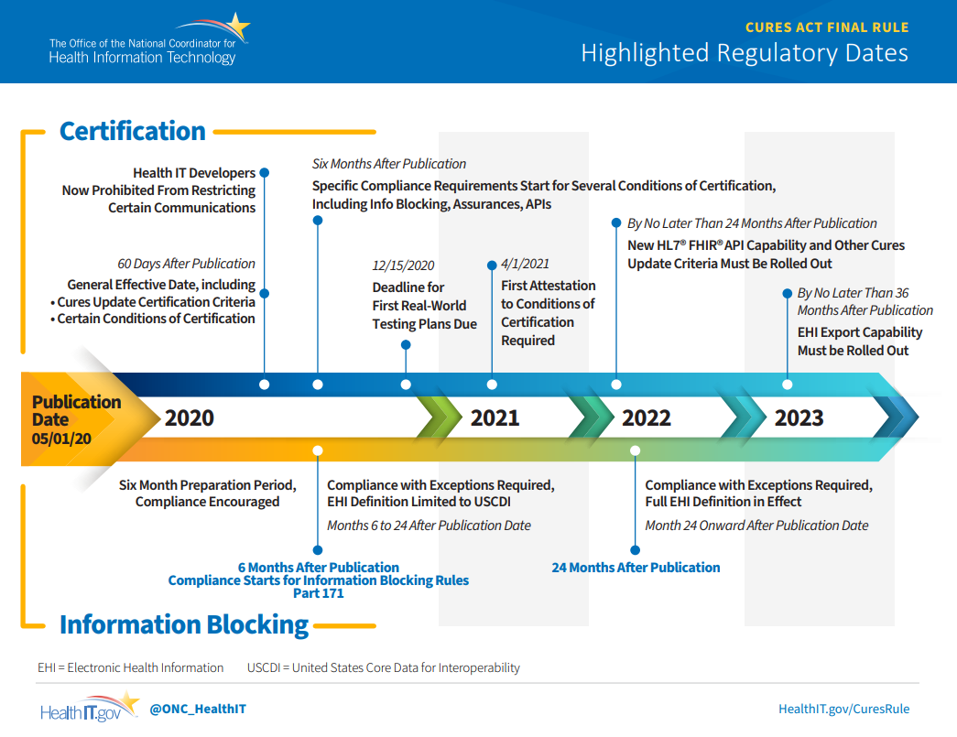
FHIR API: ONC certification timeline
Notes:
Slide title: FHIR API: ONC certification timeline
Timeline Graphic from the Office of the National Coordinator for Health Information Technology
Graphic title: Highlighted Regulatory Dates
Publication Date 05/10/20
Dates above the timeline: Certification
60 days after publication: General Effective Date, including Cures Update Certification Criteria, Certain Conditions of Certification
Health IT developers now prohibited from restricting certain communications
Six Months After Publication: Specific Compliance Requirements Start for Several Conditions of Certification, Including Info Blocking, Assurances, APIs
12/15/2020 Deadline for First Real-World Testing Plans Due
4/1/2021 First Attestation to Conditions of Certification Required
By No Later Than 24 Months After Publication: New HL7® FHIR®API Capability and Other Cures Update Criteria Must Be Rolled Out
By No Later Than 36 Months After Publication: EHI Export Capability Must be Rolled Out
Dates below the timeline: Information Blocking
Six Month Preparation Period, Compliance Encouraged
Marker at 6 Months After Publication: Compliance Starts for Information Blocking Rules Part 171
Months 6 to 24 After Publication Date: Compliance with Exceptions Required,
EHI Definition Limited to USCDI
Marker at 24 Months after Publication
Month 24 Onward After Publication Date: Compliance with Exceptions Required, Full EHI Definition in Effect
EHI = Electronic Health Information
USCDI = United States Core Data for Interoperability

Slide 24
FHIR API: Standards (API + FHIR)
Open API
Webservice: communication technology
Used to communicate between systems and mobile devices
Widely adopted by leading internet sites including social media
Open API: Technical standards to communicate with API is published to allow third-parties to access
Note: APIs can require security and authentication
FHIR
Data Structure: Set of rules regarding how data is entered or stored (e.g., numbers, letters, free text)
Native transferability: Resources do not necessarily need special packaging for transport
Compare: HL7 data needs to be packaged into C-CDA
Notes:
Slide Title: FHIR API: Standards (API + FHIR)
Top box title: Open API
Top box text:
Webservice: communication technology
Used to communicate between systems and mobile devices
Widely adopted by leading internet sites including social media
Open API: Technical standards to communicate with API is published to allow third-parties to access
Note: APIs can require security and authentication
Bottom box title: FHIR
Bottom box text:
Data Structure: Set of rules regarding how data is entered or stored (e.g., numbers, letters, free text)
Native transferability: Resources do not necessarily need special packaging for transport
Compare: HL7 data needs to be packaged into C-CDA

Slide 25
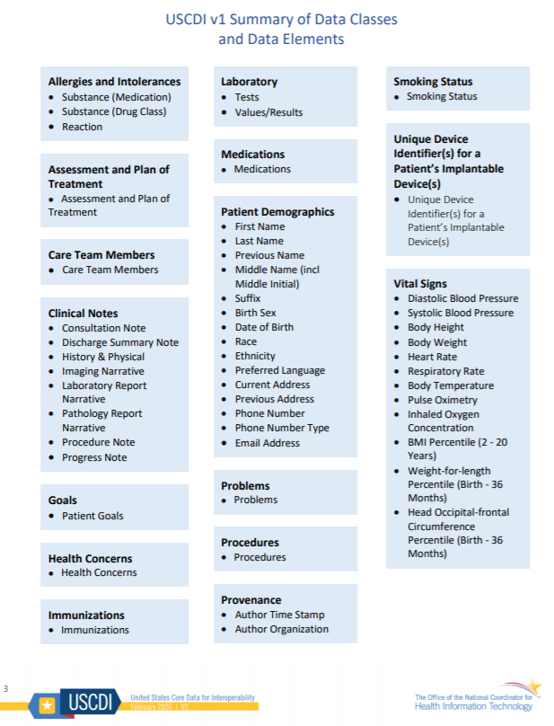
FHIR API: Standards (USCDI data elements)
USCDI requires certain data to be made available:
Data Class: An aggregation of various Data Elements by a common theme or use case
Data Element: The most granular level at which a piece of data is represented in the USCDI for exchange.
Use of national standards for Data Elements: (examples)
Logical Observation Identifiers Names and Codes (LOINC®)
SNOMED International, Systematized Nomenclature of Medicine Clinical Terms (SNOMED CT®)
Notes:
Slide title: FHIR API: Standards (USCDI data elements)
Left side of slide:
USCDI requires certain data to be made available:
Data Class: An aggregation of various Data Elements by a common theme or use case
Data Element: The most granular level at which a piece of data is represented in the USCDI for exchange.
Use of national standards for Data Elements: (Examples)
Logical Observation Identifiers Names and Codes (LOINC®)
SNOMED International, Systematized Nomenclature of Medicine Clinical Terms (SNOMED CT®)
Right of slide:
Graphical list from ONC
Allergies and Intolerances
• Substance (Medication)
• Substance (Drug Class)
• Reaction
Assessment and Plan of Treatment
• Assessment and Plan of Treatment
Care Team Members
• Care Team Members
Clinical Notes
• Consultation Note
• Discharge Summary Note
• History & Physical
• Imaging Narrative
• Laboratory Report Narrative
• Pathology Report Narrative
• Procedure Note
• Progress Note
Goals
• Patient Goals
Health Concerns
• Health Concerns
Immunizations
• Immunizations
Laboratory
• Tests
• Values/Results
Medications
• Medications
Patient Demographics
• First Name
• Last Name
• Previous Name
• Middle Name (incl Middle Initial)
• Suffix
• Birth Sex
• Date of Birth
• Race
• Ethnicity
• Preferred Language
• Current Address
• Previous Address
• Phone Number
• Phone Number Type
• Email Address Problems
• Problems
Procedures
• Procedures
Provenance
• Author Time Stamp
• Author Organization
Smoking Status
• Smoking Status
Unique Device Identifier(s) for a Patient’s Implantable Device(s)
• Unique Device Identifier(s) for a Patient’s Implantable Device(s)
Vital Signs
• Diastolic Blood Pressure
• Systolic Blood Pressure
• Body Height
• Body Weight
• Heart Rate
• Respiratory Rate
• Body Temperature
• Pulse Oximetry
• Inhaled Oxygen Concentration
• BMI Percentile (2 - 20 Years)
• Weight-for-length Percentile (Birth - 36 Months)
• Head Occipital-frontal Circumference Percentile (Birth - 36 Months)

Slide 26
FHIR API: Federal ecosystem aims at provider-to-patient communication
Federal interoperability principally focuses on patient retrieving data
Patient submits request for her data via a third-party app
Third-party app sends request to patient’s providers and payers for data
Providers and payers send data to a third-party app
2
Provider
EHR
FHIR
API
Patient
Third-party app
1
3
Payer
FHIR
API
Notes:
Slide title: FHIR API: Federal ecosystem aims at provider-to-patient communication
Top title box: Federal interoperability principally focuses on patient retrieving data
Top info box:
Patient submits request for her data via third-party app
Third-party app sends request to patient’s providers and payers for data
Providers and payers send data to third-party app
Graphic showing the operational flow of the info box
On the left, a triangle representing the patient, a box in the middle representing the third-party app, and rounded-edge rectangles on the far right representing providers and payers. In addition, the rounded-edge rectangles have a smaller rectangle attached to the left border representing FHIR APIs.

Slide 27
FHIR API: Ecosystem expanded view
Provider
Provider
Provider
Provider
Third-party app
Payer
Payer
Payer
Payer
Open API eases the ability of FHIR to flow to third-party apps
USCDI creates uniform FHIR data that allows more third-party apps to use it
The ecosystem allows standardized data to flow more easily in between
Notes:
Slide title: FHIR API: Ecosystem expanded view
Graphic to represent ecosystem
Four provider boxes at the top
Third-party app box in the middle
Four payer boxes on at the bottom
Bidirectional arrows between the provider boxes and the third-party app box
Bidirectional arrows between the payer boxes and the third-party app box
Bottom box with text
Open API eases the ability of FHIR to flow to third-party apps
USCDI creates uniform FHIR data that allows more third-party app to use it
The ecosystem allows standardized data to flow more easily in between

Slide 28
FHIR API: Recap & Discussion
Federal infrastructure benefits
Improve data availability: Providers and payers are making uniform data (USCDI) available 24/7 on demand via FHIR APIs
Centralize patient data: Patients can gather their data from various sources through the Third-party app
Promote third-party apps to develop patient tools: Third-party apps can better support patients through access to all data
State level decisions
Provider use and reliance on patient data stored in a patient’s third-party app
Should the state expand provider to provider use by leveraging the federal infrastructure?
Ex. State providers education/support services to FHIR API adoption
Ex. State creates HIway-facilitated Services that allow third-party apps for provider to provider activities
Ex. Connection requirement for provider to provider FHIR API transactions
Notes:
Slide title: FHIR API: Recap & Discussion
Top box title: Federal infrastructure benefits
Top box text:
Improve data availability: Providers and payers are making uniform data (USCDI) available 24/7 on demand via FHIR APIs
Centralize patient data: Patients can gather their data from various sources through the Third-party app
Promote third-party apps to develop patient tools: Third-party apps can better support patients through access to all data
Bottom box title: State level decisions
Bottom box text:
Is it enough that patient data on a third-party app be acceptable to be transferred to another provider?
Should the state expand provider to provider use by leveraging the federal infrastructure?
Ex. State providers education/support services to FHIR API adoption
Ex. State creates HIway-facilitated Services that allow third-party apps for provider to provider activities
Ex. Connection requirement for provider to provider FHIR API transactions

Slide 29
HIway budget
Bert Ng & David Whitham
Notes:
HIway budget
Bert Ng & David Whitham

Slide 30
HIway budget: Payment programs
HIway budget is a combination of many funding sources including federal programs
Funding program
Federal match
Uses of funds
HITECH
90%
DDI of Meaningful Use infrastructure
On-boarding to HIE (outreach)
Medicaid Enterprise Systems (MES)*
90%
75%
DDI of HIE modules benefiting MassHealth (MH)
Ops of HIE modules benefiting MH
Medicaid General Administration (GA)*
50%
General operations of MH and HIE modules
*Cost allocation: States must allocate matching percentage based on Medicaid provider and non-Medicaid provider HIE usage
Notes: DDI: Design, Development, and Implementation, Ops: Formerly known as Operations and Maintenance
Notes:
Slide Title: HIway budget: Payment programs
Blue box: HIway budget is a combination of many funding sources including federal programs
Table of funding programs, with columns of funding programs, federal match, use of funds
First row: HITECH, 90%, DDI for meaningful use infrastructure, on-boarding to HIE
Second row: Medicaid Enterprise Systems (MES), 90%, DDI of HIE modules benefiting MassHealth (MH), 75%, Ops of HIE modules benefiting MH
Third row: Medicaid General Administration (GA)*, 50%, General operations of MH and HIE modules
*Cost allocation: States must allocate matching percentage based on Medicaid provider and non-Medicaid provider HIE usage
Notes: DDI: Design, Development, and Implementation, Ops: Formerly known as Operations and Maintenance

Slide 31
HIway budget: Federal funding overview
The HITECH and MES programs provide federal funding for specific HIE activities that support the policy goals of each respective program
HITECH
MES
Authorization: ARRA (2009 stimulus package)
Initial implementation of HIT and development of HIE
Pays for DDI for HIE that supports Meaningful Use
No payment for HIE operations
Authorization: Medicaid inclusive of MITA and 1115 waivers
IT system made up of modules that benefits Medicaid
Pays for DDI of HIE modules for MES
Pays enhanced rate for Operations of HIE modules for MES
Statutory end date 9/31/2021*
No specific end date
*End Date extensions for last MU payments, audits and final SMHP/Landscape scan into FFY22
Notes:
Slide title: HIway budget: Federal funding overview
Top box: The HITECH and MES programs provide federal funding for specific HIE activities that support the policy goals of each respective program
Left box title: HITECH
Left box info: Authorization: ARRA (2009 stimulus package), Initial implementation of HIT and development of HIE, Pays for DDI for HIE that supports Meaningful Use, No payment for HIE operations
Left box date: Statutory end date 9/31/2021*
*End Date extensions for last MU payments, audits and final SMHP/Landscape scan into FFY22
Right box title: MES
Right box info: Authorization: Medicaid inclusive of MITA and 1115 waivers, IT system made up of modules that benefits Medicaid, Pays for DDI of HIE modules for MES, Pays enhanced rate for Operations of HIE modules for MES
Right box date: No specific end date

Slide 32
HIway budget: State Fiscal Year (SFY) 2018 - 2020
The HIway budget aims for efficiency in federal match. It has been shifting match toward the Medicaid Enterprise System (MES) program.
Spending Category | SFY 2018 | SFY 2019 | SFY 2020 (Est.)
Meaningful Use | $3.3 M | $2.8 M | $3.1 M
- Federal match | HITECH | HITECH | HITECH
HIway development | $3.8 M | $5.6 M | $0.7 M
- Federal match | HITECH & MES | HITECH & MES | HITECH & MES
HIway operations | $6.0 M | $4.2 M | $5.4 M
- Federal match | GA | MES | MES
HIway outreach* | $3.0 M | $2.3 M | $3.3 M
- Federal match | HITECH | HITECH | HITECH
Total | $16.1 M | $15.0 M | $12.4 M
- Federal match | HITECH & MES | HITECH & MES | HITECH & MES
*Federal guidance defined Outreach as HITECH implementation, but will likely become MES operations
Notes:
Slide Title: HIway budget: State Fiscal Year (SFY) 2018 – 2020
Top box: The HIway budget aims for efficiency in federal match. It has been shifting match toward the Medicaid Enterprise System (MES) program.
Table for spending, table columns Spending Category, SFY 2018, SFY 2019, SFY 2020 (Est.)
Row 1: Meaningful Use $3.3 million, $2.8 million, $3.1 million
Row 2: Federal match HITECH, HITECH, HITECH
Row 3: HIway development $3.8 million, $5.6 million, $0.7 million
Row 4: Federal match HITECH & MES, HITECH & MES, HITECH & MES
Row 5: HIway operations $6.0 million, $4.2 million, $5.4 million
Row 6: Federal match GA, MES, MES
Row 7: HIway outreach* $3.0 million, $2.3 million, $3.3 million
Row 8: Federal match HITECH, HITECH, HITECH
Row 9: Total $16.1 million, $15.0 million, $12.4 million
Row 10: Federal match HITECH & MES, HITECH & MES, HITECH & MES
*Federal guidance defined Outreach as HITECH implementation, but will likely become MES operations

Slide 33
HIway connection requirement & 2020 attestation
Chris Stuck-Girard
Notes:
HIway connection requirement & 2020 attestation
Chris Stuck-Girard

Slide 34
Attestation: HIway connection requirement overview
The HIway connection requirement requires providers to engage in HIE via the Mass HIway as set forth in M.G.L. Chapter 118I, Section 7, and as detailed in the Mass HIway Regulations (101 CMR 20.00).
Provider organization | First year requirement applied | Submit in 2020
Acute care hospitals | 2017 | Year 4 attestation form
Large and medium medical ambulatory practices | 2018 | Year 3 attestation form
Large community health centers
Small community health centers | 2019 | Year 2 attestation form
HIway annual connection requirement
Year 1 | Send or receive HIway Direct messages for at least one use case
Year 2 | Send or receive HIway Direct messages for at least one provider-to provider (P2P) use case
Year 3 | Send HIway Direct messages for at least one P2P use case, and Receive HIway Direct messages for at least one P2P use case
Year 4 | Meet Year 3 requirement or be subject to penalties if requirement is not met

Slide 35
Attestation: 2020 timeline
The HIway started planning for the 2020 attestation cycle last fall. Early this spring, outreach and education ramped up. After delaying the attestation deadline to account for COVID-19, as of Aug. 1, the HIway is accepting attestation/exception forms.
Attestation timeline:
Dec. 31, 2019: Deadline to implement use cases for 2020 attestation cycle
May 2020:
HIway extends attestation/ADT deadlines
First attestation webinar; PDF version of attestation/exception forms online (publicly available for submitters to prepare answers in advance)
August 1: Attestation/exception webforms go live and start accepting submissions
Dec. 31, 2020: Deadline for attestation/exception submissions
Jan. 1, 2021: Deadline for Acute Care Hospitals to submit ADTs to the Statewide ENS Framework
January 2021: HIway reaches out to POs that have not submitted
Winter 2021: When it seems that submissions have stopped, HIway closes webform
Notes:
Slide title: Attestation: 2020 timeline
Top box: The HIway started planning for the 2020 attestation cycle last fall. Early this spring, outreach and education ramped up. After delaying the attestation deadline to account for COVID-19, as of Aug. 1, the HIway is accepting attestation/exception forms.
Attestation timeline:
Dec. 31, 2019: Deadline to implement use cases for 2020 attestation cycle
May 2020:
-HIway extends attestation/ADT deadlines
-First attestation webinar
-PDF version of attestation/exception forms online (publicly available for submitters to prepare answers in advance)
August 1: Attestation/exception webforms go live and start accepting submissions
Dec. 31, 2020: Deadline for attestation/exception submissions
Jan. 1, 2021: Deadline for Acute Care Hospitals to submit ADTs to the Statewide ENS Framework
January 2021: HIway reaches out to POs that have not submitted
Winter 2021: When it seems that submissions have stopped, HIway closes webform

Slide 36
Attestation: Improvements to process
For the 2020 attestation cycle, the HIway made improvements to streamline the process for providers and collect data regarding new program requirements.
New this year:
HIway unique ID (HID): Each provider organization/sub-organization has been assigned a HID. Submitters will use HIDs on their forms (instead of the full name/location of each sub-org). This should streamline the process, especially for practices with many sub-organizations.
New section to record ADT submission by Acute Care Hospitals
Clarified language in use case transmission methods section
New questions on attestation/exception forms, including taking a deeper dive into details of use cases
Notes:
Slide title: Attestation: Improvements to process
Top box: For the 2020 attestation cycle, the HIway made improvements to streamline the process for providers and collect data regarding new program requirements.
New this year:
-HIway unique ID (HID): Each provider organization/sub-organization has been assigned a HID. Submitters will use HIDs on their forms (instead of the full name/location of each sub-org). This should streamline the process, especially for practices with many sub-organizations.
-New section to record ADT submission by Acute Care Hospitals
-Clarified language in use case transmission methods section
-New questions on attestation/exception forms, including taking a deeper dive into details of use cases

Slide 37
Conclusion
Undersecretary Lauren Peters
Notes:
Conclusion
Undersecretary Lauren Peters

Slide 38
Next HITC meeting
Fall HITC meeting
November 2nd, 2020
3:30 – 5 p.m.
Notes:
Slide title: Next HITC meeting
Fall HITC meeting
November 2nd, 2020
3:30 – 5 p.m.

Slide 39
Appendix A: HIway operations update
Notes:
Appendix A: HIway operations update

Slide 40
HIway participation January 21, 2020 – July 20, 2020
6
New participation agreements
Auburn Primary Care and Aesthetics Cedar Hill Pediatrics Family Continuity Program Harrington Physician Services PatriotDirect Family Medicine Walden Pond Pediatrics

Slide 41
HIway participation January 21, 2020 – July 20, 2020
14
New connections
Auburn Primary Care and Aesthetics* Cape Cod Healthcare Cedar Hill Pediatrics* Family Continuity Program* Fenway Community Health Center Harrington Hospital Harrington Physician Services* Lawrence General Hospital Merrimack Valley ACO Milford Regional Medical Center PatriotDirect Family Medicine* Signature Healthcare Spectrum Health Systems Walden Pond Pediatrics*
* Participants that were enrolled and connected in the same period. All others are new connections for existing clients.

Slide 42
HIway transactions
HIway transaction volume update
The Mass HIway processed a total of 14.4 million production transactions during the July reporting period, from June 21 through July 20, 2020. From August 2019 through July 2020 the average was 15.2 million production transactions/month. Public Health Reporting in July accounted for 12.3 million transactions, or 86% of the total production volume. This included 7.9 million Syndromic Surveillance transactions and 4.3 million Immunization transactions. Provider to Provider transactions totaled 211,271 for July and averaged 170,475 per month over the past year. The Mass HIway team continuously monitors transaction levels, both to support operations and to identify data that provide additional insight into HIway trends and progress.

Slide 43
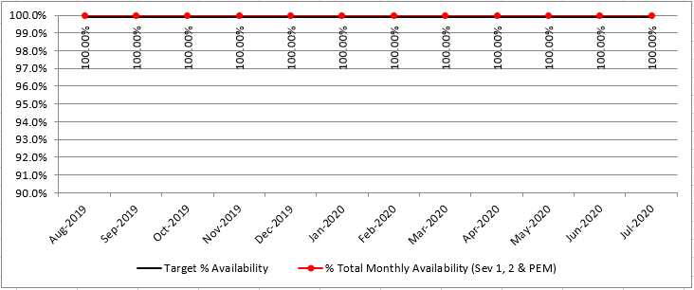
HIway availability review
Target: “Total monthly availability” – no lower than 99.9% (downtime no more than ~44 minutes/month)

Slide 44
Thank you!
Notes:
Thank you!

