Slide 1
V
Health Information Technology Council Meeting
August 1, 2022
Draft
Notes:
Title slide
Health Information Technology Council Meeting
August 1, 2022
Draft

Slide 2
Agenda
Welcome
Undersecretary Lauren Peters
Approval of May 2022 minutes (vote)
Attestation Update
Julie Creamer
ADT/ENS Research Update
Liz Reardon
Program Updates - BH Treatment and Referral Platform
Kevin Mullen
CCG API Update
Julie Creamer / Liz Reardon
Conclusion
Undersecretary Lauren Peters
Notes:
Slide title: Agenda
Welcome
Undersecretary Lauren Peters
Approval of May 2022 minutes (vote)
Attestation Update
Julie Creamer
ADT/ENS Research Update
Liz Reardon
Program Updates - BH Treatment and Referral Platform
Kevin Mullen
CCG API Update
Julie Creamer / Liz Reardon
Conclusion
Undersecretary Lauren Peters

Slide 3
Welcome
Welcome
Undersecretary Lauren Peters
Notes:
Slide Title: Welcome
Undersecretary Lauren Peters

Slide 4
Vote: Approve minutes
MOTION : That the Health Information Technology Council hereby approves the minutes of the council meeting held on May 2, 2022 as presented/amended
Notes:
Slide Title: Vote: Approve minutes
MOTION : That the Health Information Technology Council hereby approves the minutes of the council meeting held on May 2, 2022 as presented/amended

Slide 5
Attestation Update
Julie Creamer
Notes:
Slide title: Attestation Update
Julie Creamer

Slide 6
HIway attestation: HIway connection requirement overview
The HIway connection requirement requires providers to engage in health information exchange via the Mass HIway* as set forth in M.G.L. Chapter 118I, Section 7, and as detailed in the Mass HIway Regulations (101 CMR 20.00). Providers were required to attest.
Provider organization | First year requirement applied
Acute care hospitals | 2017
Large and medium medical ambulatory practices | 2018
Large community health centers
Small community health centers | 2019
HIway annual connection requirement
Year 1 | Send or receive HIway Direct messages for at least one use case
Year 2 | Send or receive HIway Direct messages for at least one provider-to provider (P2P) use case
Year 3 | Send HIway Direct messages for at least one P2P use case, and Receive HIway Direct messages for at least one P2P use case
Year 4+ | Meet Year 3 requirement or be subject to penalties if requirement is not met
*Through sub-regulatory guidance the Mass HIway will accept DirectTrust HISP-to-HISP exchange as an additional method to meet the HIway connection requirement
Notes:
Slide title: HIway attestation: HIway connection requirement overview
The HIway connection requirement requires providers to engage in health information exchange via the Mass HIway* as set forth in M.G.L. Chapter 118I, Section 7, and as detailed in the Mass HIway Regulations (101 CMR 20.00). Providers were required to attest.
Provider organization First year requirement applied
Acute care hospitals
2017
Large and medium medical ambulatory practices
2018
Large community health centers
Small community health centers
2019

Slide 7
HIway Attestation: Statistics for 2021 Reporting Year
Although attestation submissions got off to a slow start, we saw an influx of submissions towards the end of 2021. Attestation submissions received in the 2021 reporting year surpassed submissions in previous years.
Breakdown by Organization Type
Acute Care Hospitals (n=67)
53 attestations submitted
14 exception forms submitted
Submitted: 100%
Community Health Centers (n=41)
26 attestations submitted
10 exception forms submitted
Submitted: 88%
Medium/Large Medical
Ambulatory Practices (n=442)
Attestations: 314 practices
Exception forms: 65 practices
Total: 379 practices
Submitted: 86%
Final Count for 2021:
Total forms submitted: 193
Year 3/4 forms: 104
Year 5 forms: 53
Exception forms: 36
Notes:
slide title: HIway Attestation: Statistics for 2021 Reporting Year
Although attestation submissions got off to a slow start, we saw an influx of submissions towards the end of 2021. Attestation submissions received in the 2021 reporting year surpassed submissions in previous years.
Final Count for 2021:
Total forms submitted: 193
Year 3/4 forms: 104
Year 5 forms: 53
Exception forms: 36
Breakdown by Organization Type
Acute Care Hospitals (n=67)
53 attestations submitted
14 exception forms submitted
Submitted: 100%
Community Health Centers (n=41)
26 attestations submitted
10 exception forms submitted
Submitted: 88%
Medium/Large Medical
Ambulatory Practices (n=442)
Attestations: 314 practices
Exception forms: 65 practices
Total: 379 practices
Submitted: 86%

Slide 8
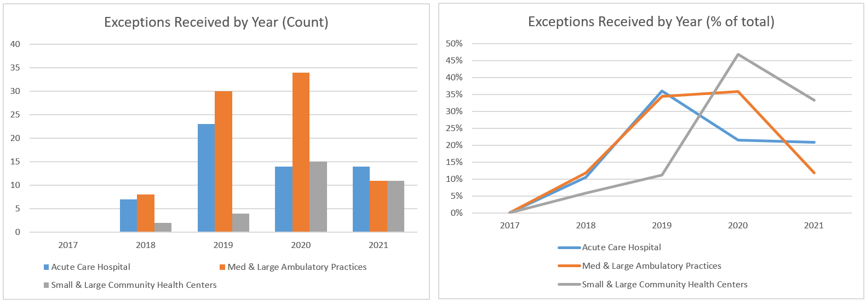
HIway attestation: 2021 statistics
More provider organizations are meeting the HIway connection requirement through DirectTrust HISP-to-HISP exchanges. As a result, more provider organizations submitted attestation forms and fewer organizations requested exceptions.
Notes:
Slide title: HIway attestation: 2021 statistics
More provider organizations are meeting the HIway connection requirement through DirectTrust HISP-to-HISP exchanges. As a result, more provider organizations submitted attestation forms and fewer organizations requested exceptions.
Explain graphs*

Slide 9
HIway Attestation Close-Out
As of July 31st, 2022, the Mass HIway will no longer require regulated providers to submit an annual attestation.
The timetable for the HIway connection requirement has been met for the regulated organizations (Acute care hospitals, Community health centers, Medical ambulatory practices)
Over 550 Provider Organizations have completed the attestation process over the last five years and many providers have integrated direct messaging within their daily workflows
It is expected that use of direct messaging will continue to persist for the foreseeable future as many providers rely upon it everyday to coordinate patient care
The HIway will continue to monitor and report on the utilization of direct messaging. Changes in transaction volume will be reviewed and any notable observations and findings will be reported to the HIT Council
Any future regulations for new use cases or new provider type connection requirements will include a new attestation web-form and process
Notes:
Slide title: HIway Attestation Close-OutAs of July 31st, 2022, the Mass HIway will no longer require regulated providers to submit an annual attestation.
The timetable for the HIway connection requirement has been met for the regulated organizations (Acute care hospitals, Community health centers, Medical ambulatory practices)
Over 550 Provider Organizations have completed the attestation process over the last five years and many providers have integrated direct messaging within their daily workflows
It is expected that use of direct messaging will continue to persist for the foreseeable future as many providers rely upon it everyday to coordinate patient care
The HIway will continue to monitor and report on the utilization of direct messaging. Changes in transaction volume will be reviewed and any notable observations and findings will be reported to the HIT Council
Any future regulations for new use cases or new provider type connection requirements will include a new attestation web-form and process

Slide 10
ADT/ENS Research Update
Liz Reardon
Notes:
Slide title: ADT/ENS Research Update
Liz Reardon

Slide 11
ADT/ENS Landscape Research
The Mass HIway is continually looking for areas to improve and refine the quality and integrity of health information exchange in Massachusetts.
As such, the HIway team has been engaging stakeholders, including MassHealth, ACOs, providers and ENS vendors on the reported challenges with the current ADT/ENS landscape in Massachusetts.
The Statewide ENS Framework works to increase access, streamline connection points, and improve timing for the flow of notification data. However, it does not solve for all the pain-points with the broader ENS/ADT exchange environment.
Statewide ENS Framework
ADT/ENS Landscape
Increased Access
Streamlined Connections
Improved Timing of Notifications
Data Quality
Technical Workflows
Connection Gaps
CMS CoP
Notes:
Slide title: ADT/ENS Landscape Research
The Mass HIway is continually looking for areas to improve and refine the quality and integrity of health information exchange in Massachusetts.
As such, the HIway team has been engaging stakeholders, including MassHealth, ACOs, providers and ENS vendors on the reported challenges with the current ADT/ENS landscape in Massachusetts.
The Statewide ENS Framework works to increase access, streamline connection points, and improve timing for the flow of notification data. However, it does not solve for all the pain-points with the broader ENS/ADT exchange environment.
Add ven diagram ***

Slide 12
ADT Landscape - Issues
The Mass HIway has received feedback from MassHealth ACOs, providers and ENS vendors about challenges with the current ADT landscape in Massachusetts. Discussions have led to the following observations:
Discussions with providers and ENS vendors have identified a few key issues:
Duplicate ADTs
Missing diagnosis codes
Technical workflow issues
These issues are impacting the value and utility of ADT/ENS notifications overall and directly affect coordination of patient care.
The vendors are taking different approaches to many of these issues and may benefit from sharing and adopting best practices with one another.
There should be a concerted effort to understand and address these roadblocks
EOHSS is interested in exploring and understanding areas to improve the value and utility of ENS notifications which may impact coordination of care
Notes:
Slide title: ADT Landscape – Issues
The Mass HIway has received feedback from MassHealth ACOs, providers and ENS vendors about challenges with the current ADT landscape in Massachusetts. Discussions have led to the following observations:
Discussions with providers and ENS vendors have identified a few key issues:
Duplicate ADTs
Missing diagnosis codes
Technical workflow issues
These issues are impacting the value and utility of ADT/ENS notifications overall and directly affect coordination of patient care.
The vendors are taking different approaches to many of these issues and may benefit from sharing and adopting best practices with one another.
There should be a concerted effort to understand and address these roadblocks
EOHSS is interested in exploring and understanding areas to improve the value and utility of ENS notifications which may impact coordination of care

Slide 13
Issue # 1: Duplicate ADTs
Providers are often receiving multiple copies of the same ADT due to a lack of coordination among existing ENS solutions and services to meet the CMS CoP.
Issue # 1: Duplicate ADTs
A single provider can receive three or more ADT notifications for the same patient encounter
This results in general alert fatigue amongst providers and creates workflow obstacles for case managers and others who use these alerts in their daily workflows
Duplicate ADTs originate from several sources:
CMS CoP Solution: The CoP solution sends all ADT notifications to the identified primary care provider. The solution does not offer any ability to filter these ADTs by sending facility, diagnosis code, etc.
ENS vendor proprietary solution: If a provider is paying to participate in an ENS vendor solution, that provider may receive a duplicate ADT from the proprietary solution and the CMS CoP solution unless they opt out of the COP solution altogether.
Epic Care Everywhere sends additional notifications outside of the ENS vendors
Technical issues within a vendor solution: There have been episodic issues where a technical issue on the vendor side causes duplicate ADTs to be sent to providers. Research on the root cause of these issues is currently underway.
Notes:
Slide title: Issue # 1: Duplicate ADTs
Providers are often receiving multiple copies of the same ADT due to a lack of coordination among existing ENS solutions and services to meet the CMS CoP.
Issue # 1: Duplicate ADTs
A single provider can receive three or more ADT notifications for the same patient encounter
This results in general alert fatigue amongst providers and creates workflow obstacles for case managers and others who use these alerts in their daily workflows
Duplicate ADTs originate from several sources:
CMS CoP Solution: The CoP solution sends all ADT notifications to the identified primary care provider. The solution does not offer any ability to filter these ADTs by sending facility, diagnosis code, etc.
ENS vendor proprietary solution: If a provider is paying to participate in an ENS vendor solution, that provider may receive a duplicate ADT from the proprietary solution and the CMS CoP solution unless they opt out of the COP solution altogether.
Epic Care Everywhere sends additional notifications outside of the ENS vendors
Technical issues within a vendor solution: There have been episodic issues where a technical issue on the vendor side causes duplicate ADTs to be sent to providers. Research on the root cause of these issues is currently underway.

Slide 14
Issue #2: Missing diagnosis codes
Diagnosis codes are often missing on ADT notifications. If there is no diagnosis code on the ADT, care managers and others must search for the reason behind the patient admission. This requires time and resources that providers don’t have. The reasons behind missing diagnosis codes include:
CoP solution does not require diagnosis codes
Since the CoP solution does not require diagnosis codes, only one of the two state certified vendors are sending them. As a result, case managers and providers are left with ENS notifications that provide little value and they are ignored.
Hospital/Provider source Data Issues:
Missing demographic data at the provider/hospital level
If social security number or zip code are missing, one of the certified vendors will not send diagnosis to subscribers (non-CoP solution)
ADT information is taken from separate platforms within hospital. Diagnosis code is captured in clinical EHR system and demographic information captured in separate registration system. Workflows do not always incorporate multiple platforms/systems and missing critical data is the result
Mental health diagnosis codes may be filtered out by hospital along with 42 CFR codes per hospital policy
Notes:
Slide title: Issue #2: Missing diagnosis codes
Diagnosis codes are often missing on ADT notifications. If there is no diagnosis code on the ADT, care managers and others must search for the reason behind the patient admission. This requires time and resources that providers don’t have. The reasons behind missing diagnosis codes include:
CoP solution does not require diagnosis codes
Since the CoP solution does not require diagnosis codes, only one of the two state certified vendors are sending them. As a result, case managers and providers are left with ENS notifications that provide little value and they are ignored.
Hospital/Provider source Data Issues:
Missing demographic data at the provider/hospital level
If social security number or zip code are missing, one of the certified vendors will not send diagnosis to subscribers (non-CoP solution)
ADT information is taken from separate platforms within hospital. Diagnosis code is captured in clinical EHR system and demographic information captured in separate registration system. Workflows do not always incorporate multiple platforms/systems and missing critical data is the result
Mental health diagnosis codes may be filtered out by hospital along with 42 CFR codes per hospital policy

Slide 15
Issue # 3: Technical workflow issues
ADT notifications sent as Direct Messages do not always contain adequate metadata to enable EHRs to accurately identify and route messages appropriately to receiving provider EHRs.
There is no way for providers to identify these messages as distinct ADT messages. They are lumped in with all other direct messages.
There may be limited ability and/or motivation by EHR vendors to automate workflows for ENS notifications.
EHR vendors may be stripping critical data from the ENS notification.
As a result, ADT notifications are often ignored completely and not used by providers
Direct Trust is working on standards that could be implemented by EHR vendors to address this issue.
Notes:
Slide title: Issue # 3: Technical workflow issues
ADT notifications sent as Direct Messages do not always contain adequate metadata to enable EHRs to accurately identify and route messages appropriately to receiving provider EHRs.
There is no way for providers to identify these messages as distinct ADT messages. They are lumped in with all other direct messages.
There may be limited ability and/or motivation by EHR vendors to automate workflows for ENS notifications.
EHR vendors may be stripping critical data from the ENS notification.
As a result, ADT notifications are often ignored completely and not used by providers
Direct Trust is working on standards that could be implemented by EHR vendors to address this issue.

Slide 16
ADTs and Psychiatric Hospitals
Both certified ENS vendors have confirmed that freestanding psychiatric hospitals are not sending ADTs currently despite the CMS mandate to participate in CoP solution. The reasons for this lack of participation include:
The CoP requirement is limited to those hospitals, psychiatric hospitals, and critical access hospitals (CAH) that utilize electronic medical record systems or other electronic administrative systems that are conformant with the HL7 2.5.1 content exchange standard
Need for consent to exchange 42 CFR information and ambiguous state laws regarding the sharing of behavioral health information.
It is technically possible and legally feasible, but the issue is more cultural with concerns around privacy and security of that data.
Need for technical segregation/flagging of behavioral health/ 42 CFR data by EHR vendor.
Challenging for hospitals and EHR vendors to manage an electronic consent process
There are no financial incentives for psychiatric hospitals to participate and less than 20% of all psychiatric hospitals have an EHR. Many still rely on paper and fax workflows.
Notes:
Slide title: ADTs and Psychiatric Hospitals
Both certified ENS vendors have confirmed that freestanding psychiatric hospitals are not sending ADTs currently despite the CMS mandate to participate in CoP solution. The reasons for this lack of participation include:
The CoP requirement is limited to those hospitals, psychiatric hospitals, and critical access hospitals (CAH) that utilize electronic medical record systems or other electronic administrative systems that are conformant with the HL7 2.5.1 content exchange standard
Need for consent to exchange 42 CFR information and ambiguous state laws regarding the sharing of behavioral health information.
It is technically possible and legally feasible, but the issue is more cultural with concerns around privacy and security of that data.
Need for technical segregation/flagging of behavioral health/ 42 CFR data by EHR vendor.
Challenging for hospitals and EHR vendors to manage an electronic consent process
There are no financial incentives for psychiatric hospitals to participate and less than 20% of all psychiatric hospitals have an EHR. Many still rely on paper and fax workflows.

Slide 17
Other areas of interest
EOHHS is reviewing healthcare system preparedness and capacity and assessing opportunities for improving connectivity and health information exchange to support these efforts.
Example: One such improvement area centers on the connection and information exchange needs between nursing homes and hospitals.
We are interested in any preliminary feedback on areas / ideas on how HIE can help improve patient throughput for these groups.
Notes:
Slide title: Other areas of interest
EOHHS is reviewing healthcare system preparedness and capacity and assessing opportunities for improving connectivity and health information exchange to support these efforts.
Example: One such improvement area centers on the connection and information exchange needs between nursing homes and hospitals.
We are interested in any preliminary feedback on areas / ideas on how HIE can help improve patient throughput for these groups.

Slide 18
For Discussion: Potential next steps
State issued guidance on sharing behavioral health information via ADTs and other electronic means would be valuable.
Convene a roundtable to gather feedback and gain consensus on the sharing of behavioral health information via ADTs and other electronic means.
Educate providers on the various sources of ENS notifications and provide guidance on how to work with their ENS and EHR vendors to improve workflow and reduce duplicate notifications.
Work with providers and vendors to educate/advocate for vendors to adopt new ADT direct message standards
Educate hospitals on the importance of including demographic information such as SSN and/or zip code for all patients whenever possible.
Consider additional certification requirements for state certified ENS vendors such as reporting on missing demographic data by hospital
Explore whether hospitals can get a waiver from CMS allowing them to opt out of use of the CoP solution if they participate in the state ENS framework.
Notes:
Slide title: For Discussion: Potential next steps
State issued guidance on sharing behavioral health information via ADTs and other electronic means would be valuable.
Convene a roundtable to gather feedback and gain consensus on the sharing of behavioral health information via ADTs and other electronic means.
Educate providers on the various sources of ENS notifications and provide guidance on how to work with their ENS and EHR vendors to improve workflow and reduce duplicate notifications.
Work with providers and vendors to educate/advocate for vendors to adopt new ADT direct message standards
Educate hospitals on the importance of including demographic information such as SSN and/or zip code for all patients whenever possible.
Consider additional certification requirements for state certified ENS vendors such as reporting on missing demographic data by hospital
Explore whether hospitals can get a waiver from CMS allowing them to opt out of use of the CoP solution if they participate in the state ENS framework.

Slide 19
Program Update: BH Treatment & Referral Platform
Kevin Mullen
Notes:
Slide title: Program Update: BH Treatment & Referral Platform
Kevin Mullen

Slide 20
BH Treatment & Referral Platform-RFR
New Behavioral Health Treatment and Referral Platform procurement
22EHSBHTRPSRFR: RFR for Behavioral Health Treatment Referral Platform Software
The Commonwealth is seeking a vendor to improve operational efficiencies among providers, carriers, and the Commonwealth by automation of the screening and referral process to move patients more quickly through the emergency department (ED) evaluation and referral process for those seeking behavioral health (BH) treatment, reducing the length of stay in EDs
The platform will enable hospitals, health plans, community-based crisis intervention teams, and state agencies to securely share required information and referral forms, including the transfer of admissions packets between stakeholders.
Notes:
Slide title: BH Treatment & Referral Platform-RFR
New Behavioral Health Treatment and Referral Platform procurement
22EHSBHTRPSRFR: RFR for Behavioral Health Treatment Referral Platform Software
The Commonwealth is seeking a vendor to improve operational efficiencies among providers, carriers, and the Commonwealth by automation of the screening and referral process to move patients more quickly through the emergency department (ED) evaluation and referral process for those seeking behavioral health (BH) treatment, reducing the length of stay in EDs
The platform will enable hospitals, health plans, community-based crisis intervention teams, and state agencies to securely share required information and referral forms, including the transfer of admissions packets between stakeholders.

Slide 21
BH Treatment & Referral Platform-Detail
The proposed Behavioral Health Treatment and Referral Platform will support:
Automation of the ED BH screening, evaluation, and referral process, including EPIA protocols
Enable the electronic transmission of standardized admissions information
Create a real-time, transparent view of patients seeking BH treatment for critical stakeholders (EDs, ESPs and behavioral health crisis intervention system providers, psychiatric units, freestanding psychiatric facilities, insurance carriers and state agencies)
Additionally, it is expected that the procured solution will:
Leverage and build upon existing vendor networks and exchanges
Integrate with the Statewide Event Notification Services (ENS) framework
Allow for future integration with technology partner(s) to enable search and identification of available psychiatric treatment beds (including inpatient and crisis stabilization) for expedited placement.
Notes:
Slide title: BH Treatment & Referral Platform-Detail
The proposed Behavioral Health Treatment and Referral Platform will support:
Automation of the ED BH screening, evaluation, and referral process, including EPIA protocols
Enable the electronic transmission of standardized admissions information
Create a real-time, transparent view of patients seeking BH treatment for critical stakeholders (EDs, ESPs and behavioral health crisis intervention system providers, psychiatric units, freestanding psychiatric facilities, insurance carriers and state agencies)
Additionally, it is expected that the procured solution will:
Leverage and build upon existing vendor networks and exchanges
Integrate with the Statewide Event Notification Services (ENS) framework
Allow for future integration with technology partner(s) to enable search and identification of available psychiatric treatment beds (including inpatient and crisis stabilization) for expedited placement.

Slide 22
BH TRP Procurement - Timetable
Event | Date/Time
Solicitation Issued | 5/24/22
Questions about Solicitation Due | 6/1/22
Answers to questions Posted (estimate) | 6/10/22
Proposals Due | 7/1/22 5 p.m.
Oral Presentations (TBD/estimate) | 7/25/22
Notification of Bidder Selection (estimate) | 8/19/22
Contract Executed (estimate) | 9/15/22
Notes:
Slide title: BH TRP Procurement – Timetable
Event Date/Time
Solicitation Issued 5/24/22
Questions about Solicitation Due 6/1/22
Answers to questions Posted (estimate) 6/10/22
Proposals Due 7/1/22 5 p.m.
Oral Presentations (TBD/estimate) 7/25/22
Notification of Bidder Selection (estimate) 8/19/22
Contract Executed (estimate) 9/15/22

Slide 23
Clinical Gateway API Development-Update
Julie Creamer & Liz Reardon
Notes:
Slide title: Clinical Gateway API Development-Update
Julie Creamer & Liz Reardon

Slide 24
Clinical Gateway API Development
The intent of this project is to develop a foundation for a common Application Programming Interface (API) and FHIR Integration infrastructure that can be used for multiple public health use cases.
The initial scope will focus on building the infrastructure, engaging early adopters and demonstrating use of the API for one or more public health use cases in a production exchange.
Notes:
Slide title: Clinical Gateway API Development
The intent of this project is to develop a foundation for a common Application Programming Interface (API) and FHIR Integration infrastructure that can be used for multiple public health use cases.
The initial scope will focus on building the infrastructure, engaging early adopters and demonstrating use of the API for one or more public health use cases in a production exchange.

Slide 25
Clinical Gateway API Development
Key Objectives
Build an alternative pathway to current public health reporting via Direct Messaging
Add support for multiple channels to send and receive data via RESTful & SOAP Services
Enable real time, synchronous message exchange between providers and public health registries
Implement FHIR integration and authentication protocols to support enhanced security and business functionality
Notes:
Slide title: Clinical Gateway API Development
Key Objectives
Build an alternative pathway to current public health reporting via Direct Messaging
Add support for multiple channels to send and receive data via RESTful & SOAP Services
Enable real time, synchronous message exchange between providers and public health registries
Implement FHIR integration and authentication protocols to support enhanced security and business functionality

Slide 26
Clinical Gateway API Development
Key Project Updates
Development work for the RESTful APIs for CCG-1 & CCG 2 nodes has been completed
CCG-1 API completed 1/23/22: includes Syndromic, Children’s Behavioral Health Initiative (CBHI), and Mass Cancer Registry (MCR)
CCG-2 API completed 2/20/22: includes Massachusetts Immunization Information System (MIIS), Electronic Lab Reporting (ELR) and Intake, Enrollment, Assessment and Transfer Service System for BSAS (IEATS / OTP)
Development work for OAuth 2.0 completed 5/31/22
a prerequisite for FHIR standard
Completed development of provider engagement plan including key tasks and timeline
Creation of several provider facing documents including draft API Instructions, Implementation Guide and Test Plan
Notes:
Slide title: Clinical Gateway API Development
Key Project Updates
Development work for the RESTful APIs for CCG-1 & CCG 2 nodes has been completed
CCG-1 API completed 1/23/22: includes Syndromic, Children’s Behavioral Health Initiative (CBHI), and Mass Cancer Registry (MCR)
CCG-2 API completed 2/20/22: includes Massachusetts Immunization Information System (MIIS), Electronic Lab Reporting (ELR) and Intake, Enrollment, Assessment and Transfer Service System for BSAS (IEATS / OTP)
Development work for OAuth 2.0 completed 5/31/22
a prerequisite for FHIR standard
Completed development of provider engagement plan including key tasks and timeline
Creation of several provider facing documents including draft API Instructions, Implementation Guide and Test Plan

Slide 27
43 days
20 days
CCG API & FHIR Development Timeline
97 days
Publish Initial API IG & Specification
Publish FHIR IG
35 days
Feb 2022
Dec 2022
2021
Jul
Sep
Nov
2022
Mar
85 days
May
Jul
Sep
Nov
2022
239 days
Today
100 days
May 2022
Publish OAuth Specification
60 days
65 days
API Design
100%
7/21 - 8/21
16 days
API Development
100%
7/21 - 11/21
310 days
REST/SOAP API Testing
100%
11/21 - 12/21
API Migration Planning
100%
10/21 - 12/21
API Migration – CG1
100%
12/21 - 1/22
API Migration – CG2
100%
1/22 - 2/22
Design & Develop OAuth Authentication Security
100%
1/22 - 4/22
Stakeholder Engagement (Providers & Registries) & BRD
50%
2/22 - 12/22
Design & Develop FHIR Integration
20%
5/22 - 9/22
FHIR Integration Testing
8/22 - 10/22
CG API Transition Project Team
50%
10/21 - 12/22
Notes:
Slide title: CCG API & FHIR Development Timeline
Fill in

Slide 28
Provider Feedback
The HIway team has had conversations with five large hospital systems* and leading EHR vendors regarding the transition to APIs for Syndromic Surveillance reporting
Provider organizations shared different perspectives regarding their readiness and approach in considering APIs
Some groups indicated they are ready to decommission their LAND/Connect devices and move toward newer technology for reporting public health data.
Others indicated less willingness, and are of the “if it isn’t broke don’t fix it…” mindset
Some differences stem from the organization’s resource availability. Those provider organizations with appropriate resources and bandwidth are more willing to invest the time and money to change the current workflow
Epic customers in particular have API implementation experience through Epic’s App Orchard and all have technical support resources through their EHR contracts.
There was overall consensus that a public health client application made available through the Epic App Orchard would be a preferred approach, simplify onboarding and speed-up adoption
* Boston Medical Center, Cambridge Health Alliance, Cape Cod Healthcare, Mass General Brigham, and Tufts Medicine
Notes:
Slide title: Provider Feedback
The HIway team has had conversations with five large hospital systems* and leading EHR vendors regarding the transition to APIs for Syndromic Surveillance reporting
Provider organizations shared different perspectives regarding their readiness and approach in considering APIs
Some groups indicated they are ready to decommission their LAND/Connect devices and move toward newer technology for reporting public health data.
Others indicated less willingness, and are of the “if it isn’t broke don’t fix it…” mindset
Some differences stem from the organization’s resource availability. Those provider organizations with appropriate resources and bandwidth are more willing to invest the time and money to change the current workflow
Epic customers in particular have API implementation experience through Epic’s App Orchard and all have technical support resources through their EHR contracts.
There was overall consensus that a public health client application made available through the Epic App Orchard would be a preferred approach, simplify onboarding and speed-up adoption
* Boston Medical Center, Cambridge Health Alliance, Cape Cod Healthcare, Mass General Brigham, and Tufts Medicine

Slide 29
Provider Feedback - Considerations
Stakeholder feedback indicates there is little incentive for providers to move in the direction of FHIR using our original RESTful API destination only approach. The development and resource costs for providers would be too high
Based on this feedback, the Mass HIway is considering the value and need to develop a middleware solution to provide integration between the CG APIs and the EHR client applications
Developing this type of solution would lower the bar for what providers need to do to move to an API and could make widespread adoption more likely
It will also better align providers with EOHHS’ direction towards establishing a FHIR foundation for public health and significantly increase the likelihood that provider organizations will move to sending FHIR-based messages
Notes:
Slide title: Provider Feedback – Considerations
Stakeholder feedback indicates there is little incentive for providers to move in the direction of FHIR using our original RESTful API destination only approach. The development and resource costs for providers would be too high
Based on this feedback, the Mass HIway is considering the value and need to develop a middleware solution to provide integration between the CG APIs and the EHR client applications
Developing this type of solution would lower the bar for what providers need to do to move to an API and could make widespread adoption more likely
It will also better align providers with EOHHS’ direction towards establishing a FHIR foundation for public health and significantly increase the likelihood that provider organizations will move to sending FHIR-based messages

Slide 30
Current v. Potential API Development
The HIway team is exploring the feasibility of a middleware integration solution for sending and receiving public health data.
RESTful API – Current CCG API Development
Benefits: Moves providers away from LAND devices, existing development team has completed the development work and is ready to implement this approach
Middleware Integration – Potential New Development
Risks: Potential for little to no adoption, unlikely to obtain FHIR data from providers
Benefits: LAND savings; scalable, easier implementation for providers, higher adoption and lower outreach and onboarding costs; providers more likely to send FHIR
Risks: Unspecified funding, greater initial investment for team to acquire skills and/or consultant(s), very difficult in current market to hire resources with appropriate skill set, unknown ongoing support risks
Notes:
Slide title: Current v. Potential API Development
The HIway team is exploring the feasibility of a middleware integration solution for sending and receiving public health data.
RESTful API – Current CCG API Development
Benefits: Moves providers away from LAND devices, existing development team has completed the development work and is ready to implement this approach
Risks: Potential for little to no adoption, unlikely to obtain FHIR data from providers
Middleware Integration – Potential New Development
Benefits: LAND savings; scalable, easier implementation for providers, higher adoption and lower outreach and onboarding costs; providers more likely to send FHIR
Risks: Unspecified funding, greater initial investment for team to acquire skills and/or consultant(s), very difficult in current market to hire resources with appropriate skill set, unknown ongoing support risks

Slide 31
Next HITC meeting
Next HITC meeting
November 7, 2022
3:30 – 5 p.m.
W
Notes:
Slide Title: Next HITC meeting
Next HITC meeting
November 7, 2022
3:30 – 5 p.m.
Next HITC meeting
August 2, 2021
3:30 – 5 p.m.

Slide 32
Appendix A: HIway operations update
Notes:
Slide Title: Appendix A: HIway operations update

Slide 33
HIway participation April 21, 2022 – July 20, 2022
1
New connection
Community Technology Cooperative / C3
* Participants that were enrolled and connected in the same period.
Confidential Draft – Policy in Development
Notes:
Slide title: HIway participation April 21, 2022 – July 20, 2022
0ne new connection
Community Technology Cooperative / C3
Participants that were enrolled and connected in the same period.
Confidential Draft – Policy in Development

Slide 34
HIway participation April 21, 2022 – July 20, 2022
2
New participation agreements
Dr. Bolívar A. Villacís-Bermeo Senscio Systems
Confidential Draft – Policy in Development
Notes:
Slide title: HIway participation April 21, 2022 – July 20, 2022
2 new participation agreements
Dr. Bolívar A. Villacís-Bermeo
Senscio Systems
Confidential Draft – Policy in Development

Slide 35
HIway transactions
HIway transaction volume update
The Mass HIway processed 36.9 million production transactions during the July 2022 reporting period (6/21/21 through 7/20/22) with consistent volume attributed to the COVID-19 queries to the MIIS. From Aug 2021 through Jul 2022, the average increased to 35.6 million production transactions per month for a total of 427 million over the past year. In July, Public Health Reporting accounted for 36.4 million transactions, or 99% of total production volume. This included 12.2 million Syndromic Surveillance transactions and 24 million Immunization transactions. Note: Immunization queries from commercial insurance companies for COVID-19 vaccination updates that processed through the new, high-volume “MIIS QBP” Clinical Gateway node are included in the Immunization total. Provider-to-provider transactions average over 376,000 per month for the past year, and support a number of use cases. For July, the total was 365,736. Quality Reporting volume has normalized over the last year and is currently averaging around 166,000 transactions per month for the past 12 months. The Mass HIway team continuously monitors transaction levels, both to support operations and to identify data that provide additional insight into HIway trends and progress.
Confidential Draft – Policy in Development
Notes:
Slide title: HIway transactions
HIway transaction volume update
The Mass HIway processed 36.9 million production transactions during the July 2022 reporting period (6/21/21 through 7/20/22) with consistent volume attributed to the COVID-19 queries to the MIIS. From Aug 2021 through Jul 2022, the average increased to 35.6 million production transactions per month for a total of 427 million over the past year.
In July, Public Health Reporting accounted for 36.4 million transactions, or 99% of total production volume. This included 12.2 million Syndromic Surveillance transactions and 24 million Immunization transactions.
Note: Immunization queries from commercial insurance companies for COVID-19 vaccination updates that processed through the new, high-volume “MIIS QBP” Clinical Gateway node are included in the Immunization total.
Provider-to-provider transactions average over 376,000 per month for the past year, and support a number of use cases. For July, the total was 365,736.
Quality Reporting volume has normalized over the last year and is currently averaging around 166,000 transactions per month for the past 12 months.
The Mass HIway team continuously monitors transaction levels, both to support operations and to identify data that provide additional insight into HIway trends and progress.
Confidential Draft – Policy in Development
HIway transaction volume update
The Mass HIway processed a record 25.1 million production transactions during the April 2021 reporting period (March 21 through April 20) with the significant increase due to the COVID-19 queries to the MIIS. From May 2020 through April 2021, the average was 15.1 million production transactions per month for a total of 181 million over the past year.
In April, Public Health Reporting accounted for 24.6 million transactions, or 98% of total production volume. This included 8.5 million Syndromic Surveillance transactions and 16.1 million Immunization transactions.
Note: Immunization queries from commercial insurance companies for COVID-19 vaccination updates that processed through the new, high-volume “MIIS QBP” Clinical Gateway node are included in the Immunization total.
Provider-to-provider transactions now average over 250,000 per month for the past year, with new use cases added regularly. For April, the total was 290,608.
The Mass HIway team continuously monitors transaction levels, both to support operations and to identify data that provide additional insight into HIway trends and progress.

Slide 36
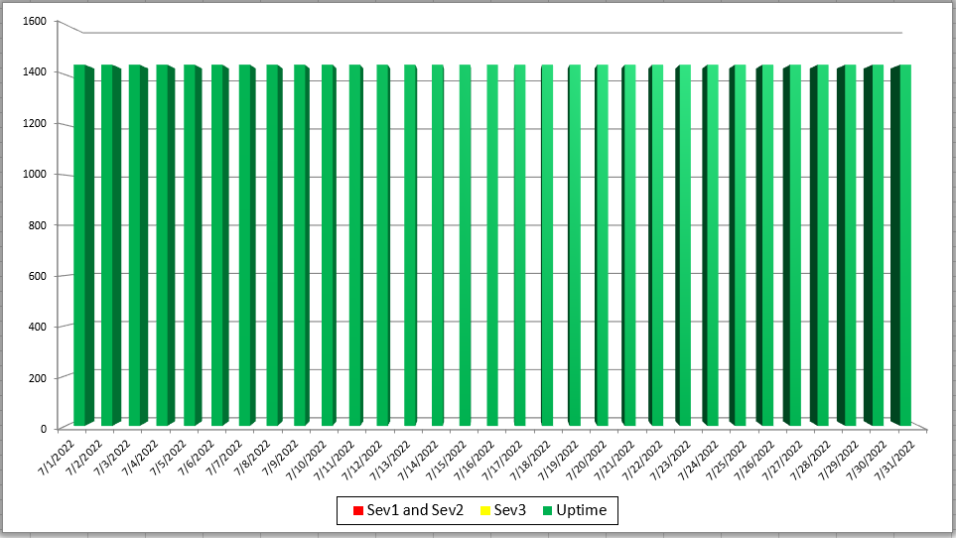
Mass HIway Incident Summary Dashboard
July 2022
Sev 1 - All / Most Mass HIway components impacted as a result of outage. For example: LAND, Webmail, Direct XDR, and DPH nodes are all down
Sev 2 - Multiple Mass HIway components impacted as a result of outage in one of the shared service. For example: LAND and Webmail are down but Direct XDR and DPH nodes are up.
Sev3 – One Mass HIway component impacted as a result of outage. For example: Webmail is down but all other services are up and running.
Notes:
Slide title: Mass HIway Incident Summary Dashboard
July 2022
Explain***

Slide 37
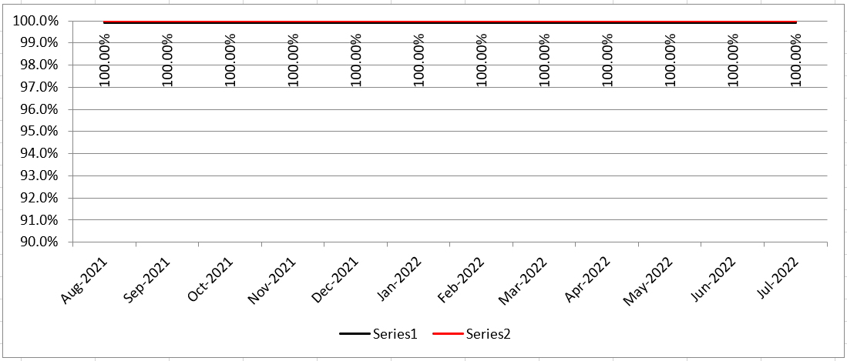
HIway Availability Trends – July 2022
Metric Targets:
“Total Monthly Availability” – no lower than 99.9% (downtime no more than ~44 minutes/month)
Notes:
Slide title: HIway Availability Trends – July 2022
Metric Targets:
“Total Monthly Availability” – no lower than 99.9% (downtime no more than ~44 minutes/month)
100% availability from Aug 2021 through July 2022

Slide 38
Thank you!
Notes:
Slide Title: Thank you!

