Slide 1
V
Health Information Technology Council Meeting
February 7, 2022
Draft
Notes:
Title slide
Health Information Technology Council Meeting
May 3, 2021

Slide 2
Agenda
Welcome
Undersecretary Lauren Peters
Approval of Nov 2021 minutes (vote)
Attestation-Update
Pam Boutin-Coviello
ENS – Utilization Update
Bert Ng
Unsolicited Notifications via Direct Messaging
Kevin Mullen
Clinical Gateway API Development-Update
Kevin Mullen
Conclusion
Undersecretary Lauren Peters
Notes:
Slide title: Agenda
Welcome
Undersecretary Lauren Peters
Approval of Nov 2021 minutes (vote)
Attestation-Update
Pam Boutin-Coviello
ENS – Utilization Update
Bert Ng
Unsolicited Notifications via Direct Messaging
Kevin Mullen
Clinical Gateway API Development-Update
Kevin Mullen
Conclusion
Undersecretary Lauren Peters

Slide 3
Welcome
Undersecretary Lauren Peters
Notes:
Slide Title: Welcome
Undersecretary Lauren Peters

Slide 4
Vote: Approve minutes
MOTION: That the Health Information Technology Council hereby approves the minutes of the council meeting held on November 1, 2021 as presented/amended
Notes:
Slide Title: Vote: Approve minutes
MOTION: That the Health Information Technology Council hereby approves the minutes of the council meeting held on February 1, 2021 as presented/amended

Slide 5
Attestation update
Pam Boutin-Coviello
Notes:
slide title: Attestation update
Pam Boutin-Coviello

Slide 6
HIway attestation: HIway connection requirement overview
The HIway connection requirement requires providers to engage in health information exchange via the Mass HIway as set forth in M.G.L. Chapter 118I, Section 7, and as detailed in the Mass HIway Regulations (101 CMR 20.00).
Provider organization | First year requirement applied | Submit in 2021
Acute care hospitals | 2017 | Year 5 attestation form
Large and medium medical ambulatory practices | 2018 | Year 4 attestation form
Large community health centers
Small community health centers | 2019 | Year 3 attestation form
HIway annual connection requirement
Year 1 | Send or receive HIway Direct messages for at least one use case
Year 2 | Send or receive HIway Direct messages for at least one provider-to provider (P2P) use case
Year 3 | Send HIway Direct messages for at least one P2P use case, and Receive HIway Direct messages for at least one P2P use case
Year 4+ | Meet Year 3 requirement or be subject to penalties if requirement is not met
Notes:
Slide title: HIway attestation: HIway connection requirement overview
The HIway connection requirement requires providers to engage in health information exchange via the Mass HIway as set forth in M.G.L. Chapter 118I, Section 7, and as detailed in the Mass HIway Regulations (101 CMR 20.00).
Provider organization First year requirement applied Submit in 2021
Acute care hospitals 2017 Year 5 attestation form
Large and medium medical ambulatory practices 2018 Year 4 attestation form
Large community health centers 2018 Year 4 attestation form
Small community health centers 2019 Year 3 attestation form
HIway annual connection requirement
Year 1 Send or receive HIway Direct messages for at least one use case
Year 2 Send or receive HIway Direct messages for at least one provider-to provider (P2P) use case
Year 3 Send HIway Direct messages for at least one P2P use case, and Receive HIway Direct messages for at least one P2P use case
Year 4+Meet Year 3 requirement or be subject to penalties if requirement is not met

Slide 7
HIway attestation: 2021 timeline
2021 Attestation timeline: Dec. 31, 2020: Use case implementation deadline
May-July 2021: HIway outreach and education
Emails and Newsletters
Website updates
Webinars
Direct contact with POs
July 2021: Webform testing
Aug. 2, 2021: HIway attestation/exception webforms go live and begin accepting submissions
Oct. 31, 2021: Deadline for attestation/exception submissions
November-December 2021: HIway reaches out to POs that have not submitted
Winter 2022: HIway closes webform
Notes:
Slide title: HIway attestation: 2021 timeline
2021 Attestation timeline: Dec. 31, 2020: Use case implementation deadline
May-July 2021: HIway outreach and education
Emails and Newsletters
Website updates
Webinars
Direct contact with POs
July 2021: Webform testing
Aug. 2, 2021: HIway attestation/exception webforms go live and begin accepting submissions
Oct. 31, 2021: Deadline for attestation/exception submissions
November-December 2021: HIway reaches out to POs that have not submitted
Winter 2022: HIway closes webform

Slide 8
HIway attestation: HISP-HISP exchanges
Through sub-regulatory guidance the Mass HIway now accepts DirectTrust HISP-to-HISP exchange as an additional method to meet the HIway connection requirement
Background
Mass HIway converted to HIway 2.0 (a HISP) in order to connect to DirectTrust, a national framework for Direct Messaging
The Council has been supportive of DirectTrust HISP-to-HISP Direct Message exchange as it leverages existing infrastructure for many POs
Technical advantage
DirectTrust exchange can now be used in addition to 1:1 contracting for security/privacy needs. DirectTrust exchange uses a common agreement for security/privacy for HISP users and DirectTrust users
Users of a DirectTrust HISP are now allowed to securely send messages to users of other DirectTrust HISPs avoiding the need for additional contracting
Business advantage
Providers now have an additional means to meet the connection requirement via DirectTrust Direct Messaging
Providers may now use EHR-native Direct Message capabilities instead of adding an extra connection to the HIway Direct Message System
Notes:
Slide title: HIway attestation: HISP-HISP exchanges
Through sub-regulatory guidance the Mass HIway will accept DirectTrust HISP-to-HISP exchange as an additional method to meet the HIway connection requirement.
Background
Mass HIway converted to HIway 2.0 (a HISP) in order to connect to DirectTrust, a national framework for Direct Messaging
The Council has been supportive of DirectTrust HISP-to-HISP Direct Message exchange as it leverages existing infrastructure for many POs
Technical advantage
DirectTrust exchange can now be used in addition to 1:1 contracting for security/privacy needs. DirectTrust exchange uses a common agreement for security/privacy for HISP users and DirectTrust users
Users of a DirectTrust HISP are now allowed to securely send messages to users of other DirectTrust HISPs avoiding the need for additional contracting
Business advantage
Providers now have additional means to meet the connection requirement via DirectTrust Direct Messaging
Providers may use EHR-native Direct Message capabilities instead of adding an extra connection to the HIway Direct Message System

Slide 9
HIway attestation: 2021 statistics
Attestation submissions got off to a slow start, we saw an influx of submissions around the attestation deadline and following the deadline. Submissions for 2021 surpassed submissions of 2020.
Acute Care Hospitals (n=67)
53 attestations submitted
14 exception forms submitted
Submitted: 100%
Community Health Centers (n=41)
24 attestations submitted
8 exception forms submitted
Submitted: 78%
Medium/Large Medical
Ambulatory Practices (n=442)
Attestations: 314 practices
Exception forms: 65 practices
Total: 379 practices
Submitted: 86%
As of Feb 1st 2022:
190 forms submitted
Year 3/4 forms: 103
Year 5 forms: 53
Exception forms: 34
Notes:
Slide Title: HIway attestation: 2021 statistics
Attestation submissions got off to a slow start, we saw an influx of submissions around the attestation deadline and following the deadline. Submissions for 2021 surpassed submissions of 2020.
As of Feb 1st 2022:
190 forms submitted
Year 3/4 forms: 103
Year 5 forms: 53
Exception forms: 34
Acute Care Hospitals (n=67)
53 attestations submitted
14 exception forms submitted
Submitted: 100%
Community Health Centers (n=41)
24 attestations submitted
8 exception forms submitted
Submitted: 78%
Medium/Large Medical
Ambulatory Practices (n=442)
Attestations: 314 practices
Exception forms: 65 practices
Total: 379 practices
Submitted: 86%

Slide 10
HIway attestation: 2021 statistics
Due to the 2021 sub-regulatory guidance to count sending and receiving submissions via DirectTrust accredited HISPs, early in the attestation cycle more provider organizations submitted attestation forms vs exception forms. This trend has continued.
Notes:
Slide title: HIway attestation: 2021 statistics
Due to the 2021 sub-regulatory guidance to count sending and receiving submissions via DirectTrust accredited HISPs, early in the attestation cycle more provider organizations submitted attestation forms vs exception forms. This trend has continued. Explain graphs….

Slide 11
Attestation update: post-deadline outreach
The HIway continues to remind organizations about their requirement even after the October 31, 2021 deadline and is executing an outreach plan for organizations that have not submitted.
Outreach schedule:
Late November 2021: Bulk blast email reminder was sent to POs that had not submitted
Mid December 2021: Personal email reminders were sent to POs that had not submitted
Mid February 2022: Personal reminder letters will be sent via US Post to large practices, and community health centers that still have not submitted.
Notes:
Slide title: Attestation update: post-deadline outreach
The HIway continues to remind organizations about their requirement even after the October 31, 2021 deadline and is executing an outreach plan for organizations that have not submitted.
Outreach schedule:
Late November 2021: Bulk blast email reminder was sent to POs that had not submitted
Mid December 2021: Personal email reminders were sent to POs that had not submitted
Mid February 2022: Personal reminder letters will be sent via US Post to large practices, and community health centers that still have not submitted.

Slide 12
Preparing for Attestation 2022 & beyond
Preparing for Attestation 2022 & beyond
Identification of the “Attestation window” for 2022
Working with development team to create a timeline for webform revision and preparation for public use
Testing of the online webforms
Creating Attestation date announcements; newsletters and standalone emails
Webinar planning and development
Developing Newsletter and Website content
Informing HIT Council of Attestation updates
Gathering insight from HIT Council to identify direction of future Attestation requirements
Planning and preparing for Attestation changes beyond 2022
Notes:
Preparing for Attestation 2022 & beyond
Identification of the “Attestation window” for 2022
Working with development team to create a timeline for webform revision and preparation for public use
Testing of the online webforms
Creating Attestation date announcements; newsletters and standalone emails
Webinar planning and development
Developing Newsletter and Website content
Informing HIT Council of Attestation updates
Gathering insight from HIT Council to identify direction of future Attestation requirements
Planning and preparing for Attestation changes beyond 2022

Slide 13
ENS Update
Bert Ng
Notes:
Slide title: ENS Update
Bert Ng

Slide 14
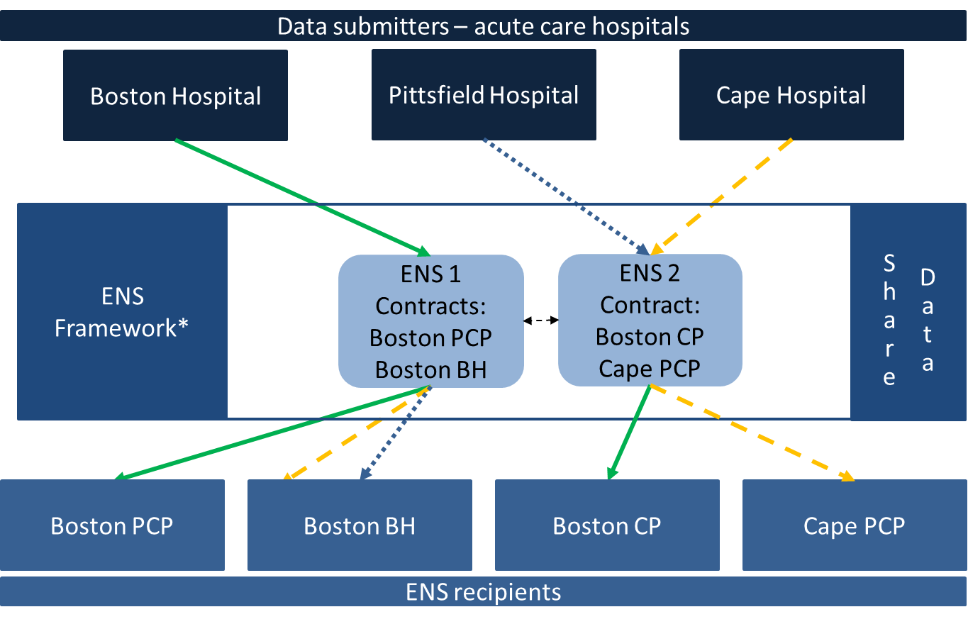
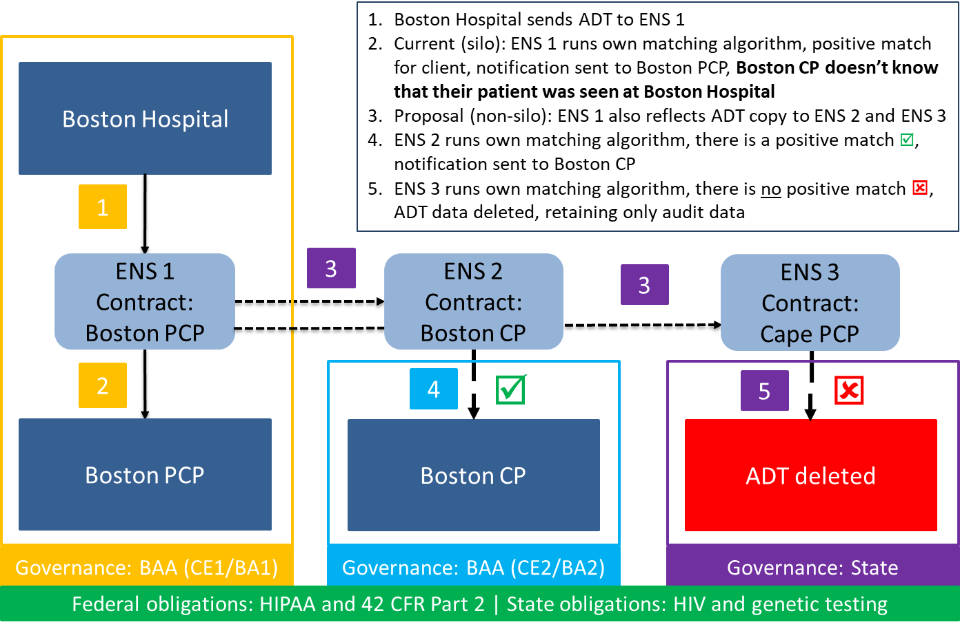
ENS: Overview
EOHHS ENS Initiative goal:
Supporting timely statewide Event Notification Services (ENS) across the Commonwealth in order to improve health care delivery, quality, and coordination
EOHHS guiding principles:
Universal access - Promoting data sharing within an ENS framework to increase accessibility to ENS for providers of all sizes
Streamline provider experience - Crafting ENS framework to allow single point of submission and single point of reception of ADT data
Improve notification timing - Improving timing for flow of data (real/near-real time)
Notes:
Slide title: ENS: Overview
EOHHS ENS Initiative goal:
Supporting timely statewide Event Notification Services (ENS) across the Commonwealth in order to improve health care delivery, quality, and coordination
EOHHS guiding principles:
Universal access - Promoting data sharing within an ENS framework to increase accessibility to ENS for providers of all sizes
Streamline provider experience - Crafting ENS framework to allow single point of submission and single point of reception of ADT data
Improve notification timing - Improving timing for flow of data (real/near-real time)

Slide 15
ENS: Number of reflected ADTs received
In the third quarter of 2021, the stabilization of Statewide ENS Framework participants resulted in more than six million ADTs being reflected
 | Q2 2021 (Apr – Jun) | Q3 2021 (Jul – Sep) | Percentage Increase
Vendor A | 325k | 3,671k | 1030%
Vendor B | 621k | 2,784k | 348%
In Q2 2021, both vendors began scaling up the transactions as they worked to define the gaps in their data
Both vendors experienced a significant increase of ADTs flowing into their systems as the gaps were increasingly closed in Q3 2021.
The Mass HIway expects the number of reflected ADTs in Q3 2021 to estimate an initial baseline.
Notes:
Slide title: ENS: Number of reflected ADTs received
In the third quarter of 2021, the stabilization of Statewide ENS Framework participants resulted in more than six million ADTs being reflected
Vendor Q2 2021 Q3 2021 percent increase
apr-jun jul-sep
A 325k 3,671k 1030%
B 621k 2,784 348%
In Q2 2021, both vendors began scaling up the transactions as they worked to define the gaps in their data
Both vendors experienced a significant increase of ADTs flowing into their systems as the gaps were increasingly closed in Q3 2021.
The Mass HIway expects the number of reflected ADTs in Q3 2021 to estimate an initial baseline.

Slide 16
ENS: Number of notifications generated by reflected ADTs
The number of notifications generated by the reflected ADTs increased for both vendors in Q3 2021 compared to Q2 2021.
 | Q2 2021 (Apr – Jun) | Q3 2021 (Jul – Sep) Notification # | Q2 2021 (Apr – Jun) Notification % | Q3 2021 (Jul – Sep) Notification %
Vendor A | 11k | 45k | 3% | 1%
Vendor B | 19k | 182k | 3% | 7%
While Vendor A saw a large growth in the number of ADTs received in Q3, it saw a percentage reduction in notifications generated
Vendor B saw an increase in the number of and percentage of notifications based on the increased reflected ADTs received
Notification percentages continue to remain relatively low to suggest the baseline is around the single digits.
Notes:
Slide title: ENS: Number of notifications generated by reflected ADTs
The number of notifications generated by the reflected ADTs increased for both vendors in Q3 2021 compared to Q2 2021.
Vendor Q2 2021 Q3 2021 Q2 2021 Q3 2021
apr-June jul-sep apr-jun jul-sep
notific# notific% notific%
A 11k 45k 3% 1%
B 19k 182k 35 7%
While Vendor A saw a large growth in the number of ADTs received in Q3, it saw a percentage reduction in notifications generated
Vendor B saw an increase in the number of and percentage of notifications based on the increased reflected ADTs received
Notification percentages continue to remain relatively low to suggest the baseline is around the single digits.

Slide 17
Unsolicited Notifications via Direct Messaging
Kevin Mullen
Notes:
Slide title: Unsolicited Notifications via Direct Messaging
Kevin Mullen

Slide 18
Unsolicited Notifications via Direct
An increase in volume of unsolicited, event notifications has been reported, driven in part by new CMS Condition of Participation (CoP) requirements on hospitals to send ADTs
The Mass HIway has received feedback from participants regarding challenges associated with Unsolicited Notifications coming through Direct Messaging
Vendors offer the ability to route patient directed event notifications to providers as identified by patients as well as to requesting community provider groups via Direct Messaging.
Although the increased volume was expected, there have been increased challenges reported resulting from inconsistent or incomplete message formats and metadata which prevent effective identification, matching and routing processes
*See Appendix B for CMS CoP background and definition of key terms
Notes:
Slide title: Unsolicited Notifications via Direct
The Mass HIway has received feedback from participants regarding challenges associated with Unsolicited Notifications coming through Direct Messaging
An increase in volume of unsolicited, event notifications has been reported, driven in part by new CMS Condition of Participation (CoP) requirements on hospitals to send ADTs
Vendors offer the ability to route patient directed event notifications to providers as identified by patients as well as to requesting community provider groups via Direct Messaging.
Although the increased volume was expected, there have been increased challenges reported resulting from inconsistent or incomplete message formats and metadata which prevent effective identification, matching and routing processes
*See Appendix B for CMS CoP background and definition of key terms

Slide 19
Unsolicited Notifications via Direct
Direct Messaging is a payload-agnostic mechanism for secure communication of health data between two known end points and can support virtually any file attachment.
Event Notifications can be communicated via Direct Messaging today
Direct Messaging is a prominent option for the transport of patient directed event notifications, requesting community provider groups and/or when the recipient may be outside of the HIE or ENS subscriber network
Why is there a problem?
Recipients of an unsolicited, event notification via Direct Message cannot differentiate a notification from another type of Direct Message.
Recipient systems may wish to route messages to a different department or automate workflows based on such information and are not able to do so currently.
Currently, there is not a universally accepted standard for messaging and terminology preventing auto-processing solutions
Notes:
Slide title: Unsolicited Notifications via Direct
Direct Messaging is a payload-agnostic mechanism for secure communication of health data between two known end points and can support virtually any file attachment.
Event Notifications can be communicated via Direct Messaging today
Direct Messaging is a prominent option for the transport of patient directed event notifications, requesting community provider groups and/or when the recipient may be outside of the HIE or ENS subscriber network
Why is there a problem?
Recipients of an unsolicited, event notification via Direct Message cannot differentiate a notification from another type of Direct Message.
Recipient systems may wish to route messages to a different department or automate workflows based on such information and are not able to do so currently.
Currently, there is not a universally accepted standard for messaging and terminology preventing auto-processing solutions

Slide 20
Unsolicited Notifications via Direct
The Mass HIway leadership team met with DirectTrust to understand how its latest standards document can help address some of the recent challenges identified with event notifications
DirectTrust is in the process of finalizing its latest standards document Event Notifications via the Direct Standard™
The standard is up for ballot and will then undergo a 30-to-60-day review and approval period by American National Standards Institute (ANSI)
Epic and Meditech are actively implementing the standard, with more vendors expected to follow once approved
The new standard includes context data to enable message routing to the appropriate person on the care team
Notes:
Slide title: Unsolicited Notifications via Direct
The Mass HIway leadership team met with DirectTrust to understand how its latest standards document can help address some of the recent challenges identified with event notifications
DirectTrust is in the process of finalizing its latest standards document Event Notifications via the Direct Standard™
The standard is up for ballot and will then undergo a 30-to-60-day review and approval period by American National Standards Institute (ANSI)
Epic and Meditech are actively implementing the standard, with more vendors expected to follow once approved
The new standard includes context data to enable message routing to the appropriate person on the care team

Slide 21
Unsolicited Notifications via Direct
Context data enhances Direct Secure Messaging for Notifications
The addition of context data allows care teams to immediately know what a Direct Secure Message is and who it’s about. This strategically selected information, including message type and patient demographic data, brings power to Direct Secure Messages by allowing care teams to properly match patients, prioritize, and enable more efficient and informed workflows.
Source: DirectTrust; Event Notifications via Direct, https://directtrust.org/standards/event-notifications-via-direct
Notes:
Slide title: Unsolicited Notifications via Direct
Context data enhances Direct Secure Messaging for Notifications
The addition of context data allows care teams to immediately know what a Direct Secure Message is and who it’s about. This strategically selected information, including message type and patient demographic data, brings power to Direct Secure Messages by allowing care teams to properly match patients, prioritize, and enable more efficient and informed workflows.
Instantly Informs: know what/who a Direct Secure Message message is about
Aids Patient Matching: link a message to the proper patient
Human Readable: Understand context data regardless of technology sophistication
Prioritizes Critical Alerts: Determine what messages need to be addressed first
Empowers Efficiency: Route messages manually or through automation to proper care team members
Source: DirectTrust; Event Notifications via Direct, https://directtrust.org/standards/event-notifications-via-direct

Slide 22
Unsolicited Notifications via Direct
The Mass HIway is exploring ways to collaborate with DirectTrust on educating providers and vendors on the standard to ensure good citizenship and best practices. Options include;
Promotion of DirectTrust Event Notifications via the Direct Standard™
Communicate message format expectations, coordinate conformance testing and collaborate to resolve issues that prevent auto-processing of messages
Convene provider and developer meetings to build awareness and improve sender and receiver behavior
Collaborate with DirectTrust on best practice guidance for Provider Directory information to include intended use fields for receiver preferences and capabilities e.g. indicating whether an address should be used to send the notifications
Consider policy changes to support and compel use of standards
Notes:
Slide title: Unsolicited Notifications via Direct
The Mass HIway is exploring ways to collaborate with DirectTrust on educating providers and vendors on the standard to ensure good citizenship and best practices. Options include;
Promotion of DirectTrust Event Notifications via the Direct Standard™
Communicate message format expectations, coordinate conformance testing and collaborate to resolve issues that prevent auto-processing of messages
Convene provider and developer meetings to build awareness and improve sender and receiver behavior
Collaborate with DirectTrust on best practice guidance for Provider Directory information to include intended use fields for receiver preferences and capabilities e.g. indicating whether an address should be used to send the notifications
Consider policy changes to support and compel use of standards

Slide 23
Clinical Gateway API Development-Update
Kevin Mullen
Notes:
Slide title: Clinical Gateway API Development-Update
Kevin Mullen

Slide 24
Clinical Gateway API Development
The intent of this project is to develop a foundation for a common Application Programming Interface (API) and FHIR Integration infrastructure that can be used for multiple public health use cases.
The initial scope will focus on building the infrastructure, engaging early adopters and demonstrating use of the API for one or more public health use cases in a production exchange.
Notes:
Slide title: Clinical Gateway API Development
The intent of this project is to develop a foundation for a common Application Programming Interface (API) and FHIR Integration infrastructure that can be used for multiple public health use cases.
The initial scope will focus on building the infrastructure, engaging early adopters and demonstrating use of the API for one or more public health use cases in a production exchange.

Slide 25
Clinical Gateway API Development
Key Objectives
Build an alternative pathway to current public health reporting via Direct Messaging
Add support for multiple channels to send and receive data via RESTful & SOAP Services
Enable real time, synchronous message exchange between providers and public health registries
Implement FHIR integration and authentication protocols to support enhanced security and business functionality
Notes:
Slide title: Clinical Gateway API Development
Key Objectives
Build an alternative pathway to current public health reporting via Direct Messaging
Add support for multiple channels to send and receive data via RESTful & SOAP Services
Enable real time, synchronous message exchange between providers and public health registries
Implement FHIR integration and authentication protocols to support enhanced security and business functionality

Slide 26
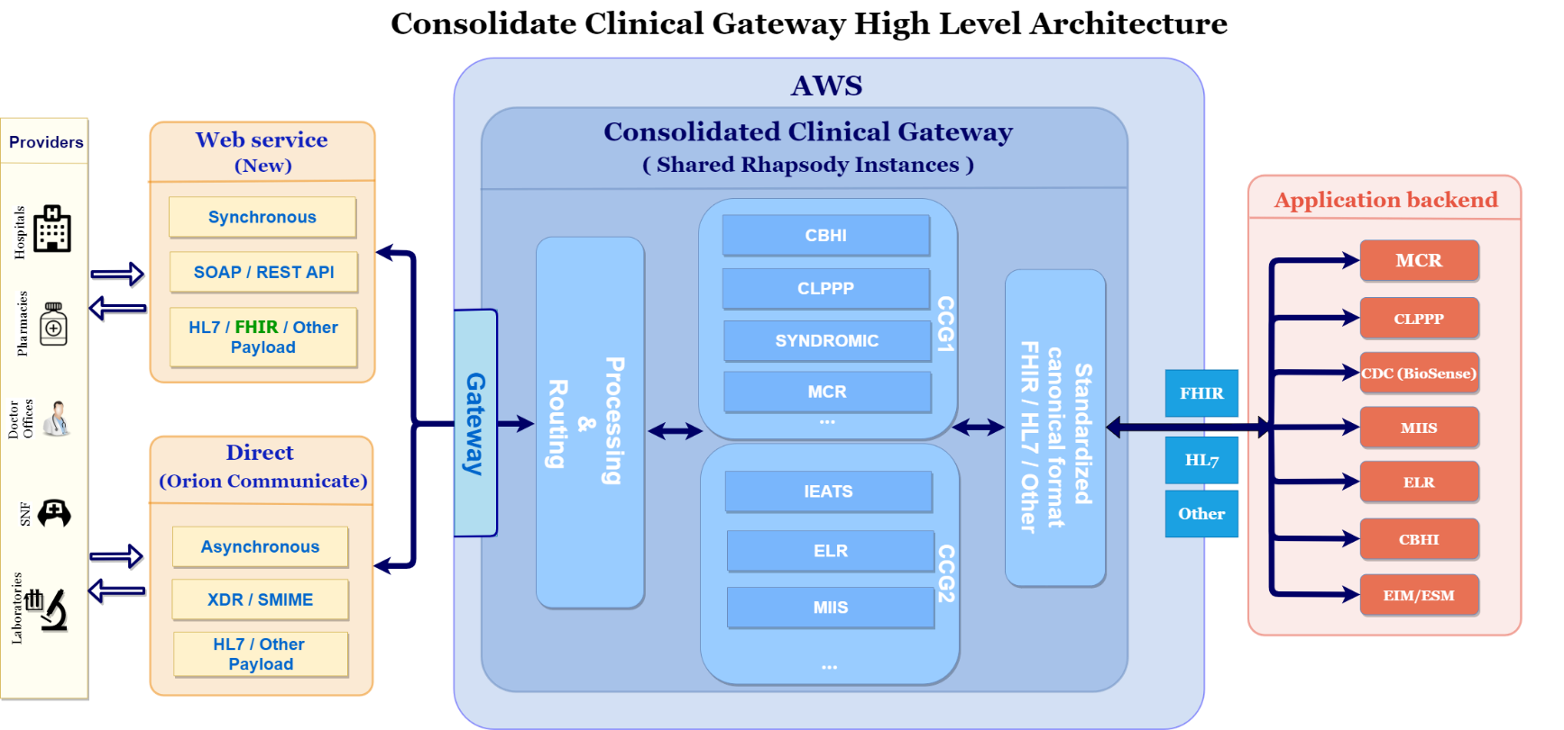
CCG – API & FHIR Services
Future State
Current State
Notes:
Slide title: CCG-API & FHIR Services
Diagram shows the high-level architecture of the Consolidated Clinical Gateway
Web service and Direct Messaging connections to the CCG will process messages to backend applications.
Currently there are seven (7) applications:
-Massachusetts Cancer Registry (MCR)
-Childhood Lead Poison Prevention Program (CLPPP)
-Children’s Behavioral Health Initiative (CBHI)
-Electronic Lab Reporting (ELR)
-Immunization (MIIS)
-Intake Enrolment Assessment and Transfer Service (OTP&TB)
-Syndromic Surveillance (SYNDROMIC)

Slide 27
Clinical Gateway API Development
Key Project Updates
Development work for API CCG-1 nodes complete
CCG-1 nodes include Syndromic, Children’s Behavioral Health Initiative (CBHI), and Mass Cancer Registry (MCR)
CCG-1 released to production on 1/23/22
CCG-2 nodes currently scheduled for 2/20/22
Identification of five potential provider pilot sites
Development of provider engagement plan including key tasks and timeline
Creation of several provider facing documents including draft API Instructions, Implementation Guide and Test Plan
Next Steps
Finalize documentation and share with identified pilot providers
Gain agreement from provider organizations to participate in pilot
Notes:
Slide title: Clinical Gateway API Development
Key Project Updates
Development work for API CCG-1 nodes complete
CCG-1 nodes include Syndromic, Children’s Behavioral Health Initiative (CBHI), and Mass Cancer Registry (MCR)
CCG-1 released to production on 1/23/22
CCG-2 nodes currently scheduled for 2/20/22
Identification of five potential provider pilot sites
Development of provider engagement plan including key tasks and timeline
Creation of several provider facing documents including draft API Instructions, Implementation Guide and Test Plan
Next Steps
Finalize documentation and share with identified pilot providers
Gain agreement from provider organizations to participate in pilot

Slide 28
43 days
20 days
CCG API & FHIR Development Timeline
97 days
Publish Initial API IG & Specification
Publish FHIR IG
35 days
Feb 2022
Dec 2022
2021
Jul
Sep
Nov
2022
Mar
85 days
May
Jul
Sep
Nov
2022
239 days
Today
100 days
May 2022
Publish OAuth Specification
60 days
65 days
API Design
100%
7/21 - 8/21
16 days
API Development
100%
7/21 - 11/21
310 days
REST/SOAP API Testing
100%
11/21 - 12/21
API Migration Planning
100%
10/21 - 12/21
API Migration – CG1
100%
12/21 - 1/22
API Migration – CG2
1/22 - 2/22
Design & Develop OAuth Authentication Security
10%
1/22 - 4/22
Stakeholder Engagement (Providers & Registries) & BRD
2/22 - 12/22
Design & Develop FHIR Integration
5/22 - 9/22
FHIR Integration Testing
8/22 - 10/22
CG API Transition Project Team
25%
10/21 - 12/22
Notes:
Slide title: CCG API & FHIR Development Timeline
Form 2021-2022
API Design 100% complete 7/21-8/21
API Development 100% complete 7/21-11/21
REST/SOAP API Testing 100% complete 11/21-12/21
API Migration Planning 100% complete 10/21-12/21
API Migration – CG1 100% complete 12/21-1/22
API Migration – CG2 1/22-2/22
Design & Develop OAuth Authentication Security 10% completed 1/22-4/22
Publish Initial API IG and Specification Feb 2022
Stakeholder Engagement (Providers & Registries) & BRD 2/22-12/22
Design & Develop FHIR Integration 5/22-9/22
Publish Oauth Specifiation May 2022
FHIR Integration Testing 8/22-10/22
CG API Transition Project Team 25% completed 10/21-12/22
Publish FHIR IG Dec 2022

Slide 29
Clinical Gateway API Development
Longer Term Goals
The technical components (eg., Amazon Web Services, Rhapsody) and new API and FHIR capabilities of the Consolidated Clinical Gateway development could be leveraged to support other FHIR API initiatives and a range of FHIR-enabled HIE services.
As the project evolves, the Mass HIway project team will identify and evaluate other strategic opportunities to utilize the API and FHIR infrastructure, to add use cases, extend utility and value and to help meet other EOHHS and Commonwealth data exchange and public health reporting requirements
Notes:
Slide title: Clinical Gateway API Development

Slide 30
Conclusion
Undersecretary Lauren Peters
Notes:
Slide Title: Conclusion
Undersecretary Lauren Peters

Slide 31
Next HITC meeting
Next HITC meeting
May 2, 2022
3:30 – 5 p.m.
W
Notes:
Slide Title: Next HITC meeting
MaY 2, 2022
3:30-5 P.M.
Next HITC meeting
August 2, 2021
3:30 – 5 p.m.

Slide 32
Appendix A: HIway Operations Update
Notes:
Slide Title: Appendix A: HIway Operations Update

Slide 33
HIway participation October 21, 2021 – January 20, 2022
1
New participation agreements
Pharmacy Online Processing System (POPS)
Confidential Draft – Policy in Development
Notes:
Slide title: HIway participation October 21, 2021 – January 20, 2022
I New Participation Agreement
Pharmacy Online Processing System (POPS)
Confidential Draft – Policy in Development

Slide 34
HIway participation October 21, 2021 – January 20, 2022
2
New connections
Mani George, MD (Great Barrington Internal Medicine) Pharmacy Online Processing System (POPS)*
* Participants that were enrolled and connected in the same period.
Confidential Draft – Policy in Development
Notes:
Slide title: HIway participation October 21, 2021 – January 20, 2022
2 New connections
Mani George, MD (Great Barrington Internal Medicine)
Pharmacy Online Processing System (POPS)*
*Participants that were enrolled and connected in the same period.
Confidential Draft – Policy in Development

Slide 35
HIway transactions
HIway transaction volume update
The Mass HIway processed 37.4 million production transactions during the Jan 2022 reporting period (12/21/21 through 1/20/22) with continued volume increases due to the COVID-19 queries to the MIIS. From Feb 2021 through Jan 2022, the average increased to 27.8 million production transactions per month for a total of 334 million over the past year. In January, Public Health Reporting accounted for 36.8 million transactions, or 98.6% of total production volume. This included 10 million Syndromic Surveillance transactions and 26 million Immunization transactions. Note: Immunization queries from commercial insurance companies for COVID-19 vaccination updates that processed through the new, high-volume “MIIS QBP” Clinical Gateway node are included in the Immunization total. Provider-to-provider transactions now average over 329,000 per month for the past year, with new use cases added regularly. For January, the total was 349,576. Quality Reporting volume has been inconsistent over the last year, but is currently averaging around 170,000 transactions per month for the past 6 months. The Mass HIway team continuously monitors transaction levels, both to support operations and to identify data that provide additional insight into HIway trends and progress.
Confidential Draft – Policy in Development
Notes:
Slide title: HIway transactions
HIway transaction volume update
The Mass HIway processed 37.4 million production transactions during the Jan 2022 reporting period (12/21/21 through 1/20/22) with continued volume increases due to the COVID-19 queries to the MIIS. From Feb 2021 through Jan 2022, the average increased to 27.8 million production transactions per month for a total of 334 million over the past year.
In January, Public Health Reporting accounted for 36.8 million transactions, or 98.6% of total production volume. This included 10 million Syndromic Surveillance transactions and 26 million Immunization transactions.
Note: Immunization queries from commercial insurance companies for COVID-19 vaccination updates that processed through the new, high-volume “MIIS QBP” Clinical Gateway node are included in the Immunization total.
Provider-to-provider transactions now average over 329,000 per month for the past year, with new use cases added regularly. For January, the total was 349,576.
Quality Reporting volume has been inconsistent over the last year, but is currently averaging around 170,000 transactions per month for the past 6 months.
The Mass HIway team continuously monitors transaction levels, both to support operations and to identify data that provide additional insight into HIway trends and progress.
Confidential Draft-Policy in Devlopment
HIway transaction volume update
The Mass HIway processed a record 25.1 million production transactions during the April 2021 reporting period (March 21 through April 20) with the significant increase due to the COVID-19 queries to the MIIS. From May 2020 through April 2021, the average was 15.1 million production transactions per month for a total of 181 million over the past year.
In April, Public Health Reporting accounted for 24.6 million transactions, or 98% of total production volume. This included 8.5 million Syndromic Surveillance transactions and 16.1 million Immunization transactions.
Note: Immunization queries from commercial insurance companies for COVID-19 vaccination updates that processed through the new, high-volume “MIIS QBP” Clinical Gateway node are included in the Immunization total.
Provider-to-provider transactions now average over 250,000 per month for the past year, with new use cases added regularly. For April, the total was 290,608.
The Mass HIway team continuously monitors transaction levels, both to support operations and to identify data that provide additional insight into HIway trends and progress.

Slide 36
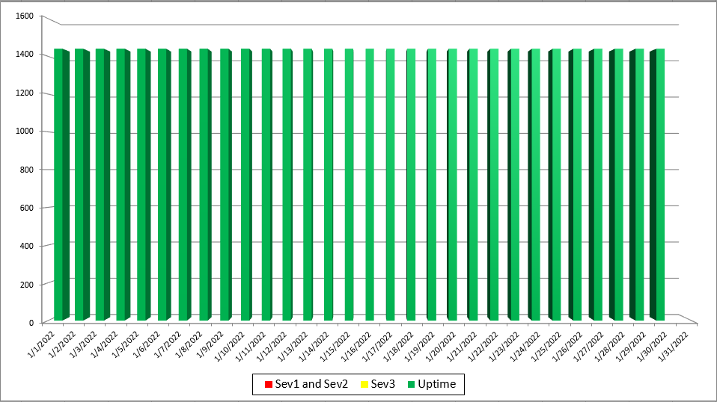
2019 Mass HIway Incident Summary Dashboard
January 2022
Sev 1 - All / Most Mass HIway components impacted as a result of outage. For example: LAND, Webmail, Direct XDR, and DPH nodes are all down
Sev 2 - Multiple Mass HIway components impacted as a result of outage in one of the shared service. For example: LAND and Webmail are down but Direct XDR and DPH nodes are up.
Sev3 – One Mass HIway component impacted as a result of outage. For example: Webmail is down but all other services are up and running.
Notes:
Slide title: 2019 Mass HIway Incident Summary Dashboard
January 2022
All daily service for Jan 2022 operated in “Uptime” ; services up and running, with no outages

Slide 37
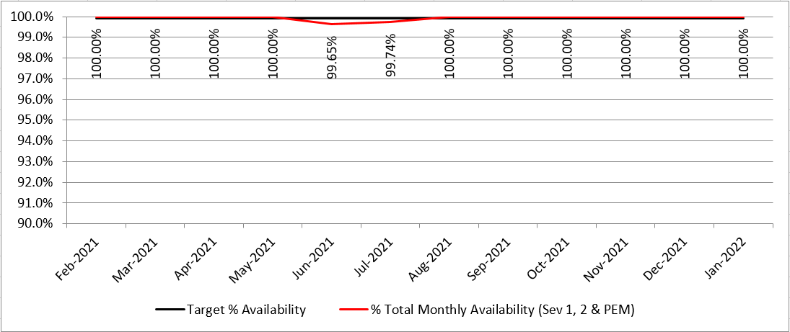
HIway Availability Trends – January 2022
Metric Targets:
“Total Monthly Availability” – no lower than 99.9% (downtime no more than ~44 minutes/month)
Notes:
slide title: HIway Availability Trends – January 2022
Metric Targets:
“Total Monthly Availability” – no lower than 99.9% (downtime no more than ~44 minutes/month)
All months Feb 2021 through Jan 2022 were 100% available with the exception of June 2021 99.65%, and July 2021 99.74%

Slide 38
Appendix B: CMS CoP Background and Definitions
Notes:
Slide Title: Appendix B: CMS CoP Background and Definitions

Slide 39
ADT CoP Background
Admission, Discharge, and Transfer Patient Event Notification Conditions of Participation (CoP)
(42 CFR 482.24(d), 482.61(f), and 485.638(d))
What are the CoP requirements for the admission, discharge, and transfer (ADT) patient event notifications within the final rule?
The patient event notification CoP requirement is limited to those hospitals, psychiatric hospitals, and critical access hospitals (CAH) that utilize electronic medical record systems or other electronic administrative systems that are conformant with the content exchange standard at 45 CFR 170.205(d)(2). However, conformance with this standard is only used to determine whether a facility will be evaluated under the CoP.
Hospitals are not required to use a specific standard or technology to implement the electronic patient event notification required by the CoP.
Hospitals subject to this rule may transmit patient event notifications using a range of approaches, including messages based on different versions of HL7 messaging standards, summary care records using the C-CDA standard, or making notification information available via a FHIR-based API
CMS does note that a fax is not considered an electronic method of data exchange in this context
The applicability date for the patient event notifications requirement is April 30, 2021. Compliance with this requirement will be assessed through established survey and certification procedures.
Source: https://www.cms.gov/about-cms/health-informatics-and-interoperability group/faqs/faqs#bookmark
Notes:
Slide title: ADT CoP Background
Admission, Discharge, and Transfer Patient Event Notification Conditions of Participation (CoP)
(42 CFR 482.24(d), 482.61(f), and 485.638(d))
What are the CoP requirements for the admission, discharge, and transfer (ADT) patient event notifications within the final rule?
The patient event notification CoP requirement is limited to those hospitals, psychiatric hospitals, and critical access hospitals (CAH) that utilize electronic medical record systems or other electronic administrative systems that are conformant with the content exchange standard at 45 CFR 170.205(d)(2). However, conformance with this standard is only used to determine whether a facility will be evaluated under the CoP.
Hospitals are not required to use a specific standard or technology to implement the electronic patient event notification required by the CoP.
Hospitals subject to this rule may transmit patient event notifications using a range of approaches, including messages based on different versions of HL7 messaging standards, summary care records using the C-CDA standard, or making notification information available via a FHIR-based API
CMS does note that a fax is not considered an electronic method of data exchange in this context
The applicability date for the patient event notifications requirement is April 30, 2021. Compliance with this requirement will be assessed through established survey and certification procedures.
Source: https://www.cms.gov/about-cms/health-informatics-and-interoperability group/faqs/faqs#bookmark

Slide 40
Terms and Definitions
Term | Definition
ADT | Admit, Discharge and Transfer. Refers to the system that manages patient access in an electronic health record system as well as the HL7 V2 Messaging Standard code set for these triggers. It is this Standard that is referenced in the CMS Final Rule.
Context | Information necessary to determine the type of context, the purpose of the message and to whom it may be of interest.
Message Metadata | Formatted discrete information about the data within a message that can be used for both automated and manual processing of the message by transporting systems without requiring the transporting system to extract and decode encapsulated information to determine the needed information
Notification Subscriptions | Requests for specific types of notifications which may be routed and filtered from the source based upon an automated or manual process in such systems. Such subscriptions may be created using electronic transactions via web-services or otherwise.
Unsolicited Notifications | Sending information based on a "standing" or "blanket" subscription or an explicit patient instruction with consent. No electronic transaction is required from the intended recipient to trigger the notification transmission.
Notes:
Slide title: Terms and Definitions
ADT: Admit, Discharge and Transfer. Refers to the system that manages patient access in an electronic health record system as well as the HL7 V2 Messaging Standard code set for these triggers. It is this Standard that is referenced in the CMS Final Rule.
Context: Information necessary to determine the type of context, the purpose of the message and to whom it may be of interest.
Message Metadata: Formatted discrete information about the data within a message that can be used for both automated and manual processing of the message by transporting systems without requiring the transporting system to extract and decode encapsulated information to determine the needed information.
Notification Subscriptions: Requests for specific types of notifications which may be routed and filtered from the source based upon an automated or manual process in such systems. Such subscriptions may be created using electronic transactions via web-services or otherwise.
Unsolicited Notifications: Sending information based on a "standing" or "blanket" subscription or an explicit patient instruction with consent. No electronic transaction is required from the intended recipient to trigger the notification transmission.

Slide 41
Thank you!
Notes:
Slide Title: Thank you!

