Slide 1
V
Health Information Technology Council Meeting
February 1, 2021
Notes:
Title slide
Health Information Technology Council Meeting
August 3, 2020

Slide 2
Agenda
Welcome
Undersecretary Lauren Peters
Approval of November 2020 minutes (vote)
Approval of 2020 Annual Report (vote)
Statewide Event Notification Services Framework update
Undersecretary Lauren Peters & Bert Ng
Federal funding update
Bert Ng
Clinical Gateway & AWS update
David Whitham
HIway connection requirement & 2020 attestation
Chris Stuck-Girard
ePOLST update
Kathryn Downes & Daniel Danon
Conclusion
Undersecretary Lauren Peters
Notes:
Slide title: Agenda
Welcome
Undersecretary Lauren Peters
-Approval of the Feb. 3, 2020 minutes (vote)
Updates from last meeting
Bert Ng
Clinical Gateway nodes
David Whitham
HIway strategic plan
Undersecretary Lauren Peters & Bert Ng
HIway budget
Bert Ng & David Whitham
HIway connection requirement & 2020 attestation
Chris Stuck-Girard
Conclusion
Undersecretary Lauren Peters

Slide 3
Welcome
Undersecretary Lauren Peters
Notes:
Welcome
Undersecretary Lauren Peters

Slide 4
Vote: Approve minutes
MOTION: That the Health Information Technology Council hereby approves the minutes of the council meeting held on November 4, 2020 as presented/amended
Notes:
Slide title: Vote: Approve minutes
MOTION: That the Health Information Technology Council hereby approves the minutes of the council meeting held on February 3, 2020 as presented/amended

Slide 5
Vote: Approve annual report
MOTION: That the Health Information Technology Council hereby approves the Health Information Technology Council 2020 annual report as presented/amended

Slide 6
Statewide Event Notification Framework
Undersecretary Lauren Peters & Bert Ng
Notes:
Welcome
Undersecretary Lauren Peters

Slide 7
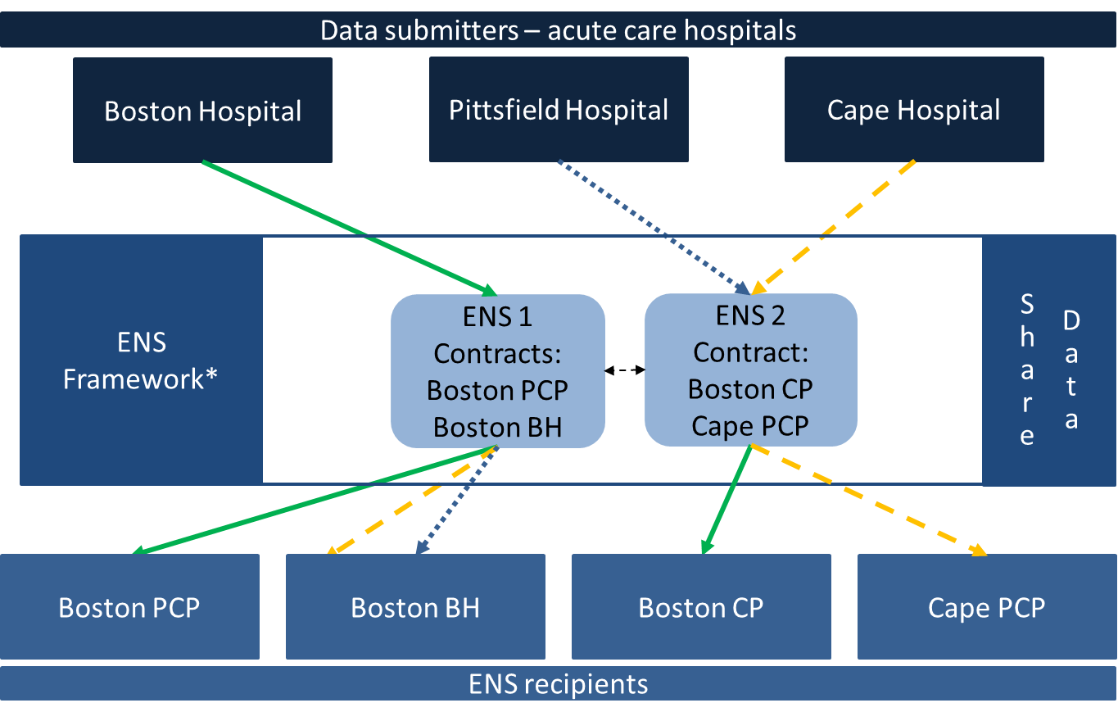
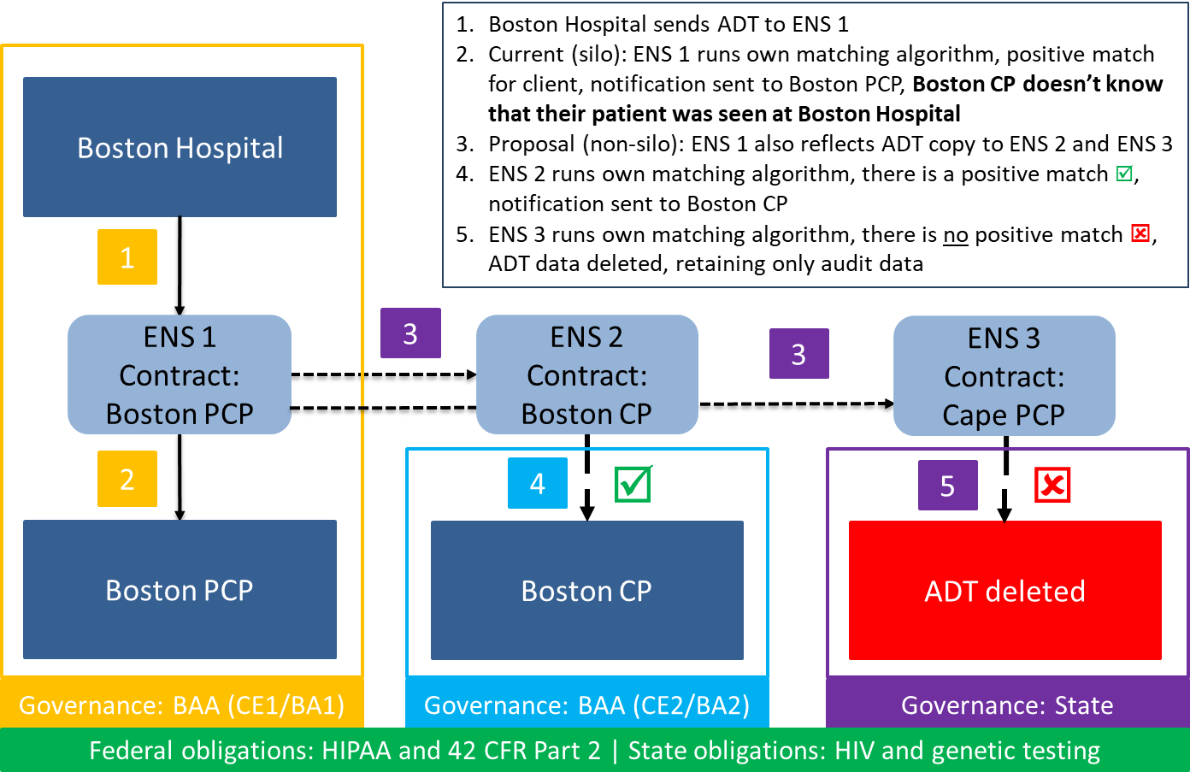
ENS: Overview
EOHHS ENS Initiative goal:
Supporting timely statewide Event Notification Services (ENS) across the Commonwealth in order to improve health care delivery, quality, and coordination
EOHHS guiding principles:
Universal access - Promoting data sharing within an ENS framework to increase accessibility to ENS for providers of all sizes
Streamline provider experience - Crafting ENS framework to allow single point of submission and single point of reception of ADT data
Improve notification timing - Improving timing for flow of data (real/near-real time)

Slide 8
ENS: Timeline
ENS is progressing along toward the development phase, and implementation is planned by April 1, 2021
Design
Development
Implementation
Regulatory
☑
RFA
☑
Certification
◻
Connecting
◻
Go Live
◻

Slide 9
ENS: Anticipated Connecting & Go Live
Certification
February 2021 (est.)
Certification complete
Connecting
February 2021
to
April 2021
Provider contracting phase
Providers with a certified ENS vendor can continue normal operations
April 1, 2021
Acute care hospitals to submit ADTs to the Statewide ENS Framework
Go live
After April 1, 2021
Statewide ENS Framework will have full hospital ADT data for streamlined notifications

Slide 10
ENS: Federal ADT rule
CMS Interoperability Rule (9115-F) requires ADTs to be transmitted by 5/1/2021
Applicable providers
Acute care hospitals
Psychiatric hospitals
Critical access hospitals
Required data
Patient name
Treating practitioner name
Sending institution name
Applicable providers must make “reasonable efforts” to provide required data to a patient’s applicable providers or suppliers (ex. PAC, PCPs, etc.) or any provider directed by the patient

Slide 11
Federal funding update
Bert Ng
Notes:
Federal funding update
Bert Ng

Slide 12
Federal funding: Payment programs
HIway budget is a combination of many federal funding sources including HITECH funds. HITECH funding is set to expire on Oct. 1, 2021
Funding program
FFP rate
Uses of funds
HITECH
90%
DDI of Meaningful Use infrastructure
On-boarding to HIE (outreach)
Medicaid Enterprise Systems (MES)*
90%
75%
DDI of certified HIE modules benefiting MassHealth (MH)
Ops of certified HIE modules benefiting MH
Medicaid General Administration (GA)*
50%
General operations of MH and HIE modules
*Cost allocation: States can claim reimbursement based on benefit to Medicaid
FFP rate
Cost allocation rate
Effective FFP
Notes: DDI: Design, Development, and Implementation, Ops: Formerly known as Operations and Maintenance

Slide 13
Federal funding: FFY 21 CMS policy changes affect cost allocation
CMS communicated its new interpretation of the federal match cost allocation methodology for the MES program in July 2020.
Issue
Prior
Current
Cost Allocation
(costs applicable to Medicaid)
Providers
91%
Patients
27%
Design, Development, Implementation
Not Required – All DDI for mixed use applications eligible for FFP
Required
Maintenance & Operations
Required
Required

Slide 14
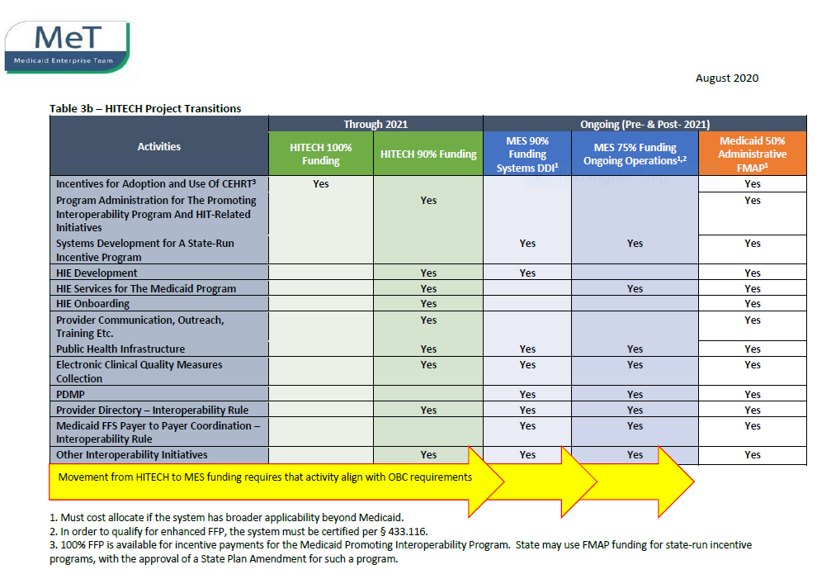
Federal funding: FFY22 FFP rates change with shift from HITECH to MES

Slide 15
Federal funding: Timeline
FFY20
FFY21
FFY22
CMS Notice of change
7/2020
Cost allocation
10/2020
Activity FFP rate
10/2021
Future cost allocation will no longer allow provider-based methodology for MES
Cost allocation for MES shifts from provider-based (91%) to patient-based (27%)
Patient-based cost allocation
HITECH activities shift to MES with new FFP
HITECH outreach (90/10) to MES outreach (50/50)

Slide 16
Clinical Gateway & AWS update
David Whitham
Notes:
Consolidated Clinical Gateway
David Whitham

Slide 17
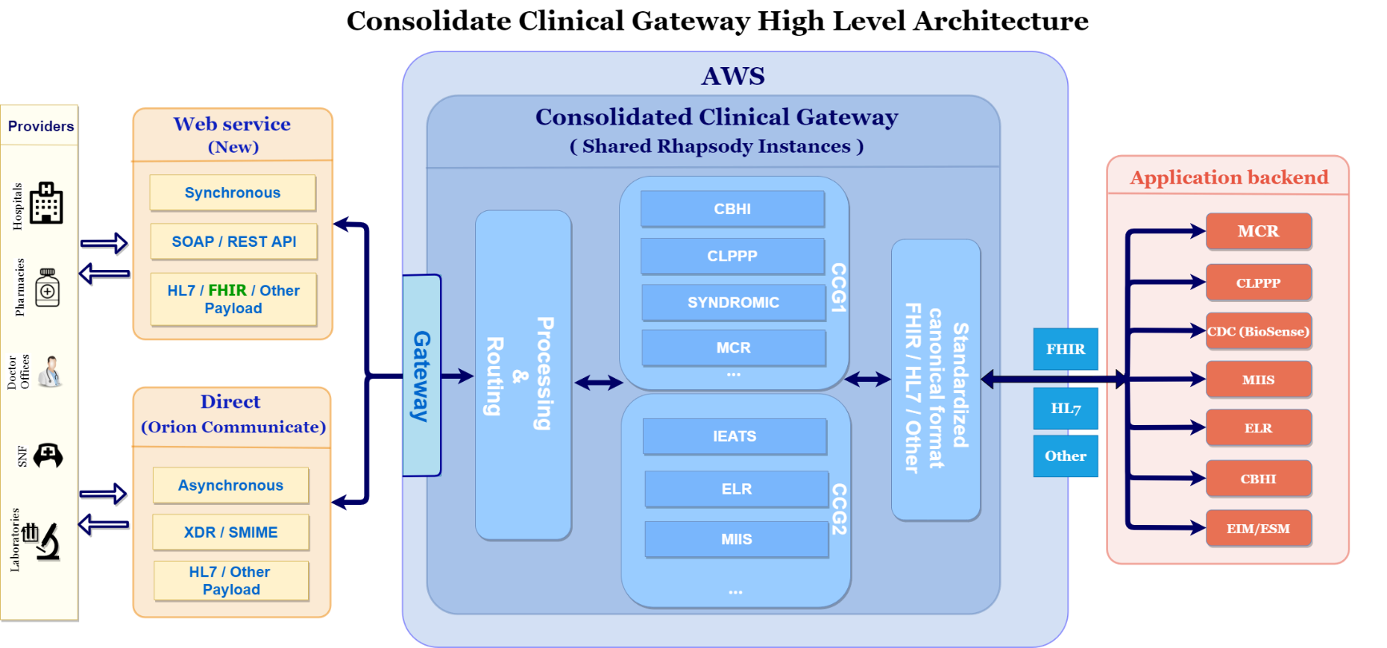
Recap: Consolidated Clinical Gateway (CCG) Project Overview
This project will migrate the current suite of Clinical Gateway nodes to the AWS cloud
Key project objectives include
Migrate to AWS to reduce infrastructure costs and address scalability
Provide future alternatives to Direct messaging for public health reporting
Support Query & Retrieve functionality to align with TEFCA
Implement a FHIR interface to support enhanced business functionality
Notes:
Slide title: Recap: Consolidated Clinical Gateway (CCG) Project Overview.
This project will migrate the current suite of Clinical Gateway nodes to the AWS cloud.
Key project objectives include
Migrate to AWS to reduce infrastructure costs and address scalability
Provide future alternatives to Direct messaging for public health reporting
Support Query & Retrieve functionality to align with TEFCA
Implement a FHIR interface to support enhanced the business functionality
Diagram shows the high-level architecture of the Consolidated Clinical Gateway
Web service and Direct Messaging connections to the CCG will process messages to backend applications.
Currently there are seven (7) applications:
-Massachusetts Cancer Registry (MCR)
-Childhood Lead Poison Prevention Program (CLPPP)
-Children’s Behavioral Health Initiative (CBHI)
-Electronic Lab Reporting (ELR)
-Immunization (MIIS)
-Intake Enrolment Assessment and Transfer Service (OTP&TB)
-Syndromic Surveillance (SYNDROMIC)

Slide 18
Consolidated Clinical Gateway (CCG) – AWS migration timeline update
Live:
Q3 CY2020 to Q1 CY2021
Live:
Early Q2 CY2021
Live:
Later Q2 CY2021
Live:
Q3 CY 2021
Design & Dev
Internal Apps
CCG Phase 1
CCG Phase 2
FHIR & Others
Internal Apps:
(Live Now!)
Attestation Forms
Masshiway.net
Sugar CRM
(Pending)
Operations Tools
CCG Phase 1:
MCR
CBHI
CLPPP
Syndromic
CCG Phase 2:
IEATS
ELR
MIIS
Enhancements
FHIR Proof of Concept
Migration notes:
CG nodes in current VG4 environment are retained until the AWS system is stabilized. This allows for a quick rollback to the VG4 environment if any issues arise
Migrations will be done on weekend nights to ensure message flow is not interrupted during peak processing hours
For CCG Phase 1, lower-volume nodes will be cutover to PROD first; Syndromic will be last
For CCG Phase 2, lower-volume nodes will be cutover to PROD first; MIIS will be last
Each production cutover will have in-depth pre-production cutover activities
Notes:
Slide Title: Consolidated Clinical Gateway (CCG) – AWS migration timeline update
Timeline graphic shows target Go-Live dates for 4 categories of applications
Internal Apps – Live Q3 CY2020 to Q1 CY2021
CCG Phase 1 – Live Early Q2 CY2021
CCG Phase 2 – Live Later Q2 CY2021
FHIR & Others – Live Q3 CY2021
Migration notes:
CG nodes in current VG4 environment are retained until the AWS system is stabilized. In case of any issues this allows for a quick rollback to the VG4 environment
Migrations will be done on weekend nights to make sure the message flow is not interrupted during peak processing hours
For CCG Phase 1, the lower volume nodes will be cutover to PROD first and Syndromic will be last
For CCG Phase 2, the lower volume nodes will be cutover to PROD first and MIIS will be last
Each production cutover will have in-depth pre-production cutover activities

Slide 19
New Mass HIway website
On January 14, 2020, the Mass HIway has updated its website (http://www.masshiway.net)
Changes to website
The site has a new look and feel with updated images and graphics as well as the addition of closed captioning on all audio and video presentations.
The website also has new content related to HAUS in addition to all previous content.
Live demonstration of new website

Slide 20
COVID-19 update: MIIS CG node
The Massachusetts Immunization Information System (MIIS) Clinical Gateway (CG) node receives immunization reports and database queries via the Mass HIway, using both Direct Messaging and synchronous API from providers across the Commonwealth.
As Massachusetts ramps up the COVID-19 Vaccination program, the MIIS plays a critical role in tracking and reporting progress. To prepare for millions of additional messages per month, the Mass HIway enhanced the interfaces, and increased capacity and throughput. The Mass HIway will continue to work with MIIS to determine future needs.
Enhancements
Increased the number of technical connections from the CG node to the MIIS, tripling throughput from the Mass HIway to leverage increased MIIS processing capacity.
Increased disk space to accommodate new monthly batches of query transactions from one of the leading pharmacy chains to support vaccination planning.
Revised the Mass HIway’s AWS migration plan to include additional software and infrastructure to extend support of a legacy version of the synchronous API used to access the MIIS, allowing providers additional time to upgrade systems.
Coordinated planning between teams to accommodate an accelerated migration of MIIS operations to AWS.
Impact
Accommodating the COVID-related requirements from the MIIS program has required the Mass HIway team to reallocate resources and adjust the schedule for the CCG2 migration.
Notes:
Slide title: COVID-19 update: MIIS CG node
The Massachusetts Immunization Information System (MIIS) Clinical Gateway (CG) node receives immunization reports and database queries via the Mass HIway, using both Direct Messaging and synchronous API from providers across the Commonwealth.
As Massachusetts ramps up the COVID-19 Vaccination program, the MIIS plays a critical role in tracking and reporting progress. To prepare for millions of additional messages per month, the Mass HIway enhanced the interfaces, and increased capacity and throughput. The Mass HIway will continue to work with MIIS to determine future needs.
Enhancements
Increased the number of technical connections from the CG node to the MIIS, tripling throughput from the Mass HIway to leverage increased MIIS processing capacity.
Increased disk space to accommodate new monthly batches of query transactions from one of the leading pharmacy chains to support vaccination planning.
Revised the Mass HIway’s AWS migration plan to include additional software and infrastructure to extend support of a legacy version of the synchronous API used to access the MIIS, allowing providers additional time to upgrade systems.
Coordinated planning between teams to accommodate an accelerated migration of MIIS operations to AWS.
Impact
Accommodating the COVID-related requirements from the MIIS program has required the Mass HIway team to reallocate resources and adjust the schedule for the CCG2 migration

Slide 21
COVID-19 recap: Syndromic and ELR CG nodes
As part of the daily COVID-19 reporting cycle, the Clinical Gateway (CG) nodes receive messages via the Mass HIway’s Direct Messaging System from hospital emergency departments and laboratories, transform them, and deliver them to the Massachusetts Department of Public Health’s Syndromic Surveillance and Electronic Lab Reporting applications for processing and analysis.
Syndromic Surveillance
All Massachusetts hospital emergency departments participate.
Highest message volume of all CG nodes with an average of 8.5 million messages per month.
ED records of admissions, discharges, and transfers of patients are processed by the Syndromic Surveillance CG node, which feeds the National Syndromic Surveillance Program’s BioSense Platform at the CDC.
BioSense data is used by the Commonwealth’s Syndromic Surveillance program at the DPH Bureau of Infectious Disease and Laboratory Sciences for analysis of trends pertaining to COVID-19.
Electronic Lab Reporting
CG node handles reports of test results from about 40% of hospital labs.
Averages about 1,500 messages per month.
Test results from other labs reported directly to the DPH Electronic Lab Reporting program.
Notes:
Slide title: COVID-19 recap: Syndromic and ELR CG nodes
As part of the daily COVID-19 reporting cycle, the Clinical Gateway (CG) nodes receive messages via the Mass HIway’s Direct Messaging System from hospital emergency departments and laboratories, transform them, and deliver them to the Massachusetts Department of Public Health’s Syndromic Surveillance and Electronic Lab Reporting applications for processing and analysis.
Syndromic Surveillance:
All Massachusetts hospital emergency departments participate.
Highest message volume of all CG nodes with an average of 8.5 million messages per month.
ED records of admissions, discharges, and transfers of patients are processed by the Syndromic Surveillance CG node, which feeds the National Syndromic Surveillance Program’s BioSense Platform at the CDC.
BioSense data is used by the Commonwealth’s Syndromic Surveillance program at the DPH Bureau of Infectious Disease and Laboratory Sciences for analysis of trends pertaining to COVID-19.
Electronic Lab Reporting:
CG node handles reports of test results from about 40% of hospital labs.
Averages about 1,500 messages per month.
Test results from other labs reported directly to the DPH Electronic Lab Reporting program.

Slide 22
HIway connection requirement & 2020 attestation
Chris Stuck-Girard
Notes:
HIway connection requirement & 2020 attestation
Chris Stuck-Girard

Slide 23
HIway attestation: HIway connection requirement overview
The HIway connection requirement requires providers to engage in health information exchange via the Mass HIway as set forth in M.G.L. Chapter 118I, Section 7, and as detailed in the Mass HIway Regulations (101 CMR 20.00).
Provider organization | First year requirement applied | Submit in 2020
Acute care hospitals | 2017 | Year 4 attestation form
Large and medium medical ambulatory practices | 2018 | Year 3 attestation form
Large community health centers
Small community health centers | 2019 | Year 2 attestation form
HIway annual connection requirement
Year 1 | Send or receive HIway Direct messages for at least one use case
Year 2 | Send or receive HIway Direct messages for at least one provider-to provider (P2P) use case
Year 3 | Send HIway Direct messages for at least one P2P use case, and Receive HIway Direct messages for at least one P2P use case
Year 4 | Meet Year 3 requirement or be subject to penalties if requirement is not met
Notes:
Slide title: HIway attestation: HIway connection requirement overview
The HIway connection requirement requires providers to engage in HIE via the Mass HIway as set forth in M.G.L. Chapter 118I, Section 7, and as detailed in the Mass HIway Regulations (101 CMR 20.00).
ACUTE CARE HOSPITALS
First year requirement applied: 2017
Submit in 2020: Year 4 attestation form
LARGE AND MEDIUM MEDICAL AMBULATORY PRACTICES & LARGE COMMUNITY HEALTH CENTERS
First year requirement applied: 2018
Submit in 2020: Year 3 attestation form
SMALL COMMUNITY HEALTH CENTERS
First year requirement applied: 2019
Submit in 2020: Year 2 attestation form
HIway annual connection requirement
Year 1: Send or receive HIway Direct messages for at least one use case
Year 2: Send or receive HIway Direct messages for at least one provider-to provider (P2P) use case
Year 3: Send HIway Direct messages for at least one P2P use case, and Receive HIway Direct messages for at least one P2P use case
Year 4: Meet Year 3 requirement or be subject to penalties if requirement is not met

Slide 24
HIway attestation: 2020 statistics so far
Due to COVID-19, the HIway deferred the 2020 attestation deadline to December 31, 2020. The 2020 attestation mirrored prior years’ participation.
Acute Care Hospitals (n=66)
52 attestations submitted
14 exception forms submitted
Total: 66/66 (100%)
Community Health Centers (n=40)
10 attestations submitted
10 exception forms submitted
Total: 20/40 (50%)
Medium/Large Medical
Ambulatory Practices (n=473)
272 entities attested
71 entities submitted an exception form
Total: 343/473 entities (73%)
As of Jan. 28, 2021:
167 forms submitted
Attestation forms: 114
Exception forms: 53
Notes:
Slide title: HIway attestation: 2020 statistics so far
Due to COVID-19, the HIway deferred the 2020 attestation deadline to December 31, 2020. The 2020 attestation mirrored prior years’ participation.
Left column:
As of Jan. 28, 2021:
167 forms submitted
Attestation forms: 114
Exception forms: 53
Right column:
Acute Care Hospitals (n=66)
52 attestations submitted
14 exception forms submitted
Total: 66/66 (100%)
Community Health Centers (n=40)
10 attestations submitted
10 exception forms submitted
Total: 20/40 (50%)
Medium/Large Medical
272 entities attested
71 entities submitted an exception form
Total: 343/473 entities (73%)

Slide 25
Attestation update: post-deadline outreach
The HIway will continue to encourage organizations to turn in their forms. The HIway is executing an outreach plan to organizations that have not yet submitted.
Despite the unique challenges of 2020, submission levels are comparable to prior years at the attestation deadline. The HIway will continue to encourage organizations to submit attestation materials.
Outreach schedule:
January 28: Blast email reminder sent to POs that have not submitted
One week later: Personal email reminder sent to POs that have not submitted
Feb. 8-12: Phone call to POs that have not submitted
Late February: Send reminder letter to large practices, community health centers, and acute care hospitals that have not submitted
Notes:
Slide title: Attestation update: post-deadline outreach
The HIway will continue to encourage organizations to turn in their forms. The HIway is executing an outreach plan to organizations that have not yet submitted.
Despite the unique challenges of 2020, submission levels are comparable to prior years at the attestation deadline. The HIway will continue to encourage organizations to submit attestation materials.
Outreach schedule:
January 28: Blast email reminder sent to POs that have not submitted
One week later: Personal email reminder sent to POs that have not submitted
Feb. 8-12: Phone call to POs that have not submitted
Late February: Send reminder letter to large practices, community health centers, and acute care hospitals that have not submitted

Slide 26
ePOLST Initiative
Kathryn Downes & Daniel Danon
Notes:
Slide title: ePOLST Initiative
Kathryn Downes & Daniel Danon

Slide 27
ePOLST: Overview
ePOLST initiative goal:
Supporting patient preferences for end-of-life care through technology that improves care coordination
Project objectives:
Transition MOLST to POLST – Transition MOLST to national POLST paradigm
Create ePOLST Repository – Create an electronic POLST registry to serve as the single source of truth across all care settings; registry will be procured with national POLST paradigm (vs. current MOLST) as target end state
Develop Integration Strategy – Develop an integration and implementation strategy with electronic health records to gain efficiency
Historical timeline:
February 2020 – Joint letter issued by EOHHS, EOEA, and DPH to explore ePOLST registry
October 2020 – CMS approved federal matching funding for ePOLST registry
January 2021 – Project management resources secured and on-boarded

Slide 28
Design Phase Project Structure
Undersecretary Peters (EHS) and Commissioner Bharel (DPH)
MOLST to POLST Transition Lead
Secretary of EOEA Elizabeth Chen
Project Management Team
Project Advisors and Subject Matter Experts
Coalition for Serious Illness Care
MA MOLST Subcommittee
Trade Organizations
Providers
EOHHS/ Mass HIway
EOEA
DPH
MeHI

Slide 29
Work Plan
~2 Months
~2 Months
~5-6 Months
Assess the Current State &
Conduct Stakeholder Engagement
Prepare a
Future State Blueprint
Draft RFP and
Provide Procurement
Support
Conduct interviews
Design and field an online survey
Conduct benchmarking against e-registries in other states
Determine final POLST format
Draft a future state blueprint
Develop IT system technical and functional requirements
Write RFP
Support bidders’ Q&A and any presentations or follow-up
Draft recommendation memo
Provide bidder selection support

Slide 30
Stakeholder Input to Date
DRAFT
What we heard for a successful state POLST program
State eRegistry
Regulatory Authority
Training &
Support
Funding
Organizational Ownership

Slide 31
Conclusion
Undersecretary Lauren Peters
Notes:
Conclusion
Undersecretary Lauren Peters

Slide 32
Next HITC meeting
Spring HITC meeting
May 3rd, 2021
3:30 – 5 p.m.
W
Notes:
Slide title: Next HITC meeting
Fall HITC meeting
November 2nd, 2020
3:30 – 5 p.m.

Slide 33
Appendix A: HIway operations update
Notes:
Slide Title: Appendix B: HIway operations update

Slide 34
HIway participation October 21, 2020 – January 20, 2021
6
New participation agreements
Boston Community Pediatrics Cape Cod Orthopaedics and Sports Medicine, P.C. Cardinal Pediatrics First Choice Community Medical Services, P.C. Northeast Rehabilitation Hospital Network South Shore Pediatric Associates

Slide 35
HIway participation October 21, 2020 – January 20, 2021
7
New connections
Boston Community Pediatrics* Cape Cod Orthopaedics and Sports Medicine, P.C.* Cardinal Pediatrics* Disability Evaluation Services (DES)/UMass First Choice Community Medical Services, P.C.* Northeast Rehabilitation Hospital Network* South Shore Pediatric Associates*
* Participants that were enrolled and connected in the same period.

Slide 36
HIway transactions
HIway transaction volume update
The Mass HIway processed a total of 12.8 million production transactions during the January reporting period (December 21, 2020 through January 20, 2021). From February 2020 through January 2021, the average was 15.0 million production transactions per month for a total of 180 million over the past year. In January, Public Health Reporting accounted for 12.6 million transactions, or 99% of total production volume. This included 8.3 million Syndromic Surveillance transactions. Provider-to-provider transactions now average over 200,000 per month for the past year, with new use cases added regularly. Quality Data Reporting totals have declined to 148,208 in January from their peak of about 2 million per month a year ago. This is due to the change in ownership and operations at the primary vendor providing these reporting services to the community. The Mass HIway team continuously monitors transaction levels, both to support operations and to identify data that provide additional insight into HIway trends and progress.
36
Notes:
Slide title: HIway transactions
HIway transaction volume update
The Mass HIway processed a total of 12.8 million production transactions during the January reporting period (December 21, 2020 through January 20, 2021). From February 2020 through January 2021, the average was 15.0 million production transactions per month for a total of 180 million over the past year.
In January, Public Health Reporting accounted for 12.6 million transactions, or 99% of total production volume. This included 8.3 million Syndromic Surveillance transactions.
Provider-to-provider transactions now average over 200,000 per month for the past year, with new use cases added regularly.
Quality Data Reporting totals have declined to 148,208 in January from their peak of about 2 million per month a year ago. This is due to the change in ownership and operations at the primary vendor providing these reporting services to the community.
The Mass HIway team continuously monitors transaction levels, both to support operations and to identify data that provide additional insight into HIway trends and progress.

Slide 37
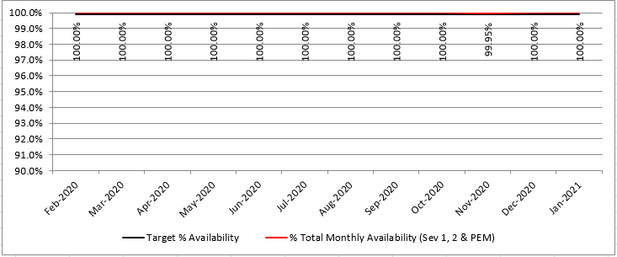
HIway availability review
Target: “Total monthly availability” – no lower than 99.9% (downtime no more than ~44 minutes/month)
Notes:
Slide title: HIway availability review
Graph show HIway availability at 100% every month from February 2020 through January 2021, except November 2020 at 99.95%.
Target: Total monthly availability – no lower than 99.9% (downtime no more than about 44 minutes/month)

Slide 38
Thank you!
Notes:
Thank you!

