Slide 1
V
Health Information Technology Council Meeting
May 1, 2023
Draft Policy in Review

Slide 2
Agenda
Welcome
Amy Bianco / Kevin Mullen
ENS Framework Update
Pam Boutin Coviello
CCG API Update
Julie Creamer
HIway Operations Update
Liz Reardon
CTC Success Story
Liz Reardon
Conclusion
Amy Bianco / Kevin Mullen
er for any MassHealth Updates – David Whitham /

Slide 3
Welcome
Welcome
Amy Bianco / Kevin Mullen

Slide 4
Vote: Approve minutes
EOHHS Leadership Transition Updates :
Kate Walsh, new Secretary of Health and Human Services
Dr. Kiame Mahaniah, new Undersecretary for Health
Karen Tseng, new Senior Advisor, Health Policy
David Whitham, new role as Deputy Chief Information Officer for EOHHS
Notes:
MOTION: That the Health Information Technology Council hereby approves the minutes of the council meeting held on February 1, 2021 as presented/amended

Slide 5
Vote: Approve minutes
MOTION : That the Health Information Technology Council hereby approves the minutes of the council meeting held on August 1, 2022, and November 7, 2022, as presented/amended
Notes:
MOTION: That the Health Information Technology Council hereby approves the minutes of the council meeting held on February 1, 2021 as presented/amended

Slide 6
Vote: Approve the 2022 Annual HITC Report to the Massachusetts Legislature
MOTION : That the Health Information Technology Council hereby approves the 2022 Annual HITC Report to the Massachusetts Legislature, as submitted.
Notes:
MOTION: That the Health Information Technology Council hereby approves the minutes of the council meeting held on February 1, 2021 as presented/amended

Slide 7
Statewide Event Notification System (ENS) Framework Update
Pam Boutin-Coviello

Slide 8
ENS Framework Update
Statewide Event Notification System (ENS) Framework Initiative Overview
Pursuant to 101 CMR 20.00 EOHHS created a Statewide ENS Framework to increase ENS availability to providers throughout the Commonwealth.
Currently the Statewide ENS Framework consists of two ENS Vendors certified by EOHHS who are responsible for collecting ADTs, sharing ADTs, and providing notifications to providers.
All Massachusetts acute care hospitals are required to submit ADT data to at least one of the Certified ENS Vendors.
Certified ENS Vendors are required to share the ADTs they collect pursuant to the submission requirements with any other Certified ENS Vendor.
The Statewide ENS Framework creates a universal data set of ADTs available to ENS Recipients, allowing them to subscribe to a single Certified ENS Vendor and receive notifications from any acute care hospital in the state.

Slide 9
ENS Certified Vendor Contract Extensions
EOHHS has extended the contracts for both ENS vendors
Certified ENS Vendor contracts had an initial term of two years, beginning on January 31, 2021
EOHHS had the option to extend contracts for up to two additional one-year terms or reopen the Request for Applications (RFA).
On October 21st, 2022, EOHHS announced to Certified ENS Vendors that it intended to extend the contract for an additional year and initiated discussions with each of the existing vendors on revisions to the contract.
EOHHS extended the contracts with existing ENS vendors for one year, ending January 31, 2024. Amendments between EOHHS and both Bamboo and CMT have been fully executed.

Slide 10
ENS Framework Improvements
Implemented modifications to improve the ENS vendor contract arrangements
Improved reporting template
Includes a detailed breakdown of data flow per hospital
Insight into the data quality of ADTs coming from the hospitals
Documented procedure for ADT message reflection
New process ensures continued access to all ADTs regardless of vendor selection
Documented data monitoring procedures
Data monitoring ensures there are limited gaps in ADT data.
Pricing transparency
Supports contractual requirements for tiered pricing based on provider type

Slide 11
Clinical Gateway API Pilot Update
Julie Creamer

Slide 12
Clinical Gateway (CG) API Adoption
The Mass HIway continues to work with Trinity Healthcare on behalf of Mercy Medical Center and Tufts Medicine on using the new Clinical Gateway (CG) Application Programming Interface (API) for submission of Syndromic Surveillance data to the Department of Public Health (DPH).
The Mass HIway facilitated a knowledge share meeting between Trinity Healthcare and Tufts Medicine to collaborate on the process and best practices for sending to the Syndromic Surveillance API.
All testing with Trinity Healthcare has been completed and was successful.
Go-live is pending the rescheduling and completion of their EHR migration.

Slide 13
Clinical Gateway (CG) API Adoption
The Mass HIway recently engaged with Tenet New England Vanguard to move their hospitals’ Syndromic Surveillance reporting to the CG API.
All testing with Tenet New England Vanguard has been completed and was successful. The planned go-live is 5/9/23.
The Mass HIway is currently working with Eaton Place Oncology’s EHR vendor to explore sending Cancer Reporting to CG API.
The Mass HIway is facilitating all testing, documenting all requirements on behalf of DPH and supporting workflow changes at the healthcare organizations.
The Mass HIway will continue to leverage these engagements as successful examples of organizations using the CG API and encourage future adoption of APIs.

Slide 14
Clinical Gateway API – Advocates, Inc.
Advocates, Inc. is a behavioral health organization that provides a broad range of services for people facing a variety of life challenges. As part of this work, the organization provides services to children and adolescents with behavioral health challenges and submits data to the statewide Children’s Behavioral Health Initiative (CBHI).

Slide 15
Clinical Gateway API – Advocates, Inc.
Previously, Advocates staff were required to sign-in to the Virtual Gateway portal to enter the Child and Adolescent Needs and Strengths (CANS) assessment data and then upload a copy of the assessment into their EHR.
With support from the Mass HIway and Children's Behavioral Health Initiative (CBHI) teams, Advocates worked with their EHR vendor, PCE Systems, to develop the means to capture their CANS data in their EHR and send it to the new CBHI API endpoint on the Mass HIway.
The new workflow allows clinicians to stay within their EHR rather than having to log into multiple systems. It also provides Advocates with a more robust EHR dataset to be used at the point of care and to perform analytics and outcomes reporting.
“The integration with our EHR and CANS has allowed us to streamline workflows. This creates more time for patient care.”
- Lauren Mazzola
Senior Clinic Director,
Advocates

Slide 16
HIway Operations Update
Liz Reardon

Slide 17
Mass HIway Account Clean-up
The Account Management Team continues outreach to provider organizations with little to no activity on their webmail account over the the last year. This maintenance exercise removes inactive accounts from the Mass HIway, providing security and cost savings to EHS.
Inactive Webmail Outreach
Summer 2022
Two groups targeted:
No Active Users: Webmail domains which had no users log into their associated account for a year or more
User Review Required: Webmail domains where less than half of the associated users had logged into their account within the past year

Slide 18
Mass HIway Account Clean-up
By initiating a third round of outreach to the "No Active Users" group and warning them of potential account deactivation if there was no response within two weeks, the Account Management Team prompted the deactivation of 35 inactive accounts, resulting in further clean-up.
 | Summer 2022 |  | Winter 2023 |  | Total
 | # Accounts | $ Savings | # Accounts | $ Savings | $ Savings
No Active Users | 29 | $8,380 | 35 | $11,500 | $19,880
User Review Required | 4 | $13,060 | - |  | $13,060
 | 33 | $21,440 | 35 | $11,500 | $32,940

Slide 19
Mass HIway Account Clean-up
The Account Management Team is now targeting inactive XDR and Connect Device connections with the Mass HIway. This reduces the amount of work provider organizations and the HIway Service Team must do to maintain domains and provides cost savings to EHS.
The group is targeting connections that have not sent messages within the past year.
Test connections (PRTST) may be kept by organization, or reestablished when needed.
Account Managers will engage provider organizations that are not using their Production connections to support their exchange of Care Coordination messages and ensure they are meeting their DPH reporting requirements.
 | Direct XDR | Connect Device | Total
PRTST (Test) | 10 | - | 10
Production | 3 | 4 | 7
Total | 13 | 4 | 17

Slide 20
Mass HIway Invoicing Outreach
Each September-October, the EOHHS Accounting Department sends the annual Mass HIway invoice to Provider Organizations. Each spring, the Account Management Team follows-up with individual organizations that have outstanding invoices.
Invoicing outreach not only supports the Mass HIway budget, but also helps reconnect with organizations that are using the Mass HIway.
Many conversations lead to user clean-up, regulatory clarifications, and support of use cases.
Tier / Description | Calls | Emails | Totals - 4/30/23
Tier 1: Large hospitals/Health Systems, Health plans, Multi-entity HIE, and Commercial imaging centers & labs | 3 | 31 | 34
Tier 2: Small hospitals, Large ambulatory practices (50+), and MassHealth ACO, CP, or CSA Technical Integrator |  | 9 | 9
Tier 3: Small LTC (less than 50 licensed beds), Large behavioral health (10+ licensed providers), Large FQHCs (10+), and Medium ambulatory practices (10-49) |  | 18 | 18
Tier 4a: Small behavioral health(less than 10 licensed providers), Home health – LTSS, Small ambulatory practices (3-9), Community Service Agency (CSA), and Outpatient Dialysis Center |  | 28 | 28
Tier 5: Very Small ambulatory practices (1-2) |  | 12 | 12
Totals | 3 | 98 | 101

Slide 21
Mass HIway Support of Mass Cancer Registry
The Mass HIway Account Management Team has been working closely with the Massachusetts Cancer Registry (MCR) to support the organization’s transition from cancer reporting via paper submissions to electronic reporting means.
Gathering and processing the backlog to the Massachusetts Cancer Registry
Some provider organizations have a significant backlog of reporting to submit since they were asked by MCR to stop sending their paper case reports.
The Mass HIway has worked with staff at MCR to establish a Mass HIway Webmail account that could accept larger attachments and more than one attachment per message to accommodate this backlog.
Supporting Scanned Documents
These provider organizations don’t have certified EHR technology (CEHRT) or the means to send a NAACCR* formatted CDA (e.g., pathology labs and certain specialty medical practices)
The Mass HIway updated the validations at the Clinical Gateway node to accept scanned PDFs of pathology reports via Direct Message.
Supporting non-NAACCR CDAs
The Account Management team is also working with the MCR and provider organizations to include non-NAACCR CDAs as acceptable reporting.
*NAACCR: North American Association of Central Cancer Registries

Slide 22
Community Technology Cooperative (CTC) joins the Mass HIway
Liz Reardon

Slide 23
What is Community Technology Cooperative (CTC)?
Community Technology Cooperative (CTC) was formed to help Federally Qualified Health Centers (FQHCs) improve health and equity for under-resourced communities through technology. Comprised of FQHCs throughout Massachusetts, CTC is focused on transitioning our existing Electronic Health Records (EHR) systems to Epic.
Why Epic?
Inefficient and outdated EHR systems add to already burdened healthcare organizations but upgrading to a new solution can be costly and overwhelming for community health centers to implement on their own. CTC’s united approach removes many traditional barriers to progress. Together, member organizations benefit from reduced costs, a collaborative process, and a coordinated community roll out.
Why Now?
Epic is a best-in-class Electronic Health Records platform (EHR) that will allow community health centers to have a single fully integrated system to better manage patient care. This move will help FQHCs achieve their major goals and objectives including improving patient care, enhancing the caregiver experience, operating more efficiently, and eliminating disparities.
Language from: https://communitytechnologycooperative.org

Slide 24
43 days
20 days
CTC Onboarding Timeline
Kick-off meeting
Live in Test
Provider Directory Development
Epic go-live
Mar 2022
June 2022
Dec 2022
97 days
September – November 2022
2022
Mar
Apr
May
Jun
35 days
Jul
Aug
Sep
Oct
Nov
Dec
2023
85 days
June - August 2022
April 2022
239 days
October 2022
Certificates Approved
DPH Reporting Discovery
Live in Production
100 days
60 days
Date | Activity
March 2022 | Kick-off meeting with CTC leadership to discuss move to Epic and implementation of Mass HIway
April 2022 | Identity proofing complete and certificates issued for Mass HIway domain
June 2022 | Live with Mass HIway CERT/Test connection
Jun-Aug 2022 | Discussions with health centers and DPH to confirm all reporting requirements will be met
Sep-Nov 2022 | Development of Provider Directory entries for twelve health centers to facilitate care coordination
October 2022 | Live with Mass HIway Production connection
December 2022 | Epic Go-Live
65 days
16 days
310 days

Slide 25
Why the Mass HIway?
The Epic EHR provides health record exchange with other Epic instances, but only through a Direct Message connection, like the Mass HIway, can providers exchange information with non-Epic entities.
Benefits of the Mass HIway
DirectTrust connection to 20+ other Direct Messaging service providers in the country
Control of Provider Directory entries to support better care coordination
Account Management support
Accessible Technical support
“Communicating through the Mass HIway promotes greater interoperability with non-Epic trading partners by allowing CTC to send and receive messages using the Direct standard. Through our partnership with the Mass HIway, we will be able to receive ADT notifications for non-Epic trading partners which will allow us to provide seamless transitions of care and notify care teams when their patients are seen elsewhere. “
- Karen Serrago, Chief Information Officer, Community Technology Cooperative

Slide 26
CTC Transactions since go-live
CTC’s Epic instance went live on 12/1/22. In this short time, they are seeing significant value from the messages received through their Mass HIway connection.
Messages Received (12/1/22 – 1/20/23)
ENS Alerts | 3371
Rx Alerts | 568
Care Coordination | 9
Total | 3948
CTC providers sent ~60 messages to non-Epic healthcare organizations via the Mass HIway during the same timeframe. The receiving organizations included Holyoke Medical Center, BIDMC, and other ambulatory practices.
We expect to see a significant increase in the number of sent and received Care Coordination messages over the coming months as Provider Directories are updated.

Slide 27
Next HITC meeting
Next HITC meeting
Monday, August 7, 2023
3:30 p.m. - 5 p.m.
W
Notes:
Slide Title: Next HITC meeting
Next HITC meeting
August 2, 2021
3:30 – 5 p.m.

Slide 28
Appendix A: HIway operations update

Slide 29
Mass HIway Participation October 21, 2022 – April 20, 2023
New connections
Community Technology Cooperative (CTC) / C3 Quantum Pathology OAK Pediatrics* Weymouth Endoscopy* Middleton Family Medicine Urgent Care MassHealth Dental Program* Mass Cancer Registry* Northeast Dermatology Associates* Beth Israel Lahey Health Primary Care* StrataDx* Norwell Pediatrics*
* Participants that were enrolled and connected in the same period.
Confidential Draft – Policy in Development

Slide 30
Mass HIway Participation October 21, 2022 – April 20, 2023
New participation agreements
Orthopedic Surgical Center of the North Shore
Confidential Draft – Policy in Development

Slide 31
Mass HIway Transactions
Mass HIway transaction volume update
The Mass HIway processed over 41 million production transactions during the April 2023 reporting period (5/21/22 through 4/20/23). From May 2022 through April 2023, the average increased to 38.9 million production transactions per month with a total of 467 million over the past year. In April 2023, Public Health Reporting accounted for ~41 million transactions, or 98% of total production volume. This included 12.9 million Syndromic Surveillance transactions and 28.2 million Immunization transactions. Note: Immunization queries from commercial insurance companies for COVID-19 vaccination updates that processed through the “MIIS QBP” Clinical Gateway node are included in the Immunization total. Provider-to-provider transactions supporting several use cases continued to increase, averaging over 433,000 per month for the past year. For April 2023 , the total was 504,251. Quality Reporting volume has normalized over the last year and is currently averaging around 163,000 transactions per month for the past 12 months. The Mass HIway team continuously monitors transaction levels, both to support operations and to identify data that provide additional insight into HIway trends and progress.
Confidential Draft – Policy in Development
Notes:
Slide title: HIway transactions
HIway transaction volume update
The Mass HIway processed a record 25.1 million production transactions during the April 2021 reporting period (March 21 through April 20) with the significant increase due to the COVID-19 queries to the MIIS. From May 2020 through April 2021, the average was 15.1 million production transactions per month for a total of 181 million over the past year.
In April, Public Health Reporting accounted for 24.6 million transactions, or 98% of total production volume. This included 8.5 million Syndromic Surveillance transactions and 16.1 million Immunization transactions.
Note: Immunization queries from commercial insurance companies for COVID-19 vaccination updates that processed through the new, high-volume “MIIS QBP” Clinical Gateway node are included in the Immunization total.
Provider-to-provider transactions now average over 250,000 per month for the past year, with new use cases added regularly. For April, the total was 290,608.
The Mass HIway team continuously monitors transaction levels, both to support operations and to identify data that provide additional insight into HIway trends and progress.

Slide 32
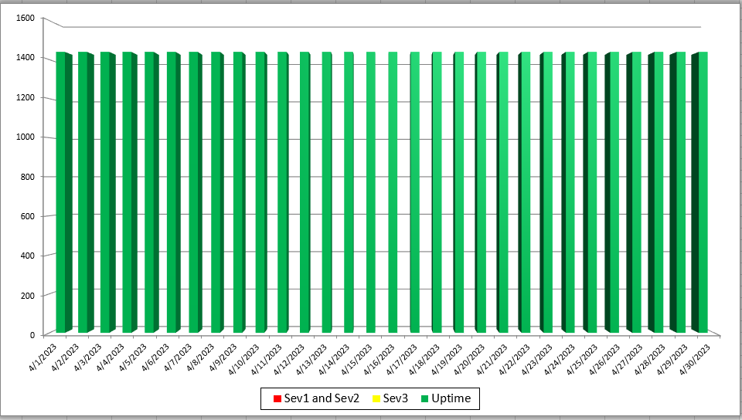
Mass HIway Incident Summary Dashboard
April 2023
Sev 1 - All / Most Mass HIway components impacted as a result of outage. For example: LAND, Webmail, Direct XDR, and DPH nodes are all down
Sev 2 - Multiple Mass HIway components impacted as a result of outage in one of the shared service. For example: LAND and Webmail are down but Direct XDR and DPH nodes are up.
Sev3 – One Mass HIway component impacted as a result of outage. For example: Webmail is down but all other services are up and running.

Slide 33
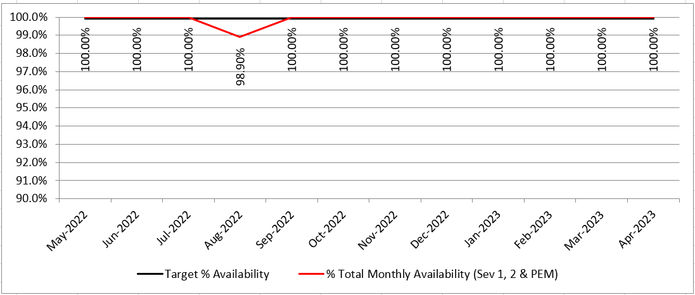
HIway Availability Trends – April 2023
c

Slide 34
Thank you!

