Slide 1
V
vHITC
Health Information Technology Council Meeting
May 3, 2021
Notes:
Title slide
Health Information Technology Council Meeting
May 3, 2021

Slide 2
Agenda
Welcome
Undersecretary Lauren Peters
Approval of February 2021 minutes (vote)
Statewide ENS Framework
Bert Ng
Clinical Gateway & AWS update
David Whitham
Attestation/connection requirement update
Chris Stuck-Girard
ePOLST update
Daniel Danon
Conclusion
Undersecretary Lauren Peters

Slide 3
Welcome
Undersecretary Lauren Peters
Notes:
Slide Title: Welcome
Undersecretary Lauren Peters

Slide 4
Vote: Approve minutes
MOTION: That the Health Information Technology Council hereby approves the minutes of the council meeting held on February 1, 2021 as presented/amended
Notes:
Slide Title: Vote: Approve minutes
MOTION: That the Health Information Technology Council hereby approves the minutes of the council meeting held on February 1, 2021 as presented/amended

Slide 5
Statewide ENS Framework
Bert Ng
Notes:
Slide Title: Statewide ENS Framework
Bert Ng

Slide 6
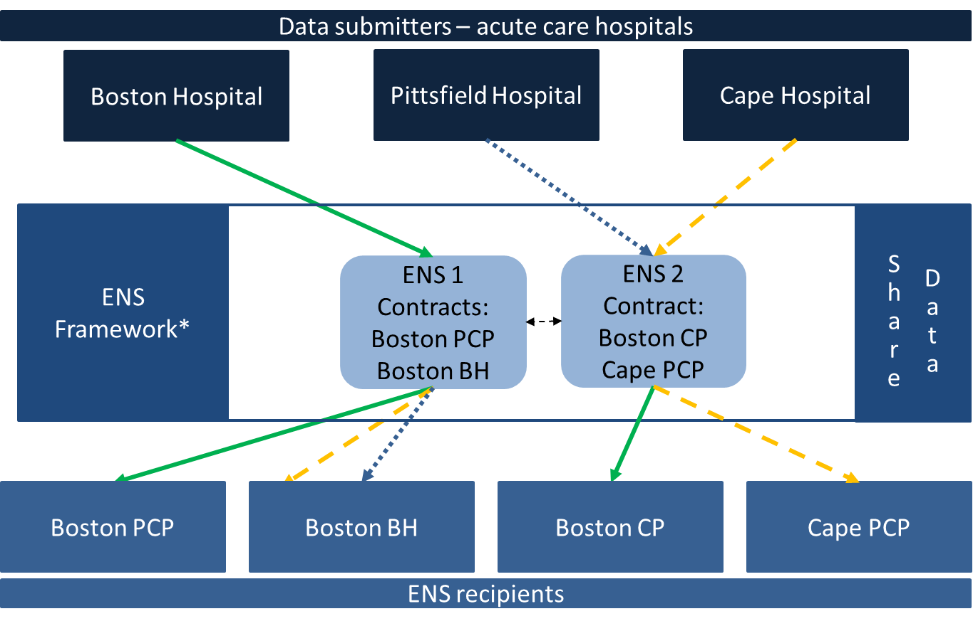
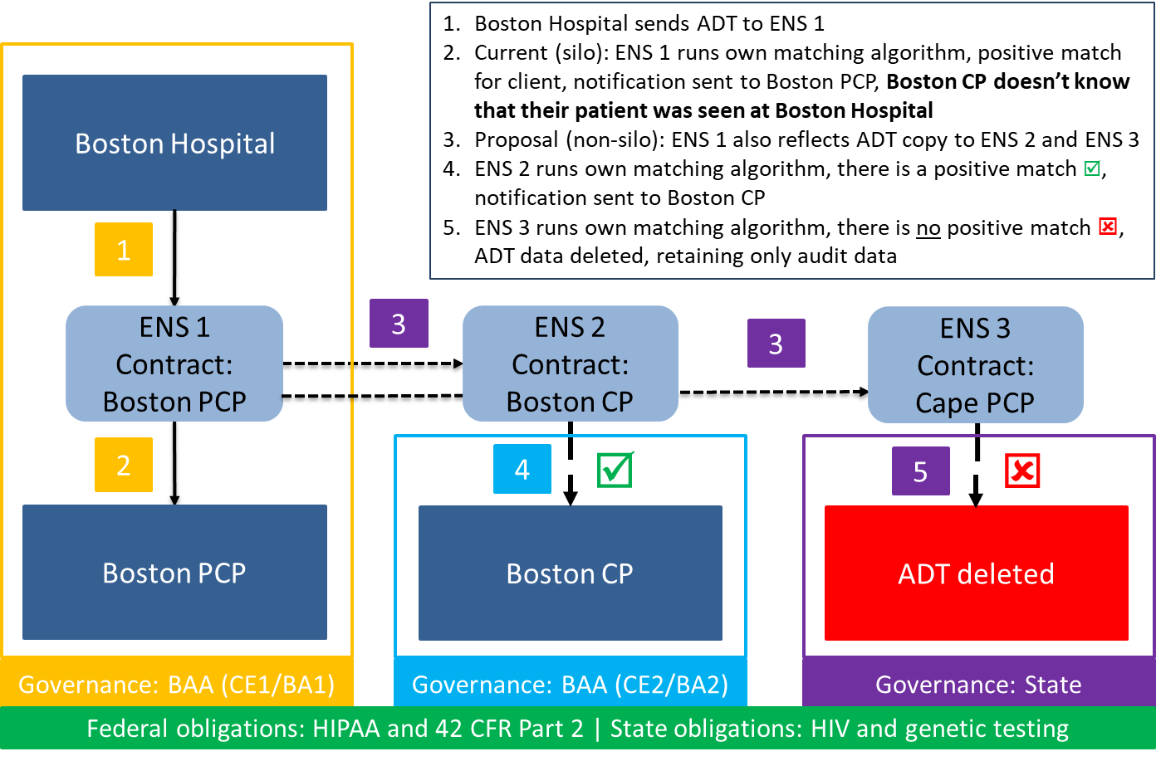
ENS: Overview
EOHHS ENS Initiative goal:
Supporting timely statewide Event Notification Services (ENS) across the Commonwealth in order to improve health care delivery, quality, and coordination
EOHHS guiding principles:
Universal access - Promoting data sharing within an ENS framework to increase accessibility to ENS for providers of all sizes
Streamline provider experience - Crafting ENS framework to allow single point of submission and single point of reception of ADT data
Improve notification timing - Improving timing for flow of data (real/near-real time)

Slide 7
ENS: Timeline
The Statewide ENS Framework was implemented in April 2021
Design
Development
Implementation
Regulatory
☑
RFA
☑
Certification
☑
Connecting
☑
Go Live
☑

Slide 8
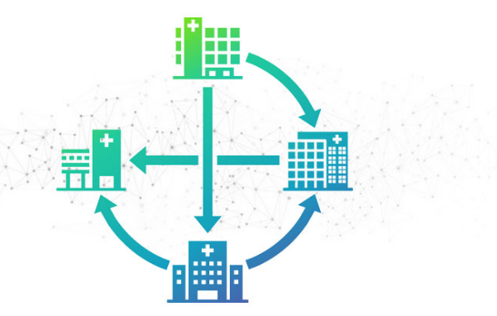
ENS: Certified ENS Vendors
ADT-Based Care Collaboration Network
CollectiveMedical offers a cost-effective solution that ensures hospitals, psychiatric hospitals, and critical access hospitals are completely compliant, without the need for any additional intermediary service providers
CollectiveMedical combines data from sources spanning the care continuum, including ADT, continuity of care documents (CCD), claims data, prescription drug histories (PDMP/PMP), imaging, and more, to give insights into patients’ activities
CollectiveMedical also supports the CMS-9115-F ADT alert requirements
To visit website, click here
Notes:
8

Slide 9
ENS: Certified ENS Vendors
Advanced E-Notifications System
PatientPing delivers real-time notifications whenever your patients experience care events, whether they are at a hospital, ED, or post-acute (SNF, LTACH, HHA, IRF, hospice)
Pings (alerts) allow you to scale how you manage your patient populations. Pings can be embedded within your existing workflow systems or used natively through our web and mobile user experience
PatientPing also supports the CMS-9115-F ADT alert requirements
To visit website, click here
Notes:
9

Slide 10
ENS: Next steps
Attestation
Acute care hospitals will attest to ADT submission through the annual connection requirement attestation process
Long-term items to explore
Increase ENS access – Assess other entities’ access to the Statewide ENS Framework as either submitters or receivers.
Expand ADT use cases – Review other use cases related to ADTs
Ex. Bed finding/bed availability
# of vendors – After stabilization, explore expanding the number of vendors participating in the ENS Framework

Slide 11
Clinical Gateway & AWS update
David Whitham
Notes:
Slide Title: Clinical Gateway & AWS update
David Whitham

Slide 12
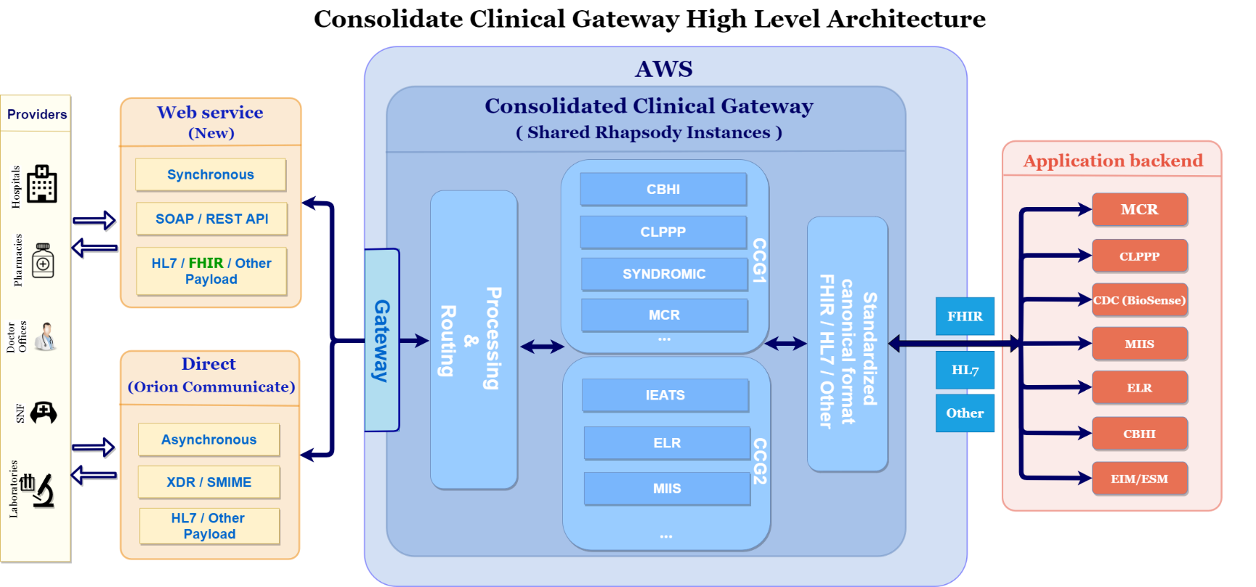
Consolidated Clinical Gateway (CCG) Project Overview
This project will migrate the current suite of Clinical Gateway nodes to the AWS cloud
Key project objectives include
Migrate to AWS to reduce infrastructure costs and address scalability
Provide future alternatives to Direct messaging for public health reporting
Support Query & Retrieve functionality to align with TEFCA
Implement a FHIR interface to support enhanced business functionality
Notes:
Slide title: Recap: Consolidated Clinical Gateway (CCG) Project Overview.
This project will migrate the current suite of Clinical Gateway nodes to the AWS cloud.
Key project objectives include
Migrate to AWS to reduce infrastructure costs and address scalability
Provide future alternatives to Direct messaging for public health reporting
Support Query & Retrieve functionality to align with TEFCA
Implement a FHIR interface to support enhanced the business functionality
Diagram shows the high-level architecture of the Consolidated Clinical Gateway
Web service and Direct Messaging connections to the CCG will process messages to backend applications.
Currently there are seven (7) applications:
-Massachusetts Cancer Registry (MCR)
-Childhood Lead Poison Prevention Program (CLPPP)
-Children’s Behavioral Health Initiative (CBHI)
-Electronic Lab Reporting (ELR)
-Immunization (MIIS)
-Intake Enrolment Assessment and Transfer Service (OTP&TB)
-Syndromic Surveillance (SYNDROMIC)

Slide 13
Consolidated Clinical Gateway (CCG): AWS migration timeline update
Live Now!
Live Now!
Live:
May 2021
Live:
Sept. 2021
Design & Dev
Internal Apps
CCG Phase 1
CCG Phase 2
FHIR & Others
Internal Apps:
Attestation Forms
Masshiway.net
Sugar CRM
Operations Tools
CCG Phase 1:
MCR
CBHI
CLPPP
Syndromic
CCG Phase 2:
IEATS
ELR
MIIS
Enhancements
FHIR Proof of Concept
Migration notes:
CG nodes in current VG4 environment are retained until the AWS system is stabilized. This allows for a quick rollback to the VG4 environment if any issues arise
Migrations will be scheduled to ensure message flow is not interrupted during peak processing hours
For CCG Phase 2, lower-volume nodes will be cutover to PROD first; MIIS will be last
Each production cutover will have in-depth pre-production cutover activities
Notes:
Slide Title: Consolidated Clinical Gateway (CCG) – AWS migration timeline update
Timeline graphic shows target Go-Live dates for 4 categories of applications
Internal Apps – Live Now!
CCG Phase 1 – Live Now!
CCG Phase 2 – Live May 2021
FHIR & Others – Live September 2021
Migration notes:
CG nodes in current VG4 environment are retained until the AWS system is stabilized. In case of any issues this allows for a quick rollback to the VG4 environment
Migrations will be scheduled to make sure the message flow is not interrupted during peak processing hours
For CCG Phase 2, the lower volume nodes will be cutover to PROD first and MIIS will be last
Each production cutover will have in-depth pre-production cutover activities

Slide 14
COVID-19: MIIS CG node
The Massachusetts Immunization Information System (MIIS) Clinical Gateway (CG) node receives immunization reports and database queries via the Mass HIway, using both Direct Messaging and synchronous API from providers across the Commonwealth.
In February and March, the Mass HIway team worked closely with the MIIS team and DPH leadership to quickly implement an additional Consolidated Clinical Gateway (CCG) instance in AWS, dedicated to MIIS, to support COVID-19 Vaccination Status queries from commercial health insurance companies for their members, as authorized by a DPH emergency order.
This new CCG went live on schedule and in April 2021 supported more than 470,000 queries per day from a variety of insurers, with additional insurers expected.
The Mass HIway will continue to work with MIIS to determine future needs.
Notes:
Slide title: COVID-19 update: MIIS CG node
The Massachusetts Immunization Information System (MIIS) Clinical Gateway (CG) node receives immunization reports and database queries via the Mass HIway, using both Direct Messaging and synchronous API from providers across the Commonwealth.
In February and March, the Mass HIway team worked closely with the MIIS team and DPH leadership to quickly implement an additional Consolidated Clinical Gateway (CCG) instance in AWS, dedicated to MIIS, to support COVID-19 Vaccination Status queries from commercial health insurance companies for their members, as authorized by a DPH emergency order.
This new CCG went live on schedule and in April 2021 supported more than 470,000 queries per day from a variety of insurers, with additional insurers expected.
The Mass HIway will continue to work with MIIS to determine future needs.

Slide 15
COVID-19: Syndromic and ELR CG nodes
As part of the daily COVID-19 reporting cycle, the Clinical Gateway (CG) nodes receive messages via the Mass HIway’s Direct Messaging System from hospital emergency departments and laboratories, transform them, and deliver them to the Massachusetts Department of Public Health’s Syndromic Surveillance and Electronic Lab Reporting applications for processing and analysis.
Syndromic Surveillance
All Massachusetts hospital emergency departments participate.
Highest message volume of all CG nodes with an average of 8.5 million messages per month.
ED records of admissions, discharges, and transfers of patients are processed by the Syndromic Surveillance CG node, which feeds the National Syndromic Surveillance Program’s BioSense Platform at the CDC.
BioSense data is used by the Commonwealth’s Syndromic Surveillance program at the DPH Bureau of Infectious Disease and Laboratory Sciences for analysis of trends pertaining to COVID-19.
Electronic Lab Reporting
CG node handles reports of test results from about 40% of hospital labs.
Averages about 1,500 messages per month.
Test results from other labs reported directly to the DPH Electronic Lab Reporting program.
Notes:
Slide title: COVID-19 recap: Syndromic and ELR CG nodes
As part of the daily COVID-19 reporting cycle, the Clinical Gateway (CG) nodes receive messages via the Mass HIway’s Direct Messaging System from hospital emergency departments and laboratories, transform them, and deliver them to the Massachusetts Department of Public Health’s Syndromic Surveillance and Electronic Lab Reporting applications for processing and analysis.
Syndromic Surveillance:
All Massachusetts hospital emergency departments participate.
Highest message volume of all CG nodes with an average of 8.5 million messages per month.
ED records of admissions, discharges, and transfers of patients are processed by the Syndromic Surveillance CG node, which feeds the National Syndromic Surveillance Program’s BioSense Platform at the CDC.
BioSense data is used by the Commonwealth’s Syndromic Surveillance program at the DPH Bureau of Infectious Disease and Laboratory Sciences for analysis of trends pertaining to COVID-19.
Electronic Lab Reporting:
CG node handles reports of test results from about 40% of hospital labs.
Averages about 1,500 messages per month.
Test results from other labs reported directly to the DPH Electronic Lab Reporting program.

Slide 16
Attestation/connection requirement update
Chris Stuck-Girard
Notes:
Slide Title: Attestation/connection requirement update
Chris Stuck-Girard

Slide 17
HIway attestation: 2020 statistics so far
Attestation submissions got off to a slow start, but an influx of submissions around the attestation deadline resulted in strong numbers overall.
Acute Care Hospitals (n=67)
53 attestations submitted
14 exception forms submitted
Submitted: 100%
Community Health Centers (n=39)
18 attestations submitted
14 exception forms submitted
Submitted: 84%
Medium/Large Medical
Ambulatory Practices (n=427)
Attestations: 298 practices
Exception forms: 89 practices
Total: 387 practices
Submitted: 91%
As of April 30:
191 forms submitted
Year 2 forms: 2
Year 3/4 forms: 127
Exception forms: 62
Notes:
Slide Title: HIway attestation: 2020 statistics so far
Due to COVID-19 and the deferral of the submission deadline, HIway attestation submissions are low so far this year.
Left column:
As of Oct. 26:
31 forms submitted
Year 3/4 forms: 16
Exception forms: 15
Right column:
Acute Care Hospitals (n=66)
7 attestations submitted
0 exception forms submitted
11% attested
Community Health Centers (n=38)
3 attestations submitted
2 exception forms submitted
8% attested
5% exception forms
Medium/Large Medical
Ambulatory Practices (n=528)
Attestations submitted for 9 practices
Exception forms submitted for 22 practices
2% attested
4% exception forms

Slide 18
HIway attestation: 2021 preview
Because the 2020 attestation deadline was delayed, the 2021 attestation deadline (Oct. 31) is fast approaching.
2021 attestation:
Because the 2020 attestation deadline was pushed back, there is a short turnaround for 2021 attestation.
This year, the submission deadline is Oct. 31. Attestation forms will go live this summer.
Provider Organizations (POs) will be attesting to use cases from calendar year 2020.
As with 2020 attestation, 2021 attestation will feature three forms:
Year 3/4 form (medium/large medical ambulatory practices, small/large community health centers)
Year 5 form (acute care hospitals)
HIE Exception Form (POs that did not meet connection requirement)
Notes:
Slide Title: Attestation: Improvements to process
Top box: For the 2020 attestation cycle, the HIway made improvements to streamline the process for providers and collect data regarding new program requirements.
New this year:
-HIway unique ID (HID): Each provider organization/sub-organization has been assigned a HID. Submitters will use HIDs on their forms (instead of the full name/location of each sub-org). This should streamline the process, especially for practices with many sub-organizations.
-New section to record ADT submission by Acute Care Hospitals
-Clarified language in use case transmission methods section
-New questions on attestation/exception forms, including taking a deeper dive into details of use cases

Slide 19
HIway attestation: 2021 estimated timeline
Outreach regarding the 2021 attestation process is underway. At this point, all submitting Provider Organizations (POs) should be familiar with the submission process, but a significant volume of ad hoc questions arise each year.
Attestation 2021 timeline:
Dec. 31, 2020: Use case deadline for 2021 attestation
May-July 2021: HIway outreach and education regarding 2021 connection requirement and attestation process continues (email outreach, updated website material, webinars, direct PO contact)
July: HIway attestation webform testing
August: HIway attestation/exception webforms go live and start accepting submissions
Oct. 31: Deadline for attestation/exception submissions
November: HIway reaches out to POs that have not submitted
Winter 2022: When it seems that submissions have stopped, HIway closes webform
Notes:
Slide title: HIway attestation: 2021 timeline
Top box: Outreach regarding the 2021 attestation process is underway. At this point, all submitting provider organizations should be familiar with the submission process, but a significant volume of ad hoc questions arise each year.
Attestation 2021 timeline:
Dec. 31, 2020: Use case deadline for 2021 attestation
May-July 2021: HIway outreach and education regarding 2021 connection requirement and attestation process continues (email outreach, updated website material, webinars, direct PO contact)
July: HIway attestation webform testing
August: HIway attestation/exception webforms go live and start accepting submissions
Oct. 31: Deadline for attestation/exception submissions
November: HIway reaches out to POs that have not submitted
Winter 2022: When it seems that submissions have stopped, HIway closes webform

Slide 20
HIway attestation: Expanding connection requirement for HISP-to-HISP exchange
The Mass HIway will add DirectTrust HISP-to-HISP exchange to meet the HIway connection requirement through sub-regulatory guidance.
Background
Mass HIway converted to HIway 2.0 (a HISP) in order to connect to DirectTrust, a national framework for Direct Message
During the Feb. 2020 meeting, the Council was supportive of DirectTrust HISP-to-HISP Direct Message exchange as it leverages existing infrastructure
Technical advantage
DirectTrust replaces 1:1 contracting for security/privacy and replaces it with a common agreement for security/privacy for HISP users and DirectTrust users
A user of a DirectTrust HISP can securely send messages to a user of any other DirectTrust HISP without any additional contracting
Business advantage
Providers will have additional opportunities to meet the connection requirement with DirectTrust Direct Messaging
Providers may use EHR-native Direct Message capabilities instead adding an extra connection to the HIway Direct Message System

Slide 21
HIway attestation: HISP-to-HISP exchange communication plan
After issuing sub-regulatory guidance, the HIway and MEHI account managers plan to update educational materials and inform Provider Organizations (POs) of the change to the connection requirement.
Educating POs on this connection requirement update:
We will communicate this update by sending a blast email to POs about the sub-regulatory changes
The HIway is prepared to quickly update educational materials, including webinars and webpages, to reflect this change
MEHI account managers will touch base with their PO contacts to ensure that they understand the update
The HIway continues to consider the connection requirement an evolving process for interoperability: the POs that must meet it, and the substance of the requirement itself, are subject to change
Notes:
Slide Title: Attestation: Improvements to process
Top box: For the 2020 attestation cycle, the HIway made improvements to streamline the process for providers and collect data regarding new program requirements.
New this year:
-HIway unique ID (HID): Each provider organization/sub-organization has been assigned a HID. Submitters will use HIDs on their forms (instead of the full name/location of each sub-org). This should streamline the process, especially for practices with many sub-organizations.
-New section to record ADT submission by Acute Care Hospitals
-Clarified language in use case transmission methods section
-New questions on attestation/exception forms, including taking a deeper dive into details of use cases

Slide 22
ePOLST update
Daniel Danon
Notes:
Slide Title: ePOLST update
???

Slide 23
ePOLST: Design timeline
~2 Months
~2 Months
~5-6 Months
Assess the Current State &
Conduct Stakeholder Engagement
Prepare a
Future State Blueprint
Draft RFP and
Provide Procurement
Support
Conduct interviews and focus groups
Conduct benchmarking against e-registries in other states
Prepare a Current State Assessment presentation
Draft a future state blueprint
Develop IT system technical and functional requirements
Draft RFP
Support bidders’ Q&A and any presentations or follow-up
Draft recommendation memo
Provide bidder selection support
Notes:
Minnesota, NY, Washington State

Slide 24
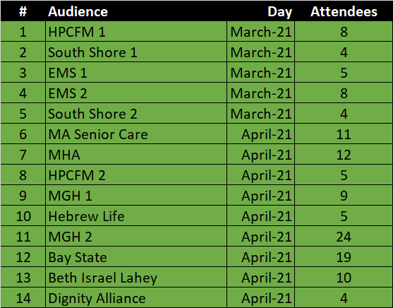
ePOLST assessment: Interviews and focus groups
Interviews
Focus groups
MA State Government
EOEA
EOHHS
DPH OEMS
MeHI
MA Process Owners
Coalition for Serious Illness Care
HPCFM
Honoring Choices
Beth Israel Deaconess
Ariadne Labs
Massachusetts Hospital Association
Benchmarking States
Oregon Center for Ethics in Health Care
Maine POLST
NY MOLST
Additional Subject Matter Experts
National POLST
UMass Boston
Reliant Medical Group Physician Group
Archdiocese of Boston
14 Focus Groups representing 5 care settings: Hospitals, PCP, SNF, Hospices, and EMS (128 participants)

Slide 25
ePOLST assessment: Stakeholder feedback paradigm
People
Technology
Process

Slide 26
ePOLST assessment: Stakeholder feedback on people
People
Technology
Process
MOLST is just one component in a multi-party, long-term relationship
Physician-patient; Goals of Care focus
Social workers, nurses, aides, EMT/paramedics
Patient relatives, agents, guardians
“Often, it is the social worker who is having the conversation and filling out the form.”
“It is not only about talking to the patient, but also about talking to the family, proxy, guardian…”
Goals of care conversations difficult to conduct
Clinicians typically not trained in these topics
Patients have little background on MOLST (or any end-of-life-related topic) → cultural challenge
PCPs have very limited time
“The MOLST conversation takes years to master.”
“The public and clinicians need to be educated so patients and families understand the form.”
“Goals of Care conversations cannot be conducted as part of an annual; we don’t have time.”
Current approach challenging for all stakeholders, particularly EMS
Form issues
Issues related to honoring the form
“Our frustration is with incomplete forms or not having the form readily available.”
“Sometimes families do not understand the form and tells us to revoke it.”
Source: Stakeholder Focus Groups

Slide 27
ePOLST assessment: Stakeholder feedback on process
People
Technology
Process
Current process 100% paper-based and manual
Patient wishes not honored accurately, consistently
“I still cannot believe that most MOLST forms exist on an 11x8.5 piece of paper…”
Current process does not result in trustworthy forms
“We have a ton of patients with 10 MOLST forms.”
Care setting workflows around MOLST are inconsistent
“What constitutes a complete MOLST form varies from care setting to care setting.”
Lack of alignment with National POLST
“We would love to be aligned with the National Form.”
Current process does not fully support health equity
Languages
Level of literacy
“It’s very hard to explain the MOLST form with its current wording, patients do not understand it… The words scare them…”
Source: Stakeholder Focus Groups

Slide 28
ePOLST assessment: Stakeholder feedback on technology
People
Technology
Process
Some interoperability with EMRs
No form validation capability
No audit or update capability
No reporting capability
No interoperability with ambulance systems
No interoperability across care settings
No transferability state-to-state
“The new registry has to be interoperable with our EMR systems… we need one source of truth…”
“We try to manually check our forms… it’s not perfect.”
“We have the ability to upload MOLST forms into our EMR but we don’t because we are concerned about version control.”
“We would love to leverage MOLST data if it was available. It would also be helpful for comparison purposes, across states and within states.”
“The MOLST form has to be transferable across states and health care settings.”
Source: Stakeholder Focus Groups

Slide 29
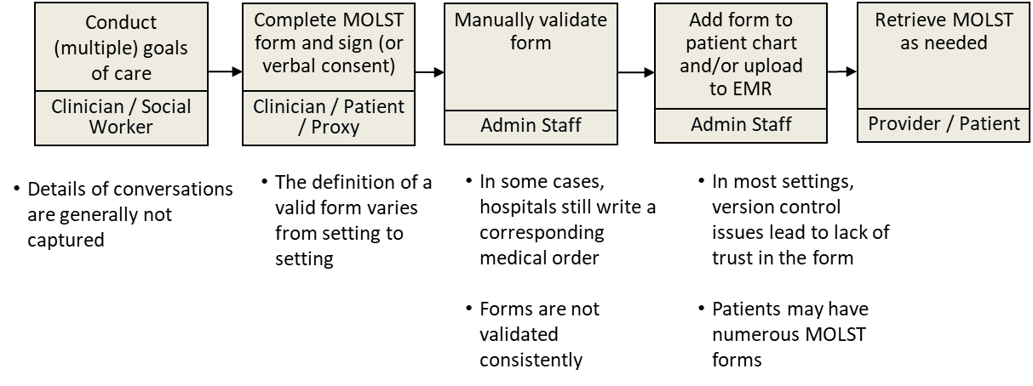
ePOLST blueprint: Current state MOLST process

Slide 30
ePOLST blueprint: Future state ePOLST process

Slide 31
ePOLST blueprint: Future state ePOLST system map
POLST Signors
Hospitals
Hospices
Automatic Validation
POLST Users
Cloud Based POLST eRegistry
EMS
Skilled Nursing
PCP
Patient / Family / Proxy
Assisted Living
System Interoperability
EHR / EMR
RVRS
Death Records
EMS/ MATRIS

Slide 32
ePOLST: Next steps
Draft RFR (incl. business requirements)
Secure CMS approval
Post RFR on Commbuys
Award contract

Slide 33
Conclusion
Undersecretary Lauren Peters
Notes:
Slide Title: Conclusion
Undersecretary Lauren Peters

Slide 34
Next HITC meeting
Next HITC meeting
August 2, 2021
3:30 – 5 p.m.
W
Notes:
Slide Title: Next HITC meeting
Next HITC meeting
August 2, 2021
3:30 – 5 p.m.

Slide 35
Appendix A: HIway operations update
Notes:
Slide Title: Appendix A: HIway operations update

Slide 36
HIway participation January 21, 2021 – April 20, 2021
6
New participation agreements
Arcadia (Massachusetts eHealth Collaborative acquired by Arcadia) Fellsway Pediatrics PC KBI Services Inc. (Kindbody) Orb Health Plymouth Pediatric Associates WeInfuse, LLC
Notes:
Slide Title: HIway participation, January 21, 2021 – April 20, 2021
6 New participation agreements
Arcadia (Massachusetts eHealth Collaborative acquired by Arcadia)
Fellsway Pediatrics PC
KBI Services Inc. (Kindbody)
Orb Health
Plymouth Pediatric Associates
WeInfuse, LLC

Slide 37
HIway participation January 21, 2021 – April 20, 2021
6
New connections
Fellsway Pediatrics PC* Cape Cod Orthopaedics and Sports Medicine, P.C. KBI Services Inc. (Kindbody)* Orb Health* Plymouth Pediatric Associates* WeInfuse, LLC*
* Participants that were enrolled and connected in the same period.
Notes:
Slide Title: HIway participation, January 21, 2021 – April 20, 2021
6 New connections
Fellsway Pediatrics PC
Cape Cod Orthopaedics and Sports Medicine, P.C.
KBI Services Inc. (Kindbody)
Orb Health
Plymouth Pediatric Associates
WeInfuse, LLC

Slide 38
HIway transactions
HIway transaction volume update
The Mass HIway processed a record 25.1 million production transactions during the April 2021 reporting period (March 21 through April 20) with the significant increase due to the COVID-19 queries to the MIIS. From May 2020 through April 2021, the average was 15.1 million production transactions per month for a total of 181 million over the past year. In April, Public Health Reporting accounted for 24.6 million transactions, or 98% of total production volume. This included 8.5 million Syndromic Surveillance transactions and 16.1 million Immunization transactions. Note: Immunization queries from commercial insurance companies for COVID-19 vaccination updates that processed through the new, high-volume “MIIS QBP” Clinical Gateway node are included in the Immunization total. Provider-to-provider transactions now average over 250,000 per month for the past year, with new use cases added regularly. For April, the total was 290,608. The Mass HIway team continuously monitors transaction levels, both to support operations and to identify data that provide additional insight into HIway trends and progress.
Notes:
Slide title: HIway transactions
HIway transaction volume update
The Mass HIway processed a record 25.1 million production transactions during the April 2021 reporting period (March 21 through April 20) with the significant increase due to the COVID-19 queries to the MIIS. From May 2020 through April 2021, the average was 15.1 million production transactions per month for a total of 181 million over the past year.
In April, Public Health Reporting accounted for 24.6 million transactions, or 98% of total production volume. This included 8.5 million Syndromic Surveillance transactions and 16.1 million Immunization transactions.
Note: Immunization queries from commercial insurance companies for COVID-19 vaccination updates that processed through the new, high-volume “MIIS QBP” Clinical Gateway node are included in the Immunization total.
Provider-to-provider transactions now average over 250,000 per month for the past year, with new use cases added regularly. For April, the total was 290,608.
The Mass HIway team continuously monitors transaction levels, both to support operations and to identify data that provide additional insight into HIway trends and progress.

Slide 39
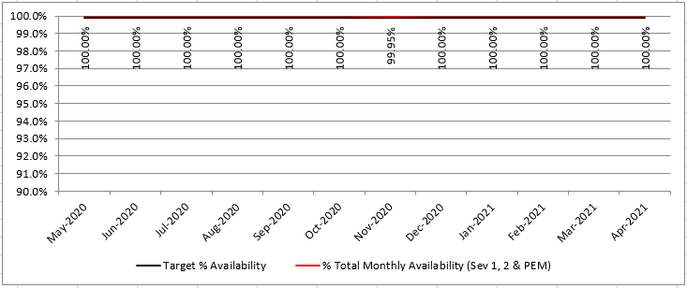
HIway availability review
Target: “Total monthly availability” – no lower than 99.9% (downtime no more than ~44 minutes/month)
Notes:
Slide title: HIway availability review
Graph show HIway availability at 100% every month from May 2020 through April 2021, except November 2020 at 99.95%.
Target: Total monthly availability – no lower than 99.9% (downtime no more than about 44 minutes/month)

Slide 40
Thank you!
Notes:
Slide Title: Thank you!

