Slide 1
V
Health Information Technology Council Meeting
November, 2021
DRAFT
Notes:
Title slide
Health Information Technology Council Meeting
November 1, 2021
Draft

Slide 2
Agenda
Welcome
Undersecretary Lauren Peters
Approval of Aug 2021 minutes (vote)
Attestation update
Pam Boutin-Coviello
ENS – Utilization Update; plans for future / expansion
Bert Ng
ePOLST – Update
Bert Ng & Kathryn Downes
Budget & Sustainability Planning
Kevin Mullen
Conclusion
Undersecretary Lauren Peters
Notes:
Slide Title: Agenda
Welcome
Undersecretary Lauren Peters
Approval of Aug 2021 minutes (vote)
Attestation update
Pam Boutin-Coviello
ENS – Utilization Update; plans for future / expansion
Bert Ng
ePOLST – Update
Bert Ng & Kathryn Downes
Budget & Sustainability Planning
Kevin Mullen
Conclusion
Undersecretary Lauren Peters

Slide 3
Welcome
Undersecretary Lauren Peters
Notes:
Slide Title: Welcome
Undersecretary Lauren Peters

Slide 4
Vote: Approve minutes
MOTION: That the Health Information Technology Council hereby approves the minutes of the council meeting held on August 1, 2021 as presented/amended
Notes:
Slide Title: Vote: Approve minutes
MOTION: That the Health Information Technology Council hereby approves the minutes of the council meeting held on August1, 2021 as presented/amended

Slide 5
Attestation update
Pam Boutin-Coviello
Notes:
Attestation update
Pam Boutin-Coviello

Slide 6
HIway attestation: HIway connection requirement overview
The HIway connection requirement requires providers to engage in health information exchange via the Mass HIway as set forth in M.G.L. Chapter 118I, Section 7, and as detailed in the Mass HIway Regulations (101 CMR 20.00).
Provider organization | First year requirement applied | Submit in 2021
Acute care hospitals | 2017 | Year 5 attestation form
Large and medium medical ambulatory practices | 2018 | Year 4 attestation form
Large community health centers
Small community health centers | 2019 | Year 3 attestation form
HIway annual connection requirement
Year 1 | Send or receive HIway Direct messages for at least one use case
Year 2 | Send or receive HIway Direct messages for at least one provider-to provider (P2P) use case
Year 3 | Send HIway Direct messages for at least one P2P use case, and Receive HIway Direct messages for at least one P2P use case
Year 4+ | Meet Year 3 requirement or be subject to penalties if requirement is not met
Notes:
Slide title: HIway attestation: HIway connection requirement overview
The HIway connection requirement requires providers to engage in HIE via the Mass HIway as set forth in M.G.L. Chapter 118I, Section 7, and as detailed in the Mass HIway Regulations (101 CMR 20.00).
ACUTE CARE HOSPITALS
First year requirement applied: 2017
Submit in 2020: Year 4 attestation form
LARGE AND MEDIUM MEDICAL AMBULATORY PRACTICES & LARGE COMMUNITY HEALTH CENTERS
First year requirement applied: 2018
Submit in 2020: Year 3 attestation form
SMALL COMMUNITY HEALTH CENTERS
First year requirement applied: 2019
Submit in 2020: Year 2 attestation form
HIway annual connection requirement
Year 1: Send or receive HIway Direct messages for at least one use case
Year 2: Send or receive HIway Direct messages for at least one provider-to provider (P2P) use case
Year 3: Send HIway Direct messages for at least one P2P use case, and Receive HIway Direct messages for at least one P2P use case
Year 4: Meet Year 3 requirement or be subject to penalties if requirement is not met

Slide 7
HIway attestation: 2021 timeline
2021 Attestation timeline: Dec. 31, 2020: Use case implementation deadline
May-July 2021: HIway outreach and education
Emails and Newsletters
Website updates
Webinars
Direct contact with POs
July 2021: Webform testing
Aug. 2, 2021: HIway attestation/exception webforms go live and begin accepting submissions
Oct. 31, 2021: Deadline for attestation/exception submissions
November 2021: HIway reaches out to POs that have not submitted
Winter 2022: HIway closes webform
Notes:
Slide Title: HIway attestation: 2021 Timeline
2021 Attestation timeline: Dec. 31, 2020: Use case implementation deadline
May-July 2021: HIway outreach and education
Emails and Newsletters
Website updates
Webinars
Direct contact with POs
July 2021: Webform testing
Aug. 2, 2021: HIway attestation/exception webforms go live and begin accepting submissions
Oct. 31, 2021: Deadline for attestation/exception submissions
November 2021: HIway reaches out to POs that have not submitted
Winter 2022: HIway closes webform

Slide 8
HIway attestation: HISP-HISP exchanges now acceptable
Through sub-regulatory guidance the Mass HIway will accept DirectTrust HISP-to-HISP exchange as an additional method to meet the HIway connection requirement.
Background
Mass HIway converted to HIway 2.0 (a HISP) in order to connect to DirectTrust, a national framework for Direct Messaging
The Council has been supportive of DirectTrust HISP-to-HISP Direct Message exchange as it leverages existing infrastructure for many POs
Technical advantage
DirectTrust exchange can now be used in addition to 1:1 contracting for security/privacy needs. DirectTrust exchange uses a common agreement for security/privacy for HISP users and DirectTrust users
Users of a DirectTrust HISP are now allowed to securely send messages to users of other DirectTrust HISPs avoiding the need for additional contracting
Business advantage
Providers now have additional means to meet the connection requirement via DirectTrust Direct Messaging
Providers may use EHR-native Direct Message capabilities instead of adding an extra connection to the HIway Direct Message System
Notes:
Slide Title: HIway attestation: HISP-HISP exchanges now acceptable
Through sub-regulatory guidance the Mass HIway will accept DirectTrust HISP-to-HISP exchange as an additional method to meet the HIway connection requirement.
Background
Mass HIway converted to HIway 2.0 (a HISP) in order to connect to DirectTrust, a national framework for Direct Messaging
The Council has been supportive of DirectTrust HISP-to-HISP Direct Message exchange as it leverages existing infrastructure for many POs
Technical advantage
DirectTrust exchange can now be used in addition to 1:1 contracting for security/privacy needs. DirectTrust exchange uses a common agreement for security/privacy for HISP users and DirectTrust users
Users of a DirectTrust HISP are now allowed to securely send messages to users of other DirectTrust HISPs avoiding the need for additional contracting
Business advantage
Providers now have additional means to meet the connection requirement via DirectTrust Direct Messaging
Providers may use EHR-native Direct Message capabilities instead of adding an extra connection to the HIway Direct Message System

Slide 9
HIway attestation: 2021 statistics so far
Attestation submissions got off to a slow start, but an influx of submissions around the attestation deadline should result in strong numbers overall.
Acute Care Hospitals (n=68)
46 attestations submitted
0 exception forms submitted
Submitted: 68%
Community Health Centers (n=40)
8 attestations submitted
3 exception forms submitted
Submitted: 28%
Medium/Large Medical
Ambulatory Practices (n=444)
Attestations: 248 practices
Exception forms: 5 practices
Total: 253 practices
Submitted: 57%
As of Oct 27:
119 forms submitted
Year 3/4 forms: 65
Year 5 forms: 46
Exception forms: 8
Notes:
Slide Title: HIway attestation: 2021 statistics so far
Attestation submissions got off to a slow start, but an influx of submissions around the attestation deadline should result in strong numbers overall.
As of Oct 27:
119 forms submitted
Year 3/4 forms: 65
Year 5 forms: 46
Exception forms: 8
Acute Care Hospitals (n=68)
46 attestations submitted
0 exception forms submitted
Submitted: 68%
Community Health Centers (n=40)
8 attestations submitted
3 exception forms submitted
Submitted: 28%
Medium/Large Medical
Ambulatory Practices (n=444)
Attestations: 248 practices
Exception forms: 5 practices
Total: 253 practices
Submitted: 57%

Slide 10
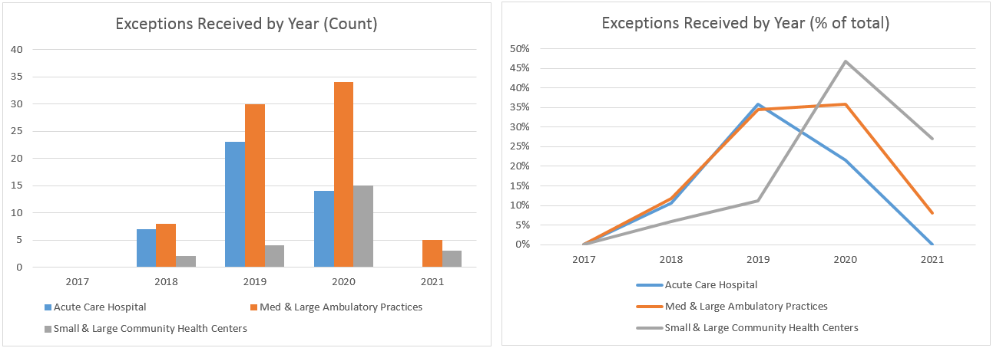
HIway attestation: 2021 statistics so far
Due to the 2021 sub-regulatory guidance to count sending and receiving through DirectTrust accredited HISPs, more provider organizations submitted an attestation form instead of an exception form. (13 attestations or 11% of all submissions)
Notes:
Slide Title: HIway attestation
Due to the 2021 sub-regulatory guidance to count sending and receiving through DirectTrust accredited HISPs, more provider organizations submitted an attestation form instead of an exception form. (13 attestations or 11% of all submissions)
: 2021 statistics so far
2017 ACH attest 61/ Exception 0/ Exception percent of total = zero, Med and Large Ambulatory practices attest/ zero exception zero/ exception percent of total= zero, Small and Large CHC attest 0 exception 0 exception percent of total =zero
2018 ACH attest 59/ Exception 7/ Exception percent of total = 11, Med and Large Ambulatory practices attest/ 60 exception 8/ exception percent of total= 12, Small and Large CHC attest 32 exception 2 exception percent of total = 6
2019 ACH attest 41/ Exception 23/ Exception percent of total = 36, Med and Large Ambulatory practices attest/ 57 exception 30/ exception percent of total= 34, Small and Large CHC attest 32 exception 4 exception percent of total =11
2020 ACH attest 51/ Exception 14/ Exception percent of total = 22, Med and Large Ambulatory practices attest/ 61 exception 34/ exception percent of total= 36, Small and Large CHC attest 17 exception 15 exception percent of total =47
2021 ACH attest 46/ Exception 0/ Exception percent of total = zero, Med and Large Ambulatory practices attest/ 56 exception 5/ exception percent of total= 8, Small and Large CHC attest 8 exception 3 exception percent of total =0027

Slide 11
Attestation update: post-deadline outreach
The HIway will continue to remind organizations about their requirement as the Oct. 31st deadline has passed. The HIway is executing an outreach plan to organizations that have not yet submitted.
2021 submission levels have shown a higher level of attestations (i.e., lower level of exception forms) to prior years at the attestation deadline.
Outreach schedule:
Late November 2021: Blast email reminder sent to POs that have not submitted
Mid December 2021: Personal email reminder sent to POs that have not submitted
Early January 2022: Send reminder letter to large practices, community health centers, and acute care hospitals that have not submitted
Notes:
Slide title: Attestation update: post-deadline outreach
The HIway will continue to remind organizations about their requirement as the Oct. 31st deadline has passed. The HIway is executing an outreach plan to organizations that have not yet submitted.
2021 submission levels have shown a higher level of attestations (i.e., lower level of exception forms) to prior years at the attestation deadline.
Outreach schedule:
Late November 2021: Blast email reminder sent to POs that have not submitted
Mid December 2021: Personal email reminder sent to POs that have not submitted
Early January 2022: Send reminder letter to large practices, community health centers, and acute care hospitals that have not submitted

Slide 12
ENS Update
Bert Ng
Notes:
ENS Update
Bert Ng

Slide 13
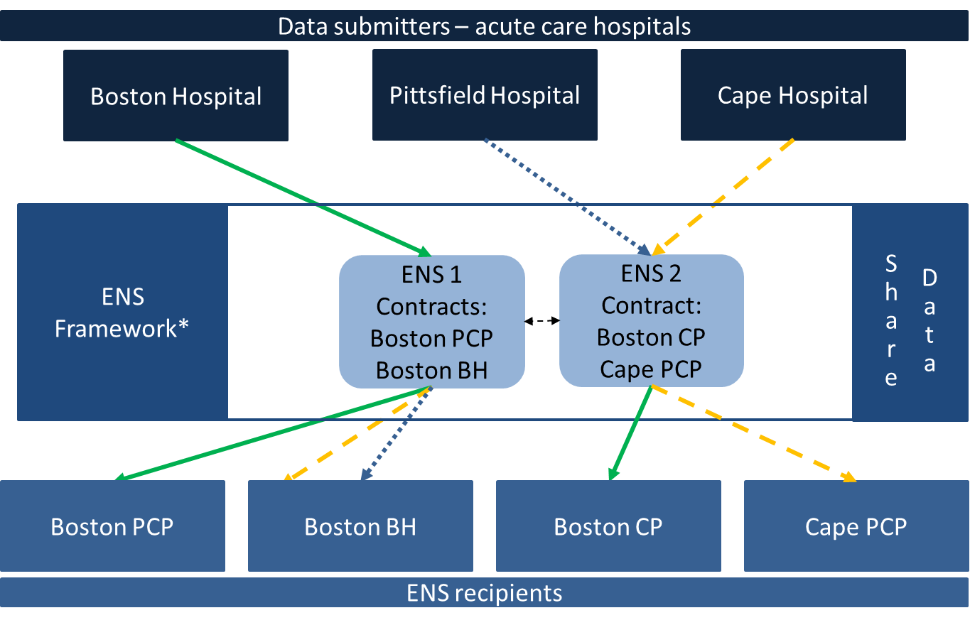
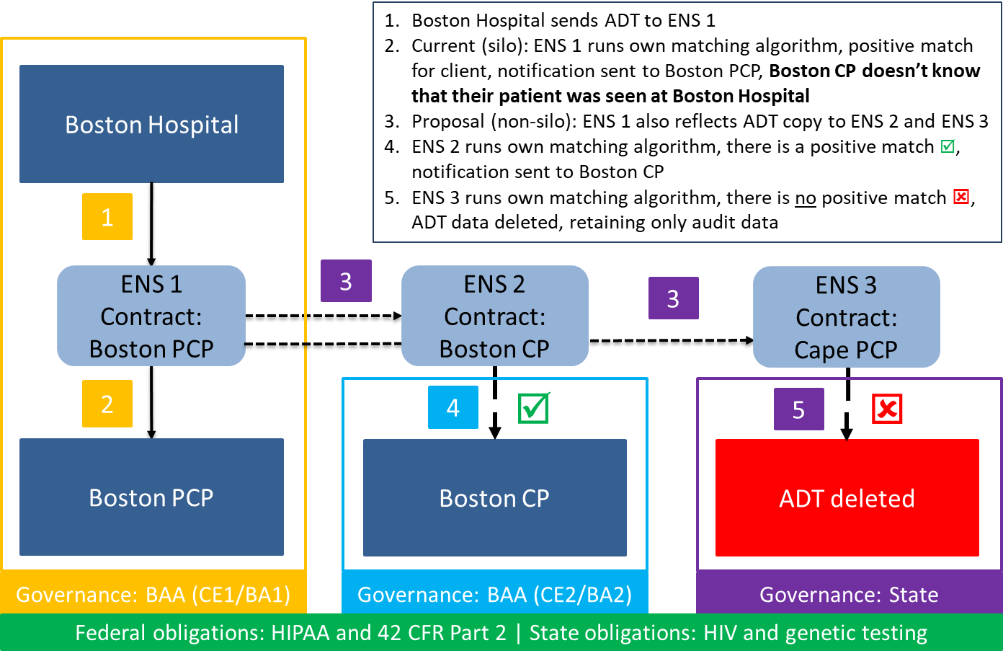
ENS: Overview
EOHHS ENS Initiative goal:
Supporting timely statewide Event Notification Services (ENS) across the Commonwealth in order to improve health care delivery, quality, and coordination
EOHHS guiding principles:
Universal access - Promoting data sharing within an ENS framework to increase accessibility to ENS for providers of all sizes
Streamline provider experience - Crafting ENS framework to allow single point of submission and single point of reception of ADT data
Improve notification timing - Improving timing for flow of data (real/near-real time)
Notes:
Slide title: ENS: Overview
EOHHS ENS Initiative goal:
Supporting timely statewide Event Notification Services (ENS) across the Commonwealth in order to improve health care delivery, quality, and coordination
EOHHS guiding principles:
Universal access - Promoting data sharing within an ENS framework to increase accessibility to ENS for providers of all sizes
Streamline provider experience - Crafting ENS framework to allow single point of submission and single point of reception of ADT data
Improve notification timing - Improving timing for flow of data (real/near-real time)

Slide 14
ENS: Q2 report
The Statewide ENS Framework reflected approximately 1 million ADTs among the two vendors in Q2 2021 (April 1 – June 30).
 | # of ADTs received by reflection | # of reflected ADTs deleted | % of reflected ADTs deleted
Vendor A | 325k | 96k | 30%
Vendor B | 621k | 474k | 76%
 | # of ADTs received by reflection | Notifications generated | % of Reflected ADTs generating a notification
Vendor A | 325k | 11k | 3%
Vendor B | 621k | 19k | 3%
The vendors exchanged about 1 million messages with slightly more than half being deleted pursuant to the Statewide ENS Framework.
Providers received a small percentage of notifications as many ADTs do not generate a notification.
Notes:
Slide title: ENS: Q2 report
The Statewide ENS Framework reflected approximately 1 million ADTs among the two vendors in Q2 2021 (April 1 – June 30).
Vendor A # of ADTs received by reflection 325k, # of reflected ADTs deleted 96k, % of reflected ADTs deleted 30%
Vendor B # of ADTs received by reflection 621k, # of reflected ADTs deleted 474k, % of reflected ADTs deleted 76%
Vendor A # of ADTs received by reflection 325k, Notifications generated 11k, % of Reflected ADTs generating a notification 3%
Vendor B # of ADTs received by reflection 621k, Notifications generated 19k, % of Reflected ADTs generating a notification 3%
The vendors exchanged about 1 million messages with slightly more than half being deleted pursuant to the Statewide ENS Framework.
Providers received a small percentage of notifications as many ADTs do not generate a notification.

Slide 15
ENS: Acute Care Hospital utilization
Attestation process
Acute care hospitals will attest to ADT submission through the annual connection requirement attestation process
Attestation closed yesterday (Oct 31), analytics to follow up at February meeting
Waivers
Specialty hospitals without ED
Shriners’ Hospital for Children (Boston)
Shriner’s Hospital for Children (Springfield)
Notes:
Slide title: ENS: Acute Care Hospital utilization
Attestation process
Acute care hospitals will attest to ADT submission through the annual connection requirement attestation process
Attestation closed yesterday (Oct 31), analytics to follow up at February meeting
Waivers
Specialty hospitals without ED
Shriners’ Hospital for Children (Boston)
Shriner’s Hospital for Children (Springfield)

Slide 16
ENS: Expand the Statewide ENS Framework submitters
Should the state include the psychiatric hospitals into the Statewide ENS Framework to align with the federal requirement?
Should inpatient rehab and long-term care facilities be included to improve transitions of care in and out of facilities?
CMS required
submitters
CMS non-required submitters
CMS interoperability rules requires certain provider types to send ADT/ENS to certain providers for care coordination.
State regulation requires acute care hospitals to submit ADTs to a certified ENS vendor
State acute care hospital definition includes Critical Access Hospitals
State
Acute care hospitals
Inpatient Rehab
Critical Access Hospitals
Long-term care facilities
Psychiatric hospitals
Notes:
Slide title: ENS: Expand the Statewide ENS Framework submitters
Should the state include the psychiatric hospitals into the Statewide ENS Framework to align with the federal requirement?
Should inpatient rehab and long-term care facilities be included to improve transitions of care in and out of facilities?
CMS interoperability rules requires certain provider types to send ADT/ENS to certain providers for care coordination.
State regulation requires acute care hospitals to submit ADTs to a certified ENS vendor
State acute care hospital definition includes Critical Access Hospitals

Slide 17
Mass HIway SFY22 Budget Update
Kevin Mullen
Notes:
Mass HIway SFY22 Budget Update
Kevin Mullen

Slide 18
Federal revenue reduction: Overview
Federal funding through the ARRA HITECH Act ended on September 30, 2021. Primary funding for Mass HIway HIE services and programs shifts from HITECH to activities covered under the Medicaid Enterprise Systems (MES).
This shift will include reduced Federal Financial Participation (FFP) rates and a change in cost allocation reducing the effective federal match of ~81% down to ~21%.
The combined effect results in a significant revenue gap for the Mass HIway in SFY22 and beyond.
The HIway Direct Messaging services and supports are not sustainable with the current cost model and reduction of federal revenues that had provided high subsidy levels.
EOHHS is executing strategies to manage the impact of the federal revenue loss to ensure existing and future health IT investments can be sustained.
Notes:
Slide Title: Federal revenue reduction: Overview
Federal funding through the ARRA HITECH Act ended on September 30, 2021. Primary funding for Mass HIway HIE services and programs shifts from HITECH to activities covered under the Medicaid Enterprise Systems (MES).
This shift will include reduced Federal Financial Participation (FFP) rates and a change in cost allocation reducing the effective federal match of ~81% down to ~21%.
The combined effect results in a significant revenue gap for the Mass HIway in SFY22 and beyond.
The HIway Direct Messaging services and supports are not sustainable with the current cost model and reduction of federal revenues that had provided high subsidy levels.
EOHHS is executing strategies to manage the impact of the federal revenue loss to ensure existing and future health IT investments can be sustained.

Slide 19
SFY22 HIE Budget Reductions
 | HIE Service Cost Center | Gross $ | FFP $ | State $ | Private $
SFY22 Initial Budget | Program & Account Management | $3,776,092 | $1,723,925 | $2,052,167
 | Direct Messaging | $2,876,331 | $682,696 | $1,693,635 | $500,000
 | Clinical Gateway | $2,766,520 | $980,164 | $1,786,355
 | CMS Incentive Program | $2,618,750 | $2,356,875 | $261,875
 | ePOLST | $463,016 | $159,289 | $0 | $303,727
 | Grand Total | $12,500,708 | $5,902,949 | $5,794,032 | $803,727
 | HIE Service Cost Center | Gross $ | FFP $ | State $ | Private $
Phase 1 Reductions | Program & Account Management | $2,297,603 | $1,238,320 | $1,059,283
 | Direct Messaging | $2,876,331 | $682,696 | $1,693,635 | $500,000
 | Clinical Gateway | $2,766,520 | $980,164 | $1,786,355
 | CMS Incentive Program | $2,618,750 | $2,356,875 | $261,875
 | ePOLST | $463,016 | $159,289 | $0 | $303,727
 | Grand Total | $11,022,219 | $5,417,344 | $4,801,148 | $803,727
 | HIE Service Cost Center | Gross $ | FFP $ | State $ | Private $
Phase 2 Reductions | Program & Account Management | $2,253,009 | $1,404,077 | $848,931
 | Direct Messaging | $2,666,085 | $638,545 | $1,527,540 | $500,000
 | Clinical Gateway | $2,446,920 | $893,814 | $1,553,106
 | CMS Incentive Program | $2,618,750 | $2,356,875 | $261,875
 | ePOLST | $463,016 | $159,289 | $0 | $303,727
 | Grand Total | $10,447,779 | $5,452,599 | $4,191,453 | $803,727
Notes:
Slide title: SFY22 HIE Budget Reductions
SFY22 Initial Budget gross FFP State Private
Program & Account Management $3,776,092 $1,723,925 $2,052,167
Direct Messaging $2,876,331 $682,696 $1,693,635 $500,000
Clinical Gateway $2,766,520 $980,164 $1,786,355
CMS Incentive Program $2,618,750 $2,356,875 $261,875
ePOLST $463,016 $159,289 $0 $303,727
Grand Total $12,500,708 $5,902,949 $5,794,032 $803,727
Phase 1 Reductions
Program & Account Management $2,297,603 $1,238,320 $1,059283
Direct Messaging $2,876,331 $682,696 $1,693,635 $500,000
Clinical Gateway $2,766,520 $980,164 $1,786,355
CMS Incentive Program $2,618,750 $2,356,875 $261,875
ePOLST $463,016 $159,289 $0 $303,727
Grand Total $11,022,219 $5,417,344 $4,801,148 $803,727
Phase 2 Reductions
Program & Account Management $2,253,009 $1,404,077 $848,931
Direct Messaging $2,666,085 $638,545 $1,527,540 $500,000
Clinical Gateway $2,446,920 $893,814 $1,553,106
CMS Incentive Program $2,618,750 $2,356,875 $261,875
ePOLST $463,016 $159,289 $0 $303,727
Grand Total $10,447,779 $5,452,599 $4,191,453 $803,727

Slide 20
SFY22 HIE Service Cost Centers
Notes:
Slide title: SFY22 HIE Service Cost Centers
CMS Incentive Program Direct Messaging Clinical Gateway Program & Account Management ePolst
Private $500,000 $303,727
State $261,875 $1,527,540 $1,553,106 $848,931
FFP $2,356,875 $638,545 $893,814 $1,404,077 $159,289

Slide 21
Sustainability Planning
Kevin Mullen
Notes:
Sustainability Planning
Kevin Mullen

Slide 22
Federal revenue reduction impacts
To programmatically manage the impacts of the federal reduction, the HIway will execute on the following 3 strategies over a multi-year timeline
Transition Direct Messaging Services
Evaluate options and set strategy immediately for a transition of the HIway Direct Messaging System by SFY24
Strategy
1
Accelerate Clinical Gateway Development
Fast track planned API development to enable provider alternatives for public health exchanges by SFY23
Strategy
2
Reduce Program & Outreach Activity
Reduce near-term Program & Outreach activities immediately (Oct 21) with potential to restore activity in SFY24
Strategy
3
Notes:
Slide Title: Federal revenue reduction impacts
To programmatically manage the impacts of the federal reduction, the HIway will execute on the following 3 strategies over a multi-year timeline
Strategy
1
Transition Direct Messaging Services
Evaluate options and set strategy immediately for a transition of the HIway Direct Messaging System by SFY24
Strategy
2
Accelerate Clinical Gateway Development
Fast track planned API development to enable provider alternatives for public health exchanges by SFY23
Strategy
3
Reduce Program & Outreach Activity
Reduce near-term Program & Outreach activities immediately (Oct 21) with potential to restore activity in SFY24

Slide 23
Levers to sustain Direct Messaging
Stakeholder engagement confirmed an interest in continuing HIway Direct Messaging services. Cost analysis and utilization review have revealed two primary levers to achieve sustainability of services.
Lower operating costs by right-sizing support resources and renegotiating vendor contract
Budget reduction strategies
Consider an increase in participant HIE fees to offset lost federal revenue share
Proposed new rate card model
Notes:
Slide title: Levers to sustain Direct Messaging
Stakeholder engagement confirmed an interest in continuing HIway Direct Messaging services. Cost analysis and utilization review have revealed two primary levers to achieve sustainability of services.
Lower operating costs by right-sizing support resources and renegotiating vendor contract
Budget reduction strategies
Consider an increase in participant HIE fees to offset lost federal revenue share
Proposed new rate card model

Slide 24
SFY24 DM and CG Costs (projected)
Current participant fees do not provide a significant share of operating costs
Projected SFY24 participant revenue at current rate card fee structure = ~ $500K
SFY24 Direct Messaging & Clinical Gateway Estimated Cost Share
Notes:
Slide title: SFY24 DM and CG Costs (projected)
Current participant fees do not provide a significant share of operating costs therefore: Projected SFY24 participant revenue at current rate card fee structure = ~ $500K
SFY24 Direct Messaging & Clinical Gateway Estimated Cost Share:
Direct Messaging and clinical Gateway costs FFP $1,035,217 State $2,322,353 rate card $500,000

Slide 25
Proposed Rate Card Model Changes
The proposed rate card model increases annual fees based on tier, transaction volume thresholds and connection type
The measured transaction volumes include;
# of Care Coordination messages Sent & Received
# of DPH messages Sent
Excludes DPH transactions received, so orgs aren’t assessed on receipt and acknowledgment notifications
Transaction adjustment applies for message volume above 1M messages per year
The model includes a separate annual fee for use of a Connect device and is designed to motivate transition to new API infrastructure
The model is structured to make no change to Tier 3-5 organizations and marginal increases for Tier 2 organizations
The model ensures that Tier 1&2 organizations that aren’t using the HIway for care coordination exchanges, but are sending a large number of DPH transactions via a HIway Connect device have a corresponding fee and are sharing in the infrastructure operating costs
Notes:
Slide Title: Proposed Rate Card Model Changes
The proposed rate card model increases annual fees based on tier, transaction volume thresholds and connection type
The measured transaction volumes include;
# of Care Coordination messages Sent & Received
# of DPH messages Sent
Excludes DPH transactions received, so orgs aren’t assessed on receipt and acknowledgment notifications
Transaction adjustment applies for message volume above 1M messages per year
The model includes a separate annual fee for use of a Connect device and is designed to motivate transition to new API infrastructure
The model is structured to make no change to Tier 3-5 organizations and marginal increases for Tier 2 organizations
The model ensures that Tier 1&2 organizations that aren’t using the HIway for care coordination exchanges, but are sending a large number of DPH transactions via a HIway Connect device have a corresponding fee and are sharing in the infrastructure operating costs

Slide 26
Proposed New Rate Card Model
Tier | # Orgs | Current Annual Service Fee | Proposed New Annual Service Fee | Current Connect Device Fee | Proposed New Connect Device Fee | Example Organization Impact
Tier 1 | 16 | $15K | $50K - $75K | $12.5K | $20K | Example Tier 1 Impact $27.5K -> $95K Example Tier 2 Impact $15K -> $45K Example Tier 1-2 DPH Only Connect Device Impact $0 -> $20K
Tier 2 | 18 | $10K | $25K - $35K | $5K
Tier 3 | 48 | $2.5K | No Change | $2K | No Change | No Change
Tier 4 | 40 | $175 |  | $175
Tier 5 | 16 | $60 |  | $60
Total | 138 | Webmail - $60 per mailbox |  | Potential Revenue: $1.93M Service Fees: $1.45M Connect Device Fees: $480K
Notes:
Slide Title: Proposed New Rate Card Model
Tier #orgs current annual svc fee proposed annual new svc fee Current connect device fee proposed new connect device fee Example Organization Impact
16 $15K 50-75K 12.5K 20K $27.5K -> $95K
18 10K 25-35K 5K 20K $15K -> $45K
48 2.5K no change 2K no change no change
40 $175 no change $175 no change no change
16 $60 no change $60 no change no change
Total138 webmail $60/box no change
Potential Revenue: $1.93M
Service Fees: $1.45M
Connect Device Fees: $480K

Slide 27
Proposed Rate Card Model - Breakdown
Current Participant Fees |  |  |  | Proposed New Rate Card Revenue
Tier | # Orgs | Current $ |  | Potential $ | Expected $ | Minimum $
Tier 1 | 16 | $297,680 |  | $1,190,000 | $952,000 | $833,000
Tier 2 | 18 | $185,240 |  | $735,420 | $588,336 | $514,794
Tier 3 | 48 | $17,755 |  | $17,755 | $17,755 | $17,755
Tier 4 | 40 | $2,230 |  | $2,230 | $2,230 | $2,230
Tier 5 | 16 | $1,020 |  | $1,020 | $1,020 | $1,020
Total | 138 | $503,925 |  | $1,925,480 | $1,561,341 | $1,368,799
Notes:
Slide Title: Proposed Rate Card Model – Breakdown
Current Participant Fees
Tier # Orgs Current $
16 $297,680
18 185,240
48 17,775
40 2,230
16 1,020
Total 138 503,925
Proposed New Rate Card Revenue
Tier Potential $ Expected $ Minimum $
1,190,000 952,000 833,000
735,420 588,336 514,794
17,755 17,755 17,755
2,230 2,230 2,230
1,020 1,020 1,020
Total $1,925,480 1,561,341 1,368,799

Slide 28
SFY24 DM and CG Costs (projected)
Consider increase in participant HIE fees to offset reduction in federal cost share
Projected SFY24 participant revenue at New rate card fee structure = ~ $1.5M
SFY24 Direct Messaging & Clinical Gateway Estimated Cost Share
Notes:
Slide Title: SFY24 DM and CG Costs (projected)
Consider increase in participant HIE fees to offset reduction in federal cost share
Projected SFY24 participant revenue at New rate card fee structure = ~ $1.5M
SFY24 Direct Messaging & Clinical Gateway Estimated Cost Share
FFP $1,035,217
State $1,322,353
Private $1,500,000

Slide 29
ePOLST
Bert Ng & Kathryn Downes
Notes:
ePOLST
Bert Ng & Kathryn Downes

Slide 30
ePOLST: Overview
ePOLST initiative goal:
Supporting patient preferences for end-of-life care through technology that improves care coordination
Project objectives:
Transition MOLST to POLST – Transition MOLST to national POLST paradigm
Create ePOLST Repository – Create an electronic POLST registry to serve as the single source of truth across all care settings; registry will be procured with national POLST paradigm (vs. current MOLST) as target end state
Develop Integration Strategy – Develop an integration and implementation strategy with electronic health records to gain efficiency
Historical timeline:
February 2020 – Joint letter issued by EOHHS, EOEA, and DPH to explore ePOLST registry
October 2020 – CMS approved federal matching funding for ePOLST registry
January 2021 – Project management resources secured and on-boarded
Summer 2021 – Stakeholder engagement to gather business and technical requirements
Notes:
Slide Title: ePOLST: Overview
ePOLST initiative goal:
Supporting patient preferences for end-of-life care through technology that improves care coordination
Project objectives:
Transition MOLST to POLST – Transition MOLST to national POLST paradigm
Create ePOLST Repository – Create an electronic POLST registry to serve as the single source of truth across all care settings; registry will be procured with national POLST paradigm (vs. current MOLST) as target end state
Develop Integration Strategy – Develop an integration and implementation strategy with electronic health records to gain efficiency
Historical timeline:
February 2020 – Joint letter issued by EOHHS, EOEA, and DPH to explore ePOLST registry
October 2020 – CMS approved federal matching funding for ePOLST registry
January 2021 – Project management resources secured and on-boarded
Summer 2021 – Stakeholder engagement to gather business and technical requirements

Slide 31
ePOLST: Funding update
The CMS guidance on cost allocation created a funding gap for the ePOLST program, which now is looking to ARPA/HCBS dollars to fill the gap for program start-up and registry development
Originally, the ePOLST project would receive 81% federal match
2020 CMS guidance reduced it to 25% federal match, creating a 56- percentage point gap
Original
Federal match: Medicaid Enterprise System (MES)
State
MES
gap
MES
Cost allocation gap
State
MA EOHHS included a request in the ARPA/HCBS funding stream to include components of the ePOLST project
The HCBS dollars are contingent on CMS approval
ARPA
MES
Home & Community Based Services (HCBS) funding
State
Notes:
Slide Title: ePOLST: Funding update
The CMS guidance on cost allocation created a funding gap for the ePOLST program, which now is looking to ARPA/HCBS dollars to fill the gap for program start-up and registry development
Originally, the ePOLST project would receive 81% federal match
2020 CMS guidance reduced it to 25% federal match, creating a 56- percentage point gap
Original Federal match: Medicaid Enterprise System (MES) plus State
MES gap: MES plus Cost allocation gap plus State
MA EOHHS included a request in the ARPA/HCBS funding stream to include components of the ePOLST project
The HCBS dollars are contingent on CMS approval
ARPA MES plus Home & Community Based Services (HCBS) funding plus State

Slide 32
ePOLST: Business requirements
Engaged 150 stakeholders to inform business requirements leading to a successful ePOLST program
(1)
Finalize answers to open policy questions (EOEA, DPH)
(5)
Develop care setting implementation guide: IT system and operational workflow
(2)
Adopt National POLST & transition to POLST Form
(6)
Develop CQI plan with a focus on health equity
(3)
Secure funding for next decade: IT system and “customer service”
(7)
Provide education/training: clinicians and consumers
(4)
Formalize governance structure
(8)
Longer term: Support incorporating POLST into clinician training
Notes:
Slide Title: ePOLST: Business requirements
Engaged 150 stakeholders to inform business requirements leading to a successful ePOLST program
(1)
Finalize answers to open policy questions (EOEA, DPH)
(2)
Adopt National POLST & transition to POLST Form(3)
Secure funding for next decade: IT system and “customer service”
(4)
Formalize governance structure
(5)
Develop care setting implementation guide: IT system and operational workflow
(6)
Develop CQI plan with a focus on health equity
(7)
Provide education/training: clinicians and consumers
(8)
Longer term: Support incorporating POLST into clinician training

Slide 33
ePOLST: Technical requirements
The stakeholder engagement helped identify some key technical requirements for a system to successfully support the transition to POLST
(1)
Ability to conduct POLST process end-to-end electronically
(6)
Portal for patients and agents (if changes → notify clinician)
(2)
Ability to identify most current & other forms for given patient
(7)
Visibility into other Advanced Care documents
(3)
Streamlined, automated form validation process and work queue for invalid forms
(8)
Interoperability with 3 major EMRs (and eventually with EMS dashboards) and Vitals Registry
(4)
Portals for clinicians
(9)
Other: SSO, HIPAA compliance, role-based access, ~100% up-time, robust reporting for CQI, HL7/FHIR CDA support
(5)
Portal for EMS w/mobile compatibility
Notes:
Slide Title: ePOLST: Technical requirements
The stakeholder engagement helped identify some key technical requirements for a system to successfully support the transition to POLST
(1)
Ability to conduct POLST process end-to-end electronically
(2)
Ability to identify most current & other forms for given patient
(3)
Streamlined, automated form validation process and work queue for invalid forms
(4)
Portals for clinicians
(5)
Portal for EMS w/mobile compatibility
(6)
Portal for patients and agents (if changes → notify clinician)
(7)
Visibility into other Advanced Care documents
(8)
Interoperability with 3 major EMRs (and eventually with EMS dashboards) and Vitals Registry
(9)
Other: SSO, HIPAA compliance, role-based access, ~100% up-time, robust reporting for CQI, HL7/FHIR CDA support

Slide 34
ePOLST: Next steps
Transition to POLST
EHS, EOEA, and DPH crafting transition strategy from MOLST to POLST
Developing a plan for early adopters
Funding
Await CMS approval for ARPA/HCBS funds
Current funding availability allows state to proceed in the short-term
RFR
Finish drafting the RFR
Notes:
Slide Title: ePOLST: Next steps
Transition to POLST
EHS, EOEA, and DPH crafting transition strategy from MOLST to POLST
Developing a plan for early adopters
Funding
Await CMS approval for ARPA/HCBS funds
Current funding availability allows state to proceed in the short-term
RFR
Finish drafting the RFR

Slide 35
Conclusion
Undersecretary Lauren Peters
Notes:
Slide Title: Conclusion
Undersecretary Lauren Peters

Slide 36
Next HITC meeting
Next HITC meeting
Feb. 7, 2022
3:30 – 5 p.m.
W
Notes:
Slide Title: Next HITC meeting
Next HITC meeting: Feb. 7, 2022
3:30 – 5 p.m.

Slide 37
Appendix A: HIway operations update
Notes:
Slide Title: Appendix A: HIway operations update

Slide 38
HIway participation July 21, 2021 – October 20, 2021
1
New participation agreements
Mani George, MD (Great Barrington Internal Medicine)
Confidential Draft – Policy in Development
Notes:
Slide Title: HIway participation July 21, 2021 – October 20, 2021
1 New Participation Agreement: Mani George, MD (Great Barrington Internal Medicine)

Slide 39
HIway participation July 21, 2021 – October 20, 2021
1
New connections
One Medical Group, PC
* Participants that were enrolled and connected in the same period.
Confidential Draft – Policy in Development
Notes:
Slide Title: HIway participation July 21, 2021 – October 20, 2021
1 New Connection: One Medical Group, PC

Slide 40
HIway transactions
HIway transaction volume update
The Mass HIway processed 32.9 million production transactions during the Oct 2021 reporting period (Sep 21 through Oct 20) with continued volume increases due to the COVID-19 queries to the MIIS. From Nov 2020 through Oct 2021, the average increased to 22.3 million production transactions per month for a total of 268 million over the past year. In October, Public Health Reporting accounted for 32.4 million transactions, or 98% of total production volume. This included 11 million Syndromic Surveillance transactions and 21 million Immunization transactions. Note: Immunization queries from commercial insurance companies for COVID-19 vaccination updates that processed through the new, high-volume “MIIS QBP” Clinical Gateway node are included in the Immunization total. Provider-to-provider transactions now average over 301,000 per month for the past year, with new use cases added regularly. For July, the total was 388,726. Quality Reporting volume has been irregular, but is now averaging over 300,000 transactions per month for the past year. The Mass HIway team continuously monitors transaction levels, both to support operations and to identify data that provide additional insight into HIway trends and progress.
Confidential Draft – Policy in Development
Notes:
Slide title: HIway transactions
HIway transaction volume update
The Mass HIway processed a record 25.1 million production transactions during the April 2021 reporting period (March 21 through April 20) with the significant increase due to the COVID-19 queries to the MIIS. From May 2020 through April 2021, the average was 15.1 million production transactions per month for a total of 181 million over the past year.
In April, Public Health Reporting accounted for 24.6 million transactions, or 98% of total production volume. This included 8.5 million Syndromic Surveillance transactions and 16.1 million Immunization transactions.
Note: Immunization queries from commercial insurance companies for COVID-19 vaccination updates that processed through the new, high-volume “MIIS QBP” Clinical Gateway node are included in the Immunization total.
Provider-to-provider transactions now average over 250,000 per month for the past year, with new use cases added regularly. For April, the total was 290,608.
The Mass HIway team continuously monitors transaction levels, both to support operations and to identify data that provide additional insight into HIway trends and progress.

Slide 41
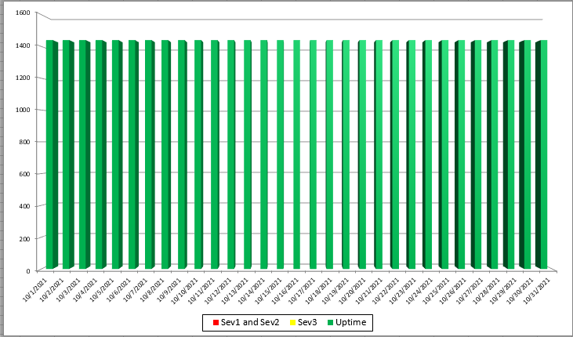
2019 Mass HIway Incident Summary Dashboard
October 2021
Sev 1 - All / Most Mass HIway components impacted as a result of outage. For example: LAND, Webmail, Direct XDR, and DPH nodes are all down
Sev 2 - Multiple Mass HIway components impacted as a result of outage in one of the shared service. For example: LAND and Webmail are down but Direct XDR and DPH nodes are up.
Sev3 – One Mass HIway component impacted as a result of outage. For example: Webmail is down but all other services are up and running.
Notes:
Slide Title: 2019 Mass HIway Incident Summary Dashboard
October 2021
All services are up and running

Slide 42
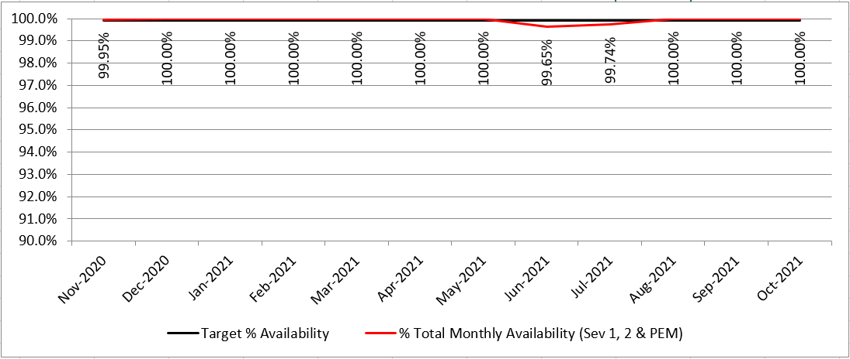
HIway Availability Trends – October 2021
Metric Targets:
“Total Monthly Availability” – no lower than 99.9% (downtime no more than ~44 minutes/month)
Notes:
Slide Title: HIway Availability Trends – October 2021
Metric Targets:
“Total Monthly Availability” – no lower than 99.9% (downtime no more than ~44 minutes/month)
Nov 2020 99.95%
Dec 2020 100%
Jan 2021 100%
Feb 2021 100%
March 2021 100%
April 2021 100%
May 2021 100%
June 2021 99.65%
July 2021 99.74%
Aug 2021 100%
Sept 2021 100%
Oct 2021 100%

Slide 43
HIway Direct Messaging Volume for Care Coordination & Annual HIway Participant Fees
 |  | Care Coordination Message Volume – 1 Month |  |  |  | CC Message Volume – Est Annual
Row Labels | # Orgs | # Messages Received | % Rec | # Messages Sent | % Sent | Est Annual Rec | Est Annual Sent | Fees Paid | Average Cost per CC Transaction
Tier 1 | 25 | 62,250 | 32.35% | 93,047 | 43.30% | 747,000 | 1,116,564 | $297,680 | $0.16
Tier 2 | 61 | 127,153 | 66.09% | 115,288 | 53.65% | 1,525,836 | 1,383,456 | $185,240 | $0.05
Tier 3 | 74 | 2,068 | 1.07% | 6,520 | 3.03% | 24,816 | 78,240 | $17,755 | $0.17
Tier 4 | 93 | 775 | 0.40% | 31 | 0.01% | 9,300 | 372 | $2,230 | $0.22
Tier 5 | 57 | 152 | 0.08% | 23 | 0.01% | 1,824 | 276 | $1,020 | $0.35
Grand Total | 310 | 192,398 | 100.00% | 214,909 | 100.00% | 2,308,776 | 2,578,908 | $503,925 | $0.19
28%
98%
97%
96%
Notes:
Slide Title: HIway Direct Messaging Volume for Care Coordination & Annual HIway Participant Fees*

Slide 44
Mass HIway Rate Card
Notes:
Slide Title: Mass HIway Rate Card
Shows HIway Rate card effective Dec. 1, 2017

Slide 45
Thank you!
Notes:
Slide Title: Thank you!

