Slide 1
V
vHITC
Health Information Technology Council Meeting
November 2, 2020
Notes:
Title slide
Health Information Technology Council Meeting
Nov 2 , 2020

Slide 2
Agenda
Welcome
  Undersecretary Lauren Peters
  Approval of August 2020 minutes (vote)
2020 attestation/connection requirement update
  Chris Stuck-Girard
Consolidated Clinical Gateway update
  David Whitham
Query HIE and FHIR update
  Julie Creamer & Kevin Mullen
eMOLST update
  Bert Ng
Conclusion
  Undersecretary Lauren Peters
Notes:
Slide title: Agenda
Welcome
Undersecretary Lauren Peters
-Approval of the August 3, 2020 minutes (vote)
Updates from last meeting
Bert Ng
Clinical Gateway nodes
David Whitham
HIway strategic plan
Undersecretary Lauren Peters & Bert Ng
HIway budget
Bert Ng & David Whitham
HIway connection requirement & 2020 attestation
Chris Stuck-Girard
Conclusion
Undersecretary Lauren Peters

Slide 3
Welcome
Undersecretary Lauren Peters
Notes:
Welcome
Undersecretary Lauren Peters

Slide 4
Vote: Approve minutes
MOTION: That the Health Information Technology Council hereby approves the minutes of the council meeting held on August 3, 2020 as presented/amended
Notes:
Slide title: Vote: Approve minutes
MOTION: That the Health Information Technology Council hereby approves the minutes of the council meeting held on August 3, 2020 as presented/amended

Slide 5
HIway connection requirement & 2020 attestation
Chris Stuck-Girard
Notes:
Slide Title: HIway connection requirement & 2020 attestation
Chris Stuck-Girard

Slide 6
HIway attestation: HIway connection requirement overview
The HIway connection requirement requires providers to engage in HIE via the Mass HIway as set forth in M.G.L. Chapter 118I, Section 7, and as detailed in the Mass HIway Regulations (101 CMR 20.00).
Provider organization | First year requirement applied | Submit in 2020
Acute care hospitals | 2017 | Year 4 attestation form
Large and medium medical ambulatory practices | 2018 | Year 3 attestation form
Large community health centers
Small community health centers | 2019 | Year 2 attestation form
HIway annual connection requirement
Year 1 | Send or receive HIway Direct messages for at least one use case
Year 2 | Send or receive HIway Direct messages for at least one provider-to provider (P2P) use case
Year 3 | Send HIway Direct messages for at least one P2P use case, and Receive HIway Direct messages for at least one P2P use case
Year 4 | Meet Year 3 requirement or be subject to penalties if requirement is not met
Notes:
Slide title: HIway attestation: HIway connection requirement overview
The HIway connection requirement requires providers to engage in HIE via the Mass HIway as set forth in M.G.L. Chapter 118I, Section 7, and as detailed in the Mass HIway Regulations (101 CMR 20.00).
ACUTE CARE HOSPITALS
First year requirement applied: 2017
Submit in 2020: Year 4 attestation form
LARGE AND MEDIUM MEDICAL AMBULATORY PRACTICES & LARGE COMMUNITY HEALTH CENTERS
First year requirement applied: 2018
Submit in 2020: Year 3 attestation form
SMALL COMMUNITY HEALTH CENTERS
First year requirement applied: 2019
Submit in 2020: Year 2 attestation form
HIway annual connection requirement
Year 1: Send or receive HIway Direct messages for at least one use case
Year 2: Send or receive HIway Direct messages for at least one provider-to provider (P2P) use case
Year 3: Send HIway Direct messages for at least one P2P use case, and Receive HIway Direct messages for at least one P2P use case
Year 4: Meet Year 3 requirement or be subject to penalties if requirement is not met

Slide 7
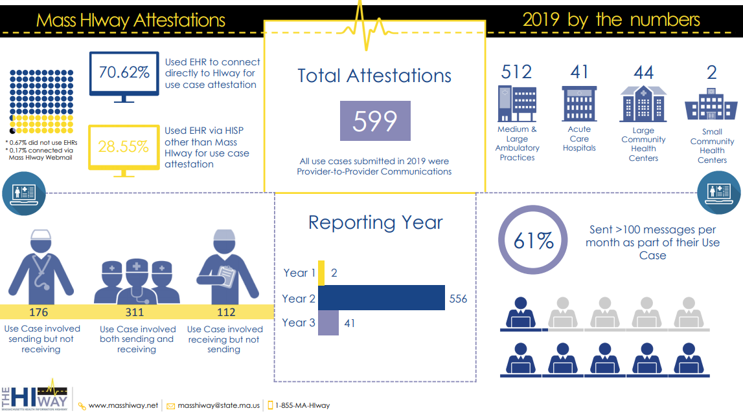
HIway attestation: 2019 statistics
Notes:
Slide title: HIway attestation: 2019 statistics
Graphic shows statistical breakdown of 2019 HIway attestation submissions.

Slide 8
HIway attestation: 2020 timeline
The HIway started planning for the 2020 attestation cycle last fall. Early this spring, outreach and education ramped up. After delaying the attestation deadline to account for COVID-19, the HIway started accepting attestation/exception forms on Aug. 1.
Attestation timeline:
Dec. 31, 2019: Deadline to implement use cases for 2020 attestation cycle
May 2020:
  HIway extends attestation/ADT deadlines
  First attestation webinar; PDF version of attestation/exception forms online (publicly available for submitters to prepare answers in advance)
Aug. 1, 2020: Attestation/exception webforms go live and start
accepting submissions
Dec. 31, 2020: Deadline for attestation/exception submissions
Jan. 1, 2021: Deadline for Acute Care Hospitals to submit ADTs to the Statewide
ENS Framework
January 2021: HIway reaches out to POs that have not submitted
Winter 2021: When it seems that submissions have stopped, HIway
closes webform
Notes:
Slide title: Attestation: 2020 timeline
Top box: The HIway started planning for the 2020 attestation cycle last fall. Early this spring, outreach and education ramped up. After delaying the attestation deadline to account for COVID-19, as of Aug. 1, the HIway is accepting attestation/exception forms.
Attestation timeline:
Dec. 31, 2019: Deadline to implement use cases for 2020 attestation cycle
May 2020:
-HIway extends attestation/ADT deadlines
-First attestation webinar
-PDF version of attestation/exception forms online (publicly available for submitters to prepare answers in advance)
August 1: Attestation/exception webforms go live and start accepting submissions
Dec. 31, 2020: Deadline for attestation/exception submissions
Jan. 1, 2021: Deadline for Acute Care Hospitals to submit ADTs to the Statewide
ENS Framework
January 2021: HIway reaches out to POs that have not submitted
Winter 2021: When it seems that submissions have stopped, HIway
closes webform

Slide 9
HIway attestation:
Improvements to process
For the 2020 attestation cycle, the HIway made improvements to streamline the process for providers and collect data regarding new program requirements.
New this year:
HIway unique ID (HID): Each provider organization/sub-organization has been assigned a HID. Submitters will use HIDs on their forms (instead of the full name/location of each sub-org). This should streamline the process, especially for practices with many sub-organizations.
Dedicated section to record ADT submission by Acute Care Hospitals
Clarified language in use case transmission methods section
New questions on attestation/exception forms, including taking a deeper dive into details of use cases
Notes:
Slide title: Attestation: Improvements to process
Top box: For the 2020 attestation cycle, the HIway made improvements to streamline the process for providers and collect data regarding new program requirements.
New this year:
-HIway unique ID (HID): Each provider organization/sub-organization has been assigned a HID. Submitters will use HIDs on their forms (instead of the full name/location of each sub-org). This should streamline the process, especially for practices with many sub-organizations.
-New section to record ADT submission by Acute Care Hospitals
-Clarified language in use case transmission methods section
-New questions on attestation/exception forms, including taking a deeper dive into details of use cases

Slide 10
HIway attestation: 2020 statistics so far
Due to COVID-19 and the deferral of the submission deadline, HIway attestation submissions are low so far this year.
Acute Care Hospitals (n=66)
7 attestations submitted
0 exception forms submitted
11% attested
Community Health Centers (n=38)
3 attestations submitted
2 exception forms submitted
8% attested
5% exception forms
Medium/Large Medical
Ambulatory Practices (n=528)
Attestations submitted for 9 practices
Exception forms submitted for 22 practices
2% attested
4% exception forms
As of Oct. 26:
31 forms submitted
Year 3/4 forms: 16
Exception forms: 15
Notes:
Slide title: HIway attestation: 2020 statistics so far
Due to COVID-19 and the deferral of the submission deadline, HIway attestation submissions are low so far this year.
Left column:
As of Oct. 26:
31 forms submitted
Year 3/4 forms: 16
Exception forms: 15
Right column:
Acute Care Hospitals (n=66)
7 attestations submitted
0 exception forms submitted
11% attested
Community Health Centers (n=38)
3 attestations submitted
2 exception forms submitted
8% attested
5% exception forms
Medium/Large Medical
Ambulatory Practices (n=528)
Attestations submitted for 9 practices
Exception forms submitted for 22 practices
2% attested
4% exception forms

Slide 11
HIway attestation: 2020 outreach
The HIway is encouraging POs to submit attestation forms ASAP and will continue to reach out to POs after the Dec. 31 deadline.
Though the HIway recognizes the unique challenges of this year, we are proceeding with attestation (deadline extended to Dec. 31)
Via webinars, mass emails, and 1-1 emails, the HIway is encouraging POs to submit attestation/exception forms ASAP
We have partnered with the Massachusetts Health & Hospital Association and the Massachusetts League of Community Health Centers, which have sent advisories to members on our behalf
We are planning how to encourage attestation submissions after Dec. 31 (snail mail, phone calls)
Notes:
Slide title: HIway attestation: 2020 outreach
The HIway is encouraging POs to submit attestation forms ASAP and will continue to reach out to POs after the Dec. 31 deadline
Though the HIway recognizes the unique challenges of this year, we are proceeding with attestation (deadline extended to Dec. 31)
Via webinars, mass emails, and 1-1 emails, the HIway is encouraging POs to submit attestation/exception forms ASAP
We have partnered with the Massachusetts Health & Hospital Association and the Massachusetts League of Community Health Centers, which have sent advisories to members on our behalf
We are planning how to encourage attestation submissions after Dec. 31 (snail mail, phone calls)

Slide 12
Consolidated Clinical Gateway update
David Whitham
Notes:
Consolidated Clinical Gateway
David Whitham

Slide 13
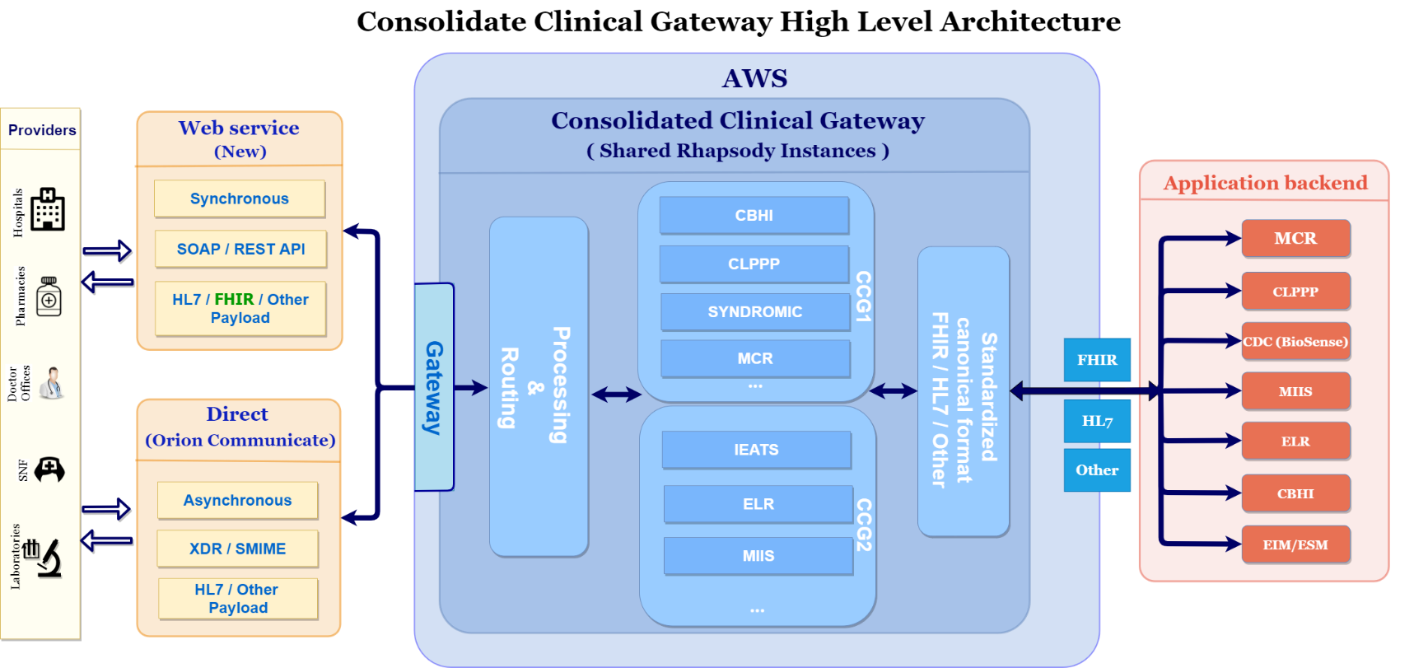
Recap: Consolidated Clinical Gateway (CCG) Project Overview
This project will migrate the current suite of Clinical Gateway nodes to the AWS cloud
Key project objectives include
    Migrate to AWS to reduce infrastructure costs and address scalability
    Provide future alternatives to Direct messaging for public health reporting
    Support Query & Retrieve functionality to align with TEFCA
  Implement a FHIR interface to support enhanced business functionality
Notes:
Slide title: Recap: Consolidated Clinical Gateway (CCG) Project Overview.
This project will migrate the current suite of Clinical Gateway nodes to the AWS cloud.
Key project objectives include
Migrate to AWS to reduce infrastructure costs and address scalability
Provide future alternatives to Direct messaging for public health reporting
Support Query & Retrieve functionality to align with TEFCA
Implement a FHIR interface to support enhanced the business functionality
Diagram shows the high-level architecture of the Consolidated Clinical Gateway
Web service and Direct Messaging connections to the CCG will process messages to backend applications.
Currently there are seven (7) applications:
-Massachusetts Cancer Registry (MCR)
-Childhood Lead Poison Prevention Program (CLPPP)
-Children’s Behavioral Health Initiative (CBHI)
-Electronic Lab Reporting (ELR)
-Immunization (MIIS)
-Intake Enrolment Assessment and Transfer Service (OTP&TB)
-Syndromic Surveillance (SYNDROMIC)

Slide 14
Consolidated Clinical Gateway (CCG) – AWS migration timeline
Live: Q3/Q4 2020
Live: Q1 CY 2021
Live: Q2 CY 2021
Live: Q3 CY 2021
Design & Dev
Internal Apps
CCG Phase 1
CCG Phase 2
FHIR & Others
Internal Apps:
Attestation Forms (Live Now!)
Masshiway.net
Sugar CRM
Operations Tools
CCG Phase 1:
MCR
CBHI
CLPPP
Syndromic
CCG Phase 2:
IEATS
ELR
MIIS
Enhancements
FHIR Proof of Concept
Migration notes:
CG nodes in current VG4 environment are retained until the AWS system is stabilized. This allows for a quick rollback to the VG4 environment if any issues arise
Migrations will be done on weekend nights to ensure message flow is not interrupted during peak
processing hours
For CCG Phase 1, lower-volume nodes will be cutover to PROD first; Syndromic will be last
For CCG Phase 2, lower-volume nodes will be cutover to PROD first; MIIS will be last
Each production cutover will have in-depth pre-production cutover activities
Notes:
Slide Title: Consolidated Clinical Gateway (CCG) – AWS migration timeline
Timeline graphic shows target Go-Live dates for 4 categories of applications
Internal Apps – Live Q3/Q4 2020
CCG Phase 1 – Live Q1 CY 2021
CCG Phase 2 – Live Q2 CY 2021
FHIR & Others – Live Q3 CY 2021
Migration notes:
CG nodes in current VG4 environment are retained until the AWS system is stabilized. In case of any issues this allows for a quick rollback to the VG4 environment
Migrations will be done on weekend nights to make sure the message flow is not interrupted during peak processing hours
For CCG Phase 1, the lower volume nodes will be cutover to PROD first and Syndromic will be last
For CCG Phase 2, the lower volume nodes will be cutover to PROD first and MIIS will be last
Each production cutover will have in-depth pre-production cutover activities

Slide 15
Query HIE and FHIR update
Julie Creamer & Kevin Mullen
Notes:
Query HIE and FHIR update
Julie Creamer & Kevin Mullen

Slide 16
Query HIE and FHIR Research
Support HIE Outreach Program through technical engagement with providers, vendors, and consortia to determine Query HIE and FHIR business and technical requirements, develop program knowledge base, and communicate capabilities to the community.
2020 - Q1
2020 – Q2
2020 – Q3
2020 – Q4
Stakeholder Engagement & Requirements
Research & Analysis; Market-Capability Assessments
Education, Web Toolkit Updates, & Outreach
Training Sessions & Content Development
Query HIE Research Process
Query HIE Work Product
  Develop expertise in the Query HIE space and with the vendors, CommonWell, and Carequality
  Facilitate meetings with stakeholders, CommonWell, Carequality, major EHR vendors, and their customers to understand requirements and workflow
  Gather and document the key processes and business and technical requirements to connect and utilize Query HIE
  Priority-Setting Framework
  Query HIE Landscape Assessment
  Business-Technical Requirements Index
  EHR-Query HIE Process Workbooks
  Training Guides
FHIR Research Process
FHIR Work Product
  Develop expertise in Fast Healthcare Interoperability Resources (FHIR) and its applicability to the Mass HIway
  Facilitate meetings with vendors, providers, and other stakeholders with FHIR implementation experience
  Gather and document technical and business requirements related to the application of FHIR to the Mass HIway
  FHIR Capability Assessment
  FHIR Market Assessment
  Business-Technical Requirements Index
  Training Guides
  FHIR Design-Approach Options
Notes:
Slide Title: Query HIE and FHIR Research
Support HIE Outreach Program through technical engagement with providers, vendors, and consortia to determine Query HIE and FHIR business and technical requirements, develop program knowledge base, and communicate capabilities to the community
2020-Q1: Stakeholder Engagement & Requirements
2020-Q2: Research & Analysis; Market-Capability Assessments
2020-Q3: Training Sessions & Content Development
2020-Q4: Education, Web Toolkit Updates, & Outreach
Query HIE Research Process:
Develop expertise in the Query HIE space and with the vendors, CommonWell, and Carequality
Facilitate meetings with stakeholders, CommonWell, Carequality, major EHR vendors, and their customers to understand requirements and workflow
Gather and document the key processes and business and technical requirements to connect and utilize Query HIE
Query HIE Work Product
Priority-Setting Framework
Query HIE Landscape Assessment
Business-Technical Requirements Index
EHR-Query HIE Process Workbooks
Training Guides
FHIR Research Process
Develop expertise in Fast Healthcare Interoperability Resources (FHIR) and its applicability to the Mass HIway
Facilitate meetings with vendors, providers, and other stakeholders with FHIR implementation experience
Gather and document technical and business requirements related to the application of FHIR to the Mass HIway
FHIR Work Product
FHIR Capability Assessment
FHIR Market Assessment
Business-Technical Requirements Index
Training Guides
FHIR Design-Approach Options

Slide 17
HIE Use Cases map to ONC 2020 ISA
Use case prioritization and technical requirement map
Key Observations
Adoption estimates indicate that stakeholders are utilizing standards and specifications to support the top priority use cases
Limited focus, internal exercise to establish a composite rank of use cases and HIE services and supports
Use cases were mapped to specific interoperability needs, standards, and implementation specifications outlined in the 2020 Interoperability Standards Advisory (ISA)
Emerging FHIR standards and specifications are enabling top use cases and a large share of specialized use cases and services
Query HIE related components are concentrated to a smaller group of use cases, services, and scenarios
There are current and new federal requirement elements supporting a majority of the top identified use cases
Indicators reflect increasing opportunities and likelihood for improved interoperability
Notes:
Slide Title: HIE Use Cases map to ONC 2020 ISA
Use case prioritization and technical requirement map:
Limited focus, internal exercise to establish a composite rank of use cases and HIE services and supports
Use cases were mapped to specific interoperability needs, standards, and implementation specifications outlined in the 2020 Interoperability Standards Advisory (ISA)
Key Observations:
Adoption estimates indicate that stakeholders are utilizing standards and specifications to support the top priority use cases
Emerging FHIR standards and specifications are enabling top use cases and a large share of specialized use cases and services
Query HIE related components are concentrated to a smaller group of use cases, services, and scenarios
There are current and new federal requirement elements supporting a majority of the top identified use cases
Indicators reflect increasing opportunities and likelihood for improved interoperability

Slide 18
Query HIE: MA Interoperability Network Market
Combined Mass HIway CRM & Attestation Data Set with Interoperability Network (Carequality & CommonWell) Active Participant Directories
1548 unique hospital-provider organizations in Massachusetts
1028 have an identified EHR-Network (breakdown table below)
520 do not have an EHR-Network identified
  350 have no EHR-Network or parent organization identified
  170 list a parent organization with an EHR capable of connecting to an interoperability network
 | Active |  | Potential |  | Unknown |  | Total
Interoperability Network | Count | % | Count | % | Count | % | Count | %
Carequality & CommonWell | 87 | 17% | 181 | 46% |  |  | 268 | 26%
Carequality* | 386 | 73% | 144 | 37% |  |  | 530 | 52%
CommonWell | 53 | 10% | 66 | 17% |  |  | 119 | 12%
No identified network |  |  |  |  | 111 | 100% | 111 | 11%
* Includes Care Everywhere
Grand Total | 526 | 100% | 391 | 100% | 111 | 100% | 1028 | 100%
 |  | 51% |  | 38% |  | 11%
Provider Engagement Opportunity
~ 38% (391) organizations with potential capability of connecting to an interop network
~ 11% (111) organizations with no identified connection capability
Actively Using Query HIE
~ 51% (526) identified organizations listed as “active” on interoperability network
Notes:
Slide Title: Query HIE: MA Interoperability Network Market
Graph:
EHR Network Identified: 1028 / 66%
EHR Not Identified: 520 / 34%
Combined Mass HIway CRM & Attestation Data Set with Interoperability Network (Carequality & CommonWell) Active Participant Directories:
1548 unique hospital-provider organizations in Massachusetts
1028 have an identified EHR-Network (breakdown table below)
520 do not have an EHR-Network identified
350 have no EHR-Network or parent organization identified
170 list a parent organization with an EHR capable of connecting to an interoperability network
Table
Interoperability Network
Carequality & Commonwell:
Active: 87 / 17%
Potential: 181 / 46%
Unknown: 0 / 0%
Total: 268 / 26%
Carequality*:
Active: 386 / 73%
Potential: 144 / 37%
Unknown: 0 / 0%
Total: 530 / 52%
Commonwell
Active: 53 / 10%
Potential: 66 / 17%
Unknown: 0 / 0%
Total: 119 / 12%
No identified network
Active: 0 / 0%
Potential: 0 / 0%
Unknown: 111 / 100%
Total: 111 / 11%
Includes Care Everywhere
Actively Using Query HIE:
~ 51% (526) identified organizations listed as “active” on interoperability network
Provider Engagement Opportunity:
~ 38% (391) organizations with potential capability of connecting to an interop network
~ 11% (111) organizations with no identified connection capability

Slide 19

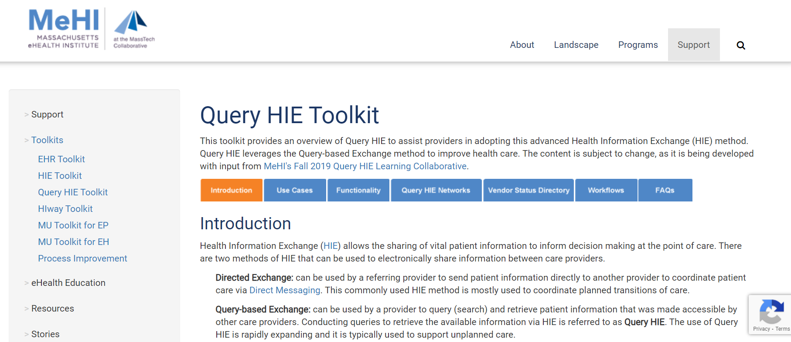
Content development with MeHI
In collaboration with MeHI, prioritized areas from the Interoperability research and data sets for focused review
Initial Focus Areas for Consumer Education
HIE Services &
Use Cases
CMS-ONC Regulatory Compliance
Query HIE
Privacy & Consent
Improving C-CDA Exchange
FHIR-APIs
Focus group reviews identify and develop content updates for web, toolkits, and education materials
Content Development Status
MeHI Query HIE Toolkit
In Process
Completed
Notes:
Slide Title: Content development with MeHI
In collaboration with MeHI, prioritized areas from the Interoperability research and data sets for focused review
Focus group reviews identify and develop content updates for web, toolkits, and education materials
Transition arrow towards > Initial Focus Areas for Consumer Education – Content Development Status:
HIE Services & Use Cases – In Process
Query HIE - Completed
Privacy & Consent – In Process
Improving C-CDA Exchange – In Process
FHIR-APIs – In Process
CMS-ONC Regulatory Compliance – In Process
Transition arrow towards > MeHI: MeHI Query HIE Toolkit

Slide 20
Query HIE: Next steps
Promote the Query HIE toolkit on the Mass HIway website via newsletter articles and reminders
Launch series of educational webinars in February 2021 targeting information technology professionals, providers and other clinical staff, and larger associations such as the Massachusetts Medical Society
Identify opportunities for specific practices to benefit from Query HIE and advise providers on the activation and onboarding process
Gather and consolidate feedback related to Query HIE from providers and use this information to guide future educational and promotional efforts
Notes:
Slide Title: Query HIE: Next steps
Promote the Query HIE toolkit on the Mass HIway website via newsletter articles and reminders
Launch series of educational webinars in February 2021 targeting information technology professionals, providers and other clinical staff, and larger associations such as the Massachusetts Medical Society
Identify opportunities for specific practices to benefit from Query HIE and advise providers on the activation and onboarding process
Gather and consolidate feedback related to Query HIE from providers and use this information to guide future educational and promotional efforts

Slide 21
FHIR API: HIE survey scan
Primary review of HIE information sources were combined with secondary HIE surveys to give an approximation of FHIR capabilities in the HIE market
Confirmed FHIR capability = 21/35 HIEs
35/55
24/38
35/55
26/38
18/55
14/38
22/55
17/38
Data Source | All HIEs | State HIEs
HIE Survey | 39 | 25
Primary Review | 31 | 27
Number of HIEs in Assessment | 55 | 38
Total HIE Service Instances | 35
Unique HIE Services | 14
Number of HIEs | 21
Notes:
Slide Title: FHIR API: HIE survey scan
Primary review of HIE information sources were combined with secondary HIE surveys to give an approximation of FHIR capabilities in the HIE market
Graph-1: HIE Capability:
Secure Web Services:
All HIEs: 35/55, 64%
State HIEs: 24/38, 60%
FHIR Capability:
All HIEs: 35/55, 64%
State HIEs: 26/38, 68%
FHIR-API Development:
All HIEs: 18/55, 33%
State HIEs: 14/38, 35%
Carequality Framework:
All HIEs: 22/55, 40%
State HIEs: 17/38, 43%
Table-1 Data Source:
HIE Survey
All HIEs: 39
State HIEs: 25
Primary Review
All HIEs: 31
State HIEs: 27
Number of HIEs in Assessment
All HIEs: 55
State HIEs: 38
Transition arrow from FHIR Capability 35/55, 64% towards > Confirmed FHIR capability = 21/35 HIEs
Transition arrow from Confirmed FHIR capability = 21/35 HIEs towards > Graph-2: FHIR Enabled HIE Services
Graph-2: FHIR Enabled HIE Services - Instances of HIE Services
HL7-FHIR Transformation & HISP – 6
FHIR API Access to Clinical Resources – 5
Query HIE – 3
SMART on FHIR API Access to Clinical – 3
FHIR API Access to Public Health Data – 3
Consolidated Clinical Summary – 3
Unspecified FHIR Capability – 3
FHIR API Access to PDMP Data – 2
Provider Directory – 2
FHIR Based Consent Management – 1
eCQM & Quality Reporting – 1
FHIR Based Event Notification Services – 1
Provider to Payer Exchange (Da Vinci) – 1
Patient Access via Mobile Apps – 1
Table-2
Total HIE Service Instances – 35
Unique HIE Services – 14
Number of HIEs - 21

Slide 22
FHIR API: Example of FHIR API use case
Provider Directory (Oregon)
The Oregon Health Authority (OHA) is implementing a shared resource for accurate, trusted provider data called the Oregon Provider Directory (OPD)
Data Sources
Provider Demographics
Data Access and Use
APIs (FHIR, RESTful, SOAP)
Secure File Transport Protocol (SFTP)
Organization Demographics
Provider Contact Info
Address & Location(s)
HIE Endpoints – including Direct secure messaging addresses
EHR Info
Affiliations
Data Types
Participating Organization and Provider data
MMIS (Oregon Medicaid providers)
National Plan and Provider Enumeration System (NPPES)
PECOS (Medicare Providers)
Other trusted data sources (CCO network tables, EHR Incentive Programs, Patient Centered Primary Care Home)
Providers
Directory Users
It is not currently accessible by consumers
Hospitals
Payers
Medicaid Coordinated Care Organizations
Other health care entities
Master Record
Source data is cleaned, matched, and merged to create a single master record
DirectTrust Flat File
Web Portal
Notes:
Slide Title: FHIR API: Example of FHIR API use case
Provider Directory (Oregon)
The Oregon Health Authority (OHA) is implementing a shared resource for accurate, trusted provider data called the Oregon Provider Directory (OPD)
Directory Users
Providers
Hospitals
Payers
Medicaid Coordinated Care Organizations
Other health care entities
It is not currently accessible by consumers
Data Sources
Participating Organization and Provider data
National Plan and Provider Enumeration System (NPPES)
PECOS (Medicare Providers)
MMIS (Oregon Medicaid providers)
Other trusted data sources (CCO network tables, EHR Incentive Programs, Patient Centered Primary Care Home)
Master Record
Source data is cleaned, matched, and merged to create a single master record
Data Types
Provider Demographics
Organization Demographics
Provider Contact Info
Address & Location(s)
HIE Endpoints – including Direct secure messaging addresses
EHR Info
Affiliations
Data Access and Use
APIs (FHIR, RESTful, SOAP)
Web Portal
DirectTrust Flat File
Secure File Transport Protocol (SFTP)

Slide 23
FHIR API: Mass HIway initiatives
FHIR API initiative
FHIR API to Consolidated Clinical Gateway
Moderate Value & Moderate Complexity / Effort
FHIR API is component of new CCG gateway architecture
Message transformation to/from back-end registry systems
Technical components (ex. Amazon Web Services, Rhapsody engine) of the Consolidated Clinical Gateway Nodes could be leveraged for other FHIR API initiatives
Potential FHIR API options for Mass HIway to explore
FHIR API to Provider Directory
Higher Value & Lower Complexity / Effort
Potential alignment-support for CMS-ONC requirements
Development of API capability is a component Mass HIway - Orion contract
FHIR Exchange / Routing Services
Undefined Value & Higher Complexity / Effort
Potential alignment with ONC FAST initiative and efforts
Assess Mass HIway technology capability gaps
HL7-FHIR Broker / Message Transformation
Undefined Value & Higher Complexity / Effort
Potentially leverage new technical capabilities gained from CCG FHIR transformation services
Need to identify interested organizations and use cases
Notes:
Slide Title: FHIR API: Mass HIway initiatives
FHIR API initiative:
FHIR API to Consolidated Clinical Gateway:
Moderate Value & Moderate Complexity / Effort
FHIR API is component of new CCG gateway architecture
Message transformation to/from back-end registry systems
Technical components (ex. Amazon Web Services, Rhapsody engine) of the Consolidated Clinical Gateway Nodes could be leveraged for other FHIR API initiatives
Potential FHIR API options for Mass HIway to explore:
FHIR API to Provider Directory:
Higher Value & Lower Complexity / Effort
Potential alignment-support for CMS-ONC requirements
Development of API capability is a component Mass HIway - Orion contract
FHIR Exchange / Routing Services
Undefined Value & Higher Complexity / Effort
Potential alignment with ONC FAST initiative and efforts
Assess Mass HIway technology capability gaps
HL7-FHIR Broker / Message Transformation:
Undefined Value & Higher Complexity / Effort
Potentially leverage new technical capabilities gained from CCG FHIR transformation services
Need to identify interested organizations and use cases

Slide 24
FHIR API – Next Steps
Gather and consolidate stakeholder feedback related to FHIR API services and use cases
Identify interested providers and organizations and use cases for 1) FHIR API access to Consolidated Clinical Gateway (CCG) and 2) FHIR API access to Provider Directory
Complete FHIR API solution scoping and scaling options and assess Mass HIway technology and capability gaps. Determine implications to Orion contract and identify add/change areas necessary to support development
Develop framework of options and opportunities to align proposed FHIR API solution(s) with the CMS & ONC requirements on regulated entities
Notes:
Slide Title: FHIR API – Next Steps
Gather and consolidate stakeholder feedback related to FHIR API services and use cases
Identify interested providers and organizations and use cases for;
FHIR API access to Consolidated Clinical Gateway (CCG)
FHIR API access to Provider Directory
Complete FHIR API solution scoping and scaling options and assess Mass HIway technology and capability gaps. Determine implications to Orion contract and identify add/change areas necessary to support development
Develop framework of options and opportunities to align proposed FHIR API solution(s) with the CMS & ONC requirements on regulated entities

Slide 25
eMOLST Initiative
Bert Ng
Notes:
Slide Title: eMolst Initiative
Bert Ng

Slide 26
eMOLST: Overview
eMOLST initiative goal:
Supporting patient preferences for end-of-life care through technology that improves care coordination
Project objectives:
Update MOLST – Update the state’s MOLST form to better align with the POLST national paradigm
Create eMOLST Repository – Create an electronic single source of truth for eMOLST forms
Develop Integration Strategy – Develop an integration and implementation strategy to gain efficiency
Historical timeline:
Feb 2020 – Joint letter issued by EOHHS, EOEA, and DPH to explore eMOLST
Oct 2020 – CMS approved project for federal matching funds
Notes:
Slide Title: eMolst Overview
eMOLST initiative goal:
Supporting patient preferences for end-of-life care through technology that improves care coordination
Project objectives:
Update MOLST – Update the state’s MOLST form to better align with the POLST national paradigm
Create eMOLST Repository – Create an electronic single source of truth for eMOLST forms
Develop Integration Strategy – Develop an integration and implementation strategy to gain efficiency
Historical timeline:
Feb 2020 – Joint letter issued by EOHHS, EOEA, and DPH to explore eMOLST
Oct 2020 – CMS approved project for federal matching funds

Slide 27
eMOLST: Two-year estimated timeline
Estimated
Design
Develop
Implement
2020
Q4
Project manager
2021
Q1 – Q4
Outreach
Procurement
Design RFR
Contracting
2022
Q1
Vendor creates repository
2022
Q2 – Q4
Go live
Provider implementation
Notes:
Slide Title: eMolst Two-year estimated timeline
2020 Q4 Design: Project Manager
2021 Q1-Q4 Design: Conduct Outreach, Procurement, Design RFR, Contracting
Q1 Develop: Vendor creates repositiory
2022 Q2-Q4Implement: Go live, Provider Implementation

Slide 28
eMOLST: Project manager tasks
EOHHS and EOEA will bring on an eMOLST project manager who will be responsible for design tasks through stakeholder engagement
Stakeholders
Coalition for Serious Illness Care
MA MOLST Subcommittee
Trade organizations
Providers
EOHHS/Mass HIway
DPH
MeHI
Assess the current state of MOLST
Define the desired future state of an ePOLST
Perform gap analysis and define ePOLST operating model
Determine design of ePOLST registry
Create RFR and support the procurement process
Develop implementation strategy
Notes:
Slide Title: e Molst: Project manager tasks
EOHHS and EOEA will bring on an eMOLST project manager who will be responsible for design tasks through stakeholder engagement
Stakeholders
Coalition for Serious Illness Care
MA MOLST Subcommittee
Trade organizations
Providers
EOHHS/Mass HIway
DPH
MeHI
Tasks
Assess the current state of MOLST
Define the desired future state of an ePOLST
Perform gap analysis and define ePOLST operating model
Determine design of ePOLST registry
Create RFR and support the procurement process
Develop implementation strategy

Slide 29
Conclusion
Undersecretary Lauren Peters
Notes:
Slide Title: Conclusion
Undersecretary Lauren Peters

Slide 30

Next HITC meeting
Winter HITC meeting
February 1st, 2021
3:30 – 5 p.m.
W
Notes:
Slide title: Next HITC meeting
Winter HITC meeting
February 1st , 2020
3:30 – 5 p.m.

Slide 31
Appendix A: HIE use cases map to ONC 2020 ISA
Notes:
Slide title: Appendix A: HIE use cases map to ONC 2020 ISA

Slide 32
HIE Use Cases map to ONC 2020 ISA
Notes:
Slide Title: HIE Use Cases map to ONC 2020 ISA
HIE Use Cases > ISA Content / Structure Standards & Specifications:
Transitions of Care:
Map to ISA – Yes
Adoption of Standards & Specifications – 5
Adoption of Query HIE Components – 1
Adoption of FHIR Components – 1
Federal Requirements – Yes
Referral Management:
Map to ISA – Yes
Adoption of Standards & Specifications – 4
Adoption of Query HIE Components – 1
Adoption of FHIR Components – 3
Federal Requirements – Yes
Care Plan Exchange:
Map to ISA – Yes
Adoption of Standards & Specifications – 1.92
Adoption of Query HIE Components – 2
Adoption of FHIR Components – 1.25
Federal Requirements – Yes
Event Notifications and Alerts:
Map to ISA – Yes
Adoption of Standards & Specifications – 3.67
Adoption of Query HIE Components – 0
Adoption of FHIR Components – 1
Federal Requirements – Yes
Opioid Monitoring and Support Services:
Map to ISA – Yes
Adoption of Standards & Specifications – 3.18
Adoption of Query HIE Components – 0
Adoption of FHIR Components – 3
Federal Requirements –
Immunization Information-Submit & Query HIE:
Map to ISA – Yes
Adoption of Standards & Specifications – 5
Adoption of Query HIE Components – 0
Adoption of FHIR Components – 0
Federal Requirements – No
Lab Orders-Results:
Map to ISA – Yes
Adoption of Standards & Specifications – 1.38
Adoption of Query HIE Components – 0
Adoption of FHIR Components – 1
Federal Requirements – Yes
Emergency Department High-Utilizers:
Map to ISA – No
Adoption of Standards & Specifications – Blank
Adoption of Query HIE Components – Blank
Adoption of FHIR Components – Blank
Federal Requirements – Blank
Social Determinants of Health:
Map to ISA – Yes
Adoption of Standards & Specifications – 1.44
Adoption of Query HIE Components – 0
Adoption of FHIR Components – 0
Federal Requirements – No
Public Health Reporting:
Map to ISA – Yes
Adoption of Standards & Specifications – 1.8
Adoption of Query HIE Components – 0
Adoption of FHIR Components – 1
Federal Requirements – Yes
Medication Reconciliation:
Map to ISA – No
Adoption of Standards & Specifications – Blank
Adoption of Query HIE Components – Blank
Adoption of FHIR Components – Blank
Federal Requirements – Blank
MOLST – Advance Directives:
Map to ISA – Yes
Adoption of Standards & Specifications – 2
Adoption of Query HIE Components – 0
Adoption of FHIR Components – 1
Federal Requirements – Yes
Population Health Analytics:
Map to ISA – Yes
Adoption of Standards & Specifications – 1.75
Adoption of Query HIE Components – 0
Adoption of FHIR Components – 2
Federal Requirements – No
Telehealth:
Map to ISA – No
Adoption of Standards & Specifications – Blank
Adoption of Query HIE Components – Blank
Adoption of FHIR Components – Blank
Federal Requirements – Blank
Longitudinal Health Records:
Map to ISA – No
Adoption of Standards & Specifications – Blank
Adoption of Query HIE Components – Blank
Adoption of FHIR Components – Blank
Federal Requirements – Blank
eCQM:
Map to ISA – Yes
Adoption of Standards & Specifications – 3.4
Adoption of Query HIE Components – 0
Adoption of FHIR Components – 1
Federal Requirements – Yes
Image Exchange:
Map to ISA – Yes
Adoption of Standards & Specifications – 3.44
Adoption of Query HIE Components – 3.5
Adoption of FHIR Components – 0
Federal Requirements – No
VA Integration:
Map to ISA – No
Adoption of Standards & Specifications – Blank
Adoption of Query HIE Components – Blank
Adoption of FHIR Components – Blank
Federal Requirements – Blank
Emergency Medical Services (EMS):
Map to ISA – Yes
Adoption of Standards & Specifications – 0
Adoption of Query HIE Components – 0
Adoption of FHIR Components – 0
Federal Requirements – No
eConsult:
Map to ISA – No
Adoption of Standards & Specifications – Blank
Adoption of Query HIE Components – Blank
Adoption of FHIR Components – Blank
Federal Requirements – Blank
Disability Determination:
Map to ISA – No
Adoption of Standards & Specifications – Blank
Adoption of Query HIE Components – Blank
Adoption of FHIR Components – Blank
Federal Requirements – Blank
Genomics:
Map to ISA – Yes
Adoption of Standards & Specifications – 1
Adoption of Query HIE Components – 0
Adoption of FHIR Components – 1
Federal Requirements – No
mHealth:
Map to ISA – Yes
Adoption of Standards & Specifications – 2.78
Adoption of Query HIE Components – 3
Adoption of FHIR Components – 1.67
Federal Requirements – Yes
Insurance Underwriting:
Map to ISA – No
Adoption of Standards & Specifications – Blank
Adoption of Query HIE Components – Blank
Adoption of FHIR Components – Blank
Federal Requirements – Blank
Research-Clinical Trials:
Map to ISA – Yes
Adoption of Standards & Specifications – 2.62
Adoption of Query HIE Components – 0
Adoption of FHIR Components – 3
Federal Requirements – Yes
HIE Services & Support > ISA Services / Transport / Exchange Standards & Specifications
HIway Adoption and Utilization Support (HAUS)*:
Map to ISA – No
Adoption of Standards & Specifications – Blank
Adoption of Query HIE Components – Blank
Adoption of FHIR Components – Blank
Federal Requirements – Blank
Query-Based Exchange:
Map to ISA – Yes
Adoption of Standards & Specifications – 3.47
Adoption of Query HIE Components – 2.75
Adoption of FHIR Components – 2.0
Federal Requirements – No
Event Notification Services (ENS) Certification Framework*:
Map to ISA – No
Adoption of Standards & Specifications – Blank
Adoption of Query HIE Components – Blank
Adoption of FHIR Components – Blank
Federal Requirements – Blank
MIIS – Immunization Information-Submit & Query HIE*:
Map to ISA – No
Adoption of Standards & Specifications – Blank
Adoption of Query HIE Components – 1.0
Adoption of FHIR Components – Blank
Federal Requirements – Blank
Healthcare Directory – Provider Directory*:
Map to ISA – Yes
Adoption of Standards & Specifications – 1.33
Adoption of Query HIE Components – 0
Adoption of FHIR Components – 1.5
Federal Requirements – Yes
Directed Exchange (Push):
Map to ISA – Yes
Adoption of Standards & Specifications – 5
Adoption of Query HIE Components – 3.67
Adoption of FHIR Components – 0
Federal Requirements – Yes
Consolidated Clinical Gateway – Public Health Reporting*:
Map to ISA – No
Adoption of Standards & Specifications – Blank
Adoption of Query HIE Components – Blank
Adoption of FHIR Components – Blank
Federal Requirements – Blank
Patient Identification Management:
Map to ISA – Yes
Adoption of Standards & Specifications – 5
Adoption of Query HIE Components – 3.67
Adoption of FHIR Components – 0
Federal Requirements – No
Clinical Decision Support Services:
Map to ISA – Yes
Adoption of Standards & Specifications – 2.13
Adoption of Query HIE Components – 0
Adoption of FHIR Components – 1.8
Federal Requirements – Yes
Consumer Mediated Exchange:
Map to ISA – No
Adoption of Standards & Specifications – Blank
Adoption of Query HIE Components – Blank
Adoption of FHIR Components – Blank
Federal Requirements – Yes
Care Service Discovery:
Map to ISA – Yes
Adoption of Standards & Specifications – 1
Adoption of Query HIE Components – 0
Adoption of FHIR Components – 0
Federal Requirements – No
* Existing Mass HIway Service
Scale Table:
1 – Low Adoption
2 – Low-Med Adoption
3 – Medium Adoption
4 – Med-High Adoption
5 – High Adoption

Slide 33

Current CCG Design with FHIR Services
Confidential Draft – Policy in Development
Notes:
Slide title: Current CCG Design with FHIR Services
CCG: High Level Architecture
Far left box (arrows pointing to and from upper and lower middle left boxes): Providers
Upper middle left box (arrows pointing to/from center box): Web Service (New)
Synchronous
SOAP / REST API
HL7 / FHIR / Other Payload
Lower middle left box (arrows pointing to/from center box): Direct (Orion Communicate)
Asynchronous
XDR / SMIME
HL7 / Other Payload
Center box (arrows pointing to/from right box): AWS Consolidated Clinical Gateway
Gateway
Processing & Routing
CCG1
CBHI
CLPPP
Syndromic
MCR
CCG2
IEATS
ELR
MIIS
Standardized enhanced format FHIR /HL7 / Other
Right box: Application backend
MCR
CLPPP
CDC BioSense
MIIS
ELR
CBHI
EIM/ESM

Slide 34
Example FHIR Diagrams
The following slides are example diagrams for the hypothetical FHIR service options
These were developed by and adapted from other sources, identified on each slide
These are included for illustration and discussion purposes only and should not be interpreted as a proposed or vetted design
Notes:
Slide Title: Example FHIR Diagrams
The following slides are example diagrams for the hypothetical FHIR service options
These were developed by and adapted from other sources, identified on each slide
These are included for illustration and discussion purposes only and should not be interpreted as a proposed or vetted design

Slide 35
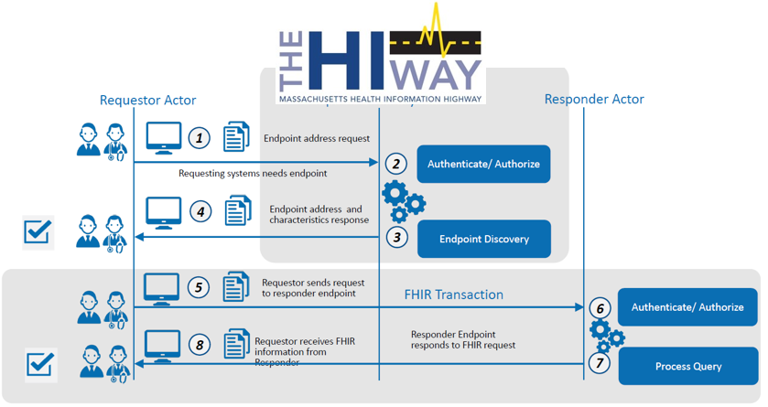
Hypothetical Provider Directory
CHALLENGE: There are multiple places to find addresses/endpoints. Is there a place I can go to find all of them?
SOLUTION: Directory services approach for endpoint discovery
Adapted diagram from ONC FHIR at Scale Taskforce (FAST) Proposed Directory Solution
Notes:
Slide Title: Hypothetical Provider Directory
CHALLENGE: There are multiple places to find addresses/endpoints. Is there a place I can go to find all of them?
SOLUTION: Directory services approach for endpoint discovery
Web Sequence Diagram
Requestor Actor: Requesting systems needs endpoint
1. Endpoint address request sent to Mass HIway
Mass HIway:
2. Authenticate/Authorize
3. Endpoint Discovery
4. Endpoint address and characteristics response sent back to Requestor Actor
Requestor Actor:
5. Requestor sends request to responder endpoint (FHIR Transaction)
Responder Actor: Responder endpoint responds to FHIR request
6. Authenticate / Authorize
7. Process Query
Requestor Actor:
8. Requestor receives FHIR information from Responder
Adapted diagram from ONC FHIR at Scale Taskforce (FAST) Proposed Directory Solution

Slide 36
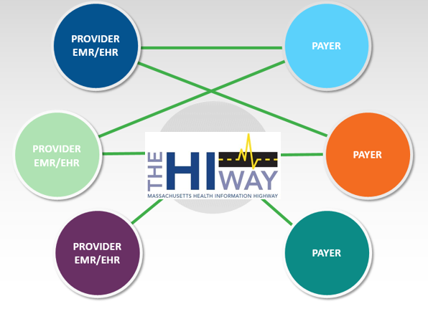
Hypothetical FHIR Exchange-Routing
Hybrid Model to support Point to Point and Intermediary Exchange
Adapted diagram from ONC FHIR at Scale Taskforce (FAST) Proposed Exchange Solution
Notes:
Slide Title: Hypothetical FHIR Exchange-Routing
Hybrid Model to support Point to Point and Intermediary Exchange
Diagram
Provider EMR/EHR-1 connects to Payer-1 & Payer-2
Payer-1 connects to Provider EMR/EHR-1 & Provider EMR/EHR-2
Payer-2 connects to center Mass HIway intermediary w/ connection options to Provider EMR/EHR-2 & Provider EMR/EHR-3 & Payer-3
Payer-3 connects to center Mass HIway intermediary w/ connection options to Provider EMR/EHR-2 & Provider EMR/EHR-3 & Payer-2
Provider EMR/EHR-3 connects to center Mass HIway intermediary w/ connection options to Provider EMR/EHR-2 & Payer-2 & Payer-3
Provider EMR/EHR-2 connects to center Mass HIway intermediary w/ connection options to Provider EMR/EHR-3 & Payer-2 & Payer-3
Adapted diagram from ONC FHIR at Scale Taskforce (FAST) Proposed Exchange Solution

Slide 37
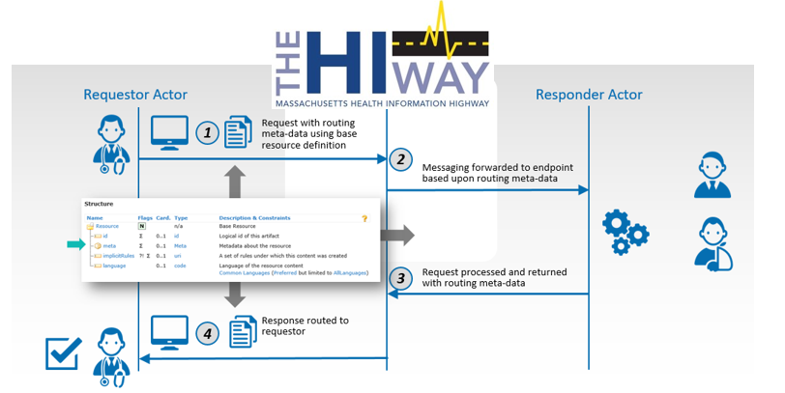
Hypothetical Exchange-Routing (1)
CHALLENGE: How do we consistently and reliably exchange clinical data across a hybrid system where partners may use one or more intermediaries for technical and business operations?
SOLUTION: Reliable Routing with Metadata Across Intermediaries
Adapted diagram from ONC FHIR at Scale Taskforce (FAST) Proposed Exchange Solution
Notes:
Slide Title: Hypothetical Exchange-Routing (1)
CHALLENGE: How do we consistently and reliably exchange clinical data across a hybrid system where partners may use one or more intermediaries for technical and business operations?
SOLUTION: Reliable Routing with Metadata Across Intermediaries
Requestor Actor:
1. Request with routing meta-data using base resource definition to Mass HIway
Mass HIway
2. Messaging forwarded to endpoint based upon routing meta-data
Responding Actor
3. Request processed and returned with routing meta-data to Mass HIway
Mass HIway
4. Response routed to Requestor Actor
Description Box - Example Metadata Structure - Resource Name-Flags-Cardinality-Type-Description & Constraints
Adapted diagram from ONC FHIR at Scale Taskforce (FAST) Proposed Exchange Solution

Slide 38
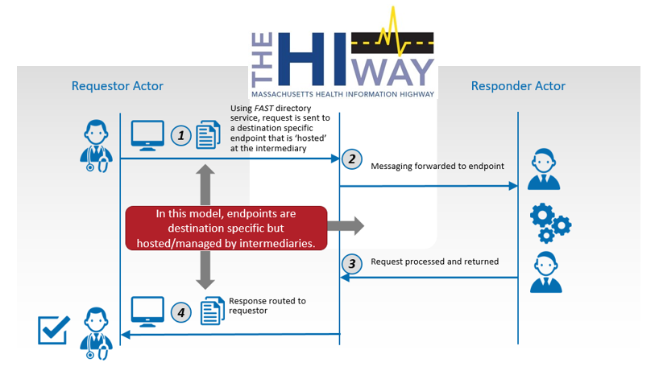
Hypothetical Exchange-Routing (2)
Adapted diagram from ONC FHIR at Scale Taskforce (FAST) Proposed Exchange Solution
Notes:
Slide Title: Hypothetical Exchange-Routing (2)
Requestor Actor:
1. Using FAST directory service, request is sent to a destination specific endpoint that is ‘hosted’ at the intermediary (Mass HIway)
Mass HIway
2. Messaging forwarded to endpoint
Responding Actor
3. Request processed and returned to Mass HIway
Mass HIway
4. Response routed to Requestor Actor
Description Box – In this model, endpoints are destination specific but hosted/managed by intermediaries.
Adapted diagram from ONC FHIR at Scale Taskforce (FAST) Proposed Exchange Solution

Slide 39

Hypothetical FHIR Broker-Message Transformation
HL7 V2
EHR System
CDA or C-CDA
HL7 V2 and CDA to FHIR Transformations
FHIR to HL7 V2 and CDA to Transformations
FHIR
HL7 v2 Legacy Data Source
HL7 V2
CDA or C-CDA
Notes:
Slide Title: Hypothetical FHIR Broker-Message Transformation
EHR System sends CDA or C-CDA to Mass HIway
HL7 v2 Legacy Data Source sends HL7 v2 to Mass HIway
Mass HIway completes HL7 and CDA to FHIR and FHIR to HL7 and CDA Transformation
Mass HIway sends out HL7 V2, FHIR, CDA or C-CDA messages based on recipient capability-preference

Slide 40
Hypothetical FHIR API Broker
EVS-POSC
MMIS
FHIR API
EOHHS IT / State API Platform / Management
FHIR Server Environment
Data Warehouse
FHIR API
FHIR API
FHIR API
FHIR API
Pharmacy
Provider / Endpoint Directory
Consolidated Clinical Gateway
Notes:
Slide Title: Hypothetical FHIR API Broker
Mass HIway has bi-directional FHIR APIs with:
Provider / Endpoint Directory
Consolidated Clinical Gateway
EOHHS IT / State API Platform / Management
EOHHS IT / State API Platform / Management has bi-directional FHIR APIs with:
Mass HIway
EVS-POSC
FHIR Server Environment for back-end systems
FHIR Server Environment for back-end systems supports:
MMIS
Data Warehouse
Pharmacy

Slide 41
Appendix B: HIway operations update
Notes:
Slide Title: Appendix B: HIway operations update

Slide 42
HIway participation
July 21, 2020 – October 20, 2020
2
New participation agreements
CHADIS / Total Child Health, LLC Disability Evaluation Services (DES) / UMass
Notes:
Slide title: HIway participation July 21, 2020 – October 20, 2020
New participation agreements: 2
CHADIS / Total Child Health, LLC
Disability Evaluation Services (DES) / UMass

Slide 43
HIway participation
July 21, 2020 – October 20, 2020
9
New connections
Berkshire Health System Cape Cod Healthcare CHADIS / Total Child Health, LLC* Cornerstone Healthcare System Harrington Hospital Heywood Hospital Holyoke Medical Center Reliant Medical Group South End Community Health Center
* Participants that were enrolled and connected in the same period. All others are new connections for existing clients.
Notes:
Slide title: HIway participation July 21, 2020 – October 20, 2020
New connections: 9
Berkshire Health System
Cape Cod Healthcare
CHADIS / Total Child Health, LLC*
Cornerstone Healthcare System
Harrington Hospital
Heywood Hospital
Holyoke Medical Center
Reliant Medical Group
South End Community Health Center

Slide 44
HIway transactions
HIway transaction volume update
The Mass HIway processed a total of 17.6 million production transactions during the October reporting period (September 21 through October 20, 2020). From November 2019 through October 2020, the average was 15.5 million production transactions per month for a total of 186 million over the past year. In October, Public Health Reporting accounted for 16.9 million transactions, or 96% of total production volume. This included 8.7 million Syndromic Surveillance transactions. September through November are peak volume times for immunizations, as demonstrated by the 8.1 million immunization transactions in October (over the past year, the average was 5.2 million monthly immunization transactions). Provider-to-provider transactions totaled 351,355 for October, a high for the past year that increased the average to 202,687 per month. The Mass HIway team continuously monitors transaction levels, both to support operations and to identify data that provide additional insight into HIway trends and progress.
Notes:
Slide title: HIway transactions
HIway transaction volume update
The Mass HIway processed a total of 17.6 million production transactions during the October reporting period, from September 21 through October 20, 2020. From November 2019 through October 2020 the average was 15.5 million production transactions/month for a total of 186 million over the past year.
Public Health Reporting in October accounted for 16.9 million transactions, or 96% of the total production volume. This included 8.7 million Syndromic Surveillance transactions.
September through November are peak volume times for immunizations, as demonstrated by the 8.1 million Immunization transactions in October when compared to the average 5.2 million over the past year.
Provider to Provider transactions totaled 351,355 for October, a high for the past year that increased the average to 202,687 per month.
The Mass HIway team continuously monitors transaction levels, both to support operations and to identify data that provide additional insight into HIway trends and progress.

Slide 45
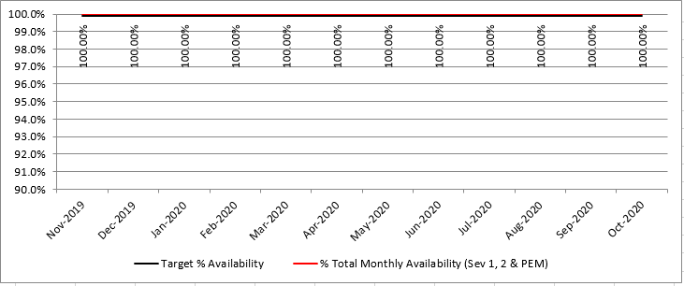
HIway availability review
Target: “Total monthly availability” – no lower than 99.9% (downtime no more than ~44 minutes/month)
Notes:
Slide title: HIway availability review
Graph show HIway availability at 100% every month from November 2019 through October 2020.
Target: Total monthly availability – no lower than 99.9% (downtime no more than about 44 minutes/month)

Slide 46
Thank you!
Notes:
Slide title: Thank you!

