Slide 1
V
Health Information Technology Council Meeting
November 7, 2022
Draft

Slide 2
Agenda
Welcome
Undersecretary Lauren Peters
Approval of August 2022 minutes (vote)
ENS Framework Update
Pam Boutin Coviello and Julie Creamer
CCG API Update
Julie Creamer
HIway Operations Update
Liz Reardon
EOHHS Updates - BH Treatment & Referral Platform / POLST Program
Kevin Mullen
Conclusion
Undersecretary Lauren Peters

Slide 3
Welcome
Welcome
Undersecretary Lauren Peters

Slide 4
Vote: Approve minutes
MOTION : That the Health Information Technology Council hereby approves the minutes of the council meeting held on August 1, 2022, as presented/amended
Notes:
MOTION: That the Health Information Technology Council hereby approves the minutes of the council meeting held on February 1, 2021 as presented/amended

Slide 5
ENS Framework Update
Pam Boutin-Coviello and Julie Creamer

Slide 6
ENS Framework Update
ENS Framework Initiative Overview
Pursuant to 101 CMR 20.00 EOHHS created a Statewide ENS Framework to increase ENS availability to providers throughout the Commonwealth.
Currently the Statewide ENS Framework consists of two ENS Vendors certified by EOHHS who are responsible for collecting ADTs, sharing ADTs, and providing notifications to providers.
All Massachusetts acute care hospitals are required to submit ADT data to at least one of the Certified ENS Vendors.
Certified ENS Vendors are required to share the ADTs they collect pursuant to the submission requirements with any other Certified ENS Vendor.
The Statewide ENS Framework creates a universal data set of ADTs available to ENS Recipients, allowing them to subscribe to a single Certified ENS Vendor and receive notifications from any acute care hospital in the state.

Slide 7
Notice of Intent to Extend Contracts
EOHHS has sent a notice of intent to extend the contracts for both vendors
Certified ENS Vendor contracts had an initial term of two years, beginning on January 31, 2021.
EOHHS has the option to extend contracts for up to two additional one-year terms or reopen the Request for Applications (RFA).
EOHHS is in discussion with each of the existing vendors about proposed revisions to the contract.
A new contract must be in place before January 31, 2023

Slide 8
ENS Quality Improvement
The Mass HIway team continually works to identify opportunities to improve the ENS Framework
The HIway team relies upon quarterly reporting by certified ENS vendors to understand data gaps and trends and areas where it can facilitate improvements for vendors, providers and entities required to submit notifications.
Improvement opportunity
Reporting templates outlined in the prior contract lacked the concrete definitions and templates proved difficult to populate and lacked meaningful data.
Action Taken
The HIway team created more specific definitions and improved reporting templates and is in discussions regarding these revisions with vendors.
Expected Outcome
The proposed revisions will clarify what is required by vendors from a reporting perspective. These changes will facilitate identification of areas of opportunity for further improvements via educational support for vendors, providers and MA Acute Care Hospitals, by the HIway thus improving usefulness of the ENS Framework
.

Slide 9
ADT Landscape Surveys
The HIway Account Management Team is introducing two surveys to better understand the challenges providers face within the current ADT landscape. Findings from the surveys will enable the team to provide appropriate educational materials for providers in the form of webinars and documentation.
Psychiatric Hospital Survey
A survey will be sent to all freestanding psychiatric hospitals and inpatient psychiatric units within the state.
The goal of the survey is to understand the hospital’s EHR and ADT landscape as well as the existing barriers for psychiatric hospitals to send or receive ADTs.
The Mass HIway has partnered with the Department of Mental Health to distribute this survey.
Federally Qualified Health Center (FQHC) Survey
A survey will be sent to all Federally Qualified Health Centers (FQHC’s) in the state.
The goal of this survey is to understand workflow challenges related to the use of ADTs.

Slide 10
Clinical Gateway API Development-Update
Julie Creamer

Slide 11
Clinical Gateway API Development
The intent is to develop a foundation for a common Application Programming Interface (API) and FHIR Integration infrastructure that can be used for multiple public health use cases.
Key Project Updates
Development work for the RESTful APIs for CCG-1 & CCG 2 nodes has been completed
CCG-1 API completed 1/23/22: includes Syndromic, Children’s Behavioral Health Initiative (CBHI), and Mass Cancer Registry (MCR)
CCG-2 API completed 2/20/22: includes Massachusetts Immunization Information System (MIIS), Electronic Lab Reporting (ELR) and Intake, Enrollment, Assessment and Transfer Service System for BSAS (IEATS / OTP)
Development work for OAuth 2.0 completed 5/31/22
a prerequisite for FHIR standard
Completed development of provider engagement plan including key tasks and timeline
Completed creation of several provider facing documents including draft API Instructions, Implementation Guide and Test Plan

Slide 12
Clinical Gateway API Adoption
Current Provider Organization Development
Tufts Medicine is actively working to move their existing Syndromic Surveillance data feed to the Syndromic API endpoint
Advocates Inc. and their EHR vendor, PCE Systems, is developing the means to capture the appropriate data in the EHR and send Child and Adolescent Needs and Strengths (CANS) reports to the Children’s Behavioral Health Initiative (CBHI) API endpoint
Future Potential Provider Organization Development
Other organizations have expressed interest in exploring a migration of their Syndromic Surveillance data feed from Direct to RESTful API

Slide 13
HIway Operations Update
Liz Reardon

Slide 14
Mass HIway Account Clean-up
The Account Management Team has initiated outreach to provider organizations with little to no activity on their webmail account over the the last year. This maintenance exercise removes all inactive accounts and users from the HIway and provides cost savings to EHS.
Two groups were targeted:
No Active Users: Webmail domains which had no users log into their associated account for a year or more
User Review Required: Webmail domains where less than half of the associated users had logged into their account within the past year
 | Accounts Deactivated | # of Users Deactivated | Annual Savings
No Active Users | 29 | 14 | $ 8,380.00
User Review Required | 4 | 139 | $ 13,060.00
 |  | Total Annual Savings (to date): | $ 21,440.00

Slide 15
Mass HIway Account Clean-up
The Mass HIway Account Management Team is targeting additional groups for more outreach, including:
Connect/LAND device users with no transactions in the past year
Potential for significant savings given cost of devices to state
Other connection types with no transactions in the past year

Slide 16
Mass HIway Onboarding Update
The Mass HIway Account Management Team has seen a significant uptick in provider organizations selecting the Mass HIway as its primary HISP and as a vehicle for public health reporting
Community Care Cooperative (C3)/Community Technology Cooperative (CTC)
Aggregate of twelve community health centers migrating to one instance of Epic EHR
Chose the Mass HIway as their HISP
The Mass HIway is providing consulting services to confirm DPH reporting needs, technology onboarding, and proper listing in the Provider Directory
Former Paper Submitters to the Massachusetts Cancer Registry
Mass HIway Account Management team is working closely with the Cancer Registry to support the move of organizations who were formerly submitting cancer reporting via paper, to electronic reporting means
Includes onboarding of specialty medical practices and pathology labs

Slide 17
Provider Directory 2.0 Updates
The Mass HIway Provider Directory 2.0 (PD 2.0) has enhancements planned for FY2023.
The DirectTrust is updating their user guide to align with changes necessary to move to a FHIR-based national provider directory
Enhanced validation against NPPES to confirm providers are active and proper NPI is used
Differentiating between provider Direct addresses and workflow Direct addresses
Mass HIway will be making some adjustments to how information is organized in the directory, including working with larger health systems to implement a sub-organization structure
The Mass HIway has received feedback from Epic EHR users regarding challenges with importing the PD 2.0 extract into their system
Mass HIway Account Management team has been connecting with these Epic EHR users to learn more about their existing processes in order to:
Work with Orion Health to make necessary enhancements to PD 2.0 in order to simplify the import process for these users
Create “Best Practices” documentation to share the successful workflows, tips, and tricks across all Mass HIway Epic users

Slide 18
EOHHS Updates:
BH Treatment & Referral Platform / POLST Program
Kevin Mullen

Slide 19
BH Treatment & Referral Platform-RFR
New Behavioral Health Treatment and Referral Platform – Procurement Update
Background
The focus of the new system is to improve operational efficiencies among providers, carriers, and the Commonwealth by automation of the screening and referral process to move patients more quickly through the emergency department (ED) evaluation and referral process for those seeking behavioral health (BH) treatment, reducing the length of stay in EDs.
Update
We are pleased to announce that EOHHS has awarded the contract for the Behavioral Health Treatment and Referral Platform
The platform will enable hospitals, health plans, community-based crisis intervention teams, and state agencies to securely share required information and referral forms, including the transfer of admissions packets between stakeholders.
EOHHS is amid contract negotiations which are being led by the MassHealth Office of Behavioral Health.
Upon execution of the contract, EOHHS will communicate next steps, timeline for implementation and opportunities for stakeholder engagement moving forward.

Slide 20
POLST Program Update
POLST Program Update
Background
EOHHS and EOEA have been working to develop a program governing the statewide use of portable orders for life-sustaining treatment (POLST).
Update
EOHHS is expecting new legislation clarifying the authority to develop, implement and administer a POLST program and implement an ePOLST Registry.
The POLST program will include implementation of a statewide electronic POLST (ePOLST) registry system which will enable the automated query and retrieval of POLST information.
The POLST program will support the transition from the use of medical orders for life-sustaining treatment (MOLST) to the national POLST model.
EOHHS has drafted a Request for Responses (RFR) to procure a statewide ePOLST registry and received approval from CMS.
EOHHS and EOEA are beginning the transition from paper MOLST to POLST, starting with a test phase comprised of at least two hospital-led cohorts. The initial cohorts include Lowell General and Fairview Hospital*
*Cohorts will begin the transition in January 2023 and the test phase will conclude in 3-months. Learnings from the test phase will inform statewide POLST adoption and eventual ePOLST implementation.

Slide 21
Appendix A: HIway operations update

Slide 22
HIway participation July 21, 2022 – October 20, 2022
1
New connection
Ibis Health (DBA Senscio Systems) Dermatology and Skin Care Associates*
* Participants that were enrolled and connected in the same period.
Confidential Draft – Policy in Development

Slide 23
HIway participation July 21, 2022 – October 20, 2022
2
New participation agreements
Quantum Pathology Middleton Family Medicine Urgent Care Mass Health Dental Program
Confidential Draft – Policy in Development

Slide 24
HIway transactions
HIway transaction volume update
The Mass HIway processed over 40 million production transactions during the Oct 2022 reporting period (9/21/21 through 10/20/22). From Nov 2021 through Oct 2022, the average increased to 37.3 million production transactions per month with a total of 448 million over the past year. In Oct, Public Health Reporting accounted for ~39 million transactions, or 99% of total production volume. This included 12.4 million Syndromic Surveillance transactions and 26.9 million Immunization transactions. Note: Immunization queries from commercial insurance companies for COVID-19 vaccination updates that processed through the “MIIS QBP” Clinical Gateway node are included in the Immunization total. Provider-to-provider transactions average over 381,000 per month for the past year, and support a number of use cases. For October, the total was 417,915. Quality Reporting volume has normalized over the last year and is currently averaging around 164,000 transactions per month for the past 12 months. The Mass HIway team continuously monitors transaction levels, both to support operations and to identify data that provide additional insight into HIway trends and progress.
Confidential Draft – Policy in Development

Slide 25
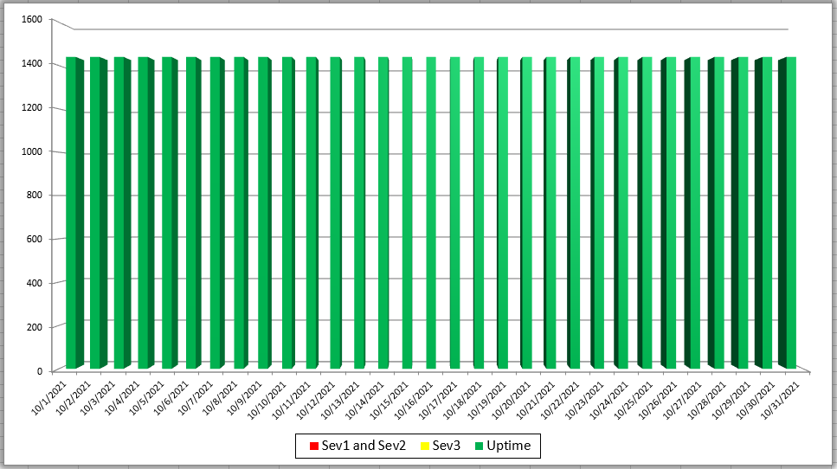
Mass HIway Incident Summary Dashboard
October 2022
Sev 1 - All / Most Mass HIway components impacted as a result of outage. For example: LAND, Webmail, Direct XDR, and DPH nodes are all down
Sev 2 - Multiple Mass HIway components impacted as a result of outage in one of the shared service. For example: LAND and Webmail are down but Direct XDR and DPH nodes are up.
Sev3 – One Mass HIway component impacted as a result of outage. For example: Webmail is down but all other services are up and running.

Slide 26
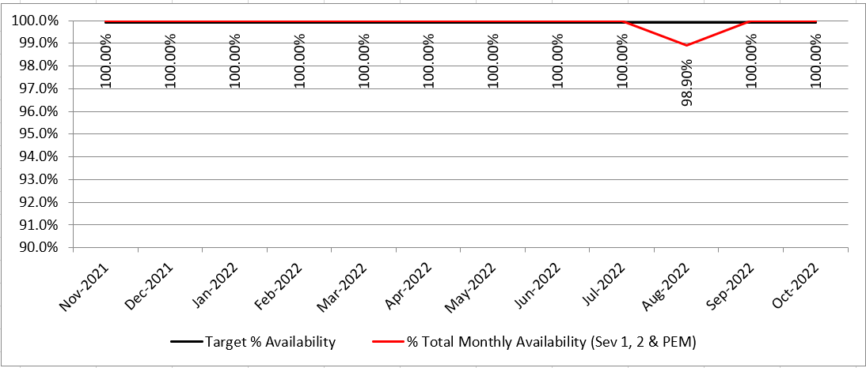
HIway Availability Trends – October 2022
Metric Targets:
“Total Monthly Availability” – no lower than 99.9% (downtime no more than ~44 minutes/month)
Notes:
HIway Availability Trends October 2022
Metric Targets: Total

Slide 27
Thank you!
Notes:
Thank you!

