Slide 1
V
Health Information Technology Council Meeting
May 2, 2022
Draft
Notes:
Title slide
Health Information Technology Council Meeting
May 2, 2022 draft

Slide 2
Agenda
Welcome
Undersecretary Lauren Peters
Approval of Feb 2022 minutes (vote)
Approval of Annual HITC Report to the Massachusetts Legislature (vote)
Governor’s Healthcare Bill – Summary Update
Lauren Peters
HIT Spotlight: Lowell Community Health Center
Padmaja Sastry
HIway Attestation & ENS Utilization Update
Pam Boutin-Coviello
New Provider Directory API
Elizabeth Reardon
BH Treatment and Referral Platform (Tentative)
Kevin Mullen
Conclusion
Undersecretary Lauren Peters

Slide 3
Welcome
Undersecretary Lauren Peters
Notes:
Slide Title: Welcome
Undersecretary Lauren Peters

Slide 4
Vote: Approve minutes & Annual Report
MOTION #1: That the Health Information Technology Council hereby approves the minutes of the council meeting held on February 7, 2022 as presented/amended
MOTION #2: That the Health Information Technology Council hereby approves the Annual HITC Report the Massachusetts Legislature as submitted
Notes:
Slide Title: Vote: Approve minutes
MOTION: That the Health Information Technology Council hereby approves the minutes of the council meeting held on February 1, 2021 as presented/amended

Slide 5
AN ACT INVESTING IN THE FUTURE OF OUR HEALTH
Lauren Peters

Slide 6
AN ACT INVESTING IN THE FUTURE OF OUR HEALTH
AN ACT INVESTING IN THE FUTURE OF OUR HEALTH
This legislation requires health care providers and payers to increase investment in primary care and behavioral health through setting a statewide spending target and addresses excess costs and affordability through a multi-faceted approach that both targets systemic cost drivers and promotes patient access to high-value, affordable care, incorporating lessons learned from the COVID-19 pandemic.
The bill centers on three key areas:
Prioritizing Primary Care and Behavioral Health: increases investment in primary care and behavioral health care through setting a statewide target to address historic underinvestment in these services, particularly for underserved populations
Managing Health Care Cost Drivers: addresses excess costs and affordability through a multi-faceted approach that targets systemic cost drivers and promotes consumer access to high-value, affordable care.
Improving Access to High-Quality Coordinated Care: promotes access to high-quality, coordinated care and modernizes licensure and practice standards.

Slide 7
AN ACT INVESTING IN THE FUTURE OF OUR HEALTH
What the legislation does to meet the future of HIE
Amends 118I to accelerate the adoption of new interoperable health information exchange activities by health care providers and payers to improve the quality of care, increase care coordination, and create provider efficiency.
Broadens EOHHS’s authority to define the types of healthcare entities (providers, payers, etc.) required to participate in health information exchange (HIE) initiatives.
Example: The bill would allow EOHHS to compel payers to participate in certain HIE initiatives such as the ED boarding referral and treatment platform, currently under development, which will support notifications from EDs to payers alerting them of a member boarding in the ED with a BH diagnosis.
Gives EOHHS the authority to establish uniform data standards to support improved interoperability, public health reporting and adoption of new use cases (e.g., ED boarding, Health Equity, Health-related social needs, etc.)
Authorizes the Executive Office of Elder Affairs (EOEA) to make the transition from the current paper based MOLST system to the electronic POLST (ePOLST) system. This transition will ensure that end-of-life wishes are more easily accessible and honored across care sites, providers, and state lines.

Slide 8
HIT Spotlight: Lowell Community Health Center
Padmaja Sastry, Director of Information Systems
Lowell Community Health Center

Slide 9
Health IT Spotlight: Lowell Community Health Center
Lowell Community Health Center uses Direct Messaging to Send and Receive Referrals and Consult Notes with Trading Partners
Lowell Community Health Center (LCHC) serves the greater Lowell communities by offering comprehensive primary healthcare as well as dental, eye care, and specialty services. It aims to provide culturally-competent health services regardless of a patient’s financial status in order to reduce health disparities and empower each individual to maximize their overall well-being.
Challenge
Referrals and consult notes were sent between LCHC and its clinical partners via paper fax and phone calls
Manual processes resulted in significant delays in closing the referral loop and a months-long backlog of paperwork to be scanned into LCHC’s EHR system

Slide 10
Health IT Spotlight: Lowell Community Health Center
Solution
LCHC leveraged its eClinicalWorks (eCW) EHR system to send referrals via P2P, eCW’s Direct messaging HISP integrated with the Mass HIway
Now, when a patient needs to see a specialist, the clinician sends the referral and appointment request to the receiving organization via P2P Direct Messaging
Text communications to patients reminding them of their appointments are sent directly through the EHR via eCW Messenger
Once the patient has been seen, the specialist sends their clinical notes back to LCHC via Direct Messaging directly into LCHC’s eCW EHR
Support from Mass HIway
A HIway Account Manager facilitated calls and correspondence with the trading partners, worked with eCW and trading partners’ EHR vendors to resolve technical issues, and documented feedback to keep the project on track

Slide 11
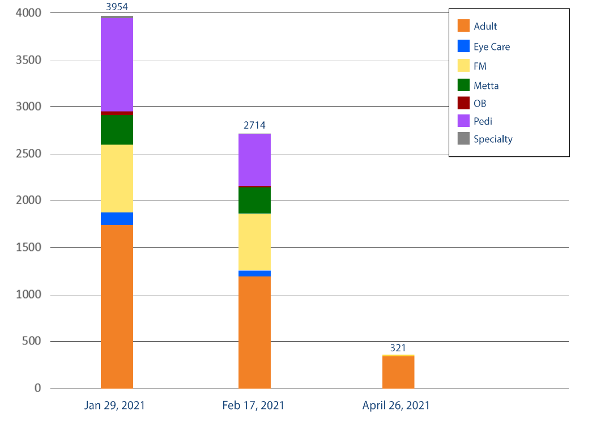
Health IT Spotlight: Lowell Community Health Center
Impact
With the new workflow, LCHC was able to close the gaps in its processes and now consistently meets its referral targets, ensuring that patients with stat or urgent needs can be seen by a specialist in a timely manner
1,500 texts are sent monthly, resulting in fewer phone calls and mailings to patients
Once the specialist’s consult notes are received, these are added to the patient’s electronic record within 24 hours
Open Referral Backlog
92% ​
reduction
Direct and Text messaging implemented

Slide 12
Attestation update
Pam Boutin-Coviello

Slide 13
HIway attestation: HIway connection requirement overview
The HIway connection requirement requires providers to engage in health information exchange via the Mass HIway as set forth in M.G.L. Chapter 118I, Section 7, and as detailed in the Mass HIway Regulations (101 CMR 20.00).
Provider organization | First year requirement applied | Submit in 2022
Acute care hospitals | 2017 | Year 5 attestation form
Large and medium medical ambulatory practices | 2018 | Year 5 attestation form
Large community health centers
Small community health centers | 2019 | Year 4 attestation form
HIway annual connection requirement
Year 1 | Send or receive HIway Direct messages for at least one use case
Year 2 | Send or receive HIway Direct messages for at least one provider-to provider (P2P) use case
Year 3 | Send HIway Direct messages for at least one P2P use case, and Receive HIway Direct messages for at least one P2P use case
Year 4+ | Meet Year 3 requirement or be subject to penalties if requirement is not met

Slide 14
HIway Attestation: Statistics for 2021 Reporting Year
Although attestation submissions got off to a slow start, we saw an influx of submissions towards the end of 2021. Attestation submissions received in the 2021 reporting year surpassed submissions in previous years.
Breakdown by Organization Type
Acute Care Hospitals (n=67)
53 attestations submitted
14 exception forms submitted
Submitted: 100%
Community Health Centers (n=41)
26 attestations submitted
9 exception forms submitted
Submitted: 85%
Medium/Large Medical
Ambulatory Practices (n=442)
Attestations: 314 practices
Exception forms: 65 practices
Total: 379 practices
Submitted: 86%
Final Count for 2021:
Total forms submitted: 192
Year 3/4 forms: 104
Year 5 forms: 53
Exception forms: 35

Slide 15
HIway attestation: 2021 statistics
More provider organizations are meeting the HIway connection requirement through DirectTrust HISP-to-HISP exchanges. As a result, more provider organizations submitted attestation forms and fewer organizations requested exceptions.

Slide 16
HIway attestation: 2022 timeline
2022 Attestation timeline:
Dec. 31, 2021: Use case implementation deadline
May-July 2022: HIway outreach and education
Emails and Newsletters
Website updates
Direct contact with POs
Summer 2022: Webform testing, HIway attestation/exception webforms go live and begin accepting submissions
Fall 2022: Deadline for attestation/exception submissions
Winter 2022: HIway reaches out to POs that have not submitted, HIway closes webform

Slide 17
Preparing for Attestation 2022 & beyond
Preparing for Attestation 2022 & beyond
Identification of the “Attestation window” for 2022
Working with development team to create a timeline for webform revision and preparation for public use
Testing of the online webforms
Creating Attestation date announcements; newsletters and standalone emails
Developing Newsletter and Website content
Informing HIT Council of Attestation updates
Planning and preparing for Attestation changes beyond 2022
Timetable for the HIway connection requirement has been completed for the regulated organizations (acute care hospitals, community health centers, medical ambulatory practices)
Consideration of future disposition, revision or sun-setting components of HIway attestation process

Slide 18
ENS Update
Pam Boutin-Coviello & Kevin Mullen

Slide 19
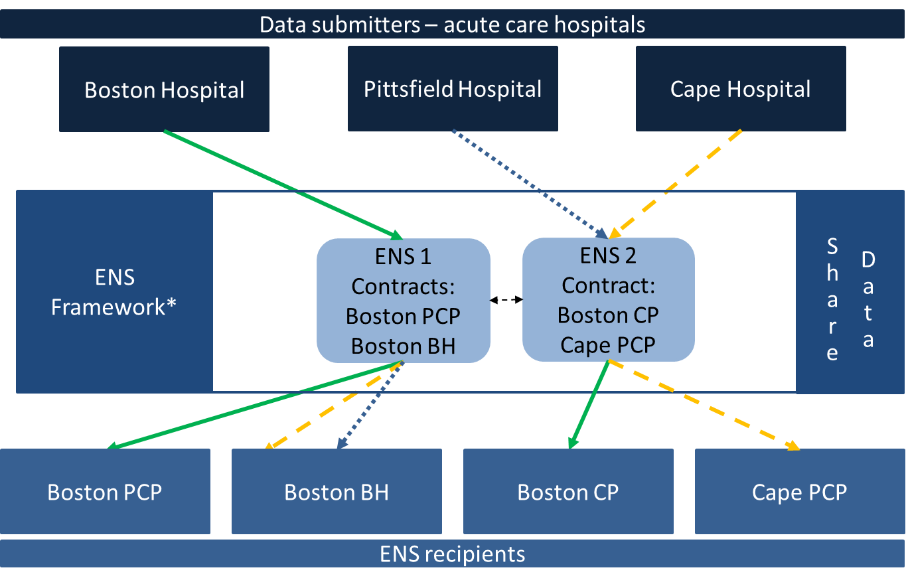
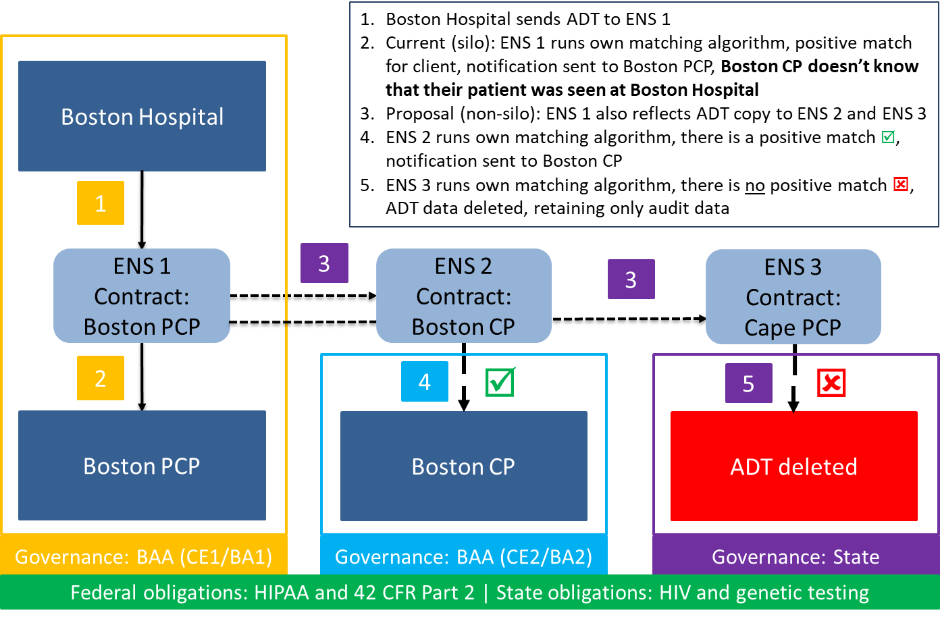
ENS: Overview
EOHHS ENS Initiative goal:
Supporting timely statewide Event Notification Services (ENS) across the Commonwealth in order to improve health care delivery, quality, and coordination
EOHHS guiding principles:
Universal access - Promoting data sharing within an ENS framework to increase accessibility to ENS for providers of all sizes
Streamline provider experience - Crafting ENS framework to allow single point of submission and single point of reception of ADT data
Improve notification timing - Improving timing for flow of data (real/near-real time)

Slide 20
ENS: Number of reflected ADTs received
In the fourth quarter of 2021, the stabilization of Statewide ENS Framework participants resulted in almost eight million ADTs being reflected
 | Q2 2021 # Received by Reflection | Q3 2021 # Received by Reflection | Q4 2021 # Received by Reflection | Percentage Increase Q3vQ4
Vendor A | 325k | 3,671k | 4,465k | 22%
Vendor B | 621k | 2,784k | 3,439k | 24%
In Q2 2021, both vendors began scaling up the transactions as they worked to define the gaps in their data
Both vendors experienced a significant increase of ADTs flowing into their systems as the gaps were increasingly closed in Q3 2021.
The number of reflected ADTs from Q3 & Q4 increased by more than 20% for both vendors.

Slide 21
ENS: Number of notifications generated by reflected ADTs
The number of notifications generated by the reflected ADTs increased for both vendors in Q4 2021 compared to Q3 2021.
 | Q2 2021 (Apr – Jun) # Notifications | Q3 2021 (Jul – Sep) # Notifications | Q4 2021 (Oct - Dec) # Notifications | Percentage Increase Q3vQ4
Vendor A | 11k | 45k | 61k | 37%
Vendor B | 19k | 182k | 234k | 29%
Both vendors reported an increased volume of reflected ADTs received and the number notifications sent between Q3 and Q4
Vendor A reported an increase of ~37% and Vendor B an increase of ~29%
Notifications as a percentage of total ADT volume remained consistent with vendor baselines (~2%-7% of total ADT volume)

Slide 22
Mass HIway Provider Directory API
Elizabeth Reardon

Slide 23
Provider Directory (PD) API
The PD API offers a direct interface to the Mass HIway Provider Directory for provider organizations to search, bulk import and export data, and/or perform individual operations for modifying data.
Benefits include:
No need to maintain cumbersome Excel documents for updates
No more risks of formatting conversions, such as IDs into dates or dropping the leading zero in zip codes
More frequent updates to provider data
Add, update, and remove provider information for your organization as it happens, instead of just once a month
Timely access to DirectTrust and other Direct messaging participant data
Search the Provider Directory on demand, including the national DirectTrust Provider Directory, and eliminate timely processes to update your internal Trading Partner Directory
Opportunity for automation
Integrate the Provider Directory API into your organization’s provider registration process to have updates sent automatically
Enhanced search capabilities
Search on one or many fields, including First Name, Last Name, Organization Name, Facility, Location (address), NPI, and Specialty
Self-service
Make updates and/or request Provider Directory information on your own time
Access to "source of truth"
You’ll have immediate access to the most current provider information, and not just a “point in time” when a file was created

Slide 24
Provider Directory (PD) API
Working with Provider Organizations to adopt this newly available technology
Large Hospital System
The MeHI and Orion teams have been working closely with a large hospital system over the past several months to test the functionality of the PD API
This system plans to adopt the use of the PD API later this year
Other Pilot Sites
The Mass HIway is in communication with other organizations who may wish to integrate the PD API into their workflows in the near term
Interested?
If your organization is interested in learning more about how to leverage the PD API to enhance your care coordination workflows, please reach out to your Mass HIway Account Manager or contact MassHIway@state.ma.us

Slide 25
New RFR: Behavioral Health Treatment & Referral Platform
Kevin Mullen

Slide 26
BH Treatment & Referral: Background
Massachusetts continues to experience significant challenges with patients waiting in EDs for inpatient psychiatric admission (otherwise known as “boarding”) and other appropriate treatment for their behavioral health diagnosis
In response, Massachusetts developed the Expedited Psychiatric Inpatient Admission (EPIA) policy.
EPIA is a protocol that establishes clear steps and responsibility for escalating cases, where an admission has not been achieved in a reasonable period of time, to senior clinical leadership at Insurance Carriers, Inpatient Psychiatric Providers, and ultimately to DMH.
EPIA aims to streamline communication across all stakeholders, reduce the length of stay in the ED for behavioral health patients needing an inpatient level of care, ensure that no one is boarding without an advocate, and establish baseline information for behavioral health patients with long stays in EDs for monitoring and policy purposes.
While there have been improvements since implementing this process, some challenges remain.
EPIA is currently a fully manual process that lacks a centralized and consistent source of information. This means that ED staff must take time away from patient care and bed searches to detail information that carriers will need for their own searches, as required by the EPIA Protocol.
The information provided to carriers and hospitals may be provided through a variety of avenues, including phone calls, emails, and faxes—increasing the risk of missing vital information on a particular case and providing such information inconsistently, which hinders data collection efforts

Slide 27
BH Treatment & Referral Platform-RFR
THIS IS AN ADVANCE NOTIFICATION OF AN UPCOMING PROCUREMENT. No RFR documents are available at this time but will be added to this page:
22EHSBHTRPSRFR: RFR for Behavioral Health Treatment Referral Platform Software
EOHHS intends to issue a procurement to procure a software system to enable acute care hospital personnel to identify patients with a psychiatric diagnosis waiting in Massachusetts EDs seeking inpatient psychiatric treatment and community crisis stabilization. The platform will enable hospitals, health plans, community-based crisis intervention teams, and state agencies to securely share required information and referral forms, including the transfer of admissions packets between stakeholders.

Slide 28
BH Treatment & Referral Platform-Detail
The Commonwealth is seeking a vendor to improve operational efficiencies among providers, carriers, and the Commonwealth by automation of the screening and referral process to move patients more quickly through the emergency department (ED) evaluation and referral process for those seeking behavioral health (BH) treatment, reducing the length of stay in EDs
The proposed Behavioral Health Treatment and Referral Platform will support;
Automation of the ED BH screening, evaluation, and referral process, including EPIA protocols
Enable the electronic transmission of standardized admissions information
Create a real-time, transparent view of patients seeking BH treatment for critical stakeholders (EDs, ESPs and behavioral health crisis intervention system providers, psychiatric units, freestanding psychiatric facilities, insurance carriers and state agencies)
Additionally, it is expected that the procured solution will;
Leverage and build upon existing vendor networks and exchanges
Integrate with the Statewide Event Notification Services (ENS) framework
Allow for future integration with technology partner(s) to enable search and identification of available psychiatric treatment beds (including inpatient and crisis stabilization) for expedited placement.

Slide 29
Conclusion
Undersecretary Lauren Peters
Notes:
Slide Title: Conclusion
Undersecretary Lauren Peters

Slide 30
Next HITC meeting
Next HITC meeting
August 1, 2022
3:30 – 5 p.m.
W
Notes:
Slide Title: Next HITC meeting
Next HITC meeting
August 2, 2021
3:30 – 5 p.m.

Slide 31
Appendix A: HIway Operations Update
Notes:
Slide Title: Appendix A: HIway operations update

Slide 32
HIway participation January 21, 2022 – April 20, 2022
1
New participation agreements
CareLinx Community Technology Cooperative / C3 David L. Stormberg, MD Tia
Confidential Draft – Policy in Development

Slide 33
HIway participation January 21, 2022 – April 20, 2022
2
New connections
Beth Israel Deaconess Family Medicine, Waltham CareLinx* David L. Stormberg, MD* Tia* Tufts Medicine
* Participants that were enrolled and connected in the same period.
Confidential Draft – Policy in Development

Slide 34
HIway transactions
HIway transaction volume update
The Mass HIway processed 37.9 million production transactions during the Apr 2022 reporting period (3/21/21 through 4/20/22) with consistent volume attributed to the COVID-19 queries to the MIIS. From May 2021 through Apr 2022, the average increased to 33.1 million production transactions per month for a total of 398 million over the past year. In April, Public Health Reporting accounted for 37.2 million transactions, or 98% of total production volume. This included 10.5 million Syndromic Surveillance transactions and 26 million Immunization transactions. Note: Immunization queries from commercial insurance companies for COVID-19 vaccination updates that processed through the new, high-volume “MIIS QBP” Clinical Gateway node are included in the Immunization total. Provider-to-provider transactions average over 352,000 per month for the past year, and which support a number of use cases. For April, the total was 426,656. Quality Reporting volume has normalized over the last year and is currently averaging around 168,000 transactions per month for the past 9 months. The Mass HIway team continuously monitors transaction levels, both to support operations and to identify data that provide additional insight into HIway trends and progress.
Confidential Draft – Policy in Development
Notes:
Slide title: HIway transactions
HIway transaction volume update
The Mass HIway processed a record 25.1 million production transactions during the April 2021 reporting period (March 21 through April 20) with the significant increase due to the COVID-19 queries to the MIIS. From May 2020 through April 2021, the average was 15.1 million production transactions per month for a total of 181 million over the past year.
In April, Public Health Reporting accounted for 24.6 million transactions, or 98% of total production volume. This included 8.5 million Syndromic Surveillance transactions and 16.1 million Immunization transactions.
Note: Immunization queries from commercial insurance companies for COVID-19 vaccination updates that processed through the new, high-volume “MIIS QBP” Clinical Gateway node are included in the Immunization total.
Provider-to-provider transactions now average over 250,000 per month for the past year, with new use cases added regularly. For April, the total was 290,608.
The Mass HIway team continuously monitors transaction levels, both to support operations and to identify data that provide additional insight into HIway trends and progress.

Slide 35
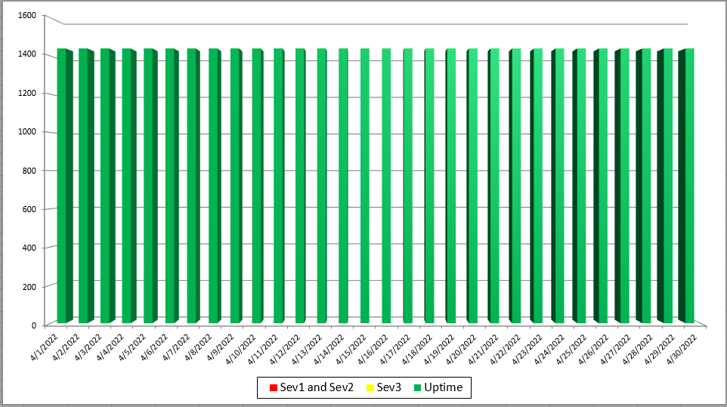
2019 Mass HIway Incident Summary Dashboard
April 2022
Sev 1 - All / Most Mass HIway components impacted as a result of outage. For example: LAND, Webmail, Direct XDR, and DPH nodes are all down
Sev 2 - Multiple Mass HIway components impacted as a result of outage in one of the shared service. For example: LAND and Webmail are down but Direct XDR and DPH nodes are up.
Sev3 – One Mass HIway component impacted as a result of outage. For example: Webmail is down but all other services are up and running.

Slide 36
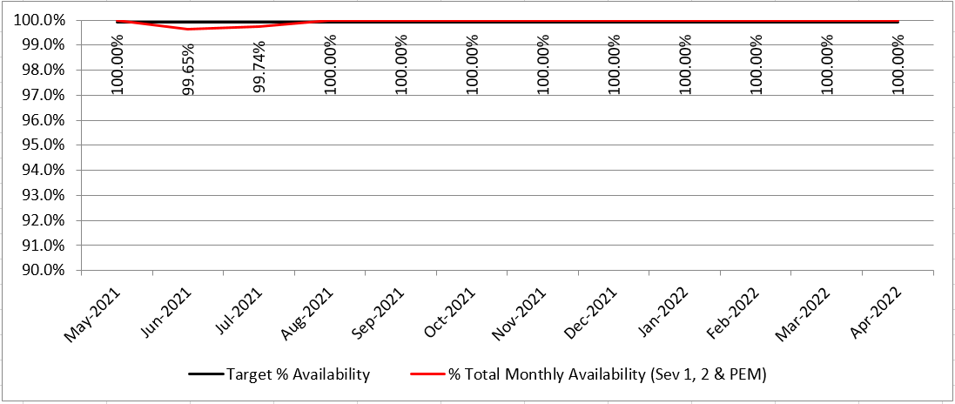
HIway Availability Trends – April 2022
Metric Targets:
“Total Monthly Availability” – no lower than 99.9% (downtime no more than ~44 minutes/month)

Slide 37
Thank you!
Notes:
Slide Title: Thank you!

