Slide 1
Agenda
Mass HIway Operations Update
POLST Transition and ePOLST Registry
Behavioral Health Treatment and Referral Platform

Slide 2
Agenda
Mass HIway Operations Update
Mass HIway Utilization
Clinical Gateway API Platform
Statewide Event Notification Services (ENS) Framework
Massachusetts League of Community Health Centers Workgroups
POLST Transition and ePOLST Registry
Behavioral Health Treatment and Referral Platform

Slide 3
Agenda
Mass HIway Operations Update
Mass HIway Utilization
Clinical Gateway API Platform
Statewide Event Notification Services (ENS) Framework
Massachusetts League of Community Health Centers Workgroups
POLST Transition and ePOLST Registry
Behavioral Health Treatment and Referral Platform

Slide 4
Mass HIway Operations
The Mass HIway continues to serve as a foundation for secure, interoperable data exchange across Massachusetts, facilitating both Public Health Reporting and Care Coordination.

Slide 5
Mass HIway Utilization 2023-2024 YTD
As of October 2024, the Mass HIway has facilitated over 396 million transactions, encompassing both public health reporting and care coordination activities.
Public Health Reporting
Public Health Reporting remains the dominant use case, showing stabilization in 2023 and steady growth into 2024.
Utilization reflects continued reliance on the Clinical Gateway for timely and accurate Public Health Reporting.
Care Coordination
Care Coordination transactions show growth in 2023 and 2024, reflecting increasing focus on care delivery optimization.
Utilization trends indicate wider adoption of care coordination workflows and deeper integration among providers.
 | 2023 |  | 2024-YTD (Oct 2024)
HIE Use Case | Total | Month Avg | Total | Month Avg | % Change
Public Health Reporting | 441,877,297 | 36,823,108 | 386,077,481 | 38,607,748 | +4.8%
Care Coordination | 8,136,580 | 678,048 | 10,354,667 | 1,035,467 | +52.7%
Total Transactions | 450,013,877 | 37,501,156 | 396,432,148 | 39,643,215 | +5.7%

Slide 6
Public Health Reporting 2023-2024 YTD

Slide 7
Combined Care Coordination 2023-2024 YTD

Slide 8
Agenda
Mass HIway Operations Update
Mass HIway Utilization
Clinical Gateway API Platform
Statewide Event Notification Services (ENS) Framework
Massachusetts League of Community Health Centers Workgroups
POLST Transition and ePOLST Registry
Behavioral Health Treatment and Referral Platform

Slide 9
Clinical Gateway API Platform
The Mass HIway Clinical Gateway APIs are fully operational, providing a common foundation for multiple public health use cases.
Alternative Reporting Pathway: Public health reporting can now be conducted via APIs, offering an efficient alternative to Direct Messaging.
Multi-Channel Data Exchange: Providers can send and receive data through both RESTful and SOAP services, ensuring flexibility across systems.
Real-Time, Synchronous Messaging: The APIs enable instant communication between providers and public health registries, improving timeliness and accuracy.
FHIR Integration & Transforms: FHIR-based standards, message transformation capabilities, and strong authentication protocols ensure secure, scalable, and adaptable data exchange.

Slide 10
Clinical Gateway APIs
Future-Ready Platform: Live since 2023, the CG API platform supports secure, real-time data exchange and scalable interoperability.
Growing Adoption: The Mass HIway is transitioning public health submitters to RESTful APIs, driving participation and API transaction growth.
Get Connected: Contact the Mass HIway to enhance data exchange capabilities with the CG API platform.

Slide 11
CG API Implementation Progress
Onboarding
Beth Israel Lahey Health (BILH) (Large Health System) - Syndromic
Testing
Trinity Healthcare (Large Health System) - Syndromic – Go Live 11/2
Live
Advocates, Inc. (Large Outpatient Behavioral Health Organization) – CANS to CBHI
UMass Memorial (Large Health System) – Syndromic, ELR
Boston Medical Center (Large Health System) – Syndromic, ELR
Berkshire Health (Health System) - Syndromic, ELR
Heywood Hospital (Acute Hospital) - Syndromic, ELR
Holyoke Medical Center (Acute Hospital) - Syndromic, ELR
Signature Healthcare (Health System) - Syndromic, ELR
eHana (Behavioral Health EHR Vendor) for IEATS – Go Live 11/6
Tufts Medicine (Large Health System) - ELR
Tenet NE Vanguard (Large Health System) - MIIS, MCR
Tenet New England Vanguard (Large Health System) - Syndromic
Baystate Healthcare (Health System) - Syndromic
Boston Children’s Hospital (Acute Care Hospital) - Syndromic
Cambridge Health Alliance (Health System) – Syndromic, ELR, MIIS
Tufts Medicine (Large Health System) - Syndromic

Slide 12
Agenda
Mass HIway Operations Update
Mass HIway Utilization
Clinical Gateway API Platform
Statewide Event Notification Services (ENS) Framework
Massachusetts League of Community Health Centers Workgroups
POLST Transition and ePOLST Registry
Behavioral Health Treatment and Referral Platform

Slide 13
Statewide ENS Framework Update
The Massachusetts Statewide ENS Framework ensures that providers across the Commonwealth receive timely ADT alerts from any Acute Care Hospital, regardless of their Certified ENS Vendor, supporting improved care coordination and healthcare delivery.

Slide 14
Statewide ENS Framework – Quarterly Report Findings
Vendor Participation & Reporting
Both certified ENS vendors, Bamboo Health and Collective Medical Technologies, addressed reporting anomalies and submitted their quarterly reports on time.
Data Exchange Volume
Significant volumes of ADT messages were processed by both vendors, reflecting strong activity across the network.
As of Q2 2024, approximately 737,000 additional notifications were generated from reflected ADTs shared between certified ENS vendors.
Data Quality
Nearly 100% inclusion of critical Demographic fields
Improvement Focus Areas: Inclusion of Chief Complaint and Diagnosis Codes
Ongoing Improvements
The ENS Framework continues to enhance data quality and timeliness, ensuring that healthcare providers have access to reliable, actionable information for better care coordination.

Slide 15
Statewide ENS Framework – 2024 Quarterly Data
 | 2024-Q1 | 2024-Q1 | 2024-Q2 | 2024-Q2 | 2024 YTD
ADT Transactions | Vendor A | Vendor B | Vendor A | Vendor B | Combined
ADTs received from Massachusetts Acute Care Hospitals | 38,568,565 | 29,704,491 | 37,908,838 | 32,241,172 | 138,423,066
Reflected ADTs received from other ENS Vendor | 2,946,926 | 24,728,621 | 3,492,302 | 25,331,024 | 56,498,873
Notifications sent using Reflected ADTs | 306,535 | 138,084 | 185,632 | 107,253 | 737,504
Quality of Demographic Information
% including Date of Birth | 97% | 100% | 97% | 100% | 99%
% including Sex | 100% | 100% | 97% | 100% | 99%
% including Address Line 1 | 99% | 99% | 96% | 99% | 98%
% including City/Town | 99% | 99% | 96% | 99% | 98%
% including Zip Code | 99% | 99% | 96% | 99% | 98%
% including Phone Number | 77% | 93% | 75% | 92% | 84%
% including SSN | 67% | 70% | 73% | 71% | 70%
Quality of Clinical Information
% of A01 messages with Chief Complaint | 39% | 0% | 35% | 0% | 19%
% of A03 messages with Diagnosis Code | 52% | 53% | 55% | 54% | 54%
% of A03 messages with Diagnosis Description | 52% | 53% | 54% | 54% | 53%

Slide 16
ENS Framework – Notice of new RFA
EOHHS and the Mass HIway want to recognize the efforts the ENS vendors and ENS participants have made in improving ADT message quality, leading to more meaningful notifications.
A new Request for Applications (RFA) was published on COMMBUYS on 10/25/24 to continue the Statewide ENS Framework.
The new RFA follows a similar structure, detailing certification criteria for eligible ENS vendors and outlining obligations for Certified ENS Vendors.
The aim is to balance effectiveness and accessibility without imposing overly restrictive requirements.

Slide 17
Agenda
Mass HIway Operations Update
Mass HIway Utilization
Clinical Gateway API Platform
Statewide Event Notification Services (ENS) Framework
Massachusetts League of Community Health Centers Workgroups
POLST Transition and ePOLST Registry
Behavioral Health Treatment and Referral Platform

Slide 18
ENS Workgroups with Mass League of CHCs
The Mass HIway has partnered with the Massachusetts League of Community Health Centers to launch a series of workgroups aimed at optimizing ADT alert usage across EHR platforms and supporting the Mass League's Health Center Control Network (HCCN) grant goal of reducing provider burden.
The workgroups are designed to address common challenges such as reducing alert duplicity, streamlining ADT alert follow-up workflows, and improving patient care and quality measure performance.
The workgroups are tailored to specific EHR systems, including OCHIN Epic, Community Technology Cooperative Epic, and other ambulatory EHRs like athenahealth and eClinicalWorks.
These sessions are crucial for fostering collaboration among health centers, sharing best practices, and ultimately reducing provider burden.

Slide 19
ENS Workgroups – Session Topics
Health Centers on the same EHR are coming together to learn and share best practices across the following workgroups.
Topic | Pre-session Questions | Attendees
Understanding the Massachusetts ADT Landscape and your health center’s ADT Alert Current State | How is your organization currently receiving ADT alerts? Are you receiving them in more than one way and from more than one source? | IT & Quality/Care Management Representatives
Making the Most of Your ADT Feed | What organizational priorities need to be considered when planning for your ideal ADT feed and ADT Follow-up workflow? (Quality measures, Care Management Programs, etc.) | IT & Quality/Care Management Representatives
The DirectTrust Event Notification Standard and Managing Inboxes | Do you currently have any EHR configurations to route Direct messages of certain types to support workflows? | IT Representatives
Quality Measures and ADTs | Which quality measures can ADTs help your health center meet? | Quality/Care Management Representatives

Slide 20
ENS Workgroups – Series Progress
OCHIN Epic Health Centers: Sessions held in June, July, and August, with tailored follow-ups for three health centers to address specific workflow needs.
CTC Epic Health Centers: Sessions conducted in July, August, and September. Additional one-on-one support scheduled for Island Healthcare in November.
Ambulatory EHRs (athenahealth, eClinicalWorks): Outreach and scheduling to begin in January.

Slide 21
Agenda
Mass HIway Operations Update
Mass HIway Utilization
Clinical Gateway API Platform
Statewide Event Notification Services (ENS) Framework
Massachusetts League of Community Health Centers Workgroups
POLST Transition and ePOLST Registry
Behavioral Health Treatment and Referral Platform

Slide 22
BEHAVIORAL HEALTH TREATMENT & REFERRAL PLATFORM
November 2024
WORK IN PROGRESS DRAFT – FOR DISCUSSION

Slide 23
Executive Summary
The current referral process for patients waiting in Emergency Departments (EDs) for inpatient psychiatric (IP) admission (boarding) lacks transparency into who is waiting where and for how long, what beds are available, and requires faxing lengthy, paper-based admission packets of required documents.
In response to the behavioral health crisis across the country and the significant challenges this has led to, the Massachusetts Health & Hospital Association (MHA) advocated to EOHHS for a real-time, electronic solution.
Chapter 102 of the Acts of 2021 required:
Phase 1: The establishment of a Behavioral Health Treatment and Referral Platform (TRP), an online portal to facilitate admission packets for patients boarding in EDs who have behavioral health needs; and
Phase 2: an electronic, real-time bed-finding solution.
These platforms will support the Department of Mental Health’s (DMH) Expedited Psychiatric Inpatient Admission (EPIA) process,

Slide 24
Summary: Treatment & Referral Platform
In the Summer of 2022 EOHHS released a Request for Responses for qualified bidders to implement, maintain, and support the Behavioral Health Treatment and Referral Platform. The contract was awarded to Point Click Care and executed in the Summer of 2023.
The Platform will digitize processes to improve operational efficiencies among providers, health insurance carriers, and the Commonwealth by automation of the referral screening process to:
Enable electronic transmission of standardized Admission Packets (eliminating faxing);
Establish baseline information for BH patients;
Create a real-time view of patients who are boarding and are referred to inpatient (IP) psychiatric treatment;
Streamline communication across all stakeholders; and
Establish a reliable and valid data source to understand boarding.
Most importantly, the goal is for this to result in:
Moving patients who are boarding more quickly through ED evaluation and referral;
Reducing the patient’s length of stay (LOS)

Slide 25
Treatment & Referral Platform: Goals and Outcomes
Access a real-time electronic waitlist of open referrals (with appropriate authorization)
Access uploaded admissions packets for patients / members
See psych boarding patient status, such as approved, declined, additional information requested
Receive robust analytics and reporting on patient boarding trends across state or managed population
Receive automated escalation emails (EPIA team, payors, and state entities) at time thresholds
Initiate referrals for IP psychiatric treatment

Slide 26
Treatment & Referral Platform: Functionality and Use
Admission Packets will be automated through Electronic Health Records (EHR), wherever possible, or uploaded to the platform manually, if needed.
The platform will include data currently required in the EPIA protocol and minimum functionality currently used in the EPIA teams’ RedCap platform and the Massachusetts Behavioral Health Partnership’s (MBHP) Massachusetts Behavioral Health Access (MABHA) platform.
By utilizing ADT data and CCD data the dashboard will be able to include data points identified through the stakeholder engagement process. Point Click Care has worked with participant organizations to determine what data is needed to make the Platform useful and successful.
A Clinical Advisory group is being organized with participant stakeholder organizations to determine what is needed to make this platform most useful and successful.
Future expansion: community-based programs’ utilization of the TRP will be part of a later phase to allow for a more robust readiness period Community Behavioral Health Centers [CBHCs], Mobile Crisis Intervention [MCI] and Program of All-inclusive Care for the Elderly [PACE]).

Slide 27
Treatment & Referral Platform: Workflow 1/2

Slide 28
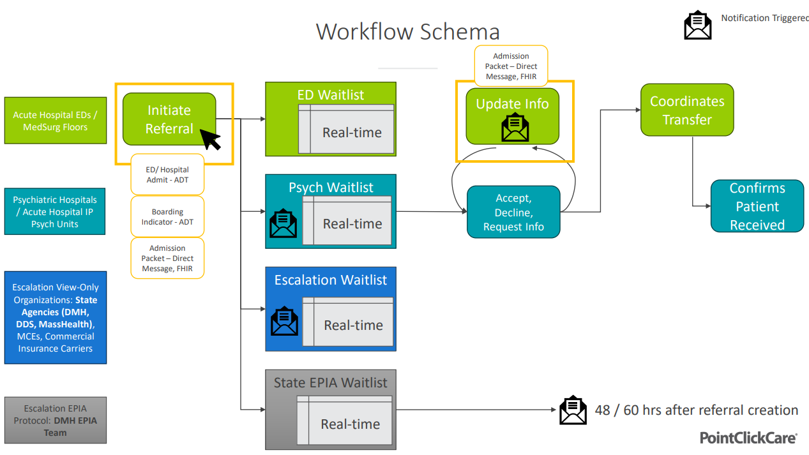
Treatment & Referral Platform: Workflow 2/2

Slide 29
Current Status – November 2024
Hospitals are contracted and implementing the tool.
Currently working through some EHR interoperability challenges, including use of PDF as exports vs XML
Many providers have not chosen full interoperability integration at this time due to staffing or resource issues within their organizations.
The Steward transitions brought one net new provider into Massachusetts and delayed the start up of one Northeast hospital absorbing the Holy Families.
Early Adopter’s cohort went live on 9/10/24 and has identified several bugs
and difficult workflows within the system that need to be fixed or updated.
In the interest of providing the best TRP solution possible the full state
go-live has been delayed to early 2025
Areas of continued improvement:
Implementing an enhancement for Receiving Facility Selection
Current EHR interoperability issues block the efficiencies of automated digital transactions
System improvements need to be rolled out

Slide 30
QUESTIONS

Slide 31
Appendix

Slide 32
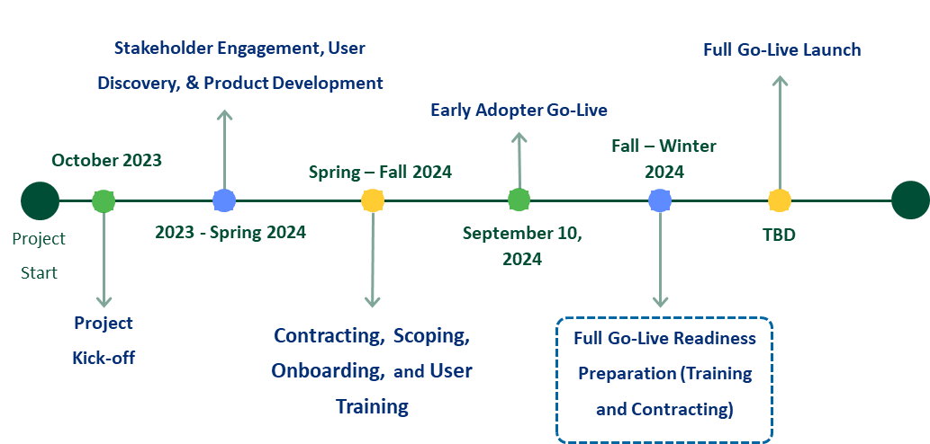
BH TRP Timeline

Slide 33
Timeline
2016: An Expedited Admissions Task Force was convened by EOHHS to establish clear steps and responsibility for escalating cases when admission has not been achieved in a reasonable period of time.
DMH, as the state licensor of IP psychiatric hospitals/units, was responsible for making changes to regulations and implementing new policy.
January 2018: The Division of Insurance, DMH, DPH, and MH issued a bulletin on the Prevention of ED Boarding of Patients with Acute BH and/or Substance Abuse Disorder Emergencies
February 2018: EPIA policy (1.0) was initiated
The EPIA Implementation Workgroup continued to meet
January 2020: DMH released EPIA 2.0
June 2021: DMH released EPIA 3.0
August 2021: Chapter 102 of the Acts of 2021 required the establishment of a TRP and a bed-finding solution
July 2022: TRP RFR bids opened on CommBuys
October 2022: PointClickCare (PCC) was selected as the vendor
Winter 2023: Latest version of the EPIA policy was released
July/August 2023: The contract was signed, and the readiness and implementation phase began
Winter 2025: Roll-out of the TRP with EDs, IP psychiatric facilities in acute and psychiatric hospitals, insurance carriers, EOHHS agencies, and the EPIA team

Slide 34
EARLY ADOPTERS
Hospitals | Bournewood Hospital​
 | Brockton Behavioral Health Center​
 | Fuller Hospital​
 | Southcoast Behavioral Health​
 | South Shore Hospital​
 | Sturdy Memorial Hospital​
Health Plans | Fallon
 | MBHP
 | MGB Health Plan
 | WellSense
 | Point32Health
State Agencies | EPIA and ACBH
 | Department of Developmental Services
 | Department of Mental Health

Slide 35
Next HITC Meeting
Next HITC meeting
Monday, February 3rd, 2025
3:30 p.m. - 5 p.m.

Slide 36
Mass HIway Participants: July 2024 – Oct 2024
New Participation Agreements
Pathnostics
Gastro Health
Mass HIway Participants – 2024 YTD | Count
Ambulatory Practices | 427
Hospitals & Health Systems | 66
Home Health, LTSS | 26
Business Associate Affiliates | 22
Federally Qualified Health Centers | 19
Local Government & Public Health | 9
Long Term Care Facilities | 9
Behavioral Health Facilities | 9
Multi-entity HIE | 8
Health Plans & ACOs | 5
Labs & Commercial Imaging Centers | 5
Total Participants | 605
New Connections
Berkshire Facial Surgery, Inc.
Star and Fox Pediatrics
Roslindale Pediatric Associates
Falmouth Pediatrics
Christopher Overtree, PhD
Blue Hills Medical Group (changed connection type)

Slide 37
Incident Summary – October 2024
Scheduled Database Maintenance 10/27/24 ~7 Hours
Sev 1: All or most components impacted, resulting in a full outage (e.g., LAND, Webmail, Direct XDR, and DPH nodes are all down).
Sev 2: Multiple components impacted due to an issue in one of the shared services (e.g., LAND and Webmail are down, but Direct XDR and DPH nodes remain operational).
Sev 3: Only a single component affected by an outage (e.g., Webmail is down, but all other services are up).

Slide 38
Mass HIway Availability – Oct 2024
Scheduled Database Maintenance 10/27/24
Metric Targets: “Total Monthly Availability” – No lower than 99.9% (downtime no more than ~44 minutes/month

