Slide 1
Title Slide

Slide 2
Welcome & Meeting Logistics
Commonwealth Procedures & Open Meeting Law
This Meeting is being recorded by agency staff for the sole purpose of drafting meeting minutes.
Agency policy prohibits the use of Artificial Intelligence for note-taking or otherwise, including the use of "bots" that summarize the meeting or otherwise monitor or record participants, or other AI tools. We appreciate your cooperation in ensuring that all discussions remain authentic and in line with our agency's guidelines.
This meeting is subject to our state's Open Meeting Law, any votes taken during the meeting will be conducted via roll-call vote:
  When conducting a vote, we will ask for a motion to approve followed by a second (i.e., a 2nd person in favor of the motion). If there is a motion and it is seconded, we will proceed to a vote.
  During a roll call, each member's name will be called and they will say how they wish to vote.
  Voting in favor of a motion, Council members should say Aye or Yes. Members wishing to vote against a motion should say Nay or No. Members can abstain, by saying abstain.
  In addition, we request all meeting attendees who are not on the Council stay muted unless called upon to speak by the Council Chair.
We request that Council members remain muted unless you are about to speak. We ask that you use the "raise hand" function or physically raise your hand unmute yourself when you would like to speak during the open discussion portions of the meeting.

Slide 3
Agenda
Home Care CDC Workforce Council Meeting Agenda
Welcome
Swearing-in Consumer Representatives
Open Meeting Law and State Ethics Overview
Overview of the Home Care CDC Workforce Council
Overview of the Home Care Program
Next Steps and Adjournment

Slide 4
Swearing In, Open Meeting Law, and State Ethics Overview

Slide 5
Home Care Program CDC Workforce Council - Overview
The Home Care Program CDC Workforce Council (or "Council") was created in 2025 with the enactment of Chapter 77 of the Acts of 2023, Section 5. The purpose of the Council is to advise on CDC workforce related topics.
The Council is responsible for the development and implementation of a communications plan to promote Consumer Directed Care services and raise awareness of the CDC Service Delivery Model option of care for eligible State Home Care consumers and potential CDC workers.
The Council also represents Consumers receiving CDC services in negotiating a collective bargaining agreement with the Union representing CDC workers.
The Council may coordinate activities with other state and local public, private, and nonprofit agencies to carry out its duties. The council may coordinate with the agencies to provide a local presence for the council and to provide consumers or consumers’ surrogates greater access to CDC information.
For more information: Consumer Directed Care (CDC) Workforce Council | Mass.gov

Slide 6
Home Care Program CDC Workforce Council - Operations
The Council is a Public Body subject to Open Meeting Law
  Notice of meeting
  Quorum
  Deliberation
  Must act as a “body”
Operations of the Council must align with limited statutory authority
  Develop and implement communications plan
  Raise awareness of CDC option
  Conduct collective bargaining activities pertaining to CDC
  Coordinate with other agencies/non-profits in carrying out its duties
Collective Bargaining
  What is Collective Bargaining
  Council and Union roles in collective bargaining negotiations
  Council preparation and Executive Session under Open Meeting Law

Slide 7
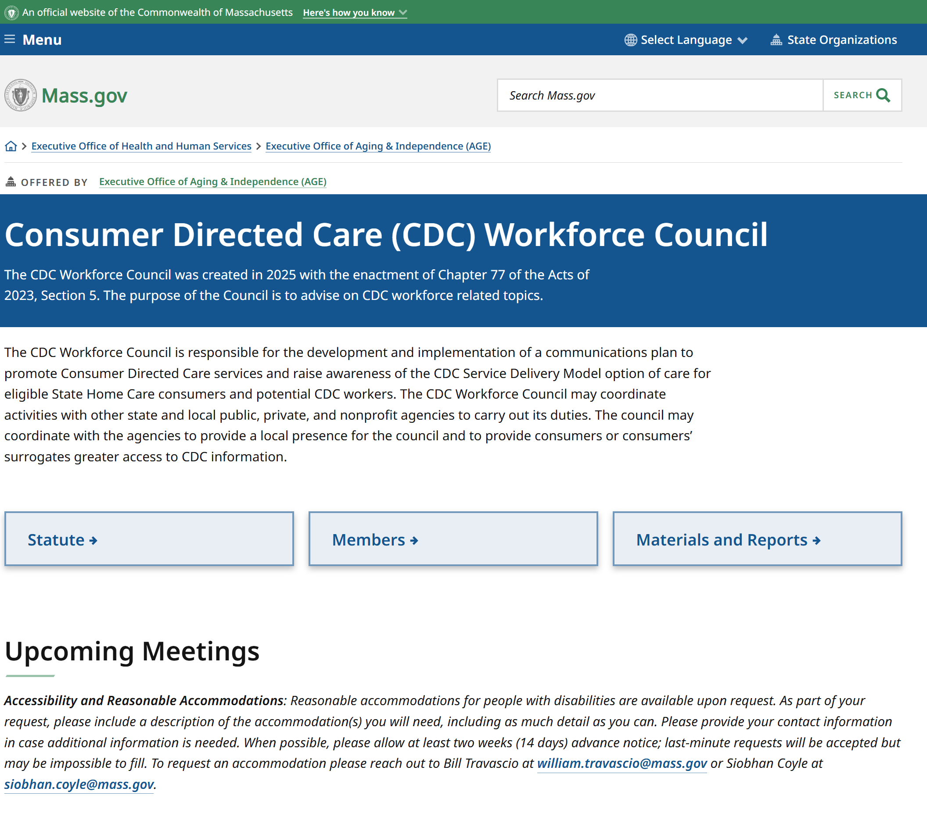
Home Care CDC Workforce Council Website

Slide 8
Council Members
Council Member Position | Council Member
Council Chair and AGE Representative | Lynn Vidler Assistant Secretary of Care Continuum – Executive Office of Aging & Independence (AGE)
Aging Services Access Points (ASAPs) Representative #1 | Lisa Gurgone Chief Executive Officer (CEO) – Mystic Valley Elder Services (MVES)
Aging Services Access Points (ASAPs) Representative #2 | Christine Johnson Director of Home Care – Aging Services of North Central Massachusetts (ASNCM)
Consumer Interests Representative #1 | Pamela Jordan
Consumer Interests Representative #2 | Lorraine Khan-Broy

Slide 9
Agency Staff Introductions
AGE Staff:
Julian Smith, General Council
Siobhan Coyle, Deputy General Counsel & Legislative Liaison
Devon Garon, Director of Home & Community Programs
Shannon Turner, Home Care Program Coordinator
Elisha Goodman, Special Projects Manager
Bill Travascio, Special Assistant to the Secretary

Slide 10
Home Care Program Overview
May 18, 2026

Slide 11


Executive Office of Aging & Independence
AGE Mission
Together we support aging adults to live and thrive, safely and independently— how and where they want
AGE Vision
We envision a state in which every person has the tools, resources, and support they need to fully embrace the aging experience

Slide 12

AGE Home Care Program Overview
*Executive Office of Aging & Independence (AGE)
Area Agencies on Aging (AAA)
The Home Care Program
Capitated Bundled Rate for Services
Aging Services Access Points (ASAP)
Capitated Bundled Rate for Case Management
Self-Direction/ CDC Service Delivery
Provider Agency Services
Consumer Contributes to Cost of Services
*AGE oversees many programs and initiatives related to older adults & The Home Care Program is 1 of those programs

Slide 13
Aging Network
Aging Service Access Points (ASAPs) / Area Agencies on Aging (AAAs)
Contracted with AGE
Provide state plan on aging programs & services to support adults aged 60+, and their caregivers
Program and/or Services provided
  Home Care Program
  Senior Nutrition Program
  Options Counseling
  Family Caregiver Support Program
  Community Transition Liaison Program
  Supportive & Congregate Housing
  Protective Services
  Information and Resources

Slide 14
ASAP History & Functions
27 Home Care Corporations (HCCs) established 1973-1975
Unique geographic service areas
Community based non-profits
51% of board members must be aged 60+
ASAP law passed in 1997 – c.19a§4b
An ASAP is a regional agency that contracts with AGE and provides programs and services to older adults and individuals with disabilities
There are 24 ASAPs in Massachusetts that are designated by AGE, ensuring coverage across the commonwealth. ASAPs are defined in Massachusetts Law M.G.L. 19A.
Provide assistance regardless of income or eligibility
Provide resource/community service information at no or low cost
Provide programs & services to older adults and individuals with disabilities based on reimbursement from AGE

Slide 15


AGE Home Care Program
The Home Care Program provides care management, care coordination, advocacy, education, and in-home and community-based support services for adults aged 60+, people with disabilities, and people under age 60 living with Alzheimer’s disease of related dementia
Program participants are connected to a trained, professional Care Manager who assesses and coordinates the participant’s care
Services are available based on participants assessed needs through service provision
Learn more about the Home Care Program

Slide 16
Home Care Program Eligibility
Age
60+
Under age 60 with a diagnosis of Alzheimer’s or related Dementia disorder
Residence
Resident of Massachusetts
Not living in an institutional setting or Assisted Living Residence

Slide 17
Function & Need Eligibility
Functional Impairment Level (FIL):
  Require assistance with at least One Activity of Daily Living (ADL)
    OR
  6 or more Instrumental Activity of Daily Living (IADL) impairments
    AND
  Intervention that Home Care will provide to meet this need at the time of enrollment - a critical unmet need (any ADL, meal preparation, food shopping, home health services, medication management, Respite, transportation for medical treatments)*
Exceptions to the Home Care Eligibility (only need 4 IADLs):
At Risk: | Older adults who are at risk due to a variety of factors, including, but not limited to substance abuse, mental health problems or cultural and linguistic barriers.
Protective Services: | Older adults who are receiving or are eligible to receive Protective Services.
Congregate Housing: | Older adults residing in a Congregate Housing Facility.
Waiver Consumers: | Older adults who are eligible for the Home and Community Based Waiver Program.

Slide 18
Cost Share
Any Income
A co-pay can only be assessed after a financial assessment has been completed
Cost share contribution based on Income & MassHealth:
  Annually adjusted based on cost-of-living adjustment (COLA)
  Exceptions to income: some VA benefits, pooled trust, etc.
2026 Cost Share Schedule
Voluntary Donation | Fixed Monthly Max Copay (ranges from $10-$199, not to exceed actual cost of qualifying services) | % Based Monthly Copay (based on qualifying services received)
Individuals whose annual income is below $16,291.00 | Based on a sliding scale, Individuals whose annual income is $16,292.00 – $36,598.00 | Based on a sliding scale, Individuals whose annual income is $36,599.00 and above
A couple whose annual income is below $21,939.00 | Based on sliding scale, A couple whose annual income is $21,940.00 - $51,785.00 | Based on a sliding scale, A couple whose annual income is $51,786.00 and above
MassHealth members whose income is at or below 300% SSI FBR ($2,982.00/month in 2026) will not have a copayment for Home Care Services, including Medicare Savings Plan

Slide 19
Home Care Rate Structure – AGE Reimbursement Rates
Home Care Program Monthly Purchase of Service (POS) Rate
$457.71
Enhanced Community Options Program (ECOP) Monthly POS Rate
$1025.12
Rate Regulations: 101 CMR 417
Establishes the payment rates for certain elder care services provided to clients of the Executive Office of Aging & Independence (AGE) by Aging Services Access Points (ASAPs) and other designated providers

Slide 20
Home Care Services
Adult Day Health
Alzheimer’s / Dementia Coaching
Assistive Technology for Telehealth
Behavioral Health Services
Certified Older Adult Peer Specialists (COAPS)
Chore Services
Companion Services
Complex Care Training and Oversight
Dementia Day Care
Electronic Comfort Pets
Emergency Shelter
Evidence Based Education Programs
Goal Engagement
Grocery Shopping or Delivery
Home Based Wandering Response Systems
Home Delivered Meals
Home Delivery of Pre-Packaged Medication
Home health Services
Home Safety –Independence Evaluation
Homemaker Services
Laundry Service
Medication Dispensing System
Money Management
Nutritional Assessment
Orientation and Mobility
Personal Care
Personal Emergency Response System
Respite Care
Supportive Day Care
Supportive Home Care Aide
Transitional Assistance
Transportation
Virtual Communication & Monitoring
Vision Rehabilitation
Aide Assisted Transportation

Slide 21

Home Care Programs and Care Plan Examples
Home Care Basic-Non-Waiver
Enhanced Community Options Program (ECOP)
Home Care Percent Based
Example Care Plan #1:
HDM 5/week
CDC 3 hours/week
Monthly Care Plan Cost: $501.50
HDM – $170.00
CDC - $282.00
Admin Task Fee – $49.50
Example Care Plan #1:
HDM 5/week
CDC 4 hours/week
Monthly Care Plan Cost: $595.50
HDM – $170.00
CDC - $376.00
Admin Task Fee – $49.50
Example Care Plan #1:
HDM 5/week
PERS Monthly
CDC 8 hours/week
Monthly Care Plan Cost: $1,011.88
HDM - $170.00
PERS - $40.00
CDC - $752.38
Admin Task Fee – $49.50
Consumer pays fixed monthly amounts:
$10.00 - $199.00
Consumer pays percentage of cost of services varying from:
50% -100%: $273 - $546
Consumer pays fixed monthly amount):
$10.00 - $199.00
*CDC wage per hour – $19.50 (Consumer Cost: $21.72 with EEC)
*Sample Care Plans Based on Program above. ASAPs develop service plans based on a Consumer's assessed need and support system, and the cost-of-service plans are generally within or around the value of the capitated bundled rate that AGE pays to ASAPs, but ASAPs may employ flexibility related to an individual's service plan cost.

Slide 22
Self-Directed Service Delivery Option within the Home Care Program
Home Care Consumer Directed Care (CDC)
A self-directed service delivery option for non-frail elder waiver enrolled consumers in accordance with AGE PI-18-02
Consumer can choose to recruit, train and hire their own worker for personal assistance services
Self-Directed service delivery options for services available within Home Care
Homemaking
Personal Care
Chore
Companion
https://umassmed.typepad.com/files/pi-18-02-consumer-directed-care-without-sign-off.pdf
ASAP assesses:
consumer ability to be the employer of record with surrogacy assessment
need & authorizes an average number of hours per week, is responsible for the overall management of program service costs within the limits for the Home Care program

Slide 23
Self-Directed Service Delivery Option
Home Care Consumer Directed Care workers ARE NOT INCLUSIVE OF the following MassHealth self-directed options:
Personal Care Attendant (PCA)
Consumer Directed Care - Senior Care Options (SCO)

Slide 24
Self-Directed Service Delivery Option Cont.
Consumer Directed Care DOES NOT Include MassHealth Personal Care Attendant (PCA)
Consumer Directed Care is not a service itself but instead a service delivery option

Slide 25
*Consumer pathway into the Home Care Program
Applicant referral received through I/R department at the ASAP
Applicant assessed for ADL and IADL impairments & determined to meet Home Care Eligibility Requirements by ASAP Case Manager
Applicant enrolled into the Home Care Program & is now consumer in Home Care Basic non-waiver. Case Manager assigned to oversee service care plan development
Consumer chooses Self-Directed Service Delivery Model
Consumer assessed for ability to self-direct services (surrogacy assessment)
Consumer receives 3 hours of HM services from CDC worker & HDM’s
Consumer has a *care plan cost of $501.50/Month.
Consumer pays: $125.00/month
Referral for services within the Home Care Program
Financial assessment determines consumer monthly co-payment of $125.00/month (based on income guidelines)
Consumer and worker paperwork completed with Fiscal Intermediary (FI)
Consumer assessed to need Home Delivered Meals (HDM’s) 5xwk and Homemaking (HM) services
Surrogate designated to oversee services (if applicable)
*Sample Consumer in Home Care Basic Non-Waiver from Side 11
*These examples are meant for illustrative purposes only

Slide 26
PHCAST Development History
“Train the Trainer” – agency clinical staff trained to teach PHCAST & have access to supplemental supporting classroom-style learning
MA recognized a need for consistent home care training specifically targeting Homemaker & Personal Care (PC) Homemakers
2010 - MA Executive Office of Health & Human Services and MA EOEA received grant from the Health Resources and Services Administration to develop, evaluate & disseminate a core-competency based curriculum for direct care workers across health and human service sectors
2011 – MA PHCAST developed as a 60 hour in-person course to teach the fundamentals of being a Homemaker & PC Homemaker
37 hrs covers Homemaker training
10 hrs covers PC Homemaker curriculum (10 hrs for hands on training with agency clinical staff)
3 hrs for employer orientation

Slide 27
Consumer Directed Care Voluntary Worker Training
Utilizes Personal and Home Care Aide State Training (PHCAST)
Free online training to prepare workers for the direct care workforce. Certificate earners will be able to assist older adults with daily housekeeping and personal care tasks so they can continue to live at home and be part of their community
The Personal and Home Care Aide State Training (PHCAST), available in English, Spanish, Haitian Creole, Brazilian Portuguese, Mandarin, Cantonese, Russian, and Vietnamese, is a free, self-paced, online training for people who want to work as a Homemaker, Personal Care Homemaker and/or Consumer Directed Care Worker
Available for consumers who identify training needs for workers
Voluntary Training available
Training for Home Care CDC workers Not Mandatory
Workers can access the free training on a smart phone, tablet and/or laptop. Learner can access certificate of completion anytime
Caregiver track to allow workers to gain knowledge in specific areas

Slide 28
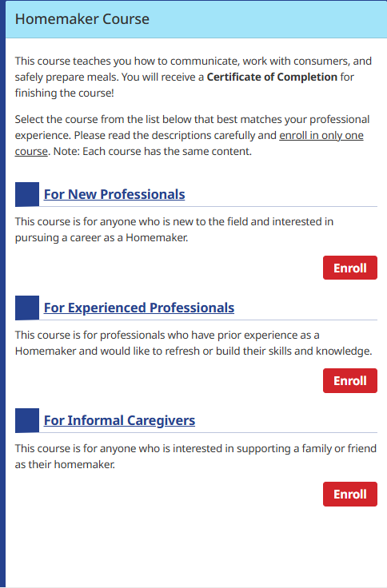
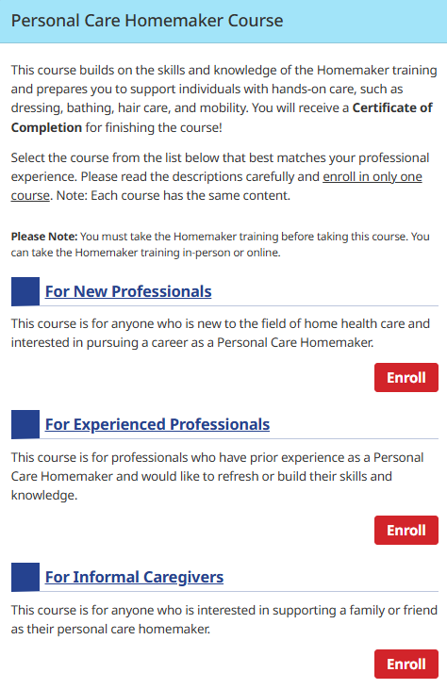
PHCAST Pathways: Personal and Home Care Aide State Training
Three pathways
New Professionals
Experienced Professionals
Informal Caregivers
Begin with Homemaker course
Creates foundation
Then can move onto Personal Care Homemaker Course
*Sample Topics Include
Communication
Culture and Diversity
Healthcare Support
Nutrition
Housekeeping
Consumer Needs
*Not a complete list of topics

Slide 29
Reminders & Next Steps
Council Member Reminders
Complete Online Ethics Training
Sign and return Form O (Affirming Council Member is sworn in)
Return OML Receipt (Confirms Council Member has received the Open Meeting Law Guide)
Next CDC Workforce Meeting(s)
Schedule next CDC Council meeting(s)/form subcommittee for negotiations
Create bylaws

Slide 30
Vote to Adjourn

