Slide 1
Housing Choice Grant Program Guidance Webinar
Community One Stop for Growth

Slide 2
Road Map
What is the Community One Stop for Growth?
Housing Choice (HC) Grant Program Overview
Where does HC Fit in the One Stop?
Important HC Parameters
How to Be Competitive
Examples of Successful Applications
Completing the Full Application
Key Dates and Opportunities to Get Guidance

Slide 3
What is the Community One Stop for Growth?
The Community One Stop for Growth is the main driver of economic development in the Commonwealth.
The One Stop is a single application portal and collaborative review process designed to streamline the experience for the applicant and better coordinate economic development programs and staff on engagement and grant making.
Executive Office of Economic Development | MassDevelopment Finance Agency | Executive Office of Housing and Livable Communities
MassWorks Infrastructure Program Rural Development Fund Urban Agenda Grant Program Massachusetts Downtown Initiative | Underutilized Properties Program Site Readiness Program Collaborative Workspaces Program Brownfields Redevelopment Fund Real Estate Services Technical Assistance | HousingWorks Infrastructure Program Housing Choice Grant Program Community Planning Grants Program

Slide 4
Housing Choice Grant Program Overview
Program Staff | McKenzie Bell, Senior Community Grants Coordinator (McKenzie.Bell@mass.gov)
What is the Purpose of the Program? | Exclusive grant program for currently designated Housing Choice Communities (HCCs) Funds a variety of activities related to planning and zoning, site preparation for development, housing development, and infrastructure
Who is Eligible? | Currently designated HCCs Related municipal entities (Public Housing Authority, Redevelopment Authority, Water/Sewer or Service District, Economic Development Industrial Corporation, bodies created by legislative act to serve a municipality) in a current HCC Regional Planning Agencies (with proposed project within a current HCC)

Slide 5
Where Does HC Fit in the One Stop?
Preparing for Growth |  |  | Catalyzing Specific Projects
Community Activation & Placemaking | Planning & Zoning | Site Preparation | Building | Infrastructure
Technical Assistance for Downtowns Downtown Design Consultant Services Downtown Mobility/Parking Consultant Services Downtown Wayfinding/Branding Consultant Services Economics of Downtown Consultant Services Pedestrian Orientation/Placemaking Consultant Services Small Business Support/E-commerce Consultant Services Forming a Downtown Management District Equitable Workforce and Business Development Programming Entrepreneurship and Small Business Development Workforce Development and Training Initiatives Community Organizing and Leadership Development | Community Plan Master Plan Neighborhood Plan Downtown Plan Urban Renewal Plan Housing Production Plan Regional Plan Corridor Plan Zoning Revision Zoning Revision to Comply with Section 3A of MGL c.40A Comprehensive Zoning Review & Revision Planning for Housing Housing Feasibility Plan Housing Site Master Plan Housing Infrastructure Plan Housing Site Design Plan District Redevelopment Technical Assistance Planning for Growth in a Commercial/Industrial District | Brownfield Site Clean Up Brownfields Site Assessment Brownfields Remediation Site Improvements to Unlock Development Site Readiness Pre-Construction Site Readiness Construction Municipal Surplus Property Disposition Municipal Surplus Property Disposition Study | Underutilized Property Rehabilitation Underutilized Property Pre-Construction Underutilized Property Construction Community Lead Housing Production Support Housing Production Support Housing Rehabilitation Support Housing Preservation Creating Collaborative Workspace Collaborative Workspace Feasibility Study Collaborative Workspace Fit-Out or Equipment | Public Infrastructure to Support Housing Growth (Residential Only) Pre-construction - Design / Engineering Documents Only Construction Public Infrastructure to Support Mixed-Use and Commercial/Industrial Growth Pre-construction - Design / Engineering Documents Only Construction Small Town Road Improvements to Enhance Public Safety (STRAP) Construction of Road Improvements to Enhance Public Safety

Slide 6
Important Project Parameters
Project Budget | Awards for single entities for site preparation, building, or infrastructure projects limited up to $500K Awards for single entities for planning & zoning projects limited up to $150K Awards over these amounts are considered only for joint or regional applications on a case-by-case basis at EOHLC’s discretion No local cash match requirements, but applications with 10% local match get bonus points
Project Timeline Requirements | 2-year grant cycle Awards made in fall 2024 Projects must be completed by June 30, 2026
Eligible Use of Funds | Activities may include, but are not limited to: Community planning and zoning revisions (as defined in the FY25 Community Planning Grant Guidelines) Feasibility, engineering, design, and construction of physical infrastructure and of existing and new buildings Rehabilitation, due diligence, plan designs, market studies, pre-permitting/permitting, engineering, acquisition, demolition, and site-related upgrades of future development sites
Ineligible Activities | Cannot fund staff time or training Applicants with locally adopted growth limitations or housing or infrastructure moratoria are ineligible

Slide 7
How To Be Competitive
Key information to consider
Is the project best achieved as a full project within one grant cycle or as a phased approach?
Guidelines include scoring rubric: How can you maximize all possible points?
Note: Awards will take score, regional diversity, previous support from EOHLC, first time grant recipients, and alignment with priorities of the Secretary into account.
Full application questions to pay attention to
2.6. Project Need: Show, not just tell, the need specific to your community
2.16. Progress to Date: Include descriptions of recently implemented local ordinances or bylaws that directly impact this project
2.20. Project Impacts: Provide best estimates for housing outcomes (if possible)
6.2. – 6.3. Housing Choice Best Practices: Claiming a Best Practice without supporting evidence will not earn point(s)
Application includes 2023 Best Practices (2024 Best Practices will be updated, but not affect/be used for the FY25 application round)
Expected attachments
2.11. Consultant/Contractor Cost Estimate
2.12. Project Location Map
Evidence of Housing Choice Best Practices
Site Plan/Construction Drawing (as applicable)

Slide 8
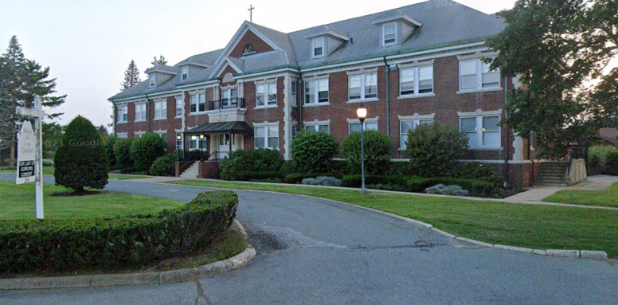
Successful Application Example #1
Applicant: | Brockton (FY22)
Project Description: | Infrastructure: Streetscape/Roadway Improvements The Planning Office for Urban Affairs will create a 160-unit multi-family residential development in the Thatcher Street Smart Growth Overlay District. The proposed development will reuse the existing Our Lady of Sorrows convent to create a sustainable, healthy, vibrant and diverse community. The project requires new sidewalks and pedestrian accommodations in the public way. The City is seeking infrastructure support to build these public improvements. This is a single-phase project that can be completed in one construction season.
What Made the Project Successful: | Clearly defined need that directly supports new housing development Justifiable cost with demonstrated ready implementation and scope of work to be completed within grant timeline
Read about Brockton’s project here.

Slide 9
Successful Application Example #2
Applicant: | Somerville & Medford (FY23) – 1st joint award!
Project Description: | Planning and Zoning: Zoning Update The City of Somerville and the City of Medford will develop and oversee adoption of a Zoning Vision Plan for Broadway between Ball Square and Magoun Square (0.5 miles) that should be ready for mixed use development near MBTA Green Line Extension T stations and address boundary between Somerville and Medford that splits many parcels, which forces developers to satisfy two sets of zoning regulations.
What Made the Project Successful: | Clear project need that shows collaboration between entities with tangible outcomes Detailed scope of work and clear path to feasible implementation Demonstrated commitment to date shown by follow up on recent comprehensive zoning updates

Slide 10
Successful Application Example #3
Applicant: | Methuen (FY24)
Project Description: | Planning & Zoning: Zoning Revisions to Comply with 3A Methuen will conduct efforts to enter into 3A compliance drafting language that will describe the new or revised districts that will meet compliance of section 3A of the state zoning law and present the proposed changes to the applicable city boards for adoption.
What Made the Project Successful: | Demonstrated readiness to begin with clear timeline to meet grant deadline Robust community engagement plan with clear path to implementation
Read about Methuen’s work here.

Slide 11
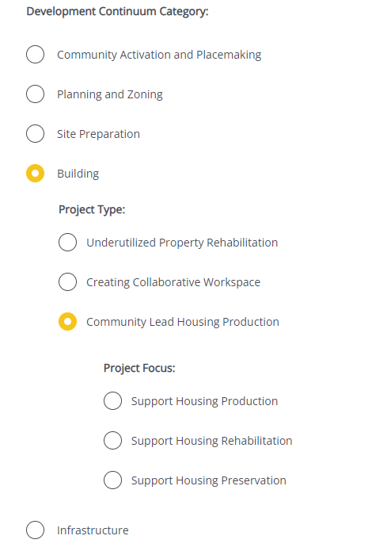
Completing the Full Application
Key Question: In Section 2 of the Full Application, applicants are asked to indicate the Project Category. To be reviewed by Housing Choice Grant Program, applicants should select an eligible Development Continuum category, Project Type, and Project Focus, and mark “Yes” to 2.4.a. Housing Choice Consideration.
For more information on completing the Full Application, visit www.mass.gov/onestop to view One Stop Webinar 2: Application Guidance
Development Continuum: | {Insert Category}
Project Type: | {Insert Project Type}
Project Focus: | Select the most appropriate Project Focus option for your application
Housing Choice Consideration: | Select “Yes” to be considered by the Housing Choice Grant Program.

Slide 12
FY25 Round Timeline
JAN
Jan.
Full Application and Expression of Interest Open (January) – The Full Application is the official form for submitting all funding requests. Applicants may now begin to work on applications in the IGX system, however applications will only be accepted during the submission period.
One Stop Guidance Phase (January – May) – A series of webinars will be hosted be both the One Stop Team and staff from each program within the One Stop. In addition, office hours will be hosted to answer applicant questions. Visit www.mass.gov/onestop for the full schedule of webinars and office hours.
Full Application Submission Period (May-June) – Applicants may submit their Full Application(s) beginning May 6, 2024. All applications must be submitted by the Full Application deadline of 11:59 p.m. on Wednesday, June 5.
Review and Evaluation (July – August) – All complete and eligible Full Applications submitted by the deadline will be reviewed and evaluated by the corresponding program managers at each state agency. The One Stop team will also conduct joint application reviews across agencies. Based on the program’s criteria, each program will prepare its list of applications recommended for funding, to be further reviewed and approved by agency and Secretariat leadership.
Notification of Grant Decisions (September) – Once final recommendation have been approved, applicants will be notified of grant decisions in writing, and announcement events will be scheduled.
Sept.

Slide 13
Opportunities for Guidance
Visit www.mass.gov/onestop for more information on:
Expression of Interest
Complete an Expression of Interest form to see if your project(s) is eligible for funding through the One Stop and get tips for preparing your application
One Stop and Program Webinars
Recordings of all One Stop webinars are now available on the One Stop website
Office Hours
One Stop General Guidance Office Hours – One Stop staff will hold office hours to discuss general One Stop process and technology questions
Program Office Hours – Staff from each program will hold an office hour to answer applicant questions related to the program
Housing Choice Grant Program’s office hours will be held on Thursday, March 14 at 3:00PM – 5:00PM

