Slide 1
HousingWorks Infrastructure Program Guidance Webinar
Community One Stop for Growth

Slide 2
Road Map
What is the Community One Stop for Growth?
HousingWorks Infrastructure Program (HWIP) Overview
Where does HWIP Fit in the One Stop?
Important HWIP Parameters
How to Be Competitive
Examples of Successful Applications
Completing the Full Application
Key Dates and Opportunities to Get Guidance

Slide 3
What is the Community One Stop for Growth?
The Community One Stop for Growth is the main driver of economic development in the Commonwealth.
The One Stop is a single application portal and collaborative review process designed to streamline the experience for the applicant and better coordinate economic development programs and staff on engagement and grant making.
Executive Office of Economic Development | MassDevelopment Finance Agency | Executive Office of Housing and Livable Communities
MassWorks Infrastructure Program Rural Development Fund Urban Agenda Grant Program Massachusetts Downtown Initiative | Underutilized Properties Program Site Readiness Program Collaborative Workspaces Program Brownfields Redevelopment Fund Real Estate Services Technical Assistance | HousingWorks Infrastructure Program Housing Choice Grant Program Community Planning Grant Program

Slide 4
HousingWorks Infrastructure Program (HWIP) Overview
Program Staff | McKenzie Bell, Senior Community Grants Coordinator (McKenzie.Bell@mass.gov)
What is the Purpose of the Program? | New program of the Healey-Driscoll Administration to support efforts to increase housing production in the Commonwealth; created as a “sibling program” to MassWorks Infrastructure Program Support housing development, preservation, or rehabilitation. Fund a variety of activities related to infrastructure projects associated with housing development including but not limited to design, construction, building, rehabilitation, repair, and other improvements to publicly-owned infrastructure
Who is Eligible? | Municipalities Related municipal entities (Public Housing Authorities, Redevelopment Authorities, and Water/Sewer or Service Districts)

Slide 5
Where Does HWIP Fit in the One Stop?
Preparing for Growth |  |  | Catalyzing Specific Projects
Community Activation & Placemaking | Planning & Zoning | Site Preparation | Building | Infrastructure
Technical Assistance for Downtowns Downtown Design Consultant Services Downtown Mobility/Parking Consultant Services Downtown Wayfinding/Branding Consultant Services Economics of Downtown Consultant Services Pedestrian Orientation/Placemaking Consultant Services Small Business Support/E-commerce Consultant Services Forming a Downtown Management District Equitable Workforce and Business Development Programming Entrepreneurship and Small Business Development Workforce Development and Training Initiatives Community Organizing and Leadership Development | Community Plan Master Plan Neighborhood Plan Downtown Plan Urban Renewal Plan Housing Production Plan Regional Plan Corridor Plan Zoning Revision Zoning Revision to Comply with Section 3A of MGL c.40A Comprehensive Zoning Review & Revision Planning for Housing Housing Feasibility Plan Housing Site Master Plan Housing Infrastructure Plan Housing Site Design Plan District Redevelopment Technical Assistance Planning for Growth in a Commercial/Industrial District | Brownfield Site Clean Up Brownfields Site Assessment Brownfields Remediation Site Improvements to Unlock Development Site Readiness Pre-Construction Site Readiness Construction Municipal Surplus Property Disposition Municipal Surplus Property Disposition Study | Underutilized Property Rehabilitation Underutilized Property Pre-Construction Underutilized Property Construction Creating Collaborative Workspace Collaborative Workspace Feasibility Study Collaborative Workspace Fit-Out or Equipment Community Lead Housing Production Support Housing Production Support Housing Rehabilitation Support Housing Preservation | Public Infrastructure to Support Housing Growth (Residential Only) Pre-construction - Design / Engineering Documents Only Construction Public Infrastructure to Support Mixed-Use and Commercial/Industrial Growth Pre-construction - Design / Engineering Documents Only Construction Small Town Road Improvements to Enhance Public Safety (STRAP) Construction of Road Improvements to Enhance Public Safety

Slide 6
Important Project Parameters
Project Budget | No set minimum or maximum amount Awards have ranged from $300K to $5M, average award of $2.5M Projects with secured funding from other sources will be more competitive (including bonus points for 10% local cash match)
Project Timeline Requirements | 4-year grant cycle Awards made in fall 2024 Projects must be completed by June 30, 2028
Eligible Use of Funds | Activities related to infrastructure projects associated with housing (pre-development and construction) Improvements to publicly-owned infrastructure including but not limited to sewers, utility extensions, streets, roads, curb-cuts, water treatment systems, transit improvements, public parks and spaces adjacent to planned or proposed housing improvements, and pedestrian and bicycle ways
Ineligible Activities | Cannot fund staff time or training Applicants with locally adopted growth limitations or housing or infrastructure moratoria are ineligible

Slide 7
How To Be Competitive
Key information to consider
Is the project best achieved as a full project within one grant cycle or as a phased approach?
Guidelines include scoring rubric: How can you maximize all possible points?
Note: Awards will take score, regional diversity, previous support from EOHLC, first time grant recipients, and alignment with priorities of the Secretary into account.
Full application questions to pay attention to
2.6. Project Need: Show, not just tell, the need specific to your community
2.7. Grant Request, 2.8. Justification of Request, 2.11. Cost Estimate
Clear delineation of infrastructure work in terms of cost/budget, timelines, scope and limits of work, and design
2.16. Progress to Date: Include descriptions of recently implemented local ordinances or bylaws that directly impact this project
2.20. Project Impacts: Provide best estimates for housing outcomes (if possible)
Expected attachments
2.11. Consultant/Contractor Cost Estimate
2.12. Project Location Map
Site Plan/Construction Drawing (as applicable)

Slide 8
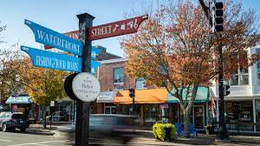
Successful HWIP Application Example #1
Applicant: | Barnstable (FY24)
Project Description: | Construction: Water/Sewer Infrastructure Barnstable will redevelop a currently vacant 1.5-acre site in downtown Hyannis with approximately 50 units of mixed income housing that will provide opportunities for low-moderate income ownership. Grant funds would be used for the project’s wastewater system, consisting of pump station and sewer connection, enabling project feasibility and accelerating delivery of much-needed housing in the heart of the community.
What Made the Project Successful: | Clear and detailed description of project, including strong justification for project need Demonstrated readiness and timely implementation, paired with identified developer to yield ultimate outcome of increased affordable housing opportunities

Slide 9
Successful HWIP Application Example #2
Applicant: | Chelsea (FY24)
Project Description: | Construction: Roadway/Streetscape Improvements Chelsea will make streetscape infrastructure enhancements surrounding an affordable housing development project located at 170 Cottage St., addressing sidewalk reconstruction, accessibility improvements, and landscape enhancements, yielding a hospitable, inclusive public realm supporting 66 new units of permeant supportive housing.
What Made the Project Successful: | Clearly described need and scope of work that is feasibly implemented within grant timeline Evidence of progress to date and follows up on a previously support project

Slide 10
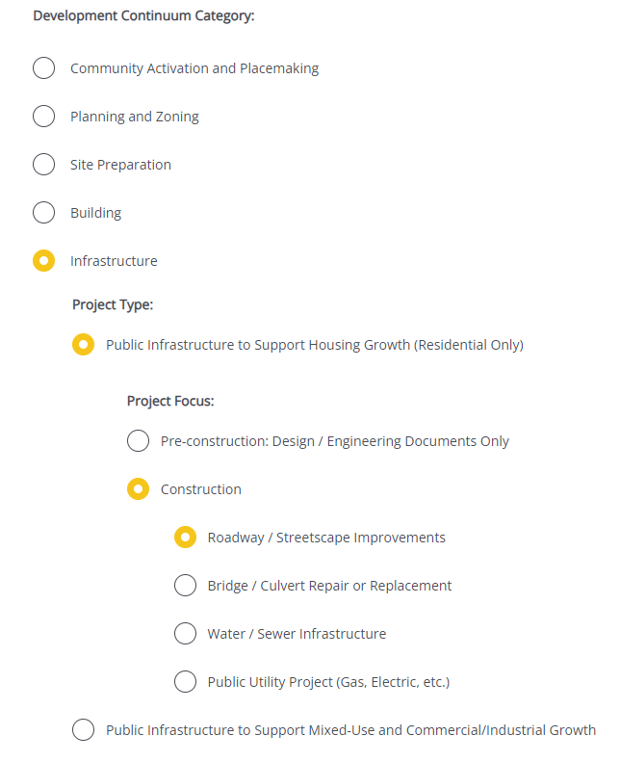
Completing the Full Application
Key Question: In Section 2 of the Full Application, applicants are asked to indicate the Project Category. To be reviewed by HWIP, applicants should make the following selections in question 2.4:
For more information on completing the Full Application, visit www.mass.gov/onestop to view One Stop Webinar 2: Application Guidance
Development Continuum: | Infrastructure
Project Type: | Public Infrastructure to Support Housing Growth (Residential Only)
Project Focus: | Select the most appropriate Project Focus option for your application

Slide 11
FY25 Round Timeline
JAN
Jan.
Full Application and Expression of Interest Open (January) – The Full Application is the official form for submitting all funding requests. Applicants may now begin to work on applications in the IGX system, however applications will only be accepted during the submission period.
One Stop Guidance Phase (January – May) – A series of webinars will be hosted be both the One Stop Team and staff from each program within the One Stop. In addition, office hours will be hosted to answer applicant questions. Visit www.mass.gov/onestop for the full schedule of webinars and office hours.
Full Application Submission Period (May-June) – Applicants may submit their Full Application(s) beginning May 6, 2024. All applications must be submitted by the Full Application deadline of 11:59 p.m. on Wednesday, June 5.
Review and Evaluation (July – August) – All complete and eligible Full Applications submitted by the deadline will be reviewed and evaluated by the corresponding program managers at each state agency. The One Stop team will also conduct joint application reviews across agencies. Based on the program’s criteria, each program will prepare its list of applications recommended for funding, to be further reviewed and approved by agency and Secretariat leadership.
Notification of Grant Decisions (September) – Once final recommendation have been approved, applicants will be notified of grant decisions in writing, and announcement events will be scheduled.
Sept.

Slide 12
Opportunities for Guidance
Visit www.mass.gov/onestop for more information on:
Expression of Interest
Complete an Expression of Interest form to see if your project(s) is eligible for funding through the One Stop and get tips for preparing your application
One Stop and Program Webinars
Recordings of all One Stop webinars are now available on the One Stop website
Office Hours
One Stop General Guidance Office Hours – One Stop staff will hold office hours to discuss general One Stop process and technology questions
Program Office Hours – Staff from each program will hold an office hour to answer applicant questions related to the program
HWIP’s office hours will be held on Tuesday, March 12 at 12:30PM

