Slide 1
FY18 Title I Program Review How to organize and submit your SY 2017-18 materials for review by ESE staff
Resource Allocation Strategy & Planning
August 2017

Slide 2
Title I program review process
Every six years each school district in the Commonwealth is scheduled for a coordinated program review of state and federal programs.
Districts receiving Title I funds undergo a Title I program review in the same year they are scheduled for coordinated program review.
Coordinated program review schedule: http://www.doe.mass.edu/pqa/review/cpr/6yrcycle.html
The Department notifies each district undergoing a Title I program review of the timeline for submitting required materials.

Slide 3
Title I program review process
ESE will notify districts scheduled for a program review (notification in summer and materials due in winter)
After materials have been received, ESE staff conduct a desk-audit of submitted materials and other extant data.
Following the review, ESE issues a report to the district describing any findings that do not meet the specified criteria and required actions, if any.
Districts then have a specified window of time within which to submit evidence that required actions have been taken.

Slide 4
Title I program review resources
The 2017-18 Title I Program Review Procedures document serves as the manual for Title I program review preparation. It gives specific information as to what documentation is required and how to organize your materials for review by ESE staff.
This document and additional information about the Title I program review process are available at http://www.mass.gov/edu/government/departments-and-boards/ese/programs/accountability/financial-support/title-i-and-other-federal-support-programs/title-i-part-a/program-review.html
The following slides illustrate how to organize and submit your district’s materials to ESE.

Slide 5
Prepare documentation
Collect your materials.
Organize your materials by tab as outlined in the 2017-18 Title I Program Review Procedures document.
Store your materials electronically (preferred) using a flash drive, or in a binder or file box.
Submit your materials to ESE via mail or in person.

Slide 6

Collect your materials
As stated in the 2017-18 Title I Program Review Procedures document, your Title I program review materials MUST be clearly organized by tab. The next slide shows the list of tabs.

Slide 7
Organize your materials by tab
Fiscal procedures
Tab 1: Comparability procedure
Tab 2: Comparability demonstration
Tab 3: Supplement, not supplant policy and procedures
Tab 4: Documentation of Title I expenditures
Parent/guardian communications
Tab 5: District and school parent/guardian involvement policies
Tab 6: School-parent/guardian compact
Tab 7: Documentation of parent/guardian outreach and involvement
Tab 8: Parent/guardian notification – report cards
Tab 9: Parent notification – right-to-know (if teacher is not appropriately licensed)
Program design and evaluation
Tab 10: Needs assessment procedure
Tab 11: Program evaluation procedure
Tab 12: Program evaluation summary, including non-public school service, if any
Tab 13: Targeted assistance program plans
Tab 14: Schoolwide program plans
Tab 15: Accountability related required actions – levels 2-5 (site visit districts only)
Data collection and management
Tab 16: Title I personnel lists
Tab 17: Time and effort records
Tab 18: Student selection procedure in targeted assistance schools
Tab 19: Title I targeted assistance program student selection criteria
Tab 20: Rank-ordered student selection list of Title I students in targeted assistance program
Opportunity and equal educational access
Tab 21: Offer of consultation to eligible non-public schools
Tab 22: Affirmation of consultation with participating non-public school officials and description of services
Tab 23: Third-party contracts
Tab 24: Neglected or delinquent (N or D) facility coordination

Slide 8
Store your materials electronically using a flash drive, or in a binder or file box
If using electronic media to store your materials, you must ensure that:
Materials are organized by tab and submitted together electronically, as ESE will not accept mixed media (e.g., a combination of paper and electronic files), and everything is on one flash drive
Contact information for the district is included
Duplicate copy is kept for district records
If using a binder or file box to organize your materials, you must ensure that:
Materials are organized by tab
Contact information for the district is included in binder or box
Duplicate copy is kept for district records (ESE does not mail hard copies back to district)

Slide 9
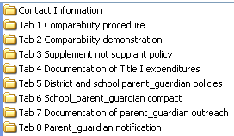
Option 1: Flash drive (preferred method)
ESE prefers that materials be submitted electronically using a flash drive. Keep in mind the following:
All materials must be submitted together electronically, as ESE will not accept mixed media (e.g., a combination of paper and electronic files)
The filenames must be clearly labeled by tab (see image above). Create a folder for each tab and place related information inside each folder.
Save your files in Microsoft Word, Excel or Adobe PDF format
Include a Microsoft Word file containing contact information
Preparation will likely involve scanning some documents and converting them to PDF

Slide 10
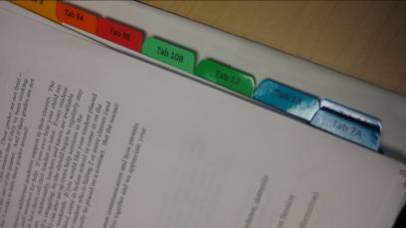
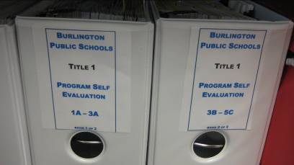
Option 2: Binder
Materials are organized by tabbed dividers in a three-ring binder
Tabs are printed or neatly written in ink
Outside of binder labeled with the name of the district and “FY18 Title I Program Review”
Contact information easily located inside front of binder
Multiple binders are clearly labeled (e.g., 1 of 2, etc.)

Slide 11
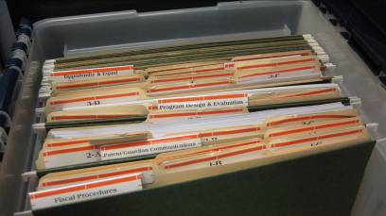
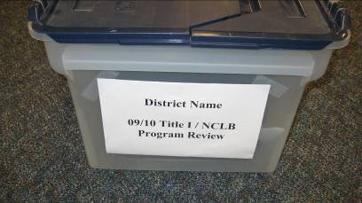
Option 3: File box
When considering multiple binders, it may make sense to submit a file box instead
Materials are organized by tabbed folders inside hanging folders. Tabs must be printed or neatly written in ink
Outside of box labeled with the name of the district
Contact information easily located inside lid of box
Multiple boxes are clearly labeled (e.g., 1 of 2, etc.)

Slide 12
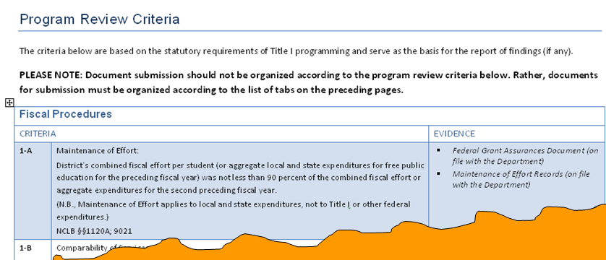

Not an option
You must organize your required documentation by tab as shown on Slide 7. Do not organize documentation according to the criteria used to review compliance (i.e., 1-A, 1-B, 1-C, etc.) found at the end of 2017-18 Title I Program Review Procedures document (image below).

Slide 13
Submit your materials to ESE via mail or in person
Mail your electronic media, binder, or box to:
FY18 Title I Program Review
ATT: Julia Foodman
Resource Allocation Strategy & Planning
Massachusetts Department of Elementary and Secondary Education
75 Pleasant Street
Malden, MA 02148
OR
Drop off your materials in person at the front desk of the Massachusetts Department of Elementary and Secondary Education in Malden. Label them ‘For Julia Foodman’. For directions, visit: www.doe.mass.edu/contact/doedirections.html

Slide 14
Checklist
Please remember to:
Organize your materials by tab as outlined in the 2017-18 Title I Program Review Procedures document and as shown in Slide 7
Store your materials electronically using a flash drive, or in a binder or file box
Make a duplicate copy of the binder, file box, or electronic media for recordkeeping purposes (This is strongly recommended)
Include contact information inside the binder or file box; or, if using electronic media, include a Microsoft Word file containing this information
Ensure your binder or file box is boxed up and sealed; or, if using electronic media, ensure you used a padded mailer and wrote “fragile” on the outside of the mailer
Consider purchasing tracking and/or delivery confirmation
Clearly label your mailing with a delivery address and return address

Slide 15
For more information
Title I website: www.mass.gov/ese/titlei
Email: titlei@doe.mass.edu
Phone: 781-338-6230

