Slide 1
OVERVIEW Housing Rehab Best Practices: Inspections & Construction Phase
Inspection Reports – Lead and HR Specialist
Environmental Review
Work List
Signatures, Approvals, Request for Funds
Bid Packet, Bid Forms, Bid Reviews
Loan Closing
Construction Phase
Project Tracking/ Meeting Unit Goals

Slide 2
LEAD PAINT CONSIDERATIONS
HOUSE BUILT PRIOR TO 1978
Determine
Risk Assessment
Comprehensive Lead Inspection
Assign project to Certified Lead Inspector
Review Lead Inspection Report for hazards
Notes:
Read Lead Report – Highlight and note violations
From here – prepare to move to General Inspection Sheet
Discussions with Homeowners regarding paths to compliance

Slide 4
HOME INSPECTION
#2 General Inspection Report
Room Identifiers
Sanitary Code Citations
Conforming/Non-confirming Conditions
Comments on non-confirming conditions
Notes:
Read Lead Report – Highlight and note violations
From here – prepared to move to General Inspection Sheet
Discussions with Homeowners regarding paths to compliance

Slide 5
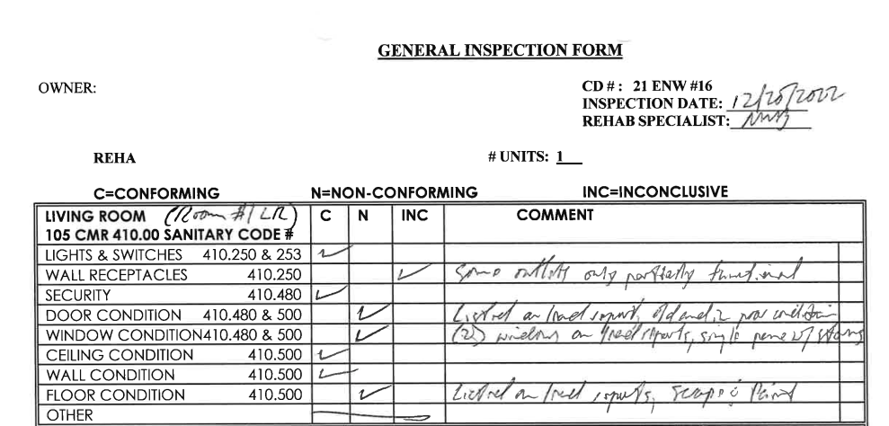

Slide 6
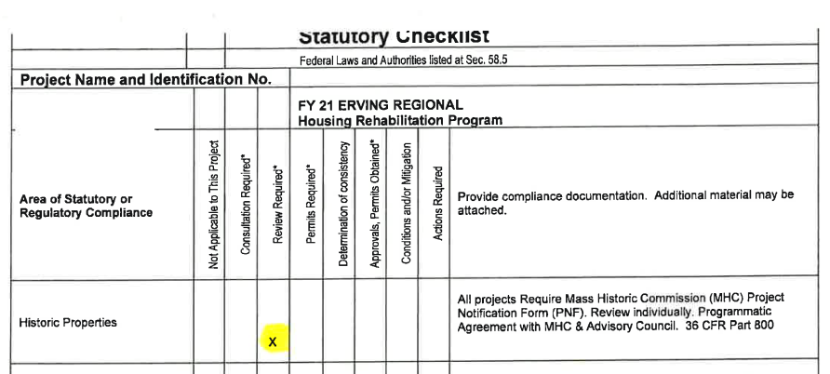
ENVIRONMENTAL REVIEW
ER Statutory Checklist
Review Required Categories
Historic Review
Notes:
Read Lead Report – Highlight and note violations
From here – prepared to move to General Inspection Sheet
Discussions with Homeowners regarding paths to compliance

Slide 7
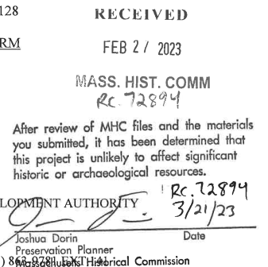

Slide 8
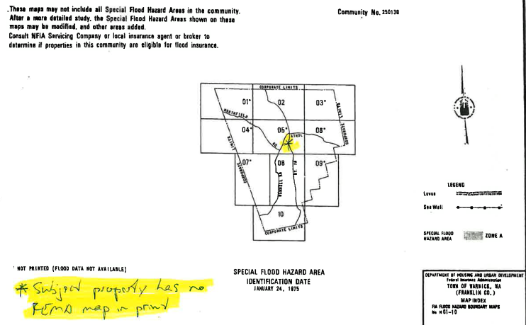
ENVIRONMENTAL REVIEW
Floodplain Management

Slide 9
Toxic Sites

Slide 12
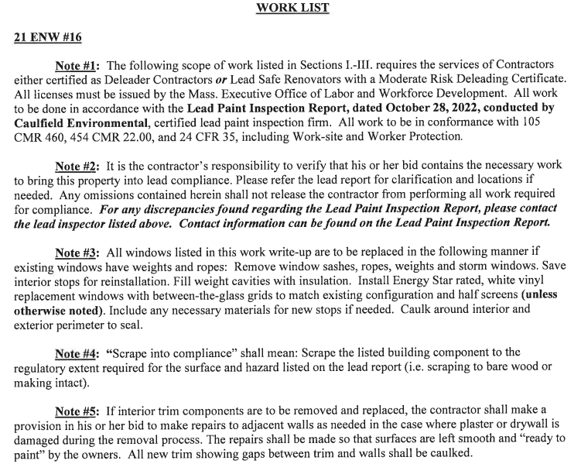
WORK LIST
Performance Standards
If applicable, reference Lead Paint Insp. Report
Notes:
Bid Packet/Additional Documents (customized for each Bid Packet)
Licenses and Insurance Requirements
Water Test
Radon Results
Septic Design
Lead Report

Slide 13
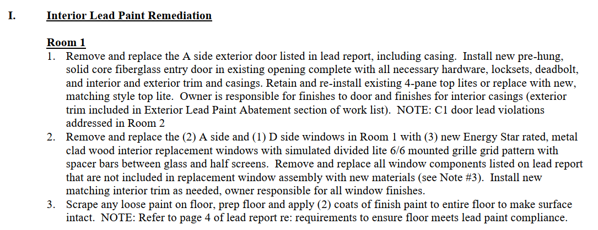
Work List
Locations
Trade Categories

Slide 15
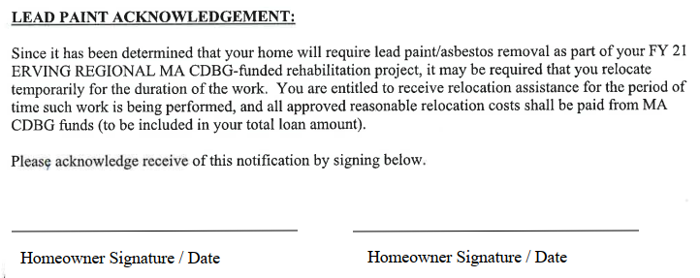
Signatures/Approvals/Acknowledgements

Slide 16
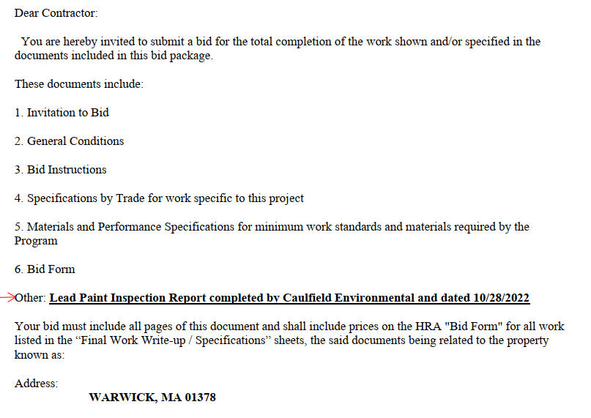
BID PACKET
Invitation to Bid
Notes:
Bid Packet/Additional Documents (customized for each Bid Packet)
Licenses and Insurance Requirements
Water Test
Radon Results
Septic Design
Lead Report

Slide 17
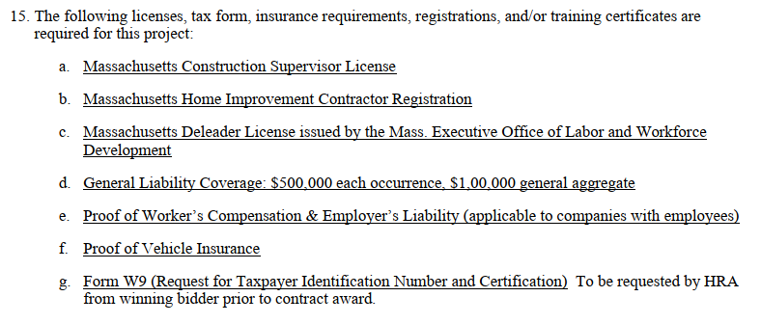
BID PACKET
General Conditions

Slide 18
BID PACKET
Bid Instructions

Slide 19
Specifications

Slide 20
Materials and Performance Specifications

Slide 21
Bid Form *Addendums to Bid Packet

Slide 22
Bid Form *Addendums to Bid Packet

Slide 23
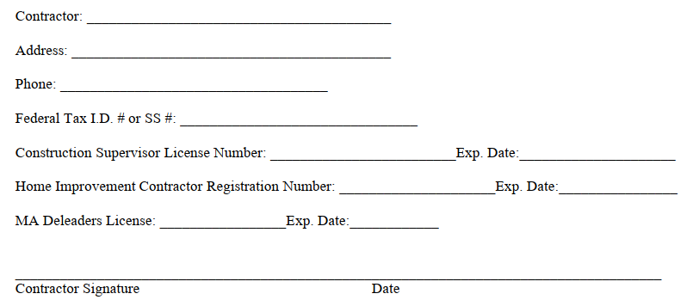
Bid Form *Addendums to Bid Packet

Slide 24
BID REVIEW
Homeowner’s Bidders Log
Bid Summary
Notices to Contractors with Bid results
Insurance/W9/Licenses/Excluded Parties
Notes:
#7 Documents included with Single Case Waiver:
EOHLC Case Waiver Request Form
List of Attachments
Waiver Cover letter to DHCD
Waiver Request Form
GTLO Waiver & GTLO Waiver Approval letter
Lead Paint Report and Lead Paint Soil Samples
General inspection form (with Code citations)
Photos of property
MA Historical Commission PNF approval
Environmental Review
Worklist
Cost estimates for Get the Lead Out and proposed CDBG funded portions of project
Bid Packet
Bid received
Single bid memo

Slide 25
Request for Final Approval and Program Funds

Slide 26
Request for Final Approval and Program Funds

Slide 27
CONTRACTS
Period of Performance
Final work write-up
Provisions for termination
Provisions for change orders
Warranty & release of lien provisions
Provisions for contractor damage
Dispute Resolution
Signature Pages

Slide 28
LOAN CLOSING
Loan Documents
Promissory Note
Assignment of Funds
Mortgage
Right of Rescission
Rental Agreements
Temporary Relocation Agreement

Slide 29
CONSTRUCTION PHASE
Contractor Notice to Proceed
HRA Oversight
Communications with Homeowners, Contractors and Inspectors
Sign Offs/Official Sign Offs
Lien Release/ Building Insp/ Electrical/Plumbing/Lead Compliance/Board of Health/etc.

Slide 30
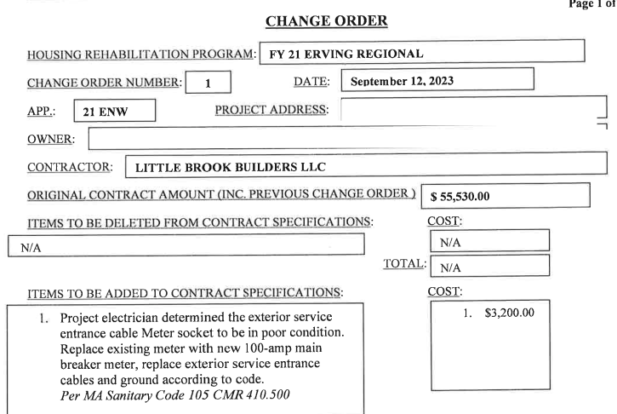
CONSTRUCTION PHASE
Change Orders

Slide 31
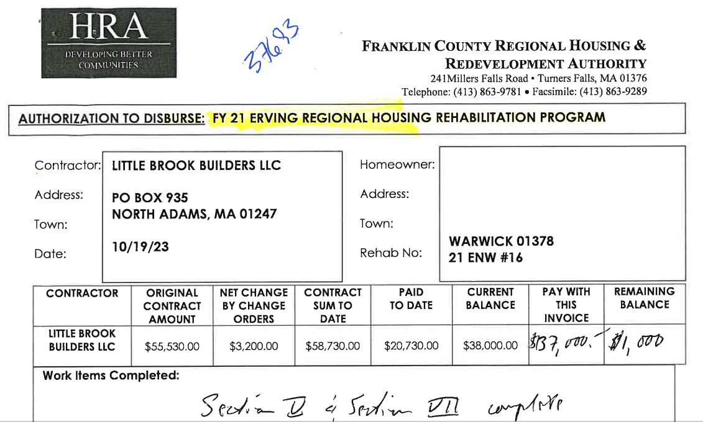
CONSTRUCTION PHASE
HRA Inspections/Payments/Permits

Slide 32
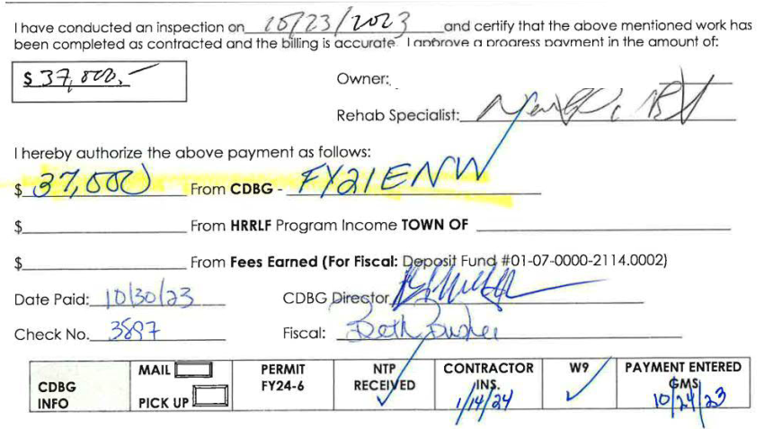
CONSTRUCTION PHASE
HRA Inspections/Payments/Permits

Slide 33
PROJECT TRACKING/GRANT FUNDS/MEETING UNIT GOALS
Inter-Department Communication
Project Tracking Sheets
Notes:
Due Dates

