Slide 1
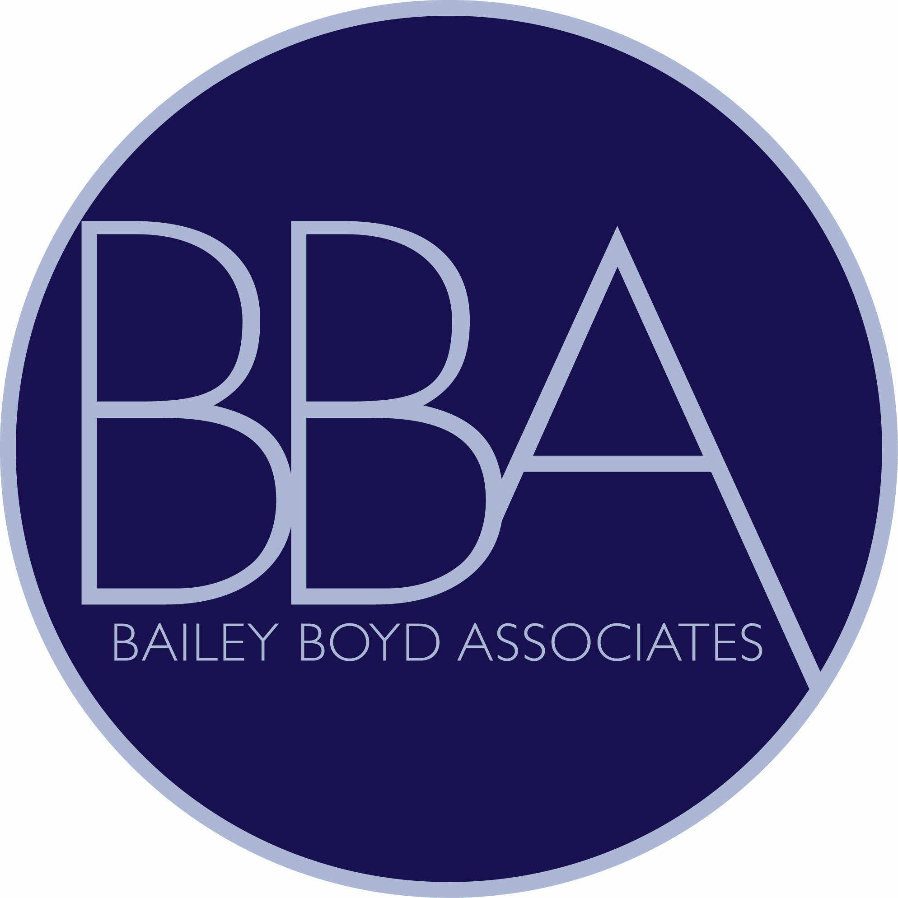
Housing Rehab Tips & Tricks
Setting Up for Success
Cassie Boyd Marsh
Bailey Boyd Associates

Slide 2
Outline
Introduction: BBA’s Background & Our Experience
Housing Rehab Program Marketing
Identifying Partners in the Community
Identifying Contractors
File Management
Sample Dropbox File Protocol
Project Pacing
Sample Project Matrix
Conclusion, Questions?

Slide 3
Introduction
Bailey Boyd Associates is a small consulting firm that’s been in operation for over 30 years, founded by Alice Boyd. I joined BBA about 15 years ago and took over as owner a year ago as Alice transitions (slowly!!!!!) towards retirement.
Over the years we’ve worked on a wide range of projects, from large municipal construction to economic development, social services and community housing.
We work with our municipal partners from project conception through the application process and as their grant administrator until project closeout.
Housing rehab has been, and continues to be, the center of most programs we administer. Through the years, we’ve worked with 45 MA communities and helped rehab more than 1,500 homes.

Slide 4
HR Tips & Tricks
We’ll be looking at the ‘pre-construction’ portion of the HR program. Starting with preparing to apply for CDBG funds up until homes are going under contract to begin construction.
In our experience, the start-up can be the most challenging part of the grant cycle. There are a lot of moving parts and a difficult start can impact the trajectory of your year.
Finding a balance that keeps progress moving forward, without it becoming overwhelming, is a scale we struggle to balance every year. We hope that some of these ideas may help your programs achieve that balance.
Before we get started, these tips & tricks are simply that. The ideas that have worked well for us over years of trial & error. Many may be obvious or may not have worked for your community. If you have new ideas that work, we’d love to hear them! And when in doubt, check with your Program Rep!

Slide 5
Marketing
Before Submitting your CDBG Application:
Educate the community
Temper expectations: start-up timing, program pace
Identify community partners
Pre-App collection: 2-3x the number of units you plan to rehab in grant application
Post Award/Start-Up:
Spread the word! Continue sharing pre-apps, growing the waitlist
Reconnect with partners you identified during the application process
Methods we’ve had success with:
Inserting a mailer in the municipal tax bill
Fliers sent through ‘email flyer’ programs at local schools & town lists
Facebook- not just the municipality’s Facebook page, but community-run groups

Slide 6
Marketing
Word of Mouth:
If you’re fortunate enough to have the first year of an HR program behind you and have secured a second year of funding, word of mouth is your new best friend.
Happy customers will do more to bring in new applicants than any other tool we’ve found.
Eligible residents may be hesitant to apply, or suspicious that this program is ‘too good to be true’. Chatting with their neighbor and hearing about their positive experience is often enough to change their tune.
Empower your happy customers! Think of the past clients you know who love the program and may be willing to help. Ask them if they’d be willing to attend an info session or be interviewed for a Council on Aging newsletter.

Slide 7
Identifying Partners in the Community
This is a big part of the Marketing process but extends to the entirety of your program. They’ll help you spread the word to residents in need, are often the first to identify ‘emergencies’ and may be aware of additional funding available for a project.
Council on Aging: CoAs are the gateway to your elderly residents who are trying to age in place, many of whom cannot afford to maintain their homes. Most CoAs are well-organized and excellent partners. They may be willing to host info sessions, provide a familiar space for client meetings, or help identify potential clients.
Past Participants: It bears repeating. Happy homeowners are invaluable partners in your community!

Slide 8
Identifying Partners in the Community
Here’s a rundown of some of the other organizations we work closely with:
Town building department
Code enforcement staff
Town/County Hoarding Task Force or Community Hoarding Agency
Food Pantry
Family Services Agencies
Fire & Police Departments
Local Weatherization & Fuel Assistance Programs
Social Service Organizations, particularly those that focus on LMI residents, elders, families, etc.

Slide 9
Identifying Contractors
Any of us who have operated an HR program knows that contractors can be your best friend or your biggest challenge. Identifying a strong group of contractors to bid on your projects is key.
First: Where are they?: Before you can determine if a contractor is the right fit for the CDBG HR program, you need to find them.
Lumber yards: Historically, we’ve had the most success finding contractors when we’ve hung out at the contractor’s desk at the local lumber yard with a box of donuts & some flyers.
Building Department: Who’s pulling permits? What contractors are acing their inspections?

Slide 10
Identifying Contractors
Next Up: Engaging Contractors:
Appeal to their sense of community! The mission of this program speaks for itself. Bidding on CDBG HR projects allows them to complete work for residents who couldn’t otherwise afford it.
Feast & famine: Our long-time contractors can tell you. Construction may be busy post-COVID, but the dry spell will come. And through the tough times, CDBG HR projects have kept many great contractors afloat.
New Contractor Phase-In:
When a new contractor enters the program we limit their bidding through a ‘trial phase’.
New contractors may only bid on 1 project at a time. If they are awarded a contract, they must complete the project successfully before bidding again.
If all goes well, we’ll increase the number of projects the contractor may have going at one time.
In rare cases, after a first project, one or both parties decide that the contractor is not the right fit for the program. Limiting their exposure to projects early on reduces the impact their leaving has on your program.

Slide 11
File Management
For about a decade now we’ve used Dropbox to maintain all client files. We hold one paper file for ‘original signatures’ as needed. Everything else is digital.
Each approved project gets the same file setup. The ‘starter’ file includes the blank forms in the appropriate files.
This allows programs to keep emails, screenshots, and all other working documents.
In addition to being a lifesaver during Covid, it allows programs to share access to necessary documents quickly- whether to a homeowner, contractor, Grant Administrator, or EOHLC staff person.

Slide 12
File Management: List of Project Files
PROJECT: YTHR22-01 SMI
Documentation Checklist
Application
Verification of Income Worksheet
Income Documentation
Bank Statements
Deed
First Page of Mortgage
Real Estate Taxes
Homeowners Insurance
Field Card
Debt to Value Assessment
Title Search
Credit Check
Statutory Checklist
MHC Form
Lead Paint Documents
Project Intake Documents
Project Bid Package
Project Bids & Results Summary
Loan Agreement & Mortgage
General Contractor & Homeowner Agreement
Project Payments
Permits, Warranties & Release of Liens
Closeout
Correspondence
Post Loan Activities
Single Case Waiver

Slide 13
Project Pacing
In our experience, learning how to successfully pace a CDBG HR program is critical. For us, that means working on multiple parts of the program simultaneously.
Once our HR program is ready to start accepting full applications, we contact the first 5-8 apps on the waitlist. We work through the approval process, site visit and initial WWU. As those projects are starting to go out to bid, program staff will start again with the next 3-5 applications.
In our experience, getting a project under contract accounts for the majority of the program staff’s workload (though we can all remember projects that went smoothly right until mid-construction!).
Having projects in multiple phases of the program preserves your staff resources and keeps you marching toward your milestones. For new programs, we find it’s especially helpful as your program has much more flexibility. Plus, no one can stay sane after income-qualifying 20 homes in one go!

Slide 14
Project Pacing: Project Matrix
We also rely on our project matrix, kept on Dropbox next to the individual project files. This is a dynamic spreadsheet that provides a snapshot of program status and individual projects.
Each program staff member, plus the grant administrators and fiscal staff members has access. It can also be shared with Rehab Specialists. With that many hands in the files, you need a live status document.
The individual project files are incredibly detailed, so this provides a zoomed-out view of the program as a whole.
Some Program Managers color code as well, to help provide a ‘quick glimpse’ status update. For example: yellow= application approved, blue = project out to bid, green = under construction, red = project closed, etc.

Slide 15
Project Matrix

Slide 16
Conclusion, Questions
Thank you! And may all your start-ups be smooth!
Questions? Comments?

