Slide 1

Health Safety Net
Annual Report
Fiscal Year 2020
December 1, 2020

Slide 2

Table of Contents
Introduction | 3
HSN Overview | 4
HSN Fiscal Year Updates 2020 | 7
HSN Total Demand and Payment Trends | 8
Hospital Payments & Volumes | 9
Community Health Centers (CHC) Disbursements | 10
Hospital Demand by Type of Service | 11
CHC Demand by Type of Service | 12
Utilization by Income (Federal Poverty Level) | 13
Executive Office of Health and Human Services
Notes:
2

Slide 3
Introduction
Introduction
The Executive Office of Health and Human Services (EOHHS) hereby submits this report to the Massachusetts Legislature in compliance with Chapter XXX [TBD when budget passes] of the Acts of 2020, Line Item 4000-0300, which calls for EOHHS to report on the utilization of the Health Safety Net Trust Fund, including the following information for Fiscal Year 2020:
  The number of persons whose medical expenses were billed to the Health Safety Net Trust Fund.
  The total dollar amount billed to the Health Safety Net Trust Fund.
  The age, income level, and insurance status of recipients using the Health Safety Net Trust Fund.
  The types of services paid for out of the Health Safety Net Trust Fund.
  The amount disbursed from the Health Safety Net Trust Fund to each hospital and community health center.
This report reflects Health Safety Net (HSN) utilization during HSN fiscal year 2020 (HSNFY20), which ran from October 1, 2019 through September 30, 2020.
Executive Office of Health and Human Services
Notes:
Need to update with Acts of 2020

Slide 4
HSN Overview
Introduction
The Health Safety Net (HSN), created by Chapter 58 of the Acts of 2006, makes payments to hospitals and community health centers for health care services provided to low-income Massachusetts residents who are uninsured or underinsured.
  Massachusetts residents who are uninsured or underinsured and have household incomes up to 150% of the Federal Poverty Level (FPL) may qualify for HSN primary or HSN secondary.
  If residents have incomes above 150% and up to 300% of the FPL, they may qualify for primary partial HSN or secondary partial HSN, which includes a sliding scale deductible based on income.
  Low income residents who are enrolled in MassHealth, Medicare or other insurance may qualify for HSN secondary for certain services not covered by their primary insurance.
  Individuals eligible for ConnectorCare (regardless of enrollment) are eligible for HSN for the first 100 days of eligibility, after such time they are eligible for HSN dental only.
  If a Massachusetts resident has allowable medical expenses that exceed a certain percent of their countable income, they may qualify for Medical Hardship, in which case the HSN would pay for HSN qualified services. Individuals who qualify for Medical Hardship must pay a required contribution, based on their family’s countable income.
Executive Office of Health and Human Services
Notes:
Complete

Slide 5
HSN Overview
Introduction
The HSN pays acute hospitals and community health centers based on services that are eligible for payment. HSN payment rates for most services are based on Medicare payment principles.
The HSN funding total for FY20 was $379,243,482 from the following sources:
  An assessment on acute hospitals’ private sector charges: $165,308,674¹
  A surcharge on payments made to hospitals and ambulatory surgical centers by HMOs, insurers, third party administrators, and individuals (assessment and surcharge are each equal to $160 million plus 50% of the estimated cost of administering the Health Safety Net): $165,308,674¹
  Offset funding for uncompensated care from the Medical Assistance Trust Fund: $32,626,134²
  A $16 million appropriation from the Commonwealth’s General Fund.³
$10,617,348 ($5,308,674 per funding source) is used for HSN administrative funding.
In FY20, disbursements were made to Cambridge Health Alliance ($12,000,000) and Boston Medical Center ($20,000,000) due to offset funding for uncompensated care from other sources.
$15M in funding for the Health Safety Net. $1M in additional funding for demonstration projects.
Executive Office of Health and Human Services
Notes:
Complete

Slide 6
HSN Overview
Introduction
The HSN also allocates funds every fiscal year for demonstration projects designed to address alternative approaches to improve health care and reduce costs for the uninsured and underinsured on a cost-neutral basis.¹ The following demonstration projects were funded in FY20:
Fishing Partnership
  The Fishing Partnership was awarded demonstration funding to connect commercial fishermen with a broad range of professional counseling services, provide assistance with health insurance applications, and offer safety and survival trainings and other special health-oriented events for fishing families: $2,000,000
Enrollment Grant
  Six community organizations (Brockton Neighborhood Health Center, East Boston Neighborhood Health Center Corporation, Greater Lawrence Family Health Center, Lowell Community Health Center, Lynn Community Health Inc., and Whittier Street Health Center) were awarded demonstration funding to support increased enrollment in comprehensive health insurance among low-income residents of the Commonwealth: $1,493,000
Long-Acting Reversible Contraception
  Two community organizations (Boston Medical Center and Upstream USA) were awarded demonstration funding to provide assistance to health care providers, both in the community and hospital settings, with the aim of decreasing the number of unintended pregnancies and improve maternal and infant health outcomes across the Commonwealth: $2,412,030
Note: Each fiscal year, the HSN makes a $1M payment to the Office of the Inspector General for auditing purposes.
$50,000 of demonstration funding is used to pay for the HSN drug utilization review contract.
Executive Office of Health and Human Services

Slide 7
HSN Fiscal Year 2020 Updates
Introduction
  The HSN shortfall decreased from $61M during HSNFY19 to $20M in HSNFY20.
  HSN received and transferred $257.5M to the Delivery System Reform Incentive Program (DSRIP) fund as mandated by the Massachusetts Budget for FY20.
Executive Office of Health and Human Services
Notes:
Complete

Slide 8
Payments
HSN Total Demand and Payment Trends
Demand represents the amount that providers would have been paid in the absence of a funding shortfall.
The HSN shortfall decreased from $61M during HSNFY19 to $20M during HSNFY20.
Note: In FY20, the HSN received A $16M appropriation from the Commonwealth’s General Fund ($15 million towards HSN general fund and $1M directly for demonstration projects)
Notes: The Health Safety Net fiscal year runs from October 1 through September 30 of the following year. Hospital and community health center payments are reported in the month in which payment was made. The shortfall amount is based on spending assumptions in place during the fiscal year and may differ from year-end shortfall estimates reported elsewhere. Data reflect payment and projected demand levels as of the end of each fiscal year and exclude adjustments made after the end of the fiscal year. Numbers are rounded to the nearest million and may not sum due to rounding; percent changes are calculated prior to rounding. Source: Health Safety Net Payment Calculation as of 09/30/20.
Executive Office of Health and Human Services
Notes:
Need to update language in the green text box to reflect FY20 numbers

Slide 9
Payments
Amounts Disbursed to Hospitals from the Health Safety Net Trust Fund
and Offset Funding (after Shortfall)
Total Hospital Disbursements for FY20:
$290,486,852¹
This represents the amount disbursed from the Health Safety Net Trust Fund to each Hospital during HSN fiscal year 2020 and
offset funding from outside sources.
Data reflects amount disbursed based on claims that have been submitted as of the date of this report.
Remediated claims for dates of service in fiscal year 2020 will be paid in subsequent fiscal years²
.
1. The total disbursements listed above incudes a legislative special payment to Boston Children’s Hospital ($3,850,000). The list does not include disbursements to Cambridge Health Alliance ($12,000,000) and Boston Medical Center ($20,000,000) due to offset funding for uncompensated care from other sources.
The Health Safety Net fiscal year runs from October 1 through September 30 of the following year. Hospital payments are reported in the month in which payment was made. The shortfall amount is based on spending assumptions in place during the fiscal year and may differ from year-end shortfall estimates reported elsewhere. Data reflect as of the end of each fiscal year and exclude adjustments made after the end of the fiscal year. Source: Health Safety Net Payment Calculation as of 09/30/20.
2. Remediated claims and calculations are submitted after the conclusion of the HSN fiscal year. Although these claims and calculations are paid in subsequent fiscal years, these claims will be counted against total demand and shortfall for the fiscal year in which it’s date of service fell.
Executive Office of Health and Human Services
Notes:
Complete

Slide 10
Payments
HSN Amounts Disbursed to Community Health Centers
Total Disbursements for FY20:
$69,189,154
This represents the amount disbursed from the Health Safety Net Trust Fund to each Community Health Center during HSN fiscal year 2020.
Data reflects amount disbursed based on claims that have been submitted as of the date of this report.
Remediated claims for dates of service in fiscal year 2020 will be paid in subsequent fiscal years.
Notes: The Health Safety Net fiscal year runs from October 1 through September 30 of the following year. Community health center payments are reported in the month in which payment was made. Data reflects payment as of the end of each fiscal year and exclude adjustments made after the end of the fiscal year. Source: Health Safety Net Payment Calculation as of 9/30/20.
Executive Office of Health and Human Services

Slide 11
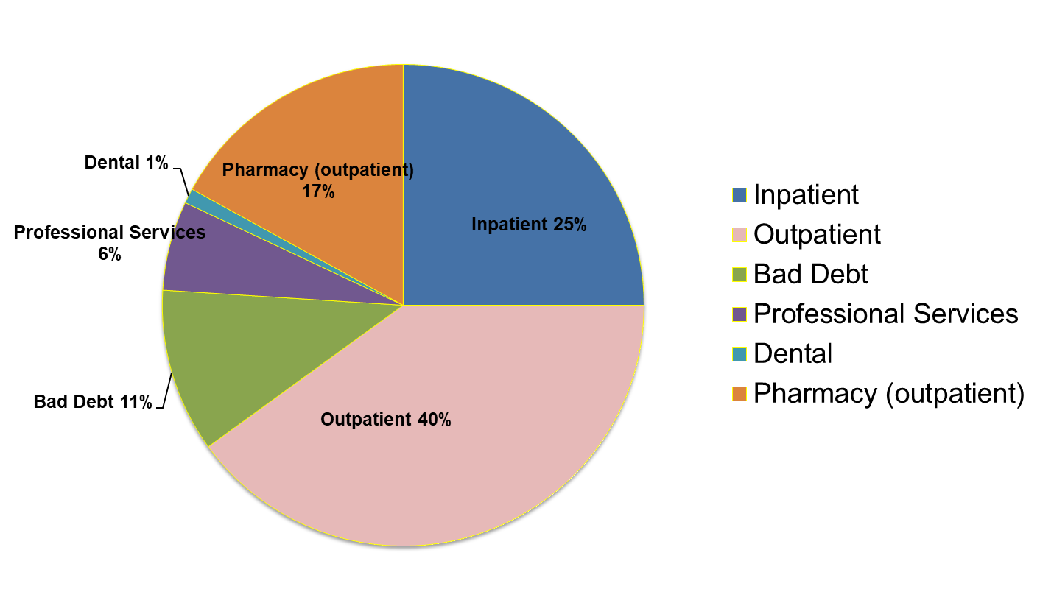
Service Patterns
Service Patterns
Hospital Demand by Type of Service
Notes: The Health Safety Net fiscal year runs from October 1 through September 30 of the following year. Hospital Inpatient excludes pharmacy claims. Hospital inpatient payments are reported in the month in which the service was provided. Source: Health Safety Net Data Warehouse and Health Safety Net Payment Calculation as of 11/17/2020.
Executive Office of Health and Human Services
Notes:
Need to update chart with FY20 numbers

Slide 12
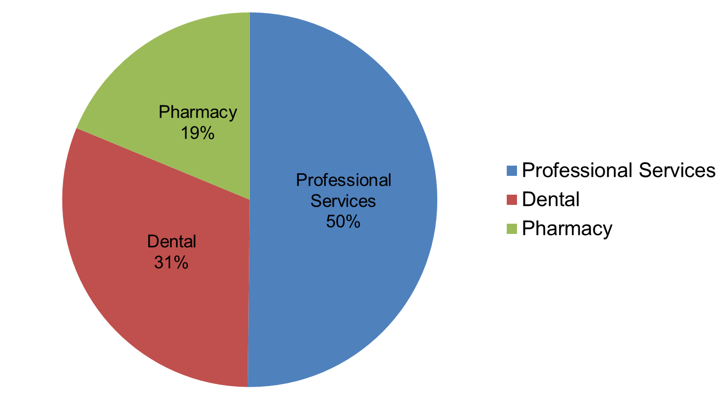
Service Patterns
Service Patterns
HSN CHC Demand by Type of Service
Notes: The Health Safety Net fiscal year runs from October 1 through September 30 of the following year. Source: Health Safety Net Payment Calculation as of 9/30/20.
Executive Office of Health and Human Services
Notes:
Complete

Slide 13
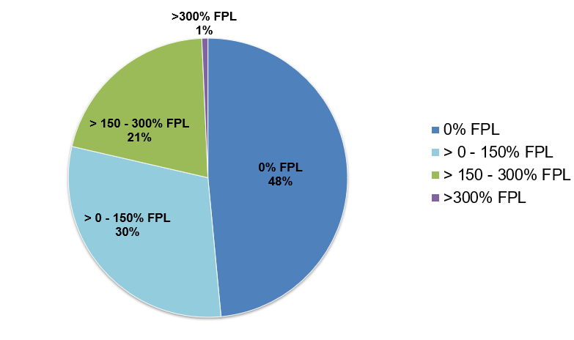
Service Patterns
Service Patterns
HSN Hospital Utilization by Federal Poverty Level (FPL)
Notes: Please note dental payment information is not included in the above calculation. The Health Safety Net fiscal year runs from October 1 through September 30 of the following year. > 300% FPL includes individuals qualifying for Medical Hardship. Source: Health Safety Net Data Warehouse as of 9/30/2020.
Executive Office of Health and Human Services
Notes:
Complete

