Slide 1
Development of Support Budgets for Self-Direction
SDAB Meeting
June 7, 2023
Valerie Bradley (Vbradley@hsri.org)
John Agosta (Jagosta@hsri.org)
Colleen Kidney (CKidney@hsri.org)
Henan Li (Hli@hsri.org)
Notes:
Notes Page Title Here
(edit this in notes view)

Slide 2
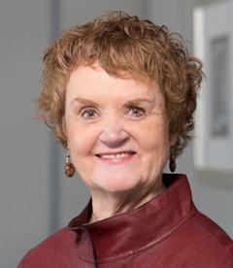
PRESENTED BY
Valerie Bradley, M.A.
Vbradley@hsri.org
she/her
John Agosta, PhD
JAgosta@hsri.org
he/him
Colleen Kidney, PhD
CKidney@hsri.org
she/her
Henan Li, PhD
HLi@hsri.org
he/him
The Human Services Research Institute is a national non-profit that was founded in 1976 to improve the availability and quality of supports for children and adults with disabilities and other vulnerable populations.
We have worked for the federal government, in all 50 states, in multiple Canadian provinces, and further abroad. Underpinning our work is a simple belief:
All people and their families have the right to live, love, work, play and pursue their life aspirations in their community.
www.hsri.org
Notes:
Notes Page Title Here
(edit this in notes view)

Slide 3
Overview
In late 2021, the Department of Developmental Services contracted with Human Services Research Institute to:
Conduct a qualitative analysis of the PDP and AWC programs building on the 3-year evaluation that HSRI conducted previously
Analyze current assessments and budget allocations
Develop a budget allocation process

Slide 4
Themes
Learning about self-direction
Choosing self-direction
Managing self-direction
Getting support to navigate self-direction
Developing the budget
Clarifying what is allowable

Slide 5
Recommendations: Equitable, Transparent and Streamlined Policies
Consolidate of service codes
Move to an a la carte menu
Create budget transparency
Create menu transparency

Slide 6
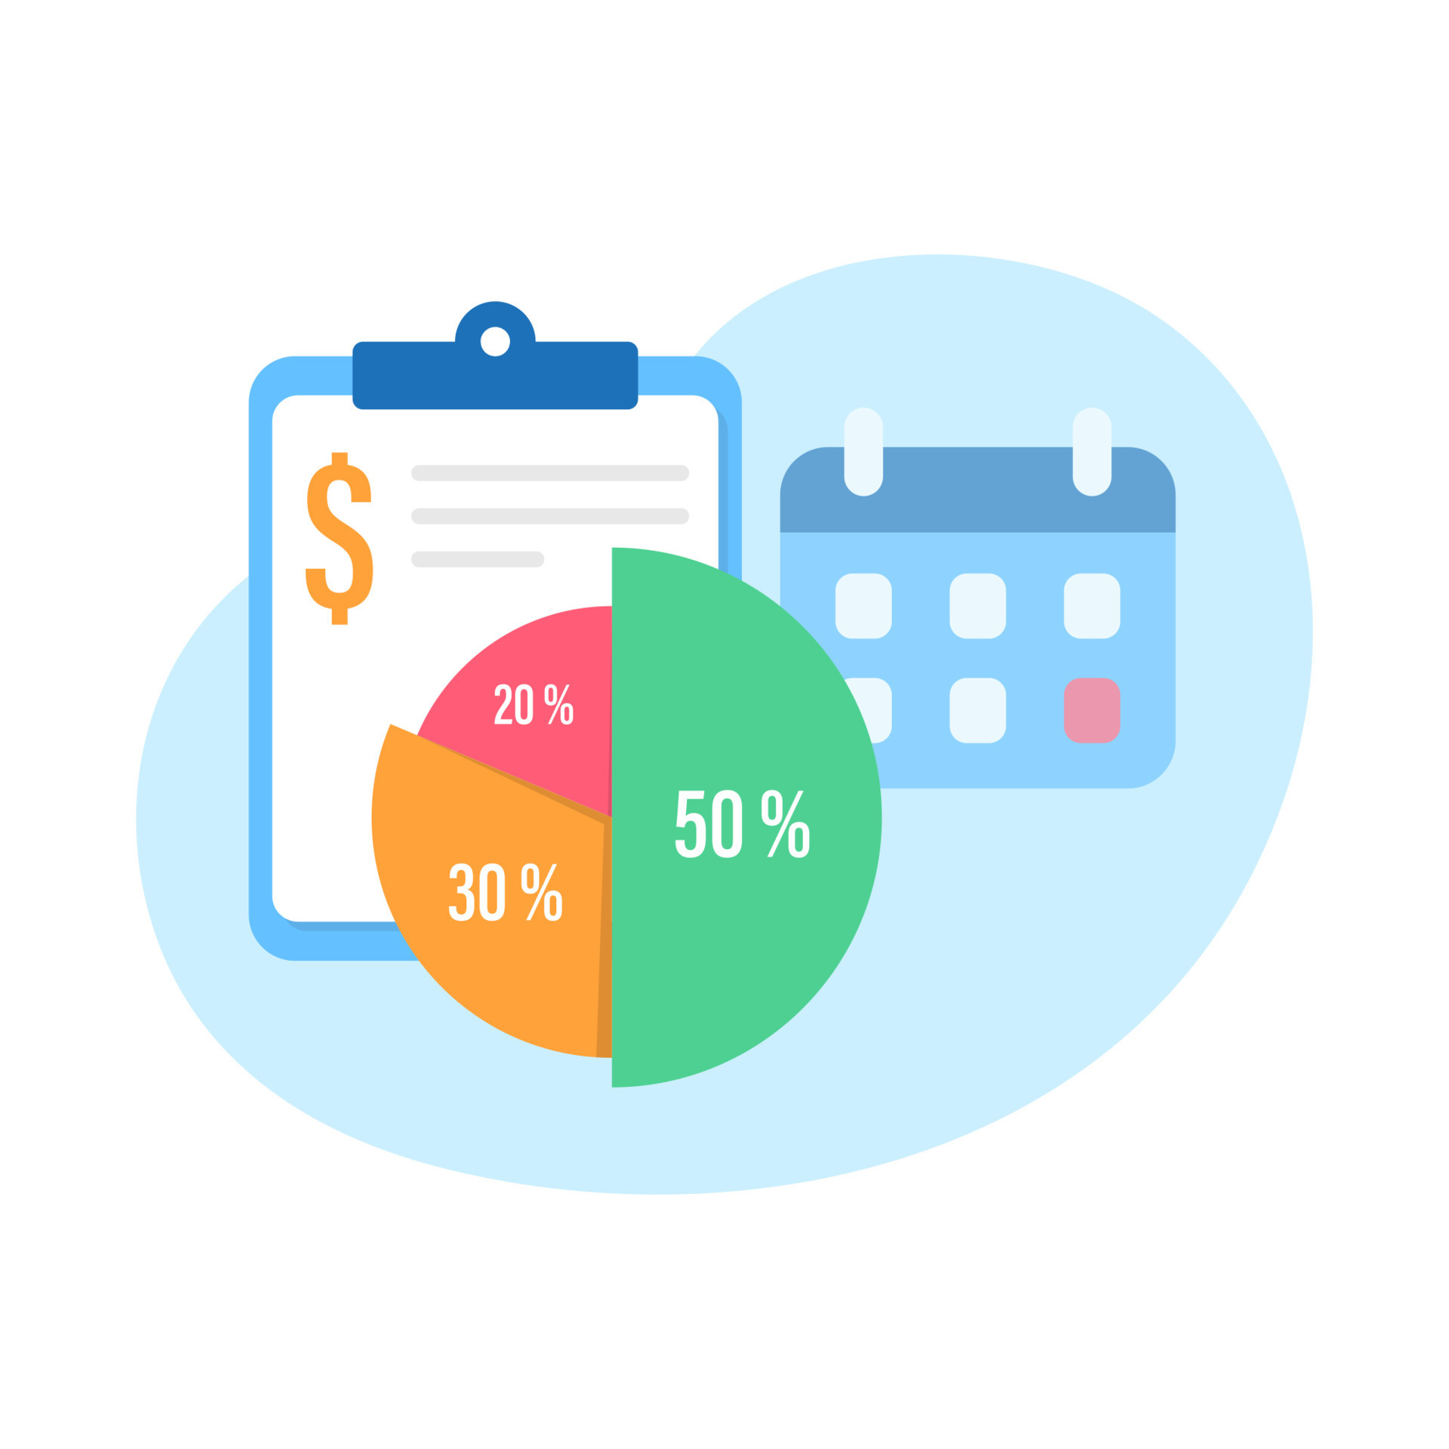
Developing Support Budgets for Massachusetts

Slide 7
HSRI uses a supports level approach, so that...
A supports budget is a targeted amount of money, or allocation that is made known to individual service recipients before service planning to acquire the services they need and prefer. The amount is determined by:
assessing the extent of an individual’s support needs, while accounting for their type of residence and age group. Additional factors may also be considered.
Agreeing on the service mix – the type and amount of services – people will typically be allocated according to their assessed need, residence, and age.
An exceptions review process is also used to ensure that extraordinary needs are addressed.
Notes:
Benefits
Increased personal control over resources, encouraging “demand driven” approaches.
Opportunity to alter service array and rates to match demands.
Increased fairness among all service recipients.
Increased allocative efficiency.
Increased predictability of overall system allocations and spending.

Slide 8
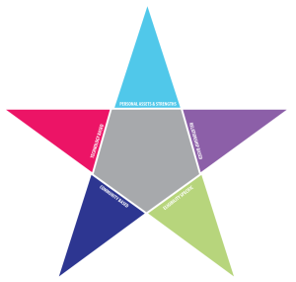
The Supports Budgets Process
While the specific circumstances of each jurisdiction’s system transformation are unique, the overarching goal of a supports budgeting
process is to create a system that is efficient, fair, and person-centered.
Policy
Intentions
Assessment & Service Supply
Personal Support Budget
Why?
Service Planning
Service Delivery
What problem(s) are being addressed?
- Self-direction
- Community integration
Expanded resources
Efficiency & equity
- System planning
Support needs - Support levels
- Service array
- Rate structures
- Service mixes by support level, residence type and age group
- Support budget
- Person-centered
- Integrated planning
- Community-centered
- Choice
- Quality
- Services that are adequate
and ample
INTENTIONS
ACTIONS
OUTCOMES
Financing Strategy &
Communication

Slide 9
Assessing Support Need
Measuring support need of individuals with IDD typically refers to:
Assessing the need people have to complete tasks of every-day living (e.g., ADLs, IADLs)
Assessing needs people have resulting from medical conditions or challenging behavior
Support need for daily activities can be quantified from low to high need within a population
Medical and behavioral support needs may be present across the spectrum of daily support needs

Slide 10
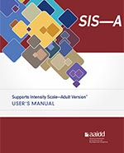
Using the Supports Intensity Scale - Adult
The SIS suite of tools shift the focus from deficiencies to support needs, by evaluating the practical supports a person needs to lead an independent life. The assessment is done through an interview with the person being assessed and those who have known the individual for at least three months.
The Supports Intensity Scale (SIS-A) measures an individual’s:
Exceptional Medical and Behavioral Needs: Documents extra support needed to deal with specified medical and behavioral conditions. Two sub-sections address these domains:
Medical Supports Needed B. Behavioral Supports Needed
Support Needs for Life Activities: Documents support needs according to frequency, amount, and type of support needed. Seven sub-sections include:
Home Living Activities E. Health and Safety Activities
Community Living Activities F. Social Activities
Lifelong Learning Activities G. Protection and Advocacy
Employment Activities
Scores from these sections are aggregated to provide a composite scale score to illustrate the magnitude of individual support need but also this need relative to others.
See: https://www.aaidd.org/sis/sis-a

Slide 11
Medical and behavioral support needs
During the SIS assessment, Supplemental Questions are asked that pertain to medical and behavioral support needs.
Certain responses may indicate that further review of support needs is warranted. These support needs are verified.
Verification is a record-review process where an individual or team with medical and behavioral expertise review case records to get a better understanding of the individual’s needs and determine if the person’s medical or behavioral support needs warrant inclusion in a specialized support level.

Slide 12
What about exceptions?
Everyone is unique!
The supports budgeting process may account for most people.
Yet some people will have exceptional needs and must be considered one by one.
An Exceptions Process is designed to ensure that these individuals have their needs met.

Slide 13
Immediate Next Steps
Finalize the Supplemental Questions
Submit data request for roster data, gather data
Finalize sampling plan and select 500 participants
Complete training for AAIDD SIS-A interviewers
Work with DDS to ensure that interviews are completed (e.g., what to do if participant refuses interview or requests a re-assessment, verify flagged participants, )
Gather SIS-A & SQ data from SIS-OnLine
Submit data request for service use and spending data related to the 500 participants
Complete analyses and build supports budgets
Work with DDS to set plans to test the supports level framework and support mixes
Notes:
Notes Page Title Here
(edit this in notes view)

