Slide 1
Evaluation of the MA Real Lives Bill and Self Directed Supports
Update for Self Determination Advisory Group
March 1, 2017

Slide 2
Summary
Review of Plan for Y1
Update on work we have done
A few things we’re finding
Next steps

Slide 3
Our team
HSRI team includes Val Bradley, Lee Vorderer, Bevin Croft, Kevin Mahoney (contractor), Cheryl Sartori, Alixe Bonardi, Elizabeth Pell (early phases)
With assistance from DDS staff: Mary Barry, Gail Grossman, Brad Keddal, Kathy Phillips
Numerous DDS staff have generously shared insight through interviews.

Slide 4
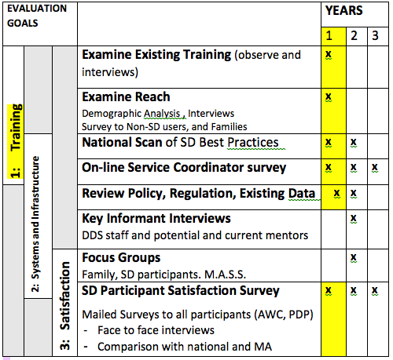
Evaluation Plan
Year 1 focused on Evaluation of Training and Outreach and
Identifying Best Practices in SD
SD Participant Satisfaction survey done each year

Slide 5
Year 1 overview
What is currently being done?
Examine (observe) existing training and outreach efforts
Examine/evaluate web site(s)
Gather best practices in other states
Who is enrolling?
- Analyze data to understand demographics
- Surveys to people and families who don’t use SD.
How is the implementation of Real Lives Bill going?
- Surveys to SD users and Service Coordinators
- Key informant interviews

Slide 6
Trainings / Meetings
Training calendar shared by Brad Keddal
Attended sessions aimed at people considering SD, staff interested in learning more, formal trainings, informal discussions,
Used structured evaluation forms to collect impressions from people at training sessions
HSRI staff used structured observation protocol

Slide 7
Key Informant Interviews
Area Directors / Regional Directors
Regional SD Support Managers
DDS staff including leadership
Association of DD providers
Senators Barrett and Sanicandro
Other people who are knowledgeable about SD roll-out and implementation in MA

Slide 8
Learning from other states
8 states identified as having innovative or well established SD models: CT, ID, NJ, OH, OR, PA, TN, WA, WI
Interviews are underway

Slide 9
Surveys
SD Non-participant
Family
SD Participant*
PDP and AWC
Service Coordinators*
MAIL Survey
On Line Survey
* Will be sent out in all years

Slide 10
Surveys
Currently being finalized
Will be fielded in March/April 2017
Beta testing of surveys:
Draft Family surveys shared through Families Organizing for Change
Focus groups with self advocates are being scheduled to gather feedback and make any final corrections to tool before sending.

Slide 11
What we are learning
SD is discussed at all regional / area forums for families, providers, consumers
Once individuals or families show interest – there are resources to help get more information.
People are motivated to explore SD when they hear of success from people currently doing it (posters, pictures, success stories)

Slide 12
What we are learning (cont’d)
Getting started with SD is a lot of work. It’s important to let people know this – and what support they can get.
People need new skills to self direct and not everyone thinks they can/will take on those skills (paperwork, managing staff etc.). Multiple types of supports are needed (training guides, personal contact etc.)
Multiple people, including ‘Mentors’ or ‘navigators’ can be instrumental in helping families to get SD off the ground.

Slide 13
Next Steps
Send surveys / data entry / analysis
Demographic analysis
Review of websites that describe Real Lives / Self Direction options, and the RL provider website.
Year 1 (Training and Outreach) report to DDS (late summer 2017) to include evaluation of training approach, reach and scope of trainings, examples from other states, efficacy and scope of outreach, enrollment, recommendations.

