Slide 1
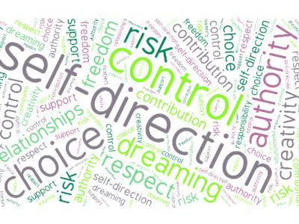
Real Lives Evaluation: Progress Report
Valerie Bradley, Human services research Institute
Real Lives Advisory Committee
June 7, 2018

Slide 2
Evaluation Goals
Goal 1: Current focus
Evaluate the effectiveness of training and outreach efforts currently being used in Massachusetts.
Goal 2:
Evaluate the quality and effectiveness of systems in place to support self-direction.
Goal 3: Evaluate satisfaction of services for individuals currently directing their services and supports.

Slide 3
Evaluation Tools
Interviews
Observations of trainings, educational sessions
Focus groups
Review of training and education materials
Review of websites
On line survey with service coordinators/service brokers
Mail surveys of PDP and AWC participants
Mail surveys of non PDP and AWC participants
Mail surveys of family members
Review of best practices in self direction in other states
Review of DDS data

Slide 4
Best Practices in Self-Direction from Other States
The program needs to be clear and simple with a modest number of self-direction options;
A clearly organized set of policies and steps to follow is a plus;
States that had self-direction specialists who became proficient in helping people decide on self-direction and then operationalize their plans were more successful;
Support from peers mentors and self advocates and experienced family members, i.e., people with lived experience makes a difference;
Special supports are needed for participants who do not have a large involved network of family and friends. Promising practices range from registries to the ability to purchase extra support;

Slide 5
Year 1: Progress to Date
Completed best practice reviews – NJ, TN, CT, ID, PA, and OH
Completed review of training curricula
Completed observations of training and educational sessions
Interviewed DDS staff, SD leads, service coordinators, service brokers, advocates, legislators, and PPL staff
Circulated on line surveys to service coordinators/service brokers
Distributed mail (and on line survey link) to families, PDP and AWC participants, non participants and families
Conducted a preliminary review of DDS data on participants in SD and non participants

Slide 6
First Impressions
Brief observations of findings to date

Slide 7
Key Informant Interviews: A few Observations
AWC staff noted the importance of giving families and people with IDD more information about the option and providing more individual support through the agency
A monthly meeting for individuals and families who are self directing that included role-playing and the ability of individuals and families to talk about what’s working and what’s not would be beneficial.
There is a need for more cross-cultural materials and training including translating materials
Rules and regulations governing SD need to be stabilized so that there is a predictable process

Slide 8
Website Review
There are multiple websites that include valuable information related to the implementation of the Real Lives Law and to Self Direction
However, they are not easy to find, and are not centrally located or easy to access.
Cross-linking to the multiple sites may increase the availability of resources, however DDS should consider creating a short list of the best and relevant materials including training guides, links to PPL and the resource locator website, and making those available in one place.

Slide 9
Surveys Returned to Date
Agency with Choice Participants – 29 (100% of participants – 355)
Participant Direction Program -- 70 (100% of participants - 528)
Family Survey – 153 (sample of families-- 600)
Online Survey of Service Coordinators – 103 (100% of SCs -- 372; survey closed)

Slide 10
Next Steps
Where do we go from here?

Slide 11
Next Quarter Activities
Analyze DDS data (e.g., characteristics of participants and non-participants, regional differences, most frequently used services by PDP participants)
Circulate non-participant survey
Finish interviews with Real Lives Advisory Board members
Enter and analyze survey responses
Prepare summary report on best practices from other states
Meet with DDS staff
Prepare draft and final Year One report

Slide 12
Questions?
vbradley@hsri.org

