Slide 1
Supports Budgets Development Overview
June 2025

Slide 2
HSRI team
Colleen Kidney
Project manager
Jasmine Hepburn
Project coordinator
Yoshi Kardell
Policy consultant
Val Bradley
Policy consultant
Jodi Franck
Data manager, SIS-A reporter
Virginia Juarez
Data analyst
Henan Li
Data analyst

Slide 3

Image
In order to add an image, click on the
image icon in the center. Find and insert
your image. To correct the sizing,
use the Reset button.
We believe that all people and their families have the right to live, love, work, play and pursue their life aspirations in their community.
Notes:
Talk about values here: Respect
Value-based decision making
Solution-focused planning
Trust & Transparency
Person-centered driven
av

Slide 4
Overarching project purpose/goal
Key characteristics of framework
Fair, consistent, and efficient use of resources
Data-driven, mixed-methods, and defensible means of determining budgets that also includes multiple avenues for people to seek support for unique needs not captured in framework
Emphasizes community engagement
Transparent
Allows for some flexibility and change over time
Responsive to policy intentions
Improves ability to predict spending based on known needs
Consistent with G.L. c. 19B, § 19, develop a supports budget framework for people receiving self-directed services in Massachusetts that provides budgets equivalent to those receiving traditional services.
Notes:
Val will introduce the project (blue side)
Colleen will talk about the characteristics of the framework

Slide 5
Overview of support budget development tasks
Data collection and analysis
Population data analysis
Level framework development
Preliminary level framework determination
Support budgets development
Preliminary budgets determination
Record review
In November 2026
Verification process development
Support needs data analysis
Service use and spend data analysis
SIS-A data collection
Through March 2026
Through June 2026
Through October 2026
Community engagement throughout process
Final report upon completion of tasks

Slide 6
SIS-A data collection
Purpose: to have a representative sample of SIS-A assessments in both the self-direction and traditional populations for analysis
Currently underway
Sample contains people who self-direct and receive traditional services
HSRI analyzes the data monthly to ensure quality and representativeness
Sample set to be completed April 2026

Slide 7
Support needs data analysis
Purpose: to explore trends in support needs across the population, including comparing needs between SD and traditional samples as well as between MA and national SIS-A data
Initial work done monthly in SIS-A assessment reports, but analyses will be in greater depth once samples are complete
Can conduct more in-depth analysis once SD is complete, but final analyses will require traditional sample to be completed as well

Slide 8
Preliminary level framework determination
Purpose: Determine the number of levels and criteria for assignment to each level using statistical testing and create level descriptions for each level
Once we have completed in-depth descriptive analyses of the sample data, we will focus analysis on creating a statistically sound level framework
Analyses will follow work we conducted nationally with nearly 200,000 SIS-A assessments and across 9 jurisdictions in the past 5 years
We use a statistical modeling procedure called latent class analysis as the backbone of our work for levels related to general needs (i.e., not extraordinary needs), though we often supplement the analysis with other tests to support the findings that come of the initial analysis, including general linear modeling
Additional analyses are conducted to identify criteria for levels for people with extraordinary needs, typically in medical and/or behavioral

Slide 9
Preliminary level framework determination
Questions that the latent class analysis helps us answer include:
What is the most appropriate number of levels for a general support needs framework?
What scores best create levels that include people who are similar to one another and different from people in other levels?
Which parts of the SIS-A should be used to assign people to levels?
1
2
3

Slide 10
Preliminary level framework determination
Creating criteria for levels for people with extraordinary medical and/or behavioral needs involves a series of analyses such as:
  Descriptive understanding of the proportion of people with high scores in these sections of the SIS-A
  Comparative analysis across states with similar SIS-A needs
Since Section 1 of the SIS-A is not part of the standardized part of the assessment (Section 2: Support Need Index) and therefore has more room for interpretation and application of the data, we also will present findings to DDS to explore potential options for criteria for these levels

Slide 11
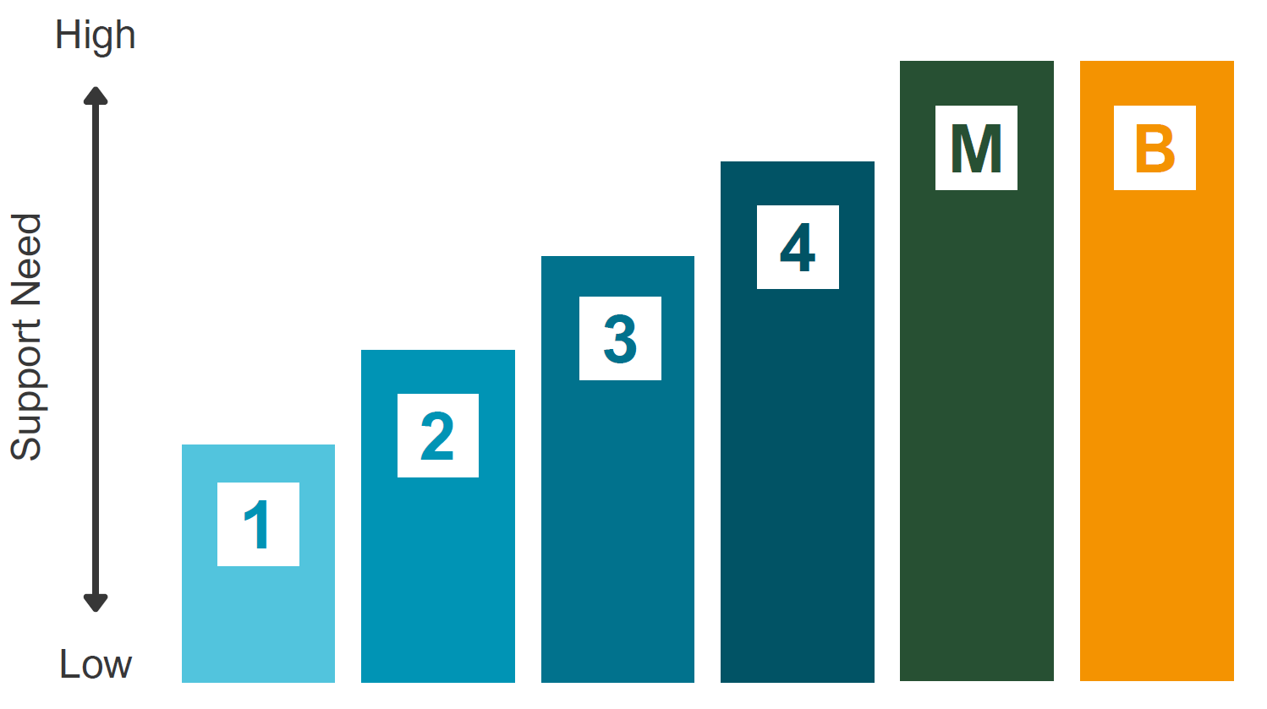
Example 6-level Support Level framework
The framework we recommend may have a different number of levels or be different in other ways than this example!
Level | Level description | SNI score | Medical score | Behavioral score
1 | Low general support needs | Up to 82 | any | any
2 | Moderate general support needs | 83-97 | any | any
3 | High general support needs | 98-113 | any | any
4 | Very high general support needs | 114 and higher | any | any
M | Extraordinary medical needs | any | 9 or higher | any
B | Extraordinary behavioral needs | any | any | 11 or higher

Slide 12
Preliminary level framework determination
In addition to developing the number of levels and criteria for level assignment, we will create “level descriptions”
Level descriptions are narrative, plain language descriptions of the typical needs of a person in each level, and will exemplify the range in needs within each level
Level descriptions are developed based on analysis of the characteristics of people in each level
Descriptions may be as succinct or thorough as needed once DDS determines what is most useful

Slide 13
Verification process development
Purpose: To develop a process addressing potential gaps in SIS-A results and avoid people being underserved and/or seeking exceptions in larger numbers, as well as apply information from the Supplemental Supports and Caregiver Context Assessment to the framework
Supplemental Questions in the SIS-A, as well as the Supplemental Supports and Caregiver Context Assessment, may be used to identify people who do not automatically meet the threshold for membership in levels dedicated to those with extraordinary need
  E.g., if someone has very extraordinary medical needs in just one item of the SIS-A, they will not score automatically into Level M, but may flag due to responses in the SQ for additional review
Once flagged, a group of state staff conduct “Verification,” a process of systematically reviewing flagged people to determine whether they should be assigned to one of the levels dedicated to those with extraordinary need

Slide 14
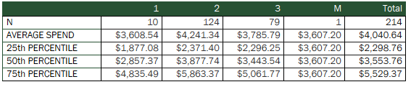
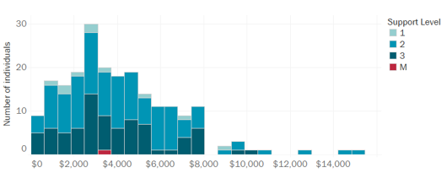
Service use and spend data analysis
Purpose: to explore spend and utilization of services by level in the SD and traditional samples to provide a starting point in constructing supports budgets
Lead by Stephen Pawlowski (HMA)
Will be used to understand trends in spend as well as compare spend and use between SD and traditional
Exploration of trends in rates for SD will also be included as part of this analysis to best inform development of budgets
EXAMPLE: Day program spend by people receiving traditional services in group homes

Slide 15
Preliminary budgets determination
Purpose: Create budgets for each support level in the level framework by living setting
Conversations that dive into the service use and spend analyses by living setting, level, and other demographics lead by HMA and HSRI
Develop model service mixes based on utilization by variables such as support level, living setting, age, etc. plus program design intentions
Often an iterative process of exploring and presenting options for models and budgets, then revising and presenting again
Likely process will involve understanding a model service mix for those receiving traditional services, then comparing it to SD spend to create an estimate for a model service mix for those in SD
  Process will be guided by findings from analysis

Slide 16
Preliminary budgets determination
A model service mix is an estimate of the types and amounts of services needed by individuals in each support level and living setting
Due to the nature of self-direction services, determinations of what units and rates to use in the model service mix will be based on historical utilization of those who receive SD today and their tradition service counterparts and may involve use of ranges or bands to capture varying service use and rates
Service A
Unit x Rate
Service B
Unit x Rate
Service C
Unit x Rate
Annual Allocation

Slide 17
Preliminary budgets determination
Consider policy goals around services and the fiscal impact of decisions
Determine how to compare traditional and SD spend and utilization
Decide which services/billing codes to include in model service mix
Establish model unit assumptions for each service, as applicable
Apply model rates
Calculate budgets

Slide 18
Record review
Purpose: collect in-depth qualitative data to explore how well the supports budget framework works for a sample of people and adjust as necessary
Do general support needs increase from low to high?
Do people assigned to medical and behavioral levels have extraordinary needs?
Level Descriptions
Do people in the same support level have similar support needs?
Do descriptions accurately reflect support needs?
How can descriptions be improved?
Support Levels
Support Budgets
Do people’s proposed budgets meet their needs?
Are any adjustments to budgets needed?
Select a sample of people’s records to review for deeper exploration
Review in-depth, detailed information about each person to understand their needs
Classify needs independently of the support level and analyze

Slide 19
Community engagement
Purpose: increase transparency and receive feedback to improve the supports budget framework from those it will impact most
We have engaged with SD advisory group in the past regarding this project
Community engagement plan is in the works– we welcome your feedback!

Slide 20
Final report
Will contain final recommended framework
Will document the process of developing the recommended framework
Will include recommendations around implementation as needed

Slide 21
Questions?
What are you excited to hear about that we should be sure to come back to present on?
Do you see any hurdles or challenges we should be thinking about as we start looking at the data and creating budgets?
Do you have ideas for improving our process?
How do you think we should hear from people who receive services and their families to make sure what we recommend works for them? Who should we talk to?

Slide 22



Applied Review Training
Training for Applied Review Participants

