Slide 1
Executive Office of Health and Human Services
Human Service Transportation Office Overview November 2021

Slide 2
Overview of the Human Service Transportation Office (HST)
Mission: To promote access to health and human services, employment and community life by managing a statewide transportation brokerage network for eligible consumers and by providing technical assistance and outreach strategies in support of local mobility and transportation coordination efforts especially for transportation disadvantaged Massachusetts residents.
At the HST office we believe that transportation is part of healthcare for each and every consumer and member. We are working to change the culture within our systems so that our drivers, schedulers and dispatchers understand that they are a part of every member’s healthcare team. At our core, our aim is to ensure the safety of the consumer and enable the consumers access to health care and human services.

Slide 3
Overview of the Human Service Transportation Office (HST)
Transportation Programs are managed for six EOHHS agencies:
MassHealth
Department of Developmental Services
Department of Public Health (Early Intervention)
Massachusetts Rehabilitation Commission
Massachusetts Commission for the Blind
Department of Mental Health

Slide 4
HST Brokers
EOHHS contracts with two Regional Transit Authorities (RTAs) that function as brokers to provide direct transportation services to EOHHS consumers in three distinct HST Areas (HST1-3), which encompass all cities and towns within the Commonwealth.
Each HST broker administers transportation services through subcontracting with qualified transportation providers in their HST Area(s).
Collectively the two RTAs subcontract with over 300 different transportation providers in the Commonwealth.
Notes:
With the recent procurement, we reduced the number of HST service areas from 9 to 3 and the number of Brokers from 6 to 2. Establishing fewer brokerage areas minimized logistical challenges associated with having trips begin in one HST region and end in another. While consumers continue to be served by the local transportation vendors in each area, having fewer broker regions allows for investments to be made in call centers, consumer facing technologies, and reduces duplicative contracting with transportation providers who operate in multiple regions.

Slide 5
HST Regions
MART – Montachusett Regional Transit Authority – Regions 1 and 2
GATRA – Greater Attleboro Taunton Regional Transit Authority – Region 3

Slide 6
Brokerage Improvements as of 7/1/21
In response to consumer feedback, the new Brokerage contract includes:
Complaints Process – Resolve 95% of complaints within 3 business days, 100% within 10 business days, HST phone and email publicized for complaints
Call Wait Times – Contract requires that all calls be answered in under 3 minutes
On-time performance and reliability – GPS systems required on all Demand Response vehicles to provide on time data beginning in January.
Driver & Vehicle Safety Standards – Quality & Assurance team within the HST office with 4 Compliance Officers triples the number of field visits
Notes:
There are contractual penalties for non-compliance with complaint resolution, call center metrics among others..
GPS systems will allow the Broker and the HST office to better monitor on-time performance.

Slide 7
HST – Total Consumers Information

Slide 8
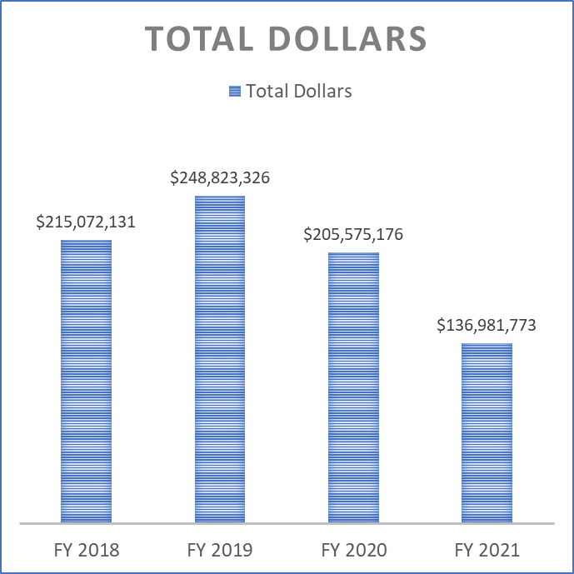
HST – Total Dollars Information
Notes:
Total dollars refers to total spend on transportation which includes direct trip costs and Broker management fees

Slide 9
HST – Total Trips Information
Notes:
We are fulfilling 100% of trip requests. There is a rise in telehealth and telehealth access.

Slide 10
HST – Average Cost per Trip Information

Slide 11
HST & Partner Agencies
The HST Office values the partnerships that we have forged with our purchasing agencies, brokers, vendors and advocacy groups. We share the priority of getting our consumers to their medical and human service programs safely, with respect and on time. Recent examples include:
Bi-weekly meetings with the Boston Center for Independent Living to improve consumer facing information.
Broker orientation sessions for consumers prior to the implementation of advanced technologies
Bi-weekly meetings with DDS and Day Hab representatives as programs re-opened following pandemic closures.
Working with DPH to establish safe operating procedures to ensure the health and safety of consumers during the pandemic.

Slide 12
Roles and Accountabilities – HST Office
Negotiates Broker Services Contract, management fee, and direct service rates
Establishes standards to ensure member/consumer safety
Monitors broker performance through field inspections and service quality metrics
Addresses day to day issues with agencies, programs, and consumers
Collects and analyzes Broker performance data
Monitors cost effectiveness
Works with Brokers and agencies to improve the member/consumer experience
Notes:
The HST office Is in the process of developing a Member Experience Monitoring Program similar to a Secret Shopper program to solicit service reviews from consumers as they use the service.

Slide 13
Roles and Accountabilities – Broker
Procure contracts with transportation providers
Processes Transportation Requests in accordance with consumer’s needs and conduct consumer surveys
Manages the entire service delivery network within its HST Service Area;
Verifies the eligibility of all MassHealth members;
Responsible for the satisfactory performance of each of its subcontractors
Facilitate access to available public transit (if applicable)
Maintains communications capability Monday through Friday from 7AM – 6PM to receive and respond to telephone requests from the agencies or consumers

Slide 14
Roles and Accountabilities – Subcontractor/Vendor
Provides the appropriate level of assistance to members/consumers accordance with transportation requests and meeting Service Provider Performance Standards established by the HST office
Submits insurance, billing and attendance to the Broker
Conducts CORI and background checks on all drivers
Arranges for fingerprinting of drivers who transport DDS consumers
Is never to leave a consumer stranded

Slide 15
Roles and Accountabilities – Purchasing Agency
Determines member eligibility for transportation services
Reviews and pays monthly bills for direct transportation costs to the Brokers
Communicates operations concerns to the HST office
DDS approves trip costs for consumers and routing

Slide 16
MassHealth Transportation
The HST Office Brokers two types of Non-Emergency Medical transportation for eligible MassHealth members:
− *Demand-Response PT-1 Transportation: transportation provided to eligible MassHealth members to MassHealth covered services such as routine medical appointments and ongoing, life-sustaining medical treatment.
− *Program-Based Transportation: Transportation to and from a specific destination, such as the site of a day habilitation or clubhouse program, on a regularly scheduled basis.
*RTA Brokers are required to award all trips and routes to the lowest priced and qualified bidder. Program based routes are competitively procured every five years by the RTA Brokers.

Slide 17
Demand Response PT-1 Transportation
Demand-Response PT-1 transportation is authorized with a PT-1 form, completed and submitted by the MassHealth member’s provider and sent to Maximus (MassHealth’s Customer Service Center) for adjudication.
PT-1 forms are filled out and submitted on-line by MassHealth medical providers
PT-1 forms may be used to authorize multiple trips to a particular location within a period of up to six (6) months for acute illness; and up to year for chronic illness.
PT-1 forms should be submitted at least three (3) business days before the date transportation is to occur.

Slide 18
Demand Response PT-1 Transportation (continued)
PT-1 transportation is only authorized to transport eligible members to and from MassHealth covered services.
Members provided PT-1 transportation may be transported with other members, unless the provider submitting the forms attests that a member’s medical condition requires that the member not share a vehicle. Providers must identify the medical or behavioral condition requiring a non-shared ride.
If the destination is more than 25 miles away from a member’s residence, the provider must justify why the member must go to that location as opposed to a closer one.

Slide 19
Accomplishments
During the Pandemic HST Transportation persevered
Provided continuous service during the pandemic
All rides requested were fulfilled
Resumption of day programs and the ramp up of transportation which had been shut down for months
Surveyed Day Program consumers throughout on service quality and driver adherence to COVID procedures
Complaints were being processed in a timely manner
Increased volume of field visits and reviews conducted by both HST Compliance Officers and the brokers

Slide 20
Challenges and Ongoing Improvements
Workforce challenges – loss of vendors, vehicles, drivers and call center staff during the pandemic
Adoption of website and web portal – we together with our brokers have work to do to ensure it is accessible and user friendly, and sufficiently publicized to the population.
Making progress around data and metrics as the technology is further developed.
Seeing marked improvement in call wait times as of October 15th when MART supplemented their call center with an outside vendor. Call wait times are now under 3 minutes.

Slide 21
Questions
Questions?

