Slide 1
Abuse-Deterrent Formulations of Opioids: Effectiveness and Value
Presentation to the Massachusetts Drug Formulary Commission
February 5, 2018

Slide 2
Presentation Agenda
Introduction to ICER
Comparative clinical effectiveness of abuse-deterrent formulations of opioids (ADFs)
Comparative value analysis of ADFs
Policy recommendations

Slide 3
About ICER and this Review
Independent health technology assessment group
Develop publicly available value assessment reports on drugs near time of FDA approval
Review “health systems” topics to aid public and private policymakers
Convene regional independent appraisal committees for public hearings on each report
ADF project undertaken for the New England Comparative Effectiveness Public Advisory Council (CEPAC) appraisal committee; completed in August 2017

Slide 4
Independent Appraisal Committees

Slide 5
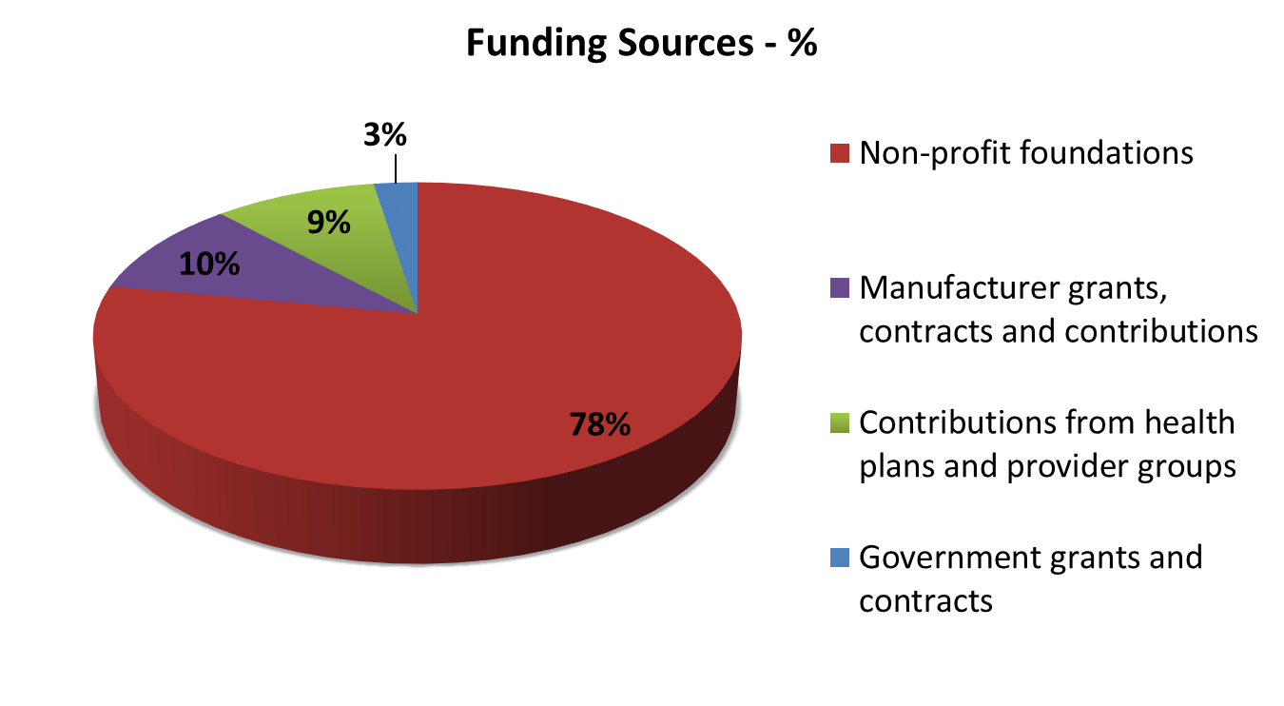
Sources of Funding (updated Jan 2018)
ICER Policy Summit only
Foundations: Laura and John Arnold Foundation, California Health Care Foundation, Blue Shield of California Foundation

Slide 6
Evidence Review
Foluso Agboola, MBBS, MPH
Research Scientist, ICER

Slide 7
Abuse deterrent formulations
ADF opioids are specially formulated to be more difficult to manipulate in order to deter chewing, intranasal, and intravenous routes of abuse.
However, none of the FDA-approved ADFs deter the most common form of abuse - swallowing more than the intended dose of intact capsules or tablets.
Opioid Products with FDA-Approved Abuse-Deterrent Labeling
OxyContin® TR (Oxycodone, Purdue)
Embeda® (Morphine + naltrexone, Pfizer)
Targiniq® (Oxycodone + naloxone ER, Purdue)
Hysingla® ER (Hydrocodone, Purdue)
Morphabond® (Morphine ER, Inspirion & Daiichi Sankyo)
Xtampza® ER (Oxycodone, Collegium Pharmaceutical Inc.)
Troxyca® ER (Oxycodone + naltrexone, Pfizer)
Arymo® ER ( Morphine, Egalet)
VantrelaTM (Hydrocodone, Teva)
RoxyBond® (Oxycodone, Inspirion & Daiichi Sankyo)

Slide 8
ADF Evidence: Pre-market Studies
We identified 15 randomized crossover trials evaluating oral or intranasal abuse of ADFs vs. non-ADFs in the same class.
Study participants were healthy, non-dependent recreational drug users.
Observed outcomes may not be generalizable to chronic pain patients.
Relative to non-ADF comparators, all ADFs produced statistically-significantly lower scores on VAS “drug liking” and ‘take drug again” measures.
There is no established threshold for what constitutes a clinically-important difference.
It is uncertain whether these endpoints are predictive of real-world abuse.

Slide 9
Post-market Studies (Real World Evidence)
Post-market data is an FDA requirement for all ADFs; however, evidence is currently available only for OxyContin.
All 26 identified studies were non-randomized, examining the aggregate periods before (1-2 years before) and after (1-4 years after) reformulation of OxyContin as an ADF.
Variety of data sources (e.g. patients entering substance abuse programs; medical claims databases; police reports; spontaneous adverse events).
No prospective studies in chronic pain patients.
Abuse and Misuse: Data suggest a 12% - 75% decline in the rate of OxyContin abuse after reformulation, in different study populations and at different time points.
Overdose and overdose death: Limited evidence indicates a 34% to 65% decline in the rates of overdose and overdose deaths attributed to OxyContin after the ADF was introduced.
Diversion: Limited evidence

Slide 10
Post-market Studies (Real World Evidence)
However, several studies also found an increase in the abuse and overdose death from other prescription opioids or heroin during the same time periods, suggesting there may have been a shift in abuse patterns. Examples:
Study among patients entering substance use disorder programs.
Changes in the past month prevalence of abuse following reformulation:
OxyContin: 42%
Heroin: 100%
ER oxymorphone: 38%
Direct interview with 153 participants entering substance abuse program: Did ADF OxyContin influence the drugs that participants used for abuse?
Cicero TJ, Ellis MS. Abuse-deterrent formulations and the prescription opioid abuse epidemic in the United States: Lessons learned from OxyContin. JAMA Psychiatry. 2015;72(5):424-429.

Slide 11
Economic Evaluation
Varun Kumar, MPH, MSc
Health Economist, ICER

Slide 12
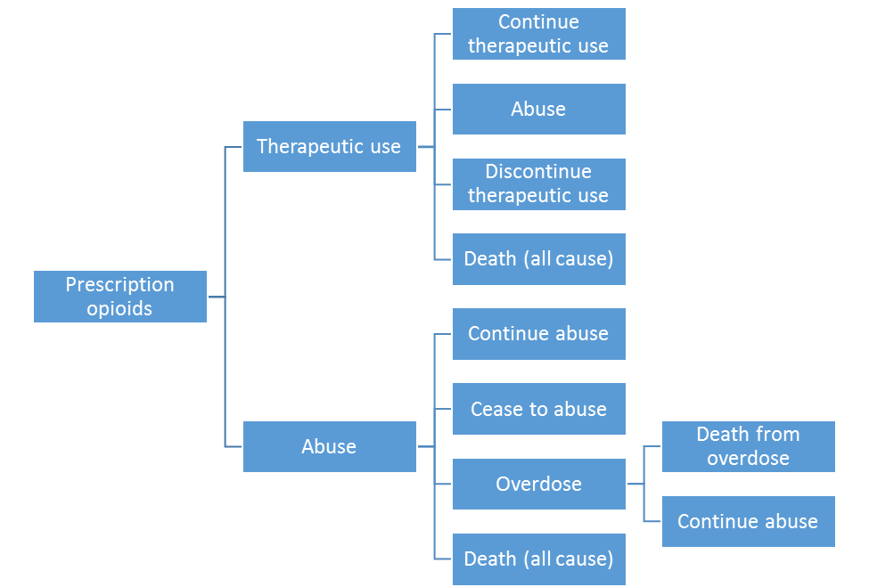
Our Approach
Hypothetical cohort model
100,000 incident ER opioid users per cohort
Massachusetts model
Prevalent ER opioid users
Pre-Oxycontin abuse rate– 3.65%
Post Oxycontin abuse rate– 2.82%
Patients in the ADF and non-ADF opioid cohorts follow the same pathway

Slide 13
Base Case Results (1/2)
Clinical outcomes of non-ADF and ADF opioids for 100,000 patients at 5 years
Outcomes | Non-ADF cohort | ADF cohort | Difference (ADF cohort – Non-ADF cohort)
New cases of abuse | 10,532 | 8,229 | (2,303)
Overdose deaths | 1.77 | 1.38 | (<1)

Slide 14
Base Case Results (2/2)
Health system cost of ADF and non-ADF opioids for 100,000 patients at 5 years
 | ADF opioids | Non-ADF opioids | Difference (ADF – non-ADF)
Health care costs* | $8.8 billion | $8.9 billion | ($113.5 million)
Prescription opioid costs (entire cohort) | $1.3 billion | $657 million | $646 million
Total costs | $10.1 billion | $9.5 billion | $533 million
Cost per incremental outcome using ADF versus non-ADF opioids
Incremental outcome | Cost
To prevent one new abuse case | $231,000
*Excluding prescription opioid costs

Slide 15
Threshold and Scenario Analyses
Cost neutrality
Could be achieved if price of ADFs was discounted by ~41%
Could not be achieved even if ADFs (at current prices) eliminated all abuse
Inclusion of societal perspective increased cost offsets for ADFs, but they still resulted in net higher costs of almost $400 million

Slide 16
Massachusetts Model
Outcomes when converting all non-ADF opioid prescriptions to ADF opioid prescriptions over one year
Non-ADF: 113,000 users ADF: 60,000 users
 | Mixed ADF/non-ADF opioid use | All ADF opioid use | Difference
Abuse cases | 5,229 | 4,387 | (842)
Abuse-related total health care costs | $225 million | $204 million | ($21 million)
Prescription opioid costs | $490 million | $1 billion | $513 million
Total health care costs | $5.3 billion | $5.8 billion | $475 million

Slide 17
Summary and Conclusions
There have been no prospective studies of patients who are newly-prescribed opioids measuring incidence of abuse of ADFs versus non-ADFs.
Current evidence shows a decrease in OxyContin-specific abuse following reformulation, however, the change in the pattern of abuse and diversion of other products remains uncertain because it is difficult to quantify.
Our model shows that ER ADF opioids have the potential to reduce abuse in opioid-prescribed chronic pain patients, but at substantially higher costs to the health system and society.

Slide 18
Policy Recommendations
Sarah K. Emond, MPP Executive Vice President and Chief Operating Officer

Slide 19
Votes of the New England CEPAC
Evidence is adequate to suggest a reduced risk of abuse among individual patients prescribed OxyContin compared to non-ADF opioids.
Evidence is not sufficient to show a reduced risk of abuse for individual patients being prescribed any of the eight other abuse-deterrent ER opioids, excluding OxyContin.
At a population level, evidence is not adequate to demonstrate a net health benefit of OxyContin over a non-ADF ER opioid, due to limited evidence and concerns about abuse shifting to other opioids.

Slide 20
Key Policy Take-Aways
Policymakers should be aware that no evidence exists to evaluate the balance of positive and unintended negative effects of mandatory ADF substitution laws.
Policymakers and clinical leaders should consider measures to phase in ADFs while ensuring adequate support for other elements of a multi-pronged approach to the opioid crisis.
Manufacturers and payers must recognize a shared commitment to making ADFs affordable to patients and to the health system.
The term “abuse-deterrent formulation” presents a significant risk that the addictive and abuse potential of ADFs will be misunderstood. The FDA should reconsider whether it can use “tamper-resistant formulation" instead.

Slide 21
For more information: https://icer-review.org/topic/abuse-deterrent-opioids/ info@icer-review.org 617-528-4013

