Slide 1
CORI Training
2020

Slide 2
What is the Department of Criminal Justice Information Services (DCJIS)?
DCJIS is the Massachusetts agency statutorily designated to:
oversee the authorized provision of Criminal Offender Record Information (CORI) to the non-criminal justice community;
provide a public safety information system and network to support data collection, information sharing, and interoperability for the Commonwealth's criminal justice and law enforcement communities;
provide support to the Criminal Records Review Board;
operate the Firearms Records Bureau; and
provide and technically support the Victim Notification Registry for the victims of crime.

Slide 3
What is CORI?
Criminal Offender Record Information
Records and data in any communicable form compiled by a Massachusetts criminal justice agency about an identifiable individual that relate to:
                nature or disposition of a criminal charge,
                an arrest, a pre-trial proceeding,
                other judicial proceedings,
                sentencing,
                incarceration,
                rehabilitation,
                or release.
Does not include juvenile criminal history,
except for charges on which a juvenile was adjudicated as an adult.

Slide 4

What is CORI Reform?
On August 6, 2010, the Governor signed into law Chapter 256 of the Acts of 2010, a.k.a. CORI Reform, making significant changes to the CORI law.
This law provides ex-offenders
with a better chance of re-integration
and obtaining employment while
taking public safety into account.
The law changed who is
authorized to access CORI and how
CORI is accessed.
Most of the CORI Reform provisions
became effective on May 4, 2012.

Slide 5
Criminal Justice Reform Bill
Chapter 69 of the Acts of 2018, signed into law by Governor Baker on April 13, 2018.
Bill contains different effective dates for certain sections.
Key provisions related to CORI and FBI records:
  Update to definition of CORI;
    CORI does not include offenses dismissed prior to arraignment.
    New definition for what is considered adjudicated as adult for CORI dissemination purposes.
  Dissemination of Not Guilty by Reason of Insanity dispositions;
    Available to those seeking records under standard and open CORI access.
  Reduced timeframes to seal records; and
  Ability to expunge certain records, also includes FBI records.

Slide 6
All Employers Have Standard Access to CORI
Employers now have access to:
Any criminal charges pending as of the date of the request, including open cases that have been continued without a finding until dismissed
All felony or misdemeanor convictions, but only if the individual was found guilty of or released from incarceration for a misdemeanor within 5 years
of the request or a felony within 10 years of the request
Findings of not guilty by reason of insanity relating to felony offenses for 10 years from disposition date.
All murder, manslaughter, and sex offense convictions (unless sealed),
regardless of the date of the individuals last misdemeanor or felony conviction
CORI Reform and the Criminal Justice bill do not
include automatic sealing

Slide 7
Certain Employers Have Required CORI Access
Employers who must comply with statutory, regulatory, or accreditation requirements regarding employees’ criminal records, (e.g. hospitals and banks) have access to additional adult CORI information dating back to an individual’s 18th birthday.
Employers that received CORI under a federal or state law authorizing or requiring them to conduct CORI checks under the former CORI
system continue to have the same access (e.g. schools, camps, day care centers, nursing homes and assisted living facilities).

Slide 8
The Public Has Limited Access to Open CORI
“Open CORI” includes:
Misdemeanor convictions within one year of conviction or
release from incarceration;
Felony convictions and findings of not guilty by reason of insanity (“NGRI”) within two years of conviction, release from incarceration or disposition date; and
All felony convictions and findings of NGRI for offenses punishable by five or more years of incarceration within ten years of conviction or release from incarceration.
All murder, manslaughter and sex offense convictions, unless sealed or expunged.

Slide 9

What is Required 1 Access?
all pending criminal charges, including cases continued without a finding of guilt, until they are dismissed;
all misdemeanor convictions and felony convictions dating from the subject’s 18th birthday;
all information relating to those offenses for which the subject was adjudicated as an adult while younger than 18 years old; and
all convictions for murder, voluntary manslaughter,
involuntary manslaughter, and sex offenses.
Examples of Required 1 agencies:
Hospitals; Healthcare Staffing Agencies;
Healthcare Clinical Programs; Banks;
Security System Installers; and Amusement Device
Operators.

Slide 10

What is Required 2 Access?
non-conviction information (e.g., Not Guilty, Dismissed, Nolle Prossed)
all pending criminal charges, including cases continued without a finding of guilt, until they are dismissed;
all misdemeanor convictions and felony convictions dating from the subject’s 18th birthday;
all information relating to those offenses for which the subject was adjudicated as an adult while younger than 18 years old; and
all convictions for murder, voluntary manslaughter, involuntary manslaughter, and sex offenses

Slide 11

Agencies with Required 2 CORI Access
Examples of Required 2 Agencies:
Schools;
Assisted Living Facilities;
Nursing Homes;
Programs for Children;
Councils on Aging; and
Military Recruiters.

Slide 12

What is Required 3 Access?
All adult and juvenile non-conviction information;
all adult and juvenile pending criminal charges, including cases continued without a finding of guilt, until they are dismissed;
all adult misdemeanor convictions and felony convictions dating from the subject’s 18th birthday and juvenile delinquency findings;
all convictions for murder, voluntary manslaughter, involuntary manslaughter, and sex offenses; and
information relating to those offenses for which the subject was adjudicated as an adult while younger than 18 years old.
              This level of CORI is only available to camps for children!

Slide 13
What is Required 4 Access?
All adult and juvenile non-conviction information;
all adult and juvenile pending criminal charges, including cases continued without a finding of guilt, until they are dismissed;
all misdemeanor convictions and felony convictions dating from the subject’s 18th birthday and juvenile delinquency findings;
all convictions for murder, voluntary manslaughter, involuntary manslaughter, and sex offenses;
information relating to those offenses for which the subject was adjudicated as an adult while younger than 18 years old; and
information regarding criminal offenses that have been sealed.
              This level of CORI is only available to the MA Department of Early Education and Care and Department of Children and Families!

Slide 14
Criminal Justice Agency Access to Sealed Records
“Criminal justice agencies may obtain all criminal offender record information, including sealed records, for the actual performance of their criminal justice duties.”

Slide 15
National Fingerprint Based Checks For Municipal License Applicants
  Pursuant to MGL c. 6, s. 172B ½ municipal police departments may submit FBI national criminal history checks for certain occupational license applicants (i.e. Liquor licensees and Ice Cream Truck vendors)
    Municipality first must have a by-law or ordinance that details which license applicants are subject to an FBI check.
    By-law/ordinance must be approved by AGO and FBI.
    Town must have a policy approved by DCJIS.
    See DCJIS website at: www.mass.gov/cjis for a full description of the procedure, model consent form and model policy.

Slide 16
National Fingerprint Based Checks For K-12 Schools and Early Education
Chapter 459 of the Acts of 2012 authorizes national fingerprint based criminal history checks for the following individuals working with children:
  Teachers, employees and subcontractors working with children in K-12 public and private schools;
  Employees of day care and after school programs licensed by the Office of Early Education and Care (EEC); and
  Adoptive and foster parents applying through EEC.
National checks and payment for checks are processed through a state vendor.
Responses are forwarded to users by DCJIS.
Additional information regarding this law is available at: www.mass.gov/cjis.

Slide 17
National Fingerprint Based Checks For the Department of Developmental Services(DDS)
M.G.L. Ch. 19B §§ 19-20 authorize national fingerprint based criminal history checks for the following individuals working with people with intellectual/developmental disabilities:
  Any applicant seeking a DDS-licensed facility offering residential/day care or any other service covering the DDS client population.
  Any household member, employee or individual regularly on the premises age 15 or older, regardless of caregiver status.
National checks and payment for checks are processed through a state vendor.
Responses are forwarded to users by DCJIS.
Additional information regarding this law is available at: www.mass.gov/cjis.

Slide 18
Consumer Reporting Agency’s Access to CORI
CRA may access criminal history from public records including:
  Police daily logs;
  Newspaper articles; and
  Criminal court files.
CRA may access CORI from DCJIS
  May access Open CORI to request public records
  May access on behalf of a registered client to obtain standard or required access
    Level of access depends on what information the client is entitled to receive
  CRAs that access through DCJIS are subject to 803 CMR 11.00 et seq.

Slide 19
CORI Policy Requirement
Any individual organization that submits five or more CORI requests annually shall maintain a CORI policy which must meet the minimum standards of the DCJIS model CORI policy .
  The DCJIS has posted a Model CORI Policy to its
  web site at mass.gov/cjis.
  A CORI policy may be developed and maintained regardless of the number of CORI requests conducted.
  DCJIS recently updated its model CORI Policy: see www.mass.gov/cjis

Slide 20
Adverse Employment & Housing Decisions Based on CORI
Before an individual employer or private landlord makes an adverse decision based on a subject’s CORI, the employer/landlord must:
Notify the applicant in person, by telephone, by fax, or by electronic or hard
copy correspondence of the potential adverse employment/housing action;
Provide a copy of the applicant’s CORI to the applicant;
Provide a copy of the employer’s CORI Policy, if applicable;
Identify the information in the applicant’s CORI that is the basis for the potential adverse action;
Provide the applicant with the opportunity to dispute the accuracy of the information
contained in the CORI;
Provide the applicant with a copy of the DCJIS document entitled “Information Regarding
the Process for Correcting CORI”; and
Document all steps taken to comply with these requirements.

Slide 21
Applicants Have a Right to Due Process
Effective May 4, 2012, if an employer has obtained criminal history information about an applicant, regardless of the source, he or she must provide the criminal history to the applicant prior to asking him or her about it.

Slide 22
“Self-Audits” Will Help Police the System
Individuals will be able to see what non-law enforcement entities have requested their CORI.
Individuals will be able to determine if
CORI checks were run prior to an interview
or job rejection.
Individuals will also be able to determine if
someone improperly accessed their CORI.

Slide 23
The Criminal Records Review Board
May 4, 2012, marked the inauguration of the Criminal Records Review Board (CRRB).
CRRB’s membership includes all members listed in c. 6, s. 168 including representatives from labor and workforce development and ex-offender rehabilitation.
CRRB’s primary role is to investigate and conduct hearings regarding complaints alleging violations of the CORI statutes and regulations.

Slide 24
Increased Civil Penalties
The Board can sanction individuals, employers and landlords with increased fines.
              $1,000-first violation.
              $2,500-second violation.
              $5,000-third or subsequent violation.
Previous fine was $500

Slide 25
Increased Criminal Penalties
Anyone who knowingly:
knowingly requests, obtains or attempts to obtain CORI or self-audit from DCJIS under false pretenses;
knowingly communicates or attempts to communicate CORI to unauthorized individual; or
knowingly falsifies criminal records
shall be punished for each offense:
NMT 1 Year HOC;
NMT $5,000 fine;
Or both.
If the offender is not a natural person,
NMT $50,000 for each offense.
Increased fines of $7,500/$75,000 for juvenile criminal history violations.

Slide 26
iCORI Service
What is iCORI? It is a secure, web-based service through which organizations will request and receive CORI.
Registration is required and is performed on-line through the iCORI Service.
Certification is no longer required
Registration renewal is required annually
There is no registration fee
In most cases, results will be returned instantaneously
iCORI can be accessed through the DCJIS homepage – mass.gov/cjis
The following pages describe the processes for registering, for submitting CORI requests, and for viewing CORI results.

Slide 27
** ICORI Requires Separate Login/Password for each user **
It is solely the responsibility of each Requestor to keep his/her username and password confidential. Under no circumstances is any Requestor's username and password to be shared with another individual. By using this service to access CORI, the Requestor agrees that he or she is assuming the risk of an unauthorized person learning the Requestor's e-mail address, Username, and password.
A Requestor may be in violation of M.G.L. c. 6, §§ 167-178B, should CORI be unlawfully accessed and/or disseminated via his/her iCORI account.
DCJIS recommends putting in place a transition plan for ensuring that new iCORI representatives and/or users create new iCORI accounts immediately upon any change of personnel using the iCORI system.

Slide 28
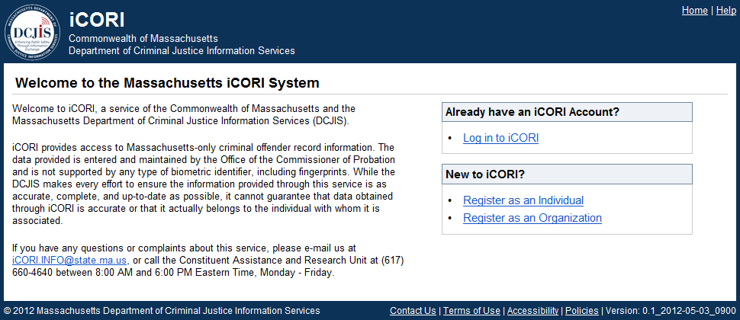
Organization Registration - Step 1
Go to the iCORI homepage and click the Register as an Organization link.

Slide 29
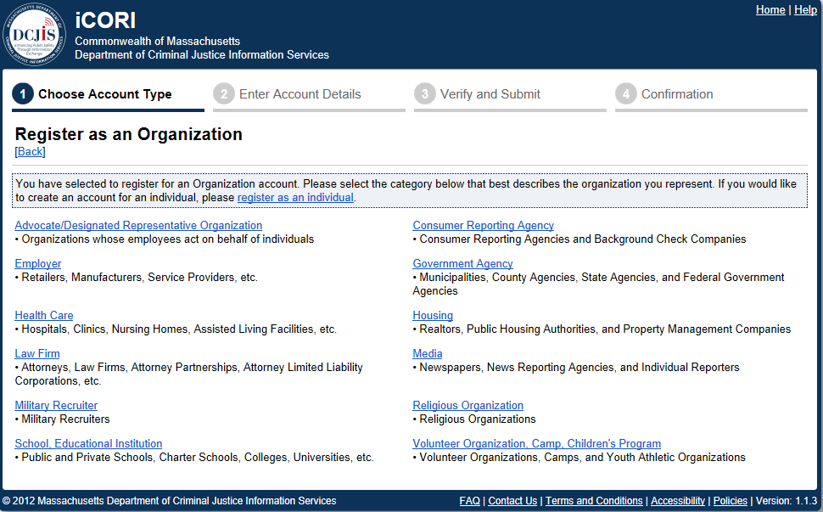
Organization Registration - Step 2
Select the appropriate Organization Category. Depending upon your selection, you may also have to choose a sub-type and answer one or more questions.

Slide 30
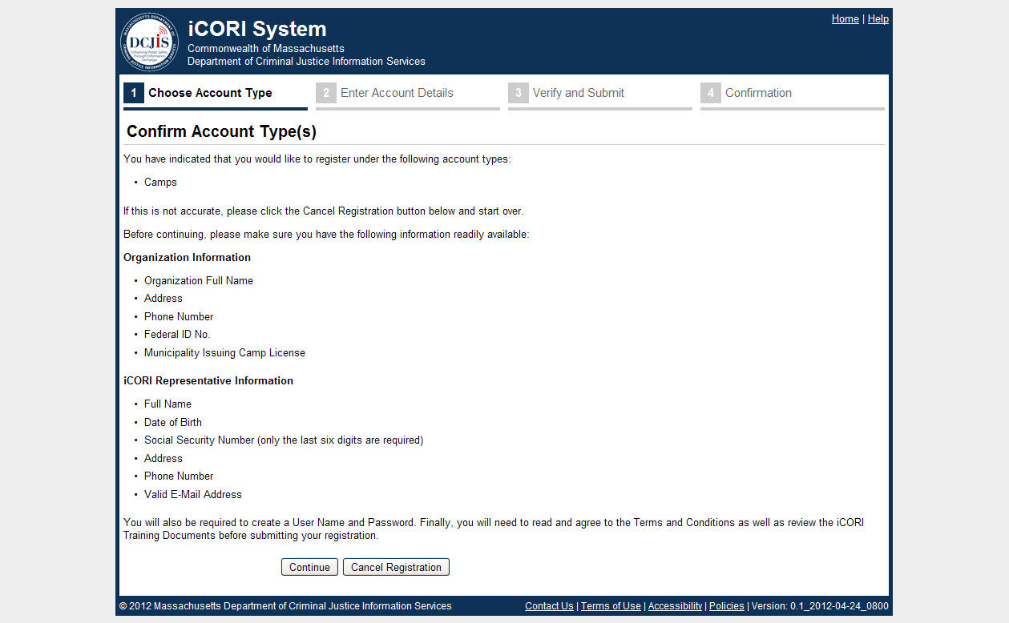
Organization Registration - Step 3
Confirm your account type on the Account Type Confirmation page.
Collect all required information listed on this page.
Click the Continue button.

Slide 31
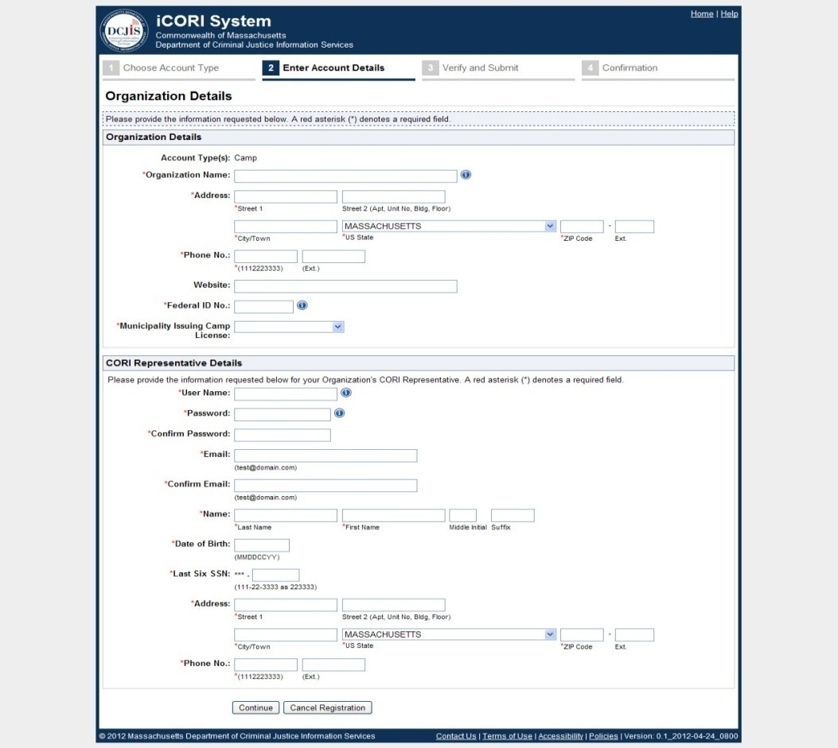
Organization Registration - Step 4
Complete the Organization and CORI Representative Details sections and then Click the Continue button.

Slide 32
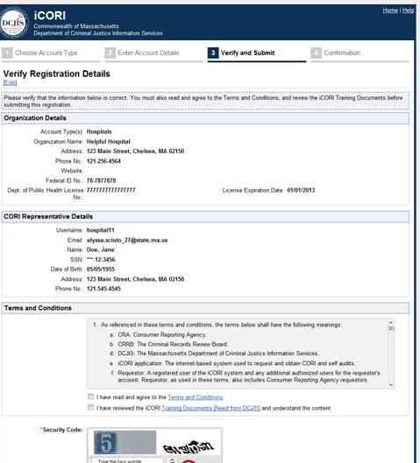
Organization Registration - Step 5
On the Verify Registration Details page, review the iCORI Service Terms and Conditions and the provided training documents.
Click the “I have read and agreed to the Terms
and Conditions” and the “I have reviewed
the iCORI Training Documents and Understand
the Content” check boxes.
Enter the two security check words displayed at
the bottom.
Click the Submit Registration button.
You will receive a confirmation page.

Slide 33
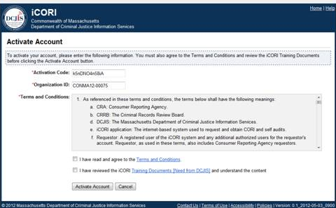
Organization Registration Activation
You will receive an iCORI Account Activation email.
Click the Log in to iCORI link within the email.
This will bring you to the Activate Account page.
Clicking the Log in to iCORI link will pre-populate the Activation Code.
Click the “I have read and agree to the Terms and Conditions” and the “I have reviewed the iCORI Training Documents and Understand the Content” check boxes.
Click the Activate Account button.
You may now submit CORI Requests.

Slide 34

Requesting and Receiving CORI
CORI Acknowledgement Forms are required must be kept on file for one year.
Verification of identity required for name provided on form.
Applicants may remotely complete this form by having it notarized.
To submit request, user enters subject’s name, date of birth, and last 6 SSN digits.
User logs in to view results which
are available in iCORI for 6 months.
DCJIS regulations allow for paper
or electronic storage of results.
NOTE: DCJIS updated regulations
allow for cloud storage and
published guidelines on its website.

Slide 35
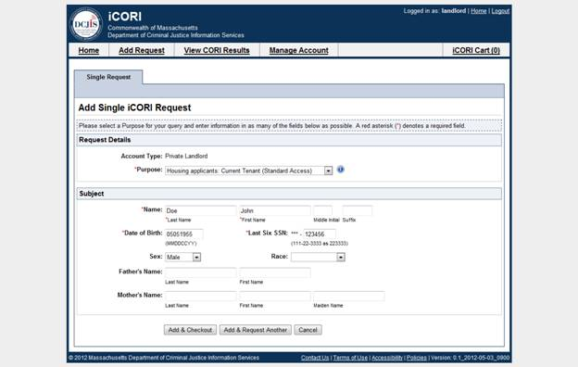
Submitting CORI Requests
Select the Add Request tab located at the top of the screen.
Select the purpose for which you are submitting the CORI request (e.g., employment, housing, etc.). Complete the Subject Information section.
If you have only one CORI request, click the Add & Checkout button, otherwise click the Add & Request Another
Requestors may also submit requests in batches of up to 100 names.

Slide 36
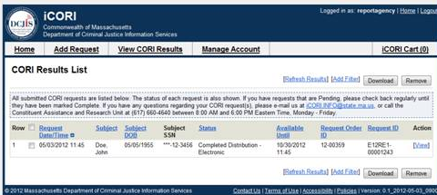
Viewing iCORI Results
To view your results, click on the View CORI Results tab
A list of submitted CORI requests, with the status of each, will be displayed.
Completed requests can be viewed by clicking the View link next to the result.
Results can also be downloaded by clicking the check box next to the request and then clicking the Download Button.
To remove a request from the list, click the Remove button.

Slide 37
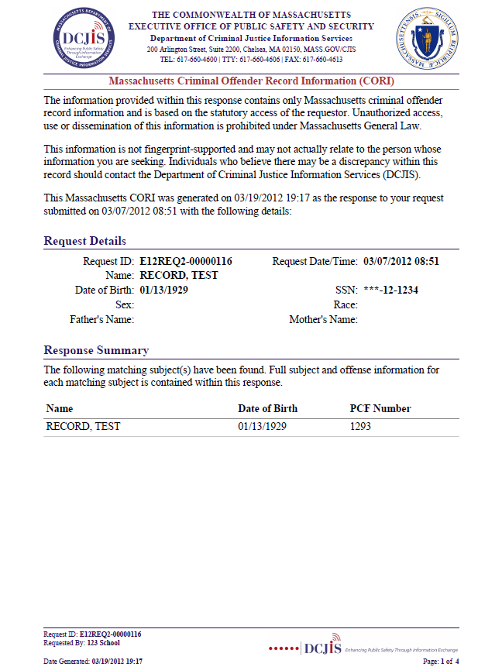
iCORI Report (pg 1)
Legal Disclaimer Summary
Details on entered Subject request
Section showing matching subject information
Footer displays requestor information

Slide 38
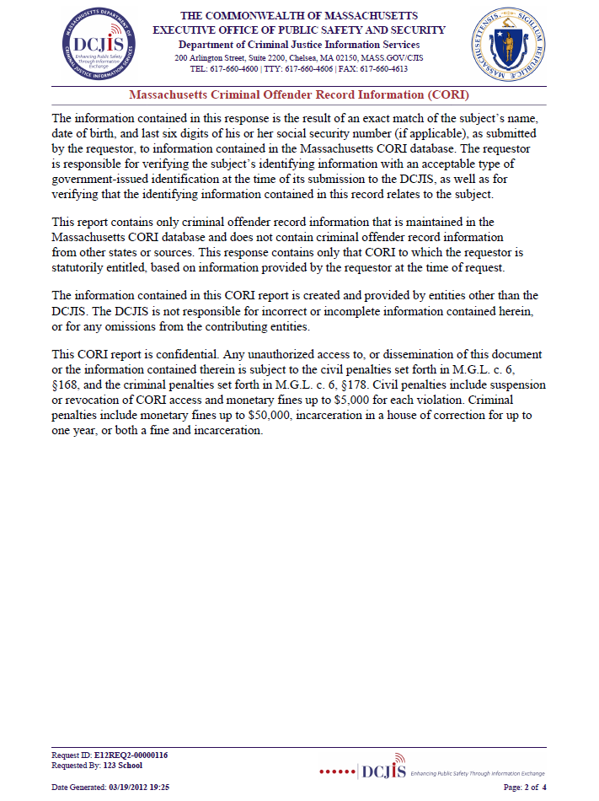
CORI Report (pg 2)
Detailed legal disclaimer

Slide 39
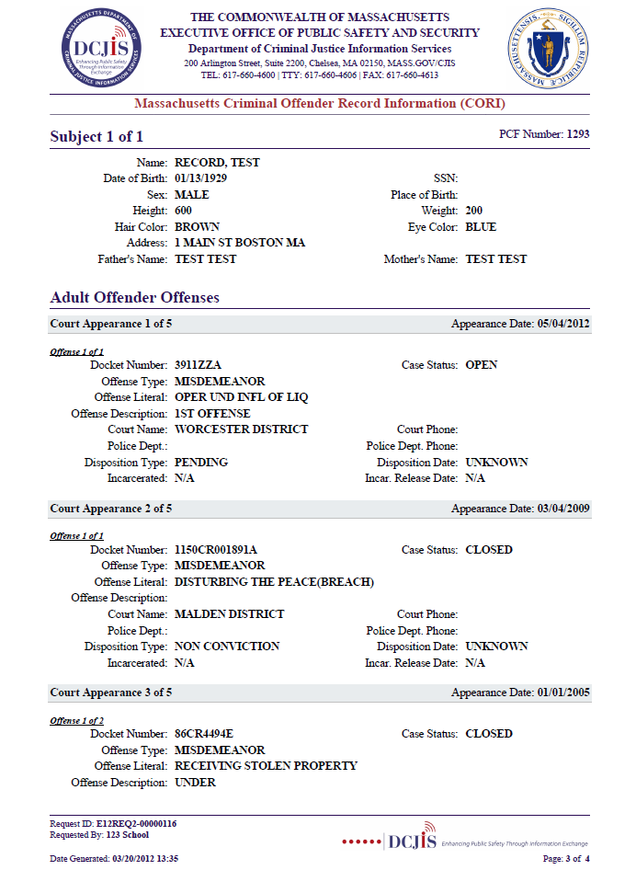
CORI Report (pg 3)
Matching subject information
Pending case
Non-conviction

Slide 40
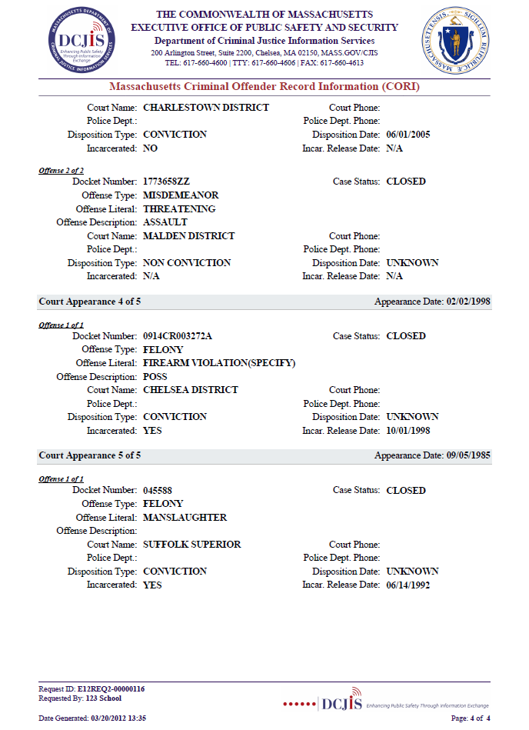
CORI Report (pg 4)
Conviction
Manslaughter conviction

Slide 41
DCJIS Contact Information
DCJIS website: www.mass.gov/cjis
Email: icori.info@state.ma.us
Phone number: 617-660-4600
Legal: 617-660-4760

