Slide 1

DER Equipment Replacement Subgroup
Presentation to MA IIRG
January 28, 2025

Slide 2
In-Service DER Equipment Replacement Subgroup
Mission:
To develop a comprehensive procedure to administer the replacement of in-service DER equipment.
Expected Group Output:
The recommended procedure from this group will be presented to the TSRG and the IIRG for potential inclusion of interconnection tariff changes.
Team
Summary of Major Accomplishments & Upcoming Activities
Fist Name | Last Name | Affiliation | Role
Muhammad | Khan | Eversource | EDC
Kelly | Musto | Eversource | EDC
Ruvini | Kankanamalge | National Grid | EDC
Nathan | Walsh | National Grid | EDC
Jeremy | Kites | Unitil | EDC
Gerry | Bingham | MA DOER | Gov.
Courtney | Feeley Karp | MA DOER | Gov.
Tim | Snyder | ACT | Industry
Sam | Feigenbaum | Kearsage Energy | Industry
Andrew | Hickok | Solect Energy | Industry
John | Mosher | Solect Energy | Industry
Mark | Durrenberger | New England Clean Energy | Industry - Residential
Claire | Chang | Solar Greensfield | Industry - Residential
Bronte | Payne | SunRun | Industry - Residential
John | Bonazoli | Unitil | Lead
Completed Activities:
DATE | DESCRIPTION OF ACTIVITY
6/10/2025 | Kick-off meeting with full subgroup with industry and government reps.
8/12/2025 | Created Matrix of equipment replacement categories and requirements
11/2/2025 | Consensus – a few replacement categories do not require Notification to EDC
Upcoming Activities/ Topics:
 | Bi-weekly meetings of subgroup and EDC only meetings every other week.
Jan, - Feb 2025 | Goal: Present consensus / non-consensus to IIRG
IIRG – DER Equipment Replacement
PAGE 2

Slide 3
Subgroup Background
Originally formed in TSRG Jan. 2024
Mainly EDC’s meeting
Industry involvement in spring 2025
DPU 25-48 – May 2025
DCAMM letter to DPU
DPU requested IIRG to address DCAMM concerns
Subgroup became subgroup of IIRG – 4th Qtr 2025
IIRG – DER Equipment Replacement
PAGE 3

Slide 4

Subgroup Efforts
Subgroup meeting biweekly
EDC’s meeting each off-week
Created matrix defining situations and analysis requirements
Industry proposed different table and definitions
EDC’s proposed tariff language
Mulitple revisions of EDC Table based on Industry concerns
Subgroup has consensus on certain situations
IIRG – DER Equipment Replacement
PAGE 4

Slide 5

Points of Consensus
Need new section of Interconnection Tariff for replacing in-service equipment
Upgraded equipment will comply to latest certification requirements
Definition “Like-for-Like” inverters
  same grounding characteristics, same nameplate capacity or smaller, same fault current or smaller
Definition “Like-for-Like” DC Equipment
  Same operating capacity in kW and kWh (batteries)
IIRG – DER Equipment Replacement
PAGE 5

Slide 6


More Points of Consensus
No notification (or application) is needed for:
  Replacement of exact same equipment
  Replacement of Like-for-Like DC Equipment
No Fees for facilities complying to Simplified process
Notification process will be exempt from Group study and separate from new application queue
IIRG – DER Equipment Replacement
PAGE 6

Slide 7
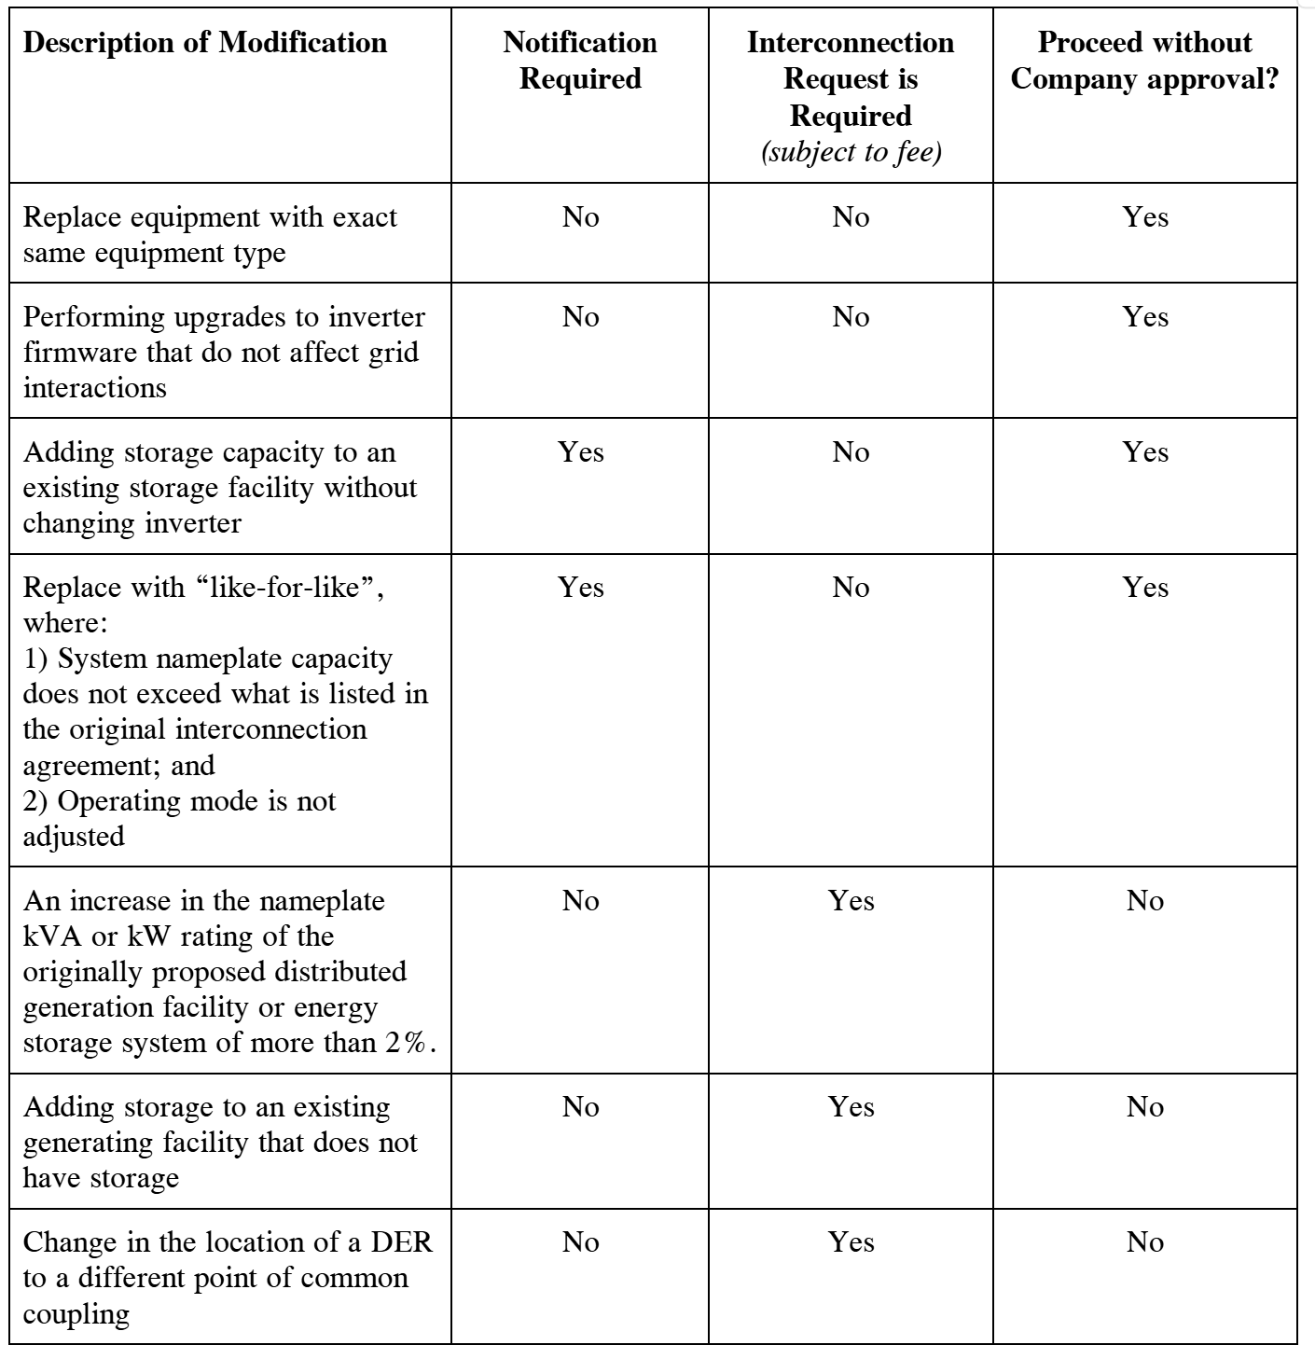
Industry Proposal
Consensus
Notification of Non-Material Modification - applies to facilities where green highlight in Table Y applies
Material Modification Request - applies to facilities where red highlight in Table Y applies
Consensus
Consensus
IIRG – DER Equipment Replacement
PAGE 7

Slide 8
EDC Proposal
For system that adheres to “Simplified” process
When notification is required, it must be done prior to replacement
Notification process will be done outside new interconnection application queue and exempt from Group Study Process
Separate Tables for Simplified and Non-Simplified
Increase of Export Capacity requires application for new installation
Addition of energy storage (where there was none) required application for new installation
Category | Replacement Type | Notification of Intent Required | Fee(s)
A | Replace equipment with exact same equipment (Manuf. and model #) | No | None
B | DC Equipment replaced with Like-for-Like Equipment | No | None
C | Any other Equipment Change (other than Category A & B) complying to “Simplified” process | Yes | None
Consensus
Consensus
Consensus
Consensus
IIRG – DER Equipment Replacement
PAGE 8

Slide 9
EDC Proposal (Cont.)
For Non-Simplified Facilities
Category | Replacement Type | Notification of Intent Required | Fee(s)
1 | Replace equipment with exact same equipment (Manufacturer, and model #) | No | None
2 | DC Equipment replaced with Like-for-Like equipment | No | None
3 | DC Equipment replaced – Changing kW or kWh capacity | Yes | Processing Fee Specific Analysis Fee (if needed)
4 | AC Equipment Replaced | Yes | Processing Fee Specific Analysis Fee (if needed)
5 | Change or addition of PCS with no change to other equipment | Yes | Processing Fee Only (No Analysis)
Consensus
Consensus
IIRG – DER Equipment Replacement
PAGE 9

Slide 10
Summary
Consensus on a number of items
Time of notification (pre or post replacement) is non-consensus
Organization (description of replacement) of tables need to be worked-out
Language of tariff section and notification form has not yet been worked
Fees need to be worked-out (Fee subgroup?)

