Slide 1
Oral Health Considerations for the Dually-Eligible Population
Kasey Wilson, Senior Policy Analyst
MARCH 2023

Slide 3
ORAL HEALTH ACCESS & CARE
Coverage Considerations
Medicare does not include a dental benefit
Medicaid dental benefits are optional for adults
12-20% of dual eligibles use (Medicaid) dental services
12.2 MIL
62%
49%
People enrolled in both Medicare and Medicaid
Of dual eligibles are age 65+
Of dual eligibles have 1+ limitation on activities of daily living
©COMMUNITY CATALYST 2023

Slide 4
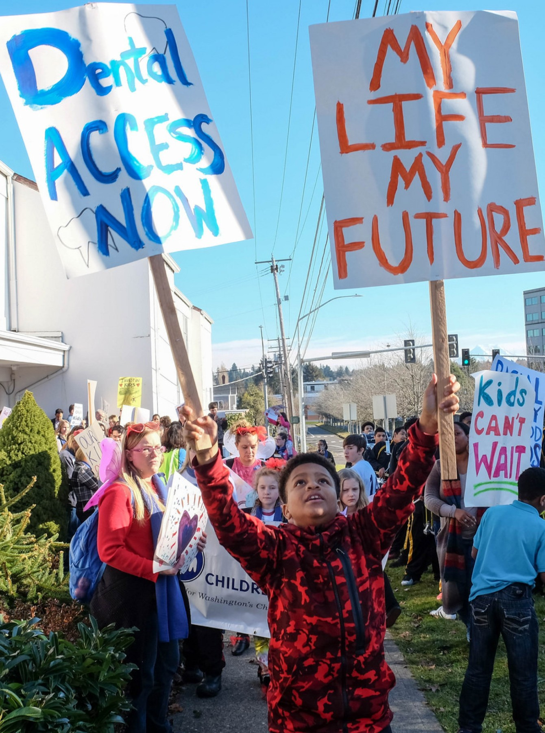
ORAL HEALTH ACCESS & CARE
Impact on Health Outcomes
Many common chronic conditions are connected to oral health
Common for people with disabilities with Medicare to have chronic health conditions
More likely to develop gum disease
Less likely to get dental care
People with developmental disabilities have higher levels of tooth decay and gum disease
1 in 5 older adults have untreated tooth decay
About 2/3 have gum disease
Dually eligible adults are more likely than other Medicare enrollees to have dental problems
Some medications can cause dry mouth or other symptoms/side effects that affect oral health
©COMMUNITY CATALYST 2023

Slide 5
ORAL HEALTH ACCESS & CARE
Accessibility Considerations
Wheelchair/mobility device accessibility
Accessibility of dental chairs/operatories
Behavioral or sensory needs
Provider education/interprofessional training
©COMMUNITY CATALYST 2022 • 5

Slide 6
Thank you

