Slide 1
One Care Implementation Council
First Term Review

Slide 2
One Care Implementation Council 1.0
Overview
Major Accomplishments
Suggested Goals for the Next Implementation Council

Slide 3
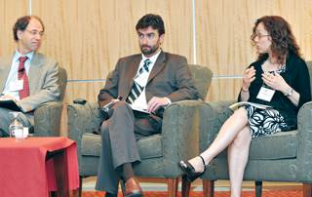
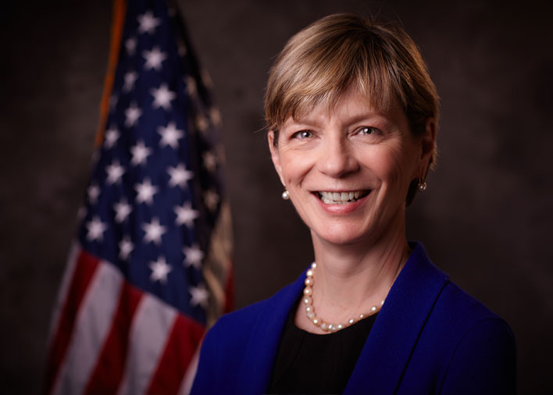
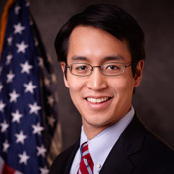
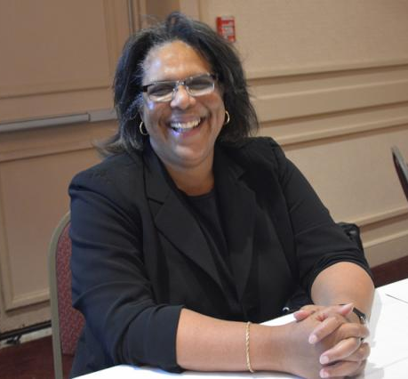
Two great plans A dedicated UMass MassHealth team
Supportive leadership

Slide 4
We have a great Council
Amazing stakeholder involvement

Slide 5
Implementation Council 1.0 Successes
One Care
is here
and thriving!

Slide 6
Positive Collaboration Between Council 1.0 and MassHealth

Slide 7
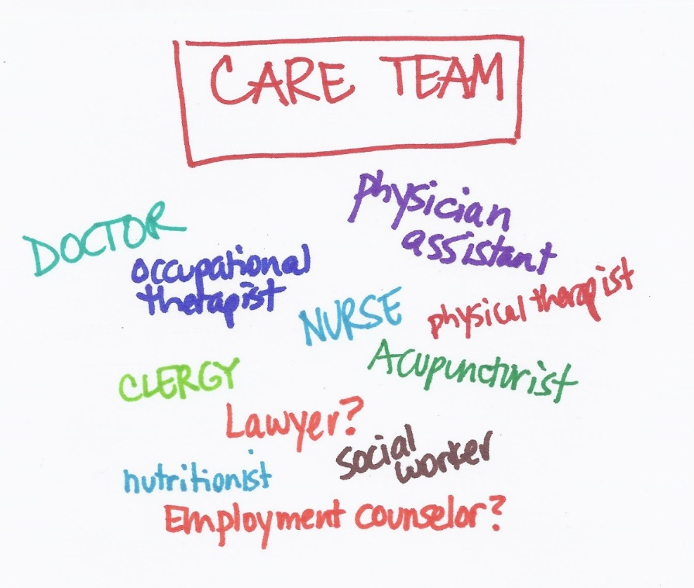
Who should be in a care team?
BH Privacy best practices

Slide 8
Quality Metrics and Contracting Requirements

Slide 9
Housing Services and Enrollment Process

Slide 10
Implementation Council 2.0

Slide 11
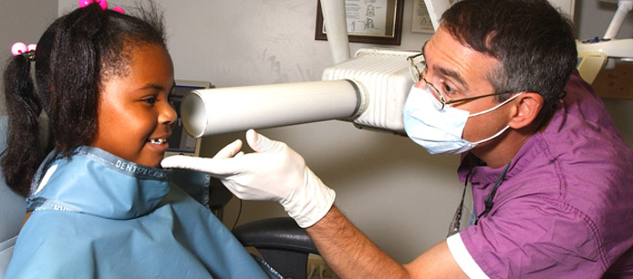
More Work Needs to Be Done
Integration of peers
Food and nutrition
Access to oral healthcare
Transportation

Slide 12
More Work Needs to Be Done
LTSS Coordinator role
Communication access

Slide 13
More Work Needs to Be Done
Partnership in outreach
Town hall meetings and more

Slide 14
The Opportunity and Obligation
It is still a demonstration
Increasing quality and growing to scale

Slide 15
The Opportunity and Obligation

Slide 16
Implementation Council 2.0 Priorities

