Slide 1
Oral Health and One Care: Opportunities for improvement
March 14, 2023

Slide 2
Introductions
Samantha Jordan, Oral Health Director
Alex Sheff, Director of Policy & Government Relations

Slide 3
Health Care For All
Direct Service: Free consumer HelpLine
Community: Outreach and organizing
Policy: Advocacy and coalitions
www.hcfama.org

Slide 4
Oral Health Advocacy Taskforce (OHAT)
Created in 2002 in response to state budget cuts to MassHealth adult dental services
Broad-based statewide coalition of consumers, advocates, health care professionals, academics, and insurers
Improve oral health for all persons in the Commonwealth

Slide 5
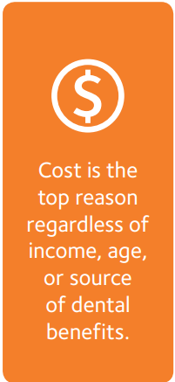
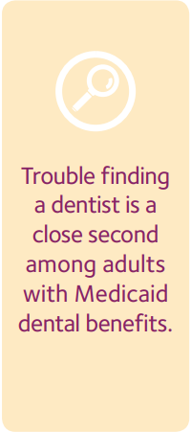
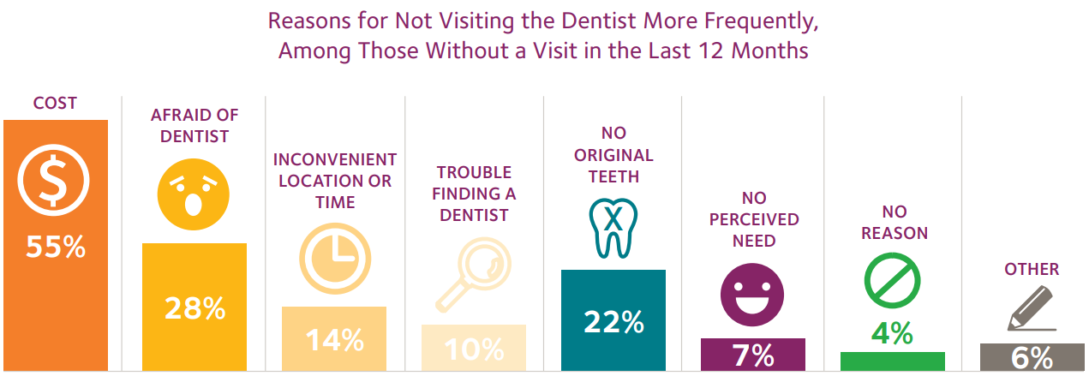
Oral Health Care is Not Accessible
Source: American Dental Association, Health Policy Institute, MA Data, 2015
Notes:
When Massachusetts residents were asked why they were not able to visit the dentist, cost was the most common reason given. In fact, cost is the main barrier to dental care across the U.S. and for all incomes, ages, and dental benefits

Slide 6
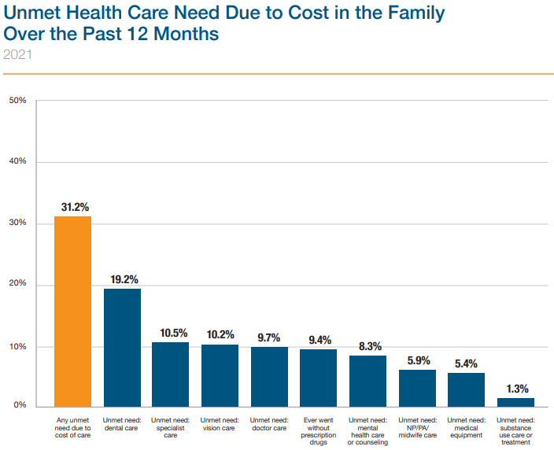
Oral Health Care is Not Affordable
Dental care is the most common unmet health care need among Massachusetts residents.
Higher than specialist care, vision care, and prescription drugs
Source: CHIA Massachusetts Health Insurance Survey, July 2022
Notes:
Dental care is consistently the most common unmet health care need among Massachusetts residents. Higher than specialist care, vision care, and prescription drugs

Slide 7
Pandemic worsened dental access disparities
Source: MA Department of Public Health, Office of Oral Health
Notes:
Individuals with special health care needs also have a high level of oral disease. Not only do these groups suffer the highest burden of oral disease, they also face the greatest barriers to accessing preventive and routine dental care.
Unfortunately, the impact of the COVID-19 pandemic has likely worsened these existing disparities in oral disease and dental care access

Slide 8
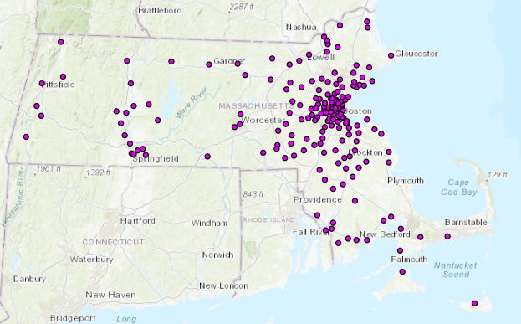
MassHealth Dental Providers – 1,620 Locations
Source: MassHealth, 2022
Notes:
The majority of MassHealth dentists are clustered in urban areas, and more than 50% of cities and towns have no MassHealth dentist
Currently 38% of dentists accept MassHealth – and only about half of those provide an appreciable amount of care.

Slide 9
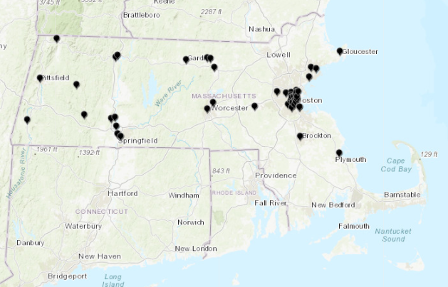
Community Health Center Dental Clinics – 56 locations
Source: MassHealth, 2022

Slide 10
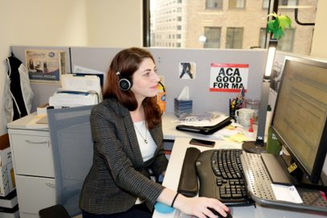
HelpLine Oral Health Concerns
Difficulty finding a MassHealth Dentist
Particularly for consumers who are best served in a language other than English or have an accent
Special needs adults

Slide 11
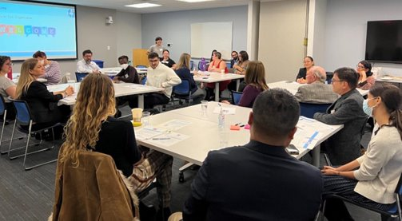
Coalition and Community Concerns
**Cost**
Need for more MassHealth dental providers
Accessibility of dental care
Need for increased language access and cultural humility among providers
Desire for oral health integration
Need for more oral health outreach and education
Meeting community members “where they are” at churches, schools, and in the community

Slide 12
MassHealth 1115 Waiver renewal
Includes new oral health integration efforts
Primary care requirements for:
Oral health screening and referral for all attributed members
Fluoride Varnish for pediatric patients under the age 6
Quality measure: Fluoride varnish application 2x/year for children under the age 21

Slide 13
Considerations for One Care
Oral health training for care coordinators
Encourage primary care to integrate oral health
Screening, referral, education
Interventions: FV, SDF
Home visits
Network adequacy
Time until next available appointment, routine and urgent
Accessibility
Quality measurement
D9920 Behavior Management code utilization
Dental visit utilization (any dental visit, preventive dental visit)
Enhanced preventive dental benefits based on caries risk assessment or medical diagnosis
3-4 dental cleanings a year
Outreach to members and providers
Partner with community-based organizations

Slide 14
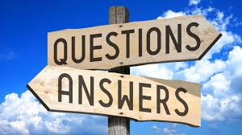
Thank you

