Slide 1
Implementation Council New Member Onboarding
December 11, 2015

Slide 2
Onboarding Agenda
Council member Introductions (12:00-12:15pm)
Icebreaker
Diversity and Inclusion
One Care 101 (12:15-12:30pm)
Implementation Council Roles & Responsibilities (12:30-12:45pm)
Opportunities for Participation (12:45-1:00pm)
Regular Council Business (1:00-2:00pm)

Slide 3
One Care 101
What is One Care?
Who is One Care for?
What services are covered?
What are the goals of One Care?
Who are the One Care plans?

Slide 4
What is One Care?

Slide 5
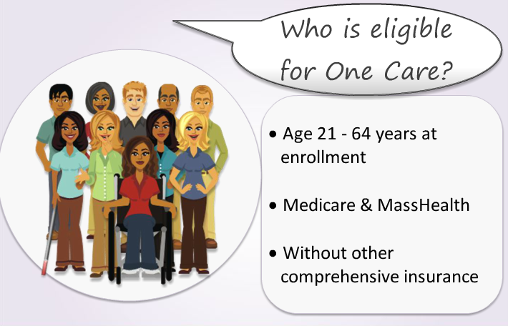
Who is One Care for?

Slide 6
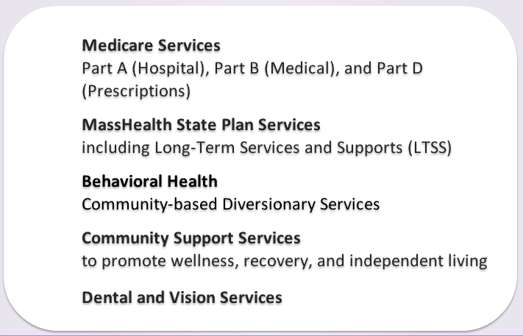
What services does One Care cover?

Slide 7
What are the goals of One Care?

Slide 8
Who are the One Care plans?

Slide 9
Implementation Council Roles & Responsibilities

Slide 10
Council Roles & Responsibilities
The Implementation Council plays a key role in monitoring access to health care and compliance with the Americans with Disabilities Act (ADA), tracking quality of services, providing support and input to EOHHS, and promoting accountability and transparency.

Slide 11
Council Workplan
Implementation Council 2015-2016 Workplan
4 Goal Areas
Identify and, when possible, address challenges experienced by One Care stakeholders and promote successes that can be implemented by MassHealth, the One Care Plans, and One Care Ombudsman.
One Care enrollees have access to covered services as needed, including medical, behavioral health, and LTSS services, and essential social services such as housing and employment.
One Care enrollees will receive high quality care
Public education and outreach activities will reach all potential One Care enrollees and providers

Slide 12
How does the Council fulfill it’s role?
Monthly meetings
Conduct Council business
Hear updates from MassHealth
Provide input to MassHealth
Hear from stakeholders
Workgroup meetings
Discuss topics more in depth
Work collaboratively with MassHealth and other stakeholders on key issues
Builds awareness of One Care
Distributes information and updates to networks and communities
Participates in outreach events and planning

Slide 13
Opportunities for Participation
Active workgroups
Work Plan Goal 1 workgroup
Work Plan Goal 2 workgroup
Behavioral Health Privacy workgroup
Encounter Data workgroup
Pending workgroups
LTS Coordinator workgroup
Work Plan Goal 3-4 workgroup
One Care Sustainability workgroup

Slide 14
How to get involved
Review the work plan and let Council staff if you’re interested in participating in any of work plan activities or any of the current or pending workgroups.
Participate in discussions during meetings.

Slide 15
Resources
Implementation Council Website
One Care Website
2015-2015 Implementation Council Workplan
Implementation Council Welcome Packet
Intro to One Care Webinar

