Slide 1
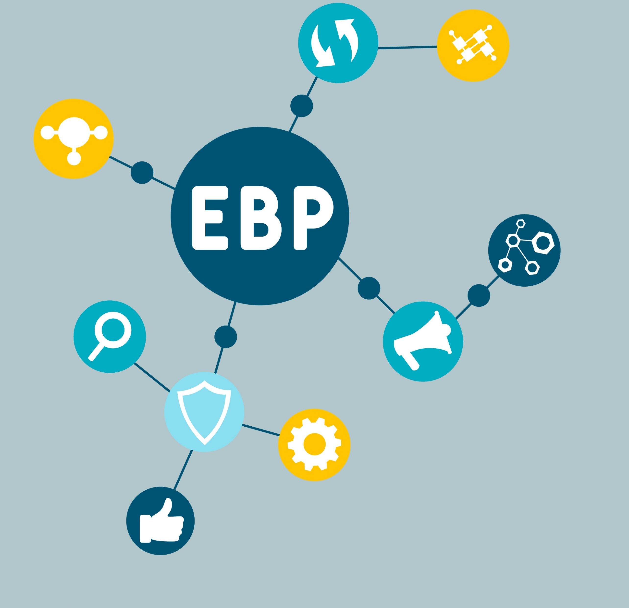
Using Evidence-Based Practices
ACCS Principles

Slide 2
Learning Objectives
During this module you will:
01
Reflect
on your own experience with Evidence-Based Practices (EBPs)
02
Learn
the definition & importance of EBPs
03
Identify Examples of
EBPs that you have more vs less experience

Slide 3
Activity
What is an evidence-based practice?
Can be:
Appropriate use of valid screening & assessment instruments
Evidence-based interventions
Notes:
Activity - Ask What is an evidence-based practice?
After they respond – show next section of slide that gives this definition:
Evidence-based practices can be a screening-to-assessment approach or an intervention (e.g., treatment program, service) for which there is scientific evidence that it will improve outcomes for persons served.

Slide 4
Why do we use evidence-based practices in ACCS?
Assist persons served with improving their functioning, well-being, and other outcomes
Evidence-based interventions are effective in improving the lives of persons served but only about 10% actually receive EBPs
Practices that are NOT evidence-based, are unrelated to improving client outcomes
Notes:
Explain:
1. We are here to assist persons served with improving their functioning, well-being, and other outcomes. Note that the other outcomes include:
Independence
Employment
Satisfying relationships/personal support, and
Good quality of life
Research has documented what interventions are effective in improving the lives of persons served with severe mental health conditions, yet studies are also showing that most persons served in routine mental health programs do not get treated with evidence-based practices. Only about 10% of persons served actually receive evidence-based practices.
Examples of practices that are NOT evidence-based, are unrelated to improving client outcomes, and in some cases may even be harmful3, include making decisions based on:
Traditional mental health service practices that do not have evidence of benefiting outcomes for persons served,
What is convenient, and
Clinicians’ preferences or wisdom without the structure of a validated approach.

Slide 5
Use validated screening and/or assessment instruments to identify:
The risks of persons served and what may be driving risks
Functional needs
The best treatment plan to help minimize clinical risks and improve overall functioning
Notes:
Explain:
We use validated screening and/or assessment instruments to identify the risks of persons served, what may be driving those risks, functional needs, and to inform the best treatment plan to help the person served minimize clinical risks (e.g., suicide, substance use) and improve overall functioning

Slide 6
Screening vs. Assessment
Screening
Assessment
Screened out
Doesn’t have the risk in question
Has the risk in question
Notes:
Explain:
Screening is conducted first as a means to determine who ‘might’ have the characteristic in question (e.g., risk for suicide) versus who can be screened out. Individuals ‘screened in’ receive a more comprehensive assessment (point out the arrow from screening to assessment on the slide). In this way, the screen serves as a ‘sorting’ process.
Example: ACCS uses the Columbia-Suicide Severity Rating Scale (C-SSRS) to screen for suicide risk and the Assessment version for those who ‘screen in’
Screening instruments are ‘portable’, these can be conducted in the moment when staff have reason for concern to determine if the person served is at elevated risk for suicide, substance use, etc. They also are intended to be conducted routinely during ITT reviews.
We will discuss how the screening to assessment process works in more detail in the Risk Management module.

Slide 7
Use of structured, valid screening tools with an evidence-base is essential to ensure accuracy, consistency across clinicians/personnel, and fairness.
Notes:
Explain:
These ensure every clinician (or other relevant personnel) is asking relatively the same questions and basing their decisions on the same information.
Research indicates use of validated instruments is a more valid approach than using one’s gut or experience alone. In the case of violence risk, for example, considerable research has indicated experienced professionals perform only slightly better than chance when trying to determine who is a risk for violence when no instrument is used.
It is important for agencies and users of screening and assessment instruments to be aware of whether their instruments have been validated for use with the individuals they serve (e.g., cultural background, gender). Some instruments also are available in different languages.

Slide 8
Interventions used with ACCS persons served
Which of these EBPs do you have experience with?
Motivational Interviewing
SBIRT and Harm-Reduction for severe substance use
Cognitive-Behavioral Therapy
Wellness Recovery Action Plan (WRAP)
Housing First
Notes:
Explain:
Clearly screening and assessment procedures are not the only type of evidence-based practice – some interventions or treatment programs are also an evidence-based practice.
Ask:
Which of these Evidence Based Practices (EBP) do you already have experience with?
FACILITATOR NOTES:
Describe a few of the interventions from the list using the notes below and include any helpful information based on your experience with the intervention:
Motivational interviewing (MI)
An effective, evidence-based technique for helping clients resolve ambivalence about behaviors that prevent change. The core goals of MI are to express empathy and elicit clients’ reasons for and commitment to changing substance use and other unhealthy behaviors (Miller & Rollnick, 2013).
Screening, Brief Intervention and Referral to Treatment (SBIRT):
SBIRT is a comprehensive, integrated public health model designed to provide universal screening, secondary prevention (detecting risky or hazardous substance use before the onset of abuse or dependence), early intervention, and timely referral and treatment for people who have SUDs (Babor et al., 2007; Babor & Higgins-Biddle, 2001; Substance Abuse and Mental Health Services Administration [SAMHSA], 2011).
Harm reduction is an approach that promotes health in a way that meets people where they are at, accepting that not everyone is ready or capable of stopping their substance use at a given time. Instead of making judgments about where individuals suffering from addiction should be with regards to their health and behavior, harm reduction focuses on promoting evidence-based methods for reducing associated health risks in the current moment (e.g., preventing HIV transmission).
The defining features of harm reduction include a focus on the prevention of harm, rather than on the prevention of substance use itself. Harm reduction initiatives run the gamut from medical care and disease prevention, to education and linkage to addiction treatment. Retrieved March 30, 2022: https://www.recoveryanswers.org/resource/drug-and-alcohol-harm-reduction/
Cognitive-Behavioral Therapy (CBT)
Cognitive behavioral therapy (CBT) is a form of psychological treatment that has been demonstrated to be effective for a range of problems including depression, anxiety disorders, alcohol and drug use problems, marital problems, eating disorders, and severe mental illness. Numerous research studies suggest that CBT leads to significant improvement in functioning and quality of life. In many studies, CBT has been demonstrated to be as effective as, or more effective than, other forms of psychological therapy or psychiatric medications. (American Psychological Association. Retrieved March 30, 2022: https://www.apa.org/ptsd-guideline/patients-and-families/cognitive-behavioral)
CBT uses behavioral therapy techniques to help clients change their thinking patterns and their behavioral patterns.
Wellness Recovery Action Plan (WRAP) is a manualized group intervention for adults with mental illness. WRAP guides participants through the process of identifying and understanding their personal wellness resources ("wellness tools") and then helps them develop an individualized plan to use these resources on a daily basis to manage their mental illness. Retrieved March 30, 2022: https://massachusetts.networkofcare.org/mh/services/agency.aspx?pid=WellnessRecoveryActionPlanWRAP_2_1632_0
Housing First is an approach to addressing homelessness that focuses on providing permanent housing without barriers to entry such as sobriety, treatment, or service participation requirements. Housing First is built upon the principles that homelessness is fundamentally a housing crisis and that having necessities like a stable place to live must come before other, less critical needs. Retrieved March 30, 2022: https://www.mamh.org/science-innovation/tested-solutions/housing-first

Slide 9
Activity:
Agencies that use WRAP
Notes:
Agencies that use WRAP might consider showing this video: https://youtu.be/pZLgVSF18ug

Slide 10
Evidence-based practices must be followed with fidelity to be effective
Research shows that offering an intervention that ‘resembles’ an evidence-based practice is not sufficient
Providing interventions that are administered with fidelity will result in superior outcomes
Persons served have a right to access to interventions that are known to be effective
Notes:
SLIDE 10: Evidence-based practices (EBP) must be followed to fidelity to be effective.
Explain: Meaning these interventions and screening and assessment procedures are to be followed exactly as described in the manuals (aka the ‘active ingredients’)
Research shows that offering an intervention that ‘resembles’ an evidence-based practice is not sufficient for obtaining good outcomes
Providing interventions that are administered with fidelity will result in superior outcomes
Persons served have a right to access to interventions that are known to be effective
Some, but not all, evidence-based practices have adaptations available for use with individuals from different cultural backgrounds, if necessary. Know what is available for your EBP

Slide 11
Reference
Drake et al. (2001). Implementing evidence-based practices in routine mental health service settings. Psychiatric Services, 52(2) p. 179-182

