Slide 1
Improve Population Health Outcomes
Leveraging EHR and Patient Registries
Anita Christie, RN MHA CPHQ
MA Department of Public Health

Slide 2
Objectives
To define Population Health
To understand how Electronic Medical Record implementation and reporting can help to manage outcomes
To provide basic information regarding quality improvement
To discuss how this presentation can help better coordinate care in your practice

Slide 3
Population Health and Management

Slide 4
What is Population Health
Often stated as:
“ The health outcomes of a group of individuals including the distribution of such outcomes within the group.”¹
¹ Kindig and Stoddart, What is Population Health?; American Journal of Public Health, 2003; 93: 380-383

Slide 5
Subpopulations
Described as: ²
Discrete/defined – such as populations receiving care within a health system or from a specific health plan. For example those patients enrolled in specific provider panel.
Regional/Community – geographical population segments that have a common need, such as older adults with complex needs that may receive their care in a variety of settings
² Populations, Population Health, and the Evolution of Population Management: Making Sense of the Terminology in US Health Care Today; Institute of Health Care Improvement, Leadership Blog; Accessed April 2, 2014
http://www.ihi.org/communities/blogs/_layouts/ihi/community/blog/itemview.aspx?List=81ca4a47-4ccd-4e9e-89d9-14d88ec59e8d&ID=50

Slide 6
Population Health Management
Has evolved with new payment mechanisms and effort such as
Patient Centered Medical Home
Accountable care organizations
Health Policy Commission – certification of risk sharing organizations
Shift has begun to focus on management of discrete/defined sub-populations

Slide 7
What do you need your EHR to do?
Stage 1: Meaningful use criteria focus on: | Stage 2: Meaningful use criteria focus on: | Stage 3: Meaningful use criteria focus on:
Electronically capturing health information in a standardized format | More rigorous health information exchange (HIE) | Improving quality, safety, and efficiency, leading to improved health outcomes
Using that information to track key clinical conditions | Increased requirements for e-prescribing and incorporating lab results | Decision support for national high-priority conditions
Communicating that information for care coordination processes | Electronic transmission of patient care summaries across multiple settings | Patient access to self-management tools
Initiating the reporting of clinical quality measures and public health information | More patient-controlled data | Access to comprehensive patient data through patient-centered HIE
Using information to engage patients and their families in their care |  | Improving population health
http://mehi.masstech.org/meaningful-use-and-incentives/stages-1-2-3/meaningful-use

Slide 8
How do we measure it?
Not only for insurance providers – You can have this available ongoing
EMR can be useful in providing real time data for analysis and improvement
EMR can be used to create registries to help coordinate care
Quality Measures may include:
HTN measurement and control
Asthma measurement and control
Diabetes measurement and control
Behavioral health
Preventive health – Paps, Mammography, Colorectal screening

Slide 9
Patient Registries
Common tool used in Patient Centered Medical Home Initiatives
Uses:
Care Coordination
Team huddles – Managing daily care
Trending care for the population
Quality Improvement and Process Redesign initiatives

Slide 10
Data Elements included in a Registry
Patient name, phone number, age
Last primary care visit date
BMI
Diagnoses
Last recorded blood pressure
Lab values for A1C, fasting plasma glucose, or oral glucose tolerance test

Slide 11
Criteria to consider for inclusion
Dates for inclusion in your EMR search
Diagnosis of hypertension or prediabetes
Start to explore potentially undiagnosed hypertension consider conservative criteria such as:
Patients who had a single encounter with a SBP > 180, or a DBP > 100, but no diagnosis
Explore potential prediabetes with recent lab values
A1C = 5.7-6.4
Fasting plasma glucose =100-125 mg/dL
oral glucose tolerance test = 140-199 mg/dl

Slide 12
Choosing Clinical Criteria
2+ values ≥ 140/90
2+ values ≥ 150/90
1 value ≥ 160/100
1 value ≥ 180/100
More liberal criteria, lower PPV
More resources for HTN confirmation
More conservative criteria, higher PPV
Fewer resources for HTN confirmation
PPV = Positive Predictive Value
Source: Wall, HK; “Finding Patients with Undiagnosed Hypertension: Hiding in Plain Sight” presentation Jan 20, 2016.
Notes:
PPV – likelihood that the clinical criteria will correctly identify patients with HTN (how many false positives)

Slide 13
Azara DRVS Diabetes Registry Demo

Slide 14
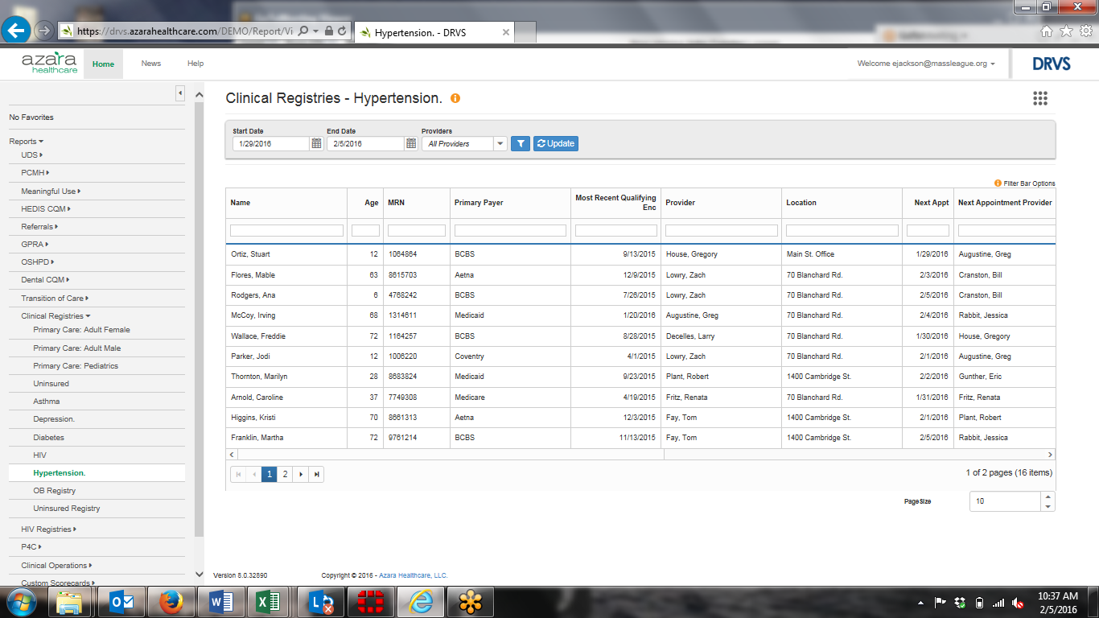
Azara DRVS Hypertension Registry Demo

Slide 15
Care Coordination
Call back and reminders
Identification of patients in need of services
Coordination of care across team members
Nurses
MA
Community Health Worker/Patient Navigator
Physicians
Pharmacists
Community services
Education

Slide 16
Team Huddles
Can assist in organizing daily work
Identification of patients with specific chronic conditions who are scheduled for appointments
May allow for implementation of standard order sets ahead of an appointment
Promotes collaboration of daily work among team members

Slide 17
Data Trending
Can identify trends in care of patients with specific conditions
Control of chronic condition
Complete services according to clinical guidelines
Medication prescribing practices
Overall management of a sub-population

Slide 18
Quality Improvement and Redesign
Data trends can be used to identify areas for improvement in practice design
For example:
Missed BP follow-up
Need for client reminders
Need for provider reminders of preventive care
Missed foot exams or retina exams for diabetics
Poor control of disease among sub-populations

Slide 19
QUALITY IMPROVEMENT

Slide 20
Institute of Healthcare Improvement (IHI)
Triple Aim Framework
Improving the patient experience of care (including quality and satisfaction);
Improving the health of populations; and
Reducing the per capita cost of health care.
Assessment Tool
http://www.ihi.org/Engage/Initiatives/TripleAim/Pages/default.aspx

Slide 21
QI – What does it mean?
The Institute of Medicine defines quality as:
The degree to which health services for individuals and populations increase the likelihood of desired health outcomes and are consistent with current professional knowledge.
http://www.iom.edu/Global/News%20Announcements/Crossing-the-Quality-Chasm-The-IOM-Health-Care-Quality-Initiative.aspx; Accessed 4/4/2014

Slide 22
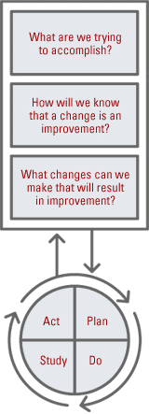
Tools
EMR Registries that:
Identify patient populations
Identify missed opportunities
Trend information over time
QI techniques to improve care:
Aim statements
Flow charting
Process redesign
Cause and effect diagrams
Pie, scatter, run, bar charts that transform the data into information
PDSA cycles

Slide 23
How often?
Reporting can be designed and run as needed to identify high risk population and monitor impact of improvement
Populations should be stratified to identify
Age
Race/ethnicity
Co-morbidities
Diagnosis
Will require updates to Family/Personal History and Problem lists
Ability to identify discrete elements such as actual values of lab results

Slide 24
What do you need to be in place?
Leadership
Dedicated team and leadership time to work on improvement initiatives
EMR reporting capability
Knowledge of data collection, interpretation, translation into meaningful action steps for improvement
Teams to support implementation of change

Slide 25
Resources
Million Hearts Action Guide – Hypertension Control Change Package for Clinicians
http://millionhearts.hhs.gov/Docs/HTN_Change_Package.pdf
Categories include:
Make HTN control a practice priority
Implement a policy and process to address BP at every visit
Train and evaluate direct care staff on accuracy of BP measurement
Systematically use evidence based HTN guidelines
Equip staff to facilitate self-management
Use a registry to identify, track and manage HTN
http://bit.ly/12k9MT1*
Use of clinician managed protocols
Use data to drive improvement
Etc…….

Slide 26
Resources
National Association of Community Health Centers
Launch a national initiative to fight hypertension in health center patients
http://www.nachc.com/pressrelease-detail.cfm?PressReleaseID=982
Data collection plan includes:
HTN prevalence
Identification of undiagnosed HTN
Missed opportunities
BP control – NQF 0018
Age, sex, race, poverty level, insurance status and co-morbidities

Slide 27
Resources
Centers for Disease Control and Prevention
Effective Public Health Strategies to Prevent and Control Diabetes: A Compendium – April 2013
http://www.cdc.gov/diabetes/pubs/pdf/PublicHealthCompedium.pdf
Provides insights from across the country
Builds on work of Diabetes Collaborative
Patient Centered Primary Care Collaborative
The Medical Home and Diabetes Care
https://www.pcpcc.org/sites/default/files/media/diabetes_guide_2011.pdf

Slide 28
Questions/Discussion

Slide 29
Contact Information
Anita Christie, RN MHA CPHQ | Director
Office of Clinical Preventive Services
Massachusetts Department of Public Health
Office 617-624-5441
EMAIL: anita.christie@state.ma.us

