Slide 1
Million Hearts®: Improving Clinical Processes to Prevent One Million Heart Attacks and Strokes
Hilary K. Wall, MPH
Million Hearts® Science Lead
Division for Heart Disease and Stroke Prevention
U.S. Centers for Disease Control and Prevention
Massachusetts Hypertension Learning Collaborative
October 16, 2015

Slide 2
Financial and/or Commercial Disclosures
None
The opinions expressed by authors contributing to this project do not necessarily reflect the opinions of the US Department of Health and Human Services, the Public Health Service, the Centers for Disease Control and Prevention, or the authors’ affiliated institutions. Use of trade names is for identification only and does not imply endorsement by any of the groups named below.

Slide 3
Presentation Outline
Million Hearts® overview
Hypertension in the U.S.
Continuous Quality Improvement
Million Hearts® Hypertension Control Change Package
Additional tools

Slide 4
Million Hearts®
Goal: Prevent one million heart attacks
and strokes by 2017
US Department of Health and Human Services initiative, co-led by:
Centers for Disease Control and Prevention (CDC)
Centers for Medicare & Medicaid Services (CMS)
Partners across federal and state agencies and private organizations
4

Slide 5
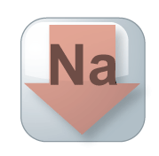
Key Components of Million Hearts®
Keeping Us Healthy
Changing the environment
Health Disparities
Excelling in the ABCS
Optimizing care
Aspirin when appropriate
Blood pressure control
Cholesterol management
Smoking cessation
Focus on the ABCS
Health information technology
Innovations in care delivery
TRANS
FAT

Slide 6
Targets for the ABCS
Intervention | Pre-Initiative Estimate (2009-2010) | 2017 Population-wide Goal | 2017 Clinical Target
Aspirin when appropriate | 53.8% | 65% | 70%
Blood pressure control | 52.4% | 65% | 70%
Cholesterol management | 33.0% | 65% | 70%
Smoking cessation | 22.2% | 65% | 70%
National Ambulatory Medical Care Survey, National Health and Nutrition Examination Survey
6

Slide 7
70 Million Adults with Hypertension (29.1%)
Nwankwo T, Yoon SS, Burt V, Gu Q. Hypertension among adults in the United States: National Health and Nutrition Examination Survey, 2011–2012. NCHS data brief, no 133. Hyattsville, MD: National Center for Health Statistics. 2013.

Slide 8
34M Adults With Uncontrolled Hypertension By Awareness And Treatment Status
Source: 2009-2010 National Health and Nutrition Examination Survey
Data may not add due to rounding.

Slide 9
Uncontrolled Hypertension and Access to Care
Yes No
Usual Source of Care
Yes No
Health Insurance
≥2 1 None
# Times Received Care in Past Year
CDC. MMWR. 2012;61(35):703–9.

Slide 10
Barriers to Achieving Hypertension Control
Patient resistance to treatment
Patient non-adherence to medications and lifestyle changes
Multiple medication choices and dosages
Up-titration and follow-up timelines
Therapeutic inertia
White-coat hypertension and resistant hypertension
Wofford MR, et al. Curr Hypertens Rep. 2009;11:323–8
Persell SD. Hypertension. 2011;57:1076–80

Slide 11
Moving the Dial

Slide 12
What is continuous quality improvement?
A quality management process that encourages all health care team members to continuously ask:
How are we doing?
Can we do better?
Culture of improvement for the patient, the practice, and the population in general
Structured planning approach to evaluate the current practice processes and improve systems to achieve improvement
Enables team members to assess and improve health care delivery and services
Continuous Quality Improvement (CQI) Strategies to Optimize your Practice: Primer, 2013

Slide 13
Success Story: Kaiser Permanente Northern California
87%
Hypertension control reports every 1–3 months and evidence-based hypertension control protocol
Percent of patients with controlled hypertension
44%
Jaffe, M.G., et al. (2013). Improved blood pressure control associated with a large-scale hypertension program. JAMA, 310 (7).

Slide 14
“It is not necessary to change. Survival is not mandatory.”
– W. Edwards Deming

Slide 15
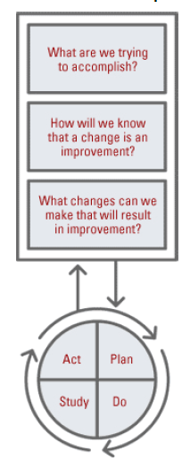
The Model for Improvement
Developed by Associates in Process Improvement
Used by the Institute for Healthcare Improvement (IHI)
The IHI Improvement Project Planning Form http://bit.ly/1IhzWZ7
The Science of Improvement: How to Improve

Slide 16
What are we trying to accomplish?
Based on:
Staff perceptions/insights of needed improvements
Patient surveys
Chart reviews
Ambulatory Health IT-enabled Quality Improvement Worksheet (http://bit.ly/1KB3Xny)
Start small, narrow focus
One clinical area
Authority and resources to make changes

Slide 17
Establish SMART Aims
Specific, Measurable, Achievable, Realistic, Timebound
Examples
Increase the number of patients with hypertension who receive reminders for follow-up visits from 25% to 100% today.
Increase the hypertension control rate for diagnosed hypertensive patients from 33% to 48% in 6 months.

Slide 18
How will we know that a change is an improvement?
Determine data source
Chart reviews on samples of patients
Patient registries
EHR data
Patient surveys
Share results

Slide 19
What changes can we make that will result in improvement?
“All improvement requires change but not all changes result in improvement.”
Sources for ideas for change:
Creative problem solving
Insights of those who work in the system
Scientific literature
Borrowing from others who have successfully improved

Slide 20
Plan-Do-Study-Act (PDSA) Cycles
Rapid tests of change
Way to test an idea in a real-life work setting
The Institute for Healthcare Improvement (IHI) PDSA Worksheet for Testing Change http://bit.ly/1KMP7rq

Slide 21
Repeating PDSA
Changes to the system resulting in improvement
A
P
S
D
D
Modify the change as needed and make it standard practice
Data
S
P
A
A
Wide-scale tests of change
S
P
D
A
P
Modify the change and use it with other patients
S
D
Change Idea
Pilot the change with small group of patients and refine it

Slide 22
Selecting Changes
Source for ideas for change: Borrowing from others who have successfully improved
A “change package” is an evidence-based set of changes that are critical to the improvement of an identified care process.
Improving Chronic Illness Care, 2014

Slide 23
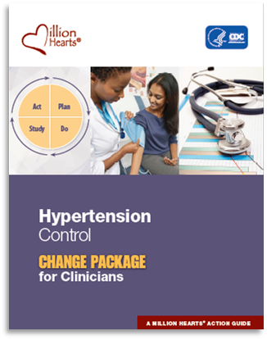
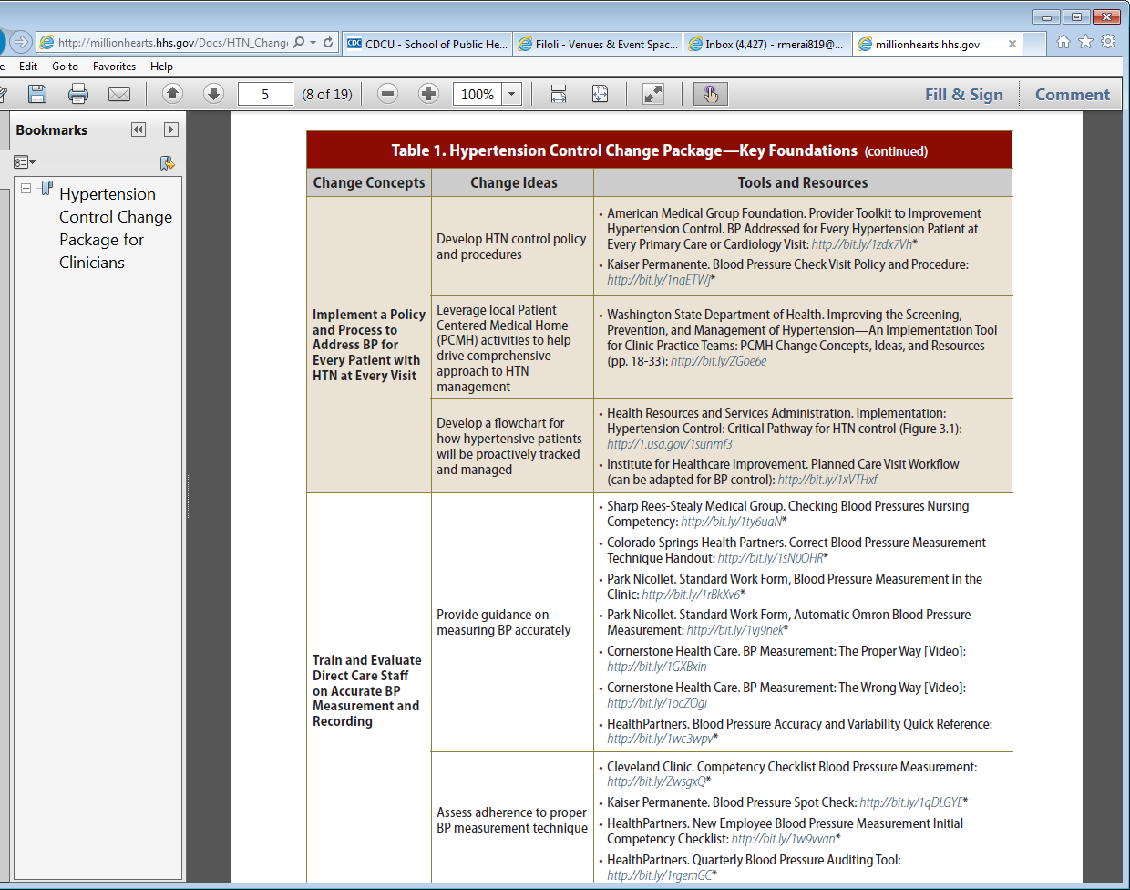
Hypertension Control Change Package
Access the Change Package at: http://millionhearts.hhs.gov/Docs/HTN_Change_Package.pdf

Slide 24
Change Concept
General notions that are useful in the development of more specific ideas for changes that lead to improvement
Change Idea
Actionable, specific ideas for changing a process
Tools & Resources
Can be adapted by or adopted in a health care setting

Slide 25
Hypertension Control Change Package Focus Areas
Key foundations
Population health management
Individual patient supports
→ Hypertension control case studies

Slide 26
Key Foundations
Change Concepts:
Make hypertension control a practice priority
Implement a policy to address blood pressure for every patient with hypertension at every visit
Train and evaluate direct care staff on accurate blood pressure measurement and recording
Systematically use evidence-based hypertension guidelines and treatment protocols
Equip direct care staff to facilitate patient self-management

Slide 27
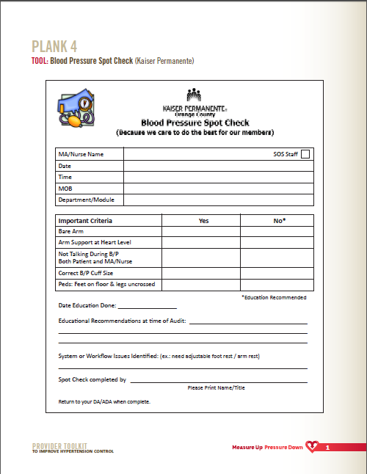
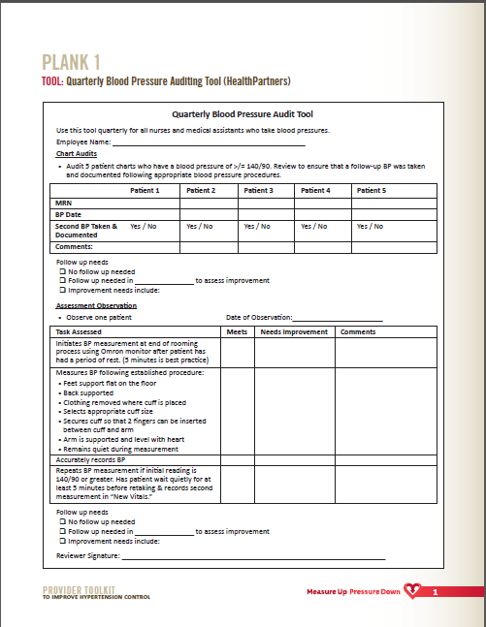
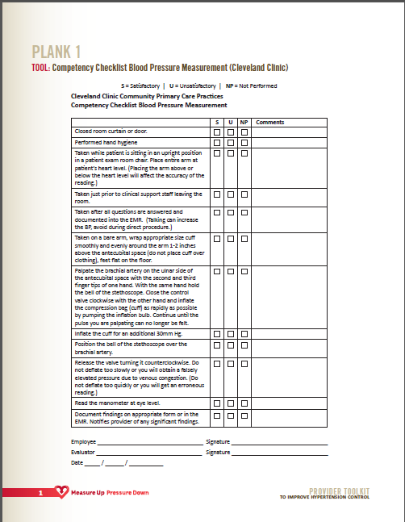
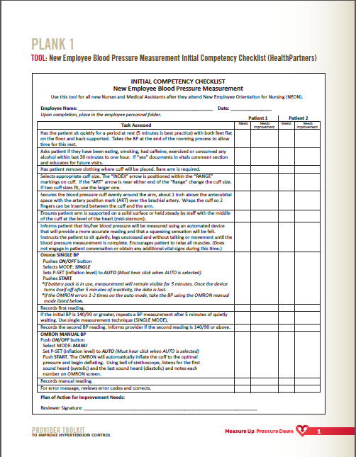
Change Concept
Train And Evaluate Direct Care Staff On Accurate Blood Pressure Measurement And Recording
1. Provide Guidance On Measuring BP Accurately
2. Assess Adherence To Proper BP Measurement Technique
Change Ideas
Tools & Resources

Slide 28
Population Health Management
Change Concepts:
Use a registry to identify, track, and manage patients with hypertension
Use clinician-managed protocols for medication adjustment and lifestyle recommendations
Use practice data to drive improvement

Slide 29
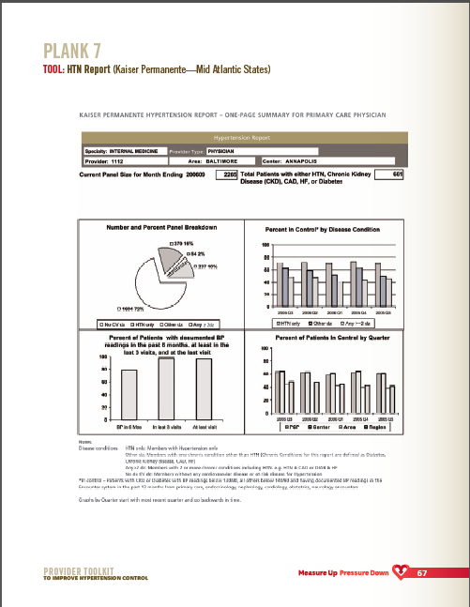
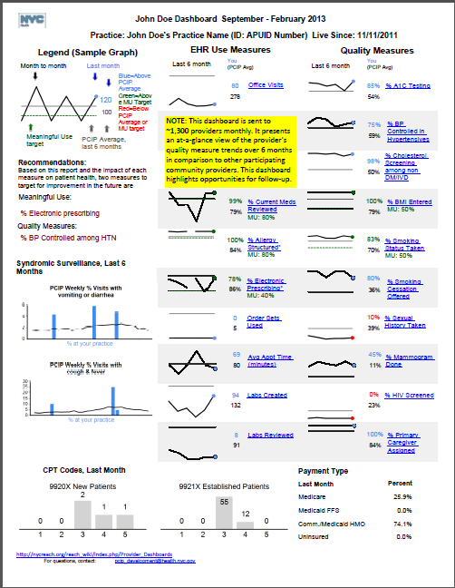
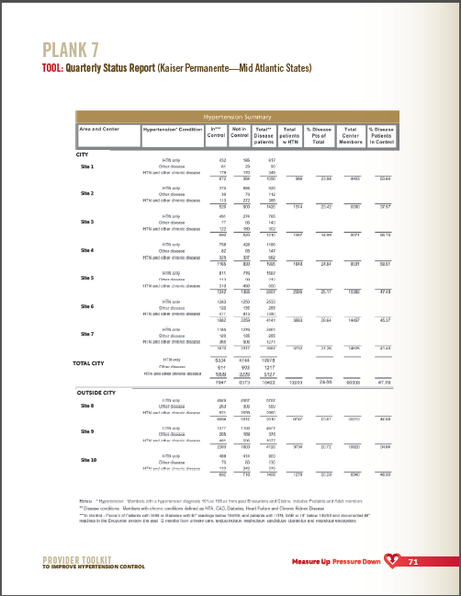
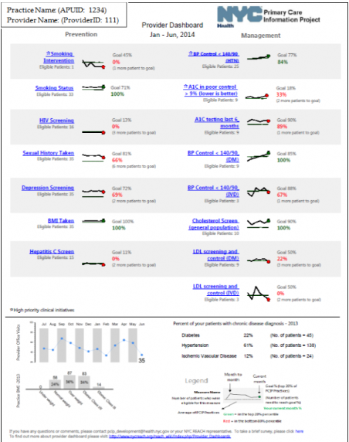
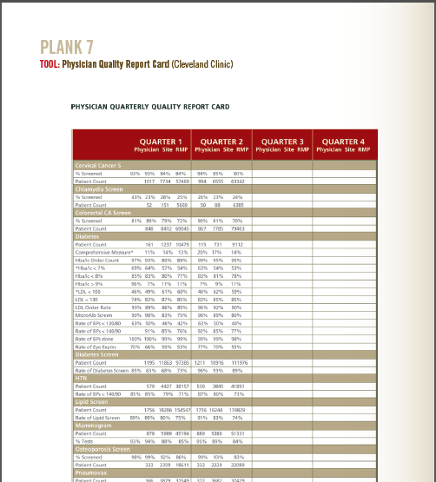
Change Concept
Use Practice Data To Drive Improvement
1. Determine HTN Control Metrics For The Practice
2. Regularly Provide A Dashboard With BP Goals, Metrics, And Performance
Change Ideas
Tools & Resources

Slide 30
Individual Patient Supports
Change Concepts:
Support patients in hypertension self-management during their routine daily activities
Prepare patients and care team beforehand for effective hypertension management during office visits
Use opportunities during each patient visit phase to optimize blood pressure management
Intake
Provider Encounter
Encounter Closing
Follow up after visits to monitor and reinforce blood pressure management plans

Slide 31
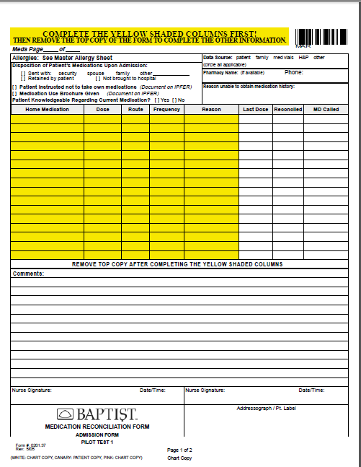
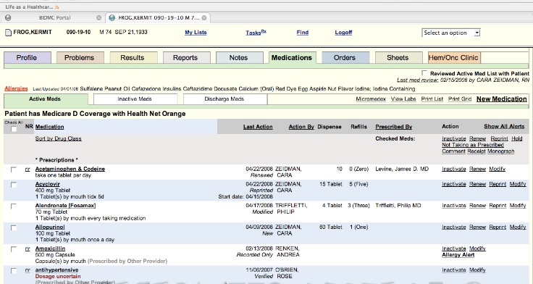
Change Concept
Use Each Patient Visit Phase to Optimize HTN Management: Intake (e.g., check-in, waiting, rooming)
1. Provide patients with educational materials to help them understand HTN and its implications
2. Provide patient with tools to support their visit agenda and goal setting
3. Measure, document and repeat BP correctly as indicated; flag abnormal readings
4. Reconcile medications patient is actually taking with the record’s medication list
Change Ideas
Tools & Resources

Slide 32
Additional Resources

Slide 33
Standardized HTN Treatment Protocols
http://millionhearts.hhs.gov/resources/protocols.html
Evidence-based protocols examples:
U.S. Department of Veterans Affairs
Kaiser Permanente
Institute for Clinical Systems Improvement
NYC Health and Hospitals Corporation
Customizable template
Key protocol components
Implementation guidance
COMING SOON – Tobacco cessation treatment protocols

Slide 34
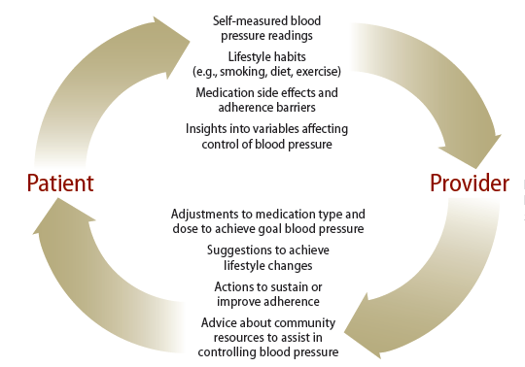
Self-Measured BP Monitoring Feedback Loop
Clinician

Slide 35
Self-Measured Blood Pressure Monitoring: Action Steps for Clinicians
Guidance for clinicians on SMBP
Prepare Care Teams to Support SMBP
Select and Incorporate Clinical Support Systems for SMBP
Empower Patients to Use SMBP
Encourage Coverage for SMBP Plus Additional Clinical Support
Teach patients to use monitors
Check home machines for accuracy
Suggested protocol for home monitoring
http://millionhearts.hhs.gov/Docs/MH_SMBP_Clinicians.pdf

Slide 36
34M Adults With Uncontrolled Hypertension By Awareness And Treatment Status
Source: 2009-2010 National Health and Nutrition Examination Survey
Data may not add due to rounding.

Slide 37
Finding Undiagnosed Hypertensives
Wall HK, Hannan JA, Wright JS. Patients with Undiagnosed Hypertension: Hiding in Plain Sight. JAMA. 2014;312(19):1973-74.
NorthShore University HealthSystem, Evanston, IL
Geisinger Health, Pennsylvania
Palo Alto Medical Foundation in Palo Alto, CA
11 primary care centers in West Virginia
CDC project with National Association of Community Health Centers
10 health centers from 5 states (AR, CA, KY, MO, TN)
Developed a change package – http://mylearning.nachc.com/diweb/fs/file/id/229350

Slide 38
NorthShore University HealthSystem
Undiagnosed HTN Project
Embedded several algorithms into their EHR to identify patients at risk for undiagnosed HTN
Used an Automated Office Blood Pressure (AOBP) machine to verify HTN status
Verified undiagnosed hypertension, NOT undocumented hypertension
Rakotz MK, Ewigman BG, Sarav M, et al. A technology-based quality innovation to identify undiagnosed hypertension among active primary care patients. Ann Fam Med. 2014;12(4):352-358.

Slide 39
Rakotz MK, Ewigman BG, Sarav M, et al. A technology-based quality innovation to identify undiagnosed hypertension among active primary care patients. Ann Fam Med. 2014;12(4):352-358.

Slide 40
Geisinger Health
Used data from 400K+ adult outpatients to ID patients with HTN
The problem list
ICD-9-CM diagnosis
Antihypertensive medications Rx
Two elevated BP values based on JNC-7 criteria
2 systolic measures ≥140 or 2 diastolic measures ≥90
Found 106K patients with one or more criteria
30% based solely on #4 (i.e. undiagnosed)
HTN Prevalence – ~18.6% vs ~26.5%
Shah NR. Identifying hypertension in electronic health records: a comparison of various approaches. Paper presented at: AHRQ Comparative Effectiveness Research Methods Symposium; June 2009; Rockville, MD. Of Various Approaches. AHRQ Comparative Effectiveness Research Methods Symposium, Rockville, MD, June 2009.

Slide 41
Palo Alto Medical Foundation
250,000 adult patients (active 2006 - 2008)
For patients with ≥ 2 BP readings of 140/90 or higher, an antihypertensive medication prescription, or both, 37.1% did not have an ICD-9-CM code
HTN prevalence went from 18.0% (ICD code only) to 28.7%
Much more likely to be on an antihypertensive with a HTN diagnosis
92.6% diagnosed vs 15.8% undiagnosed, P < .001
Banerjee D, Chung S, Wong EC, Wang EJ, Stafford RS, Palaniappan LP. Underdiagnosis of hypertension using electronic health records. Am J Hypertens. 2012;25(1):97-102.

Slide 42
University of West Virginia
11 primary care centers in West Virginia
Chronic Disease Electronic Management System (CDEMS)
Query found 14,893 patients with:
ICD-9-CM code 401
2 or more blood pressure readings of 140/90 or higher (n = 1076)
A diagnosis of essential hypertension based on free-text entries (n = 898)
13.3% potentially hypertensive patients overall
Varied across the sites from 3.6% to 47.9%
Baus A, Hendryx M, Pollard C. Identifying patients with hypertension: a case for auditing electronic health record data [published online April 1, 2012]. Perspect Health Inf Manag. 2012;9:1e.

Slide 43
University of Wisconsin
14,970 patients (2008-2011)
Clinical criteria:
Excluded patients with a diagnosis code or current antihypertensive Rx
≥ 3 outpatient BPs from 3 separate dates, at least 30 days apart, within a 2-year period (≥140 or ≥ 90)
≥ 2 elevated BPs (≥ 160 or ≥ 100), at least 30 days apart, but within a 2-year period
After 4 years, 18–31-year-olds had a 33% slower rate of receiving a diagnosis compared to those 60+
Johnson HM, Thorpe CT,. Bartels CM, Schumacher JR, Palta M, Pandhi N, Sheehy AM, Smith MA. Undiagnosed hypertension among young adults with regular primary care use. J Hypertens . 2014, 32:65–74

Slide 44
Special Thanks
Rikita Merai – CDC
Jerry Osheroff – TMIT Consulting
Brita Roy – Yale University
American Medical Group Foundation
Clinical Decision Support Collaborative for Performance Improvement
Health Center Network of New York
Institute for Healthcare Improvement
Kaiser Permanente Northern California
New York City Department of Health and Mental Hygiene Primary Care Information Project
Redwood Community Health Coalition
Washington State Department of Health

Slide 45
Questions?
Hilary Wall – hwall@cdc.gov

