Slide 1
Health Policy Commission and
Massachusetts Hospital Association
Information Sessions on RBPO/ACO Appeals
July 14, 2016 and July 20, 2016

Slide 2
AGENDA
Introduction to RBPO and ACO Appeals
Topics of Interest
Notice
Types of Issues for Appeal
Standard of Review
Reporting
Ongoing Role of OPP
Stakeholder Input on Best Practices

Slide 3
AGENDA
Introduction to RBPO and ACO Appeals
Topics of Interest
Notice
Types of Issues for Appeal
Standard of Review
Reporting
Ongoing Role of OPP
Stakeholder Input on Best Practices

Slide 4
Introduction: Appeals Processes for RBPOs and ACOs
Chapter 224 requires the HPC to develop internal appeals and external review processes for RBPOs and ACOs.
Office of Patient Protection (OPP) is directed to establish requirements for DOI-certified Risk Bearing Provider Organizations (RBPO) or HPC-certified Accountable Care Organizations (ACO) to implement appeals processes for reviewing consumer appeals as well as an external review process to obtain third party review of such appeals.
Statutory requirement are comparable to existing consumer protection rules regarding appeals to health plan medical necessity determinations. Appeals process applies to RBPO/ACO provider determinations on referrals, appropriate treatments and timely access to care for patients attributed to the organization.

Slide 5
Introduction: Statutory Requirements
 | RBPO | ACO
M.G.L. c. 6D, §15 | N/A | (b)(vi) calls for internal appeals plan as required for RBPOs; plan shall be approved by OPP; plan to be included in membership packets
M.G.L. c. 6D, §16 | N/A | (a)(8) OPP to establish regs, procedure, rules for appeals re: patient choice, denials of services or quality of care (b) establish external review including expedited review
M.G.L. c. 176O, §24 | (a) certified RBPOs shall create internal appeals processes (b) 14 days/3 days for expedited; written decision (b) RBPO shall not prevent patient from seeking outside medical opinion or terminate services while appeal is pending (d) OPP to establish standard and expedited external review process | ACO is to follow M.G.L. c. 176O, §24 when developing internal appeals plan (see M.G.L. c. 6D, §15(b)(vi))

Slide 6
Introduction: Objectives of Interim Guidance
Advance consumer protection established in Chapter 224 without duplicating existing rights under carrier insurance appeals
Protect patients while recognizing the needs of different providers and minimizing administrative burden and expense
Inform consumers about RBPO/ACO providers
Build on existing provider mechanisms for addressing complaints
Gather and analyze data, to provide foundation for developing appeals processes and rules
1
2
3
4
5

Slide 7
Introduction: Overview of Proposed Interim Guidance
Office of Patient Protection Bulletin released on May 6, 2016
Available at www.mass.gov/hpc/opp
Sample notice to patient accompanies Bulletin
Requirement to establish an appeals process by September 1, 2016
Complete process within statutory timeframes
Provide written notice of decision to patients inclusive of OPP contact information

Slide 8
AGENDA
Introduction to RBPO and ACO Appeals
Topics of Interest
Notice
Types of Issues for Appeal
Standard of Review
Reporting
Ongoing Role of OPP
Stakeholder Input on Best Practices

Slide 9
Notice
Provide Adequate Notice to Patients
Bulletin Applies to Commercial Risk Patients
Sample, “Notice to Patients,” Accompanies OPP Bulletin
Sample notice is for guidance
Make notice available in writing at all locations where patients regularly seek care and include a phone number or other contact information for patients to file an appeal inclusive of OPP contact information
Primary care patients for whose care the RBPO or ACO is at risk through an alternative payment contract with a carrier
Not including MassHealth patients
Not including Medicare patients
RBPOs/ACOs can decide best method of notice
RBPOs and ACOs are not required to use sample notice

Slide 10
Types of Issues for RBPO and ACO Appeals
Provider Decisions - Access
Carrier Decisions - Coverage
Referral Restrictions
Type or intensity of treatment or services
Timely access to treatment or services
Out of network services
Cost sharing
Medical necessity of treatment or service
RBPO/ACO Appeals Process
(M.G.L. c. 176O, § 24)
Carrier Appeals Process
(M.G.L. c. 176O, §§ 13, 14)

Slide 11
Case Example – Carrier Appeals Process
Patient Y, her PCP, and her neurologist agree that Patient Y needs a specific kind of treatment for her condition. Patient Y’s neurologist submits a prior authorization to Patient Y’s carrier to request coverage for the treatment. Patient Y’s carrier agrees that Patient Y obtained a proper referral from her PCP and that the neurologist who plans to perform the treatment is in Patient Y’s HMO network. However, the carrier determines that the treatment requested is not medically necessary.
Carrier Decisions - Coverage
Medical necessity of treatment or service
Carrier Appeals Process
(M.G.L. c. 176O, §§ 13, 14)

Slide 12
Case Example – RBPO/ACO Appeals Process
Patient Z requires a referral to a neurologist for symptoms that have just developed. Patient Z’s PCP is part of an RBPO and refers Patient Z to a neurologist that is affiliated with her RBPO. Patient Z had a neurological condition 5 years ago that was treated by a neurologist affiliated with another provider organization. Patient Z prefers to see this neurologist again due to continuity of care considerations and the possibility that the new symptoms are related to the previous condition. In order to see the specialist, Patient Z needs a referral from her PCP under the terms of her HMO plan and the recommended neurologist is in the HMO network. Patient Z cannot resolve the referral issue with her PCP.
Provider Decisions - Access
Referral Restrictions
RBPO/ACO Appeals Process
(M.G.L. c. 176O, § 24)

Slide 13
Standard of Review
Appeals process should give the patient an opportunity to raise concerns about an RBPO/ACO decision or action that affects his or her care
The review should consider medical necessity and/or considerations of clinical appropriateness, as necessary
Minimally, the reviewer should have:
Clinical background and be in current, active practice
Some level of independence from the individual who made the initial decision that the patient is appealing
RBPOs/ACOs may opt to manage appeals at whichever organizational level is appropriate given their unique business structure and staffing levels

Slide 14
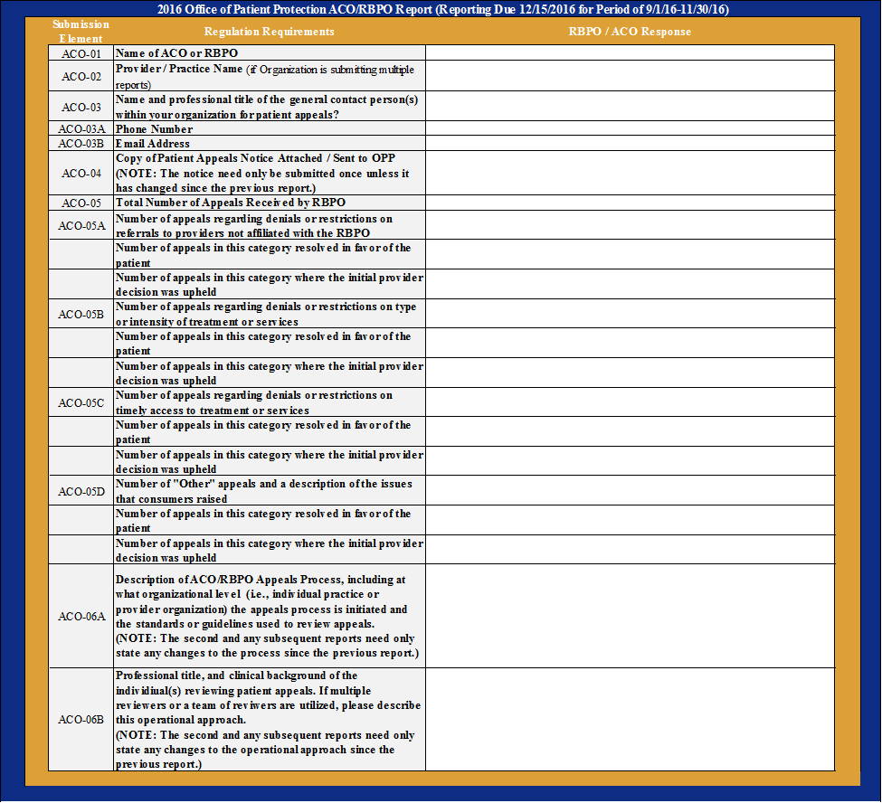
Reporting
RBPOs/ACOs must submit two reports to OPP:
First report is due on December 15, 2016 for complaints received during the period of September 1, 2016 through November 30, 2016.
Second report is due on March 15, 2017 for complaints received during the period of December 1, 2016 through February 28, 2017.

Slide 15
Ongoing Role of OPP
Develop FAQ for provider organizations and consumers on RBPO/ACO appeals process
Create and distribute a template for provider reporting
Develop protocols and tracking system for OPP staff to manage consumer calls on RBPO/ACO appeals process
OPP will educate consumers about the RBPO/ACO appeals process but will not, currently, take a direct role in resolving disputes

Slide 16
AGENDA
Introduction to RBPO and ACO Appeals
Topics of Interest
Notice
Types of Issues for Appeal
Standard of Review
Reporting
Ongoing Role of OPP
Stakeholder Input on Best Practices

Slide 17
Stakeholder Discussion: Best Practices
One of HPC’s objectives in developing the RBPO/ACO appeals process is to build on existing provider mechanisms for addressing complaints.
Please take this opportunity to discuss some of those best practices with the HPC and your fellow provider organizations.

Slide 18
If you have further questions, please contact:
Steven Belec, MPA
Director, Office of Patient Protection
Steven.Belec@state.ma.us
(617) 979-1413

