Slide 1
Commonwealth of Massachusetts
Department of Public Health
Prescription Monitoring Program
Massachusetts Prescription Awareness Tool (MassPAT)
Informational Tutorial for New Residents
Notes:
Good / morning/afternoon.
I am Eric Sheehan, Bureau Director of the Bureau of Health Care Safety & Quality for the Department of Public Health
I am delighted to be here today to share with all of you how MassPAT can assist all of us to help to stem the Opioid epidemic in the Commonwealth.

Slide 2
Overview MA PMP
Overview MA PMP :
The MA PMP was originally established by joint regulation of the Drug Control Program and Board of Registration in Pharmacy in 1992.
The MA PMP collects dispensing information on Massachusetts Schedule II through V controlled substances and Gabapentin, a Schedule VI medication, dispensed pursuant to a prescription.
Massachusetts General Laws Ch. 94C, Sec. 24A requires a practitioner to utilize the prescription monitoring program each time prior to issuing a prescription to a patient for a narcotic drug in Schedule II or III, and prior to prescribing to a benzodiazepine to a patient for the first time.
MassPAT (MA Prescription Awareness Tool) provides a patient’s prescription history (1 year) for Schedules II – V to authorized end users (prescribers, pharmacists, law enforcement and regulatory board investigators).

Slide 3
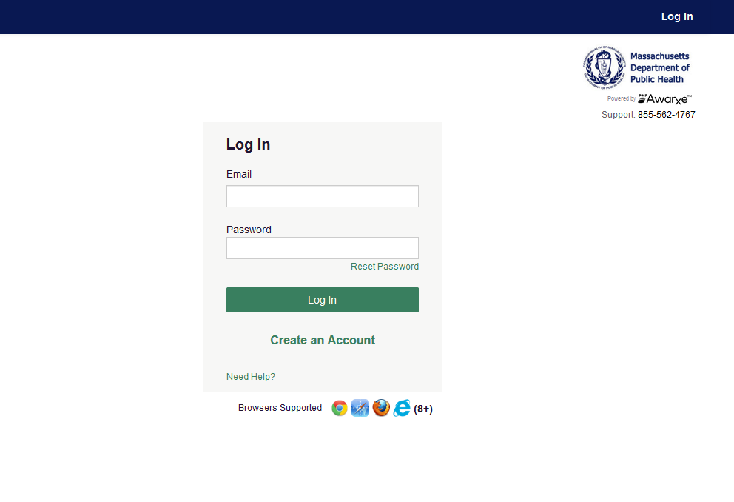
Create an account
www.mass.gov/dph/masspat

Slide 4
New Resident Registration -continued
www.mass.gov/dph/masspat

Slide 5
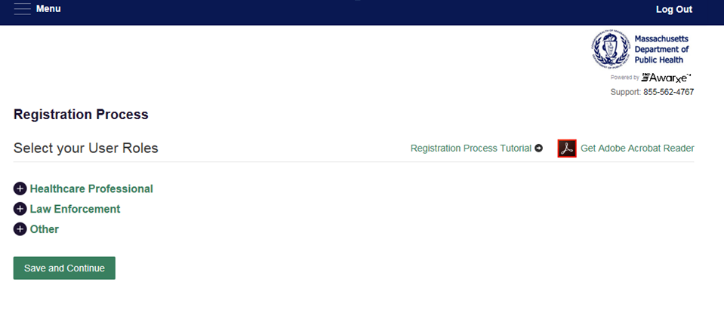
New Resident Registration - continued

Slide 6
New Resident Role Select User Role

Slide 7
Residents will be required to enter their NPI# and Professional License (MA license) Numbers
NPI required
Medical License Number. Ex. MA Board of Medicine Registration # (BORIM)

Slide 8
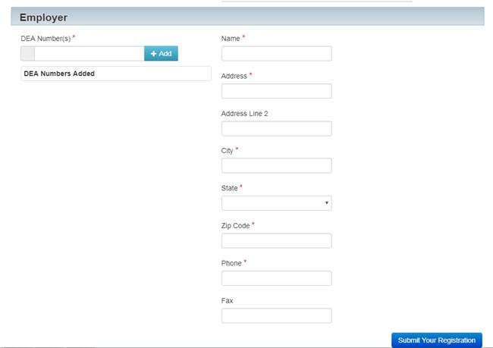
Enter Employer Information
Facility DEA# required .
Do not include your personal suffix

Slide 9
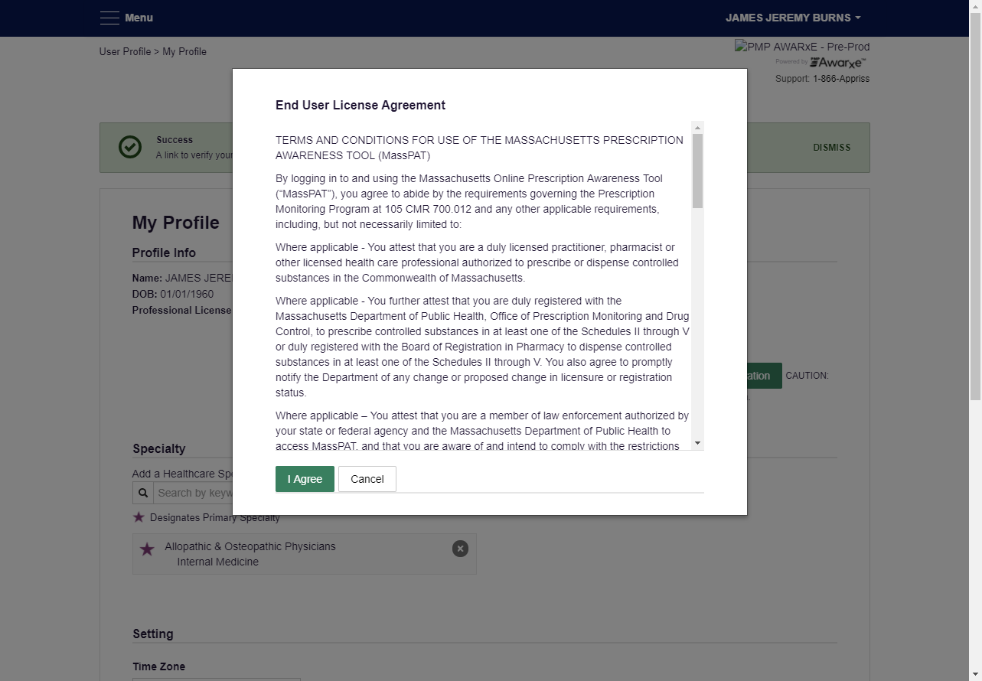
End User License Agreement
Notes:
Ok, so we’ve logged back into the physician account we first created. On the dashboard you can see that we have a lot more activity on this screen shot.
We now have several recent requests
Again recent requests are patient searches that either you as the primary account holder, or your delegate has successfully conducted.
At a glance you can see the patient, the request date and if you authorized one of your delegates to search, which delegate conducted that patient request
Below recent requests is where your delegates or residents can be found. The delegate we just created is pending approval.
You can see the notification of the pending delegate.
Also an email was sent alerting me to check my dashboard for a pending delegate.
If I click on Caroline’s name, I’m taken to the delegate management screen to continue with the approval process.

Slide 10
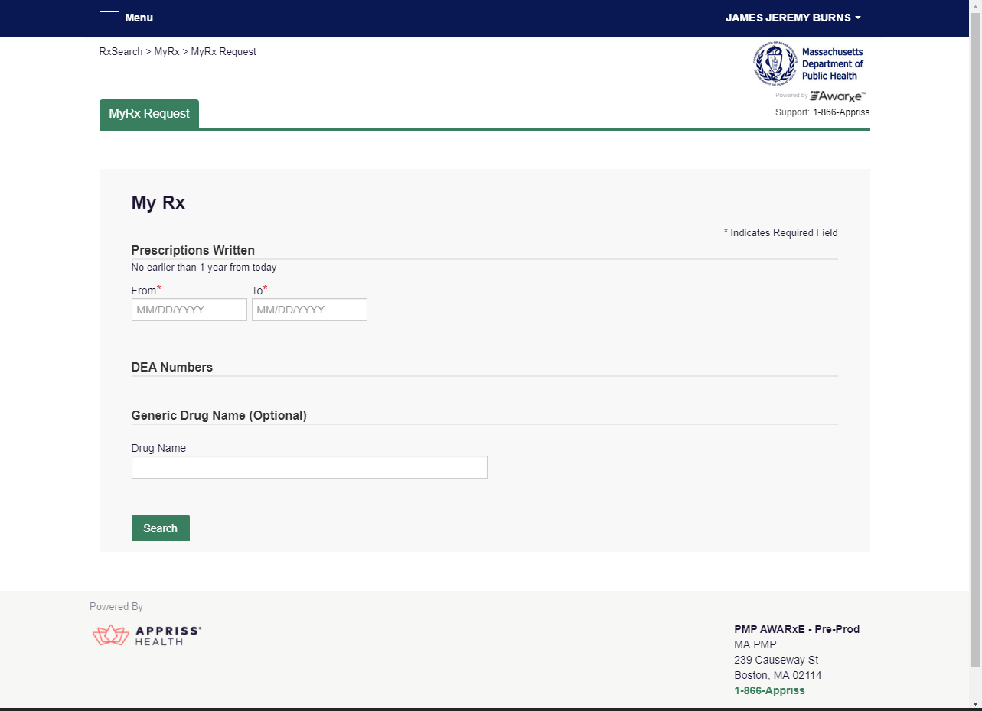
New Resident can now access their
prescribing history in MyRx
Select the date range (within past year)
Option to search by drug name
Notes:
Still under the Rx Search tab we have jumped over to the My Rx section
My Rx is a function for prescribers to check the prescriptions that have been written and have been filled with their DEA number(s).
If you have more than 1 DEA# you can choose all of them to query or you can choose just one or select from the ones you have
You select the date range you would like
Again, the farthest back a provider can query is 12 months
You also have the option to search by a drug name
So for example if you wanted to see how many, and at what times you prescribed oxycodone in the last year you can view just that particular drug
This report is also available to be exported in both PDF and csv/ excel files for you further analyze your own prescribing trends

Slide 11
If you have questions or concerns please contact
MAPMP.DPH@State.MA.US
or call the PMP
617-753-7310

