Slide 1
Welcome to the Re-Employment Services and Eligibility Assessment (RESEA) Orientation
Notes:
Script:
Welcome to the Re-Employment Services and Eligibility Assessment Orientation
Known as RESEA

Slide 2
Participating in the RESEA Program
What is RESEA?
RESEA is a federal program to help customers get back to work sooner by engaging in re-employment services and meeting with MassHire Career Center staff to discuss job search goals.
Who is selected for the RESEA program?
Customers who are receiving unemployment benefits are selected.
Benefits of being selected for the RESEA program?
You were selected for RESEA to receive re-employment and job search services through the MassHire Career Center system. Staff will also assist you with your Unemployment Insurance (UI) Eligibility requirements to continue receiving UI benefits.
Notes:
Script:
RESEA is federal program to help unemployment customers get back to work sooner. Those who are receiving unemployment benefits are selected.
One of the benefits of being selected for the RESEA program is receiving re-employment and job search services through the MassHire Career Center system.

Slide 3
Attending the RESEA Meetings
Receive DUA letter for RESEA meeting deadline dates
and details to continue collecting UI benefits
Attend Initial RESEA Meeting within 3 weeks
__________________________________
Attend RESEA Review meeting within 5 weeks
MassHire Staff will set up your one-on-one Initial RESEA Meeting
Failure to attend both RESEA meetings may affect your UI benefits
Notes:
Script: Please do not read words in parenthesis; boxes will each be a pushout
(Yellow box – push out) In the letter you received from the Department of Unemployment Assistance, there were 2 RESEA meeting deadline dates that you must attend in order to keep collecting your unemployment benefits.
(Purple box – push out) The first meeting is your Initial RESEA meeting Review and the second meeting is your RESEA Review meeting. Both of these meetings will be scheduled based on your three and five week deadline dates. This means you will have two meetings with MassHire staff.
(Green box – push out) MassHire staff will set up your one-on-one Initial RESEA meeting today.
(Blue box – push out) Failure to attend both RESEA meetings by your deadline dates may affect your unemployment benefits
A benefit of these RESEA meetings is receiving re-employment services early in your claim, and this will help you jumpstart your job search planning.

Slide 4
How we can help you to continue receiving Unemployment Insurance (UI) Benefits
Overall RESEA Objectives:
Help you be successful at your one-on-one Initial RESEA and RESEA Review meetings
Learn about RESEA requirements for your continued UI eligibility
Schedule your Initial RESEA and RESEA Review meetings
Introduction to re-employment services
Notes:
Script:
The purpose of this presentation is to explain the requirements of the RESEA program and to have you be successful in completing these requirements.
Nationwide research by the United States Department of Labor indicates that UI claimants return to work sooner when they participate in mandatory programs like RESEA.
This presentation will help you prepare for your one-one Initial RESEA Review meeting and provide you an introduction to re-employment services.

Slide 5
Initial RESEA Meeting
Review of Individual Needs Assessment / Career Action Plan
Overview of JobQuest (JQ)
Explanation of Labor Market Information (LMI)
Explanation of Resume requirement
Review of how to fill out work search logs
Explanation of UI Eligibility Questionnaire
Expectations for one-on-one Initial RESEA Review meeting
Expectations for RESEA Review meeting
5
Notes:
Script:
During this orientation, these are the RESEA components that will be discussed to prepare you for your one-on-one Initial RESEA meeting.
In the Career Center Seminar, you learned about the Individual Needs Assessment (INA) and the Career Action Plan (CAP) which you and MassHire staff will go over together to work on your job search goals.
There are several requirements, such as completing a JobQuest profile, an explanation of labor market information (LMI), the significance of an updated resume, completing your work search logs, and the UI Eligibility Questionnaire, along with scheduling your RESEA meetings.
The remainder of this orientation will explain these requirements.

Slide 6
Individual Needs Assessment
An Individual Needs Assessment (INA) assists you with identifying your specific needs such as:
Re-employment Goals
Specialized Services
*Youth and Young Adults
*Veterans
3. Potential Training Opportunity
4. Referrals to Partner and Community Resources
Notes:
Script:
As discussed during the CCS, the INA is a job search tool to help you identify your reemployment goals.
When you have your one-on-one Initial RESEA meeting, MassHire staff will work with you to help you develop your INA, identify barriers, and answer any questions you may have regarding your reemployment needs.

Slide 7
Intro to Re-Employment Services
Career Action Plan (CAP)
The RESEA Career Action Plan (CAP) assists customers in job search planning; these may include:
Develop a plan of action to achieve employment goals
Ensure successful progression and completion of your job search plan
Notes:
Script:
Once you have completed your INA, you are now ready to develop your Career Action Plan.
As discussed during the CCS, your CAP lays out how you will use MassHire services to achieve your job search plan.
When you meet with MassHire Career Center staff, you will discuss your job search plan and how we can help you overcome any barriers to re-employment.

Slide 8
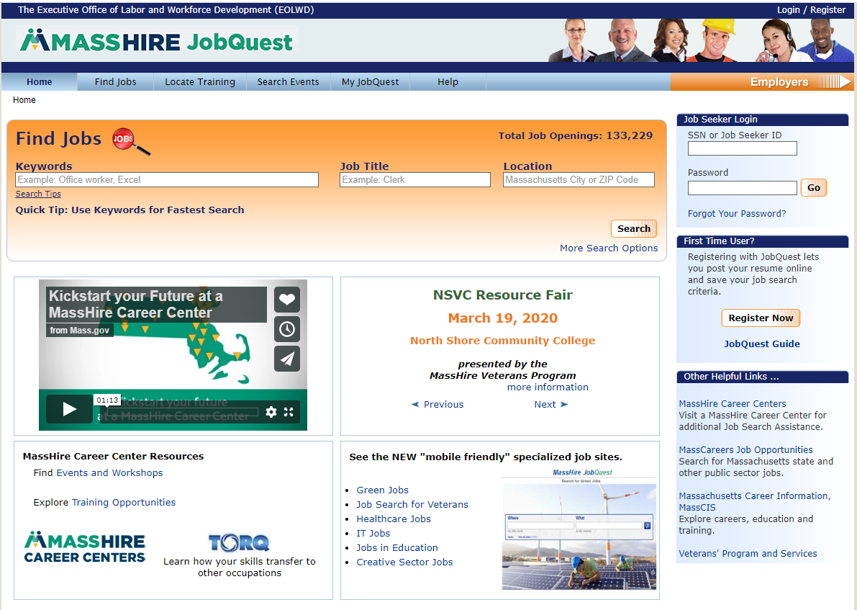
JobQuest (JQ)
Search for:
Jobs
Training Schools
Events
Access to:
My Job Quest
Log In
First Time User
Registration
Event Announcements
Notes:
NOTE: on the red, bold words below, can you have a circle or arrow point to each one on the top navigation bar in conjunction with the voiceover?
Script:
JobQuest is the state’s online job board and is another essential part of creating your career action plan and finding a job.
JobQuest is a valuable tool where you can find jobs by occupation and location and check the most recent job postings closest to you!
Explore training options and schools to upgrade your skills, and
You can view and prepare for upcoming job fairs and recruitments.
On the My JobQuest tab, you can do skills and job matches, then upload your resume for potential employers to view
In preparation for your Initial RESEA meeting, you must be registered on JobQuest. MassHire Career Center staff can review the many features and discuss how to best use this tool in your job search.

Slide 9
Benefits of JobQuest
Benefits of using JobQuest in Your Job Search:
Skills Match
Job Match
Upload resume
Employment history
Search for training programs
Employer recruitments
Locate events such as job fairs
Green jobs
Notes:
Note for voiceover: fly in each bullet
Script: (Please do not read words in parenthesis)
There are many benefits to using JobQuest in your job search
*(skills match) Once you enter your skills into the system, it will then select jobs that match to your individual skill set
*(job Match) Job Match is similar, where once you enter your occupation, JobQuest will match you with appropriate jobs.
*(upload resume) By uploading your resume, you have the option for employers to view your experience to see if you are a potential candidate.
*(Employment History) Entering your employment history, you can see many of your transferable skills, and it helps you to create or update your resume.
*(locate training) JobQuest can help you locate training vendors and certification programs in your area.
*(Employer recruitments) The MassHire Business Services team promotes local employer recruitments which are listed on JobQuest.
*(Locate events such as job fairs) You can also find many local events, such as job fairs throughout the state.
*(Green jobs) JobQuest even has a list of environmentally conscious “green jobs”, such as solar technicians, water quality and green builders.

Slide 10
The Purpose of Using
Labor Market Information (LMI)
What is LMI?
LMI is research of the labor market to understand where your occupation fits within the job market.
Why use LMI in my job search?
It answers questions to help you make better, more informed decisions.
LMI can help you assess your knowledge, skills, abilities, values and interests to help you through the job search process.
Notes:
Script:
Labor Market Information, referred to as LMI, helps you understand where your occupation fits into today’s job market, and is useful throughout your job search journey for several reasons and answers many questions:

Slide 11
Questions that LMI Answers
How can labor market information (LMI) help me with my job search?
Identify skills and salary information
Know what jobs are growing or declining
Understand the knowledge, skills and abilities needed for the job
Identify training programs
Resume preparation
LMI Tools:
MassCIS
O*Net
Notes:
Script:
Some examples of questions that LMI can answer, are:
What are my knowledge, skills and interests?
Is my occupation increasing or decreasing?
What are jobs paying? and
What are the educational requirements?
You and MassHire Career Center staff can discuss some of the online LMI tools such as MassCIS, O*Net, and the US Bureau of Labor & Statistics, to name a few, and how these tools can help you make better, more informed decisions and answer your job search questions.
Come prepared to your Initial RESEA meeting to learn more about LMI and to complete an LMI worksheet to get you started.

Slide 12
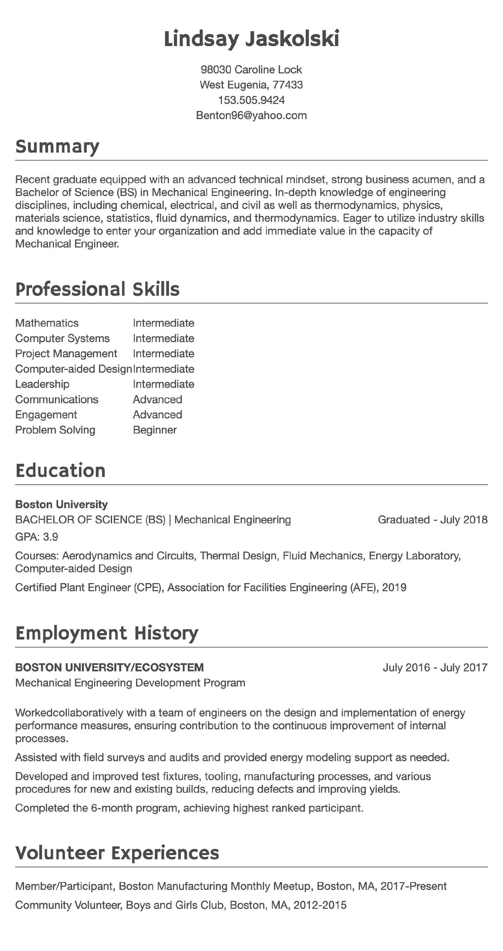
Resume
Notes:
Script:
As your job search progresses, you will want to highlight your skills, experiences, and achievements in one valuable document –your resume.
During your one-on-one Initial meeting, MassHire staff will review and provide beneficial feedback on various components such as your summary, work experience, education, format, grammar and font size.
You, along with MassHire staff, will decide together what type of resume format may work best for you.
As a reminder, please be prepared to present your resume at your meeting.

Slide 13
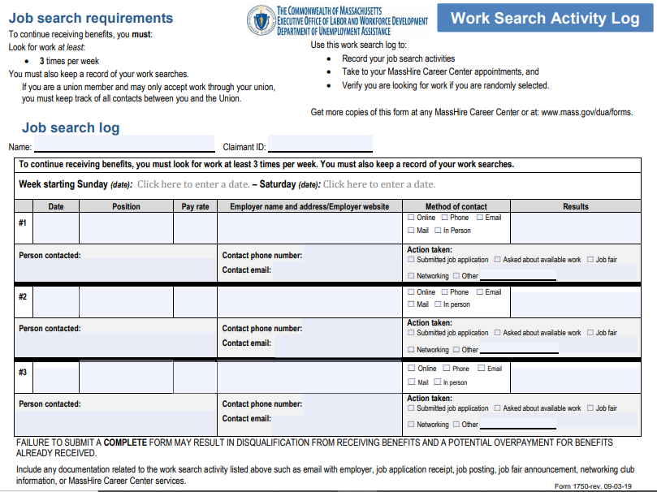
Work Search Activity log
Notes:
Script:
Another UI requirement is providing work search activity logs for every week you requested UI benefits. This is a very valuable tool for keeping track of where you applied, whether you need to follow up with an employer, and to evaluate if your job search strategies are working for you.
Together with MassHire staff, you can see whether you are completing these logs correctly, and confirming that you are able, available and actively looking for work per UI eligibility requirements.
You will also need to be prepared to have these work search logs at your one-on-one Initial RESEA meeting.

Slide 14
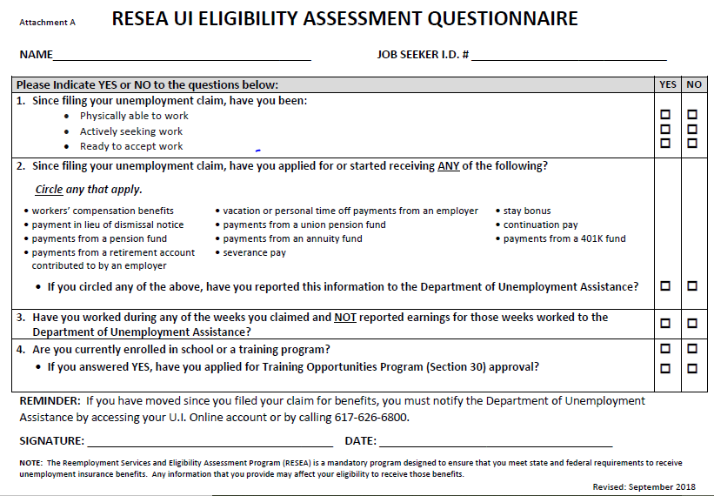
UI Eligibility Assessment Questionnaire
Notes:
Script:
At each of your RESEA meetings, the UI Eligibility Assessment Questionnaire will need to be completed for continued UI eligibility.
At those meetings, you can update information that may have changed.

Slide 15
Career Center Activities and Workshops
Assessments
Identifying Skills
WorkKeys
TORQ
Myers-Briggs Type Indicator
Resume
Resume Development
Cover letters
Networking
Networking Works
LinkedIn
Company Recruitments
Job Fairs
Job Search
Organizing your Job Search
Applicant Tracking Systems
Developing Your Self-Marketing Pitch
Using Age to your Advantage
Interviewing
Ace the Interview
Telephone Interviews
Salary Negotiation
Notes:
Script:
During your meeting, a referral to an appropriate career center activity, such as attending a resume workshop or updating your resume is known as an interim service. You and MassHire staff will identify the appropriate service for your job search.
MassHire Career Centers offer many workshops and opportunities to work on any career challenges you may face in looking for employment. These workshops are designed to help you in your job search, and to enhance your skills. It is also an opportunity to be engaged with MassHire staff while using Career Center services.
At your initial RESEA meeting, you will have the opportunity to choose from a variety of workshops or other options, such as setting up a full JobQuest profile, or using JobQuest to search for job fairs and recruitments.
The interim service referral is part of your career action plan.

Slide 16
Summary:
One-on-One Initial RESEA Meeting
One-on-One Initial RESEA Meeting
Review value of completing JobQuest Registration
Review resume or prepare to create a resume
Present completed work search logs for each
week you requested UI benefits
Review labor market information (LMI) worksheet
Complete fillable UI Eligibility Assessment Questionnaire
Schedule a Career Center activity (Interim Service)
Schedule a RESEA Review Meeting
16
Notes:
Script:
MassHire staff look forward to setting up your one-on-one Initial RESEA meeting. They will work with you to help you meet your UI eligibility requirements to continue collecting UI benefits, and introduce you to additional Career Center services.
We are excited for your continued engagement with the MassHire Career Center system as you move forward in your job search.
If you get a job, please notify MassHire staff and we wish you the best in your future job.

Slide 17
Next Steps: After the Initial RESEA Meeting
Participate in a RESEA Review Meeting
Let us know when you get a job so we can celebrate your success and update our database!
Notes:
Script:
After your Initial RESEA meeting, you will have an individualized career meeting, called a RESEA Review where you will have the opportunity to ask questions and get help with your RESEA requirements.
MassHire staff will set up your second RESEA meeting, and they will remind you to be prepared to present your resume, work search logs, LMI worksheet and UI Eligibility RESEA Questionnaire in order to have an effective meeting.
Working with a MassHire Career Center is a partnership so please let us know when you find a job!
We not only want to help you prepare for your new job, we also want to celebrate your success and update our database!
.

Slide 18
Remember, failure to complete your two RESEA meetings will affect your unemployment benefits!
MassHire staff look forward to working with you!
Notes:
Script:
Remember, failure to complete your two RESEA meetings will affect your unemployment benefits.
Thank you for your participation in this Initial RESEA Orientation, and MassHire staff look forward to working with you!

