Slide 1
Welcome to the Re-Employment Services and Eligibility Assessment (RESEA) Orientation

Slide 2
Participating in the RESEA Program
What is RESEA?
RESEA is a federal program to help customers get back to work sooner by engaging in re-employment services and meeting with MassHire Career Center staff to discuss job search goals.
Who is selected for the RESEA program?
Customers who are receiving unemployment benefits are selected.
Benefits of being selected for the RESEA program?
You were selected for RESEA to receive re-employment and job search services through the MassHire Career Center system. Staff will also assist you with your Unemployment Insurance (UI) Eligibility requirements to continue receiving UI benefits.

Slide 3
Attending the RESEA Meetings
Receive DUA letter for RESEA meeting deadline dates
and details to continue collecting UI benefits
Attend Initial RESEA Meeting within 3 weeks
__________________________________
Attend RESEA Review meeting within 5 weeks
MassHire Staff will set up your one-on-one Initial RESEA Meeting
Failure to attend both RESEA meetings may affect your UI benefits

Slide 4
How we can help you to continue receiving Unemployment Insurance (UI) Benefits
Overall RESEA Objectives:
Help you be successful at your one-on-one Initial RESEA and RESEA Review meetings
Learn about RESEA requirements for your continued UI eligibility
Schedule your Initial RESEA and RESEA Review meetings
Introduction to re-employment services

Slide 5
Initial RESEA Meeting
Review of Individual Needs Assessment / Career Action Plan
Overview of JobQuest (JQ)
Explanation of Labor Market Information (LMI)
Explanation of Resume requirement
Review of how to fill out work search logs
Explanation of UI Eligibility Questionnaire
Expectations for one-on-one Initial RESEA Review meeting
Expectations for RESEA Review meeting
5

Slide 6
Individual Needs Assessment
An Individual Needs Assessment (INA) assists you with identifying your specific needs such as:
Re-employment Goals
Specialized Services
*Youth and Young Adults
*Veterans
3. Potential Training Opportunity
4. Referrals to Partner and Community Resources

Slide 7
Intro to Re-Employment Services
Career Action Plan (CAP)
The RESEA Career Action Plan (CAP) assists customers in job search planning; these may include:
Develop a plan of action to achieve employment goals
Ensure successful progression and completion of your job search plan

Slide 8
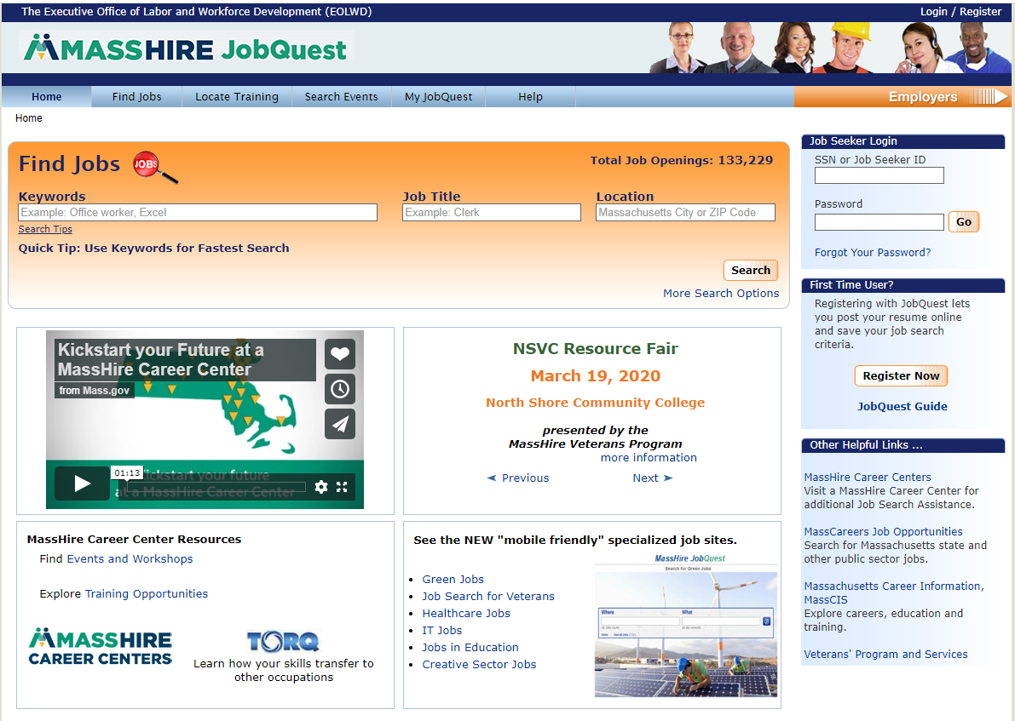
JobQuest (JQ)
Search for:
Jobs
Training Schools
Events
Access to:
My Job Quest
Log In
First Time User
Registration
Event Announcements

Slide 9
Benefits of JobQuest
Benefits of using JobQuest in Your Job Search:
Skills Match
Job Match
Upload resume
Employment history
Search for training programs
Employer recruitments
Locate events such as job fairs
Green jobs

Slide 10
The Purpose of Using
Labor Market Information (LMI)
What is LMI?
LMI is research of the labor market to understand where your occupation fits within the job market.
Why use LMI in my job search?
It answers questions to help you make better, more informed decisions.
LMI can help you assess your knowledge, skills, abilities, values and interests to help you through the job search process.

Slide 11
Questions that LMI Answers
How can labor market information (LMI) help me with my job search?
Identify skills and salary information
Know what jobs are growing or declining
Understand the knowledge, skills and abilities needed for the job
Identify training programs
Resume preparation
LMI Tools:
MassCIS
O*Net

Slide 12
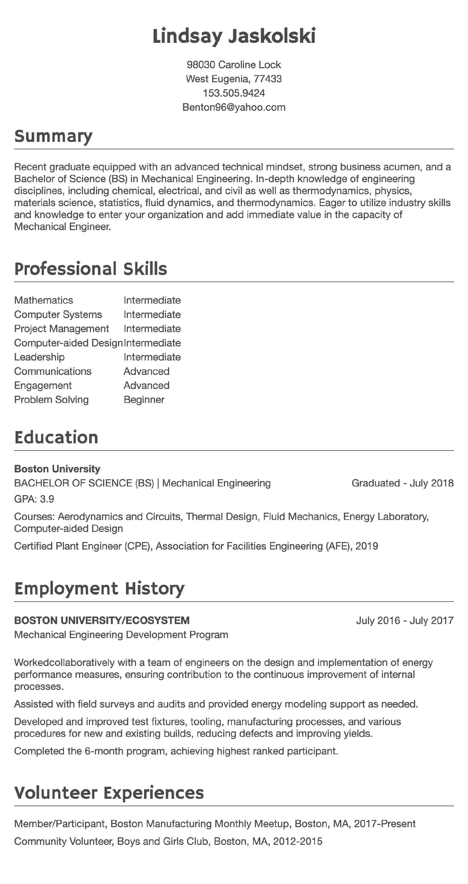
Resume

Slide 13
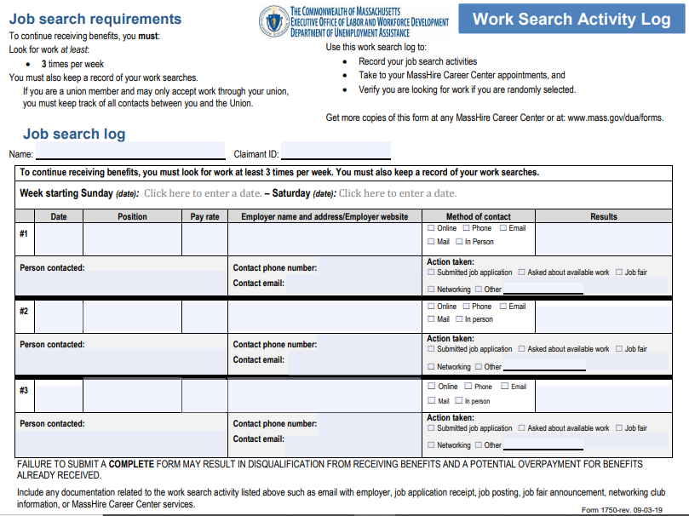
Work Search Activity log

Slide 14
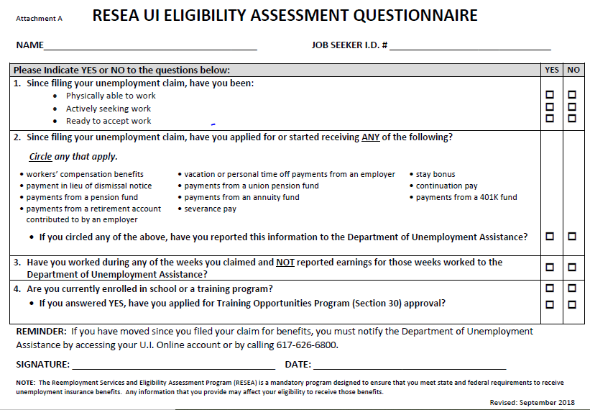
UI Eligibility Assessment Questionnaire

Slide 15
Career Center Activities and Workshops
Assessments
Identifying Skills
WorkKeys
TORQ
Myers-Briggs Type Indicator
Resume
Resume Development
Cover letters
Networking
Networking Works
LinkedIn
Company Recruitments
Job Fairs
Job Search
Organizing your Job Search
Applicant Tracking Systems
Developing Your Self-Marketing Pitch
Using Age to your Advantage
Interviewing
Ace the Interview
Telephone Interviews
Salary Negotiation

Slide 16
Summary:
One-on-One Initial RESEA Meeting
One-on-One Initial RESEA Meeting
Review value of completing JobQuest Registration
Review resume or prepare to create a resume
Present completed work search logs for each
week you requested UI benefits
Review labor market information (LMI) worksheet
Complete fillable UI Eligibility Assessment Questionnaire
Schedule a Career Center activity (Interim Service)
Schedule a RESEA Review Meeting
16

Slide 17
Next Steps: After the Initial RESEA Meeting
Participate in a RESEA Review Meeting
Let us know when you get a job so we can celebrate your success and update our database!

Slide 18
Remember, failure to complete your two RESEA meetings will affect your unemployment benefits!
MassHire staff look forward to working with you!

