Slide 1
欢迎参加再就业服务和资格评估（RESEA）培训过程
Notes:
Script:
Welcome to the Re-Employment Services and Eligibility Assessment Orientation
Known as RESEA

Slide 2
参加RESEA计划
RESEA是什么?
RESEA 是一项联邦计划帮助客户接触再就业服务和与MassHire职业中心工作人员会面,讨论求职目标,等来早点恢复工作.
谁人被选择入RESEA计划?
选择入RESEA计划大多数是正在领取失业金的客户.
被选中参加RESEA计划的好处?
您已被选中参加RESEA计划,通过MassHire职业中心系统,您接受再就业和求职服务.工作人员也将会协助您继续领取失业金的资格要求.
Notes:
Script:
RESEA is federal program to help unemployment customers get back to work sooner. Those who are receiving unemployment benefits are selected.
One of the benefits of being selected for the RESEA program is receiving re-employment and job search services through the MassHire Career Center system.

Slide 3
参加RESEA会议
收到DUA通知信关于RESEA 会议的截止日期和继续领取失业金细节
在3周内参加RESEA初次会议__________________________________
在5周内参加RESEA重温会议
MassHire 工作人员将安排一对一的RESEA初始会议给您
不参加两次RESEA会议可能会影响您的失业金
Notes:
Script: Please do not read words in parenthesis; boxes will each be a pushout
(Yellow box – push out) In the letter you received from the Department of Unemployment Assistance, there were 2 RESEA meeting deadline dates that you must attend in order to keep collecting your unemployment benefits.
(Purple box – push out) The first meeting is your Initial RESEA meeting Review and the second meeting is your RESEA Review meeting. Both of these meetings will be scheduled based on your three and five week deadline dates. This means you will have two meetings with MassHire staff.
(Green box – push out) MassHire staff will set up your one-on-one Initial RESEA meeting today.
(Blue box – push out) Failure to attend both RESEA meetings by your deadline dates may affect your unemployment benefits
A benefit of these RESEA meetings is receiving re-employment services early in your claim, and this will help you jumpstart your job search planning.

Slide 4
我们如何能够帮助您继续领取失业金
RESEA总体目标 :
帮助您达到您的一对一RESEA和RESEA重温会议
继续了解失业金資格关于RESEA要求
安排您的初次RESEA和RESEA重温会议
介绍再就业服务
Notes:
Script:
The purpose of this presentation is to explain the requirements of the RESEA program and to have you be successful in completing these requirements.
Nationwide research by the United States Department of Labor indicates that UI claimants return to work sooner when they participate in mandatory programs like RESEA.
This presentation will help you prepare for your one-one Initial RESEA Review meeting and provide you an introduction to re-employment services.

Slide 5
RESEA初次会议
复看个人需求评估/职业行动计划
JobQuest (JQ) 概述
解释劳动市场信息（LMI）
解释简历要求
复看如何填工作记录
期望失业金资格问题卷
期望一对一RESEA重温会议
期望 RESEA重温会议
5
Notes:
Script:
During this orientation, these are the RESEA components that will be discussed to prepare you for your one-on-one Initial RESEA meeting.
In the Career Center Seminar, you learned about the Individual Needs Assessment (INA) and the Career Action Plan (CAP) which you and MassHire staff will go over together to work on your job search goals.
There are several requirements, such as completing a JobQuest profile, an explanation of labor market information (LMI), the significance of an updated resume, completing your work search logs, and the UI Eligibility Questionnaire, along with scheduling your RESEA meetings.
The remainder of this orientation will explain these requirements.

Slide 6
个人需求评估
个人需求评估(INA)帮助您确定自己的特定需求,例如 :
再就业目标
专业服务
*青少年和年轻成人
*退伍军人
3. 可能的培训机会
4. 推荐给合作伙伴和社区资源
Notes:
Script:
As discussed during the CCS, the INA is a job search tool to help you identify your reemployment goals.
When you have your one-on-one Initial RESEA meeting, MassHire staff will work with you to help you develop your INA, identify barriers, and answer any questions you may have regarding your reemployment needs.

Slide 7
介绍再就业服务 职业行动计划（CAP）
RESEA职业行动计划(CAP)协助客户策划求职计划;这些可能包括:
制定行动计划以实现就业目标
确保您的求职计划的顺利进展和完成
Notes:
Script:
Once you have completed your INA, you are now ready to develop your Career Action Plan.
As discussed during the CCS, your CAP lays out how you will use MassHire services to achieve your job search plan.
When you meet with MassHire Career Center staff, you will discuss your job search plan and how we can help you overcome any barriers to re-employment.

Slide 8
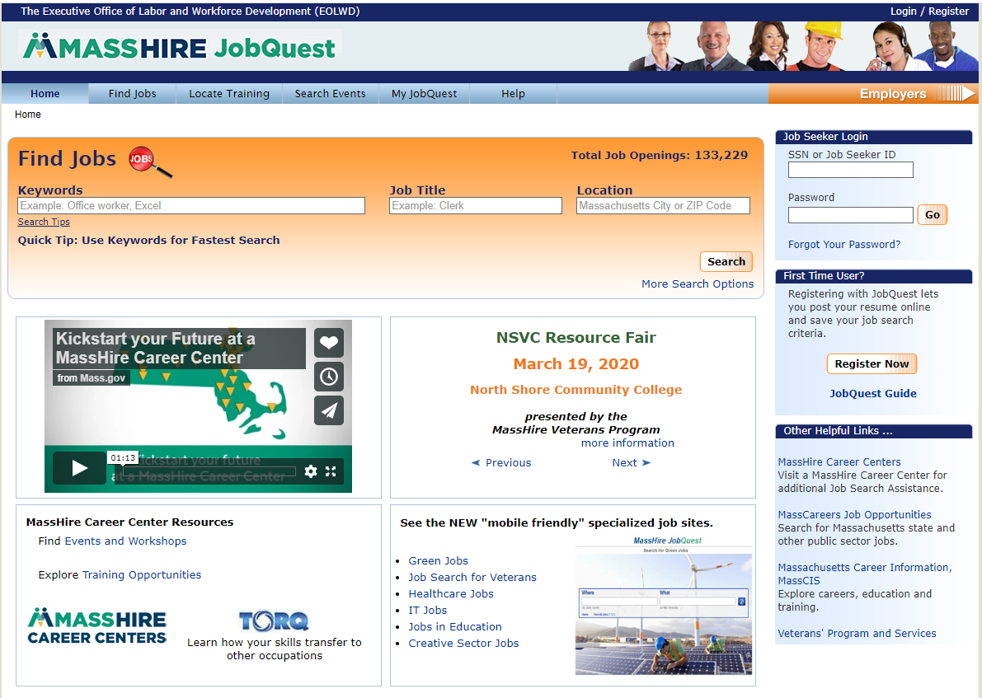
JobQuest (JQ)
寻找:
工作
培训学校
活动
进入:
My Job Quest
登录
初次使用者
注册
活动公告
Notes:
NOTE: on the red, bold words below, can you have a circle or arrow point to each one on the top navigation bar in conjunction with the voiceover?
Script:
JobQuest is the state’s online job board and is another essential part of creating your career action plan and finding a job.
JobQuest is a valuable tool where you can find jobs by occupation and location and check the most recent job postings closest to you!
Explore training options and schools to upgrade your skills, and
You can view and prepare for upcoming job fairs and recruitments.
On the My JobQuest tab, you can do skills and job matches, then upload your resume for potential employers to view
In preparation for your Initial RESEA meeting, you must be registered on JobQuest. MassHire Career Center staff can review the many features and discuss how to best use this tool in your job search.

Slide 9
JobQuest 的好处
使用JobQuest求职的好处 :
配合技能
配合职位
上传简历
工作经历
留意培训计划
雇主招聘
留意招聘事件例如招聘会
保护环境工作
Notes:
Note for voiceover: fly in each bullet
Script: (Please do not read words in parenthesis)
There are many benefits to using JobQuest in your job search
*(skills match) Once you enter your skills into the system, it will then select jobs that match to your individual skill set
*(job Match) Job Match is similar, where once you enter your occupation, JobQuest will match you with appropriate jobs.
*(upload resume) By uploading your resume, you have the option for employers to view your experience to see if you are a potential candidate.
*(Employment History) Entering your employment history, you can see many of your transferable skills, and it helps you to create or update your resume.
*(locate training) JobQuest can help you locate training vendors and certification programs in your area.
*(Employer recruitments) The MassHire Business Services team promotes local employer recruitments which are listed on JobQuest.
*(Locate events such as job fairs) You can also find many local events, such as job fairs throughout the state.
*(Green jobs) JobQuest even has a list of environmentally conscious “green jobs”, such as solar technicians, water quality and green builders.

Slide 10
利用劳动力市场信息的目的(LMI)
LMI是什么?
LMI是劳动力市场的研究,了解您的职业在劳动力市场中的适合 性.
为什么使用LMI在求职中?
它回答问题以帮助您做出更好,更明智的决策.
LMI可以帮助您评估知识,技能,能力,价值和兴趣,以帮助您完成求职过程.
Notes:
Script:
Labor Market Information, referred to as LMI, helps you understand where your occupation fits into today’s job market, and is useful throughout your job search journey for several reasons and answers many questions:

Slide 11
LMI回答的问题
劳动力市场信息(LMI)如何帮助我寻找工作?
查明技能和薪资信息
了解哪些工作正在增长或减小
了解工作所需要的知识,技能和能力
查明培训计划
简历准备
LMI 工具 :
MassCIS
O*Net
Notes:
Script:
Some examples of questions that LMI can answer, are:
What are my knowledge, skills and interests?
Is my occupation increasing or decreasing?
What are jobs paying? and
What are the educational requirements?
You and MassHire Career Center staff can discuss some of the online LMI tools such as MassCIS, O*Net, and the US Bureau of Labor & Statistics, to name a few, and how these tools can help you make better, more informed decisions and answer your job search questions.
Come prepared to your Initial RESEA meeting to learn more about LMI and to complete an LMI worksheet to get you started.

Slide 12
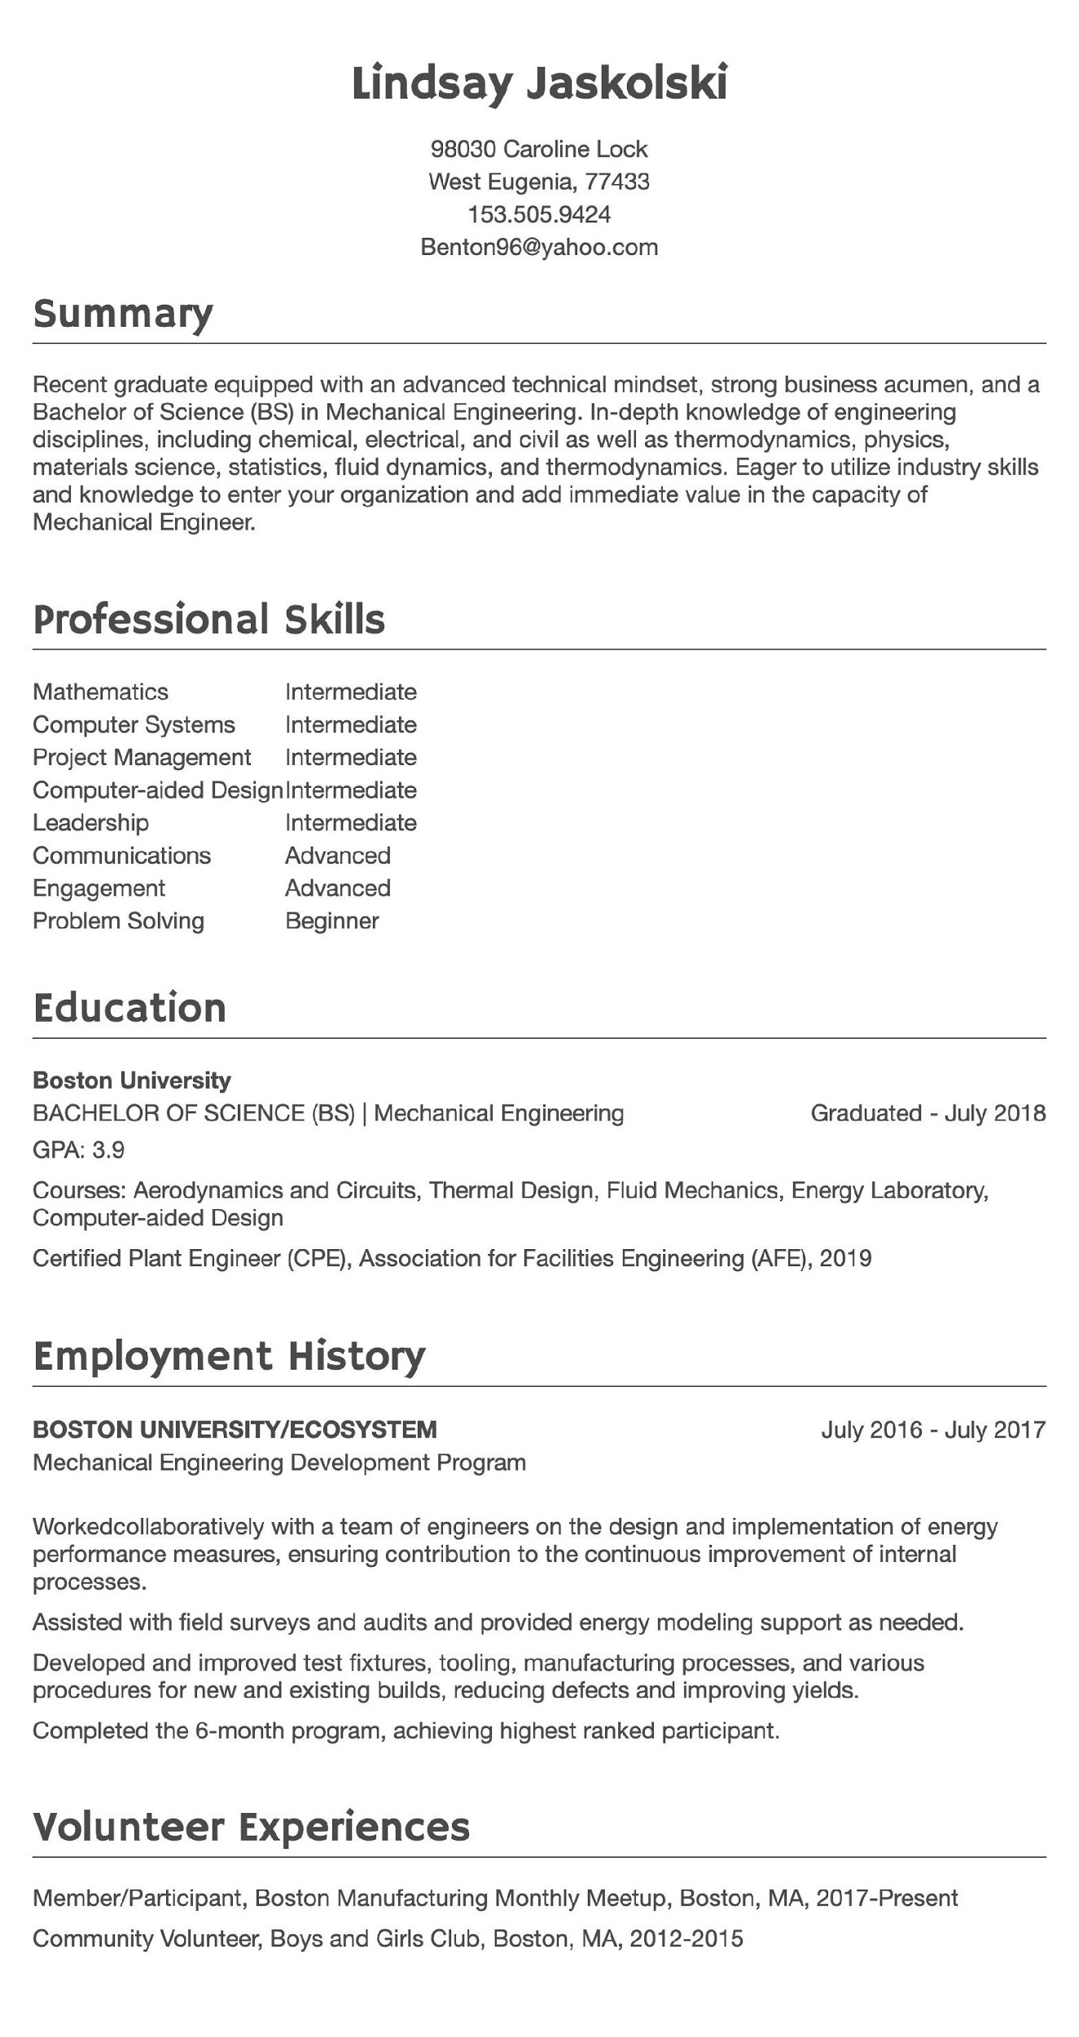
简历
Notes:
Script:
As your job search progresses, you will want to highlight your skills, experiences, and achievements in one valuable document –your resume.
During your one-on-one Initial meeting, MassHire staff will review and provide beneficial feedback on various components such as your summary, work experience, education, format, grammar and font size.
You, along with MassHire staff, will decide together what type of resume format may work best for you.
As a reminder, please be prepared to present your resume at your meeting.

Slide 13
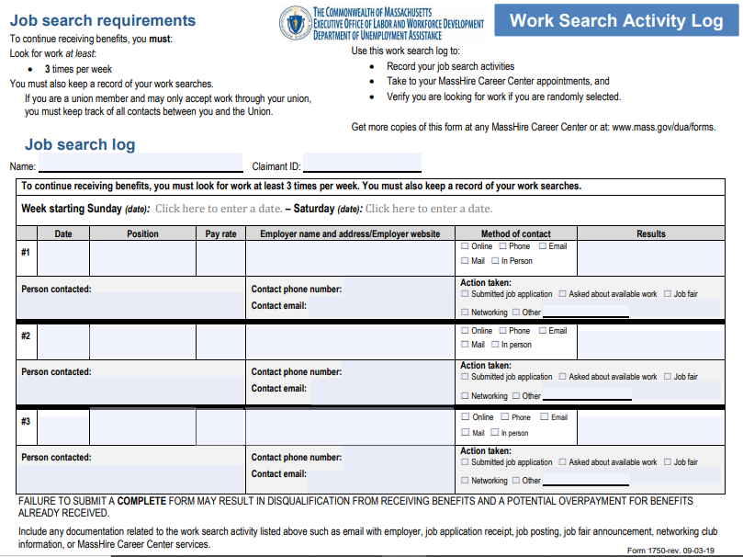
寻找工作记录
Notes:
Script:
Another UI requirement is providing work search activity logs for every week you requested UI benefits. This is a very valuable tool for keeping track of where you applied, whether you need to follow up with an employer, and to evaluate if your job search strategies are working for you.
Together with MassHire staff, you can see whether you are completing these logs correctly, and confirming that you are able, available and actively looking for work per UI eligibility requirements.
You will also need to be prepared to have these work search logs at your one-on-one Initial RESEA meeting.

Slide 14
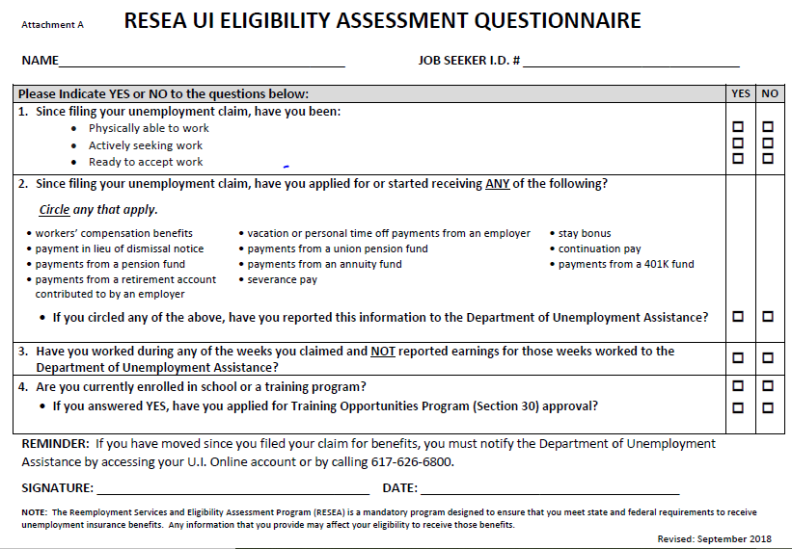
失业金资格评估问卷
Notes:
Script:
At each of your RESEA meetings, the UI Eligibility Assessment Questionnaire will need to be completed for continued UI eligibility.
At those meetings, you can update information that may have changed.

Slide 15
职业中心活动和讲习班
评估
确定技能
WorkKeys
TORQ
Myers-Briggs Type Indicator
简历
简历草稿
求职信
联网
联网工作
LinkedIn
公司招聘
招聘会
求职
整理你的求职
Applicant tracking System
发展你的自我营销策略
利用年龄优势
面试
表现好面试
电话面试
工资谈判
Notes:
Script:
During your meeting, a referral to an appropriate career center activity, such as attending a resume workshop or updating your resume is known as an interim service. You and MassHire staff will identify the appropriate service for your job search.
MassHire Career Centers offer many workshops and opportunities to work on any career challenges you may face in looking for employment. These workshops are designed to help you in your job search, and to enhance your skills. It is also an opportunity to be engaged with MassHire staff while using Career Center services.
At your initial RESEA meeting, you will have the opportunity to choose from a variety of workshops or other options, such as setting up a full JobQuest profile, or using JobQuest to search for job fairs and recruitments.
The interim service referral is part of your career action plan.

Slide 16
总结：
一对一的RESEA初次会议
一对一的RESEA初次会议
复看完成JobQuest注册
复看简历或准备草案简历
提交每一周的寻找工作记录当您请求失业金
复看劳动力市场信息(LMI)工作表
完全地填写UI资格评估问卷
安排职业中心活动(临时服务）
安排RESEA重温会议
16
Notes:
Script:
MassHire staff look forward to setting up your one-on-one Initial RESEA meeting. They will work with you to help you meet your UI eligibility requirements to continue collecting UI benefits, and introduce you to additional Career Center services.
We are excited for your continued engagement with the MassHire Career Center system as you move forward in your job search.
If you get a job, please notify MassHire staff and we wish you the best in your future job.

Slide 17
下一步：首次RESEA会议之后
参加RESEA重温会议
让我们知道您何时找到工作,以便我们庆祝您的成功并更新我们的数据库!
Notes:
Script:
After your Initial RESEA meeting, you will have an individualized career meeting, called a RESEA Review where you will have the opportunity to ask questions and get help with your RESEA requirements.
MassHire staff will set up your second RESEA meeting, and they will remind you to be prepared to present your resume, work search logs, LMI worksheet and UI Eligibility RESEA Questionnaire in order to have an effective meeting.
Working with a MassHire Career Center is a partnership so please let us know when you find a job!
We not only want to help you prepare for your new job, we also want to celebrate your success and update our database!
.

Slide 18
请记住,不参加你的两个RESEA会议将影响你的失业金!
MassHire 全体员工期待与您合作!
Notes:
Script:
Remember, failure to complete your two RESEA meetings will affect your unemployment benefits.
Thank you for your participation in this Initial RESEA Orientation, and MassHire staff look forward to working with you!

