Slide 1
InnovateA&F – AI Initiative
Nov 21, 2024

Slide 2
InnovateA&F – AI Initiative
Jan. 2024
Established an AI platform in January 2024
8 Feb. 2024
Request for Proposals
12 Feb. 2024
Live Q & A session
14 Mar. and 15 Mar.
Idea Presentation – March 14 & 15, 2024
26 Mar. 2024
Final list of selected ideas
26–29 Mar.
Open-up for Participation – March 26 to 29, 2024
Apr. 2024
Sandbox Access
1 June 2024
Project Completion
Project Design Fair
Deadline 02/16

Slide 3
Pilot Projects
Document Analyzer
SummArIto
Amrit Maharjan
Tom Farl
Intelligent Dashboard
State Employee Diversity Dashboard
Andrew Netson
Chuck Meredith
Intelligent Dashboard
Kousalya Jagadisan
John Pan
Srinivas Kandru
Private AI
Private AI using Open-Source Solutions
Syed Ali
Dom Giacchetta
Dashboard for Cigarette/Cigar/e-Cigarette Tax Accounts
Predictive Model
NCP Payment Compliance Predictive Model
Chris Martino
Subbu Perumal
Yuhui Luo
Masilamani Dharmarajan
Smart Code Development
Better Terraform using Amazon Q Developer
Asad Khalid
Sathish Konda
Kasirao Thanikonda
Scott McDonald

Slide 4
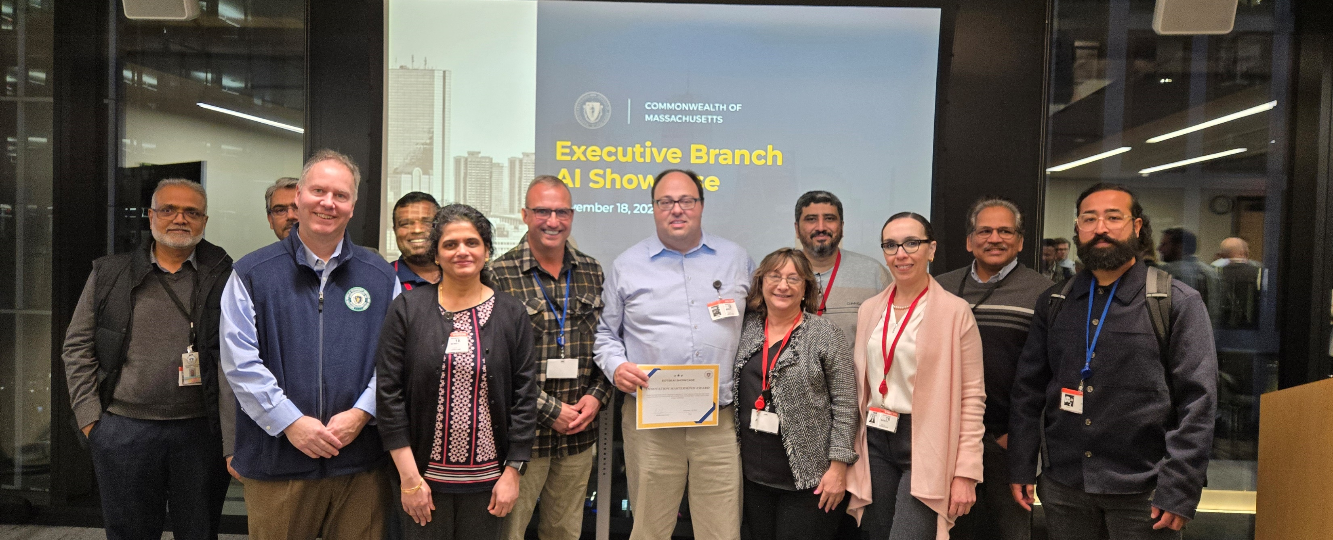
Congratulations Team Predictive Model on winning Innovation Master Mind Award in EOTSS AI Showcase Event
  Non-custodial Parent (NCP) Payment Compliance Predictive Model
  Yuhui Luo – ML Expert
Chris Martino – Project (Data) Manager
Mani Dharmarajan – Project Observer
Subbu Perumal – Project Observer

Slide 5
What’s next
Moving AI pilot projects to Prod
Planning for Round #2 of AI Initiative
Develop your ideas and formalize it
Lookout for the emails ☺

