Slide 1

Distributed Energy Resources
Interconnection Seminar
Simplified Process
Thank you for joining us.
The presentation will begin at 9:00am.
Please mute your phones to avoid any feedback.
Thank you.

Slide 2
Distributed Energy Resources Interconnection Seminar
Simplified Process
September 17, 2025
Eversource Energy

Slide 3





Co-Hosts
Mass ACA

Slide 4
Safety
Is the most important thing to consider in designing, connecting and operating a successful DG project.
Overhead power lines are not insulated and carry enough energy to cause serious injury or even death. Regard all wires as live.
Keep yourself, your co-workers, tools, ladders and vehicles at least 10 feet away from electric lines and equipment.
Make sure the area is clear of wires before working near trees or shrubs.
Never attach or tie anything off to power lines or electrical equipment.
If you need to dig, first call Dig Safe at 1-888-dig-safe (1-888-344-7233) to get underground utilities marked. (www.digsafe.com)

Slide 5
Interconnection Contacts
Eversource Energy – Eastern MA DG (Simplified)
  Email: emdg@eversource.com
  Jeena Hatton
  Evan Melillo
  Julia Bucceri
Expedited Projects
  Melanie Khederian
  Zachary Tedford
  Kelly Musto
  Evan Melillo
  Brandon Natale

Slide 6
Simplified
Interconnection Information

Slide 7
Simplified Process flow
Initiation Phase
Construction Phase
Final Phase
Installer/Customer submits an online application via Power Clerk
“Acknowledgement” is sent upon submission with Project ID number
Technical Review is completed (if applicable)
Electric Service Support Center (ESSC) creates work order
Review application
Send acknowledgment letter to customer/installer via email
Send “Time Frame Verification” letter via email
Customer builds their system
Upon completion – All DG Interconnection documents are uploaded to Power Clerk
-City/Town Inspector Approval
- ESS Questionnaire
- Valid Schedule Z
- One Line Diagram
- Inverter Cut Sheet
- Photos (Inverter, AC Disconnect, Closed –Up Meter, and PV Array)
- Fully Executed Exhibit H (3rd Party Only)
Review completion documents
If any discrepancies are identified, additional information is requested
Communication “Meter Set Scheduled” is sent to customer & installer
Release to Meter Department for meter exchange/Install with a net meter and/or production meter for SMART participants
Send letter authorization (PTO) to go online via email to solar installer
Send final valid schedule Z to Billing Department

Slide 8
Simplified Time Frame
 | Simplified Process
Eligible Facilities | Listed Small Inverter
Acknowledge Receipt of Application (Note 2) | (3 days)
Review Application for Completeness | 10 days
Complete Review of All Screens | 15 days (20 Days) (Note 3)
Complete Supplemental Review (if needed) | N/A
Complete Standard Process Initial Review | N/A
Send Follow-on Studies Cost/Agreement | N/A
Complete Impact Study (if needed) | N/A
Complete Detailed Study (if needed) | N/A
Send Executable Agreement (Note 4) | Done. The agreement is part of the application.
Total Maximum Days (Note 5) | 25 days (30 days in case of failure of Screen #5)
Construction Schedule | By Mutual Agreement
Witness Test | Within 10 days from receipt of Certificate of Completion or by mutual agreement.
Typically little or no utility system modifications required. If meter only – usually no charges passed to customer.
If system modifications are required, they must be completed before approval to operate is granted.

Slide 9
Simplified Application
APPLIES TO:
  Single phase service on radial feed 15.0 kW or less.
  Three phase service on radial feed 25.0 kW or less.
  Simplified Spot Network Process: listed inverter based system 1/15th of electric customer’s MINIMUM load.
  Simplified Area Network Process: listed inverter based system 15.0 kW or less and 1/15th of electric customer’s MINIMUM load.
  A listed inverter means:
    Complies with current IEEE Standard 1547 and utility’s technical standard. MA has adopted UL 1741 SB* as the standard for inverters to comply with IEEE 1547.
    Nationally recognized test lab results.

Slide 10

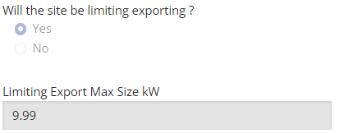
Curtailments
Field or Factory limiting projects require the below documents
  A curtailment letter with manufacturer's letterhead indicating the inverter is curtailed to - kW AC along with the project information (account holder’s name, address, and curtailment information).
  One line diagram lists the limit information
Field or Factory limiting projects require the below information to be submitted at the application submission
  AC System Design Capacity (Maximum) is the equipment capacity and Limiting Export Max Size kW show curtailed size under System Details page

Slide 11
Qualifying Facility to Net Metering
For completed projects that need to be changed to Net Metering, please use ‘Qualify Facility to Schedule Z Conversion – Customer Request’ form under Available Forms to submit the request
  Attach Schedule Z

Slide 12
MASS ACA
In accordance with D.P.U. 23-140-B, Order – Private Behind The Meter and anything 25 kW and under won’t be required to send Mass ACA approval
  Existing projects currently in queue over 10 kw will only be required to submit a Schedule Z in addition to the standard required Compliance Documents

Slide 13
Everything starts with application
A complete application includes:
  Completed applications online
  Electrical Sketch
  One Line Diagram
  Site Plan / Drawing
  Inverter cut sheet
  UL 1741 SB* certification (if not already on file)
  Work Request number if there is a new service or there is a service upgrade
  If necessary, identify ownership of property and provide proof of site control if Customer and/or Interconnecting Customer does not own the property.
  Identify electric utility customer and owner of proposed generation
Errors or problems with application will slow down the process and “stop the clock”
Send Electronic copy of all documents if possible – Easier to distribute, saves paper and is faster.

Slide 14
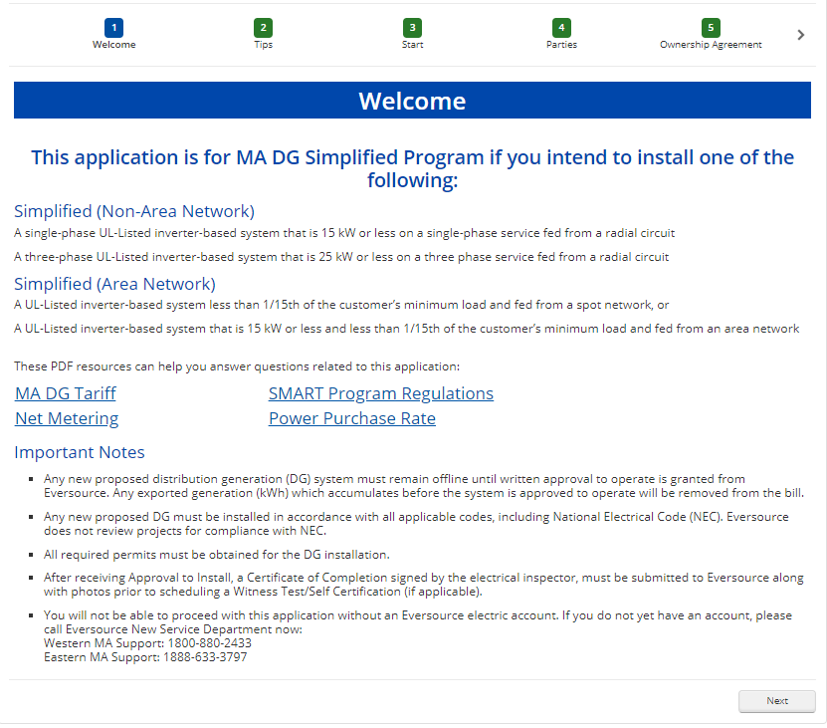
Example – DG Interconnection Application

Slide 15
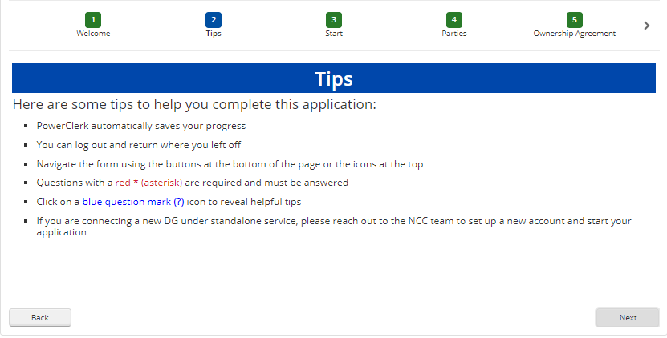
Example – DG Interconnection Application

Slide 16
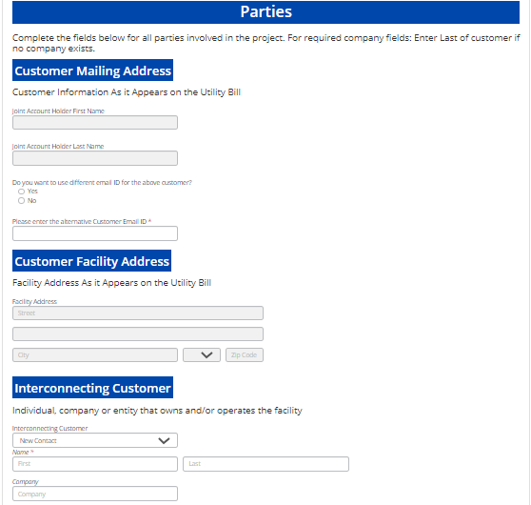
Example – DG Interconnection Application

Slide 17
Simplified Requirements
Submit an electrical sketch with application:
  DOES NOT need to be stamped by a MA PE.
  Must show the existing/proposed service, including the revenue metering and production meter, and how/where the proposed generation will interconnect to it.
  Can be hand drawn but must be legible.
  Include: Size of main breaker, external disconnect switch (when required or installed), kW rating, Customer name, address of facility, Inverter(s) and existing and back up generation (if applicable)
  Must show actual proposed equipment. Ex: Do NOT include “MIN 60A” for a disconnect size.
  Inverter settings.
  SHOULD NOT specify equipment TBD by Company.
  If you submit a revised electrical sketch, please include a date and/or revision number on the sketch.

Slide 18
Certificate of Completion
Massachusetts wire inspectors are no longer required to submit a Certificate of Completion during the interconnection process.
Instead, the inspector will either need to call in their approval directly to our Electric Service Support Center (ESSC) or visit our website at eversource.com to complete approval via the inspector portal.
ESSC Eastern MA 888-633-3797/ ESSC Western MA 800-880-2433
We still have the Certificate of Completion upload field enabled in Power Clerk for inspectors that still choose to sign however, this is not a required field

Slide 19
Net Metering in Massachusetts
December 2009 Net Metering Tariff, updated periodically by DPU.
Means the process of measuring the difference between electricity delivered by a Distribution Company and the electricity generated by a Class 1, Class II, or Class III Net Metering Facility and fed back to the Distribution Company.
Three Classes of Net Metering Facility
Net Metering facilities in Net Metering Tariff:
    Class I: Any generator up to 60 kW is eligible (though compensation differs depending on type of generation).
    Class II: Agricultural, Anaerobic Digestion, Solar, or Wind Net Metering Facility over 60 kW but less than or equal to 1 MW (for Municipality or Other Governmental Entity it’s “per unit”).
    Class III: Agricultural, Anaerobic Digestion, Solar, or Wind Net Metering Facility over 1 MW but less than or equal to 2 MW (for Municipality or Other Governmental Entity it’s “per unit”).

Slide 20
Net Metering Eligibility
11-11E issued 7/1/13 which allows for ‘an exception for optimal interconnection’.
Utility can have more than one interconnection point and meter for technical and/or operational reasons.
DPU ruling adopts blanket exceptions to parcel rule such as:
  Multiple technologies
  Rooftop cap exempt facilities
The Department established an application form to apply for blanket exceptions
Customers can petition DPU for exceptions.
Can have a separate metered service for net metering facility along with other non-net metered services on the single parcel.
Parcel boundaries needed to be set in 2010.

Slide 21
Net Metering Process
Customer is compensated for energy produced after receiving approval to operate and all other requirements have been met.
  If you have questions regarding billing, compensation for exported energy, and/or credit allocation contact:
  Western MA = Customer Care Department at 888-783-6616
  Eastern MA = Residential Contact Center 800-592-2000.
Net metering credits may not be applied to the Host Customer’s account until the next billing cycle.
  Customers may be on different billing cycles.
  Credits allocated to other Eversource accounts may be applied on a different billing cycle than the Host Customer’s account.
Once online, review and implementation of a new Schedule Z will take a minimum of one-two billing cycle.

Slide 22
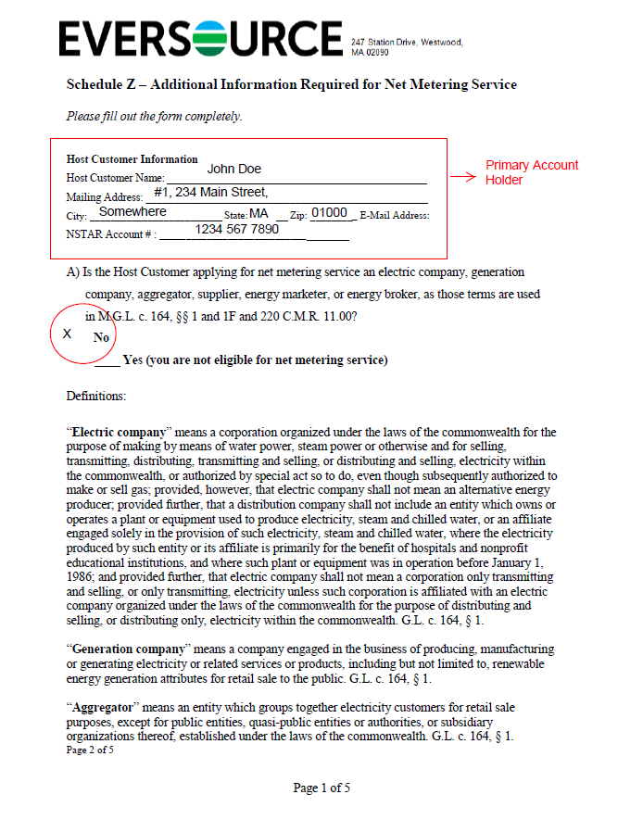
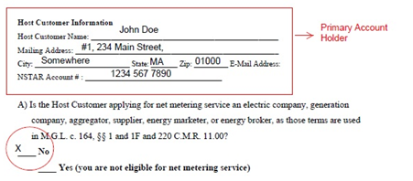

Slide 23
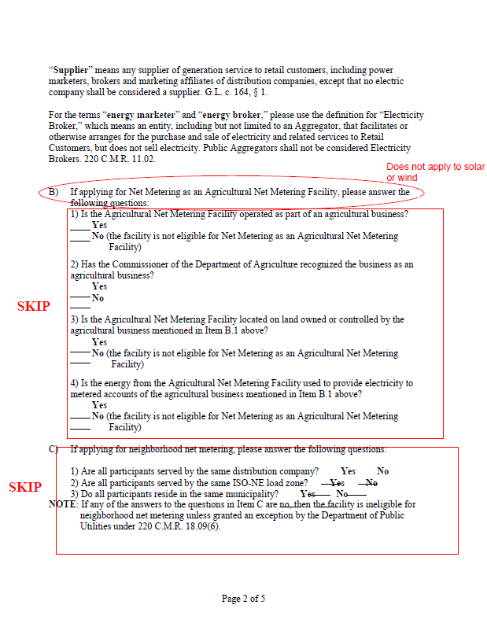

Slide 24
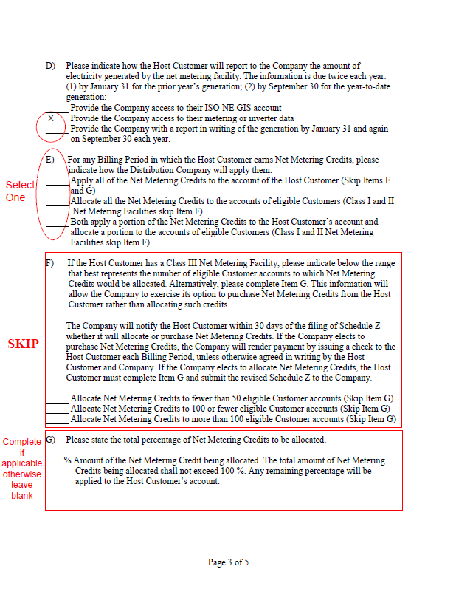



Slide 25
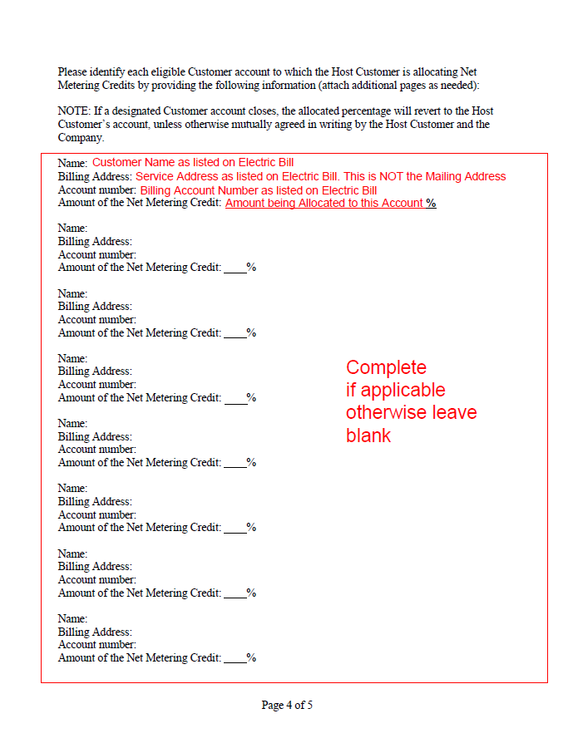

Slide 26
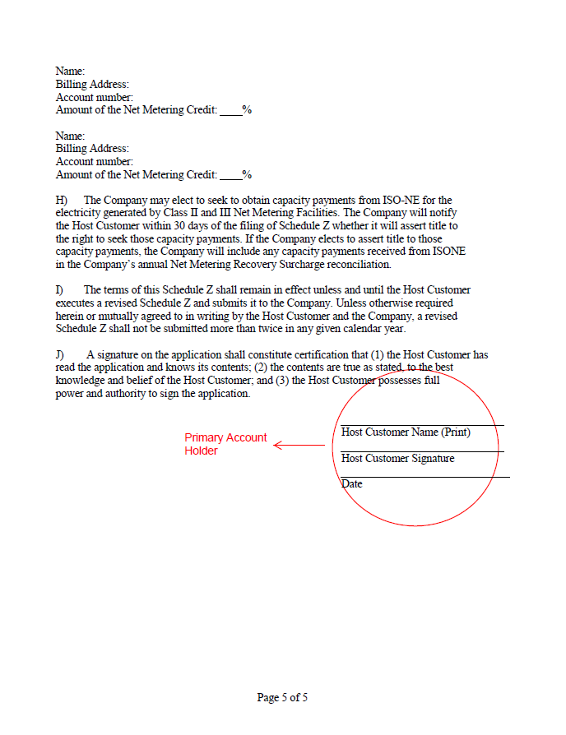

Slide 27
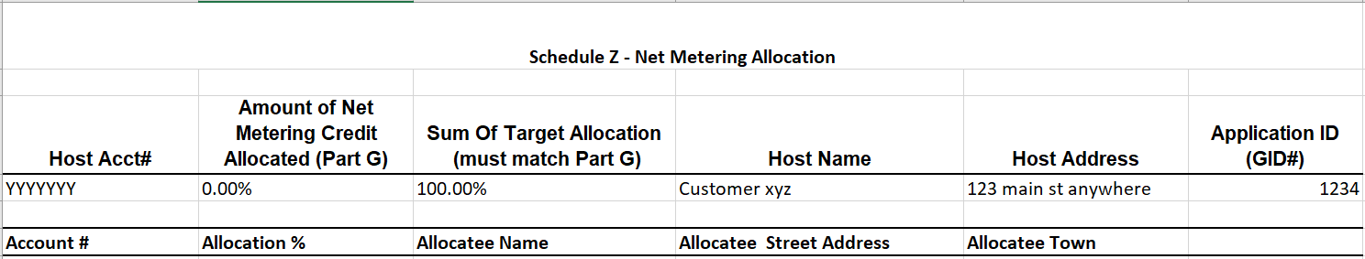
Schedule Z Allocations
  The DPU ordered that after July 31. 2018, host customers must include an electronic Excel spreadsheet that details the net metering credit transfers in addition to the paper schedule Z document.

Slide 28
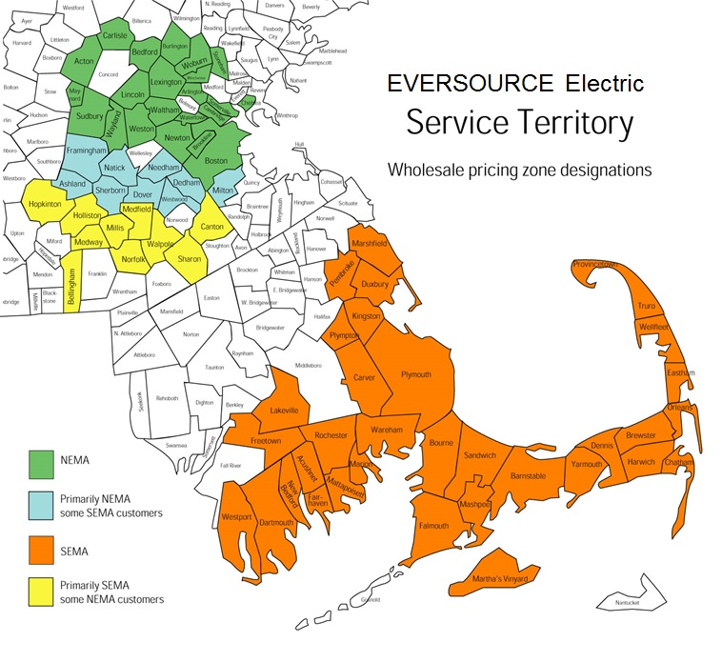

Slide 29
Questions?

