Slide 1

Title Slide: Event Name
Empowering Voices: Intervenor Support Grant Program
June 25, 2026

Slide 2
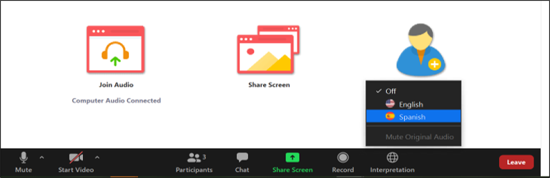
Interpretation Instructions
Language Interpretation is being offered in:
Español, Kreyòl ayisyen, Português, 普通话, and Tiếng Việt
To participate in English, click the “Globe” icon and select English.
Para entrar no canal em português, clique no ícone “Globe” e selecione “Portuguese”
Si alguien desea interpretación en español, haga clic en “Globe” y seleccione “Spanish”
Pou rantre nan chanèl kreyòl ayisyen an, klike sou ikòn “Globe” an epi chwazi “Haitian Creole”
要以普通话参加会议，请单击口语图标并选择 "Chinese”.
Để tham gia bằng tiếng Việt, hãy bấm vào biểu tượng "Quả địa cầu" và chọn Tiếng Việt
For those attending in-person, please return interpretation equipment to DPU staff prior to leaving the building.
All Attendees:
Please speak slowly.
You must select a language channel, even if viewing the presentation in English.

Slide 3
Agenda
6:00-6:05: Interpretation details
6:05-6:15: Opening Remarks – Chair McDiarmid; Undersecretary Power; Sari Kayyali, GreenRoots
6:15-6:45: Presentation on Intervenor Support Grant Program
6:45-6:55: AGO Considerations in Proceedings & Key Considerations for Intervenors
6:55-7:20: Q&A
7:20-7:30: Closing Remarks - Commissioner Rubin, Commissioner Anderson, Attorney General Campbell (recorded remarks)

Slide 4
Topic Areas Covered in Presentation
Purpose of the Intervenor Support Grant Program
Proceedings Eligible for Intervention
Rights and Responsibilities of an Intervenor
Process to Become an Intervenor
Process to Intervene and Process to Apply for an Intervenor Grant
Entities Eligible to Receive Grant Funding
Information Required in Grant Application
Grant Awards and Payment Process
Use of Grant Funding
Grants Management System (GMS) – Online Grant Application Portal
Resources Available

Slide 5

Purpose of the Intervenor Support Grant Program (“Program”)
Provides funding to eligible groups who are unable to participate in Department of Public Utilities (“DPU” or “Department”) or Energy Facilities Siting Board (“Siting Board”) proceedings because of financial hardship
Allows grantees to cover fees for attorneys, expert witnesses, community experts, administrative, and other eligible expenses
Provides diverse voices a seat at the table and an opportunity to influence decisions
Administered by the Department’s Division of Public Participation (DPP)
Funding is available for proceedings initiated on or after July 1st, 2026

Slide 6
Proceedings Eligible for Grant Funding for Intervening
Department
Petitions from utilities to change electric and gas distribution rates for customers
Grid modernization and infrastructure investment plans
Net metering and interconnection petitions (e.g., approval of revised interconnection standards)
Energy efficiency and decarbonization programs (e.g., pilot programs for networked geothermal, heat pump rates)
Siting Board
Reviews proposed large energy infrastructure facilities
Renewable energy generating facilities (Solar, wind)
Battery energy storage facilities
Sub-stations
Transmission and distribution infrastructure
Gas pipelines and related facilities
Investigations and rulemaking initiated by the Department are not eligible for grant funding.

Slide 7
Rights and Responsibilities of an Intervenor
Increasing Levels of Participation in a Proceeding
An Intervenor is a legally recognized participant (party) with a higher level of involvement in the proceeding
  Submit evidence
  Issue information requests
  Present and cross-examine witnesses
  File briefs
  Appeal decisions
Being an intervenor requires time, energy, and resources
Intervenor
Limited Participant
A person or entity whose participation is restricted to specific issues in a proceeding. Can file comments, file a brief, and receive copies of information requests and responses, responses to information requests, and testimony.
Limited Participant
Public Commentor
Provides written or oral feedback on a proceeding but does not have the rights of an intervenor
Public Commentor

Slide 8
Process to Become an Intervenor
Department or Board issues a Notice* for the proceeding
Prospective intervenor reviews proceeding Notice to identify deadline to intervene
Prospective intervenor files written petition to intervene with required information by deadline
Intervenor status may be granted in full or for a portion of the proceeding
Hearing Officer/Presiding Officer grants or denies intervenor status
Hearing Officer (DPU) or Presiding Officer (Siting Board) reviews the petition
Petition to intervene must include basic information about petitioner (name, address, and contact information), how the petitioner is substantially and specifically affected by the proceeding, and what issues they will address as an intervenor
Timing to submit petition to intervene
  Department – usually 7 days before the public comment hearing
  Siting Board – usually 14 days after public hearing
  Can request additional time to file petition to intervene if done prior to original deadline
*Notice is referred to as Notice of Filing and Public Hearing in a Department Proceeding or a Notice of Adjudication and Public Hearing in a Siting Board Proceeding

Slide 9
Process to Intervene & Process to Apply for an Intervenor Grant
Process to Intervene in a Proceeding
Prospective intervenor submits petition to intervene
DPU or Siting Board rules on petition to intervene
Intervenor status is granted or denied
Receiving intervenor status is a prerequisite to receive funding through the Program
Department or Siting Board Issues Proceeding Notice
Process to Apply for an Intervenor Grant
Grant Applicant creates MyMassGov Account and Profile
Grant Applicant submits application by deadline to intervene
DPP reviews application for completeness within 10 business days
Submit final report within 30 days of the end of the proceeding
Submit grant payment request once grant approved & intervenor status received
DPP reviews application & issues a written decision in 30 days
Conditional award if decision on petition to intervene is not issued

Slide 10
Entities Eligible to Receive Grant Funding
Organizations representing residential customers, low-or moderate-income residents, residents of historically marginalized or overburdened and underserved communities, or residents of Burdened Areas
Governmental bodies (city, town, district, regional school district, or county)
Regional planning agencies, e.g., Metropolitan Area Planning Council, Cape Cod Commission
Federally-recognized, state-recognized, or state-acknowledged Tribes
A group of three of more individuals (“unincorporated association”) and may be specifically and substantially affected by the proceeding
Only parties granted intervenor status are eligible to receive grant funding
Ineligible Entities include Individuals, Limited Participants, and those whose petitions to intervene are unsuccessful

Slide 11
Information Required in Grant Application
Grant Application Should
Demonstrate significant financial hardship (inability to participate without receiving Grant)
Provide information about last 3 proceedings applicant intervened in, if applicable
Describe applicant’s position and interest in the proceeding
Describe a clearly stated, reasonable, and achievable plan for participation in proceeding, including expected contribution to evidentiary record
Detail applicant’s unique perspective
Documents to be Submitted with Application
Proposed itemized budget
Attorney and Expert Information Form
Electronic Funds Transfer (EFT) Form
W-9 form with TIN (EIN or SSN)
Form 990

Slide 12
Grant Awards and Payments
Award Amounts
Up to $150,000 per Grantee
Up to $500,000 across all Grantees in a Proceeding
Payment Options
Grantees choose to receive Grant Award as either:
a) Advance payments (installments of up to 20% of award)
  Advance payments require showing of good cause and significant financial hardship
b) Reimbursements after costs are incurred throughout proceeding
Payment Requests should be submitted in GMS with supporting documentation (estimates, invoices, or receipts)
Payments disbursed within 30 days of receiving a Payment Request

Slide 13
Use of Grant Funding
Eligible Uses
Administrative costs up to 10% of Award amount or greater if allowed by DPP Director
Attorney fees
Expert witness fees, including Community Expert fees*
Ineligible Uses
Purchase or lease of equipment
Political lobbying
Advertising/marketing to publicize Grantee’s view on proceeding
Costs to appeal DPU or EFSB final decision in proceeding
Other unlawful, unethical, or improper use
*Community Experts: Members of an affected community, including residents or community groups, with knowledge or lived experience relevant to the proceeding

Slide 14
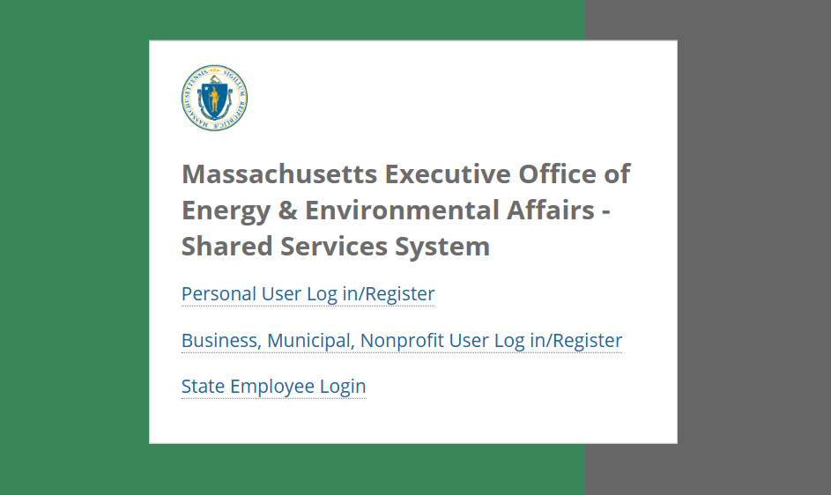
Grants Management System (GMS) – Log-in Screen
Applicants will need to first register for a MyMassGov account and wait for approval (can take up to 48 hours)

Slide 15
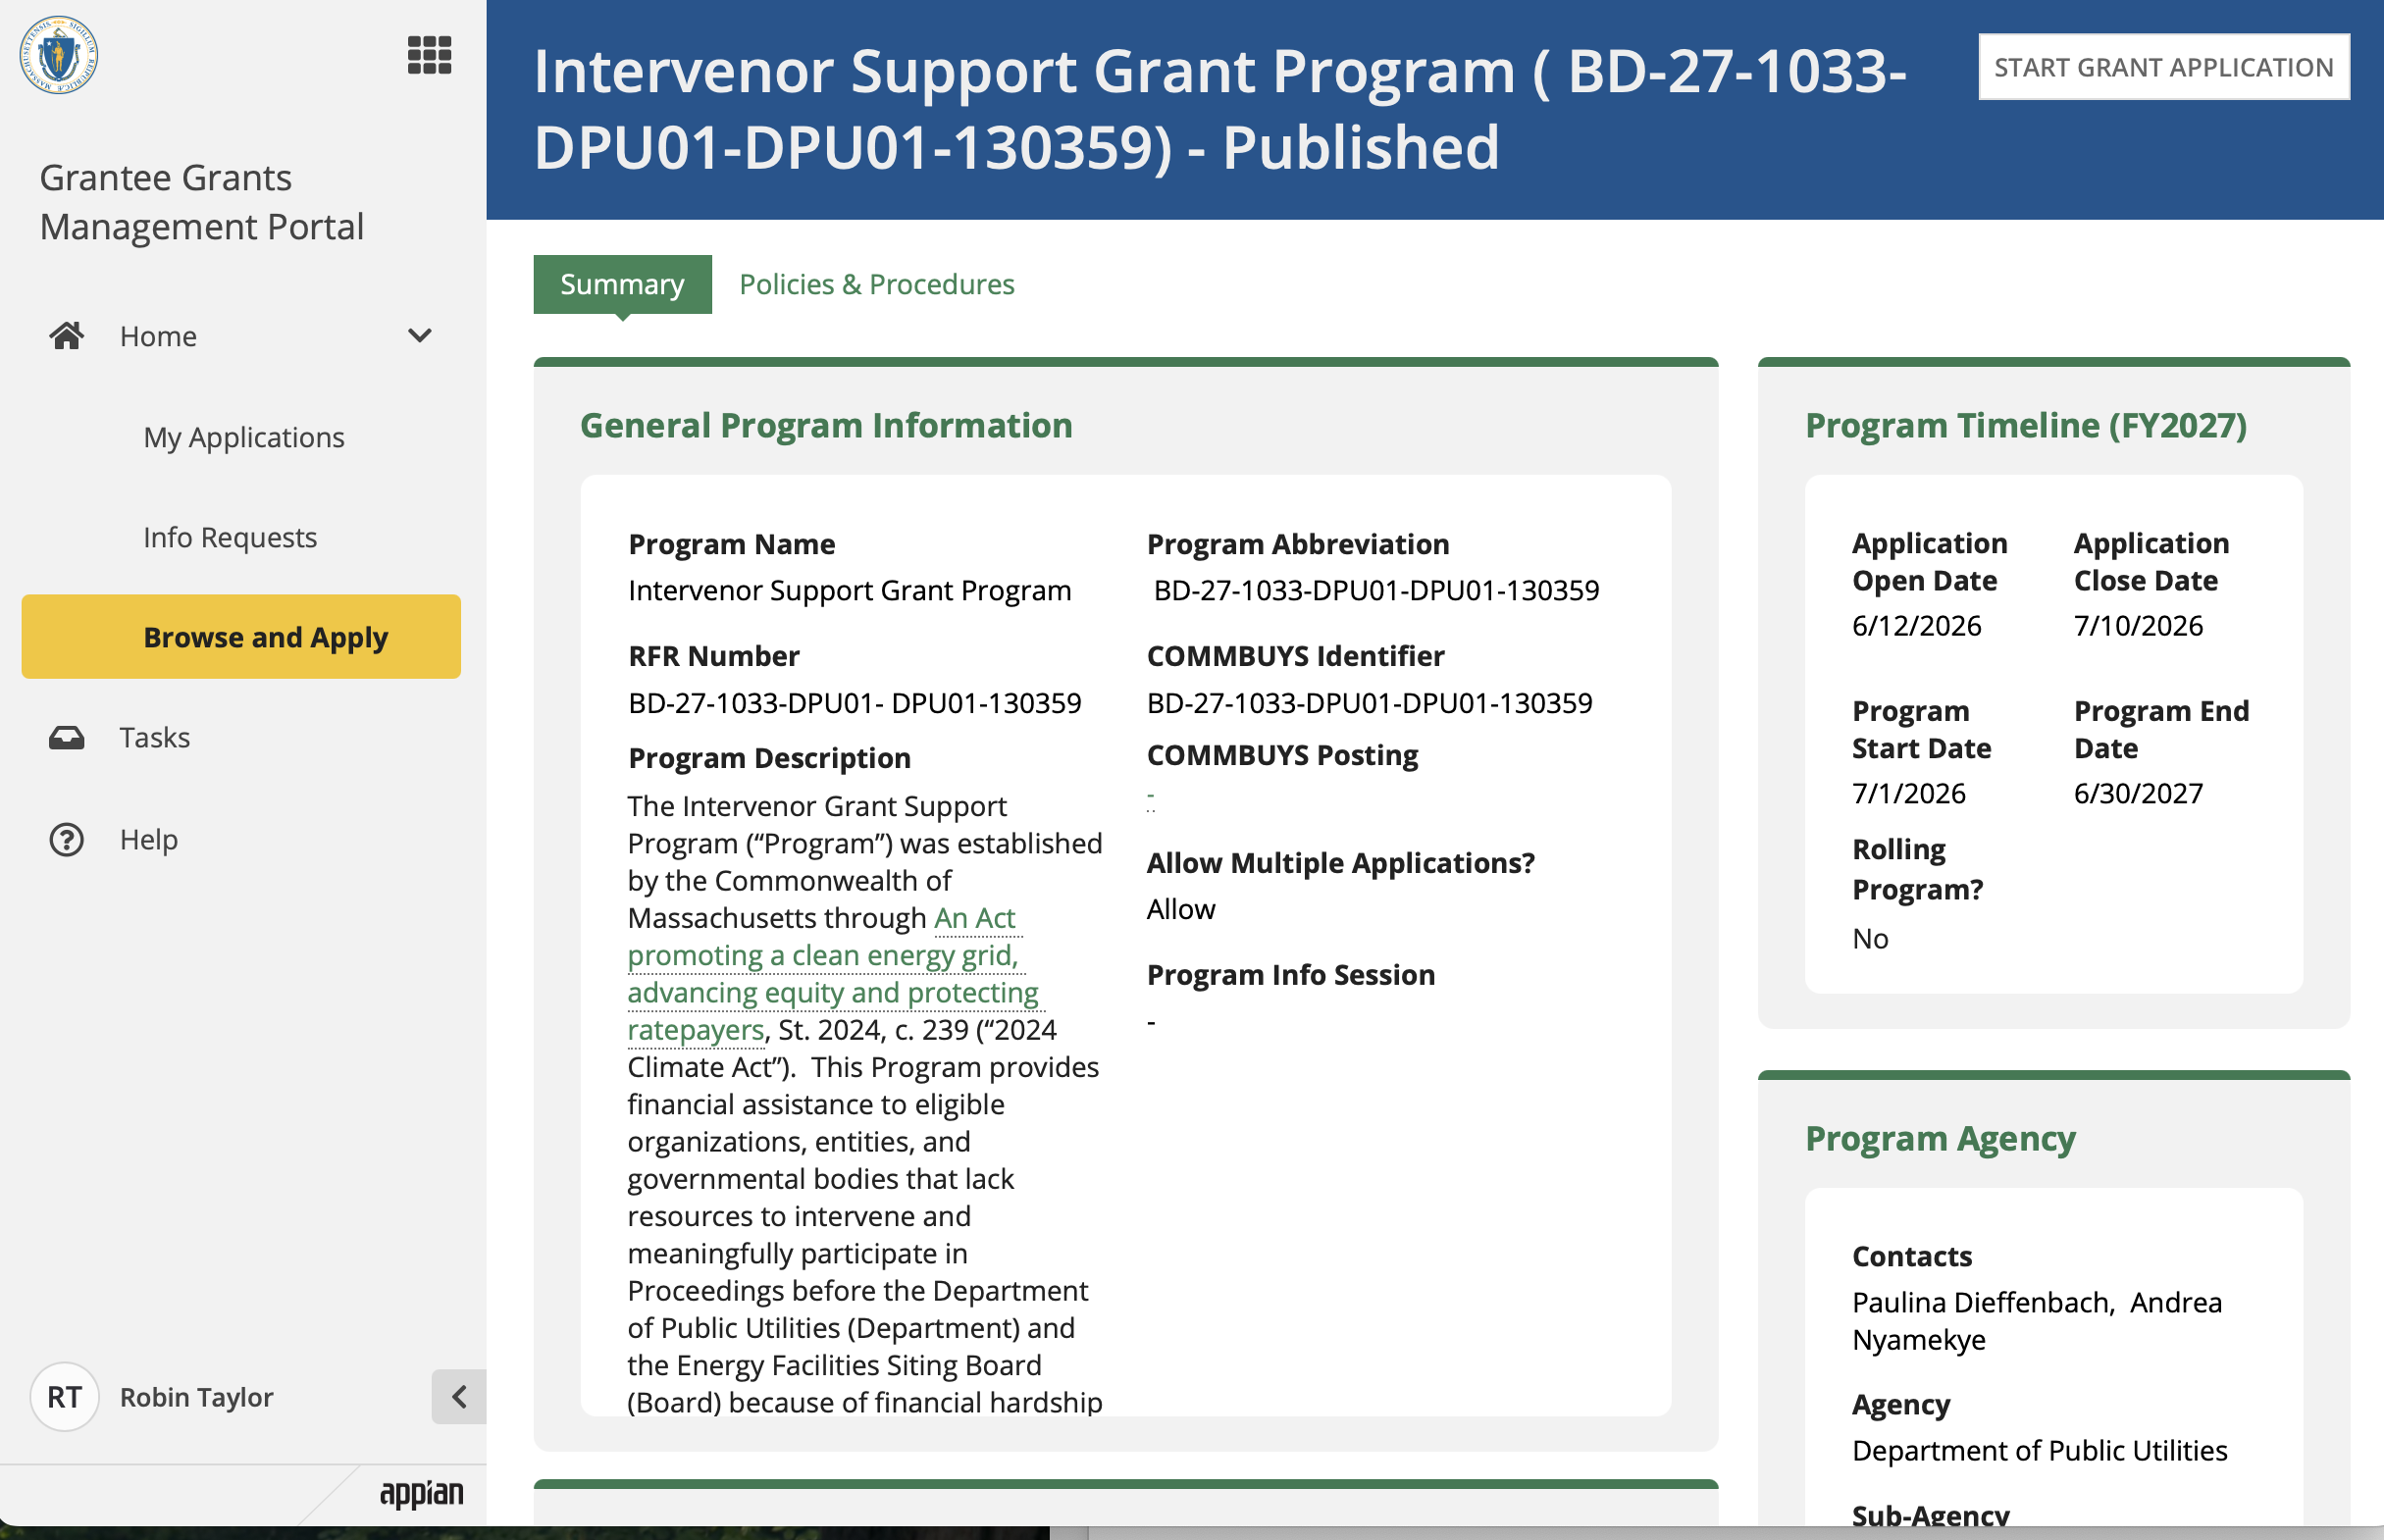
Grants Management System (GMS) – Online Application Portal
A video and written guide on how to use GMS are coming soon

Slide 16
Resources Available for Applicants
Intervenor Support Grant Program webpage - (mass.gov/IntervenorProgram)
Intervenor Support Grant Program Guide (July 1, 2026)
  Detailed explanation of how to intervene, differences in intervention for Siting Board vs Department proceedings, application process, glossary of terms, etc.
Video modules (in development)
  Overview of DPU and Siting Board
  Overview of Intervenor Support Grant Program
  Participating as an Intervenor- Roles and Process
  How to Apply for the Intervenor Support Grant Program in GMS (with screen recordings)
Grants Management System Guide
Understanding Steps in a Department Proceeding
Understanding Steps in a Siting Board Proceeding
Program email - dpu.isgp@mass.gov

Slide 17

Intervenor Support Grant Program
Jessica Freedman
Assistant Attorney General
Energy and Ratepayer Advocacy Division
Office of Attorney General Andrea Joy Campbell
June 2026

Slide 18
Energy and Ratepayer Advocacy Division (ERA) of the Attorney General’s Office (AGO)
The Attorney General is the ratepayer advocate in the Commonwealth and is authorized by statute to intervene on behalf of utility ratepayers in Department of Public Utilities (DPU) & federal (FERC) proceedings. See M.G.L. ch. 12, § 11E.
Our job:
  Advocate on behalf of Massachusetts ratepayers in administrative, regulatory, & judicial proceedings of investor-owned gas, electric, and water utilities
  Help ensure that Massachusetts residents & businesses have access to safe, affordable, & reliable service
  Support an equitable & affordable clean energy transition
  Protect consumers from predatory energy company practices
Attorney General Andrea Joy Campbell
Energy and Ratepayer Advocacy (ERA)
Environmental Protection
Environmental Crimes Strike Force
Energy and Environment Bureau
5 Other Bureaus
© 2026 Massachusetts Attorney General’s Office
Notes:
.

Slide 19

Stakeholder
Working Group
Barriers:
Cost of legal representation (attorneys fees) & cost to hire an expert witness
Inaccessible procedures & filing requirements
Solutions:
A program that covers reasonable costs for lawyers, experts (including community experts), & non-profit staff time if an intervening group would incur a significant financial hardship
Educational & other resources/examples
© 2026 Massachusetts Attorney General’s Office

Slide 20
Why Participate?
A Robust Record = Better Decisions
Energy decisions have broad ramifications that will impact populations & communities in different ways
You know your community; ensure that decision-makers are informed about the issues that impact you & your community
Participation & broad engagement supports accountability & transparency
© 2026 Massachusetts Attorney General’s Office

Slide 21
How can you participate?
Visit the DPU File Room
File written comments
Speak at a public hearing
Limited Participant
Intervenor Status
Lowest amount of time, money, energy
Highest amount of time, money, energy
© 2026 Massachusetts Attorney General’s Office

Slide 22
Considerations for New Intervenors
(this is not legal advice)
What are your primary goals for the proceeding?
    What is the scope: Can these decision-makers address your goals through this adjudicatory proceeding?
What types of experts will you need to support your case?
    Community, technical, scientific, financial, legal experts
Are there are other entities that share your perspective?
    Explore opportunities to collaborate and/or potentially share expenses
© 2026 Massachusetts Attorney General’s Office

Slide 23
Considerations for New Intervenors (cont.)
(this is not legal advice)
Track all deadlines
  Shortly after a petition is filed, the DPU will issue an “Order of Notice” & a “Notice of Filing and Public Hearing” announcing:
      Public hearings dates (with an opportunity for oral & written Comments)
      Deadlines for petitions to intervene, deadline to apply for the ISGP & deadlines for Comments
  Procedural Schedule will include key deadlines
  Add deadlines to your calendar or make a spreadsheet
Intent to file testimony
Discovery
Briefing
Testimony
Evidentiary Hearings
and more…
© 2026 Massachusetts Attorney General’s Office

Slide 24
Considerations for New Intervenors (cont.)
(this is not legal advice)
What educational resources are available from the DPU/Energy Facilities Siting Board (EFSB)?
    The Division of Public Participation is a good starting point
Learn to navigate the DPU File Room & the new EFSB File Room
  Search by Docket #/case type/petitioner
Look into past cases on the same issue (if any)
Read docket filings – some proceedings have hundreds of filings
  Did the DPU direct the petitioner to file a discovery log?
© 2026 Massachusetts Attorney General’s Office

Slide 25
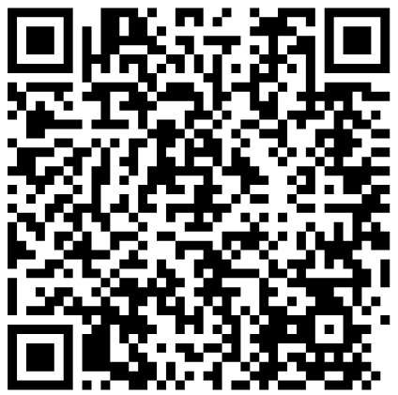
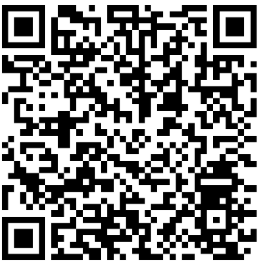
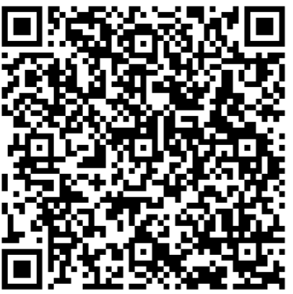
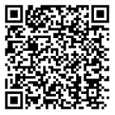
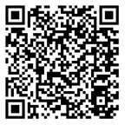
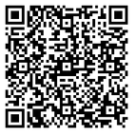
AGO Resources
Bi-annual newsletters:
AGO FAQ Pages
Winter 2025-2026 Edition
  Summer 2026 Edition releasing soon, available on the AGO Energy and Environment webpage
  Sign-up for future newsletters
Electric and Gas Utilities*
Competitive Electric Supply*
Solar
  *Featuring Fact Sheets in English, Cape Verdean Creole, Haitian Creole, Khmer, Portuguese, Simplified Chinese, Spanish, and Vietnamese
© 2026 Massachusetts Attorney General’s Office

Slide 26
AGO Contacts
Contact the AGO Consumer Division:
  Consumer Hotline: 617-727-8400
  File a complaint about a business: https://www.mass.gov/how-to/file-a-consumer-complaint
Request a presentation from our Energy Consumer Liaison
  Sierra Moll, sierra.moll@mass.gov
    Utility Bills 101 – Walkthrough of Gas and Electric Utility Bills
    Avoiding Utility Scams
    Competitive Electric Supply
    Solar Energy and Consumer Protection
© 2026 Massachusetts Attorney General’s Office

Slide 27
Questions or Comments??
Questions or Comments??

