Slide 1
Is The Sky Really Falling?
A Review of the Funded Status of Public Pension Plans
Presented by
Becky Sielman
Principal and Consulting Actuary
PERAC Emerging Issues Forum
September 14, 2011
The statements and opinions expressed herein are solely those of the presenter and do not constitute official statements or positions of Milliman, Inc.

Slide 2
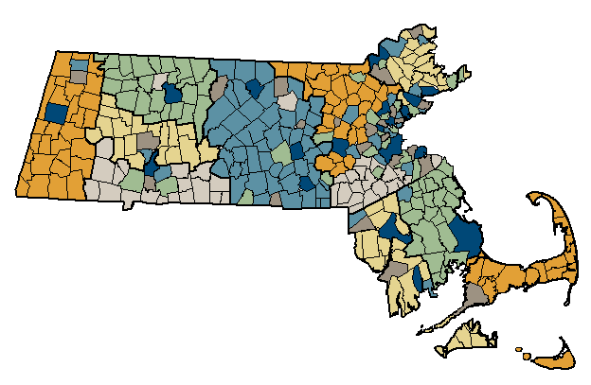
Massachusetts Public Employee Retirement Systems
105 systems covering 540,000 members
Identical benefit provisions
Centralized oversight for funding valuations

Slide 3
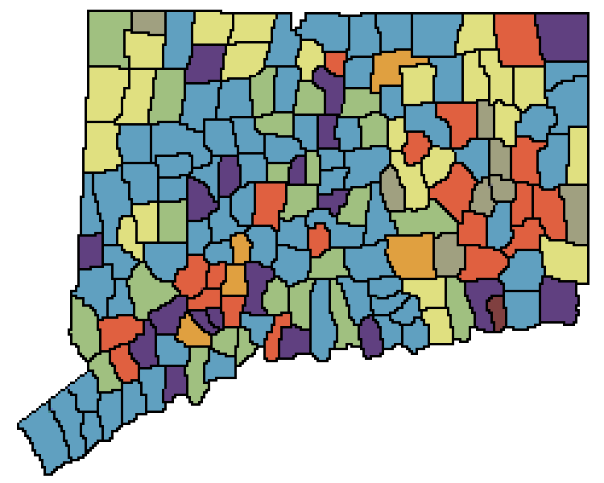
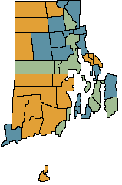
Connecticut and Rhode Island

Slide 4
How well funded are Massachusetts plans compared to other public pension plans?

Slide 5
Funded Ratios
median: 66%
median: 77%
median: 79%
median: 42%

Slide 6
Historical Funded Ratios - Massachusetts
average 74%
77%
75%
71%
67%
69%
71%
64%
65%
70%
63%
62%

Slide 7
Historical Funded Ratios - Connecticut
average 83%
86%
86%
84%
86%
84%
81%
79%

Slide 8
How well are Massachusetts plan sponsors funding their plans compared to other public pension plan sponsors?

Slide 9
Percentage of Actuarial Contributions Paid
Massachusetts: near universal full payment of actuarially determined appropriation amount
Graphs display the average for the past six fiscal years of the ratio of actual contributions to the Annual Required Contribution

Slide 10
Relationship of Funding to Funded Ratios
Does paying the actuarially determined contribution each year lead to better funded systems?
Correlation Coefficient: 0.11
Correlation Coefficient: 0.01
Correlation Coefficient: 0.23
Correlation Coefficient: 0 = no correlation; 1 = perfect correlation

Slide 11
How are appropriations for Massachusetts plans determined, compared to other public pension plans?

Slide 12
Funding Methods - Massachusetts
Cost Method: Entry Age Normal
Most plans will be fully funded in 20 years
Level percent amortization is the overwhelming method used
Asset smoothing reduces contribution volatility

Slide 13
Funding Methods - Connecticut
Wide variety of methods in use
Median period is 20 years
Use of level dollar amortization is front-loaded

Slide 14
Funding Methods – Large State-Wide Plans
30 out of 81 plans are using level percent amortization with a 30-year open period

Slide 15
How do the actuarial assumptions used for Massachusetts plans compare to other public pension plans?

Slide 16
Assumptions - Massachusetts
median: 8.0%

Slide 17
Assumptions - Connecticut
median: 7.75%
Most CT plans use a single salary scale, unlike MA and large state-wide plans
Low spreads are conservative: low interest rates plus high salary scales

Slide 18
Assumptions – Large State-Wide Plans
median: 8.0%

Slide 19
What does the future hold for Massachusetts plans?

Slide 20
The “Median” Massachusetts Plan Today
January 2010 | 000s
Market Value of Assets | $91,646
Actuarial Value of Assets | 104,707
Actuarial Value / Market Value | 114%
Accrued Liability | 168,427
Funded Ratio | 62.2%
Total Normal Cost | 4,217
Expected Member Contributions | 2,613
Net Normal Cost | 1,604
Administrative Expenses | 250
Amortization Payment | 4,576
Interest | 514
FY11 Appropriation | 6,944
Annual Benefit Payments | 10,043
Median calculations exclude the State Employees and State Teachers plans

Slide 21
The “Median” Massachusetts Plan

Slide 22
The “Median” Massachusetts Plan

Slide 23
Source Data
Massachusetts: PERAC Annual Reports and data compiled by Jim Lamenzo
Connecticut: data compiled by Milliman from 2010 CAFRs
Rhode Island: 2011 Report of the Senate Municipal Pensions Study Commission
Large State-Wide Plans: data compiled by Milliman from 2010 CAFRs

Slide 24
Questions?

