Slide 1
Department of Developmental Services
Massachusetts Rehabilitation Commission
Individual Support Plan (ISP) Module – Release 7.7
Training - Provider Staff

Slide 2
Introduction
The purpose of today’s training session is to provide an overview of the enhancements that are being included in the new release of the ISP module, which will go live on February 8th, 2016.
Enhancements included in this release will be reviewed in detail throughout today’s training and include the following:
Progress Summaries
Modifications
Additional Functionality

Slide 3
Chapter Plan
Chapter 1: Overview of the ISP Module
Chapter 2: Year Selection
Chapter 3: Progress Summaries
Chapter 4: Progress Summary Report
Chapter 5: Area Office Director Approval of the ISP
Chapter 6: Modifications
Chapter 7: Additional Functionality and Conclusion

Slide 4
Chapter Plan
Chapter 1: Overview of the ISP Module
ISP Workflow
Refresher on Recent Enhancements
Chapter 2: Year Selection
Year Selection for ISP
Chapter 3: Progress Summaries
Overview of Progress Summaries
Progress Summary Review Switchboard
Scenario: Initiate a Progress Summary
Scenario: Review an Progress Summary
Chapter 4: Progress Summary Report
Scenario: Accessing a Progress Summary Report
Chapter 5: Area Office Director Approval of the ISP
New Trigger for Locking the ISP in HCSIS
Lock Icon on Individual Dashboard
Chapter 6: Modifications
Overview of Modifications
Scenario: Initiate a Modification
Scenario: Review and Revise a Modification
Chapter 7: Additional Functionality and Conclusion
Internal Provider Workflow Enhancement
Other Enhancements
Training Summary and Conclusion

Slide 5
WebEx: Chat Function
1. Click ‘Chat’.
2. Select ‘Send to’ Everyone.
3. Type your message here.
4. Click ‘Send’ or use enter on your keyboard.

Slide 6
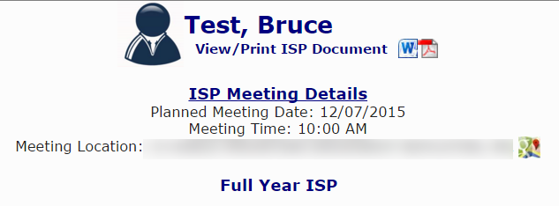
Confidential Information Protocol
No confidential information is used in the presentation.
All images of HCSIS in the presentation are populated with test data
All personally identifiable data fields such as addresses have been blurred out.
All the scenarios in the presentation use an individual with a fake name, Bruce Test, to demonstrate the processes.

Slide 7
Chapter 1: Overview of the ISP Module
Chapter 1
Chapter 2
Chapter 3
Chapter 4
Chapter 5
Chapter 6
Chapter 7

Slide 8
Chapter 1 Overview
This Chapter will cover:
ISP Workflow
Refresher on Recent Enhancements

Slide 9
ISP Workflow

Slide 10
ISP Workflow
Set ISP Meeting Date
Complete and Review ISP Document
Initiate ISP Planning Process
Review Objectives and Supports Agreements
Request and Review Assessments
The ISP module provides an efficient mechanism for streamlining data entry and enabling efficient information sharing between members of the ISP team.
Enhancements have been added in this release that will allow additional tasks to be complete within HCSIS.

Slide 11
Refresher on Recent Enhancements

Slide 12
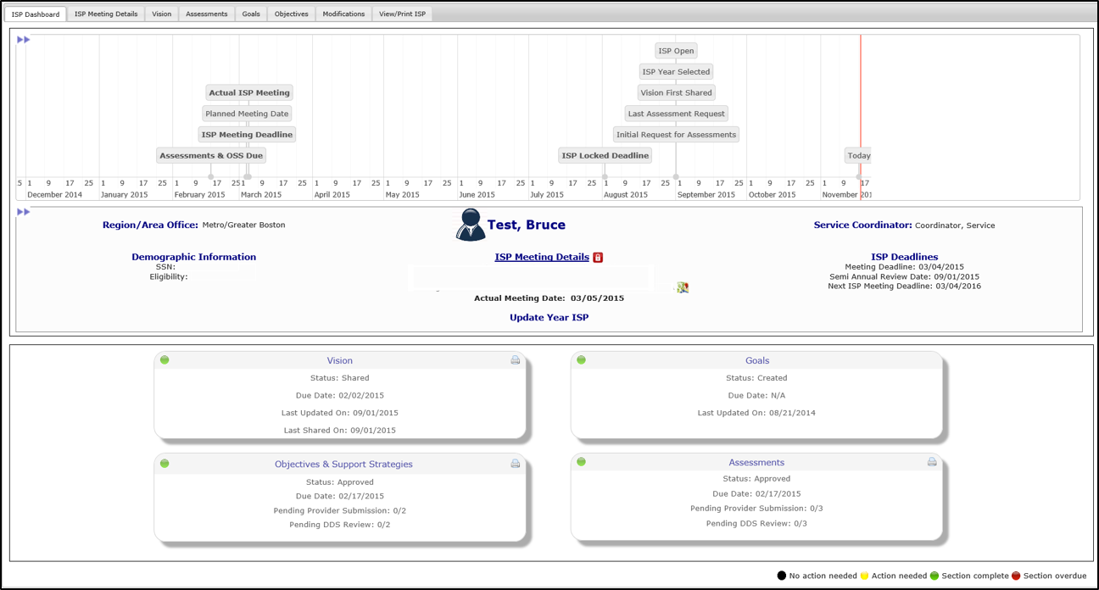
Timeline for ISP Plan Type Selection
Above each individual's ISP dashboard, there is a personalized ISP timeline graph for that individual. In order to view the timeline click (>>) above the Individual Dashboard.
The “ISP Open” is the date the ISP process was initiated, 90 days prior to the ISP Meeting Date.
The “ISP Year Selected” is the date the plan type selection was made.

Slide 13
Recall Functionality
The following sections will be recalled for an Update Year ISP:
Vision Statement recorded in the previous year’s ISP will be recalled and updated by SCs and shared with Providers.
Goals recorded in previous ISP will be recalled and can be updated by both SCs and Providers.
Objectives from the previous ISP will be recalled, updated and submitted by Providers.
Once requested by the SC, Assessments recorded in the previous year’s ISP can be recalled, updated and submitted by Providers.
Other ISP components will be recalled and updated by SCs.
The following sections will be recalled for a Full Year ISP:
Vision Statement recorded in the previous year’s ISP will be recalled and revised by SCs and shared with Providers.
Goals recorded in previous ISP will be recalled and can be revised by both SCs and Providers.
Objectives from the previous ISP will be recalled, revised and submitted by Providers.
Once requested by the SC, Assessments recorded in the previous year’s ISP can be recalled, revised and submitted by Providers.
Other ISP components will be recalled and revised by SCs.
The same sections are recalled in both an Update Year or Full Year. However, in an update year recalled information can be updated versus in a full year the recalled information should be revised to reflect a completely new plan.

Slide 14
Historical ISP Materials
On the View/Print ISP tab, click “View Historical ISP Materials” to view historical Goals, Objectives and Assessments.

Slide 15
Summary Report
The ISP Summary Report is a reporting tool for DDS and Provider staff to review the timeliness of actions that occurred leading up to the ISP Meeting for each individual. Only the initial submission of assessments and objectives is considered for this report. For an individual to appear, the actual meeting date must have been entered in MEDITECH.
Additional enhancements made to the Summary Report in the August release:
Historical ISPs can be seen in the Summary Report. If the date range entered spans across more than one Actual Meeting Date for an individual, all plans between the selected Actual Meeting Dates will be included as separate line items in the report.
The column “No. of Revisions Requested” is now included in the report
Additional filters are available to narrow search results. Those filters that are newly added are in bold:
Area Office
Provider
Document Status
Report Display Option
Service/Activity Code
Security Group

Slide 16
Update Year Status for Goals and Objectives
The column Update Year Status appears for Goals and Objectives in an Update Year ISP. The table below further describes how to use the five statuses available for Goals and Objective Support Strategy.
Update Year Status | Description
Met | Used to describe a goal or objective that has been achieved by the individual and no longer remains a goal or objective for the Update Year ISP.
Discontinued | Used to identify a goal or objective that is no longer relevant for the individual or has ended. *Goals or Objectives should not be discontinued if there is a minor change. In this case, the status should be changed to updated*
Current | Used to identify a goal or objective from the previous year’s ISP that has not changed and continues into the update year ISP. *All recalled goals and objectives will be defaulted to current* *If a current goal or objective is updated, the status should be changed to updated*
Updated | Used to identify a goal or objective from the previous year’s ISP that has been changed for the update year ISP.
New | Used to identify a newly added goal or objective. *Newly added goals or objectives will be defaulted to new*

Slide 17
Chapter 1 Summary
This Chapter covered:
ISP Workflow
Refresher on Recent Enhancements

Slide 18
Chapter 2: Year Selection
Chapter 1
Chapter 2
Chapter 3
Chapter 4
Chapter 5
Chapter 6
Chapter 7

Slide 19
Chapter 2 Overview
This Chapter will cover:
Year Selection for ISP

Slide 20
Year Selection for ISP

Slide 21
Year Selection for ISP
Previous Functionality | Service Coordinators are required to manually make the year selection (i.e. Full-Year, Update Year) for individuals in HCSIS. Provider Data Entry Users and Supervisors are only able to access an individual’s plan after the Service Coordinator has completed this task.
New Functionality | Data Entry User and Provider Supervisor continue to receive access to an individual’s plan after the plan type selection has been made. The year selection process, however, has been partially automated. If the plan type for the most recently completed plan is a full year, the Service Coordinator is still required to manually make the year selection. If the plan type for the most recently completed plan is an update year, however, HCSIS will automatically choose full year for the new plan 90 days before the ISP meeting date. This will allow Provider staff immediate access to an individual’s dashboard in a Full Year.

Slide 22
Chapter 2 Summary
This Chapter covered:
Year Selection for ISP

