Slide 1
Department of Developmental Services
Massachusetts Rehabilitation Commission
Individual Support Plan (ISP) Module – Release 7.7
Training - Provider Staff

Slide 2
Chapter 3: Progress Summary
Chapter 1
Chapter 2
Chapter 3
Chapter 4
Chapter 5
Chapter 6
Chapter 7

Slide 3
Chapter 3 Overview
This Chapter will cover:
Overview of Progress Summaries
Progress Summary Review Switchboard
Scenario: Complete a Progress Summary
Scenario: Revise an Progress Summary

Slide 4
Overview of Progress Summaries

Slide 5
Progress Summary Workflow
ISP Meeting is Held
Progress Summaries due at annual ISP
Objectives are approved, included in ISP and frequency is selected by SC
Progress Summaries due at semi- annual review
Progress Summary Alerts received by Provider staff
Per DDS Regulation 115 CMR 6.21.5 J and Regulation 115 CMR 6.21.6, semi-annual and annual Progress Summaries are required as part of the ISP process. The ISP module provides an efficient mechanism for streamlining the submission process. The SC has the option, after conferring with the provider agency, of requesting quarterly Progress Summaries.

Slide 6
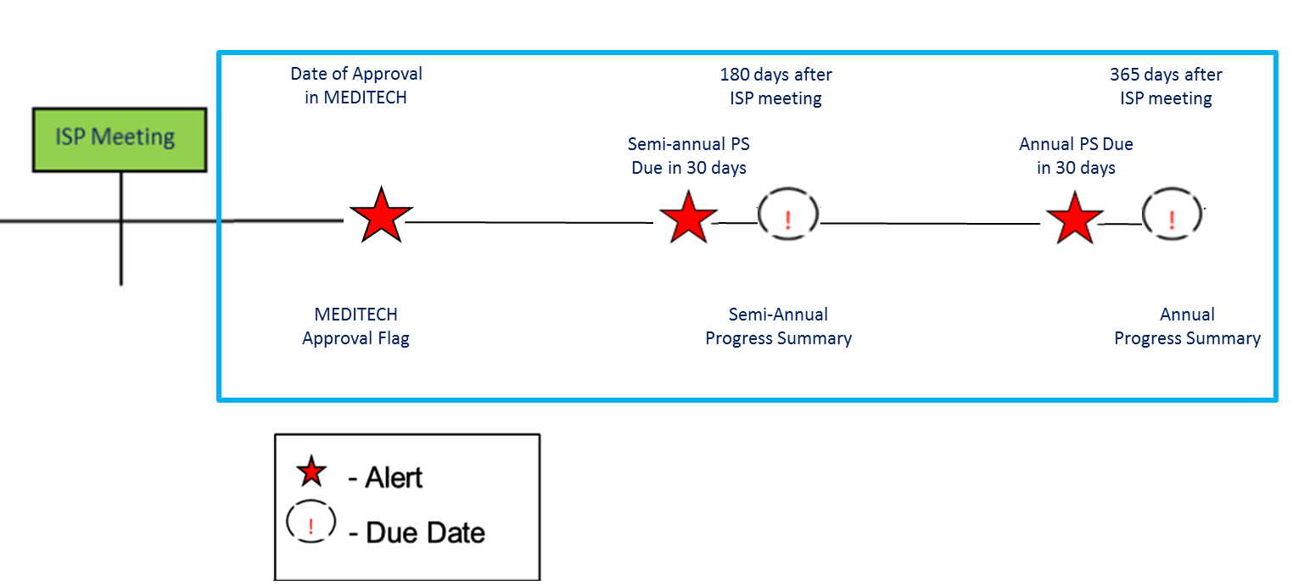
Timeline for Completion of Progress Summary
Semi-Annual
The default frequency for Progress Summary is semi-annual. The due dates for Progress Summaries are as follows:
Semi Annual Progress Summary - 180 days after ISP Meeting
Annual Progress Summary– 15 days prior to the next planned meeting date or the ISP Meeting Deadline
When the due date for an Progress Summary is within 30 days, Provider Data Entry Users will receive an alert indicating that they are able to complete the Progress Summaries.
15 days before
next Planned ISP meeting

Slide 7
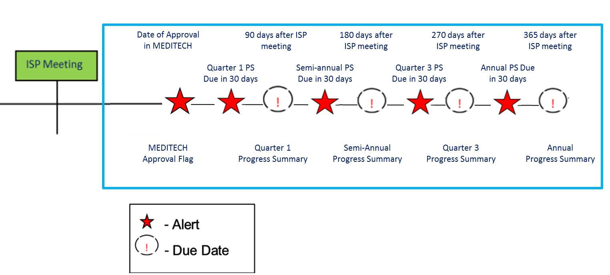
Timeline for Completion of Progress Summary
Quarterly
If the Service Coordinator selects the frequency of the Progress Summary as quarterly, the due dates for Progress Summary are as follows:
Quarter 1 – 90 days after ISP meeting
Semi-Annual – 180 days after ISP meeting
Quarter 3 – 270 days after ISP meeting
Annual –15 days prior to the next planned meeting date or the ISP Meeting Deadline
When the due date for an Progress Summary is within 30 days, Provider Data Entry Users will receive an alert indicating that they are able to complete the Progress Summaries.
15 days before next Planned ISP meeting

Slide 8
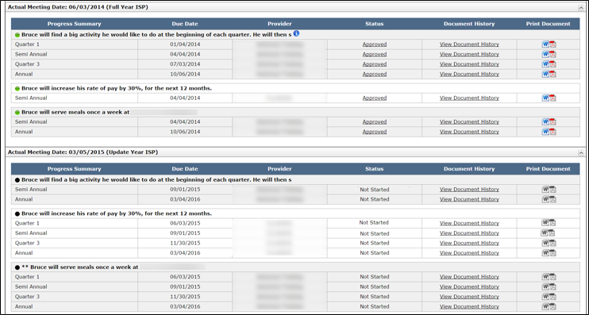
Timeline for Completion of Progress Summary
Due Dates
The due date for the annual Progress Summary is calculated differently from the other deadlines
Quarter 1 = Actual Meeting Date + 90 Days
Semi-Annual = Actual Meeting Date + 180 Days
Quarter 3 ISP = Actual Meeting Date + 270 Days
Annual = Next Planned Meeting Date (or ISP Meeting Deadline) – 15 Days

Slide 9
Progress Summary Roles and Responsibilities
Provider Roles and Responsibilities
Provider Data Entry User
Submit an Progress Summary for Internal Review
Revise an Progress Summary
Provider Supervisor
Review an Progress Summary
Return an Progress Summary for Internal Revision
Submit an Progress Summary to DDS Staff

Slide 10
Progress Summary Review Switchboard

Slide 11
Navigate to the PS Review Switchboard
There are two ways to navigate to the Progress Summary Review Switchboard.
Option 1
It is possible to navigate to the Progress Summary Review Switchboard from the Individual Dashboard.
Above the Individual Dashboard, click the third-level menu item, “Progress Summary.”

Slide 12
Navigate to the PS Review Switchboard
There are two ways to navigate to the Progress Summary Review Switchboard.
Option 2
Alternatively, it is possible to navigate to the Progress Summary Review Switchboard from the Individual Search.
View the new Progress Summary column and click the “View Progress Summary” link.

Slide 13
Progress Summary Review Switchboard
Progress Summary Review Switchboard
The Progress Summary Review Switchboard is composed of two sections.
1
Progress Summary Bar Graph
2
Progress Summary Details

Slide 14
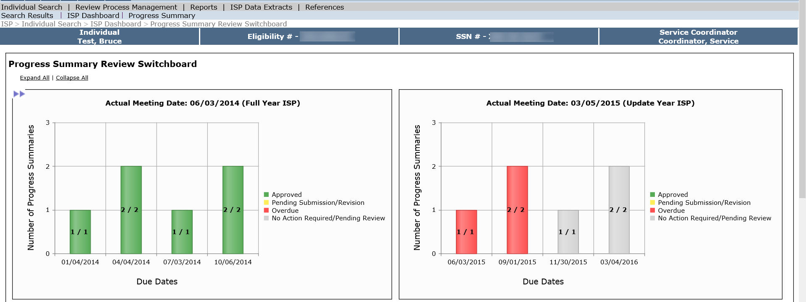
Features of the PS Review Switchboard
Progress Summary Bar Graph
This section contains information for both previous and current ISP.
The graph provides a visual of the status of all the Progress Summaries required in a given year.

Slide 15
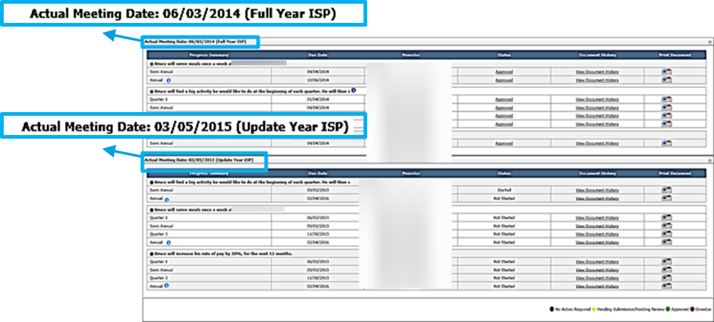
Features of the PS Review Switchboard
Progress Summary Details
Displays all Progress Summaries associated with the Actual Meeting Date for the two most recent years :
All Progress Summaries required for the prior year.
All Progress Summaries required for the current year – not just those that are approaching their due date.

Slide 16
Features of the PS Review Switchboard
Progress Summary Details
Progress Summary
The Progress Summary column displays which Progress Summary (e.g. quarter 1, annual).
Due Date
The Due Date column displays the due date for the Progress Summary.
Provider
The Provider column displays the Provider that is required to complete the Progress Summary.

Slide 17
Features of the PS Review Switchboard
Progress Summary Details
Status
To view or edit a Progress Summary, click the link in the Status column.

Slide 18
Features of the PS Review Switchboard
Progress Summary Details
Print Document
Click either the Word or PDF icon to print a Progress Summary.
Until the Service Coordinator approves the Progress Summary, it will print with a draft watermark.
Document History
To view the Document History of a Progress Summary, select the “View Document History” link in the Document History column.

Slide 19
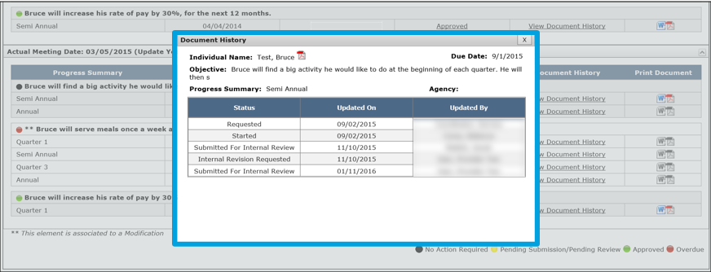
Features of the PS Review Switchboard
Progress Summary Details
Document History
Upon clicking “View Document History”, the Document History pop-up screen will display.

Slide 20
View / Print ISP Tab
Progress Summary Details
Historical Documents
All of the Progress Summaries completed prior to the two most recent plans are viewable in the Historical ISP Materials section.
To access Historical ISP Materials, click the “View / Print ISP” tab and then click the “View Historical ISP Materials” button.

Slide 21
View / Print ISP Tab
Progress Summary Details
Historical Documents
Historical Progress Summaries are located on the “Goals and Objectives” Tab.
Click the PDF icon next to the desired Progress Summary to view and print.

Slide 22
Scenario: Complete a Progress Summary

Slide 23
Scenario: Complete a Progress Summary
Description: Once the due date for an Progress Summary is within 30 days, Provider Data Entry Users will receive an alert indicating that they are able to complete and submit Progress Summaries. In order to submit a Progress Summary, Provider Data Entry Users need to submit the form to Provider Supervisors who need to review the document and determine if it is ready to submit to DDS. While both roles can work on these forms prior to 30 days before the due date, as long as the Service Coordinators has initiated the Progress Summary process, they cannot submit until 30 days prior.
Roles and Responsibilities:
Provider Data Entry User: Submit an Progress Summary for Internal Review
Provider Supervisor: Review an ISP Progress Summary; Submit an Progress Summary to DDS Staff
15 days before next Planned ISP meeting

Slide 24
Scenario: Complete a Progress Summary
Step 1
Data Entry User Receives Alert & Navigates to Form
Step 2
Data Entry User Completes Form and Submits for Internal Review
Step 3
Provider Supervisor Receives Alert & Navigates to Form
Step 4
Provider Supervisor Reviews &
Requests Revision
Step 5
Data Entry User Receives Alert & Navigates to Form
Step 6
Data Entry User Completes Form and Submits for Internal Review
Step 7
Provider Supervisor Accepts and Submits to DDS
Step 1: Data Entry User Receives Alert & Navigates to Form
Data Entry Users will receive an alert 30 days prior to the Progress Summary Due Date.
Click “Progress Summary due.”

Slide 25
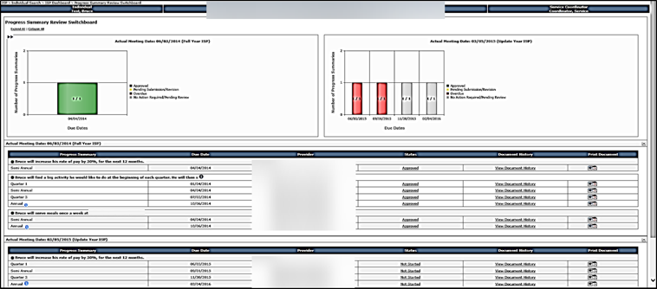
Scenario: Complete a Progress Summary
Step 1
Data Entry User Receives Alert & Navigates to Form
Step 2
Data Entry User Completes Form and Submits for Internal Review
Step 3
Provider Supervisor Receives Alert & Navigates to Form
Step 4
Provider Supervisor Reviews &
Requests Revision
Step 5
Data Entry User Receives Alert & Navigates to Form
Step 6
Data Entry User Completes Form and Submits for Internal Review
Step 7
Provider Supervisor Accepts and Submits to DDS
Step 1: Data Entry User Receives Alert & Navigates to Form
The system will redirect to the Progress Summary Review Switchboard.

Slide 26
Scenario: Complete a Progress Summary
Step 1
Data Entry User Receives Alert & Navigates to Form
Step 2
Data Entry User Completes Form and Submits for Internal Review
Step 3
Provider Supervisor Receives Alert & Navigates to Form
Step 4
Provider Supervisor Reviews &
Requests Revision
Step 5
Data Entry User Receives Alert & Navigates to Form
Step 6
Data Entry User Completes Form and Submits for Internal Review
Step 7
Provider Supervisor Accepts and Submits to DDS
Step 1: Data Entry User Receives Alert & Navigates to Form
Providers will have access to the switchboard at all times but will not be able to submit the forms until 30 days prior to the Progress Summary Due Date. This is to ensure that the information is recent / up to date.

Slide 27
Scenario: Complete a Progress Summary
Step 1
Data Entry User Receives Alert & Navigates to Form
Step 2
Data Entry User Completes Form and Submits for Internal Review
Step 3
Provider Supervisor Receives Alert & Navigates to Form
Step 4
Provider Supervisor Reviews &
Requests Revision
Step 5
Data Entry User Receives Alert & Navigates to Form
Step 6
Data Entry User Completes Form and Submits for Internal Review
Step 7
Provider Supervisor Accepts and Submits to DDS
Step 1: Data Entry User Receives Alert & Navigates to Form
Click on the “Not Started” link to begin the Progress Summary for an objective.

Slide 28
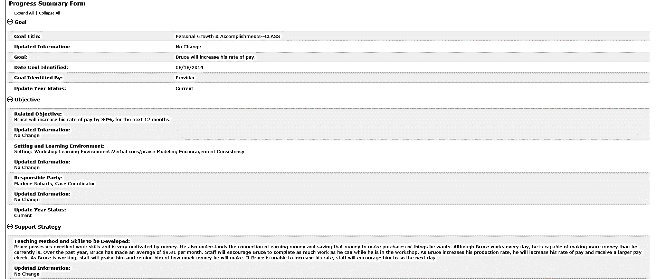
Scenario: Complete a Progress Summary
Step 1
Data Entry User Receives Alert & Navigates to Form
Step 2
Data Entry User Completes Form and Submits for Internal Review
Step 3
Provider Supervisor Receives Alert & Navigates to Form
Step 4
Provider Supervisor Reviews &
Requests Revision
Step 5
Data Entry User Receives Alert & Navigates to Form
Step 6
Data Entry User Completes Form and Submits for Internal Review
Step 7
Provider Supervisor Accepts and Submits to DDS
Step 1: Data Entry User Receives Alert & Navigates to Form
The system will display the Progress Summary. The “Goal”, “Objective” and “Support Strategy” for the identified objective are available for reference.

Slide 29
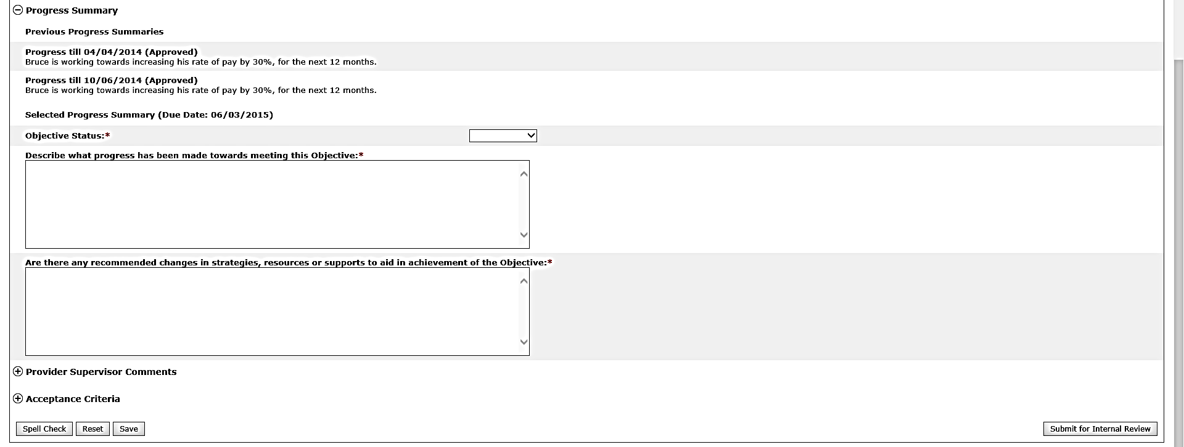
Scenario: Complete a Progress Summary
Step 1
Data Entry User Receives Alert & Navigates to Form
Step 2
Data Entry User Completes Form and Submits for Internal Review
Step 3
Provider Supervisor Receives Alert & Navigates to Form
Step 4
Provider Supervisor Reviews &
Requests Revision
Step 5
Data Entry User Receives Alert & Navigates to Form
Step 6
Data Entry User Completes Form and Submits for Internal Review
Step 7
Provider Supervisor Accepts and Submits to DDS
Step 2: Data Entry User Completes Form and Submits for Internal Review
Begin filling in the Progress Summary.

Slide 30
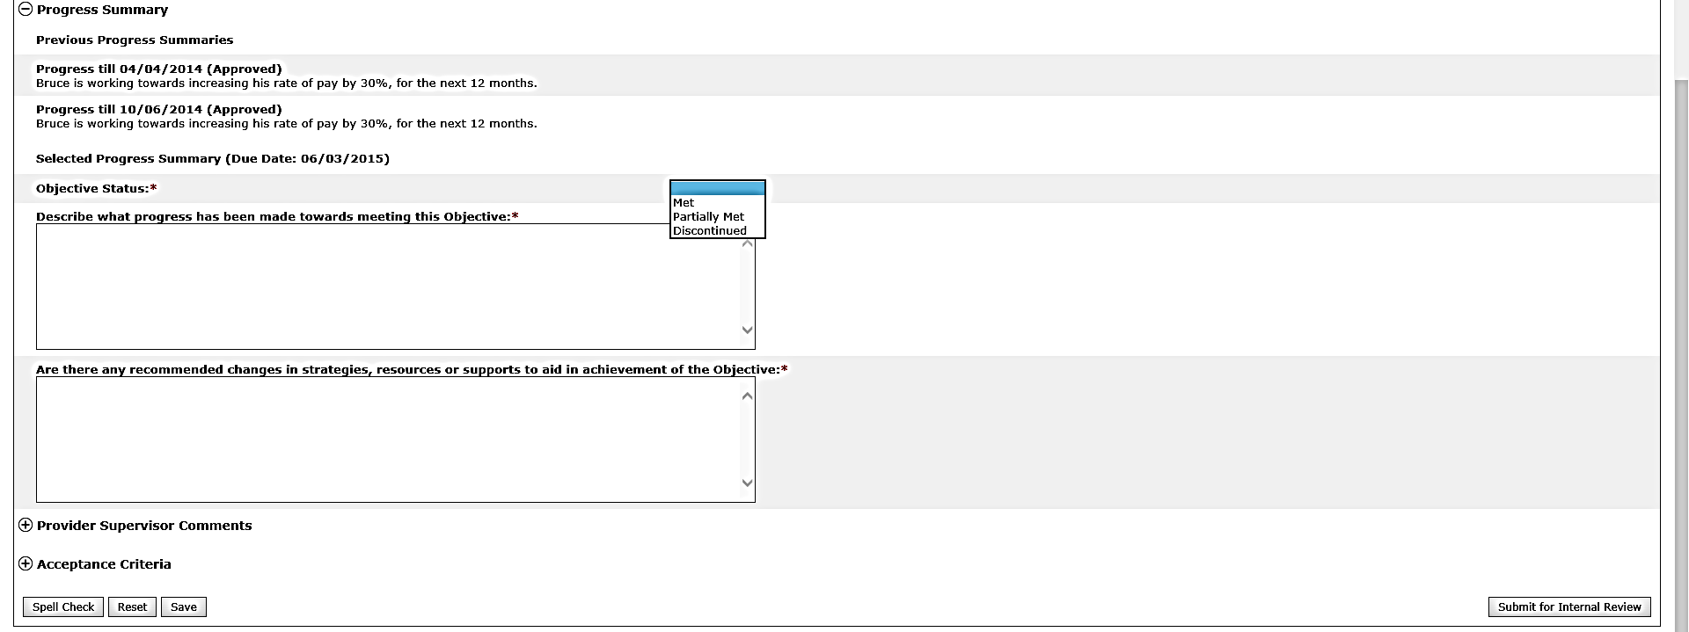
Scenario: Complete a Progress Summary
Step 1
Data Entry User Receives Alert & Navigates to Form
Step 2
Data Entry User Completes Form and Submits for Internal Review
Step 3
Provider Supervisor Receives Alert & Navigates to Form
Step 4
Provider Supervisor Reviews &
Requests Revision
Step 5
Data Entry User Receives Alert & Navigates to Form
Step 6
Data Entry User Completes Form and Submits for Internal Review
Step 7
Provider Supervisor Accepts and Submits to DDS
Step 2: Data Entry User Completes Form and Submits for Internal Review
Select the status of the objective from the drop-down list.

Slide 31
Scenario: Complete a Progress Summary
Step 1
Data Entry User Receives Alert & Navigates to Form
Step 2
Data Entry User Completes Form and Submits for Internal Review
Step 3
Provider Supervisor Receives Alert & Navigates to Form
Step 4
Provider Supervisor Reviews &
Requests Revision
Step 5
Data Entry User Receives Alert & Navigates to Form
Step 6
Data Entry User Completes Form and Submits for Internal Review
Step 7
Provider Supervisor Accepts and Submits to DDS
Step 2: Data Entry User Completes Form and Submits for Internal Review
The table below explains the Progress Summary status types.
Objective Status | Description
Met | Use to describe an objective that has been achieved by the individual
Partially Met | Use to describe an objective that has been partially completed but continues to remain open
Discontinued | Use to identify an objective that is no longer relevant for the individual or has ended.

Slide 32
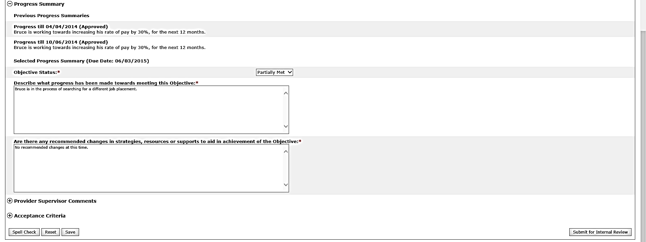
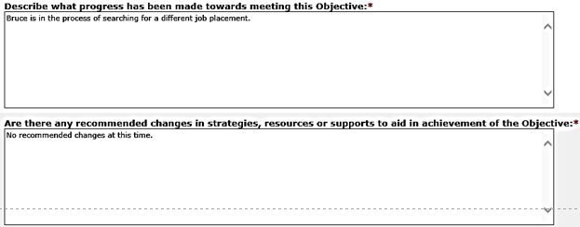
Scenario: Complete a Progress Summary
Step 1
Data Entry User Receives Alert & Navigates to Form
Step 2
Data Entry User Completes Form and Submits for Internal Review
Step 3
Provider Supervisor Receives Alert & Navigates to Form
Step 4
Provider Supervisor Reviews &
Requests Revision
Step 5
Data Entry User Receives Alert & Navigates to Form
Step 6
Data Entry User Completes Form and Submits for Internal Review
Step 7
Provider Supervisor Accepts and Submits to DDS
Step 2: Data Entry User Completes Form and Submits for Internal Review
Respond to the required questions by entering comments into the text boxes.

Slide 33
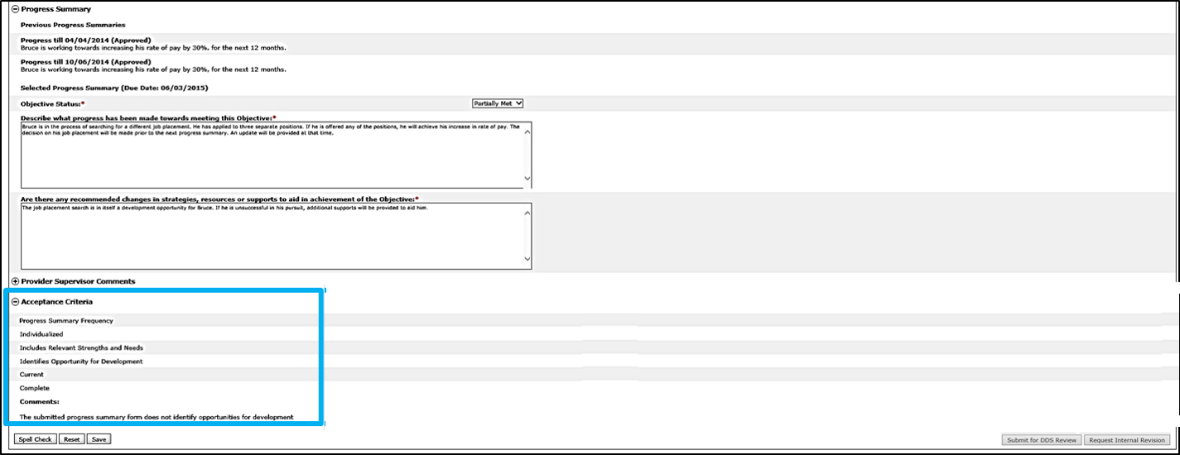
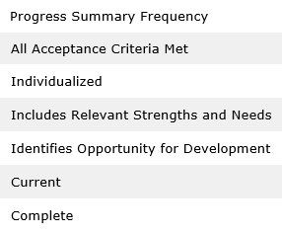
Scenario: Complete a Progress Summary
Step 1
Data Entry User Receives Alert & Navigates to Form
Step 2
Data Entry User Completes Form and Submits for Internal Review
Step 3
Provider Supervisor Receives Alert & Navigates to Form
Step 4
Provider Supervisor Reviews &
Requests Revision
Step 5
Data Entry User Receives Alert & Navigates to Form
Step 6
Data Entry User Completes Form and Submits for Internal Review
Step 7
Provider Supervisor Accepts and Submits to DDS
Step 2: Data Entry User Completes Form and Submits for Internal Review
If desired, refer to the Acceptance Criteria section.

Slide 34
Scenario: Complete a Progress Summary
Step 1
Data Entry User Receives Alert & Navigates to Form
Step 2
Data Entry User Completes Form and Submits for Internal Review
Step 3
Provider Supervisor Receives Alert & Navigates to Form
Step 4
Provider Supervisor Reviews &
Requests Revision
Step 5
Data Entry User Receives Alert & Navigates to Form
Step 6
Data Entry User Completes Form and Submits for Internal Review
Step 7
Provider Supervisor Accepts and Submits to DDS
Step 2: Data Entry User Completes Form and Submits for Internal Review
Once completed, click “Submit for Internal Review.”

Slide 35
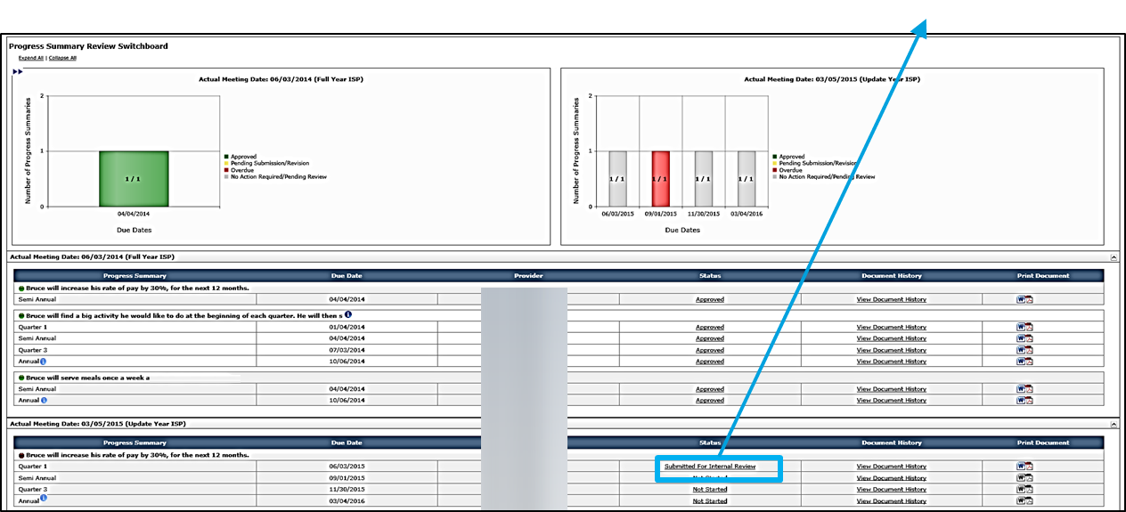
Scenario: Complete a Progress Summary
Step 1
Data Entry User Receives Alert & Navigates to Form
Step 2
Data Entry User Completes Form and Submits for Internal Review
Step 3
Provider Supervisor Receives Alert & Navigates to Form
Step 4
Provider Supervisor Reviews &
Requests Revision
Step 5
Data Entry User Receives Alert & Navigates to Form
Step 6
Data Entry User Completes Form and Submits for Internal Review
Step 7
Provider Supervisor Accepts and Submits to DDS
Step 2: Data Entry User Completes Form and Submits for Internal Review
The system will navigate back to the Progress Summary Review Switchboard. The status of the Progress Summary will change to “Submitted for Internal Review.”

Slide 36
Scenario: Complete a Progress Summary
Step 1
Data Entry User Receives Alert & Navigates to Form
Step 2
Data Entry User Completes Form and Submits for Internal Review
Step 3
Provider Supervisor Receives Alert & Navigates to Form
Step 4
Provider Supervisor Reviews &
Requests Revision
Step 5
Data Entry User Receives Alert & Navigates to Form
Step 6
Data Entry User Completes Form and Submits for Internal Review
Step 7
Provider Supervisor Accepts and Submits to DDS
Step 3: Provider Supervisor Receives Submission Alert and Navigates to Form
Once the Progress Summary is submitted for internal review, Provider Supervisors will receive an alert.
Click “Progress Summaries Submitted for Internal Review.”

Slide 37
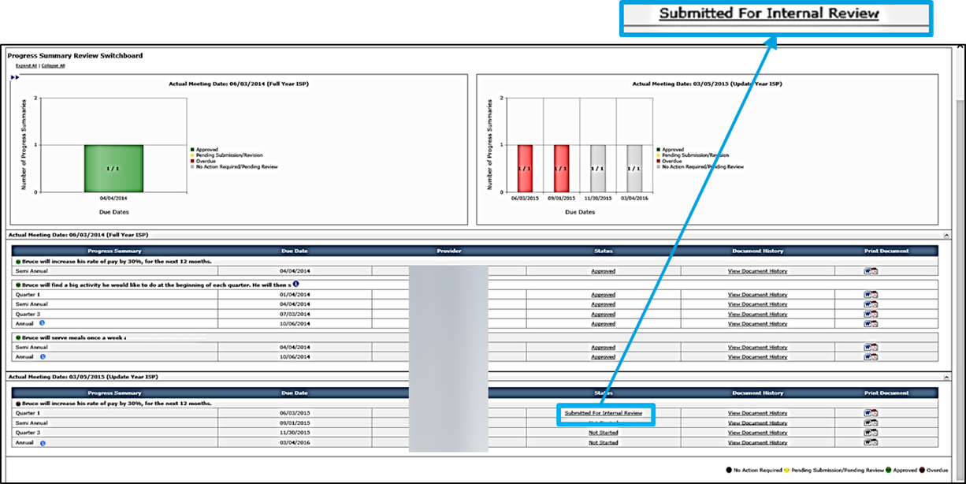
Scenario: Complete a Progress Summary
Step 1
Data Entry User Receives Alert & Navigates to Form
Step 2
Data Entry User Completes Form and Submits for Internal Review
Step 3
Provider Supervisor Receives Alert & Navigates to Form
Step 4
Provider Supervisor Reviews &
Requests Revision
Step 5
Data Entry User Receives Alert & Navigates to Form
Step 6
Data Entry User Completes Form and Submits for Internal Review
Step 7
Provider Supervisor Accepts and Submits to DDS
Step 3: Provider Supervisor Receives Submission Alert and Navigates to Form
The system will redirect to the Progress Summary Review Switchboard. Click “Submitted for Internal Review.”

Slide 38
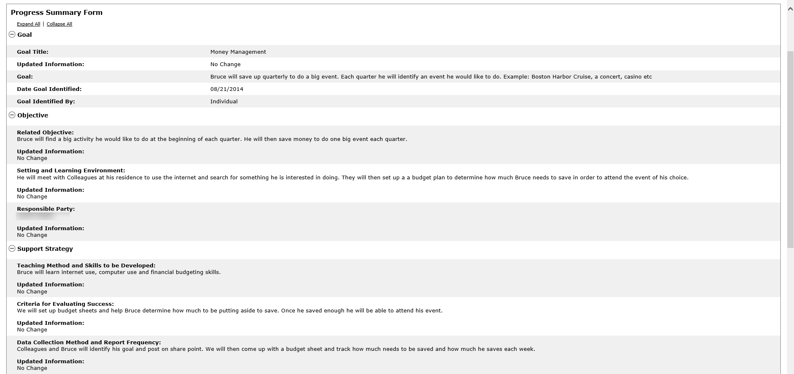
Scenario: Complete a Progress Summary
Step 1
Data Entry User Receives Alert & Navigates to Form
Step 2
Data Entry User Completes Form and Submits for Internal Review
Step 3
Provider Supervisor Receives Alert & Navigates to Form
Step 4
Provider Supervisor Reviews &
Requests Revision
Step 5
Data Entry User Receives Alert & Navigates to Form
Step 6
Data Entry User Completes Form and Submits for Internal Review
Step 7
Provider Supervisor Accepts and Submits to DDS
Step 3: Provider Supervisor Receives Submission Alert
The system will display the Progress Summary. The “Goal”, “Objective” and “Support Strategy” for the identified objective are available for reference.

Slide 39
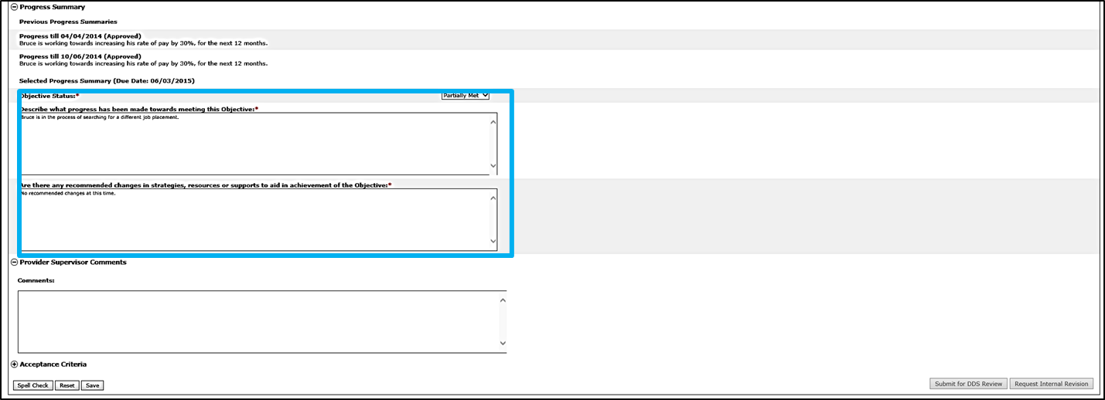
Scenario: Complete a Progress Summary
Step 1
Data Entry User Receives Alert & Navigates to Form
Step 2
Data Entry User Completes Form and Submits for Internal Review
Step 3
Provider Supervisor Receives Alert & Navigates to Form
Step 4
Provider Supervisor Reviews &
Requests Revision
Step 5
Data Entry User Receives Alert & Navigates to Form
Step 6
Data Entry User Completes Form and Submits for Internal Review
Step 7
Provider Supervisor Accepts and Submits to DDS
Step 4: Provider Supervisor to Review and Request Revision
Review the content that the Data Entry User has written.

Slide 40
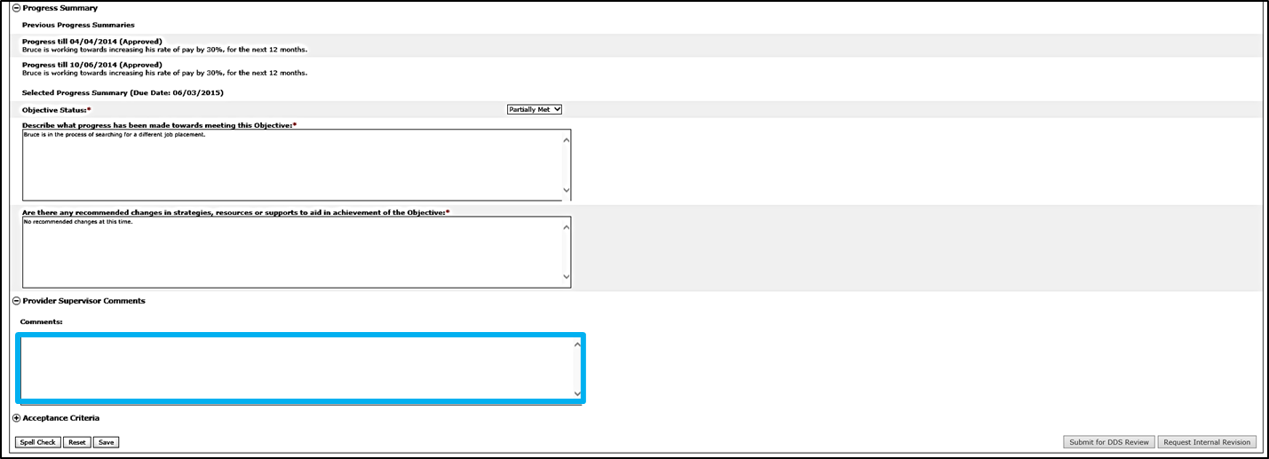
Scenario: Complete a Progress Summary
Step 1
Data Entry User Receives Alert & Navigates to Form
Step 2
Data Entry User Completes Form and Submits for Internal Review
Step 3
Provider Supervisor Receives Alert & Navigates to Form
Step 4
Provider Supervisor Reviews &
Requests Revision
Step 5
Data Entry User Receives Alert & Navigates to Form
Step 6
Data Entry User Completes Form and Submits for Internal Review
Step 7
Provider Supervisor Accepts and Submits to DDS
Step 4: Provider Supervisor to Review and Request Revision
Provider Supervisors have the ability to request internal revisions from Data Entry Users. If any changes are required or information needs to be added, insert text in the Provider Supervisor Comments field to explain the required revisions.
NOTE: Provider Supervisors now also have the ability to request internal revisions from Data Entry Users on Objectives and Assessments

Slide 41
Scenario: Complete a Progress Summary
Step 1
Data Entry User Receives Alert & Navigates to Form
Step 2
Data Entry User Completes Form and Submits for Internal Review
Step 3
Provider Supervisor Receives Alert & Navigates to Form
Step 4
Provider Supervisor Reviews &
Requests Revision
Step 5
Data Entry User Receives Alert & Navigates to Form
Step 6
Data Entry User Completes Form and Submits for Internal Review
Step 7
Provider Supervisor Accepts and Submits to DDS
Step 4: Provider Supervisor to Review and Request Revision
Click “Request Internal Revision.” This action will send an alert to the Data Entry User that a revision was requested.

Slide 42
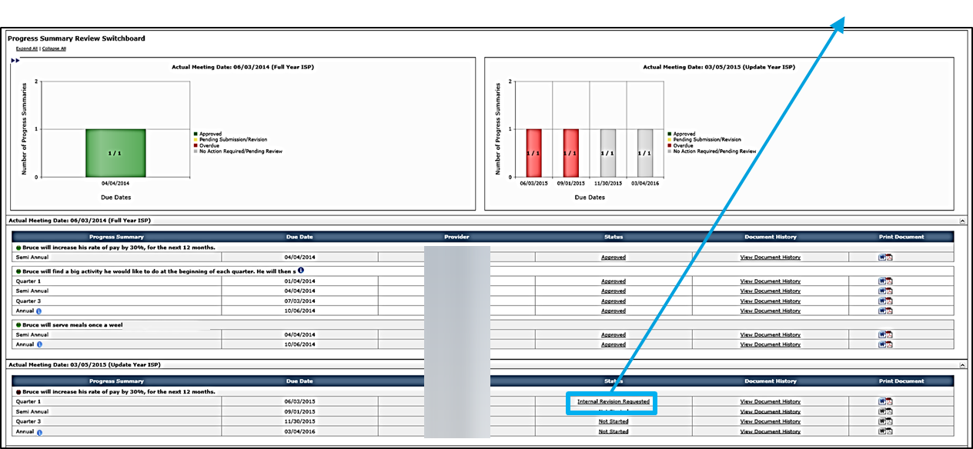
Scenario: Complete a Progress Summary
Step 1
Data Entry User Receives Alert & Navigates to Form
Step 2
Data Entry User Completes Form and Submits for Internal Review
Step 3
Provider Supervisor Receives Alert & Navigates to Form
Step 4
Provider Supervisor Reviews &
Requests Revision
Step 5
Data Entry User Receives Alert & Navigates to Form
Step 6
Data Entry User Completes Form and Submits for Internal Review
Step 7
Provider Supervisor Accepts and Submits to DDS
Step 4: Provider Supervisor to Review and Request Revision
The system will return to the Progress Summary Review Switchboard. The status of the Progress Summary will change to “Internal Revision Requested.”

Slide 43
Scenario: Complete a Progress Summary
Step 1
Data Entry User Receives Alert & Navigates to Form
Step 2
Data Entry User Completes Form and Submits for Internal Review
Step 3
Provider Supervisor Receives Alert & Navigates to Form
Step 4
Provider Supervisor Reviews &
Requests Revision
Step 5
Data Entry User Receives Alert & Navigates to Form
Step 6
Data Entry User Completes Form and Submits for Internal Review
Step 7
Provider Supervisor Accepts and Submits to DDS
Step 5: Data Entry User Receives Alert and Navigates to Form
Data Entry Users will receive an alert.
Click “Revisions Requested for proposed Progress Summaries.”

Slide 44
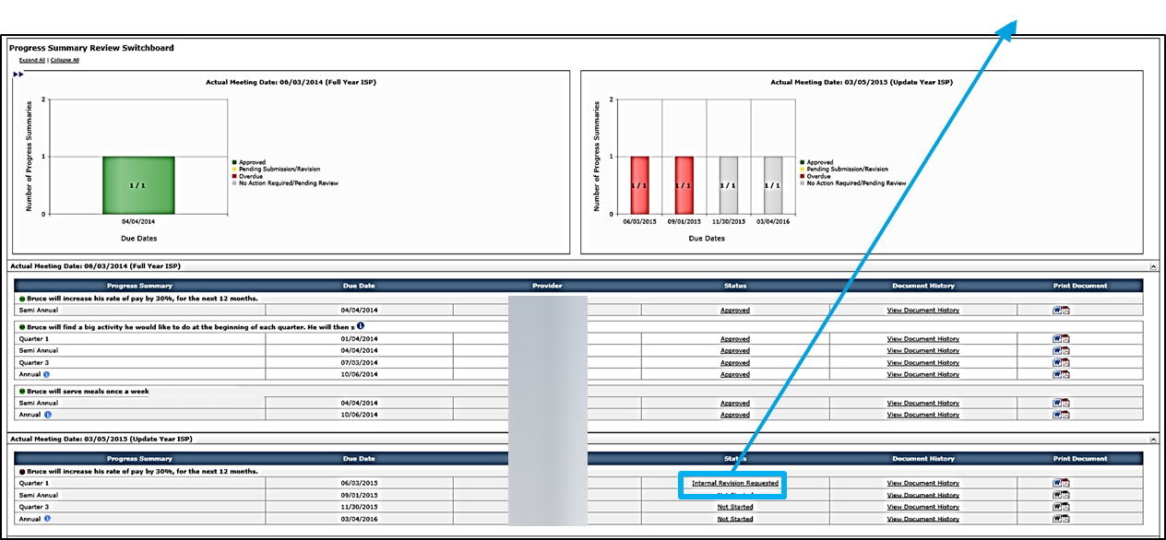
Scenario: Complete a Progress Summary
Step 1
Data Entry User Receives Alert & Navigates to Form
Step 2
Data Entry User Completes Form and Submits for Internal Review
Step 3
Provider Supervisor Receives Alert & Navigates to Form
Step 4
Provider Supervisor Reviews &
Requests Revision
Step 5
Data Entry User Receives Alert & Navigates to Form
Step 6
Data Entry User Completes Form and Submits for Internal Review
Step 7
Provider Supervisor Accepts and Submits to DDS
Step 5: Data Entry User Receives Alert and Navigates to Form
The system will redirect to the Progress Summary Review Switchboard.
Click “Internal Revision Requested.”

Slide 45
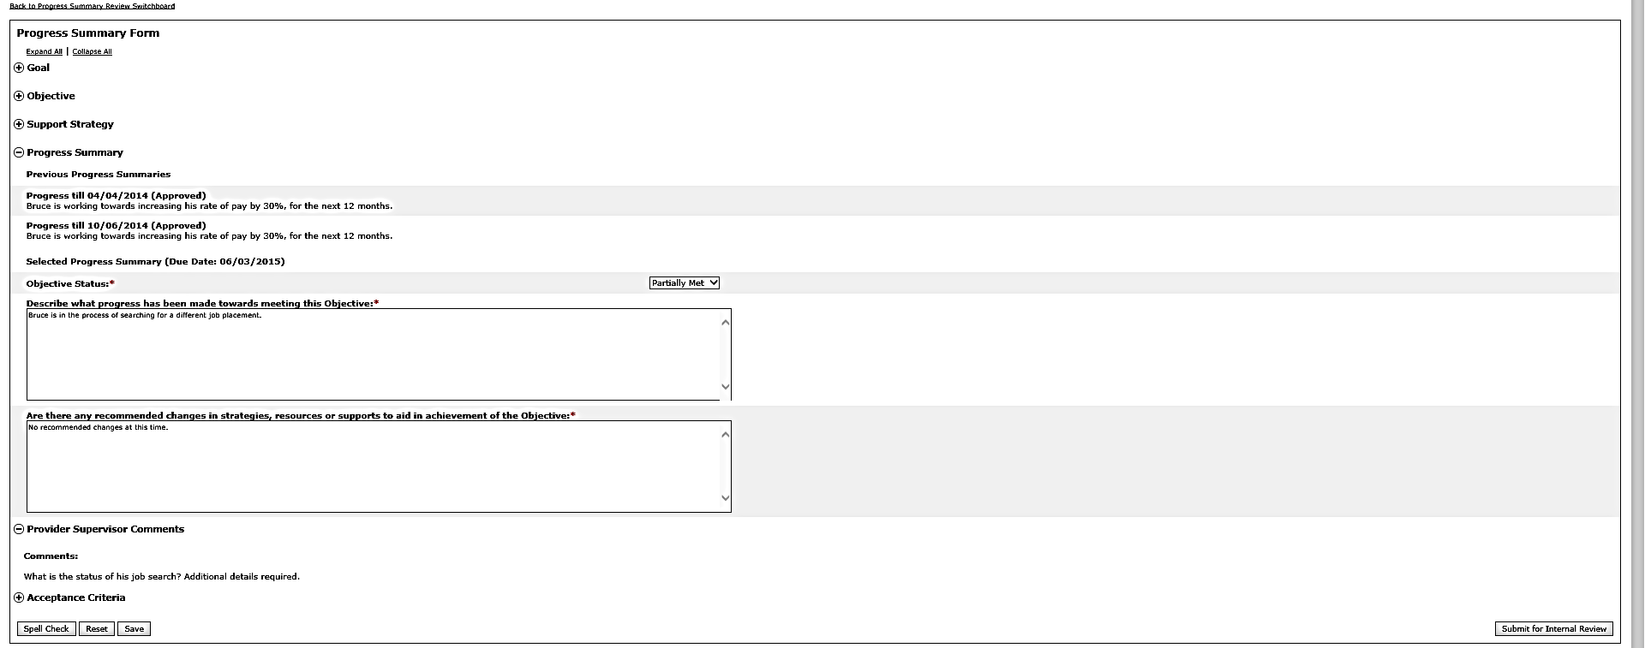
Scenario: Complete a Progress Summary
Step 1
Data Entry User Receives Alert & Navigates to Form
Step 2
Data Entry User Completes Form and Submits for Internal Review
Step 3
Provider Supervisor Receives Alert & Navigates to Form
Step 4
Provider Supervisor Reviews &
Requests Revision
Step 5
Data Entry User Receives Alert & Navigates to Form
Step 6
Data Entry User Completes Form and Submits for Internal Review
Step 7
Provider Supervisor Accepts and Submits to DDS
Step 6: Data Entry User Completes Form and Submits for Internal Review
The system will display the Progress Summary. Review the Provider Supervisor Comments.
Submit for internal review

Slide 46
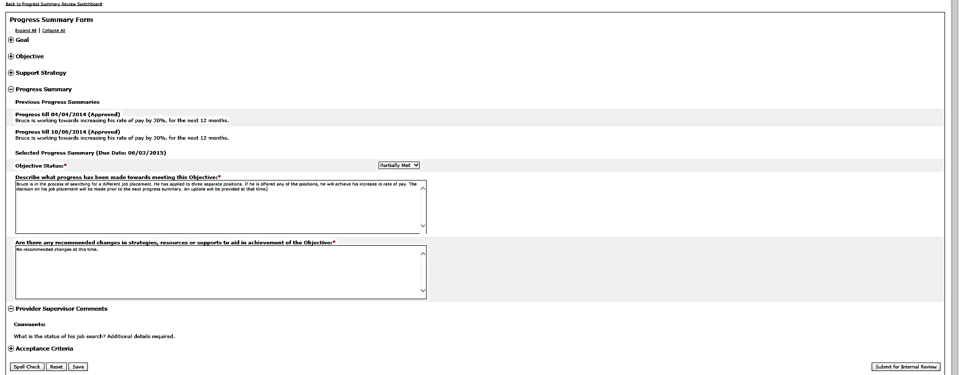
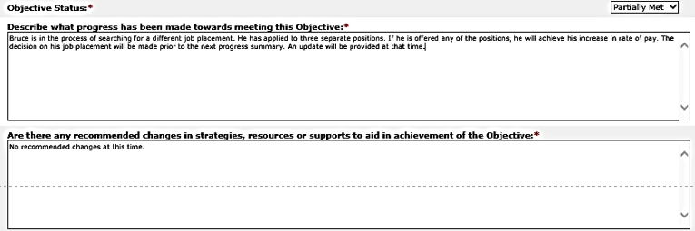
Scenario: Complete a Progress Summary
Step 1
Data Entry User Receives Alert & Navigates to Form
Step 2
Data Entry User Completes Form and Submits for Internal Review
Step 3
Provider Supervisor Receives Alert & Navigates to Form
Step 4
Provider Supervisor Reviews &
Requests Revision
Step 5
Data Entry User Receives Alert & Navigates to Form
Step 6
Data Entry User Completes Form and Submits for Internal Review
Step 7
Provider Supervisor Accepts and Submits to DDS
Step 6: Data Entry User Completes Form and Submits for Internal Review
Revise the Progress Summary to account for the comments made by the Provider Supervisor.

Slide 47
Scenario: Complete a Progress Summary
Step 1
Data Entry User Receives Alert & Navigates to Form
Step 2
Data Entry User Completes Form and Submits for Internal Review
Step 3
Provider Supervisor Receives Alert & Navigates to Form
Step 4
Provider Supervisor Reviews &
Requests Revision
Step 5
Data Entry User Receives Alert & Navigates to Form
Step 6
Data Entry User Completes Form and Submits for Internal Review
Step 7
Provider Supervisor Accepts and Submits to DDS
Step 6: Data Entry User Completes Form and Submits for Internal Review
Click “Submit for Internal Review.”

Slide 48
Scenario: Complete a Progress Summary
Step 1
Data Entry User Receives Alert & Navigates to Form
Step 2
Data Entry User Completes Form and Submits for Internal Review
Step 3
Provider Supervisor Receives Alert & Navigates to Form
Step 4
Provider Supervisor Reviews &
Requests Revision
Step 5
Data Entry User Receives Alert & Navigates to Form
Step 6
Data Entry User Completes Form and Submits for Internal Review
Step 7
Provider Supervisor Accepts and Submits to DDS
Step 7: Provider Supervisor Accepts and Submits to DDS
Provider Supervisor receives an alert indicating that the Progress Summary has been submitted for internal review.
Click “Progress Summaries Submitted for Internal Review.”

Slide 49
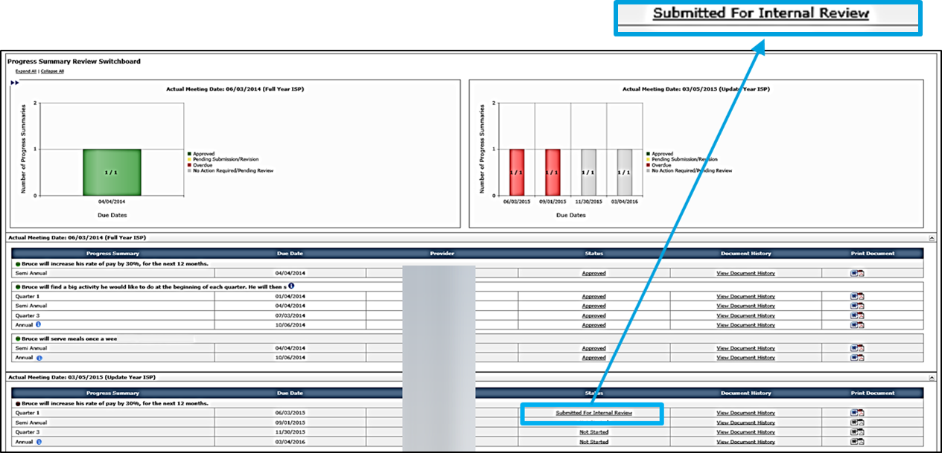
Scenario: Complete a Progress Summary
Step 1
Data Entry User Receives Alert & Navigates to Form
Step 2
Data Entry User Completes Form and Submits for Internal Review
Step 3
Provider Supervisor Receives Alert & Navigates to Form
Step 4
Provider Supervisor Reviews &
Requests Revision
Step 5
Data Entry User Receives Alert & Navigates to Form
Step 6
Data Entry User Completes Form and Submits for Internal Review
Step 7
Provider Supervisor Accepts and Submits to DDS
Step 7: Provider Supervisor Accepts and Submits to DDS
The system redirects to the Progress Summary Review Switchboard. Click “Submitted for Internal Review.”

Slide 50
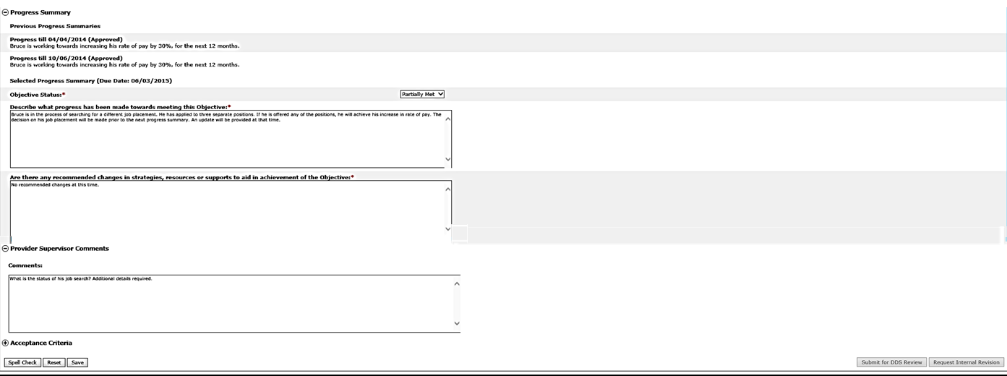
Scenario: Complete a Progress Summary
Step 1
Data Entry User Receives Alert & Navigates to Form
Step 2
Data Entry User Completes Form and Submits for Internal Review
Step 3
Provider Supervisor Receives Alert & Navigates to Form
Step 4
Provider Supervisor Reviews &
Requests Revision
Step 5
Data Entry User Receives Alert & Navigates to Form
Step 6
Data Entry User Completes Form and Submits for Internal Review
Step 7
Provider Supervisor Accepts and Submits to DDS
Step 7: Provider Supervisor Accepts and Submits to DDS
For your reference, the Progress Summary displays previous Progress Summaries completed for this objective associated to the same ISP year as well as the details for the selected Objective.

Slide 51
Scenario: Complete a Progress Summary
Step 1
Data Entry User Receives Alert & Navigates to Form
Step 2
Data Entry User Completes Form and Submits for Internal Review
Step 3
Provider Supervisor Receives Alert & Navigates to Form
Step 4
Provider Supervisor Reviews &
Requests Revision
Step 5
Data Entry User Receives Alert & Navigates to Form
Step 6
Data Entry User Completes Form and Submits for Internal Review
Step 7
Provider Supervisor Accepts and Submits to DDS
Step 7: Provider Supervisor Accepts and Submits to DDS
Review the content that the Provider Data Entry User has written.

Slide 52
Scenario: Complete a Progress Summary
Step 1
Data Entry User Receives Alert & Navigates to Form
Step 2
Data Entry User Completes Form and Submits for Internal Review
Step 3
Provider Supervisor Receives Alert & Navigates to Form
Step 4
Provider Supervisor Reviews &
Requests Revision
Step 5
Data Entry User Receives Alert & Navigates to Form
Step 6
Data Entry User Completes Form and Submits for Internal Review
Step 7
Provider Supervisor Accepts and Submits to DDS
Step 7: Provider Supervisor Accepts and Submits to DDS
If the Provider Supervisor decides to submit the Progress Summary to DDS, there is no action required in the Provider Supervisor Comments textbox. Do note, however, that the comments are not visible to DDS.

Slide 53
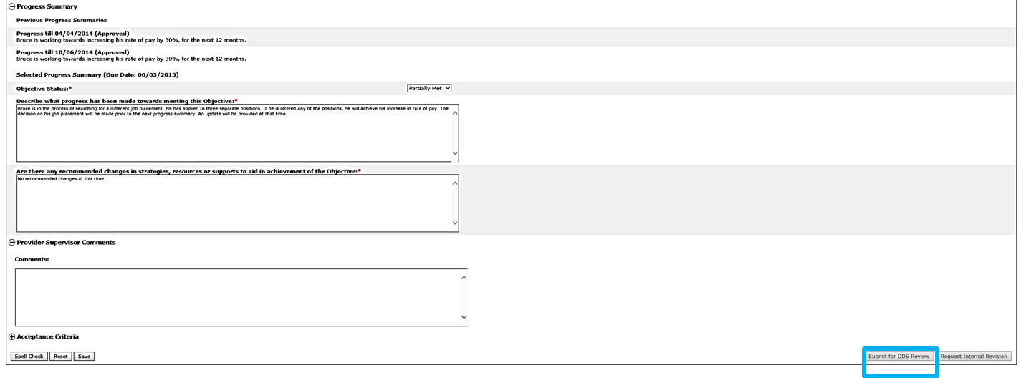
Scenario: Complete a Progress Summary
Step 1
Data Entry User Receives Alert & Navigates to Form
Step 2
Data Entry User Completes Form and Submits for Internal Review
Step 3
Provider Supervisor Receives Alert & Navigates to Form
Step 4
Provider Supervisor Reviews &
Requests Revision
Step 5
Data Entry User Receives Alert & Navigates to Form
Step 6
Data Entry User Completes Form and Submits for Internal Review
Step 7
Provider Supervisor Accepts and Submits to DDS
Step 7: Provider Supervisor Accepts and Submits to DDS
Click “Submit for DDS Review.”

Slide 54
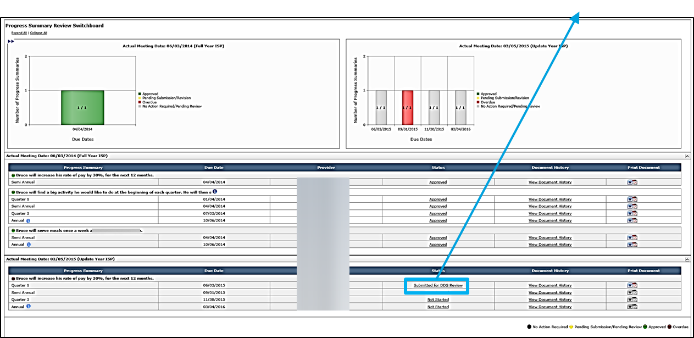
Scenario: Complete a Progress Summary
Step 1
Data Entry User Receives Alert & Navigates to Form
Step 2
Data Entry User Completes Form and Submits for Internal Review
Step 3
Provider Supervisor Receives Alert & Navigates to Form
Step 4
Provider Supervisor Reviews &
Requests Revision
Step 5
Data Entry User Receives Alert & Navigates to Form
Step 6
Data Entry User Completes Form and Submits for Internal Review
Step 7
Provider Supervisor Accepts and Submits to DDS
Step 7: Provider Supervisor Accepts and Submits to DDS
The system will redirect to the Progress Summary Review Switchboard. The status of the Progress Summary will change to “Submitted for DDS Review.”

Slide 55
Next Steps and Notes
Next Steps
Provider Data Entry Users and Provider Supervisors should continue tracking progress of the Objective and Support Strategies. They may also begin entering data into upcoming Progress Summaries, but will not be able to submit until 30 days prior to the due date.
Service Coordinators will be responsible for reviewing the Progress Summary. They will have the options to approve or request revision to the Progress Summary based on acceptance criteria.
Provider Data Entry Users and Provider Supervisors can monitor the individual’s Progress Summary Review Switchboard to view the status of the Progress Summary.
Alerts
Provider Data Entry Users and Provider Supervisors will receive an alert if the Service Coordinator has approved a submitted Progress Summary.
Provider Data Entry Users and Provider Supervisors will receive an alert if the Service Coordinator requests revision of proposed Progress Summaries.

Slide 56
Key Considerations
Availability of Progress Summary
The availability of Progress Summaries in the system is the responsibility of the Service Coordinator. The Progress Summary will only display in the system after the Service Coordinator has marked the objectives as included in the ISP. If a Progress Summary is not yet available to you, please contact the Service Coordinator.
Change of Progress Summary Frequency
The Service Coordinator has the ability to change the frequency of Progress Summaries for an objective, after consulting with the provider staff. If the Service Coordinator changes the frequency from semi-annual to quarterly, the Provider Data Entry will now be required to complete four Progress Summaries rather than two.
Progress Summaries for Ended Services:
If a service has ended prior to the ISP meeting, and a Progress Summary has not yet been completed, the Progress Summary must be completed off-line on paper. The ending of a service removes the ability for the provider to enter this information in HCSIS. However, the Progress Summary is still required for the annual ISP. We will address this item in a future release.

Slide 57
Scenario: Revise an Progress Summary

Slide 58
Scenario: Revise a Progress Summary
Description: Once DDS reviews and requests revision of a Progress Summary, Providers are required to make revisions and resubmit the form to DDS for review.
Roles and Responsibilities:
Provider Data Entry User: Submit a Progress Summary for Internal Review
Provider Supervisor: Review a Progress Summary; Submit an Progress Summary to DDS Staff
15 days before next Planned ISP meeting

Slide 59
Scenario: Revise a Progress Summary
Step 1
Data Entry User Receives Alert & Navigates to Form
Step 2
Data Entry User Revises and Submits for Internal Review
Step 3
Provider Supervisor Receives Alert & Navigates to Form
Step 4
Provider Supervisor Reviews and Submits to DDS
Step 1: Data Entry User Receives Alert and Navigates to Progress Summary
Provider Data Entry Users and Provider Supervisors will receive an alert indicating that DDS has returned a Progress Summary for revision.
Click “Revisions requested for proposed Progress Summaries.”

Slide 60
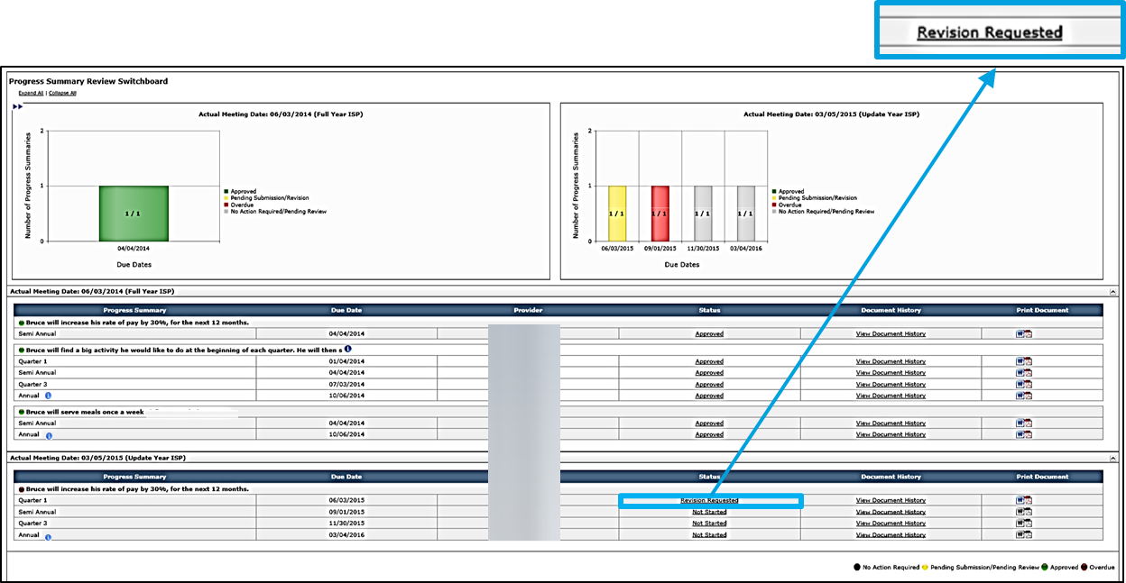
Scenario: Revise a Progress Summary
Step 1
Data Entry User Receives Alert & Navigates to Form
Step 2
Data Entry User Revises and Submits for Internal Review
Step 3
Provider Supervisor Receives Alert & Navigates to Form
Step 4
Provider Supervisor Reviews and Submits to DDS
Step 1: Data Entry User Receives Alert and Navigates to Progress Summary
The system redirects to the Progress Summary Review Switchboard. Click “Revision Requested.”

Slide 61
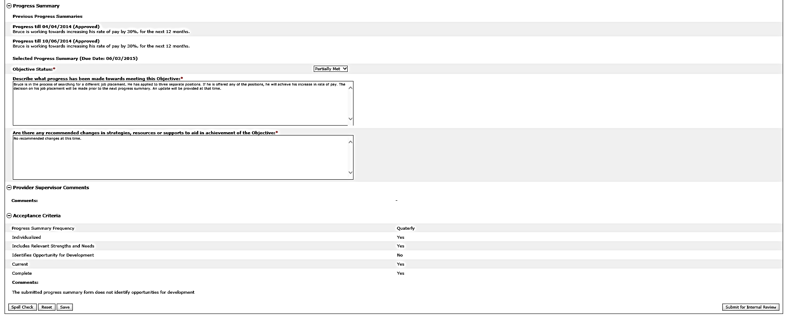
Scenario: Revise a Progress Summary
Step 1
Data Entry User Receives Alert & Navigates to Form
Step 2
Data Entry User Revises and Submits for Internal Review
Step 3
Provider Supervisor Receives Alert & Navigates to Form
Step 4
Provider Supervisor Reviews and Submits to DDS
Step 2: Data Entry User Revises the Form and Submits It for Internal Review
The system will display the Progress Summary Form. By default all fields are expanded. Review the Acceptance Criteria section and any comments entered by the SC to identify the requested revisions.

Slide 62
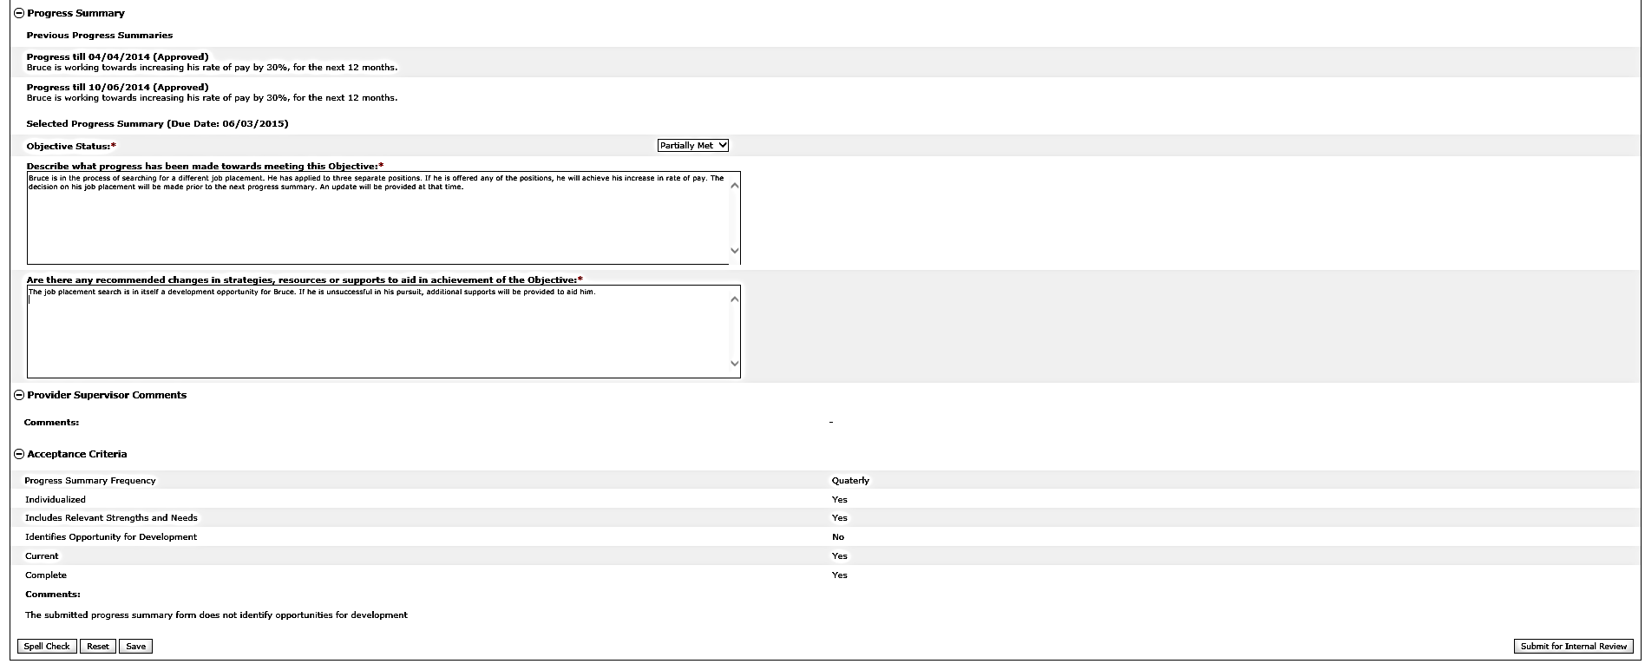
Scenario: Revise a Progress Summary
Step 1
Data Entry User Receives Alert & Navigates to Form
Step 2
Data Entry User Revises and Submits for Internal Review
Step 3
Provider Supervisor Receives Alert & Navigates to Form
Step 4
Provider Supervisor Reviews and Submits to DDS
Step 2: Data Entry User Revises the Form and Submits It for Internal Review
Revise the Progress Summary to incorporate the suggested revisions.

Slide 63
Scenario: Revise a Progress Summary
Step 1
Data Entry User Receives Alert & Navigates to Form
Step 2
Data Entry User Revises and Submits for Internal Review
Step 3
Provider Supervisor Receives Alert & Navigates to Form
Step 4
Provider Supervisor Reviews and Submits to DDS
Step 2: Data Entry User Revises the Form and Submits It for Internal Review
Click “Submit for Internal Review.”

Slide 64
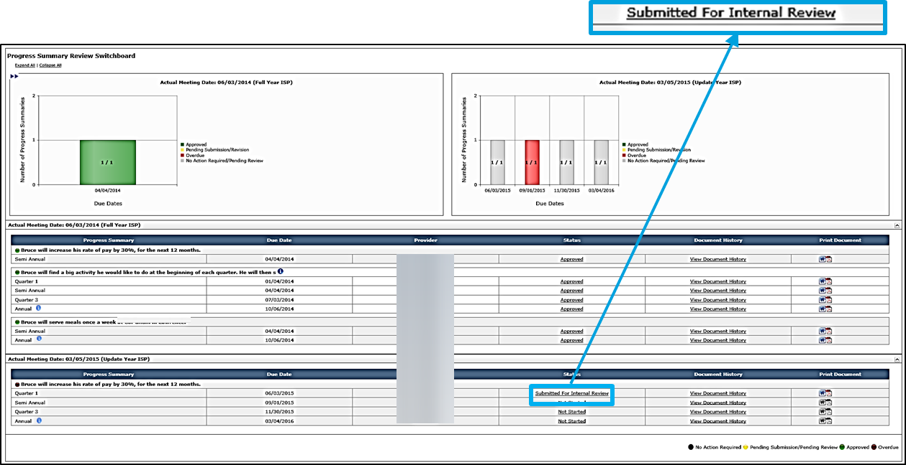
Scenario: Revise a Progress Summary
Step 1
Data Entry User Receives Alert & Navigates to Form
Step 2
Data Entry User Revises and Submits for Internal Review
Step 3
Provider Supervisor Receives Alert & Navigates to Form
Step 4
Provider Supervisor Reviews and Submits to DDS
Step 2: Data Entry User Revises the Form and Submits It for Internal Review
The system will redirect to the Progress Summary Review Switchboard. The status of the Progress Summary will change to “Submitted for Internal Review.”

Slide 65
Scenario: Revise a Progress Summary
Step 1
Data Entry User Receives Alert & Navigates to Form
Step 2
Data Entry User Revises and Submits for Internal Review
Step 3
Provider Supervisor Receives Alert & Navigates to Form
Step 4
Provider Supervisor Reviews and Submits to DDS
Step 3: Provider Supervisor Receives Submission Alert and Navigates to Form
Provider Supervisor receives an alert when the Data Entry User submits a Progress Summary for internal review.
Click “Progress Summaries Submitted for Internal Review.”

Slide 66
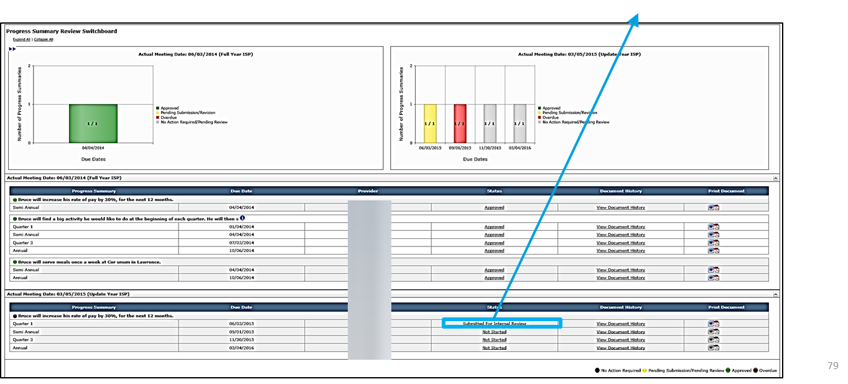
Scenario: Revise a Progress Summary
Step 1
Data Entry User Receives Alert & Navigates to Form
Step 2
Data Entry User Revises and Submits for Internal Review
Step 3
Provider Supervisor Receives Alert & Navigates to Form
Step 4
Provider Supervisor Reviews and Submits to DDS
Step 3: Provider Supervisor Receives Submission Alert and Navigates to Form
The system will redirect to the Progress Summary Review Switchboard.
Click “Submitted for Internal Review.”

Slide 67
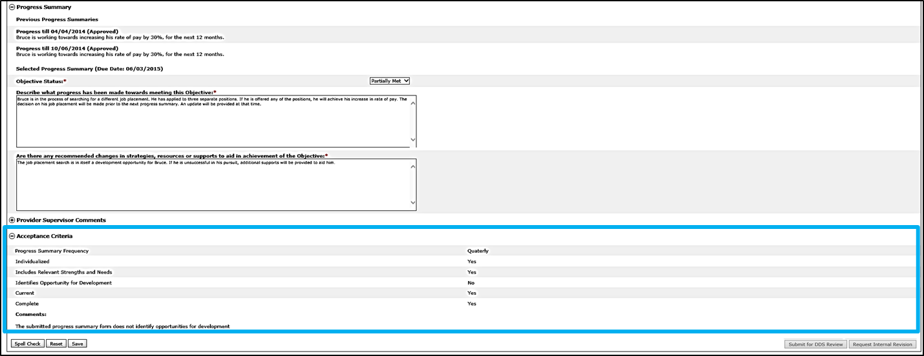
Scenario: Revise a Progress Summary
Step 1
Data Entry User Receives Alert & Navigates to Form
Step 2
Data Entry User Revises and Submits for Internal Review
Step 3
Provider Supervisor Receives Alert & Navigates to Form
Step 4
Provider Supervisor Reviews and Submits to DDS
Step 4: Provider Supervisor Reviews and Submits to DDS
The system will display the Progress Summary. By default all fields are expanded.
Review the Acceptance Criteria section to identify what revisions had been requested.

Slide 68
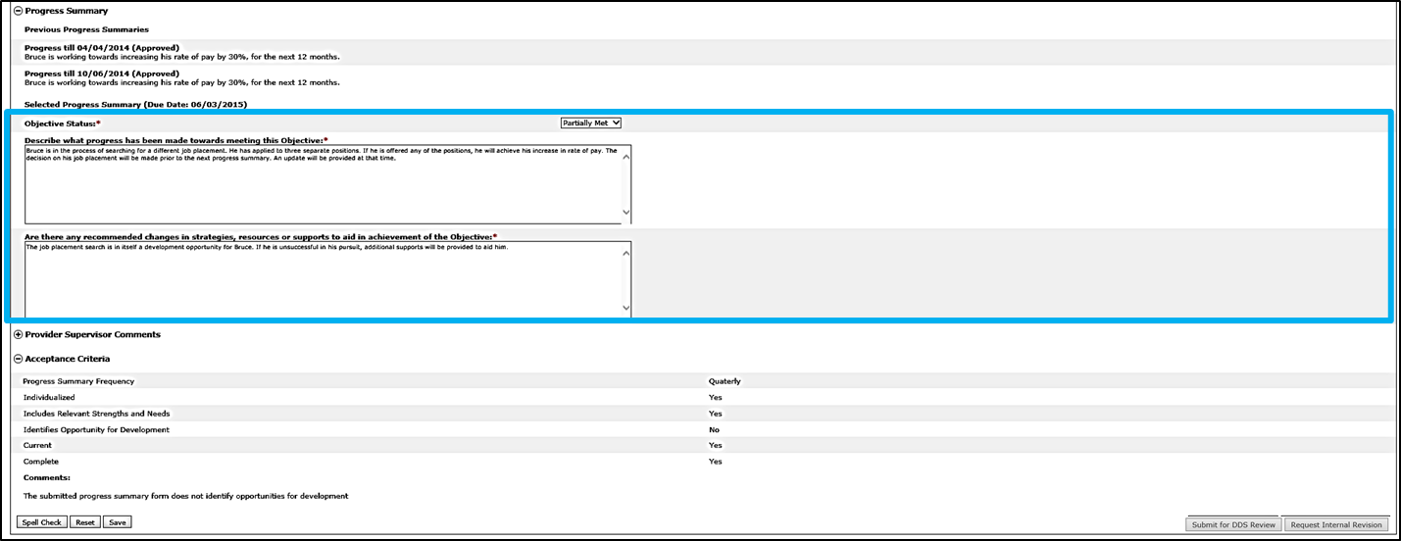
Scenario: Revise a Progress Summary
Step 1
Data Entry User Receives Alert & Navigates to Form
Step 2
Data Entry User Revises and Submits for Internal Review
Step 3
Provider Supervisor Receives Alert & Navigates to Form
Step 4
Provider Supervisor Reviews and Submits to DDS
Step 4: Provider Supervisor Reviews and Submits to DDS
Review the Progress Summary to validate that the requested revisions have been made.

Slide 69
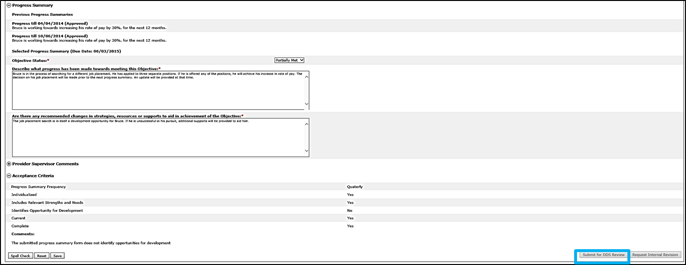
Scenario: Revise a Progress Summary
Step 1
Data Entry User Receives Alert & Navigates to Form
Step 2
Data Entry User Revises and Submits for Internal Review
Step 3
Provider Supervisor Receives Alert & Navigates to Form
Step 4
Provider Supervisor Reviews and Submits to DDS
Step 4: Provider Supervisor Reviews and Submits to DDS
If all the requested revisions have been applied, click “Submit for DDS Review.”
NOTE: Provider Supervisor can Request Internal Revision again if needed.

Slide 70
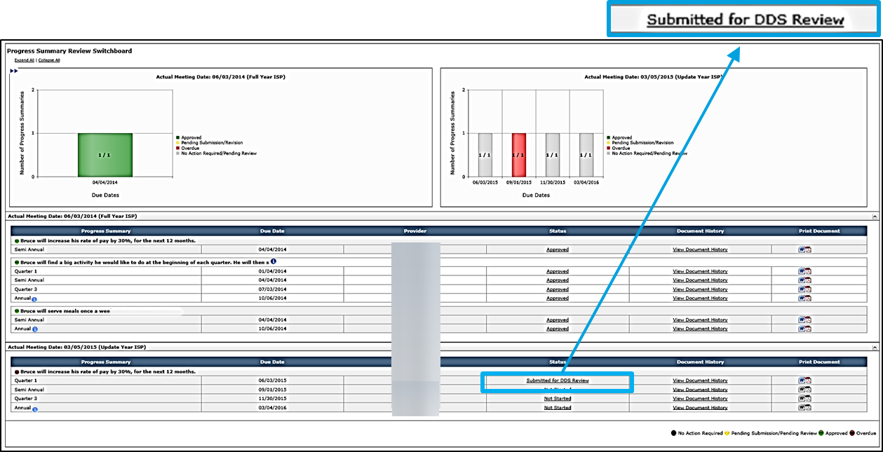
Scenario: Revise a Progress Summary
Step 1
Data Entry User Receives Alert & Navigates to Form
Step 2
Data Entry User Revises and Submits for Internal Review
Step 3
Provider Supervisor Receives Alert & Navigates to Form
Step 4
Provider Supervisor Reviews and Submits to DDS
Step 4: Provider Supervisor Reviews and Submits to DDS
The system redirects to the Progress Summary Review Switchboard. The status of the Progress Summary changes to “Submitted for DDS Review.”

Slide 71
Next Steps and Notes
Provider Data Entry Users and Provider Supervisors should continue tracking progress. If desired, it is possible to access the next Progress Summary and record information in it. It is not possible, however, to submit a Progress Summary until 30 days prior to the due date.
DDS Staff will be responsible for reviewing the Progress Summary, and approving or requesting additional revision.
Provider Data Entry Users and Provider Supervisors are able to monitor the individual’s Progress Summary Review Switchboard to view the progress of any revisions.
The status of a Progress Summary changes to “Approved” when DDS Staff has approved the Progress Summary.
Provider Data Entry Users and Provider Supervisors receive an alert when a Service Coordinator approves all of an individual’s proposed Progress Summaries.
If an objective is identified as in Met or Discontinued status in a Progress Summary during an ISP update year, the objective will be recalled in the subsequent year.

Slide 72
Next Steps and Notes
If an objective is determined to be met or discontinued as a part of a Semi-annual or Annual Progress Summary, subsequent Progress Summaries for that objective will not be required.
In the scenario below, the Quarter 3 and annual Progress Summaries are no longer required because the Objective is deemed to be met in the Semi-Annual Progress Summary.
Quarter 3 and Annual Forms No Longer Display
Regardless of whether the objective has been deemed to be met or discontinued the objective will still be recalled and require update in an ISP update year

Slide 73
Next Steps and Notes
Action | End User | Regulations | Alert?
Consult with Guardian and Individual on required Assessments, Vision, and Goals | Service Coordinator | 45-60 days prior to the ISP meeting | No
Notification of ISP meeting and request for Assessments | Service Coordinator | 30 days prior to the ISP meeting | Yes
Create and enter proposed Goals for the individual | Providers and DDS Staff | N/A | No
Assessments and Proposed Objectives & Support Strategies submitted to Service Coordinator | Providers | 15 days prior to the ISP meeting | Yes
Annual Progress Summary Due | Service Coordinators and Providers | 15 days prior to the ISP meeting | Yes
Review and approval or request for revision of submitted documents | Service Coordinator | 7 days prior to the ISP meeting | Yes
Print documents for ISP meeting | Providers and DDS staff | N/A | No
Revise ISP documents if required | Providers and DDS staff | Up to 45 days after the ISP meeting | Depends on the type of revision
ISP Mailed to ISP Team | Service Coordinator | 45 Days after the ISP meeting | No
Semi-Annual Progress Summary Due | Service Coordinators and Providers | 180 Days after the ISP Meeting | Yes

Slide 74
Chapter 3 Summary
This Chapter covered:
Overview of Progress Summaries
Progress Summary Review Switchboard
Scenario: Complete a Progress Summary
Scenario: Revise a Progress Summary

Slide 75
Chapter 4: Progress Summary Report
Chapter 1
Chapter 2
Chapter 3
Chapter 4
Chapter 5
Chapter 6
Chapter 7

Slide 76
Chapter 4 Overview
This Chapter will cover:
Scenario: Accessing the Progress Summary Report

Slide 77
Scenario: Accessing the Progress Summary Report

Slide 78
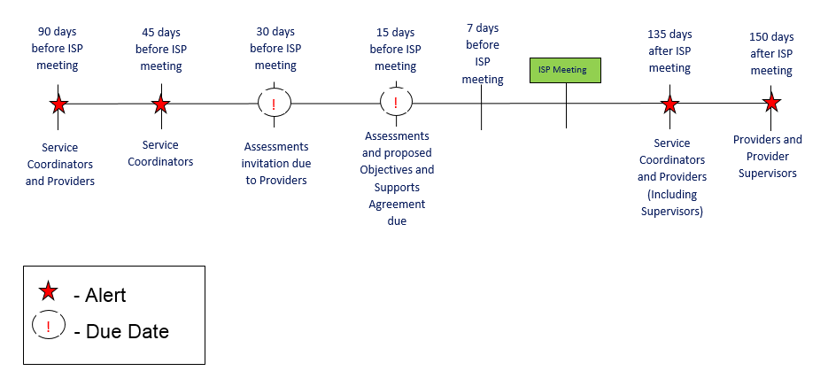
Scenario: Accessing the Progress Summary Report
Description: The Progress Summary Report provides information about the Progress Summary submission, review and approval process. The report aggregates progress summaries based on their due date and enables you to identify upcoming or overdue progress summaries. It is a consolidated view of the status of the progress summaries assigned to you.
Roles and Responsibilities:
Provider Data Entry User: Generate and view a report
Provider Supervisor: Generate and view a report

Slide 79
Scenario: Accessing the Progress Summary Report
Step 1
Navigate to ISP Module and select “Reports”
Step 2
Select “Progress Summary Report”
Step 3
Select Search Parameters
Step 4
Select “View Report”
Step 5
View Summary Report details
Step 6
Print Progress Summary Report
Step 1: Navigate to ISP Module and select “Reports”
Click on “Reports” in the second level menu.

Slide 80
Scenario: Accessing the Progress Summary Report
Step 1
Navigate to ISP Module and select “Reports”
Step 2
Select “Progress Summary Report”
Step 3
Select Search Parameters
Step 4
Select “View Report”
Step 5
View Summary Report details
Step 6
Print Progress Summary Report
Step 2: Select “Progress Summary Report”
Select the “Progress Summary Report” link.

Slide 81
Scenario: Accessing the Progress Summary Report
Step 1
Navigate to ISP Module and select “Reports”
Step 2
Select “Progress Summary Report”
Step 3
Select Search Parameters
Step 4
Select “View Report”
Step 5
View Summary Report details
Step 6
Print Progress Summary Report
Step 3: Select Search Parameters
The system redirects to the Progress Summary Report.
Select the date from the calendar dropdown for the “From ISP Date” and the “To ISP Date” fields. Please note these fields are calculated based on the Progress Summary due date.

Slide 82
Scenario: Accessing the Progress Summary Report
Step 1
Navigate to ISP Module and select “Reports”
Step 2
Select “Progress Summary Report”
Step 3
Select Search Parameters
Step 4
Select “View Report”
Step 5
View Summary Report details
Step 6
Print Progress Summary Report
Step 3: Select Search Parameters
Additional filters are available to narrow search results. Those filters are as follows:
Area Office
Provider
Objective Status
Report Display Option
Security Group
Document Status

Slide 83
Scenario: Accessing the Progress Summary Report
Step 1
Navigate to ISP Module and select “Reports”
Step 2
Select “Progress Summary Report”
Step 3
Select Search Parameters
Step 4
Select “View Report”
Step 5
View Summary Report details
Step 6
Print Progress Summary Report
Step 4: Select “View Report”
Click “View Report.”

Slide 84
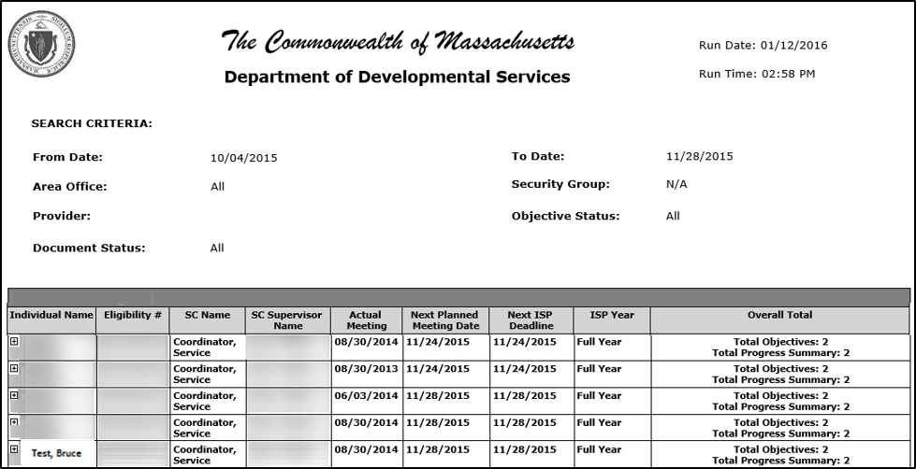
Scenario: Accessing the Progress Summary Report
Step 1
Navigate to ISP Module and select “Reports”
Step 2
Select “Progress Summary Report”
Step 3
Select Search Parameters
Step 4
Select “View Report”
Step 5
View Summary Report details
Step 6
Print Progress Summary Report
Step 5: View Summary Report Details
The system will display all the individuals satisfying the search criteria.

Slide 85
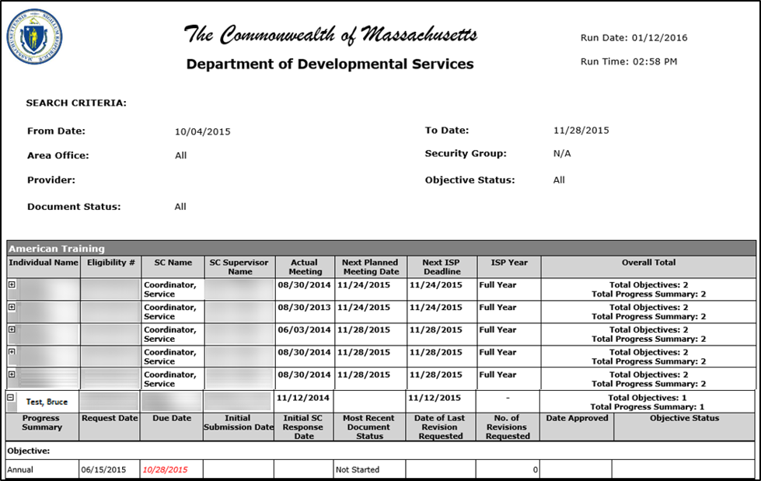
Scenario: Accessing the Progress Summary Report
Step 1
Navigate to ISP Module and select “Reports”
Step 2
Select “Progress Summary Report”
Step 3
Select Search Parameters
Step 4
Select “View Report”
Step 5
View Summary Report details
Step 6
Print Progress Summary Report
Step 5: View Summary Report Details
Select the next to an individual to expand/view the Progress Summary details on the Reports page.

Slide 86
Scenario: Accessing the Progress Summary Report
Step 1
Navigate to ISP Module and select “Reports”
Step 2
Select “Progress Summary Report”
Step 3
Select Search Parameters
Step 4
Select “View Report”
Step 5
View Summary Report details
Step 6
Print Progress Summary Report
Step 6: Print Progress Summary Report
To download and print the report, click the save icon and select either “PDF” or “Word.”
NOTE: The PDF will print the exact image displayed on the Reports page. If the Progress Summary Report is shown with expanded information, all of that information will be printed.

Slide 87
Next Steps and Notes
The Progress Summary Report will be by used by Licensing to track Provider’s compliance with the Progress Summary regulations. Providers, however, will receive a grace period. Licensing will not begin to track compliance until six months have passed.

Slide 88
Chapter 4 Summary
This Chapter covered:
Accessing a Progress Summary Report

