Slide 1
Department of Developmental Services
Massachusetts Rehabilitation Commission
Individual Support Plan (ISP) Module – Release 7.7
Training - Provider Staff

Slide 2
Chapter 5: Area Office Director Approval of the ISP
Chapter 1
Chapter 2
Chapter 3
Chapter 4
Chapter 5
Chapter 6
Chapter 7

Slide 3
Chapter 5 Overview
This Chapter will cover:
New Trigger for Locking the ISP in HCSIS
Lock Icon on the Individual Dashboard

Slide 4
New Trigger for Locking the ISP in HCSIS

Slide 5
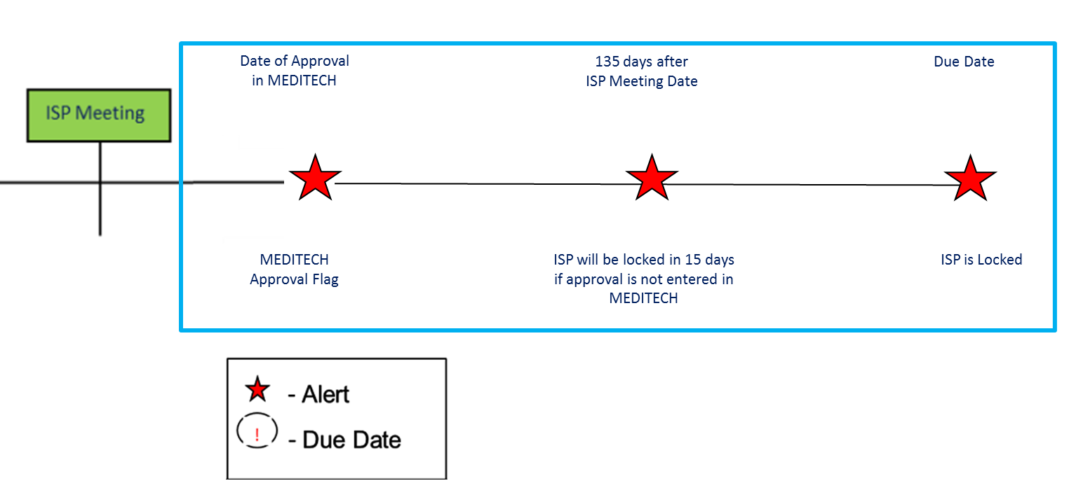
New Trigger for Locking the ISP in HCSIS
The approval process for a ISP remains the same but the process by which the system locks the plans in HCSIS has changed. The system now uses a different trigger to lock the plan.
Topic | Previous Functionality | New Functionality
Trigger for Locking the ISP in HCSIS | Once 150 days have passed since the ISP Meeting Date, the plan will be automatically locked in HCSIS. | Once an Area Office Director (AOD) approves an ISP in MEDITECH, the plan will lock in HCSIS. Alternatively, if the approval has not been submitted in MEDITECH and 150 days have passed since the ISP Meeting Date, the plan will automatically lock in HCSIS, per current functionality.

Slide 6
Lock Icon on the Individual Dashboard

Slide 7
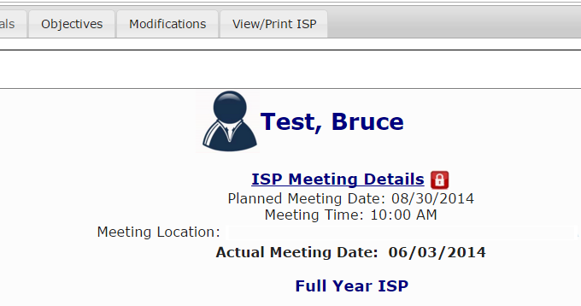
Lock Icon on the Individual Dashboard
An ISP Lock Icon will appear on the Individual Dashboard.
Area Office Directors and Area Office Director Designees have the ability to manually unlock plans, if needed. The ISP should only be unlocked, however, to make minor corrections or a correction needed in response to an appeal. Contact the service coordinator to make this request.

Slide 8
Chapter 5 Summary
This Chapter covered:
New Trigger for Locking the ISP in HCSIS
Lock Icon on the Individual Dashboard

Slide 9
Chapter 6: Modifications
Chapter 1
Chapter 2
Chapter 3
Chapter 4
Chapter 5
Chapter 6
Chapter 7

Slide 10
Chapter 6 Overview
This Chapter will cover:
Overview of Modifications
Scenario: Provider Initiates a Modification
Scenario: Reviewing and Revising Modification

Slide 11
Overview of Modifications

Slide 12
Modifications Process
Modifications are used to make changes to a locked ISP document
Per DDS Regulation 115 CMR 6.25, a modification to an ISP may include one or any combination of the following elements all under the same Reason for Modification:
Any change in the Goals for an individual
Any change in the types of supports or services that will be used to help the individual to attain his or her outcomes, or changes in the duration and frequency of such supports
A change in the strategies that will be used to meet unmet support needs
A change in the priority for services or supports assigned to the individual’s needs where such a change will affect the services or supports that are provided and available to the individual
Initiation of a behavior modification plan or modification of any part of a behavior modification plan involving the use of an aversive or intrusive technique
A change in the location of an individual’s home, from a home operated by the Department or a provider certified by the Department to another such home
NOTE: Major changes in an individual’s life that would substantially change the ISP content should be considered for a full ISP meeting.

Slide 13
Modifications Process
Modifications are used to make changes to a locked ISP document
With this release, HCSIS includes functionality for Service Coordinators and Providers to initiate and submit modifications to the current ISP document in the system
Modifications can be submitted once the current ISP has been locked
As explained in the previous Chapter, the plan will be locked based on the Area Director’s approval of the ISP in MEDITECH.
If the Area Director does not approve the ISP within 150 days, the plan will be locked per current process in HCSIS.

Slide 14
Modifications Workflow
ISP Meeting is Held
Area Director
Approves /Disapproves
Modification
ISP is approved and locked in HCSIS
SC Reviews and Accepts or Returns for Revision to Provider
Provider Supervisor Initiates and Submits Modification to DDS
The ISP module provides an efficient mechanism for streamlining the Modification submission process. It allows Provider and DDS staff to coordinate the review, revision, acceptance and approval of a Modification per DDS Regulations.

Slide 15
Modifications Roles and Responsibilities
Provider Roles and Responsibilities
Provider Data Entry User
N/A
Provider Supervisors Role
Initiate a Modification
Revise a Modification
Submit for DDS Review

Slide 16
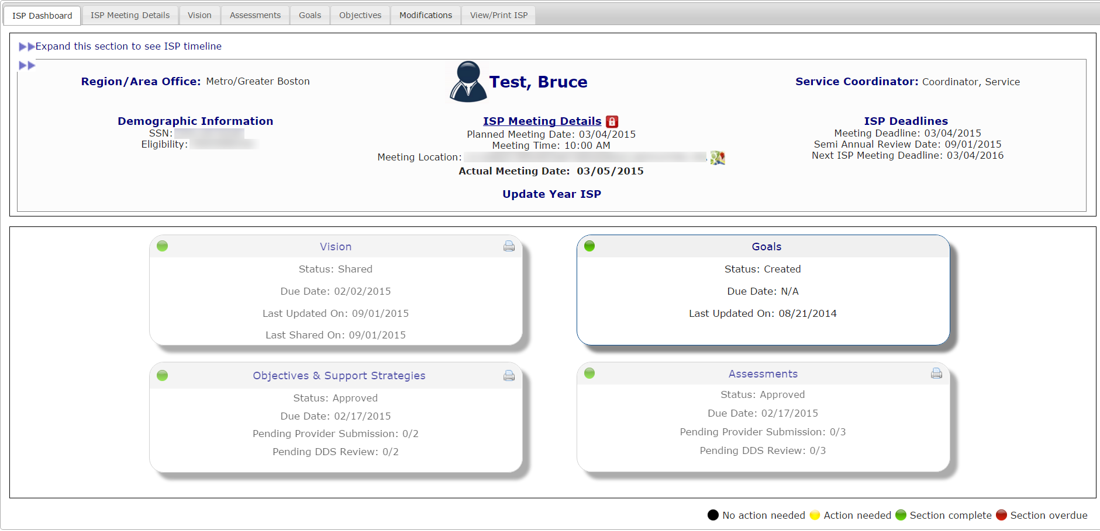
Navigating to Modifications
Click Modifications Tab on Individual Dashboard
Navigate to the Modifications Review Switchboard from the Individual Dashboard. On the Individual dashboard, click the “Modifications” tab

Slide 17
Scenario: Provider Initiates a Modification

Slide 18
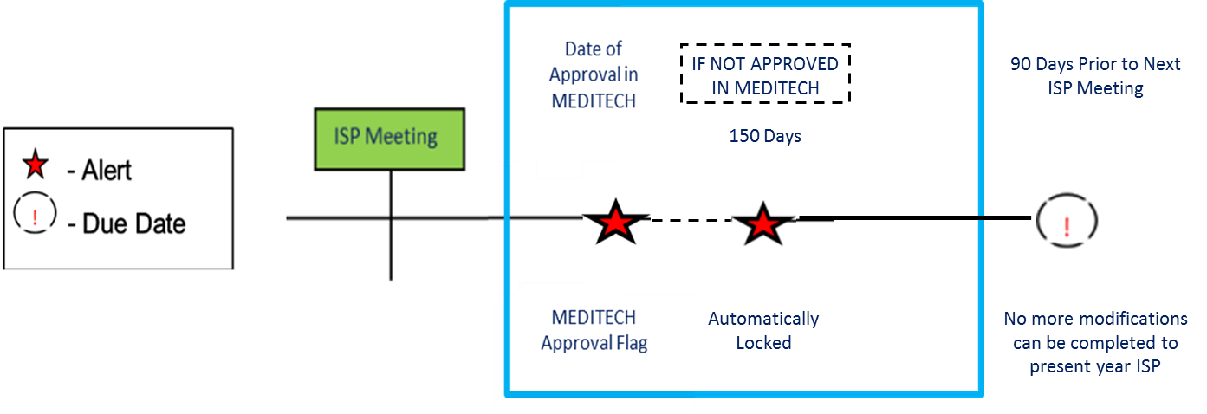
Scenario: Provider Initiates a Modification
Description: Provider Supervisors can initiate an Modification once a Full or Update Year ISP has been locked. A single modification initiated by a Provider can include any combination of the following elements: Goals, Objective Support Strategy, Residential Support / Behavior Plan / Other
Roles and Responsibilities:
Provider Data Entry User: N/A
Provider Supervisor: Initiate a Modification

Slide 19
Scenario: Provider Initiates a Modification
Step 1
Navigate to
Dashboard & Select “Modifications”
Step 2
Click “Add New Modification” &
Enter Modification
Reason
Step 3
Select Element to Modify
Step 4
Complete Modification of
Element
Step 5
(Optional)
Repeat for Other Element/s
Step 6
Complete the Review Section
And Submit
Step 1: Navigate to Individual Dashboard & Select “Modifications”
Navigate to the Individual Dashboard. Select the “Modifications” tab.

Slide 20
Scenario: Provider Initiates a Modification
Step 1
Navigate to
Dashboard & Select “Modifications”
Step 2
Click “Add New Modification” &
Enter Modification
Reason
Step 3
Select Element to Modify
Step 4
Complete Modification of
Element
Step 5
(Optional)
Repeat for Other Element/s
Step 6
Complete the Review Section
And Submit
Step 2: Click on “Add New Modification” and Enter Reason for Modification
The system will redirect to the Modifications Review Switchboard. Click “Add New Modification.”

Slide 21
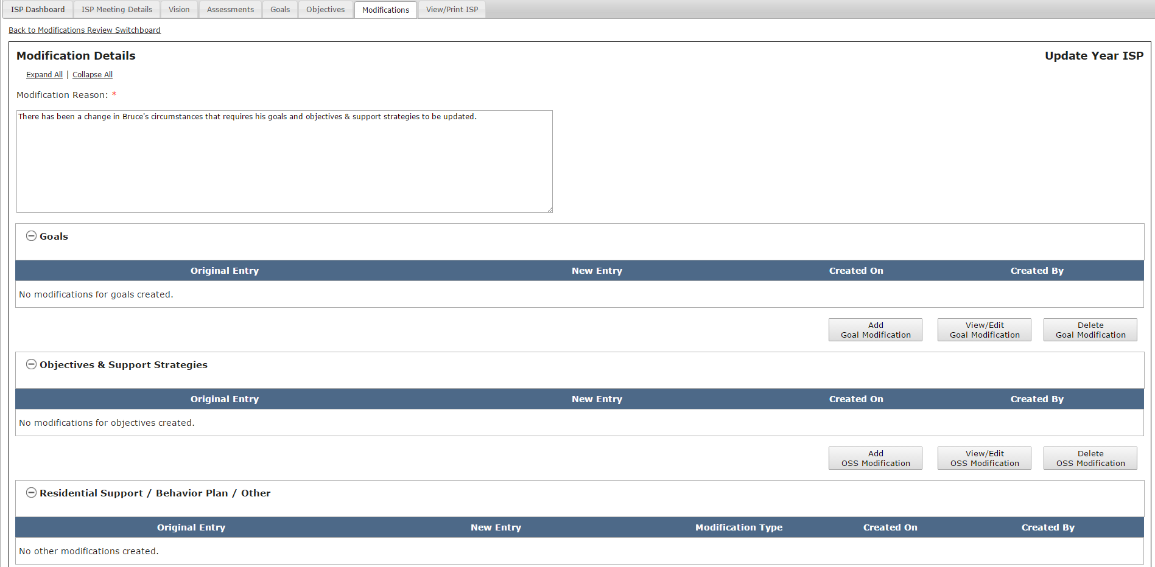
Scenario: Provider Initiates a Modification
Step 1
Navigate to
Dashboard & Select “Modifications”
Step 2
Click “Add New Modification” &
Enter Modification
Reason
Step 3
Select Element to Modify
Step 4
Complete Modification of
Element
Step 5
(Optional)
Repeat for Other Element/s
Step 6
Complete the Review Section
And Submit
Step 2: Click on “Add New Modification” and Enter Reason for Modification
The system will display the Modification Details screen.

Slide 22
Scenario: Provider Initiates a Modification
Step 1
Navigate to
Dashboard & Select “Modifications”
Step 2
Click “Add New Modification” &
Enter Modification
Reason
Step 3
Select Element to Modify
Step 4
Complete Modification of
Element
Step 5
(Optional)
Repeat for Other Element/s
Step 6
Complete the Review Section
And Submit
Step 2: Click on “Add New Modification” and Enter Reason for Modification
Insert comments into the Modification Reason text box.

Slide 23
Scenario: Provider Initiates a Modification
Step 1
Navigate to
Dashboard & Select “Modifications”
Step 2
Click “Add New Modification” &
Enter Modification
Reason
Step 3
Select Element to Modify
Step 4
Complete Modification of
Element
Step 5
(Optional)
Repeat for Other Element/s
Step 6
Complete the Review Section
And Submit
Step 3: Select Elements to Modify
Decide which elements require modification: A.) “Goals” B.) “Objectives & Support Strategy” and/or C.) “Residential Support / /Behavior Plan / Other.”

Slide 24
Scenario: Provider Initiates a Modification
Step 1
Navigate to
Dashboard & Select “Modifications”
Step 2
Click “Add New Modification” &
Enter Modification
Reason
Step 3
Select Element to Modify
Step 4
Complete Modification of
Element
Step 5
(Optional)
Repeat for Other Element/s
Step 6
Complete the Review Section
And Submit
Step 4: Complete Modification of Element
A.) Goals
Select “Add Goal Modification” to initiate a modification to goals.

Slide 25
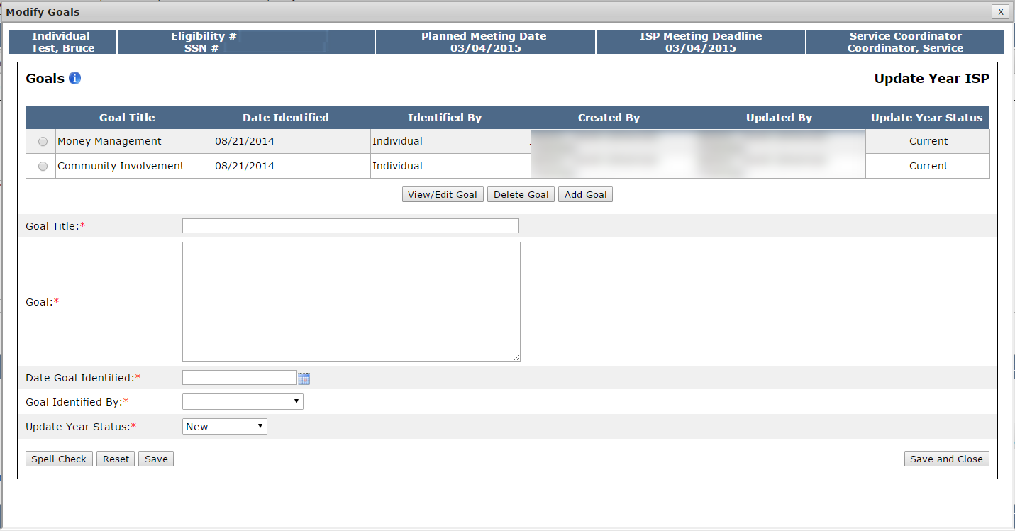
Scenario: Provider Initiates a Modification
Step 1
Navigate to
Dashboard & Select “Modifications”
Step 2
Click “Add New Modification” &
Enter Modification
Reason
Step 3
Select Element to Modify
Step 4
Complete Modification of
Element
Step 5
(Optional)
Repeat for Other Element/s
Step 6
Complete the Review Section
And Submit
Step 4: Complete Modification of Element
A.) Goals
The system will display the Goals pop-up screen. All of the goals that have been included in the ISP document display on this screen.

Slide 26
Scenario: Provider Initiates a Modification
Step 1
Navigate to
Dashboard & Select “Modifications”
Step 2
Click “Add New Modification” &
Enter Modification
Reason
Step 3
Select Element to Modify
Step 4
Complete Modification of
Element
Step 5
(Optional)
Repeat for Other Element/s
Step 6
Complete the Review Section
And Submit
Step 4: Complete Modification of Element
A.) Goals
At this point, the user has two options – adding a new goal or modifying an existing goal. We will display the process for both options.

Slide 27
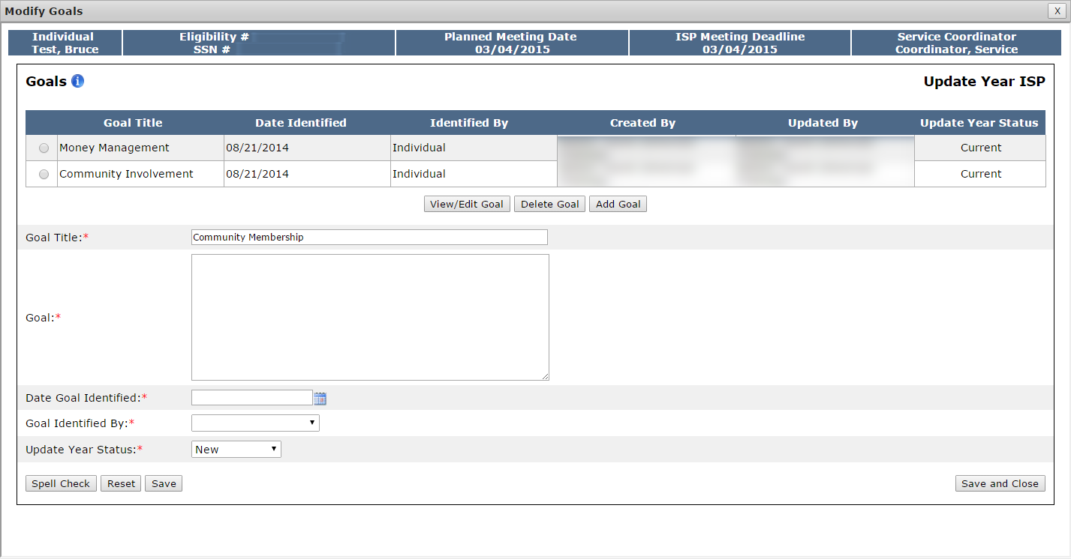
Scenario: Provider Initiates a Modification
Step 1
Navigate to
Dashboard & Select “Modifications”
Step 2
Click “Add New Modification” &
Enter Modification
Reason
Step 3
Select Element to Modify
Step 4
Complete Modification of
Element
Step 5
(Optional)
Repeat for Other Element/s
Step 6
Complete the Review Section
And Submit
Step 4: Complete Modification of Element
A.) Goals
Option 1: Adding a New Goal
Enter the title of the goal in the Goal Title text box.

Slide 28
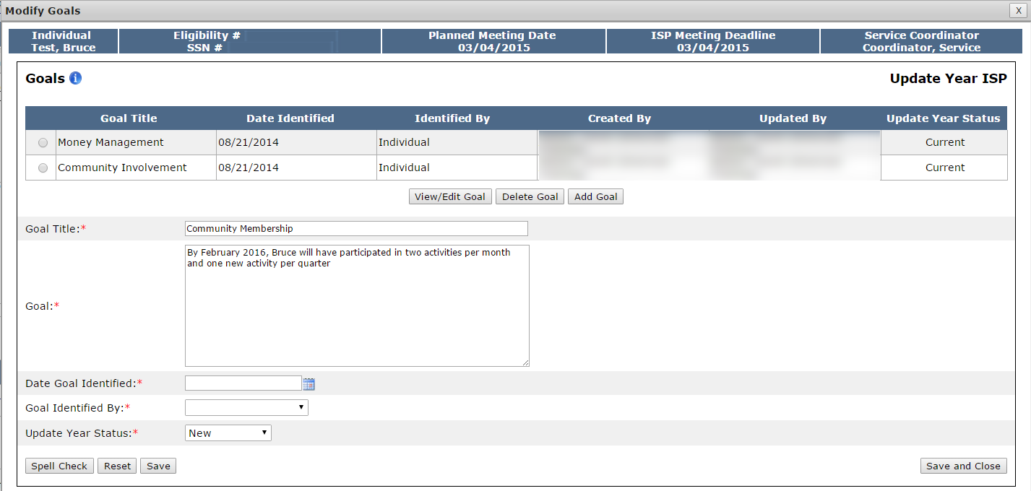
Scenario: Provider Initiates a Modification
Step 1
Navigate to
Dashboard & Select “Modifications”
Step 2
Click “Add New Modification” &
Enter Modification
Reason
Step 3
Select Element to Modify
Step 4
Complete Modification of
Element
Step 5
(Optional)
Repeat for Other Element/s
Step 6
Complete the Review Section
And Submit
Step 4: Complete Modification of Element
A.) Goals
Option 1: Adding a New Goal
Enter the goal description in the Goal text box.

Slide 29
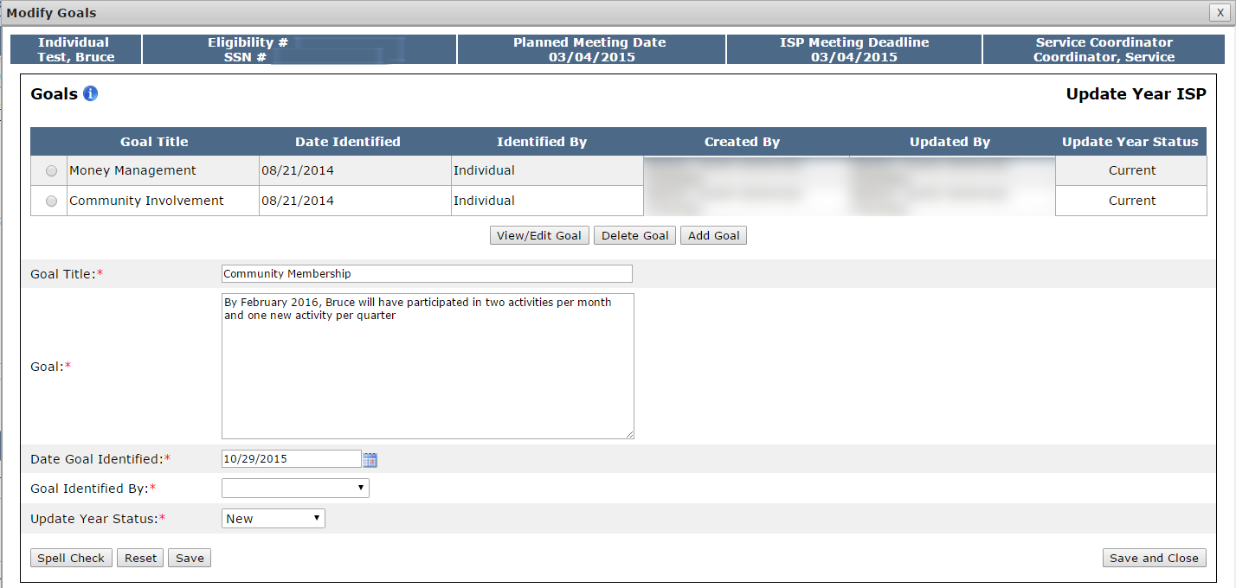
Scenario: Provider Initiates a Modification
Step 1
Navigate to
Dashboard & Select “Modifications”
Step 2
Click “Add New Modification” &
Enter Modification
Reason
Step 3
Select Element to Modify
Step 4
Complete Modification of
Element
Step 5
(Optional)
Repeat for Other Element/s
Step 6
Complete the Review Section
And Submit
Step 4: Complete Modification of Element
A.) Goals
Option 1: Adding a New Goal
Select a date in the “Date Goal Identified” calendar drop down.

Slide 30
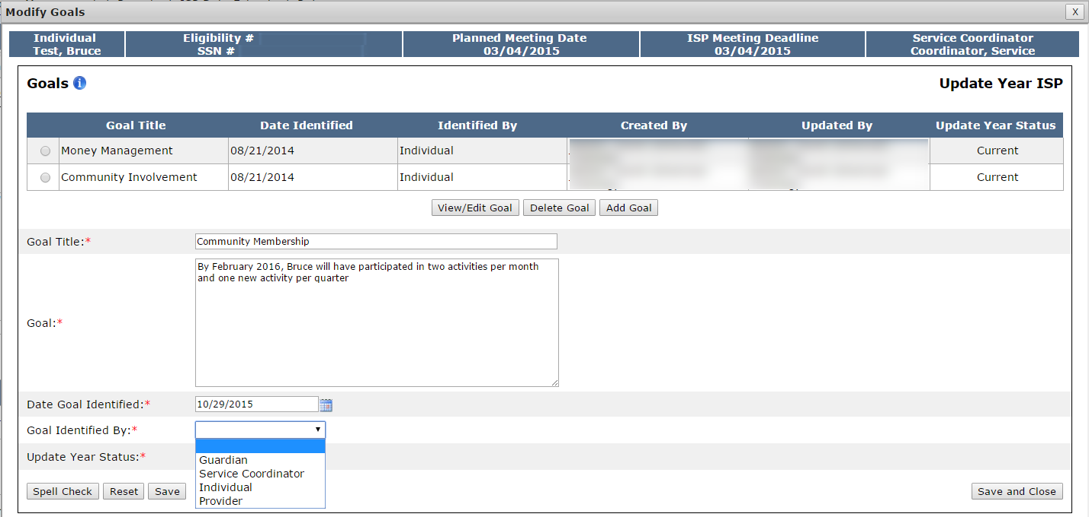
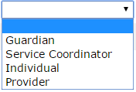
Scenario: Provider Initiates a Modification
Step 1
Navigate to
Dashboard & Select “Modifications”
Step 2
Click “Add New Modification” &
Enter Modification
Reason
Step 3
Select Element to Modify
Step 4
Complete Modification of
Element
Step 5
(Optional)
Repeat for Other Element/s
Step 6
Complete the Review Section
And Submit
Step 4: Complete Modification of Element
A.) Goals
Option 1: Adding a New Goal
Select an option from the “Goal Identified by” drop down.

Slide 31
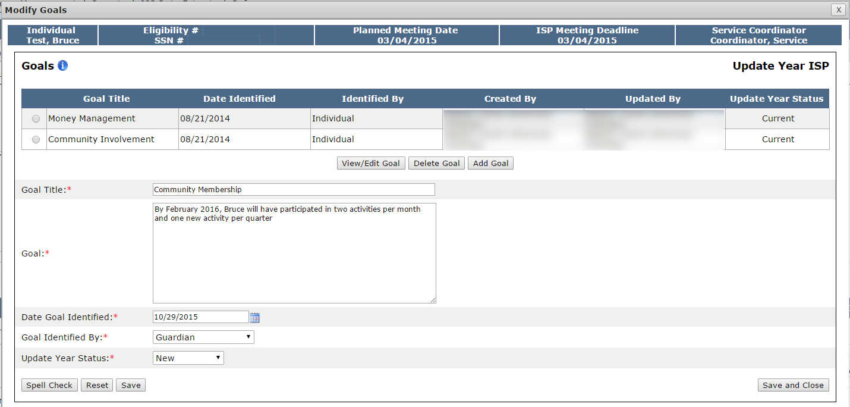
Scenario: Provider Initiates a Modification
Step 1
Navigate to
Dashboard & Select “Modifications”
Step 2
Click “Add New Modification” &
Enter Modification
Reason
Step 3
Select Element to Modify
Step 4
Complete Modification of
Element
Step 5
(Optional)
Repeat for Other Element/s
Step 6
Complete the Review Section
And Submit
Step 4: Complete Modification of Element
A.) Goals
Option 1: Adding a New Goal
Click “Save and Close.” Alternatively, to add additional goals, follow this process again on the same screen.

Slide 32
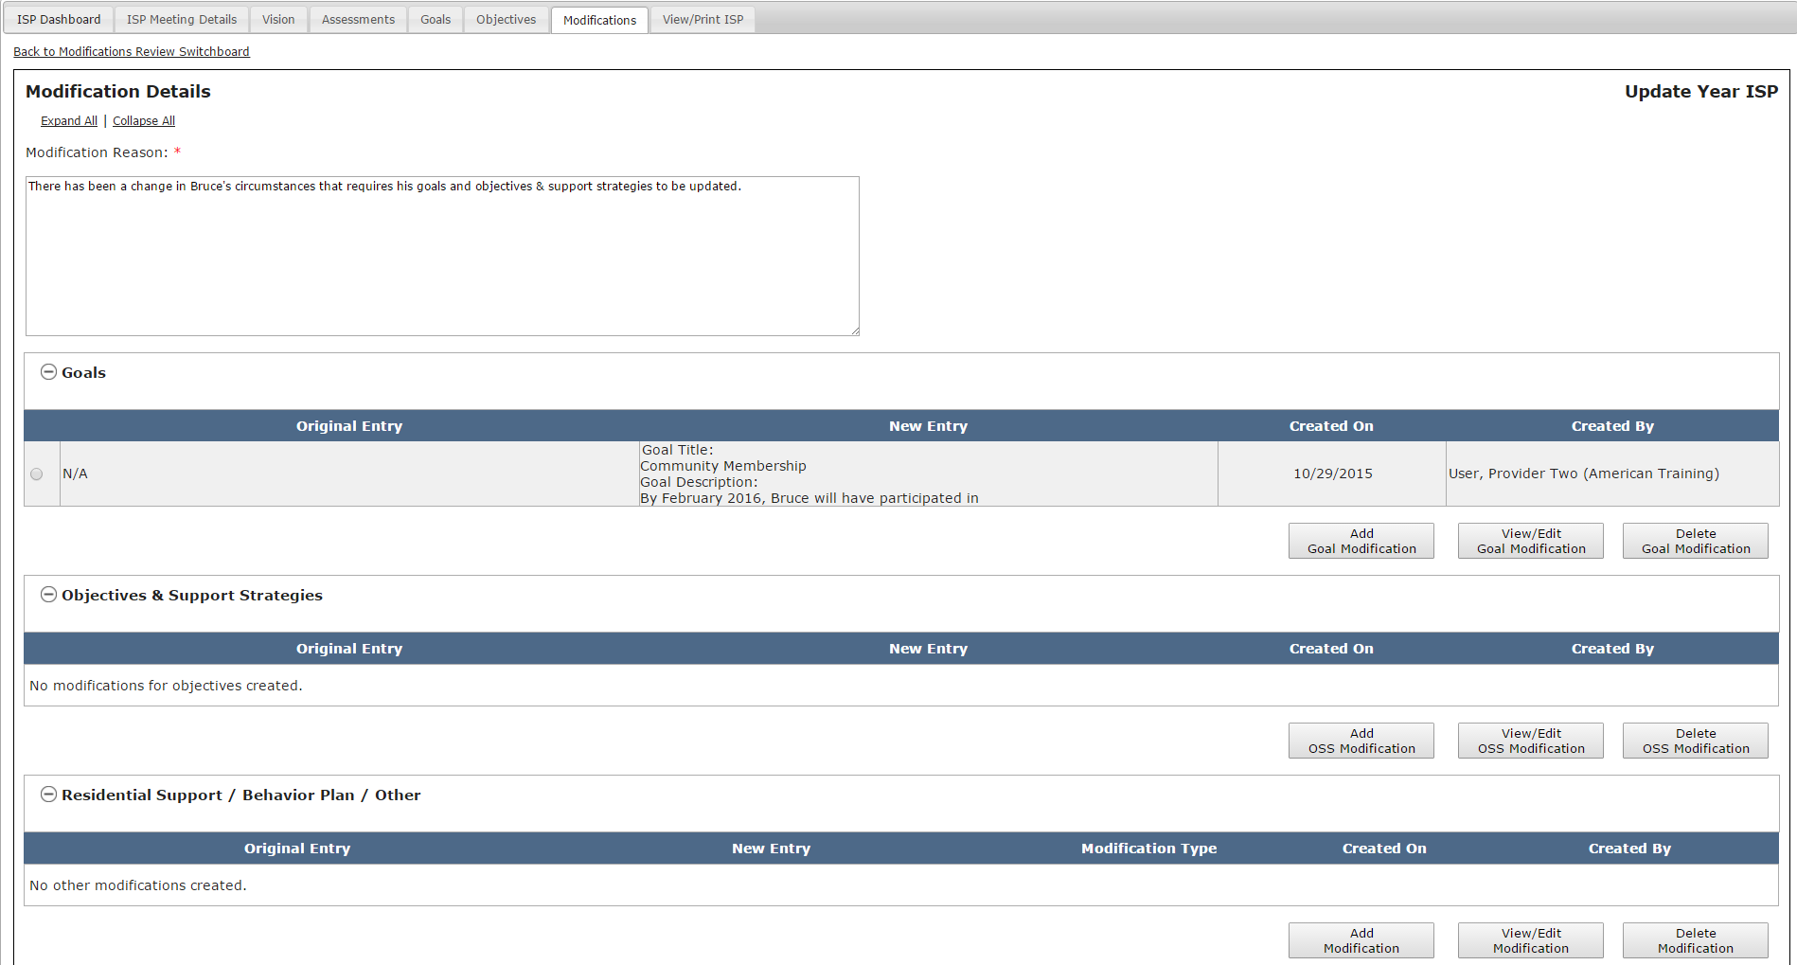
Scenario: Provider Initiates a Modification
Step 1
Navigate to
Dashboard & Select “Modifications”
Step 2
Click “Add New Modification” &
Enter Modification
Reason
Step 3
Select Element to Modify
Step 4
Complete Modification of
Element
Step 5
(Optional)
Repeat for Other Element/s
Step 6
Complete the Review Section
And Submit
Step 4: Complete Modification of Element
A.) Goals
Option 1: Adding a New Goal
The system will return to the Modifications Details screen. The details of the goal modification will display. The original entry column displays the original goal if one exists. In this scenario, the original entry displays as “N/A” because it is a new goal. The new entry column displays the new goal description.

Slide 33
Scenario: Provider Initiates a Modification
Step 1
Navigate to
Dashboard & Select “Modifications”
Step 2
Click “Add New Modification” &
Enter Modification
Reason
Step 3
Select Element to Modify
Step 4
Complete Modification of
Element
Step 5
(Optional)
Repeat for Other Element/s
Step 6
Complete the Review Section
And Submit
Step 4: Complete Modification of Element
A.) Goals
Option 2: Modify an Existing Goal
To initiate a modification to a goal, click “Add Goal Modification” on the Modifications Details screen.

Slide 34
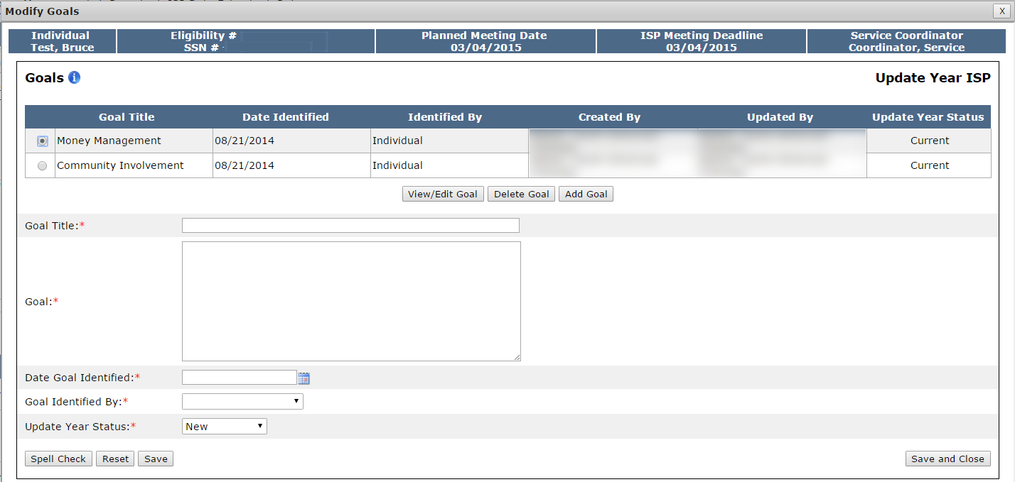
Scenario: Provider Initiates a Modification
Step 1
Navigate to
Dashboard & Select “Modifications”
Step 2
Click “Add New Modification” &
Enter Modification
Reason
Step 3
Select Element to Modify
Step 4
Complete Modification of
Element
Step 5
(Optional)
Repeat for Other Element/s
Step 6
Complete the Review Section
And Submit
Step 4: Complete Modification of Element
A.) Goals
Option 2: Modify an Existing Goal
Select the radio button next to the desired goal and click “View/Edit Goal.”

Slide 35
Scenario: Provider Initiates a Modification
Step 1
Navigate to
Dashboard & Select “Modifications”
Step 2
Click “Add New Modification” &
Enter Modification
Reason
Step 3
Select Element to Modify
Step 4
Complete Modification of
Element
Step 5
(Optional)
Repeat for Other Element/s
Step 6
Complete the Review Section
And Submit
Step 4: Complete Modification of Element
A.) Goals
Option 2: Modify an Existing Goal
Click “View / Edit Goal.”

Slide 36
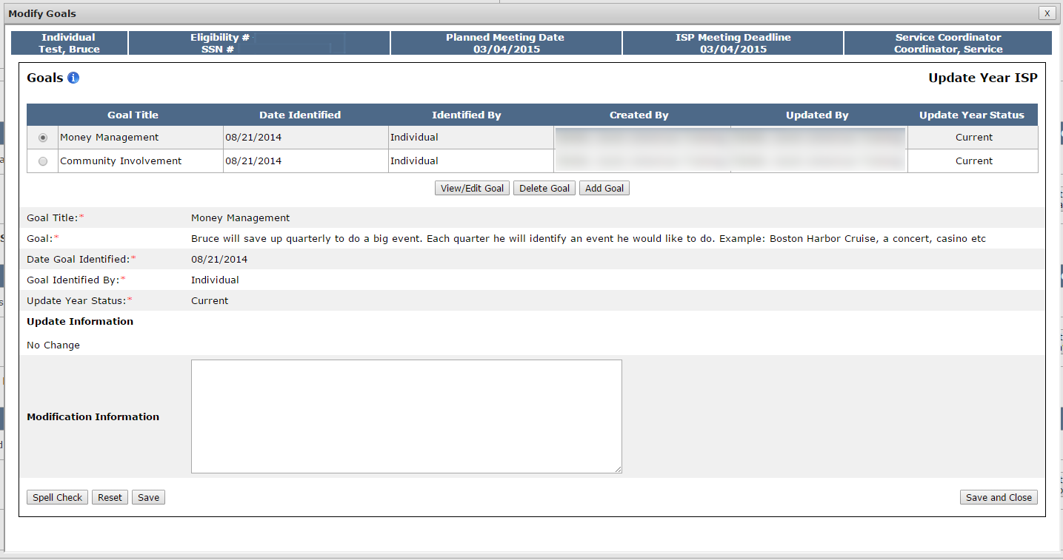
Scenario: Provider Initiates a Modification
Step 1
Navigate to
Dashboard & Select “Modifications”
Step 2
Click “Add New Modification” &
Enter Modification
Reason
Step 3
Select Element to Modify
Step 4
Complete Modification of
Element
Step 5
(Optional)
Repeat for Other Element/s
Step 6
Complete the Review Section
And Submit
Step 4: Complete Modification of Element
A.) Goals
Option 2: Modify an Existing Goal
The screen will display the existing Goal details.

Slide 37
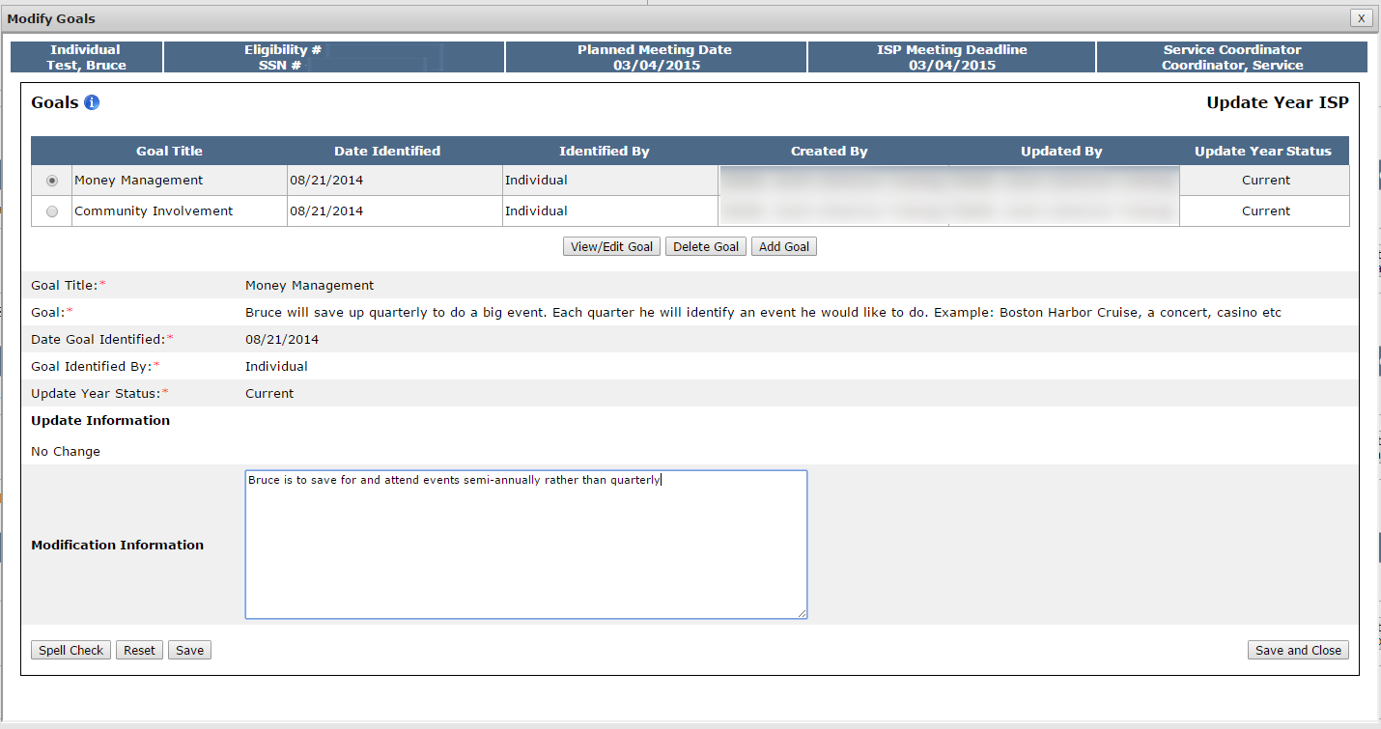
Scenario: Provider Initiates a Modification
Step 1
Navigate to
Dashboard & Select “Modifications”
Step 2
Click “Add New Modification” &
Enter Modification
Reason
Step 3
Select Element to Modify
Step 4
Complete Modification of
Element
Step 5
(Optional)
Repeat for Other Element/s
Step 6
Complete the Review Section
And Submit
Step 4: Complete Modification of Element
A.) Goals
Option 2: Modify an Existing Goal
Enter text in the Modification Information textbox and explain what changes are required to the goal.

Slide 38
Scenario: Provider Initiates a Modification
Step 1
Navigate to
Dashboard & Select “Modifications”
Step 2
Click “Add New Modification” &
Enter Modification
Reason
Step 3
Select Element to Modify
Step 4
Complete Modification of
Element
Step 5
(Optional)
Repeat for Other Element/s
Step 6
Complete the Review Section
And Submit
Step 4: Complete Modification of Element
A.) Goals
Option 2: Modify an Existing Goal
Select “Save and Close.”

Slide 39
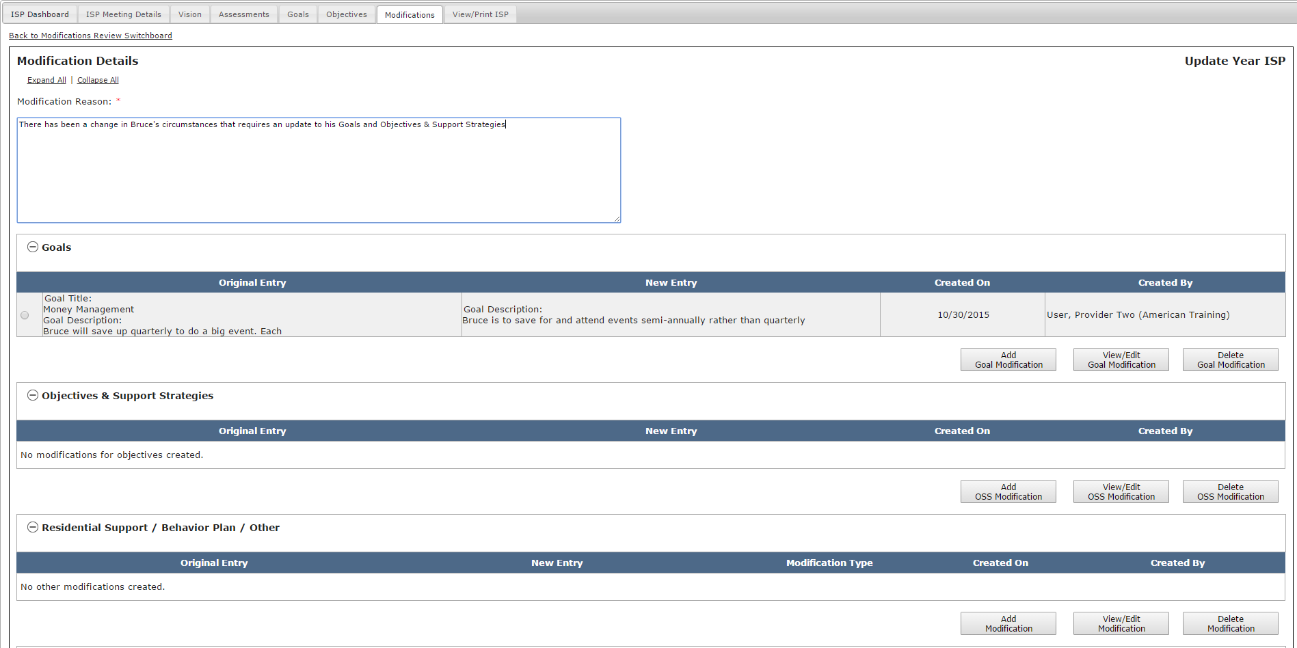
Scenario: Provider Initiates a Modification
Step 1
Navigate to
Dashboard & Select “Modifications”
Step 2
Click “Add New Modification” &
Enter Modification
Reason
Step 3
Select Element to Modify
Step 4
Complete Modification of
Element
Step 5
(Optional)
Repeat for Other Element/s
Step 6
Complete the Review Section
And Submit
Step 4: Complete Modification of Element
A.) Goals
Option 2: Modify an Existing Goal
The system will return to the Modifications Details screen. The details of the goal modification will display. In this scenario, the Original Entry column displays the original goal description.

Slide 40
Scenario: Provider Initiates a Modification
Step 1
Navigate to
Dashboard & Select “Modifications”
Step 2
Click “Add New Modification” &
Enter Modification
Reason
Step 3
Select Element to Modify
Step 4
Complete Modification of
Element
Step 5
(Optional)
Repeat for Other Element/s
Step 6
Complete the Review Section
And Submit
Step 4: Complete Modification of Element
A.) Goals
Option 3: Delete Goal
Once a Goal has been added to the Modification, a third option is available. It is possible to use the “Delete Goal” option. The delete function operates differently for newly added goals and existing goals:
Newly Added Goal
Deleting a newly added goal will remove the entire goal from the modification.
Modified Existing Goal
Deleting an existing goal which has been modified will only remove the modified information. The goal will remain a part of the ISP.
Unmodified Existing Goal
It is not possible to delete an unmodified existing goal. A goal that has been met or discontinued should be marked as such in the upcoming progress summary.

Slide 41
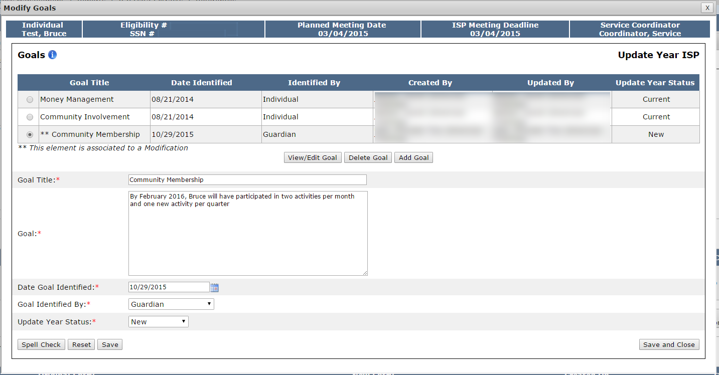
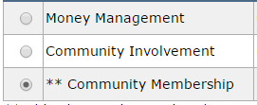
Scenario: Provider Initiates a Modification
Step 1
Navigate to
Dashboard & Select “Modifications”
Step 2
Click “Add New Modification” &
Enter Modification
Reason
Step 3
Select Element to Modify
Step 4
Complete Modification of
Element
Step 5
(Optional)
Repeat for Other Element/s
Step 6
Complete the Review Section
And Submit
Step 4: Complete Modification of Element
A.) Goals
Option 3: Delete Goal
On the Goals pop-up screen, select the radio button for the newly added goal that requires deletion.

Slide 42
Scenario: Provider Initiates a Modification
Step 1
Navigate to
Dashboard & Select “Modifications”
Step 2
Click “Add New Modification” &
Enter Modification
Reason
Step 3
Select Element to Modify
Step 4
Complete Modification of
Element
Step 5
(Optional)
Repeat for Other Element/s
Step 6
Complete the Review Section
And Submit
Step 4: Complete Modification of Element
A.) Goals
Option 3: Delete Goal
Click “Delete Goal.”

Slide 43
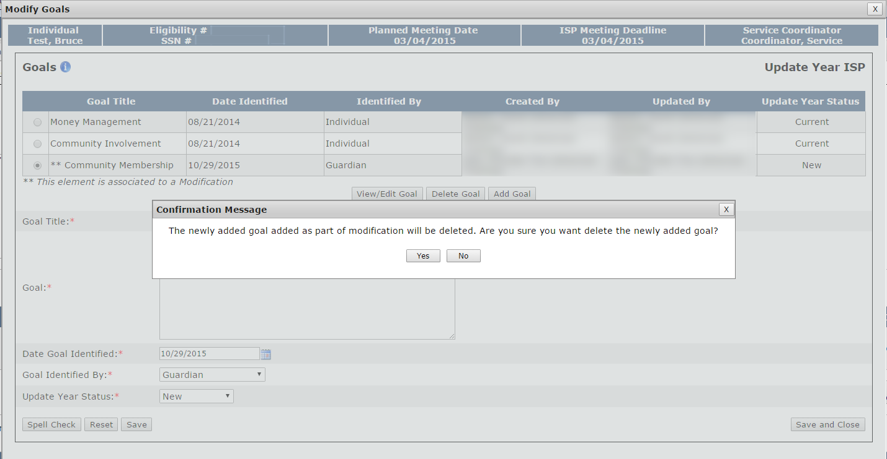
Scenario: Provider Initiates a Modification
Step 1
Navigate to
Dashboard & Select “Modifications”
Step 2
Click “Add New Modification” &
Enter Modification
Reason
Step 3
Select Element to Modify
Step 4
Complete Modification of
Element
Step 5
(Optional)
Repeat for Other Element/s
Step 6
Complete the Review Section
And Submit
Step 4: Complete Modification of Element
A.) Goals
Option 3: Delete Goal
The system will display a pop-up Confirmation Message. Click “Yes.”

Slide 44
Scenario: Provider Initiates a Modification
Step 1
Navigate to
Dashboard & Select “Modifications”
Step 2
Click “Add New Modification” &
Enter Modification
Reason
Step 3
Select Element to Modify
Step 4
Complete Modification of
Element
Step 5
(Optional)
Repeat for Other Element/s
Step 6
Complete the Review Section
And Submit
Step 4: Complete Modification of Element
A.) Goals
Option 3: Delete Goal
The system will return to the Goals pop-up screen. The goal will no longer appear.

Slide 45
Scenario: Provider Initiates a Modification
Step 1
Navigate to
Dashboard & Select “Modifications”
Step 2
Click “Add New Modification” &
Enter Modification
Reason
Step 3
Select Element to Modify
Step 4
Complete Modification of
Element
Step 5
(Optional)
Repeat for Other Element/s
Step 6
Complete the Review Section
And Submit
Step 4: Complete Modification of Element
A.) Goals
Option 3: Delete Goal
Click “Save and Close.”

Slide 46
Scenario: Provider Initiates a Modification
Step 1
Navigate to
Dashboard & Select “Modifications”
Step 2
Click “Add New Modification” &
Enter Modification
Reason
Step 3
Select Element to Modify
Step 4
Complete Modification of
Element
Step 5
(Optional)
Repeat for Other Element/s
Step 6
Complete the Review Section
And Submit
Step 4: Complete Modification of Element
A.) Goals
Option 3: Delete Goal
The system will return to the Modifications Details Screen.

Slide 47
Scenario: Provider Initiates a Modification
Step 1
Navigate to
Dashboard & Select “Modifications”
Step 2
Click “Add New Modification” &
Enter Modification
Reason
Step 3
Select Element to Modify
Step 4
Complete Modification of
Element
Step 5
(Optional)
Repeat for Other Element/s
Step 6
Complete the Review Section
And Submit
Step 5: (Optional) Repeat for Other Element/s
If desired it is possible to complete additional modifications to “Goals”, “Objectives”, or “Behavior Plan, Residential Support, or Other.”
If there are multiple elements that require a modification and that are required for the same reason, it is best practice to submit a single modification that includes multiple elements rather than submit multiple modifications.

Slide 48
Scenario: Provider Initiates a Modification
Step 1
Navigate to
Dashboard & Select “Modifications”
Step 2
Click “Add New Modification” &
Enter Modification
Reason
Step 3
Select Element to Modify
Step 4
Complete Modification of
Element
Step 5
(Optional)
Repeat for Other Element/s
Step 6
Complete the Review Section
And Submit
Step 5: (Optional) Repeat for Other Element/s
Additionally, after a modification has been completed for an element but prior to submission, it is possible to edit or delete completed elements.
To edit a Goal Modification, click “View / Edit Goal Modification.”
To delete a Goal Modification, click “Delete Goal Modification.”

Slide 49
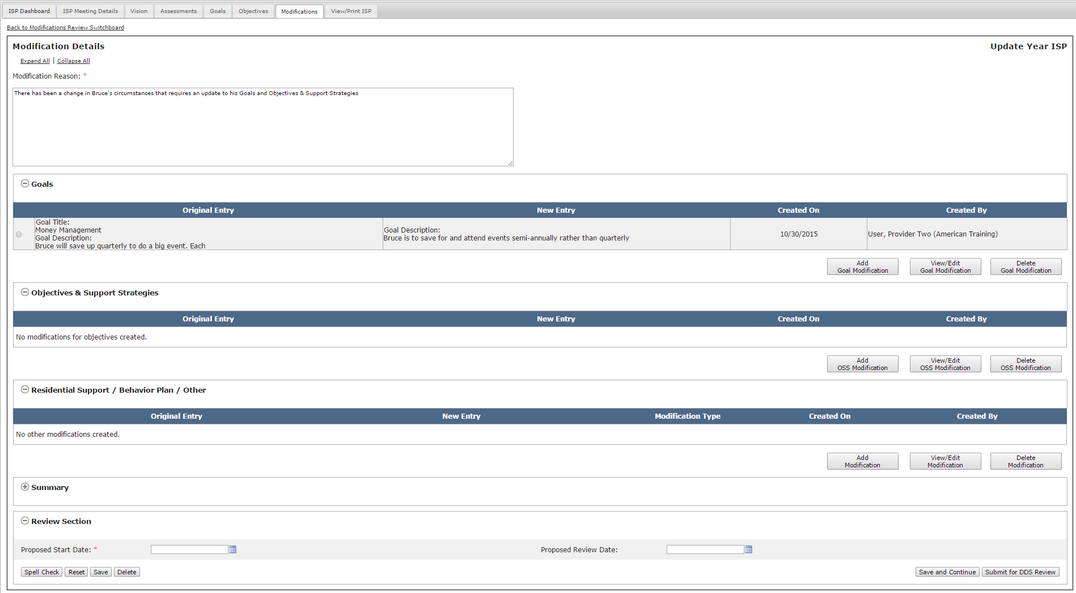
Scenario: Provider Initiates a Modification
Step 1
Navigate to
Dashboard & Select “Modifications”
Step 2
Click “Add New Modification” &
Enter Modification
Reason
Step 3
Select Element to Modify
Step 4
Complete Modification of
Element
Step 5
(Optional)
Repeat for Other Element/s
Step 6
Complete the Review Section
And Submit
Step 6: Complete the Review Section and Submit to DDS for Review
Prior to submitting, it is mandatory to complete the Review Section at the bottom of the Modifications Details Screen. Enter a Proposed Start Date. Optionally, also add in Proposed Review Date.

Slide 50
Scenario: Provider Initiates a Modification
Step 1
Navigate to
Dashboard & Select “Modifications”
Step 2
Click “Add New Modification” &
Enter Modification
Reason
Step 3
Select Element to Modify
Step 4
Complete Modification of
Element
Step 5
(Optional)
Repeat for Other Element/s
Step 6
Complete the Review Section
And Submit
Step 6: Complete the Review Section and Submit to DDS for Review
Click “Submit for DDS Review”. Alternatively, click on the “Save” or “Save and Continue” buttons to save this information so that it can be worked on at a later time.

Slide 51
Notes and Next Steps
Service Coordinator and/or Service Coordinator Supervisor
Once a modification has been submitted to DDS, the Service Coordinator or Service Coordinator Supervisor is responsible for reviewing the modification. They can either Disapprove, Accept, or Request Revision on the Modification.
If the Service Coordinator or Service Coordinator Supervisor determines that the modification has been submitted in error or is not required, they will disapprove the modification. In this case, the Provider Supervisor will receive an alert indicating that it has been disapproved. No additional action is required.
If the Service Coordinator or Service Coordinator Supervisor determines that the modification requires revision, the Provider Supervisor will receive an alert and will be responsible for revising the modification.
If the Service Coordinator or Service Coordinator Supervisor determines that the modification is accurate, they will submit the modification for Area Office Director review. The Provider Supervisor will receive an alert indicating that the proposed modification has been accepted by DDS.

Slide 52
Notes and Next Steps
Acceptance v. Approval
If the Service Coordinator or Service Coordinator Supervisor submits the modification for Area Office Director review, Providers will receive an alert indicating that the modification has been accepted but they still must wait for approval by the AOD.
Provider Alert | Reviewer
“Service Coordinator has accepted proposed Modification” | Service Coordinator Service Coordinator Supervisor
“AOD has approved your proposed Modification” | Area Office Director

Slide 53
Notes and Next Steps
Area Office Director
If the Area Office Director approves the modification, the status is changed to approved in the Modifications Review Switchboard and the modification can be printed without a draft watermark.
If the Area Office Director disapproves the modification, the status is changed to disapproved in the Modifications Review Switchboard and no further action is required. The modification content, however, is not deleted and the AOD has the option of changing the status of the modification to approved or requesting revision on the form at a later date if circumstances require it.
Once a modification for a newly added objective is submitted and approved, Progress Summaries will be triggered for the objective.

Slide 54
Scenario: Reviewing and Revising a Modification

Slide 55
Scenario: Revising a Modification
Description: Once DDS has returned a modification for revision, Providers Supervisors can revise and re-submit an Modification.
Roles and Responsibilities:
Provider Data Entry User: N/A
Provider Supervisor: Revise a Modification, Submit for DDS Review

Slide 56
Scenario: Revising a Modification
Step 1
Navigate to Modifications Review Switchboard
Step 2
Select “Revision Requested” Status
Step 3
Review and Revise Modification
Step 4
Click “Submit for DDS Review”
Step 1: Navigate to Modifications Review Switchboard
If DDS returns a modification for revision, the Provider Supervisor will receive an alert.
Click “Revision Requested for Proposed Modification.”

Slide 57
Scenario: Revising a Modification
Step 1
Navigate to Modifications
Review Switchboard
Step 2
Select “Revision Requested” Status
Step 3
Review and Revise Modification
Step 4
Click “Submit for DDS Review”
Step 2: Select “Revision Requested Status”
The system will navigate to the Modifications Review Switchboard and display the modification that has been returned.
Click “Revision Requested.”

Slide 58
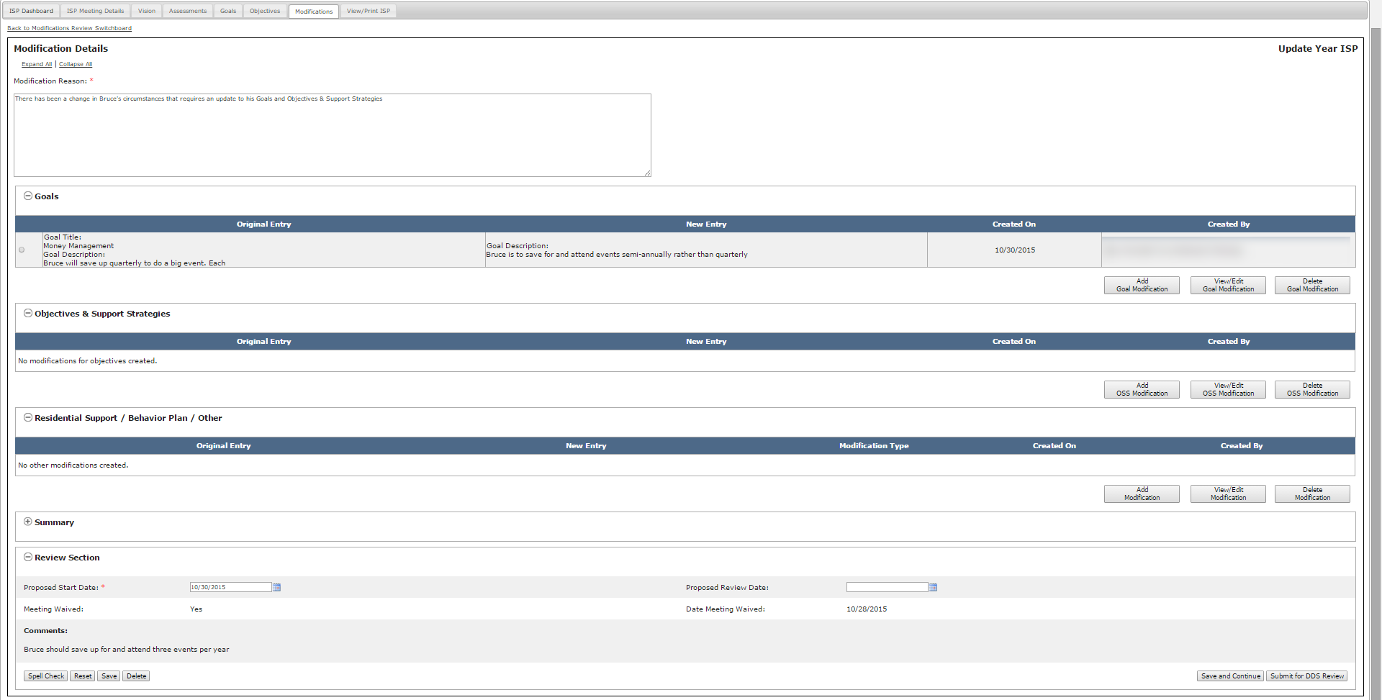
Scenario: Revising a Modification
Step 1
Navigate to Modifications Review Switchboard
Step 2
Select “Revision Requested” Status
Step 3
Review and Revise Modification
Step 4
Click “Submit for DDS Review”
Step 3: Review and Revise Modification
The Modifications Details Form will display. Review the comments section to identify the requested revisions.

Slide 59
Scenario: Revising a Modification
Step 1
Navigate to Modifications
Review
Switchboard
Step 2
Select “Revision Requested” Status
Step 3
Review and Revise Modification
Step 4
Click “Submit for DDS Review”
Step 3: Review and Revise Modification
Select the Radio Button for the modification element you would like to edit.

Slide 60
Scenario: Revising a Modification
Step 1
Navigate to Modifications
Review Switchboard
Step 2
Select “Revision Requested” Status
Step 3
Review and Revise Modification
Step 4
Click “Submit for DDS Review”
Step 3: Review and Revise Modification
Click “View / Edit Goal Modification.”

Slide 61
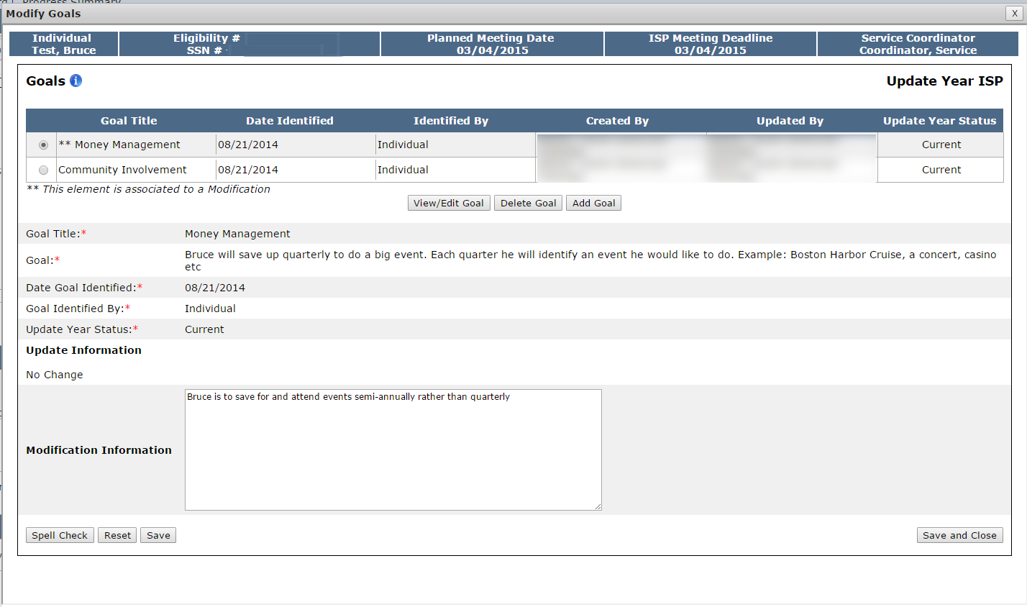
Scenario: Revising a Modification
Step 1
Navigate to Modifications Review Switchboard
Step 2
Select “Revision Requested” Status
Step 3
Review and Revise Modification
Step 4
Click “Submit for DDS Review”
Step 3: Review and Revise Modification
The Goals pop-up screen will display. An element associated with a modification will display with two asterisks.

Slide 62
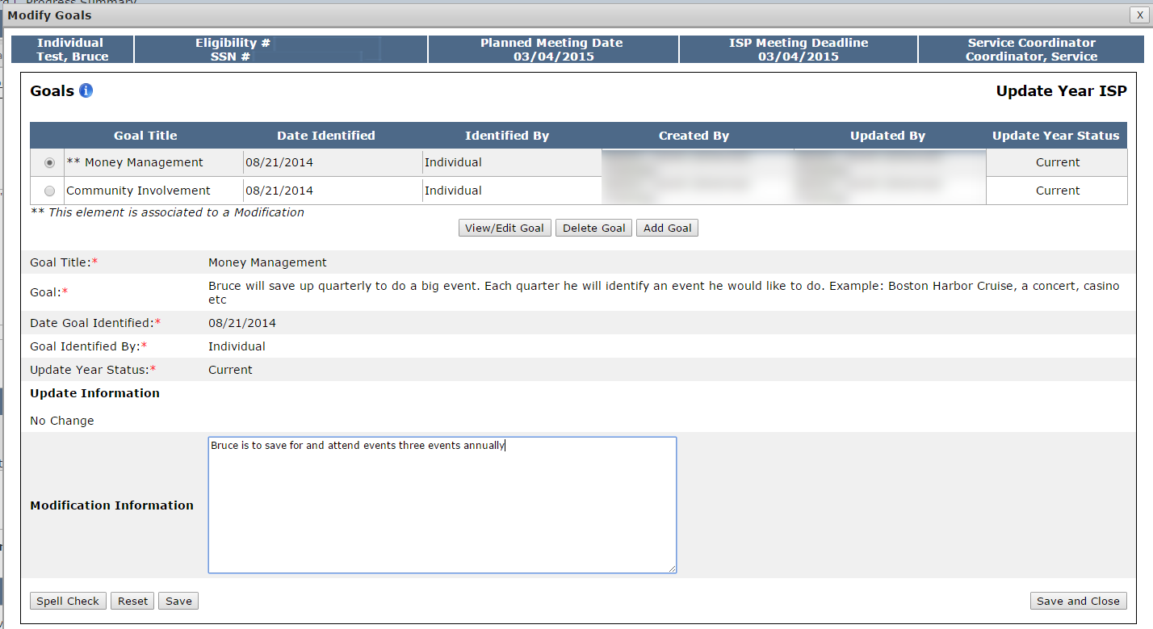
Scenario: Revising a Modification
Step 1
Navigate to Modifications
Review
Switchboard
Step 2
Select “Revision Requested” Status
Step 3
Review and Revise Modification
Step 4
Click “Submit for DDS Review”
Step 3: Review and Revise Modification
Modify the goal as requested.

Slide 63
Scenario: Revising a Modification
Step 1
Navigate to Modifications
Review Switchboard
Step 2
Select “Revision Requested” Status
Step 3
Review and Revise Modification
Step 4
Click “Submit for DDS Review”
Step 3: Review and Revise Modification
Click “Save and Close.” The system will return to the Modifications Details screen.

Slide 64
Scenario: Revising a Modification
Step 1
Navigate to Modifications
Review Switchboard
Step 2
Select “Revision Requested” Status
Step 3
Review and Revise Modification
Step 4
Click “Submit for DDS Review”
Step 4: Click “Submit for DDS Review”
Revise the Proposed Start Date, if desired, and then click “Submit for DDS Review.”

Slide 65
Notes and Next Steps
Service Coordinator and/or Service Coordinator Supervisor
Once a modification has been submitted to DDS, the Service Coordinator or Service Coordinator Supervisor are responsible for reviewing the modification. They can either Disapprove, Accept, or Request Revision on the Modification.
If the Service Coordinator or Service Coordinator Supervisor determines that the modification is acceptable, they will submit the modification for Area Office Director review. The Area Office Director is able to approve or disapprove the modification.
Area Office Director
If the Area Office Director approves, the status of modification is changed to approved in the Modifications Review Switchboard and the modification can be printed without a draft watermark.
If the Area Office Director disapproves the modification, the status is changed to disapproved in the Modifications Review Switchboard and no further action is required. The modification content, however, is not deleted and the AOD has the option of changing the status of the modification to approved at a later date if circumstances require it.

Slide 66
Notes and Next Steps
NOTE: Once a modification for a newly added objective is submitted and approved, progress summaries will be triggered for the objective.
NOTE: All modifications for a plan need to be approved or disapproved for next years plan to open.
NOTE: DDS Staff is capable of initiating a modification to a Goal or Residential Support Plan / Other – but not for an Objective Support Strategy. If a modification is initiated by a Service Coordinator or Service Coordinator Supervisor, the Provider Supervisor is not required to complete the form but will receive access to the form once the modification has been approved.

Slide 67
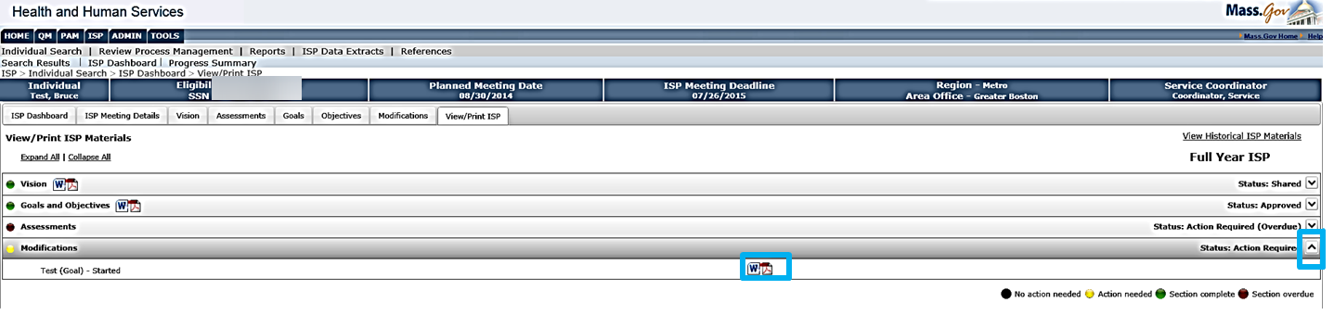
Printing Modifications
To print modifications for the current ISP, navigate to the “View / Print ISP” tab from the Individual Dashboard.
Click on ^ icon on the Modification bar to expand the modification section.
Once initiated, all Modifications will appear in the “View / Print” tab.
Until an Area Office Director approves the modification, however, all modifications will print with a draft watermark.

Slide 68
Review Process Management
The Review Process Management table now includes a “Modification” column, which indicates the status of any modifications associated with an individual’s ISP.
If no modifications have been submitted for an individual, the text in the column will read “Not Applicable.”

Slide 69
Chapter 6 Summary
This Chapter covered:
Overview of Modifications
Scenario: Provider Initiates a Modification
Scenario: Reviewing and Revising Modification

