Slide 1
Department of Developmental Services
Massachusetts Rehabilitation Commission
Individual Support Plan (ISP) Module – Release 7.7
Training - Provider Staff

Slide 2
Chapter 7: Additional Functionality and Conclusion
Chapter 1
Chapter 2
Chapter 3
Chapter 4
Chapter 5
Chapter 6
Chapter 7

Slide 3
Chapter 7 Overview
This Chapter will cover:
Internal Provider Workflow Enhancement
Additional Enhancements
Training Summary and Conclusion

Slide 4
Internal Provider Workflow Enhancement

Slide 5
Internal Provider Workflow Enhancement
Provider Supervisors now have the ability to request internal revisions from Data Entry Users on Objectives, Assessments, and Progress Summaries. Individuals with the Provider Supervisor role have the option to return documents submitted for internal review back to Provider Data Entry Users, prior to submitting to DDS.
Provider Supervisor View :

Slide 6
Additional Enhancements

Slide 7
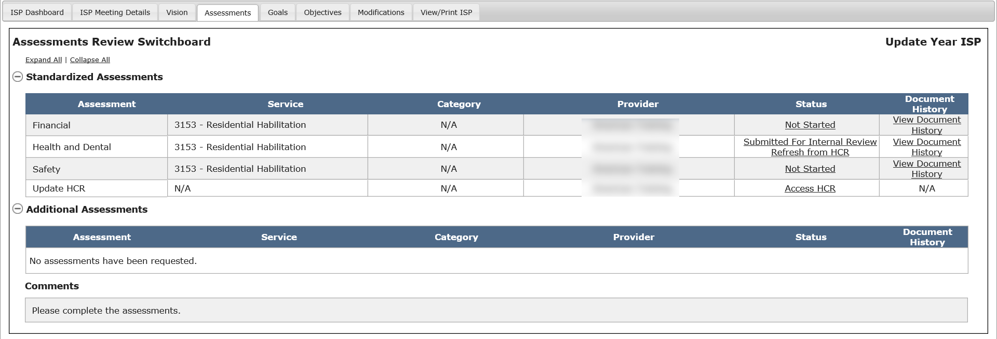
Other Enhancements
Health Care Record and Health & Dental Assessment – Date Format
Previous Functionality | New Functionality
Only the year – “yyyy” format- for dates for physical and medical examination dates are entered in the Health Care Record and, after the record has been refreshed, the dates populate in the Health and Dental Assessment. | The Health Care Record has been enhanced to now allow the physical and medical examination dates to be entered in “mm/dd/yyyy” format. Once the user has entered the date in the new format in the HCR and clicked the “Refresh from HCR” button on the Assessments Review Switchboard, the new date format for physical and medical examinations will appear on the H&D assessment.

Slide 8
Other Enhancements
Below is a list that briefly describes how the new, smaller enhancements will affect HCSIS:
Topic | Previous Functionality | New Functionality
RICCI Class Member ISP Submission | The ISP process for RICCI class members had been a paper process | It is now possible to complete the ISP Process for all RICCI class members on HCSIS
Provider Access to Plans | When a Provider agency stops providing services to an individual, they would no longer have access to the individual in HCSIS. They would be unable to access the individuals current or previous plan. | If and when a Provider agency stops providing services to an individual, the agency will retain read-only access to the last ISP document which the Provider had been involved in.

Slide 9
Future Enhancements
Below is a list that briefly describes requests for enhancements that will be deployed in a future release:
Access to Historical ISP Documents
This enhancement will enable Providers, Area Directors, and Service Coordinators to access historical sections of the ISP document regardless of whether the year selection status has been made by the service coordinator
Data Extracts
Accessing an ISP Data Extract
Document Upload to HCSIS
Additional assessments
Supporting documentation

Slide 10
Chapter 7 Summary
This Chapter covered:
Internal Provider Workflow Enhancement
Additional Enhancements

Slide 11
Training Conclusion and Next Steps

Slide 12
Training Summary
Chapter 1: Overview of the ISP Module
Chapter 2: Year Selection
Chapter 3: Progress Summary
Chapter 4: Progress Summary Report
Chapter 5: Area Office Director Approval of the ISP
Chapter 6: Modifications
Chapter 7: Additional Functionality and Conclusion

Slide 13
Additional References
Additional references are accessible on the ISP References page. To access the page, click the References second level menu tab in the ISP module.

Slide 14
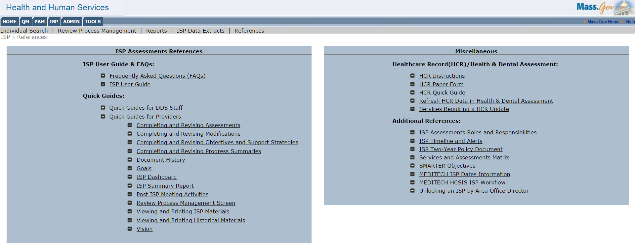
Additional References
The References page provides links to FAQs, ISP User Guide, Quick Guides, and additional references relating to the ISP Module. This is the expanded view of the ISP Module references.

Slide 15
Additional References
Quick Guides on the new enhancements are available to you on the reference page.

Slide 16
Additional References
One of the reference documents on the reference page is the ISP Timeline and Alerts document which identifies all of the alerts that the system generates

Slide 17
Additional References
Additional training content is available to you on DDSLearning.com. The content on the website includes video reference material. Be sure to use Google Chrome when accessing this website.
1. Click “Training and Development Opportunities”
2. Click “HCSIS Online Training”

Slide 18
Key Considerations
The ISP Assessments module enhancements will be accessible starting February 8th, 2016.
Post go-live webinars will be conducted in the few months following the go-live date to address outstanding questions related to the changes.
IMPORTANT NOTE: On February 8th, the Progress Summary process will be activated. If a Progress Summary is due on or after March 9th – which is 30 days after the go-live – Providers will be required to complete the Progress Summary in the system and will receive alerts associated with the Progress Summary.
February 8th | PS due < 30 days after go-live | PS due >= 30 days after go-live
Go-live | Complete Paper Form | Complete form in HCSIS

Slide 19
Next Steps
A recording of this training session will be posted on the DDSlearning.com.
If you have any additional questions, feel free to contact the DDS Help Desk
‒ 617-994-5050**
dds.customerservices@state.ma.us
Hours of operation: 7AM – 7PM M-F
**Please note that, as of 6/1/2015, the help desk phone number was changed to the above.

