Slide 1
Department of Developmental Services
Massachusetts Rehabilitation Commission
Individual Support Plan (ISP) Module Training
Release 7.7 – DDS Staff

Slide 2
Introduction
The purpose of today’s training session is to provide you with an overview of the enhancements that are being included in the new release of the ISP module, which will go live on February 8th, 2016.
Enhancements included in this release will be reviewed in detail throughout today’s training and include the following:
Progress Summary
Modifications
Auto-Save for ISP document components
Additional Functionality

Slide 3
Chapter Plan
Chapter 1: Overview of the ISP Module
Chapter 2: Year Selection
Chapter 3: Progress Summaries
Chapter 4: Progress Summary Report
Chapter 5: Area Director Approval of the ISP
Chapter 6: Modifications
Chapter 7: Additional Functionality and Conclusion

Slide 4
Chapter Plan
Chapter 1: Overview of the ISP Module
ISP Workflow
Refresher on Recent Enhancements
Chapter 2: Year Selection
Year Selection for ISP
Chapter 3: Progress Summaries
Overview of Progress Summaries
Progress Summary Review Switchboard
Scenario: Initiate a Progress Summary
Scenario: Review an Progress Summary
Chapter 4: Progress Summary Report
Accessing a Progress Summary Report
Chapter 5: Area Director Approval of the ISP
New Trigger for Locking the ISP In HCSIS
Lock Icon on Individual Dashboard
Chapter 6: Modifications
Overview of Modifications
Scenario: Initiating a Modification
Scenario: Reviewing a Modification
Chapter 7: Additional Functionality and Conclusion
Auto Save Functionality
Other Enhancements
Training Summary and Conclusion

Slide 5
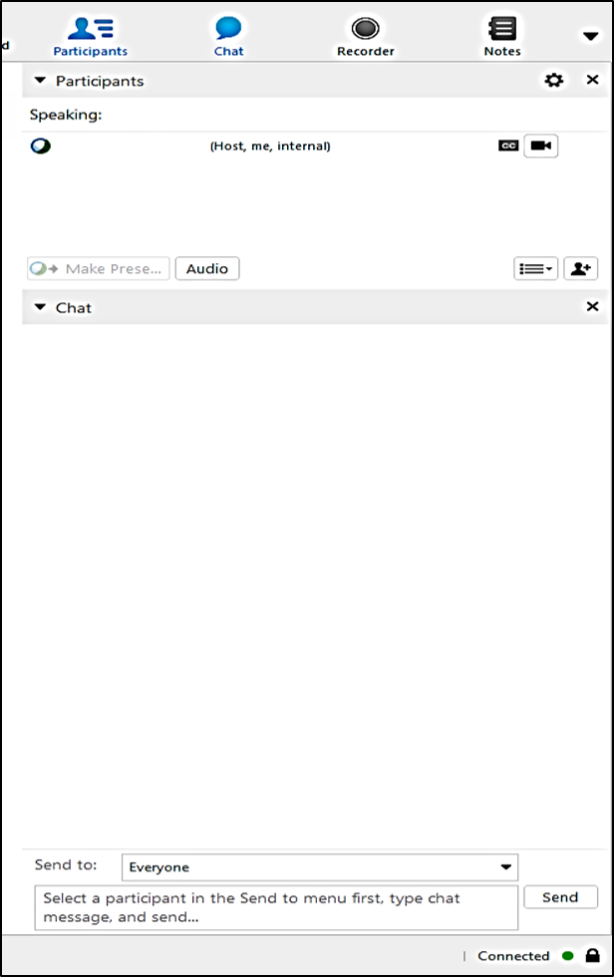
WebEx: Chat Function
1. Click ‘Chat’.
2. Select ‘Send to”
All Participants.
3. Type your message here.
4. Click ‘Send’ or use enter on your keyboard.
All Participants

Slide 6
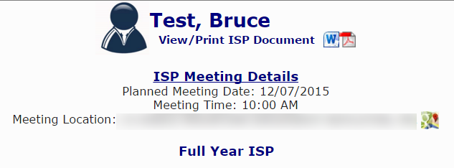
Confidential Information Protocol
No confidential information is used in the presentation.
All images of HCSIS in the presentation are populated with test data.
All personally identifiable data fields such as addresses have been blurred out.
All the scenarios in the presentation use an individual with a fake name, Bruce Test, to demonstrate the processes.

Slide 7
Chapter 1: Overview of the ISP Module
Chapter 1
Chapter 2
Chapter 3
Chapter 4
Chapter 5
Chapter 6
Chapter 7

Slide 8
Chapter 1 Overview
This Chapter will cover:
ISP Workflow
Refresher on Recent Enhancements

Slide 9
ISP Workflow

Slide 10
ISP Workflow
Set ISP Meeting Date
Complete and Review ISP Document
Initiate ISP Planning Process
Review Objectives and Supports Agreements
Request and Review Assessments
The ISP module provides an efficient mechanism for streamlining data entry and enabling efficient information sharing between members of the ISP team.

Slide 11
Refresher on Recent Enhancements

Slide 12
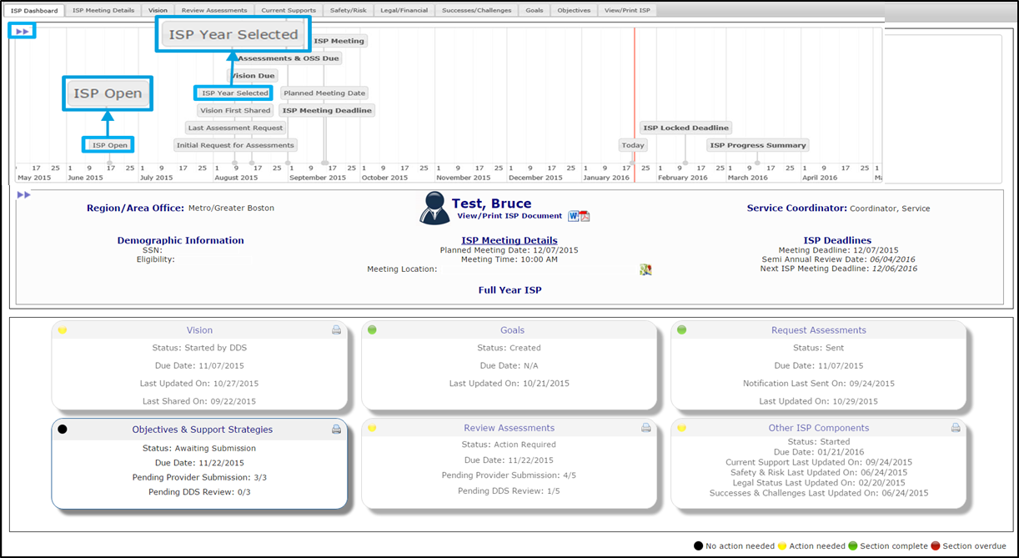
Timeline for ISP Plan Type Selection
Above each individual's ISP Dashboard details is a personalized ISP timeline graph for that individual. In order to view the timeline click above the Individual Dashboard.
The “ISP Open” is the date the ISP process was initiated, 90 days prior to the ISP Meeting Date.
The “ISP Year Selected” is the date the plan type selection was made.

Slide 13
Recall Functionality
The following sections will be recalled for an Update Year ISP:
Vision Statement recorded in the previous year’s ISP will be recalled and updated by SCs and shared with Providers.
Goals recorded in previous ISP will be recalled and can be updated by both SCs and Providers.
Objectives from the previous ISP will be recalled, updated and submitted by Providers.
Once requested by the SC, Assessments recorded in the previous year’s ISP can be recalled, updated and submitted by Providers.
Other ISP components will be recalled and updated by SCs.
The following sections will be recalled for a Full Year ISP:
Vision Statement recorded in the previous year’s ISP will be recalled and revised by SCs and shared with Providers.
Goals recorded in previous ISP will be recalled and can be revised by both SCs and Providers.
Objectives from the previous ISP will be recalled, revised and submitted by Providers.
Once requested by the SC, Assessments recorded in the previous year’s ISP can be recalled, revised and submitted by Providers.
Other ISP components will be recalled and revised by SCs.
The same sections are recalled in both an Update Year or Full Year. However, in an update year recalled information can be updated versus in a full year the recalled information should be revised to reflect a completely new plan.

Slide 14
Historical ISP Materials
On the View / Print ISP tab, click View Historical ISP Materials to view historical ISP Documents, Assessments, Goals, and Objectives.

Slide 15
Historical ISP Materials
The system will display the Historical ISP Materials pop-up. There are separate tabs for ISP Documents, Assessments and Goals and Objectives. To view and / or print any of the documents, click the PDF icon.

Slide 16
Summary Report
The Summary Report is a reporting tool for DDS and Provider staff to review the timeliness of actions that occurred leading up to the ISP Meeting for each individual. Only the initial submission of assessments and objectives is considered for this report. For an individual to appear, the actual meeting date must have been entered in MEDITECH.
Additional enhancements made to the Summary Report in the August release:
Historical ISPs can be seen in the Summary Report. If the date range entered spans across more than one Actual Meeting Date for an individual, all plans of the individual between the selected Actual Meeting Dates will be included in separate lines of the report.
The column “No. of Revisions Requested” is now included in the report.
Additional filters are available to narrow search results. Those filters that were added are in bold:
Area Office
Provider
Document Status
Report Display Option
Service/Activity Code
Group Results By

Slide 17
Update Year Status for Goals and Objectives
The column Update Year Status appears for Goals and Objectives in an update year ISP. The table below further describes how to use the five statuses available for Goals and Objectives.
Update Year Status | Description
Met | Used to describe a goal or objective that has been achieved by the individual and no longer remains a goal or objective for the Update Year ISP.
Discontinued | Used to identify a goal or objective that is no longer relevant for the individual or has ended. *Goals or Objectives should not be discontinued if there is a minor change. In this case, the status should be changed to updated*
Current | Used to identify a goal or objective from the previous year’s ISP that has not changed and continues into the update year ISP. *All recalled goals and objectives will be defaulted to current* *If a current goal or objective is updated, the status should be changed to updated*
Updated | Used to identify a goal or objective from the previous year’s ISP that has been changed for the update year ISP.
New | Used to identify a newly added goal or objective. *Newly added goals or objectives will be defaulted to new*

Slide 18
Chapter 1 Summary
This Chapter covered:
ISP Workflow
Refresher on Recent Enhancements

Slide 19
Chapter 2: Year Selection
Chapter 1
Chapter 2
Chapter 3
Chapter 4
Chapter 5
Chapter 6
Chapter 7

Slide 20
Chapter 2 Overview
This Chapter will cover:
Year Selection for ISP

Slide 21
Year Selection for ISP

Slide 22
Year Selection for ISP
Previous Functionality | Service Coordinators are required to manually make the year selection (i.e. Full-Year, Update Year) for individuals in HCSIS. Data Entry Users and Provider Supervisors are only able to access an individual’s plan after the Service Coordinator has completed this task and made the plan type selection.
New Functionality | The year selection process has been partially automated If the plan type for the most recently completed plan is an update year, the system will automatically choose full year for the subsequent plan. If, on the other hand, the plan type for the most recently completed plan is a full year, the Service Coordinator is still required to manually make the year selection. Provider staff continue to receive access to an individual’s plan after the plan type selection has been made.
New Pop-Up Box for Year Selection for ISP:

Slide 23
Chapter 2 Summary
This Chapter covered:
Year Selection for ISP

