Slide 1
Department of Developmental Services
Massachusetts Rehabilitation Commission
Individual Support Plan (ISP) Module Training
Release 7.7 – DDS Staff

Slide 2
Chapter 3: Progress Summaries
Chapter 1
Chapter 2
Chapter 3
Chapter 4
Chapter 5
Chapter 6
Chapter 7

Slide 3
Chapter 3 Overview
This Chapter will cover:
Overview of Progress Summaries
Progress Summary Review Switchboard
Scenario: Initiate a Progress Summary
Scenario: Review a Progress Summary

Slide 4
Overview of Progress Summaries

Slide 5
Progress Summary Workflow
ISP Meeting is Held
Progress Summaries due at annual ISP
Objectives are approved, included in ISP and frequency is selected by SC
Progress Summaries due at semi- annual review
Progress Summary Alerts received by Provider staff
Per DDS Regulation 115 CMR 6.21.5 J and Regulation 115 CMR 6.21.6, semi-annual and annual Progress Summaries are required as part of the ISP process. The ISP module provides an efficient mechanism for streamlining the submission process. The SC has the option, after conferring with the provider agency, of requesting quarterly Progress Summaries.

Slide 6
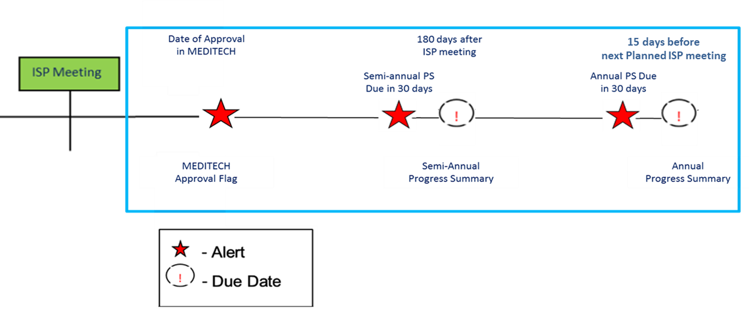
Timeline for Completion of Progress Summary
Semi-Annual
The default frequency for Progress Summary is semi-annual. The due dates for Progress Summary are as follows:
Semi Annual Progress Summary – 180 days after the ISP Meeting
Annual Progress Summary – 15 days prior to the next planned meeting date or the deadline
When the due date for an Progress Summary is within 30 days, Service Coordinators and Provider Data Entry Users will receive an Alert indicating that the provider is able to complete the Progress Summaries.

Slide 7
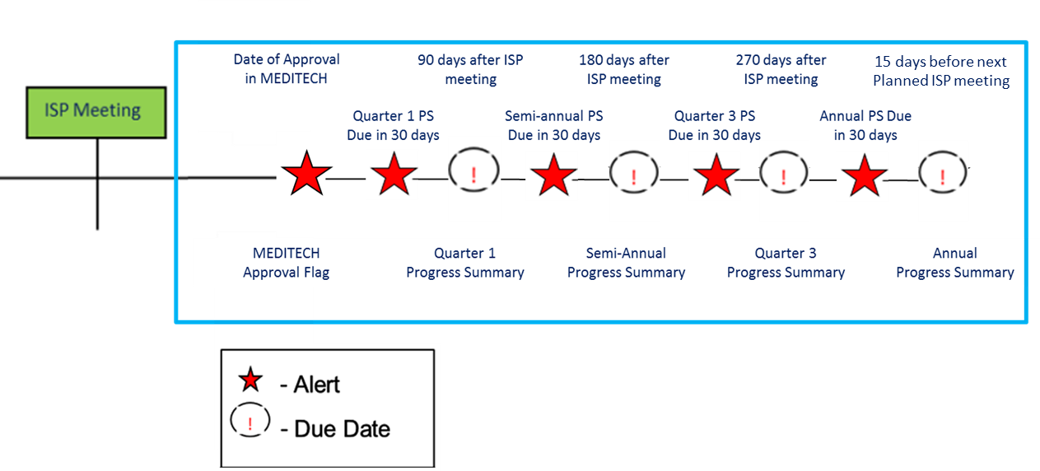
Timeline for Completion of Progress Summary
Quarterly
If the Service Coordinator selects the frequency of the Progress Summary as quarterly, the due dates for Progress Summaries are as follows:
Quarter 1 – 90 days after the ISP meeting
Semi-Annual – 180 days after the ISP meeting
Quarter 3 – 270 days after the ISP meeting
Annual – 15 days prior to the next planned meeting date or the deadline
When the due date for ISP Progress Summaries is within 30 days, Service Coordinators and Provider Data Entry Users will receive an Alert indicating that the provider is able to complete the Progress Summaries.

Slide 8
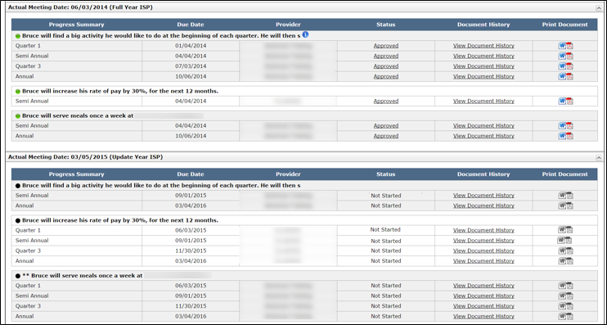
Timeline for Completion of Progress Summary
The due date for the annual Progress Summary is calculated differently from the other deadlines.
Quarter 1 = Actual Meeting Date + 90 Days
Semi-Annual = Actual Meeting Date + 180 Days
Quarter 3 ISP = Actual Meeting Date + 270 Days
Annual = Next Planned Meeting Date (or ISP Meeting Deadline) – 15 Days

Slide 9
Progress Summary Review Switchboard

Slide 10
Navigate to the PS Review Switchboard
There are two ways to navigate to the Progress Summary Review Switchboard.
Option 1
It is possible to navigate to the Progress Summary Review Switchboard from the Individual Dashboard.
Above the Individual Dashboard, click the third-level menu item, “Progress Summary .”

Slide 11
Navigate to the PS Review Switchboard
There are two ways to navigate to the Progress Summary Review Switchboard.
Option 2
Alternatively, it is possible to navigate to the Progress Summary Review Switchboard from the Individual Search.
View the new Progress Summary column and click the “View Progress Summary ” link.

Slide 12
PS Review Switchboard
Progress Summary Review Switchboard
The Progress Summary Review Switchboard is composed of two sections.
1
Progress Summary Bar Graph
2
Progress Summary Details

Slide 13
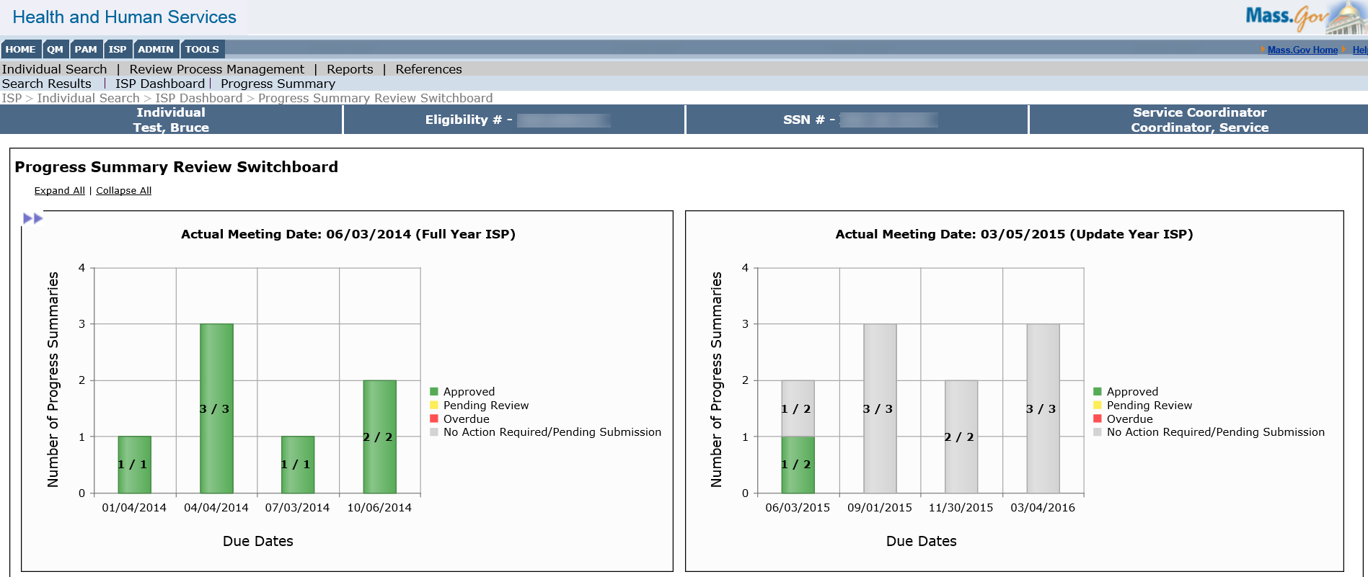
Features of the PS Review Switchboard
Progress Summary Bar Graph
This section contains information for both previous and current ISP.
The graph provides a visual of the status of all the Progress Summaries included in the previous and current ISP.

Slide 14
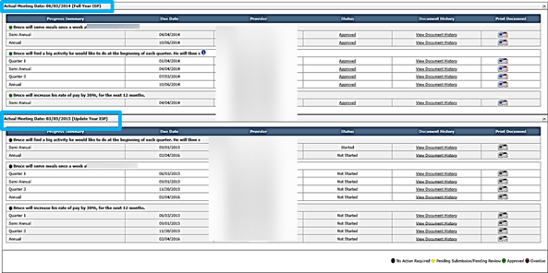
Features of the PS Review Switchboard
Progress Summary Details
Displays all Progress Summaries associated with the Actual Meeting Date for the two most recent years :
All Progress Summaries required for the prior year.
All Progress Summaries required for the current year – not just those that are approaching their due date.

Slide 15
Features of the PS Review Switchboard
Progress Summary Details
Progress Summary
The Progress Summary column displays which Progress Summary (e.g. quarter 1, annual).
Due Date
The Due Date column displays the due date for the Progress Summary .
Provider
The Provider column displays which Provider is required to complete the Progress Summary .

Slide 16
Features of the PS Review Switchboard
Progress Summary Details
Status
To view a Progress Summary , click the link in the Status column.

Slide 17
Features of the PS Review Switchboard
Progress Summary Details
Print Document
Click either the Word or PDF Icon to print a Progress Summary .
Until the Service Coordinator approves the Progress Summary, it will print with a draft watermark.
Document History
To view the Document History of a Progress Summary , select the View Document History link in the Document History column.

Slide 18
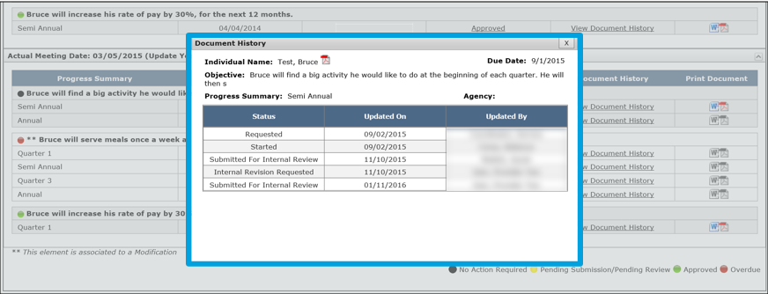
Features of the PS Review Switchboard
Progress Summary Details
Document History
To view document history of a Progress Summary , select the View Document History link in the Document History column.

Slide 19
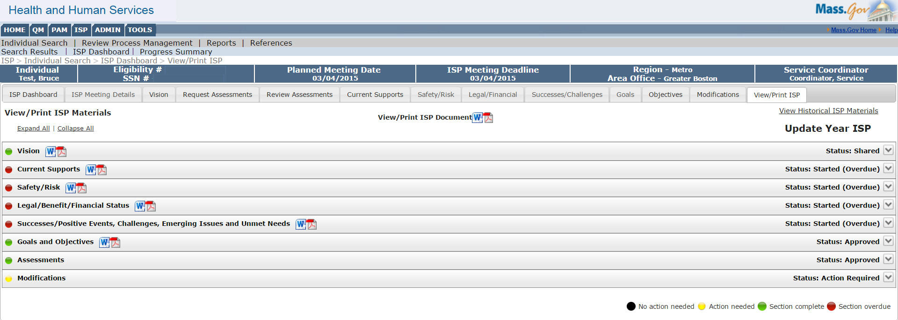
View / Print ISP Tab
Progress Summary Details
Historical Documents
All Progress Summaries that are older than two years are viewable in Historical ISP Materials section.
To access Historical ISP Materials, click the “View / Print ISP” tab and then click the “View Historical ISP Materials” button.

Slide 20
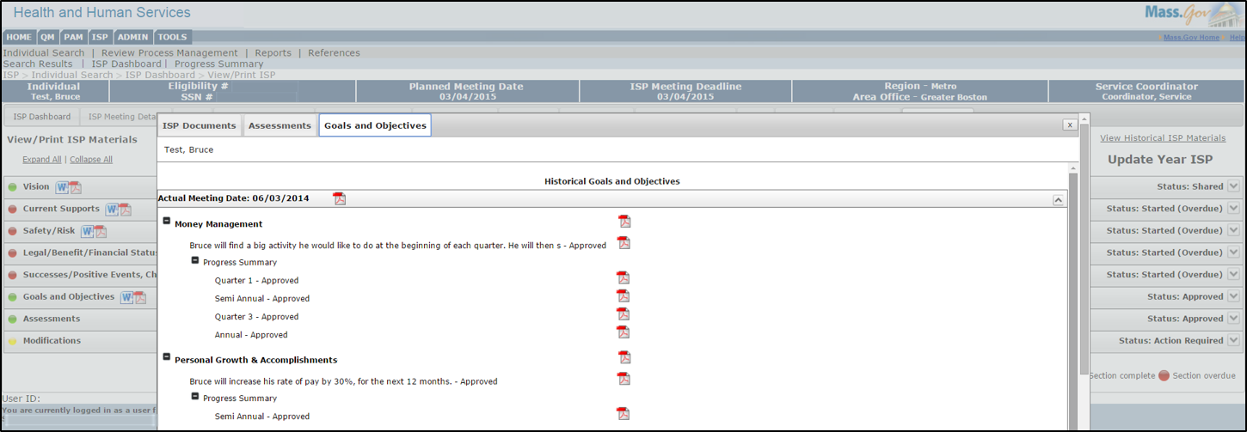
View / Print ISP Tab
Progress Summary Details
Historical Documents
Historical Progress Summaries are located on the “Goals and Objectives Tab.”
Click the PDF icon next to the desired Progress Summary to view and print.

Slide 21
Scenario: Initiate a Progress Summary

Slide 22
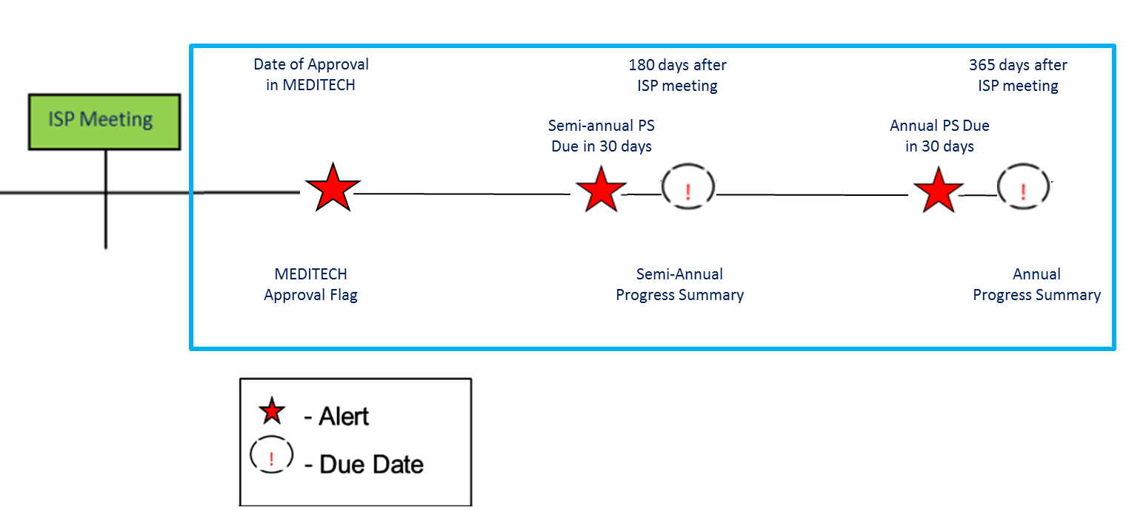
Scenario: Initiate a Progress Summary
Description: The Progress Summary process is now included in the HCSIS system. These Progress Summaries, which track the progress of Objectives following the ISP Meeting, were previously completed outside of the system. With the implementation of Progress Summaries within HCSIS, once an Actual Meeting Date has been entered in MEDITECH, DDS staff are able to initiate the Progress Summary process by adding approved Objectives for inclusion in the ISP Document. Until Progress Summaries have been initiated by the DDS user, Providers will be unable to access and complete the forms.
Roles and Responsibilities:
Service Coordinator: Initiate an Progress Summary
Service Coordinator Supervisor: Initiate an Progress Summary
15 days before next Planned ISP meeting

Slide 23
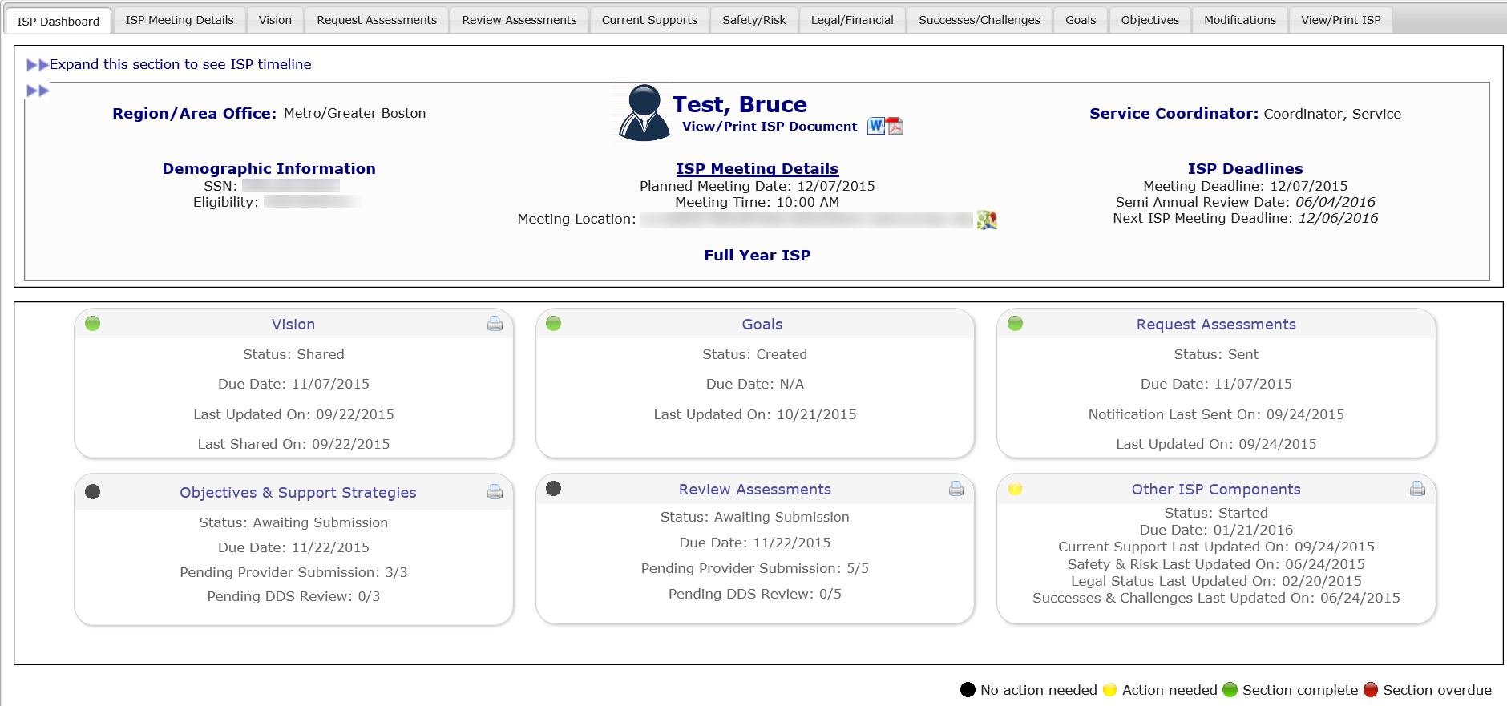
Scenario: Initiate a Progress Summary
Step 1
Click
“Objectives” tab
Step 2
Select “Include in ISP” for Objectives
Step 3
Select “PS Frequency” drop-down option
Step 4
Click “Include in ISP document and Initiate Progress Summary ”
Step 5
Navigate to Progress Summary Review Switchboard
Step 1: Click “Objectives Tab”
Navigate to the Individual Dashboard. Click “Objectives.”

Slide 24
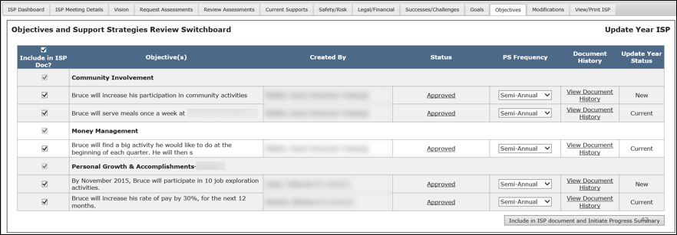
Scenario: Initiate a Progress Summary
Step 1
Click
“Objectives” tab
Step 2
Select “Include in ISP” for Objectives
Step 3
Select “PS Frequency” drop-down option
Step 4
Click “Include in ISP document and Initiate Progress Summary ”
Step 5
Navigate to Progress Summary Review Switchboard
Step 2: Select “Include in ISP” for Objectives
On the objectives switchboard, select the objectives that you would like to include in the ISP Document.
Only Approved objectives can be included in the ISP document once the Actual Meeting Date for the plan is available.

Slide 25
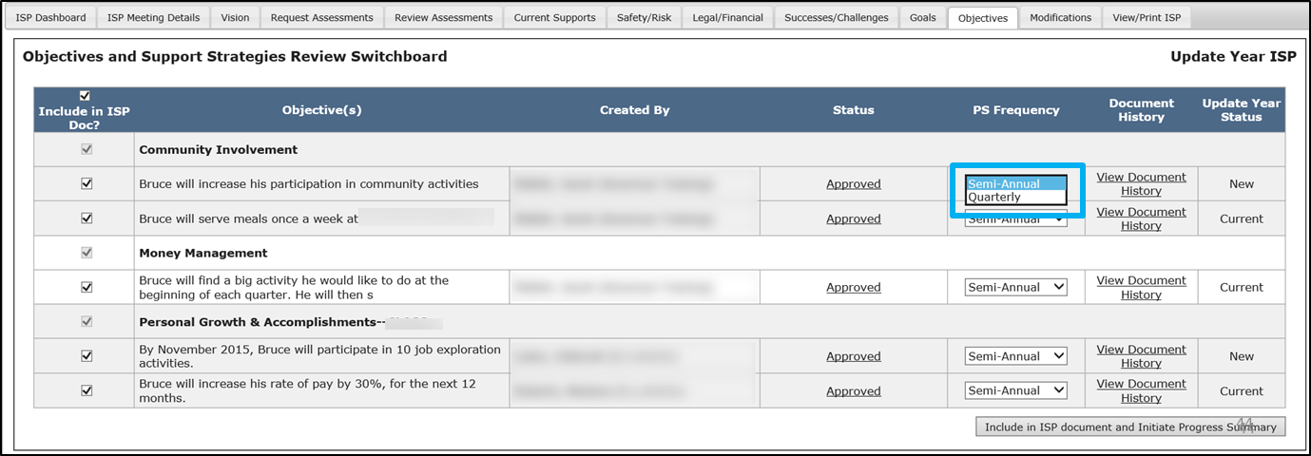
Scenario: Initiate a Progress Summary
Step 1
Click
“Objectives” tab
Step 2
Select “Include in ISP” for Objectives
Step 3
Select “PS Frequency” drop-down option
Step 4
Click “Include in ISP document and Initiate Progress Summary ”
Step 5
Navigate to Progress Summary Review Switchboard
Step 3: In the PS Frequency column, use the drop-down to set frequency
The two options in the “PS Frequency” column are “Semi-annual” or “Quarterly.”
The system defaults to “Semi-Annual.”
If Semi-Annual is selected, Providers will be required to complete two Progress Summaries– a semi annual Progress Summary and an annual Progress Summary .

Slide 26
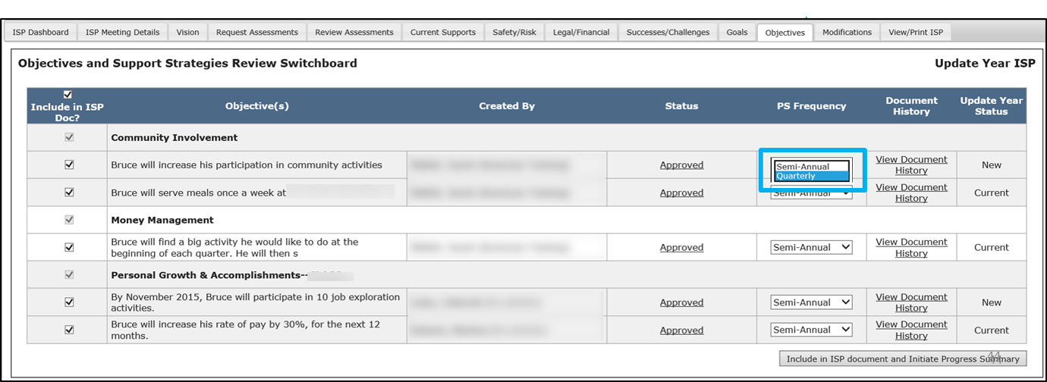
Scenario: Initiate a Progress Summary
Step 1
Click
“Objectives” tab
Step 2
Select “Include in ISP” for Objectives
Step 3
Select “PS Frequency” drop-down option
Step 4
Click “Include in ISP document and Initiate Progress Summary ”
Step 5
Navigate to Progress Summary Review Switchboard
Step 3: In the PS Frequency column, use the drop-down to set frequency
The two options in the “PS Frequency” column are “Semi-annual” or “Quarterly.”
If Quarterly is selected, Providers will be required to complete four Progress Summaries throughout the year: – Quarter 1, Semi-Annual, Quarter 3 and Annual

Slide 27
Scenario: Initiate a Progress Summary
Step 1
Click
“Objectives” tab
Step 2
Select “Include in ISP” for Objectives
Step 3
Select “PS Frequency” drop-down option
Step 4
Click “Include in ISP document and Initiate Progress Summary ”
Step 5
Navigate to Progress Summary Review Switchboard
Step 4: Click “Include in ISP document and Initiate Progress Summary ”
Click “Include in ISP document and Initiate Progress Summary .” The system will display an “Operation Successful Message.”

Slide 28
Scenario: Initiate a Progress Summary
Step 1
Click
“Objectives” tab
Step 2
Select “Include in ISP” for Objectives
Step 3
Select “PS Frequency” drop-down option
Step 4
Click “Include in ISP document and Initiate Progress Summary ”
Step 5
Navigate to Progress Summary Review Switchboard
Step 5: Navigate to Progress Summary Review Switchboard
Click the “Progress Summary ” third menu tab.

Slide 29
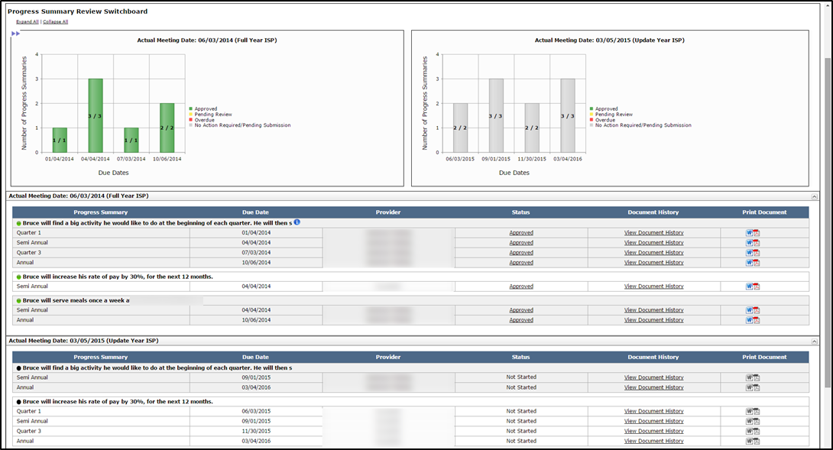
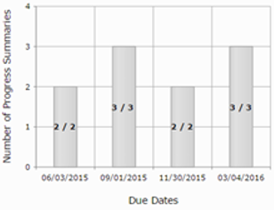
Scenario: Initiate a Progress Summary
Step 1
Click
“Objectives” tab
Step 2
Select “Include in ISP” for Objectives
Step 3
Select “PS Frequency” drop-down option
Step 4
Click “Include in ISP document and Initiate Progress Summary ”
Step 5
Navigate to Progress Summary Review Switchboard
Step 5: Navigate to Progress Summary Review Switchboard
The system will display the Progress Summary Review Switchboard. The graph will now populate and the links to the Progress Summaries will display in "Not Started" status.

Slide 30
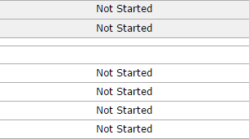
Scenario: Initiate a Progress Summary
Step 1
Click
“Objectives” tab
Step 2
Select “Include in ISP” for Objectives
Step 3
Select “PS Frequency” drop-down option
Step 4
Click “Include in ISP document and Initiate Progress Summary ”
Step 5
Navigate to Progress Summary Review Switchboard
Step 5: Navigate to Progress Summary Review Switchboard
The system will display the Progress Summary Review Switchboard. The graph will now populate and the links to the Progress Summaries will display in "Not Started" status.

Slide 31
Next Steps and Notes
Next Steps
The Progress Summary Review Switchboard will display Progress Summaries for the objectives included in the ISP document.
The status of all newly requested Progress Summaries is in “Not Started” status.
Providers can access the Progress Summary in not started status and complete, but they cannot submit to a Service Coordinator until it is 30 days prior to the due date.
Alerts
SCs and Providers will both receive an Alert 30 days prior to the due date of the Progress Summary.
On Tuesdays / Fridays, SCs will receive alerts for each Progress Summary submitted by Providers.
On Tuesdays / Fridays, SCs will receive an Alert indicating if the due date for any Progress Summary has passed without provider submission.
Screenshot of what a submitted alert looks like
Progress Summaries submitted for review by:
Progress Summaries submitted for review by:

Slide 32
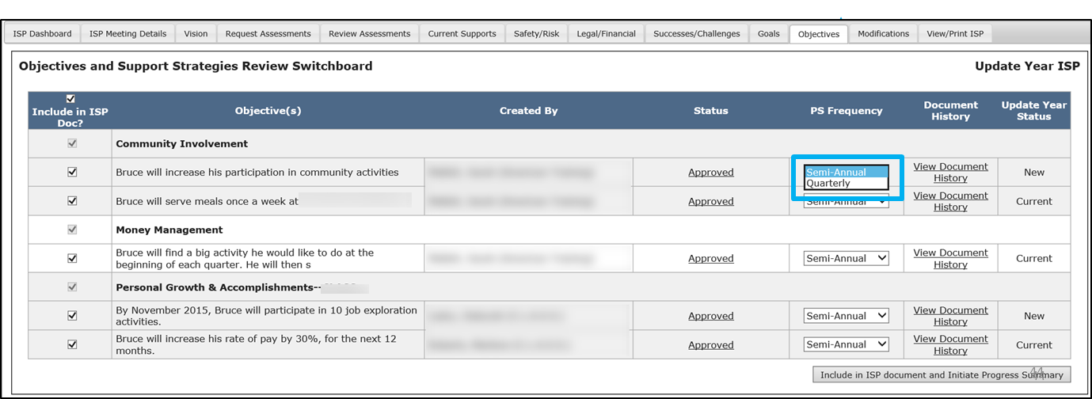
Next Steps and Notes
Progress Summary Frequency
Service Coordinators can change the frequency of a Progress Summary prior to the point the plan is locked. If the Progress Summary Frequency is changed, only those Progress Summaries due going forward will be required.
If there is a need to change the frequency of progress summaries for an objective after a plan is locked, Area Office Directors are able to manually unlock the plan.

Slide 33
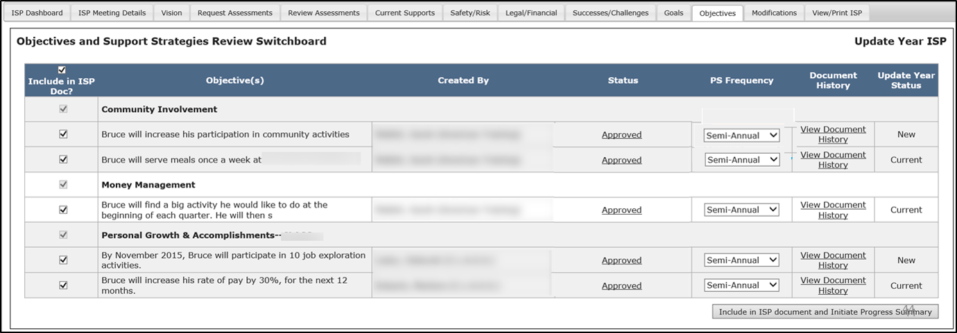
Next Steps and Notes
Objectives Included in Error
Once the provider has begun work on a Progress Summary, Service Coordinators cannot unselect the associated objective and remove it from the ISP document. If the objective was included in error, however, Service Coordinators can call the helpdesk to have the “Started” Progress Summary deleted prior to unselecting the objective from inclusion in ISP document.
Progress Summaries for Ended Services
If a service has ended prior to the ISP meeting, and a Progress Summary has not yet been completed, the Progress Summary must be completed off-line on paper. The ending of a service removes the ability for the provider to enter this information in HCSIS. However, the Progress Summary is still required. We will address this issue in a future release.

Slide 34
Scenario: Review a Progress Summary

Slide 35
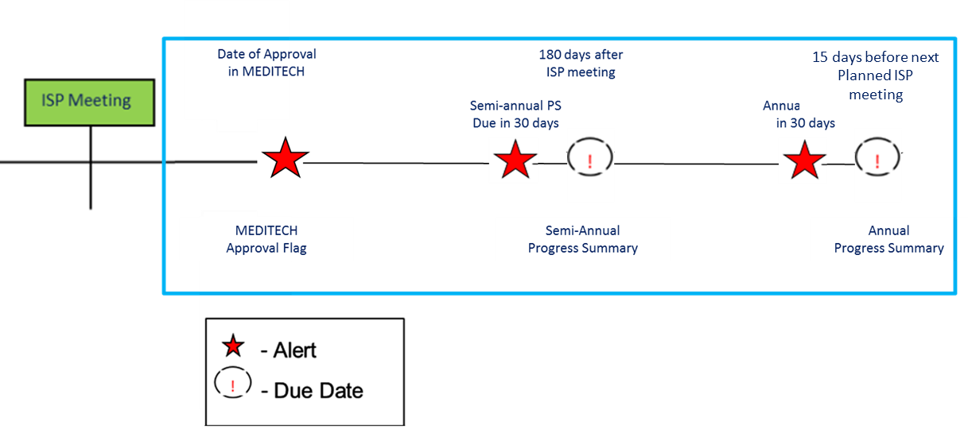
Scenario: Review a Progress Summary
Description: Once DDS has initiated a Progress Summary and the due date for the Progress Summary is within 30 days, Provider Data Entry Users are required to complete and submit the form. Providers are able to access the form to begin work prior to 30 days before the due date, however will not be able to submit until 30 days before the deadline. Provider Data Entry Users complete the form and submit it for internal review to Provider Supervisors, who can request internal revision or submit the form to DDS for review. Once a provider has submitted a Progress Summary , DDS Staff are responsible for reviewing the form and determining whether the form meets the acceptance criteria or requires revisions.
Roles and Responsibilities:
Service Coordinators: Review Form, Request Revision, Approve
Service Coordinator Supervisor: Review Form, Request Revision, Approve

Slide 36
Scenario: Review a Progress Summary
Step 1
Navigate to Submission Alert
Step 2
Review Form and Request Revision
Step 3
Navigate to Submission Alert
Step 4
Review and Approve
Step 5
Print Progress Summary
Step 1: Navigate to the Progress Summary from the Submission Alert
Service Coordinators will receive alerts on Tuesdays and Fridays indicating that Progress Summaries have been submitted by Provider agencies for an individual.
Click on the Alert message “Progress Summaries submitted for review.”
Progress Summaries submitted for review by:
Progress Summaries submitted for review by:

Slide 37
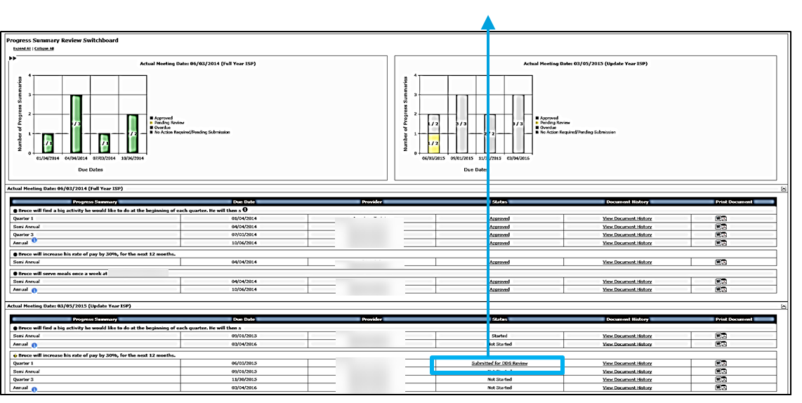
Scenario: Review a Progress Summary
Step 1
Navigate to Submission Alert
Step 2
Review Form and Request Revision
Step 3
Navigate to Submission Alert
Step 4
Review and Approve
Step 5
Print Progress Summary
Step 1: Navigate to the Progress Summary from the Submission Alert
The system will redirect to the Progress Summary Review Switchboard. Click on the “Submitted for DDS Review” link.

Slide 38
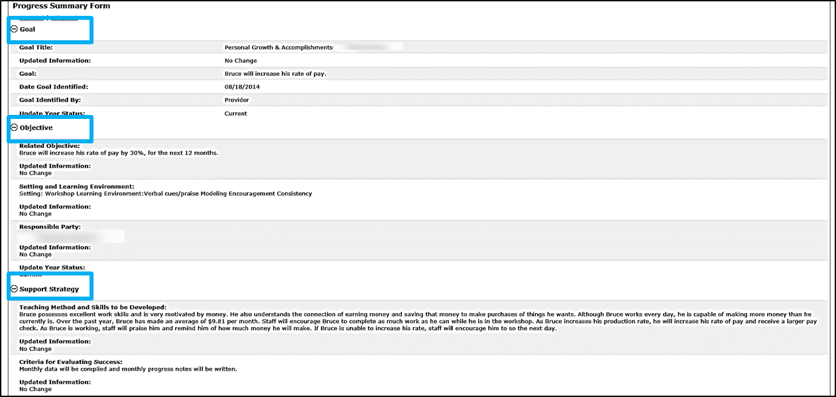
Scenario: Review a Progress Summary
Step 1
Navigate to Submission Alert
Step 2
Review Form and Request Revision
Step 3
Navigate to Submission Alert
Step 4
Review and Approve
Step 5
Print Progress Summary
Step 2: Review Progress Summary and Request Revision
The system will display the Progress Summary Form. The “Goal”, “Objective” and “Support Strategy” for the identified objective are available for reference.

Slide 39
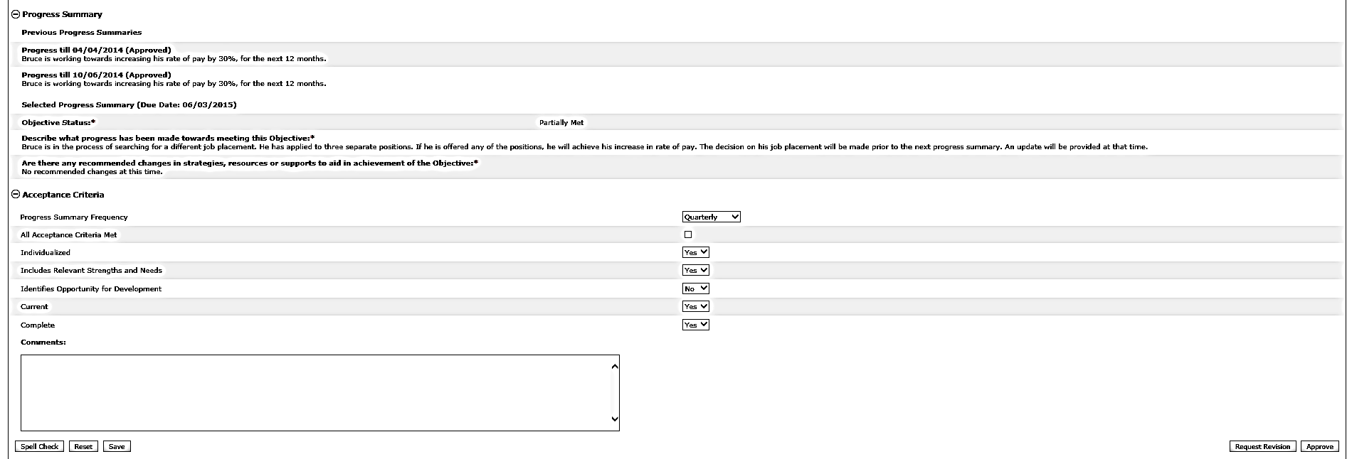
Scenario: Review a Progress Summary
Step 1
Navigate to Submission Alert
Step 2
Review Form and Request Revision
Step 3
Navigate to
Submission Alert
Step 4
Review and Approve
Step 5
Print Progress Summary
Step 2: Review Progress Summary and Request Revision
For your reference, the Progress Summary displays previous Progress Summaries completed for this objective associated to the same ISP year.

Slide 40
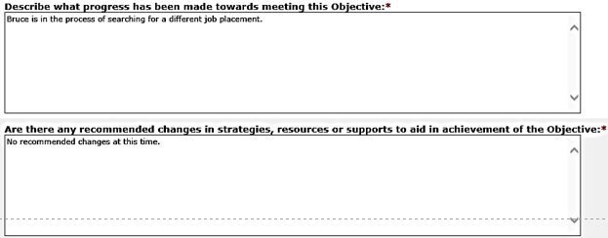
Scenario: Review a Progress Summary
Step 1
Navigate to Submission Alert
Step 2
Review Form and Request Revision
Step 3
Navigate to
Submission Alert
Step 4
Review and Approve
Step 5
Print Progress Summary
Step 2: Review Progress Summary and Request Revision
Review the content that the Provider Data Entry User has written.

Slide 41
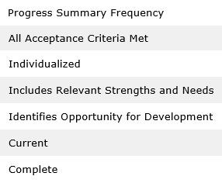
Scenario: Review a Progress Summary
Step 1
Navigate to Submission Alert
Step 2
Review Form and Request Revision
Step 3
Navigate to Submission Alert
Step 4
Review and Approve
Step 5
Print Progress Summary
Step 2: Review Progress Summary and Request Revision
Fill in the Acceptance Criteria Section.

Slide 42
Scenario: Review a Progress Summary
Step 1
Navigate to Submission Alert
Step 2
Review Form and Request Revision
Step 3
Navigate to Submission Alert
Step 4
Review and Approve
Step 5
Print Progress Summary
Step 2: Review Progress Summary and Request Revision
If there is a need to return a form for revision, at least one acceptance criteria must not be met and reflect a status of “No”. Select the “No” dropdown for the category that requires revision.

Slide 43
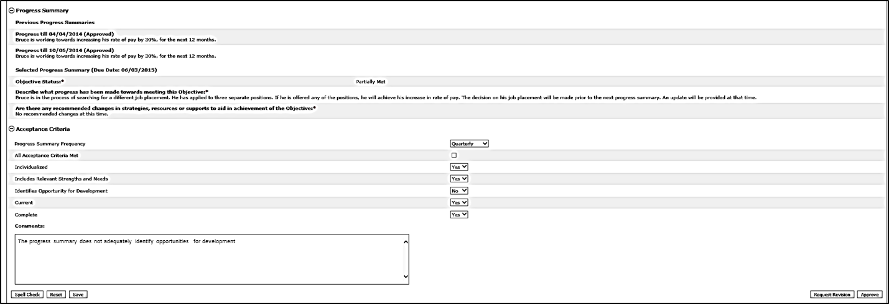
Scenario: Review a Progress Summary
Step 1
Navigate to Submission Alert
Step 2
Review Form and Request Revision
Step 3
Navigate to Submission Alert
Step 4
Review and Approve
Step 5
Print Progress Summary
Step 2: Review Progress Summary and Request Revision
Insert text in the Comments text box to explain why the acceptance criteria was not met.

Slide 44
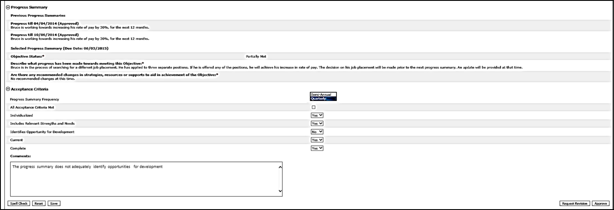
Scenario: Review a Progress Summary
Step 1
Navigate to Submission Alert
Step 2
Review Form and Request Revision
Step 3
Navigate to Submission Alert
Step 4
Review and Approve
Step 5
Print Progress Summary
Step 2: Review Progress Summary and Request Revision
If desired, use the drop down to change the Progress Summary Frequency. If you opt to change the frequency, this will modify the Progress Summaries displayed in the switchboard.

Slide 45
Scenario: Review a Progress Summary
Step 2
Review Form and Request Revision
Step 3
Navigate to Submission Alert
Step 4
Review and Approve
Step 4
Review and Approve
Step 5
Print Progress Summary
Step 1
Navigate to Submission Alert
Step 5
Print Progress Summary
Step 2: Review Progress Summary and Request Revision
Click “Request Revision.”

Slide 46
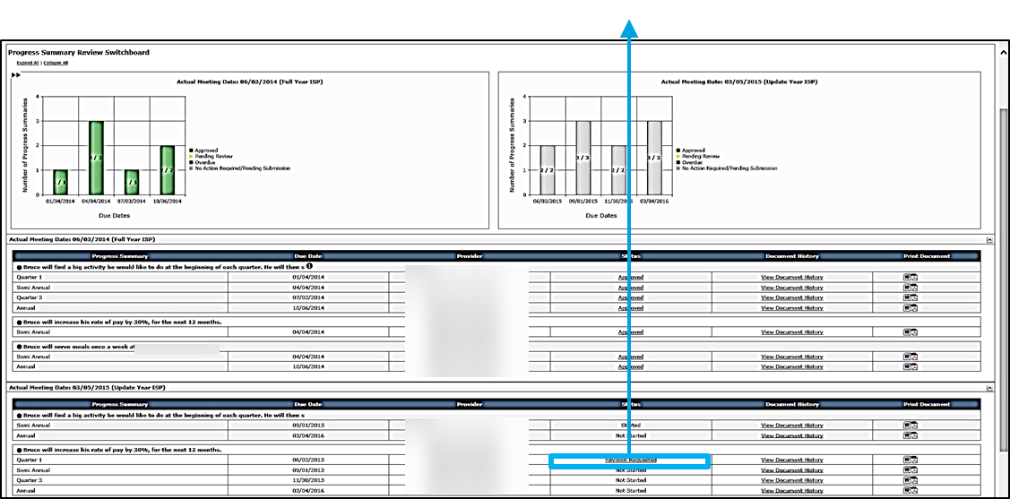
Scenario: Review a Progress Summary
Step 1
Navigate to Submission Alert
Step 2
Review Form and Request Revision
Step 3
Navigate to Submission Alert
Step 4
Review and Approve
Step 5
Print Progress Summary
Step 2: Review Progress Summary and Request Revision
The system will redirect to the Progress Summary Review Switchboard. The status of the form will change to “Revision Requested.”

Slide 47
Scenario: Review a Progress Summary
Step 1
Navigate to Submission Alert
Step 2
Review Form and Request Revision
Step 3
Navigate to Submission Alert
Step 4
Review and Approve
Step 5
Print Progress Summary
Step 3: Navigate to Form from Re-Submission Alert
Once the Provider revises the Progress Summary and re-submits it to DDS, you will receive an Alert.
Click “Progress Summaries submitted for review.”
Progress Summaries submitted for review by:
Progress Summaries submitted for review by:

Slide 48
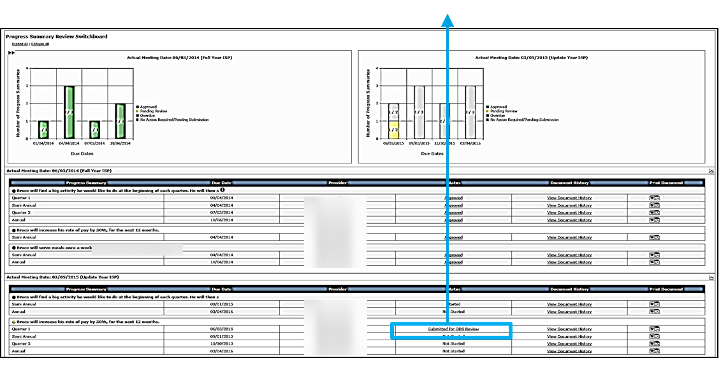
Scenario: Review a Progress Summary
Step 1
Navigate to Submission Alert
Step 2
Review Form and Request Revision
Step 3
Navigate to Submission Alert
Step 4
Review and Approve
Step 5
Print Progress Summary
Step 3: Navigate to Form from Re-Submission Alert
The system will redirect to the Progress Summary Review Switchboard. Click “Submitted for DDS Review.”

Slide 49
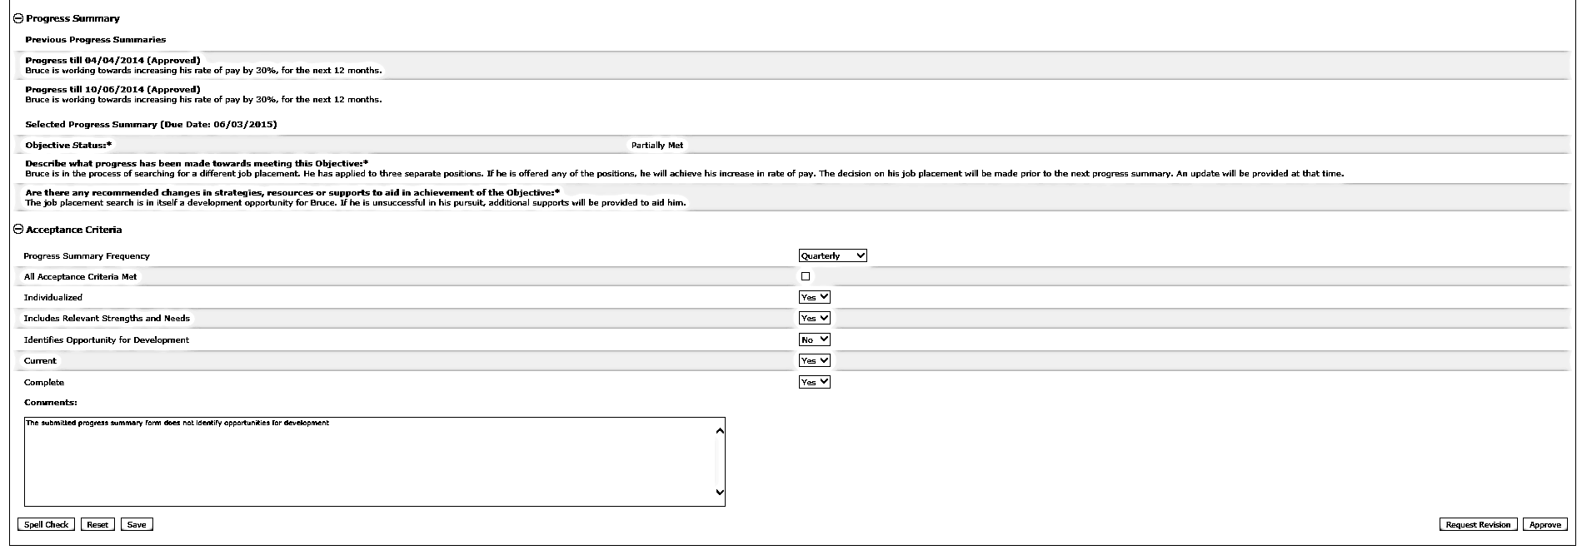
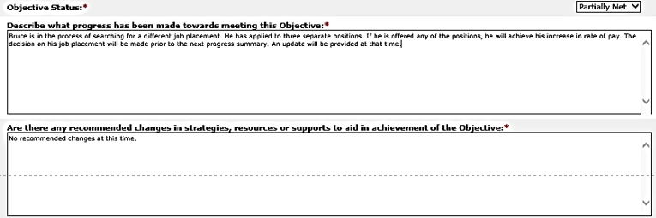
Scenario: Review a Progress Summary
Step 1
Navigate to Submission Alert
Step 2
Review Form and Request Revision
Step 3
Navigate to Submission Alert
Step 4
Review and Approve
Step 5
Print Progress Summary
Step 4: Review and Approve
The system will display the Progress Summary which the Provider revised and submitted. Review the form to validate that the requested revisions have been made.

Slide 50
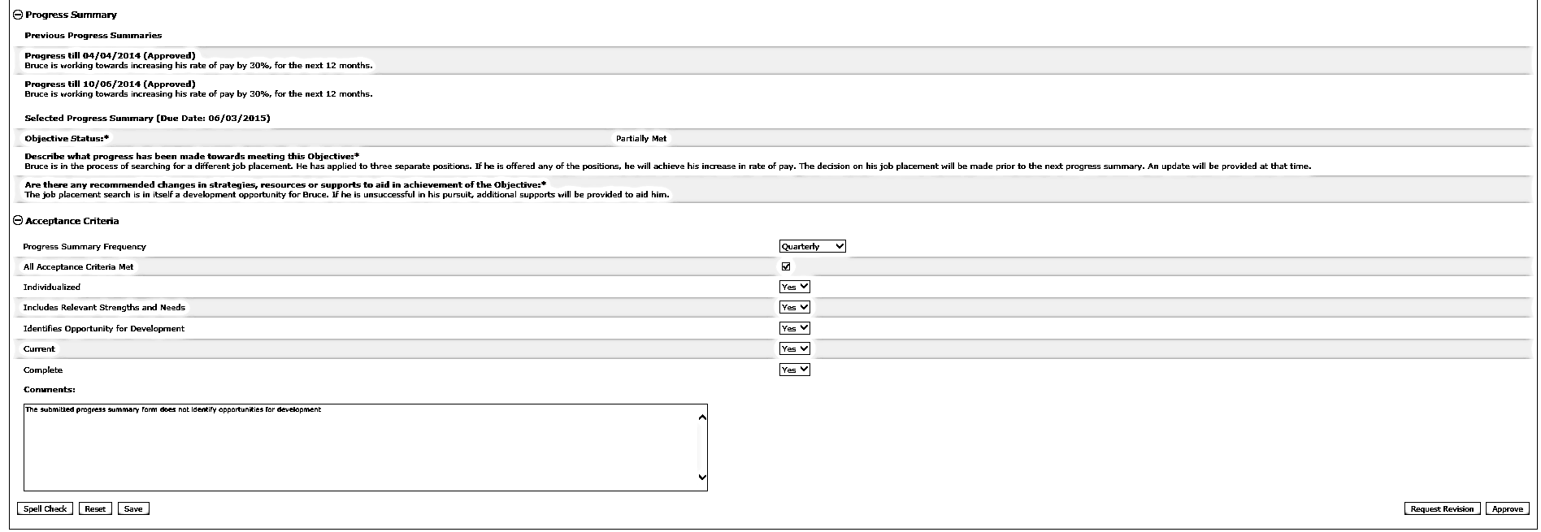
Scenario: Review a Progress Summary
Step 1
Navigate to Submission Alert
Step 2
Review Form and Request Revision
Step 3
Navigate to Submission Alert
Step 4
Review and Approve
Step 5
Print Progress Summary
Step 4: Review and Approve
If all revisions have been applied, click the “All Acceptance Criteria Met.” This will change all of the drop-down fields to “Yes.”

Slide 51
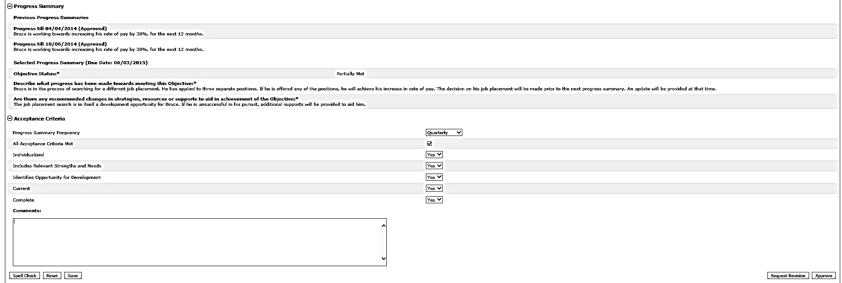
Scenario: Review a Progress Summary
Step 1
Navigate to Submission Alert
Step 2
Review Form and Request Revision
Step 3
Navigate to Submission Alert
Step 4
Review and Approve
Step 5
Print Progress Summary
Step 4: Review and Approve
If no longer applicable, delete or revise the notes in the “Comments” the text box.

Slide 52
Scenario: Review a Progress Summary
Step 1
Navigate to Submission Alert
Step 2
Review Form and Request Revision
Step 3
Navigate to Submission Alert
Step 4
Review and Approve
Step 5
Print Progress Summary
Step 4: Review and Approve
Click “Approve.”

Slide 53
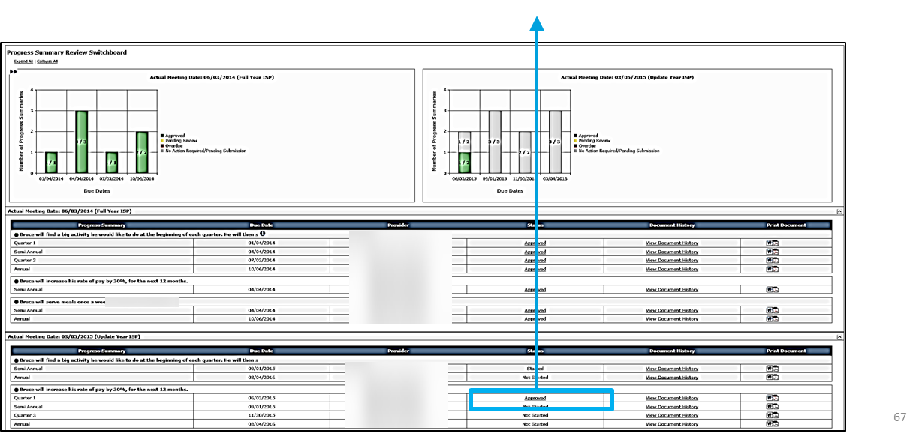
Scenario: Review a Progress Summary
Step 1
Navigate to Submission Alert
Step 2
Review Form and Request Revision
Step 3
Navigate to Submission Alert
Step 4
Review and Approve
Step 5
Print Progress Summary
Step 4: Review and Approve
The system will redirect to the Progress Summary Review Switchboard. The status of the Progress Summary will change to “Approved.”

Slide 54
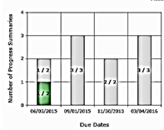
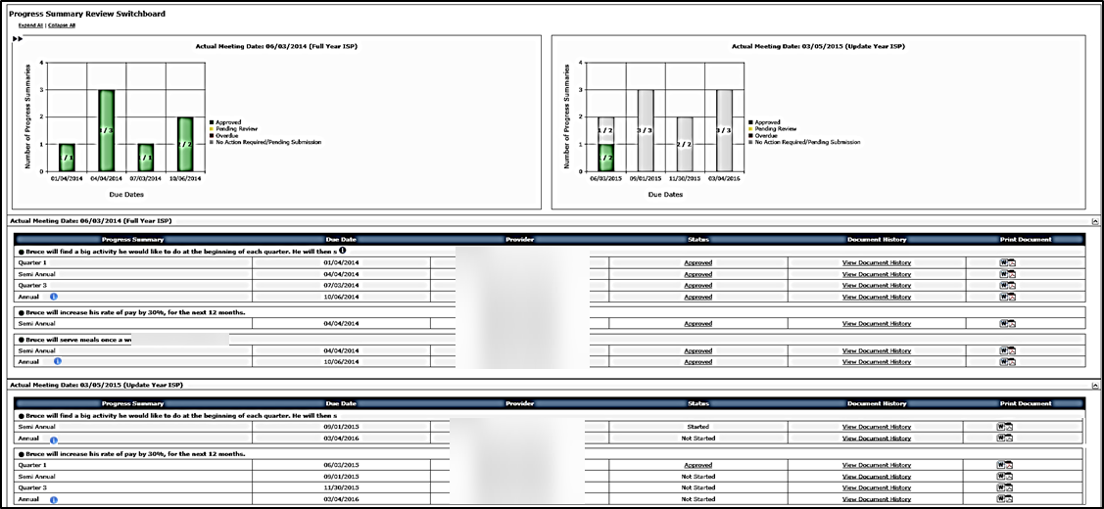
Scenario: Review a Progress Summary
Step 1
Navigate to Submission Alert
Step 2
Review Form and Request Revision
Step 3
Navigate to Submission Alert
Step 4
Review and Approve
Step 5
Print Progress Summary
Step 4: Review and Approve
Please note that the Progress Summary Bar Graph will update to reflect the change in status.

Slide 55
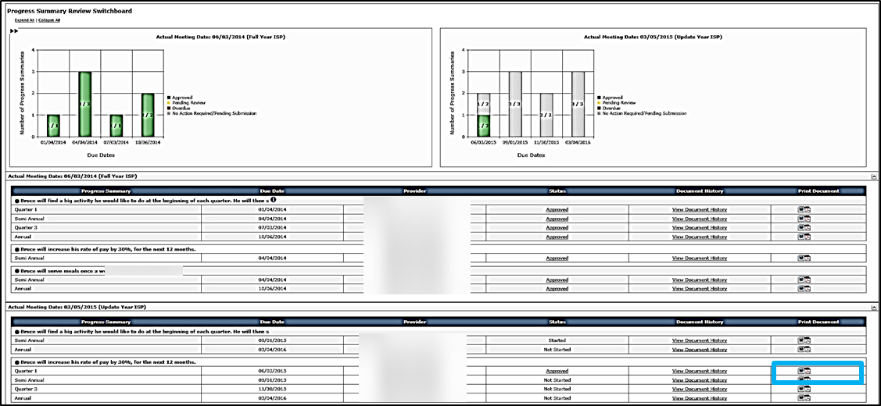
Scenario: Review a Progress Summary
Step 1
Navigate to Submission Alert
Step 2
Review Form and Request Revision
Step 3
Navigate to Submission Alert
Step 4
Review and Approve
Step 5
Print Progress Summary
Step 5: Print Progress Summary
To Print, click either the Word or PDF icon for that Progress Summary .
Until a Progress Summary has been approved, it will print with a Draft Watermark.

Slide 56
Next Steps and Notes
Next Steps
If DDS approve a Progress Summary, Providers will receive an Alert
Service Coordinators or Service Coordinator Supervisors can continue reviewing other Progress Summaries.
An objective that is met or discontinued in the Progress Summary will still be recalled in an ISP update year.
Notes
Contact the Help Desk in the following situations for assistance:
If a Service Coordinator mistakenly includes an objective in the ISP document and the Provider initiates work on the Progress Summary, the objective cannot be unselected. In this scenario, the Progress Summary must be deleted by the Help Desk. Once the Progress summary is deleted, the SC can then unselect the objective.
If a service ends, a Service Coordinator needs to contact help desk to request deletion of the Progress Summary. In this scenario, because providers lose access to that individual when a service ends, providers are required to complete next Progress Summary off-line.

Slide 57
Next Steps and Notes
If an objective is determined to be met or discontinued as a part of a Semi-Annual Progress Summary, subsequent Progress Summaries for that objective will not be required unless that objective is included again as part of the ISP.
In the scenario below, the quarter 3 and annual Progress Summaries are no longer required because the objective is deemed to be met in the Semi-Annual Progress Summary .
Quarter 3 and Annual Forms No Longer Display
Regardless of whether the objective has been deemed to be met or discontinued the objective will still be recalled and require update in an ISP update year

Slide 58
Next Steps and Notes
Action | End User | Regulations | Alert?
Consult with Guardian and Individual on required Assessments, Vision, and Goals | Service Coordinator | 45-60 days prior to the ISP meeting | No
Notification of ISP meeting and request for Assessments | Service Coordinator | 30 days prior to the ISP meeting | Yes
Create and enter proposed Goals for the individual | Providers and DDS Staff | N/A | No
Assessments and Proposed Objectives & Support Strategies submitted to Service Coordinator | Providers | 15 days prior to the ISP meeting | Yes
Annual Progress Summary Due | Service Coordinators and Providers | 15 days prior to the ISP meeting | Yes
Review and approval or request for revision of submitted documents | Service Coordinator | 7 days prior to the ISP meeting | Yes
Print documents for ISP meeting | Providers and DDS staff | N/A | No
Revise ISP documents if required | Providers and DDS staff | Up to 45 days after the ISP meeting | Depends on the type of revision
ISP Mailed to ISP Team | Service Coordinator | 45 Days after the ISP meeting | No
Semi-Annual Progress Summary Due | Service Coordinators and Providers | 180 Days after the ISP Meeting | Yes

Slide 59
Chapter 3 Summary
This Chapter covered:
Overview of Progress Summary
Progress Summary Review Switchboard
Scenario: Initiate a Progress Summary
Scenario: Review a Progress Summary

Slide 60
Chapter 4: Progress Summary Report
Chapter 1
Chapter 2
Chapter 3
Chapter 4
Chapter 5
Chapter 6
Chapter 7

Slide 61
Chapter 4 Overview
This Chapter will cover:
Scenario: Accessing the Progress Summary Report
85

Slide 62
Scenario: Accessing the Progress Summary Report

Slide 63
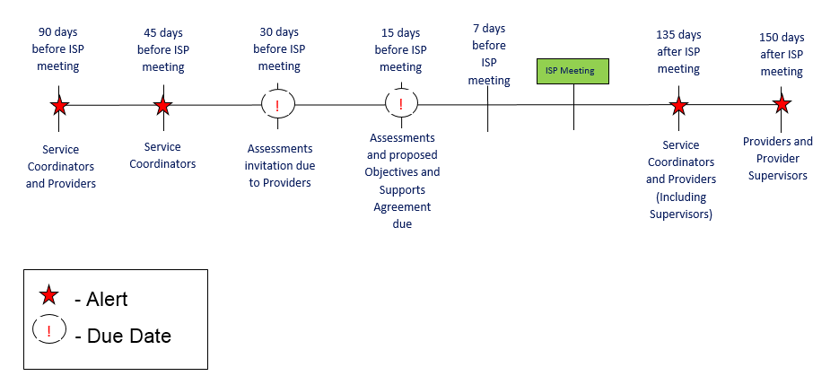
Scenario: Accessing the Progress Summary Report
Description: The Progress Summary Report displays information about actions associated with the Progress Summary submission, review and approval process. It displays information related to Progress Summaries completed in HCSIS based on the due dates specified on the report.
Roles and Responsibilities:
Service Coordinators: Generate and view a report
Service Coordinator Supervisors: Generate and view a report

Slide 64
Scenario: Accessing the Progress Summary Report
Step 1
Navigate to ISP Module and select “Reports”
Step 2
Select “Progress Summary Report”
Step 3
Select search parameters
Step 4
Select “View Report”
Step 5
View Summary Report details
Step 6
Print Progress Summary Report
Step 1: Navigate to ISP Module and Select “Reports”
Click on the Reports link in the second level menu. The system navigates to the Reports page.

Slide 65
Scenario: Accessing the Progress Summary Report
Step 1
Navigate to ISP Module and select “Reports”
Step 2
Select “Progress Summary Report”
Step 3
Select search parameters
Step 4
Select “View Report”
Step 5
View Summary Report details
Step 6
Print Progress Summary Report
Step 2: Select “Progress Summary Report”
The system navigates to the Progress Summary Report. Click the Progress Summary Report link.

Slide 66
Scenario: Accessing the Progress Summary Report
Step 1
Navigate to ISP Module and select “Reports”
Step 2
Select “Progress Summary Report”
Step 3
Select search parameters
Step 4
Select “View Report”
Step 5
View Summary Report details
Step 6
Print Progress Summary Report
Step 3: Select Search Parameters
Select the date from the calendar dropdown next to the “From ISP Date” and “To ISP Date” fields.
The “From ISP Date” and “To ISP Date” are based on the Progress Summary due date.

Slide 67
Scenario: Accessing the Progress Summary Report
Step 1
Navigate to ISP Module and select “Reports”
Step 2
Select “Progress Summary Report”
Step 3
Select search parameters
Step 4
Select “View Report”
Step 5
View Summary Report details
Step 6
Print Progress Summary Report
Step 3: Select Search Parameters
Additional filters are available to narrow search results. Those filters are as follows:
Area Office
Provider
Objective Status
Report Display Option
Group Results By
Document Status

Slide 68
Scenario: Accessing the Progress Summary Report
Step 1
Navigate to ISP Module and select “Reports”
Step 2
Select “Progress Summary Report”
Step 3
Select search parameters
Step 4
Select “View Report”
Step 5
View Summary Report details
Step 6
Print Progress Summary Report
Step 4: Select “View Report”
Click “View Report.”

Slide 69
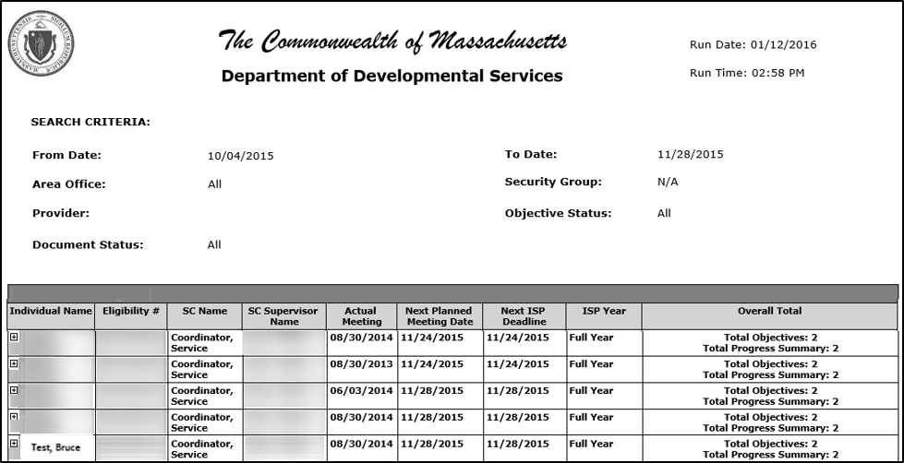
Scenario: Accessing the Progress Summary Report
Step 1
Navigate to ISP Module and select “Reports”
Step 2
Select “Progress Summary Report”
Step 3
Select search parameters
Step 4
Select “View Report”
Step 5
View Summary Report details
Step 6
Print Progress Summary Report
Step 5: View Summary Report Details
The system displays all the individuals satisfying the search criteria.

Slide 70
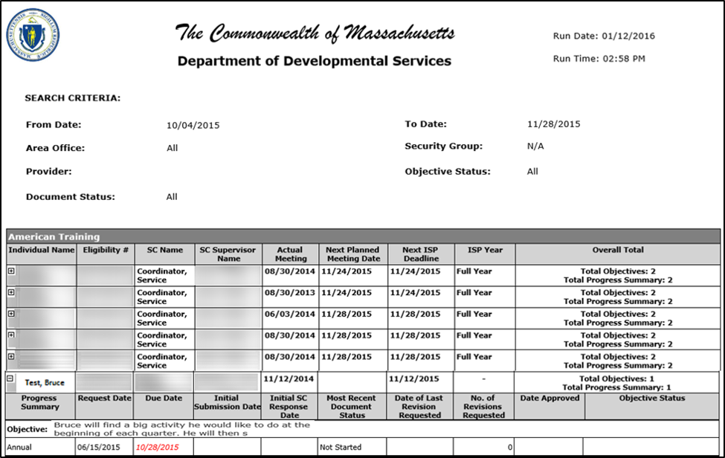
Scenario: Accessing the Progress Summary Report
Step 1
Navigate to ISP Module and select “Reports”
Step 2
Select “Progress Summary Report”
Step 3
Select search parameters
Step 4
Select “View Report”
Step 5
View Summary Report details
Step 6
Print Progress Summary Report
Step 5: View Summary Report Details
Select the next to an individual to expand and view Progress Summary details on the Reports page.

Slide 71
Scenario: Accessing the Progress Summary Report
Step 1
Navigate to ISP Module and select “Reports”
Step 2
Select “Progress Summary Report”
Step 3
Select search parameters
Step 4
Select “View Report”
Step 5
View Summary Report details
Step 6
Print Progress Summary Report
Step 6: Print Progress Summary Report
To download and print the report, click the save icon and select either “PDF” or “Word.”
Please note, the PDF will print the exact image that is displayed on the Reports page. If the Progress Summary Report is shown with the expanded information, that will be printed.

Slide 72
Chapter 4 Summary
This Chapter covered:
Accessing Progress Summary Report

