Slide 1
Department of Developmental Services
Massachusetts Rehabilitation Commission
Individual Support Plan (ISP) Module Training
Release 7.7 – DDS Staff

Slide 2
Chapter 5: Area Office Director Approval of the ISP
Chapter 1
Chapter 2
Chapter 3
Chapter 4
Chapter 5
Chapter 6
Chapter 7

Slide 3
Chapter 5 Overview
This Chapter will cover:
New Trigger for Locking the ISP In HCSIS
Lock Icon on Individual Dashboard

Slide 4
New Trigger for Locking the ISP In HCSIS

Slide 5
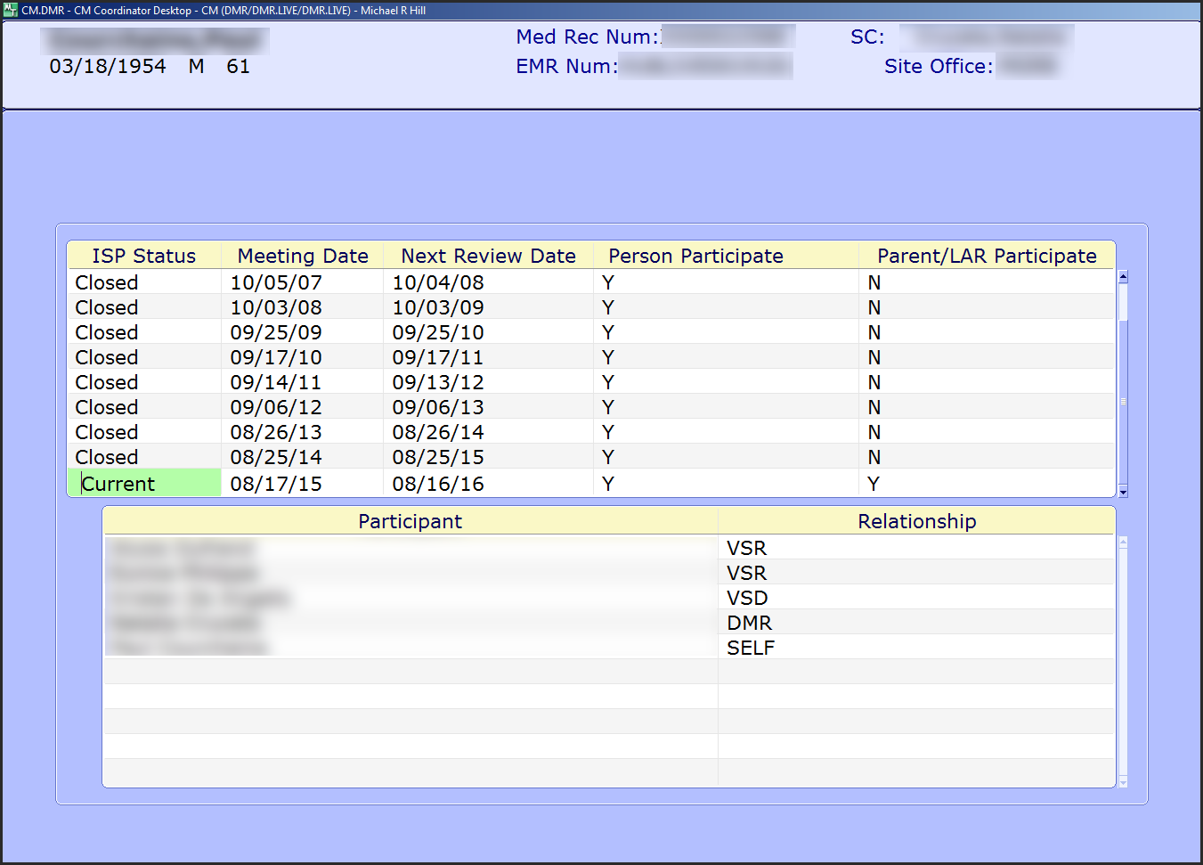
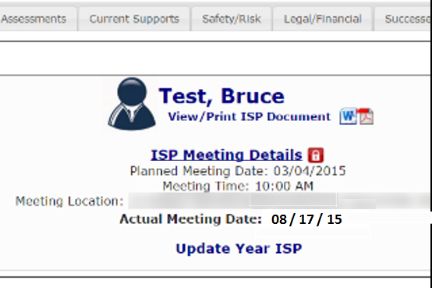
New Trigger for Locking the ISP In HCSIS
The approval process for a ISP remains the same but the process by which the system locks the plans in HCSIS has changed. The system now uses an additional trigger to lock the plan.
Previous Functionality | Once 150 days have passed since the ISP Meeting Date, HCSIS will automatically lock the plan.
New Functionality | Once an Area Office Director (AOD) approves an ISP in MEDITECH, HCSIS will lock the plan. Alternatively, if the approval has not been submitted in MEDITECH and 150 days have passed since the ISP Meeting Date, the plan will automatically lock in HCSIS, per current functionality.
MEDITECH
HCSIS

Slide 6
Lock Icon on Individual Dashboard

Slide 7
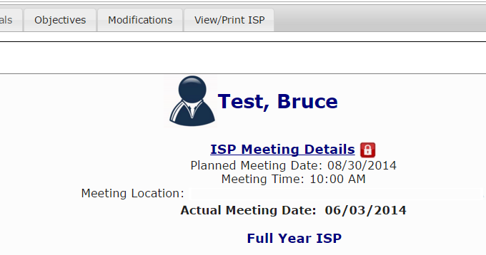
Lock Icon on Individual Dashboard
An ISP Lock Icon will appear on the Individual Dashboard.
This enhancement to show a visual for lock status has been added due to feedback from providers

Slide 8
Notes and Next Steps
New Alerts
“ISP is locked”
Recipient
Service Coordinator, Service Coordinator Supervisor.
Trigger
The system generates an alert when an Area Office Director changes the status of the ISP to current in MEDITECH and an ISP is locked in HCSIS.
“ISP will be locked in 15 days if approval is not entered in MEDITECH”
Recipient
Service Coordinator, Service Coordinator Supervisor, Provider Data Entry User, Provider Supervisor
Trigger
The system generates an alert if 135 Days have passed since the ISP Meeting Due Date and an Area Office Director has not changed the status of the ISP to current in MEDITECH.
Notes
Area Office Directors and Area Office Director Designees continue to have the ability to manually unlock plans, if needed. Do note, however, that the ISP should only be unlocked to make minor corrections or a correction needed in response to an appeal.
Service Coordinators, Service Coordinator Supervisors, and Area Office Directors will continue to receive an Alert if a plan that had been unlocked has not been manually relocked within 30 days of unlocking the plan.

Slide 9
Chapter 5 Summary
This Chapter covered:
New Trigger for Locking the ISP In HCSIS
Lock Icon on Individual Dashboard

Slide 10
Chapter 6: Modifications
Chapter 1
Chapter 2
Chapter 3
Chapter 4
Chapter 5
Chapter 6
Chapter 7

Slide 11
Chapter 6 Overview
This Chapter will cover:
Overview of Modifications
Scenario: Initiating a Modification
Scenario: Reviewing a Modification

Slide 12
Overview of Modifications

Slide 13
Modifications Process
Modifications are used to make changes to a locked ISP document
Per DDS Regulation 115 CMR 6.25, a Modification to an ISP may include one or any combination of the following elements all under the same Reason for Modification.
Any change in the Goals for an individual
Any change in the types of supports or services that will be used to help the individual to attain his or her outcomes or changes in the duration and frequency of such supports
A change in the strategies that will be used to meet unmet support needs
A change in the priority for services or supports assigned to the individual’s needs where such a change will affect the services or supports that are provided and available to the individual
Initiation of a behavior Modification plan or Modification of any part of a behavior Modification plan involving the use of an aversive or intrusive technique
A change in the location of an individual’s home, from a home operated by the Department or a provider certified by the Department to another such home
NOTE: Changes in an individual’s life that would substantially change the ISP content should be considered for a full ISP meeting.

Slide 14
Modifications Process
Modifications are used to make changes to a locked ISP document.
With this release, HCSIS includes functionality for Service Coordinators and Providers to initiate and submit Modifications to the current ISP document in the system.
Modifications can be submitted once the current ISP has been locked.
As explained in the previous Chapter, the plan will be locked based on the Area Director’s approval of the ISP in MEDITECH.
If the Area Director does not approve the ISP within 150 days, the plan will be locked per current process in HCSIS.

Slide 15
Modifications Workflow
ISP Meeting is Held
Area Director Approves or Disapproves Modification
ISP is approved and locked in HCSIS
ISP is approved and locked in HCSIS
SC Reviews and Accepts or Returns for Revision to Provider
Provider Supervisor Initiates and Submits Modification to DDS
Per DDS Regulation 115 CMR 6.25, Modifications are used to make changes to a locked ISP document. The ISP module provides an efficient mechanism for streamlining the Modification submission process. It allows Provider and DDS staff to coordinate the review, revision, acceptance and approval of an Modification per DDS regulations.

Slide 16
Modifications Roles and Responsibilities
Responsible Party | Modification Process
Service Coordinator | Initiate a Modification Review and Accept a Modification Submitted by a Provider Review and Request Revision of a Modification Submitted by a Provider
Service Coordinator Supervisor | Initiate a Modification Review and Accept a Modification Submitted by a Provider Review and Request Revision of a Modification Submitted by a Provider
Area Office Director | Review and Approve a Modification Review and Disapprove a Modification
Modification Type | Responsible Party
Goal | Service Coordinator Provider Supervisor
Objectives and Support Strategy | Provider Supervisor
Residential Support / Other | Service Coordinator Provider Supervisor
Behavior Plan | Provider Supervisor

Slide 17
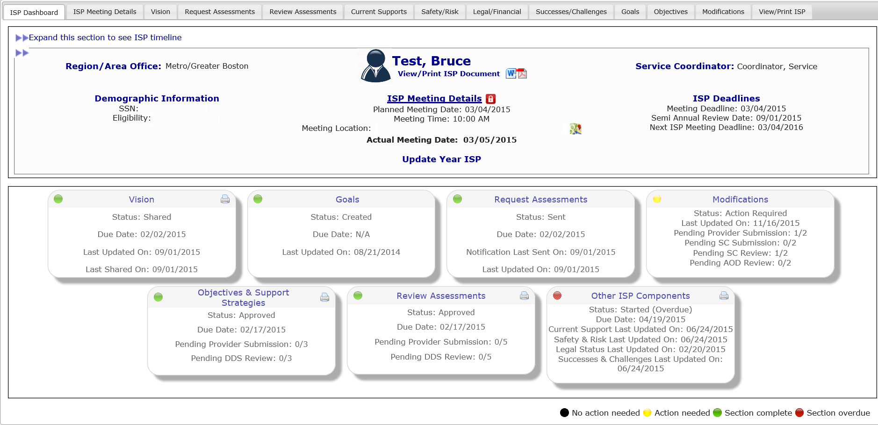
Navigating to the Modifications Review Switchboard
Click Modifications Tab above Individual Dashboard
Navigate to the Modifications Review Switchboard from the Individual Dashboard by clicking the ”Modifications” tab.

Slide 18
Scenario: SC Initiates a Modification

Slide 19
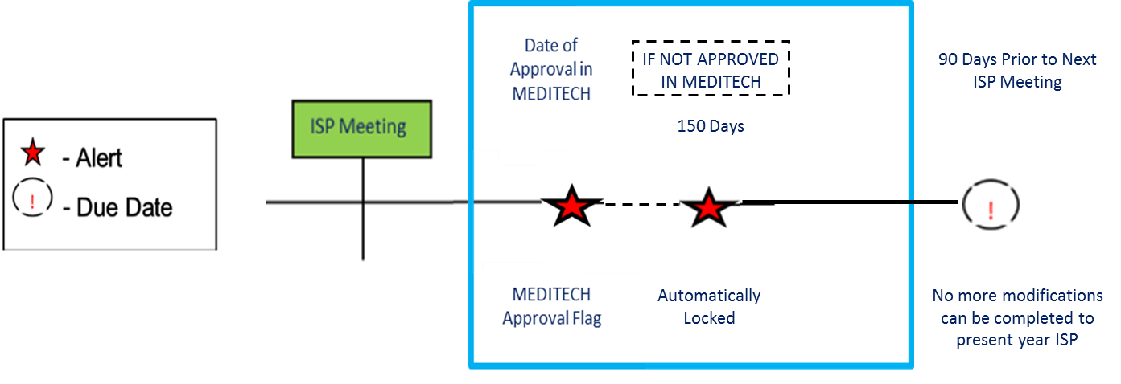
Scenario: SC Initiates a Modification
Description: Service Coordinators can create a Modification once a Full or Update Year ISP has been completed and the approval has been entered in MEDITECH by an Area Director, locking the plan in HCSIS. At this point, DDS Staff can initiate a Modification. A single Modification can include any combination of the following elements: Goals, Residential Support / Other.
Roles and Responsibilities:
Service Coordinators: Initiate a Modification
Service Coordinator Supervisors: Initiate a Modification
Area Office Director: Review a Modification, Approve a Modification, Disapprove a Modification

Slide 20
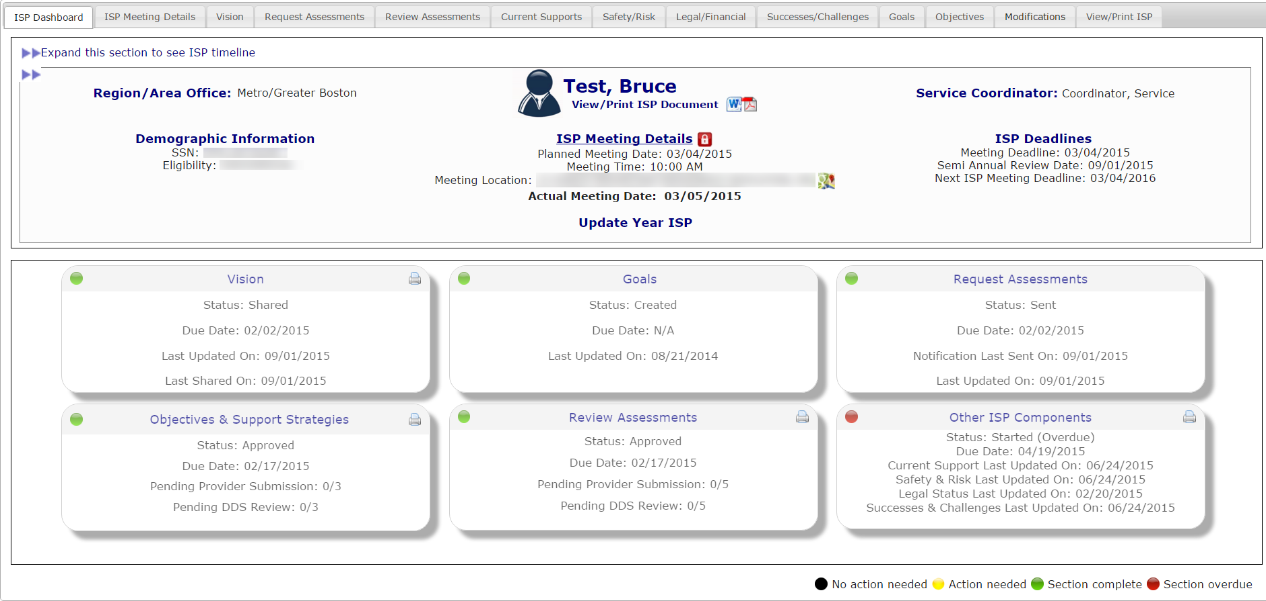
Scenario: SC Initiates a Modification
Step 1
Navigate to
Dashboard & Select “Modifications”
Step 2
Click “Add New Modification” &
Enter Modification
Reason
Step 3
Select Element to Modify
Step 4
Complete Modification of
Element
Step 5
(Optional)
Repeat for Other Element/s
Step 6
Complete the Review Section
And Submit
Step 7
AOD Review and Approve
Step 1: Navigate to Individual Dashboard and Select “Modifications”
Navigate to the Individual Dashboard. Select the “Modifications” tab.

Slide 21
Scenario: SC Initiates a Modification
Step 1
Navigate to
Dashboard & Select “Modifications”
Step 2
Click “Add New Modification” &
Enter Modification
Reason
Step 3
Select Element to Modify
Step 4
Complete Modification of
Element
Step 5
(Optional)
Repeat for Other Element/s
Step 6
Complete the Review Section
And Submit
Step 7
AOD Review and Approve
Step 2: Click on “Add New Modification” and Enter Reason for Modification
The system will display the Modifications Review Switchboard. Select “Add New Modification”

Slide 22
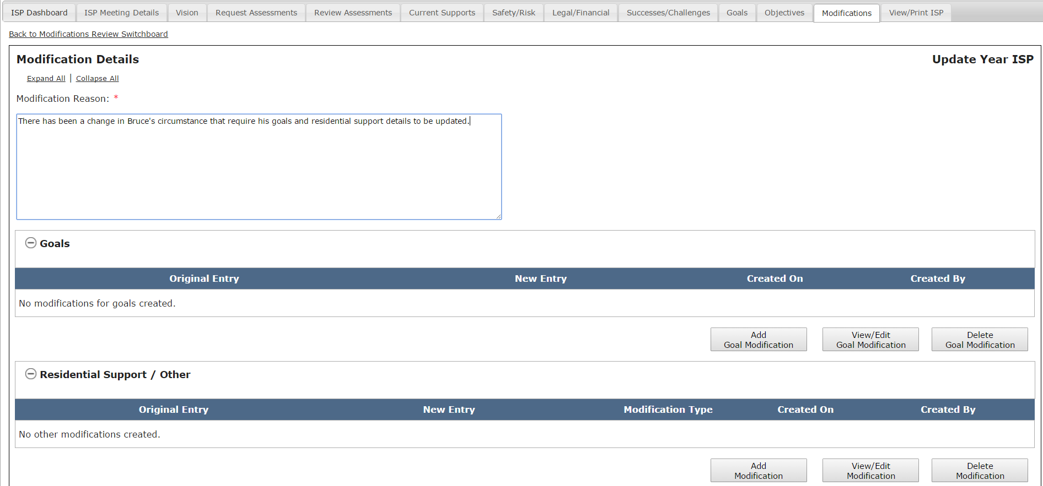
Scenario: SC Initiates a Modification
Step 1
Navigate to
Dashboard & Select “Modifications”
Step 2
Click “Add New Modification” &
Enter Modification
Reason
Step 3
Select Element to Modify
Step 4
Complete Modification of
Element
Step 5
(Optional)
Repeat for Other Element/s
Step 6
Complete the Review Section
And Submit
Step 7
AOD Review and Approve
Step 2: Click on “Add New Modification” and Enter Reason for Modification
The system will display the Modification Details page.

Slide 23
Scenario: SC Initiates a Modification
Step 1
Navigate to
Dashboard & Select “Modifications”
Step 2
Click “Add New Modification” &
Enter Modification
Reason
Step 3
Select Element to Modify
Step 4
Complete Modification of
Element
Step 5
(Optional)
Repeat for Other Element/s
Step 6
Complete the Review Section
And Submit
Step 7
AOD Review and Approve
Step 2: Click on “Add New Modification” and Enter Reason for Modification
Insert comments into the Modification Reason text box.

Slide 24
Scenario: SC Initiates a Modification
Step 1
Navigate to
Dashboard & Select “Modifications”
Step 2
Click “Add New Modification” &
Enter Modification
Reason
Step 3
Select Element to Modify
Step 4
Complete Modification of
Element
Step 5
(Optional)
Repeat for Other Element/s
Step 6
Complete the Review Section
And Submit
Step 7
AOD Review and Approve
Step 3: Select Elements to Modify
Decide which element you’d like to modify: A.) “Goal” and/or B.) “Residential Support / Other”. In this scenario, we will demonstrate how to complete a goal Modification.

Slide 25
Scenario: SC Initiates a Modification
Step 1
Navigate to
Dashboard & Select “Modifications”
Step 2
Click “Add New Modification” &
Enter Modification
Reason
Step 3
Select Element to Modify
Step 4
Complete Modification of
Element
Step 5
(Optional)
Repeat for Other Element/s
Step 6
Complete the Review Section
And Submit
Step 7
AOD Review and Approve
Step 4: Complete Modification of Element
A.) Goals
To initiate a Modification to goals, click “Add Goal Modification” on the Modifications Details screen.

Slide 26
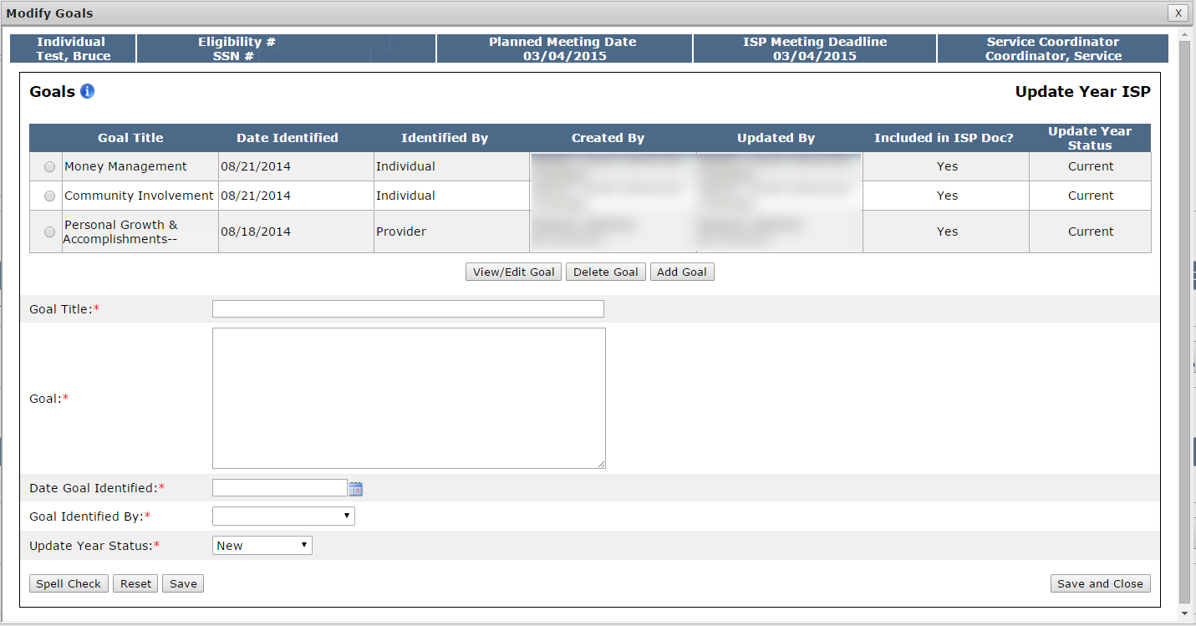
Scenario: SC Initiates a Modification
Step 1
Navigate to
Dashboard & Select “Modifications”
Step 2
Click “Add New Modification” &
Enter Modification
Reason
Step 3
Select Element to Modify
Step 4
Complete Modification of
Element
Step 5
(Optional)
Repeat for Other Element/s
Step 6
Complete the Review Section
And Submit
Step 7
AOD Review and Approve
Step 4: Complete Modification of Element
A.) Goals
The system will display the Goals pop-up screen. The screen displays all of the goals that had been included in the ISP document.

Slide 27
Scenario: SC Initiates a Modification
Step 1
Navigate to
Dashboard & Select “Modifications”
Step 2
Click “Add New Modification” &
Enter Modification
Reason
Step 3
Select Element to Modify
Step 4
Complete Modification of
Element
Step 5
(Optional)
Repeat for Other Element/s
Step 6
Complete the Review Section
And Submit
Step 7
AOD Review and Approve
Step 4: Complete Modification of Element
A.) Goals
At this point, the SC has two options – adding a new goal or modifying an existing goal. We will display the process for both options.

Slide 28
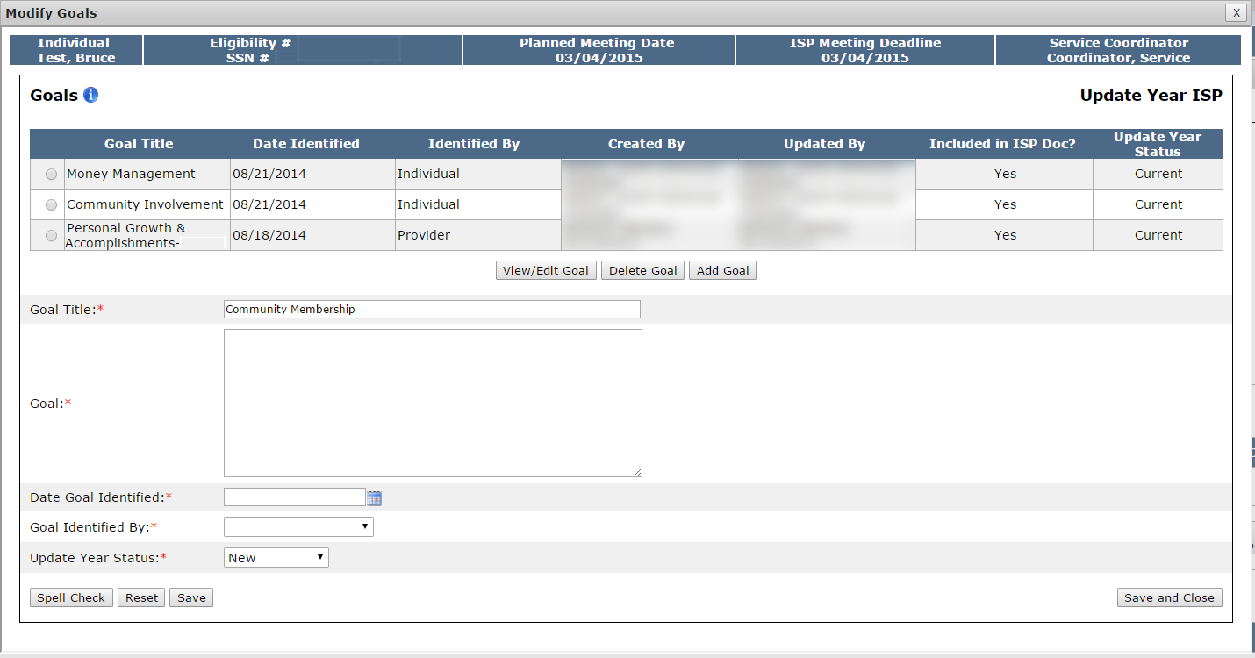
Scenario: SC Initiates a Modification
Step 1
Navigate to
Dashboard & Select “Modifications”
Step 2
Click “Add New Modification” &
Enter Modification
Reason
Step 3
Select Element to Modify
Step 4
Complete Modification of
Element
Step 5
(Optional)
Repeat for Other Element/s
Step 6
Complete the Review Section
And Submit
Step 7
AOD Review and Approve
Step 4: Complete Modification of Element
A.) Goals
Option 1: Adding a New Goal
Enter the title of the goal in the Goal Title text box.

Slide 29
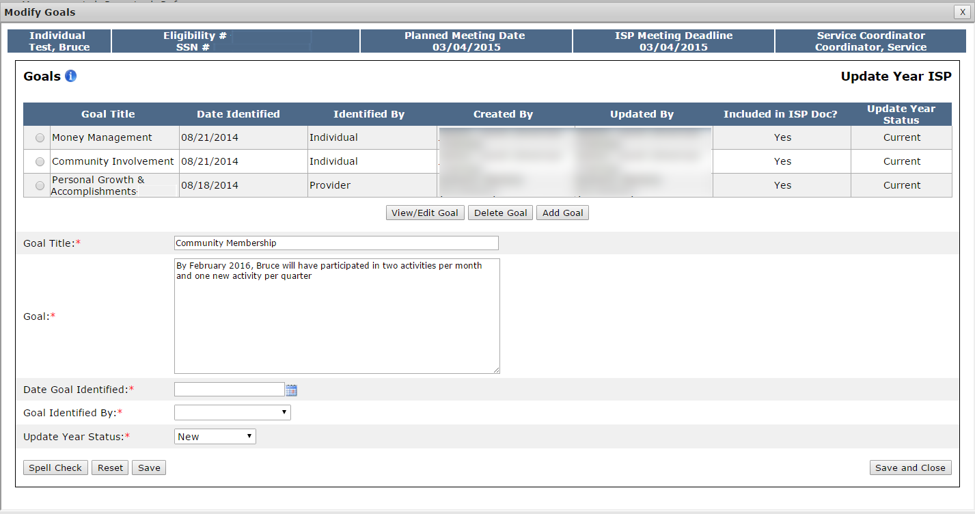
Scenario: SC Initiates a Modification
Step 1
Navigate to
Dashboard & Select “Modifications”
Step 2
Click “Add New Modification” &
Enter Modification
Reason
Step 3
Select Element to Modify
Step 4
Complete Modification of
Element
Step 5
(Optional)
Repeat for Other Element/s
Step 6
Complete the Review Section
And Submit
Step 7
AOD Review and Approve
Step 4: Complete Modification of Element
A.) Goals
Option 1: Adding a New Goal
Enter the goal description in the Goal text box.

Slide 30
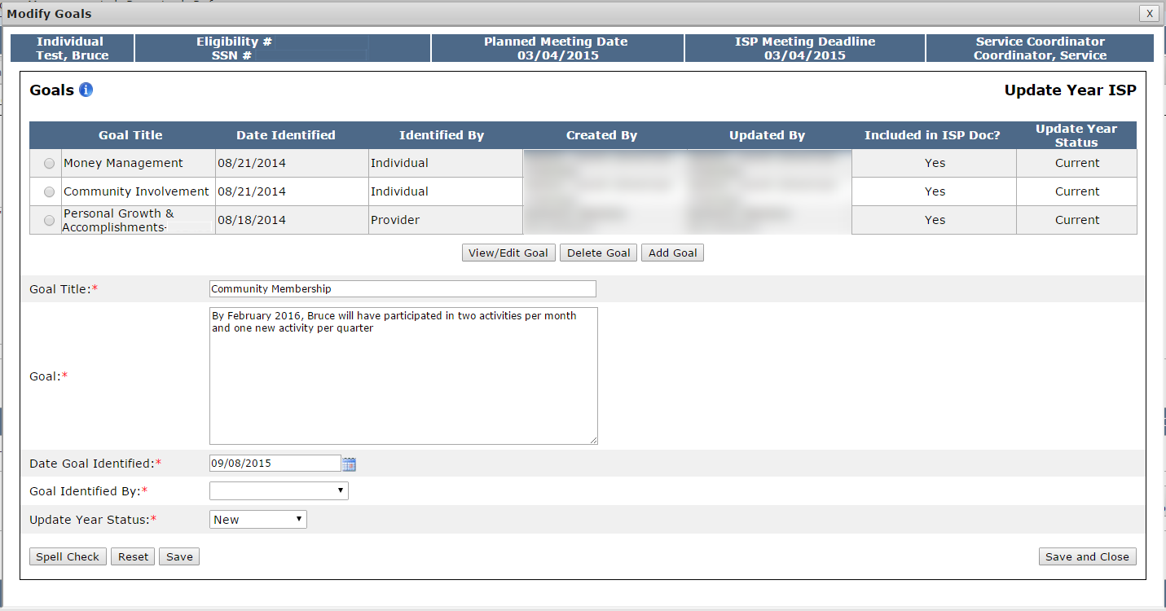
Scenario: SC Initiates a Modification
Step 1
Navigate to
Dashboard & Select “Modifications”
Step 2
Click “Add New Modification” &
Enter Modification
Reason
Step 3
Select Element to Modify
Step 4
Complete Modification of
Element
Step 5
(Optional)
Repeat for Other Element/s
Step 6
Complete the Review Section
And Submit
Step 7
AOD Review and Approve
Step 4: Complete Modification of Element
A.) Goals
Option 1: Adding a New Goal
Select a date in the Date Goal Identified calendar drop down.

Slide 31
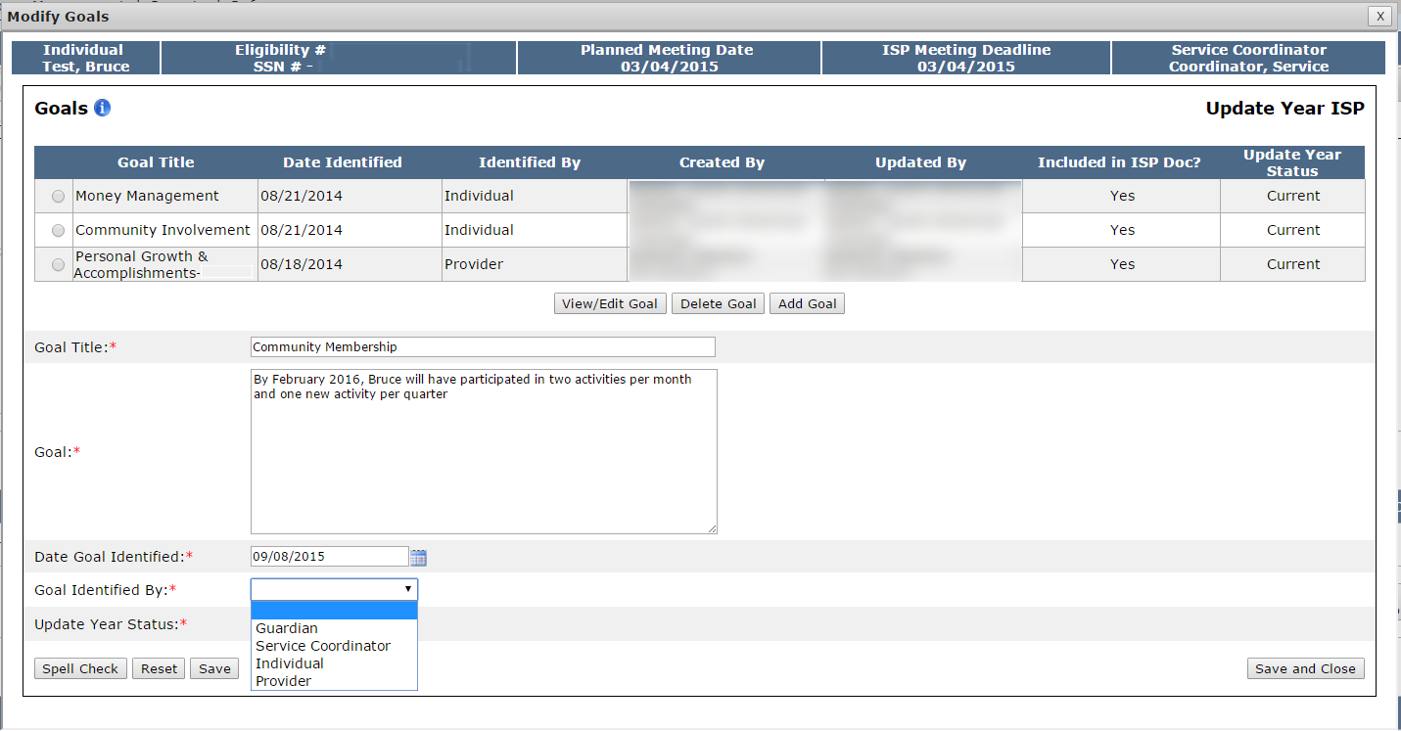
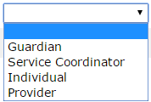
Scenario: SC Initiates a Modification
Step 1
Navigate to
Dashboard & Select “Modifications”
Step 2
Click “Add New Modification” &
Enter Modification
Reason
Step 3
Select Element to Modify
Step 4
Complete Modification of
Element
Step 5
(Optional)
Repeat for Other Element/s
Step 6
Complete the Review Section
And Submit
Step 7
AOD Review and Approve
Step 4: Complete Modification of Element
A.) Goals
Option 1: Adding a New Goal
Select an option from the Goal Identified by drop down.

Slide 32
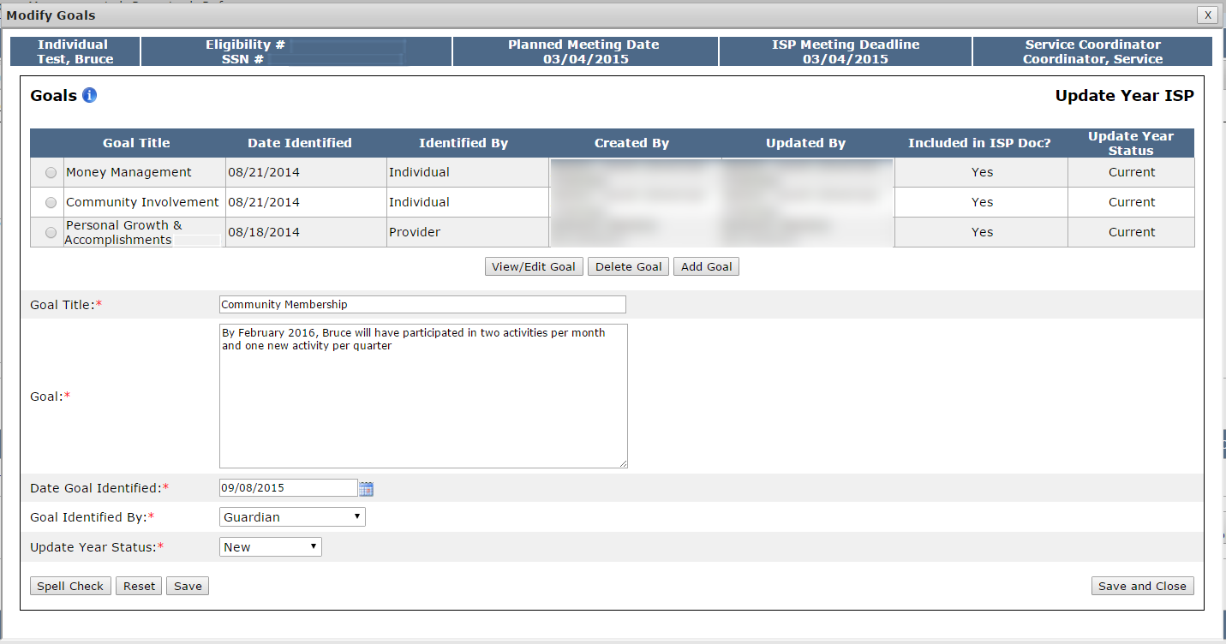
Scenario: SC Initiates a Modification
Step 1
Navigate to
Dashboard & Select “Modifications”
Step 2
Click “Add New Modification” &
Enter Modification
Reason
Step 3
Select Element to Modify
Step 4
Complete Modification of
Element
Step 5
(Optional)
Repeat for Other Element/s
Step 6
Complete the Review Section
And Submit
Step 7
AOD Review and Approve
Step 4: Complete Modification of Element
A.) Goals
Option 1: Adding a New Goal
Click “Save and Close.” Alternatively, to add additional goals, follow this process again on the same screen.

Slide 33
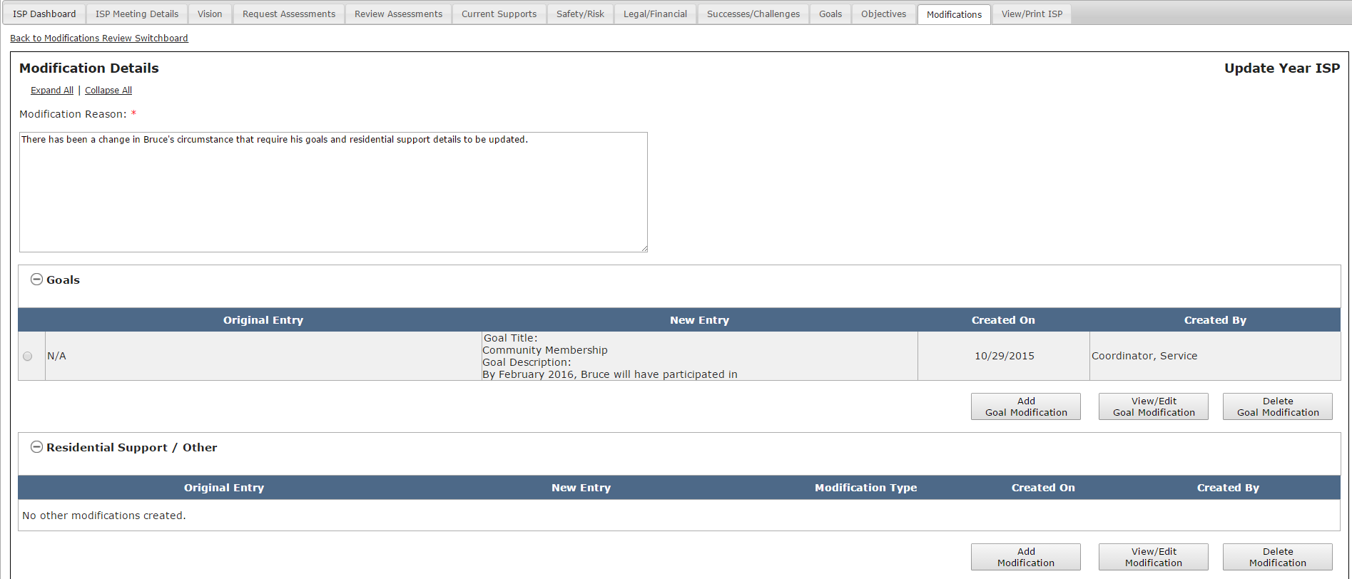
Scenario: SC Initiates a Modification
Step 1
Navigate to
Dashboard & Select “Modifications”
Step 2
Click “Add New Modification” &
Enter Modification
Reason
Step 3
Select Element to Modify
Step 4
Complete Modification of
Element
Step 5
(Optional)
Repeat for Other Element/s
Step 6
Complete the Review Section
And Submit
Step 7
AOD Review and Approve
Step 4: Complete Modification of Element
A.) Goals
Option 1: Adding a New Goal
The system will return to the Modifications Details screen. The details of the goal Modification will display. The original entry column displays the original goal objective if one exists. In this scenario, the original entry displays N/A because it is a new goal. The new entry column displays the title and description of the newly added goal.

Slide 34
Scenario: SC Initiates a Modification
Step 1
Navigate to
Dashboard & Select “Modifications”
Step 2
Click “Add New Modification” &
Enter Modification
Reason
Step 3
Select Element to Modify
Step 4
Complete Modification of
Element
Step 5
(Optional)
Repeat for Other Element/s
Step 6
Complete the Review Section
And Submit
Step 7
AOD Review and Approve
Step 4: Complete Modification of Element
A.) Goals
Option 2: Modify an Existing Goal
To initiate a Modification to goals, click “Add Goal Modification” on the Modifications Details screen.

Slide 35
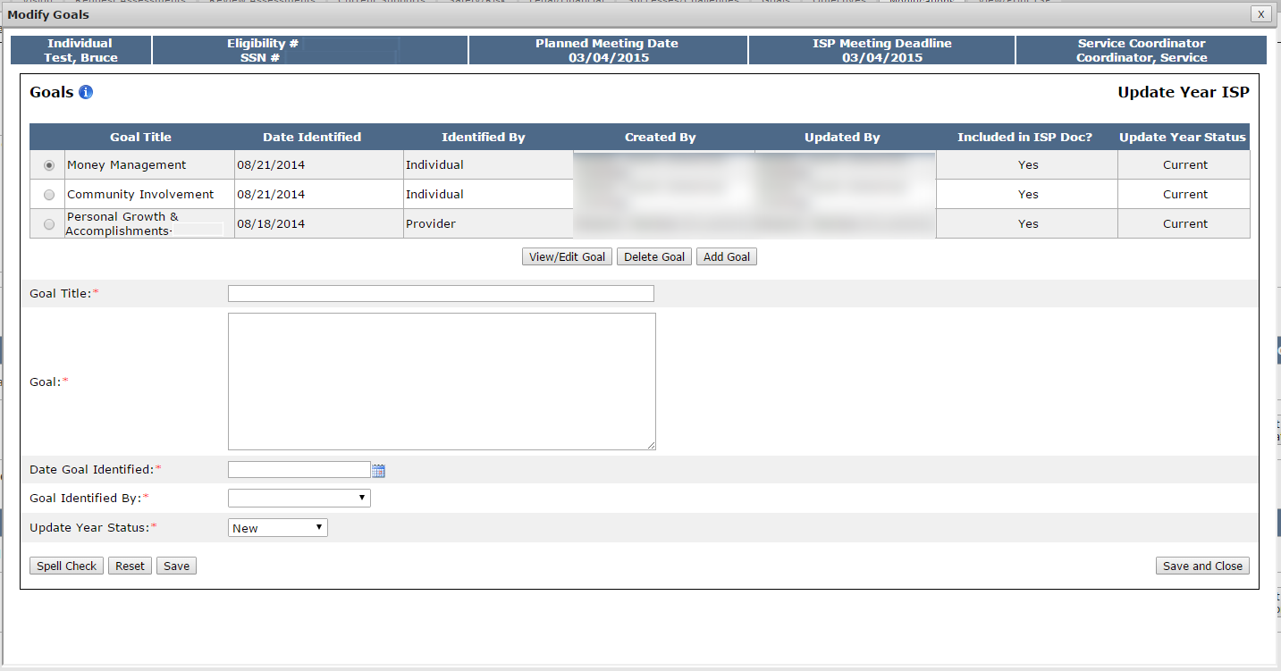
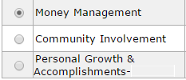
Scenario: SC Initiates a Modification
Step 1
Navigate to
Dashboard & Select “Modifications”
Step 2
Click “Add New Modification” &
Enter Modification
Reason
Step 3
Select Element to Modify
Step 4
Complete Modification of
Element
Step 5
(Optional)
Repeat for Other Element/s
Step 6
Complete the Review Section
And Submit
Step 7
AOD Review and Approve
Step 4: Complete Modification of Element
A.) Goals
Option 2: Modify an Existing Goal
Select the radio button next to the desired goal.

Slide 36
Scenario: SC Initiates a Modification
Step 1
Navigate to
Dashboard & Select “Modifications”
Step 2
Click “Add New Modification” &
Enter Modification
Reason
Step 3
Select Element to Modify
Step 4
Complete Modification of
Element
Step 5
(Optional)
Repeat for Other Element/s
Step 6
Complete the Review Section
And Submit
Step 7
AOD Review and Approve
Step 4: Complete Modification of Element
A.) Goals
Option 2: Modify an Existing Goal
Click “View/Edit Goal.”

Slide 37
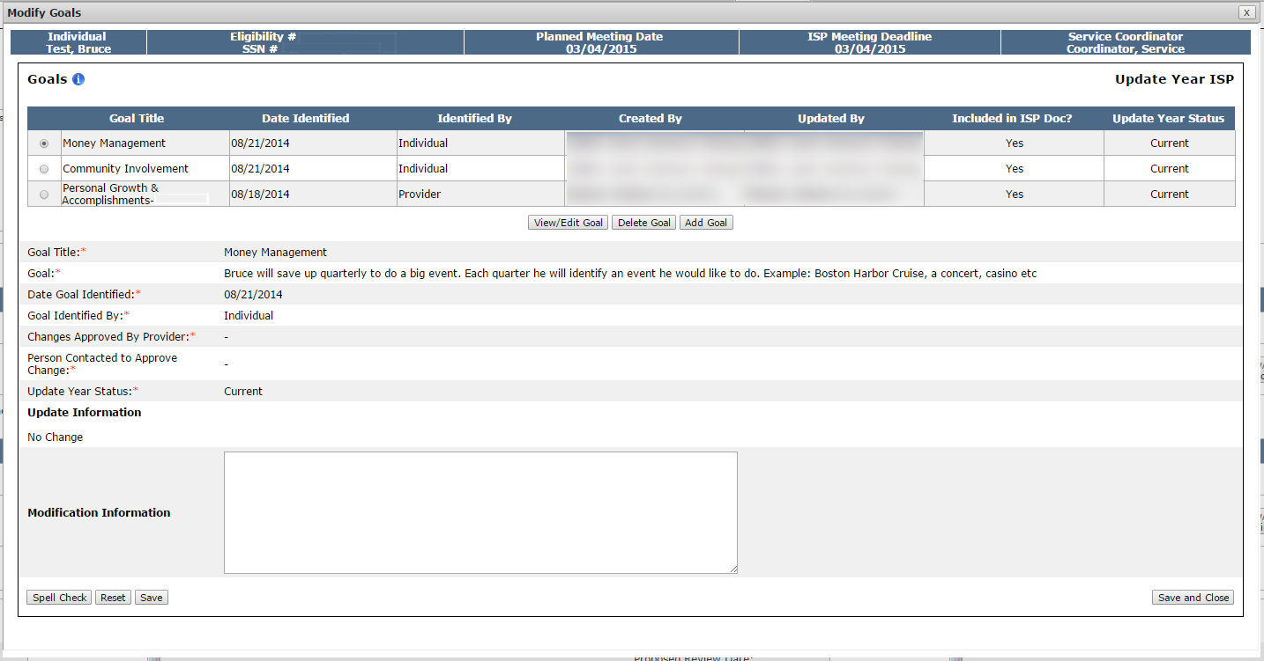
Scenario: SC Initiates a Modification
Step 1
Navigate to
Dashboard & Select “Modifications”
Step 2
Click “Add New Modification” &
Enter Modification
Reason
Step 3
Select Element to Modify
Step 4
Complete Modification of
Element
Step 5
(Optional)
Repeat for Other Element/s
Step 6
Complete the Review Section
And Submit
Step 7
AOD Review and Approve
Step 4: Complete Modification of Element
A.) Goals
Option 2: Modify an Existing Goal
The system will display the existing goal details.

Slide 38
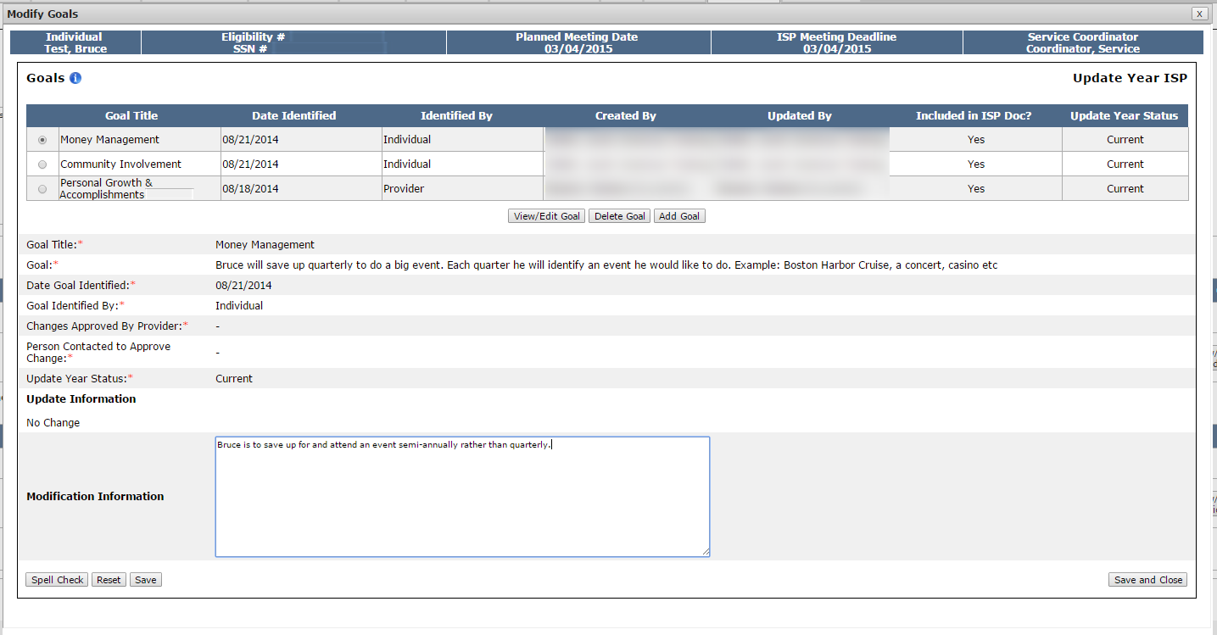
Scenario: SC Initiates a Modification
Step 1
Navigate to
Dashboard & Select “Modifications”
Step 2
Click “Add New Modification” &
Enter Modification
Reason
Step 3
Select Element to Modify
Step 4
Complete Modification of
Element
Step 5
(Optional)
Repeat for Other Element/s
Step 6
Complete the Review Section
And Submit
Step 7
AOD Review and Approve
Step 4: Complete Modification of Element
A.) Goals
Option 2: Modify an Existing Goal
Enter the desired Modification detail in the Modification Information textbox.

Slide 39
Scenario: SC Initiates a Modification
Step 1
Navigate to
Dashboard & Select “Modifications”
Step 2
Click “Add New Modification” &
Enter Modification
Reason
Step 3
Select Element to Modify
Step 4
Complete Modification of
Element
Step 5
(Optional)
Repeat for Other Element/s
Step 6
Complete the Review Section
And Submit
Step 7
AOD Review and Approve
Step 4: Complete Modification of Element
A.) Goals
Option 2: Modify an Existing Goal
Select “Save and Close.”

Slide 40
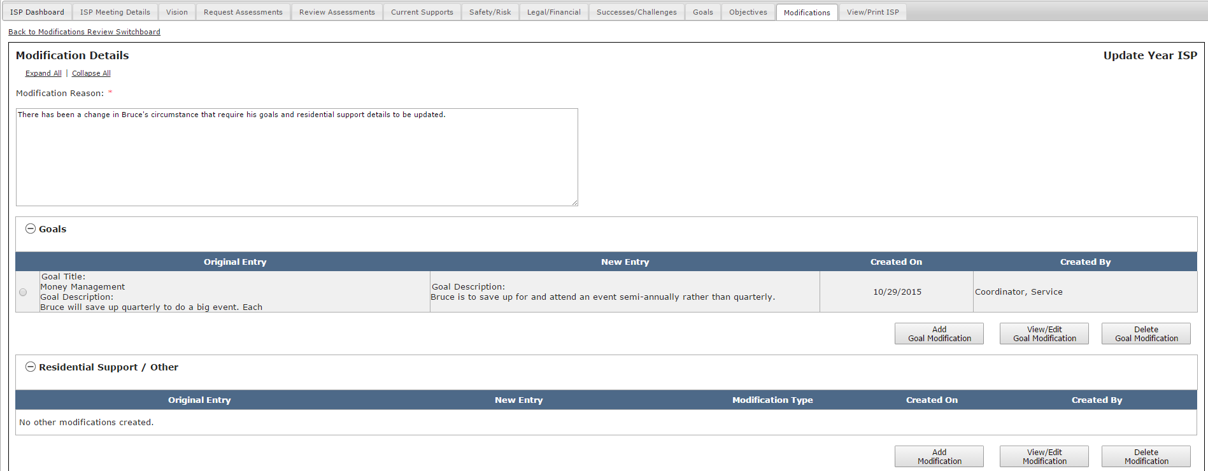
Scenario: SC Initiates a Modification
Step 1
Navigate to
Dashboard & Select “Modifications”
Step 2
Click “Add New Modification” &
Enter Modification
Reason
Step 3
Select Element to Modify
Step 4
Complete Modification of
Element
Step 5
(Optional)
Repeat for Other Element/s
Step 6
Complete the Review Section
And Submit
Step 7
AOD Review and Approve
Step 4: Complete Modification of Element
A.) Goals
Option 2: Modify an Existing Goal
The system will return to the Modifications Details screen. The details of the goal Modification will display.
In this scenario, the Original Entry column displays the original goal description.

Slide 41
Scenario: SC Initiates a Modification
Step 1
Navigate to
Dashboard & Select “Modifications”
Step 2
Click “Add New Modification” &
Enter Modification
Reason
Step 3
Select Element to Modify
Step 4
Complete Modification of
Element
Step 5
(Optional)
Repeat for Other Element/s
Step 6
Complete the Review Section
And Submit
Step 7
AOD Review and Approve
Step 4: Complete Modification of Element
A.) Goals
Option 3: Delete Goal
Once a Goal has been added to the Modification, a third option is available. It is possible to use the “Delete Goal” option. The delete function operates differently for newly added goals and existing goals:
Newly Added Goal
Deleting a newly added goal will remove the entire goal from the Modification.
Modified Existing Goal
Deleting an existing goal modified will only remove the modified information. The goal will remain a part of the ISP.
Unmodified Existing Goal
It is not possible to delete an unmodified existing goal. A goal that has been met or discontinued should be marked as such in the upcoming Progress Summary.

Slide 42
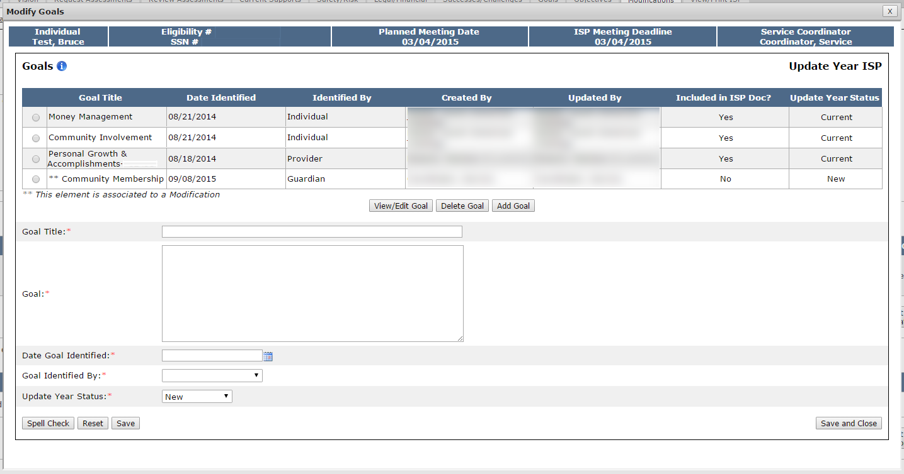
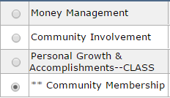
Scenario: SC Initiates a Modification
Step 1
Navigate to
Dashboard & Select “Modifications”
Step 2
Click “Add New Modification” &
Enter Modification
Reason
Step 3
Select Element to Modify
Step 4
Complete Modification of
Element
Step 5
(Optional)
Repeat for Other Element/s
Step 6
Complete the Review Section
And Submit
Step 7
AOD Review and Approve
Step 4: Complete Modification of Element
A.) Goals
Option 3: Delete Goal
From the Modify Goals screen, select the radio button for the newly added goal that requires deletion. The element associated with the previous Modification will display with two asterisks.

Slide 43
Scenario: SC Initiates a Modification
Step 1
Navigate to
Dashboard & Select “Modifications”
Step 2
Click “Add New Modification” &
Enter Modification
Reason
Step 3
Select Element to Modify
Step 4
Complete Modification of
Element
Step 5
(Optional)
Repeat for Other Element/s
Step 6
Complete the Review Section
And Submit
Step 7
AOD Review and Approve
Step 4: Complete Modification of Element
A.) Goals
Option 3: Delete Goal
Click “Delete Goal.”

Slide 44
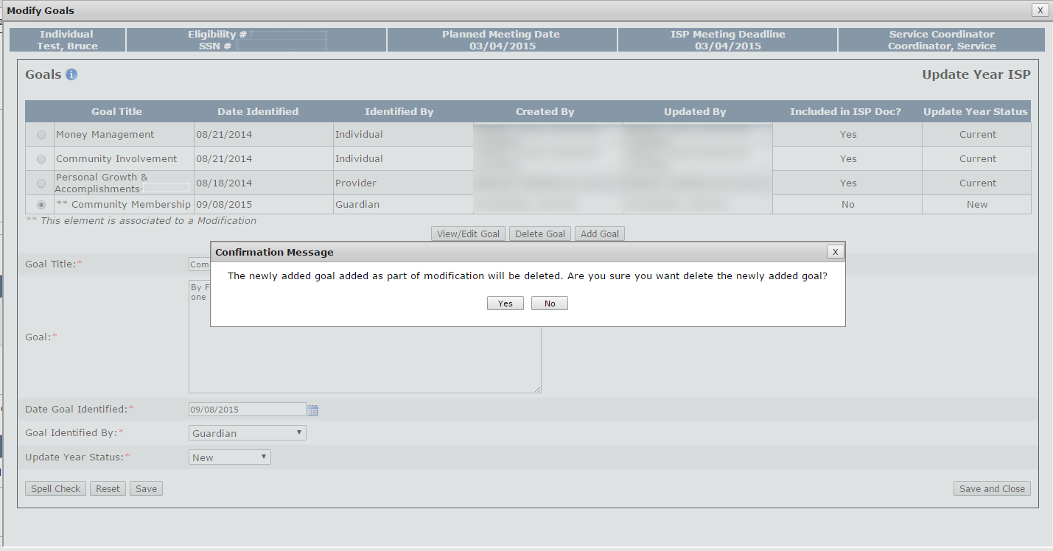
Scenario: SC Initiates a Modification
Step 1
Navigate to
Dashboard & Select “Modifications”
Step 2
Click “Add New Modification” &
Enter Modification
Reason
Step 3
Select Element to Modify
Step 4
Complete Modification of
Element
Step 5
(Optional)
Repeat for Other Element/s
Step 6
Complete the Review Section
And Submit
Step 7
AOD Review and Approve
Step 4: Complete Modification of Element
A.) Goals
Option 3: Delete Goal
The system will display a pop-up Confirmation Message. Click “Yes.”

Slide 45
Scenario: SC Initiates a Modification
Step 1
Navigate to
Dashboard & Select “Modifications”
Step 2
Click “Add New Modification” &
Enter Modification
Reason
Step 3
Select Element to Modify
Step 4
Complete Modification of
Element
Step 5
(Optional)
Repeat for Other Element/s
Step 6
Complete the Review Section
And Submit
Step 7
AOD Review and Approve
Step 4: Complete Modification of Element
A.) Goals
Option 3: Delete Goal
The system will return to the Modify Goals screen. The goal will no longer appear.

Slide 46
Scenario: SC Initiates a Modification
Step 1
Navigate to
Dashboard & Select “Modifications”
Step 2
Click “Add New Modification” &
Enter Modification
Reason
Step 3
Select Element to Modify
Step 4
Complete Modification of
Element
Step 5
(Optional)
Repeat for Other Element/s
Step 6
Complete the Review Section
And Submit
Step 7
AOD Review and Approve
Step 4: Complete Modification of Element
A.) Goals
Option 3: Delete Goal
Click “Save and Close.”

Slide 47
Scenario: SC Initiates a Modification
Step 1
Navigate to
Dashboard & Select “Modifications”
Step 2
Click “Add New Modification” &
Enter Modification
Reason
Step 3
Select Element to Modify
Step 4
Complete Modification of
Element
Step 5
(Optional)
Repeat for Other Element/s
Step 6
Complete the Review Section
And Submit
Step 7
AOD Review and Approve
Step 4: Complete Modification of Element
A.) Goals
Option 3: Delete Goal
The system will return to the Modifications Details Screen.

Slide 48
Scenario: SC Initiates a Modification
Step 1
Navigate to
Dashboard & Select “Modifications”
Step 2
Click “Add New Modification” &
Enter Modification
Reason
Step 3
Select Element to Modify
Step 4
Complete Modification of
Element
Step 5
(Optional)
Repeat for Other Element/s
Step 6
Complete the Review Section
And Submit
Step 7
AOD Review and Approve
Step 5: (Optional) Repeat for Other Element/s
If desired it is possible to complete additional Modifications to “Goals”, or “Residential Support / Other.”
If there are multiple elements that require a Modification and that are required for the same reason, it is best practice to submit a single Modification that includes multiple elements rather than submit multiple Modifications. For example, a medical issue such as a broken leg would require Modification to several elements.

Slide 49
Scenario: SC Initiates a Modification
Step 1
Navigate to
Dashboard & Select “Modifications”
Step 2
Click “Add New Modification” &
Enter Modification
Reason
Step 3
Select Element to Modify
Step 4
Complete Modification of
Element
Step 5
(Optional)
Repeat for Other Element/s
Step 6
Complete the Review Section
And Submit
Step 7
AOD Review and Approve
Step 5: (Optional) Repeat for Other Element/s
Additionally, after a Modification has been completed for an element but prior to submission, it is possible to edit or delete completed elements.
To edit a Goal Modification, click “View /Edit Goal Modification.
To delete a Goal Modification, click “Delete Goal Modification

Slide 50
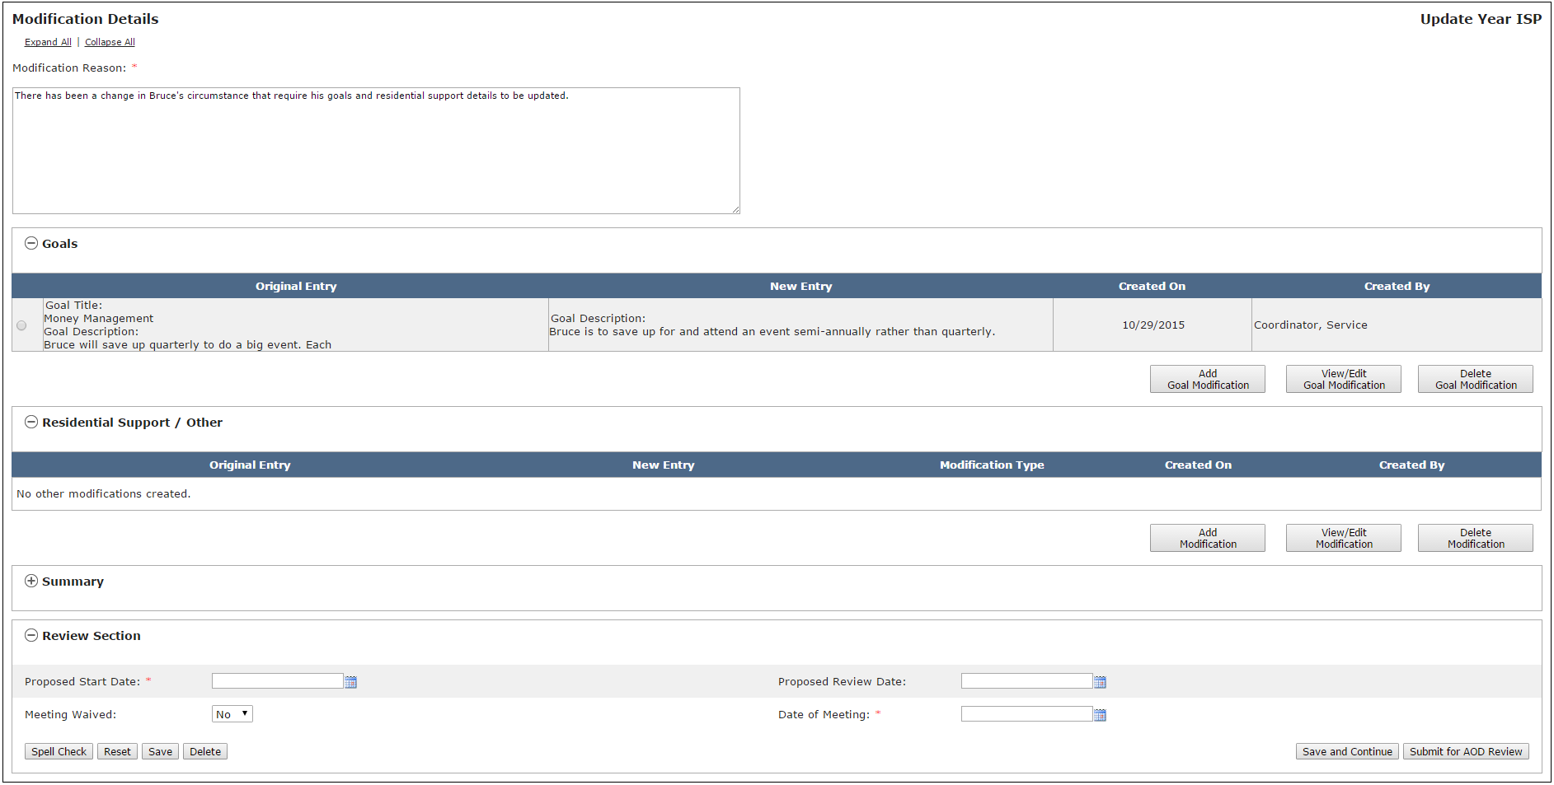
Scenario: SC Initiates a Modification
Step 1
Navigate to
Dashboard & Select “Modifications”
Step 2
Click “Add New Modification” &
Enter Modification
Reason
Step 3
Select Element to Modify
Step 4
Complete Modification of
Element
Step 5
(Optional)
Repeat for Other Element/s
Step 6
Complete the Review Section
And Submit
Step 7
AOD Review and Approve
Step 6: Complete the Review Section and Submit to AOD for Review
Prior to submitting, it is mandatory to complete the Review Section at the bottom of the Modifications Details Screen. Enter a Proposed Start Date. Optionally, also enter a Proposed Review Date.

Slide 51
Scenario: SC Initiates a Modification
Step 1
Navigate to
Dashboard & Select “Modifications”
Step 2
Click “Add New Modification” &
Enter Modification
Reason
Step 3
Select Element to Modify
Step 4
Complete Modification of
Element
Step 5
(Optional)
Repeat for Other Element/s
Step 6
Complete the Review Section
And Submit
Step 7
AOD Review and Approve
Step 6: Complete the Review Section and Submit to AOD for Review
If the Modification meeting has occurred, select “No” for the prompt Meeting Waived and select the date from the calendar drop down. If the meeting has not occurred, select “Yes” and identify the date the meeting was waived.

Slide 52
Scenario: SC Initiates a Modification
Step 1
Navigate to
Dashboard & Select “Modifications”
Step 2
Click “Add New Modification” &
Enter Modification
Reason
Step 3
Select Element to Modify
Step 4
Complete Modification of
Element
Step 5
(Optional)
Repeat for Other Element/s
Step 6
Complete the Review Section
And Submit
Step 7
AOD Review and Approve
Step 6: Complete the Review Section and Submit to AOD for Review
Click “Submit for AOD Review.”
NOTE: SCs retain the ability to edit a submitted Modification until an AOD approves the Modification. SCs retain these editing rights because AODs do not have the ability to edit and can only approve or disapprove. In the scenario that an AOD disapproves of a Modification because it requires revision, the AOD will explain the reason for disapproving in an offline discussion with the SC. The SC will be responsible for making any necessary revisions and resubmitting for AOD review.

Slide 53
Scenario: SC Initiates a Modification
Step 1
Navigate to
Dashboard & Select “Modifications”
Step 2
Click “Add New Modification” &
Enter Modification
Reason
Step 3
Select Element to Modify
Step 4
Complete Modification of
Element
Step 5
(Optional)
Repeat for Other Element/s
Step 6
Complete the Review Section
And Submit
Step 7
AOD Review and Approve
Step 7: AOD Review and Approve
AOD receives Alert indicating that a Modification has been submitted for review.
AOD clicks “A Modification has been accepted for an individual.”

Slide 54
Scenario: SC Initiates a Modification
Step 1
Navigate to
Dashboard & Select “Modifications”
Step 2
Click “Add New Modification” &
Enter Modification
Reason
Step 3
Select Element to Modify
Step 4
Complete Modification of
Element
Step 5
(Optional)
Repeat for Other Element/s
Step 6
Complete the Review Section
And Submit
Step 7
AOD Review and Approve
Step 7: AOD Review and Approve
The system will redirect to the Modifications Review Switchboard.
AOD to click “Submitted for AOD Review.”

Slide 55
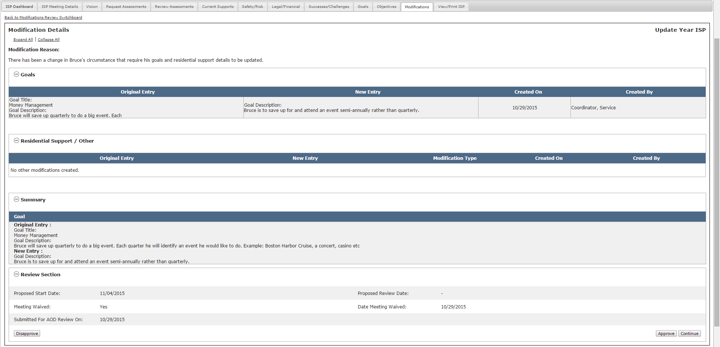
Scenario: SC Initiates a Modification
Step 1
Navigate to
Dashboard & Select “Modifications”
Step 2
Click “Add New Modification” &
Enter Modification
Reason
Step 3
Select Element to Modify
Step 4
Complete Modification of
Element
Step 5
(Optional)
Repeat for Other Element/s
Step 6
Complete the Review Section
And Submit
Step 7
AOD Review and Approve
Step 7: AOD Review and Approve
The system will display the Modifications Detail screen.
AOD to evaluate the Summary and Review section.
.

Slide 56
Scenario: SC Initiates a Modification
Step 1
Navigate to
Dashboard & Select “Modifications”
Step 2
Click “Add New Modification” &
Enter Modification
Reason
Step 3
Select Element to Modify
Step 4
Complete Modification of
Element
Step 5
(Optional)
Repeat for Other Element/s
Step 6
Complete the Review Section
And Submit
Step 7
AOD Review and Approve
Step 7: AOD Review and Approve
Once the review is complete, the AOD has two options - “Approve” or “Disapprove.”

Slide 57
Scenario: SC Initiates a Modification
Step 1
Navigate to
Dashboard & Select “Modifications”
Step 2
Click “Add New Modification” &
Enter Modification
Reason
Step 3
Select Element to Modify
Step 4
Complete Modification of
Element
Step 5
(Optional)
Repeat for Other Element/s
Step 6
Complete the Review Section
And Submit
Step 7
AOD Review and Approve
Step 7: AOD Review and Approve
Option 1: Disapprove
In an offline discussion with the SC, the AOD will explain the reason that the Modification has not been approved. The AOD will either indicate that the Modification is not required altogether or that it requires revision. The reason will determine the next steps.
If the reason is that the Modification is not required altogether, the AOD will disapprove the Modification and no action is required by the SC.
If the reason is that revision of the Modification is required, the AOD will neither disapprove nor approve the Modification and inform the SC who will request revisions from the Provider.

Slide 58
Scenario: SC Initiates a Modification
Step 1
Navigate to
Dashboard & Select “Modifications”
Step 2
Click “Add New Modification” &
Enter Modification
Reason
Step 3
Select Element to Modify
Step 4
Complete Modification of
Element
Step 5
(Optional)
Repeat for Other Element/s
Step 6
Complete the Review Section
And Submit
Step 7
AOD Review and Approve
Step 7: AOD Review and Approve
Option 2: Approve
If AOD selects “Approve,” the system will redirect to the Modifications Review Switchboard. The status of the Modification will change to “Approved by AOD.”
In this scenario, the AOD approves the Modification.

Slide 59
Scenario: SC Initiates a Modification
Step 1
Navigate to
Dashboard & Select “Modifications”
Step 2
Click “Add New Modification” &
Enter Modification
Reason
Step 3
Select Element to Modify
Step 4
Complete Modification of
Element
Step 5
(Optional)
Repeat for Other Element/s
Step 6
Complete the Review Section
And Submit
Step 7
AOD Review and Approve
Step 7: AOD Review and Approve
The Modifications Review Switchboard displays summary details for the submitted Modification

Slide 60
Notes and Next Steps
Next Steps:
If the Area Office Director approves the Modification, the status of Modification changes to approved in the Modifications Review Switchboard and it is possible to print the Modification without a draft watermark.
If the Area Office Director disapproves the Modification, the status of the Modification changes to disapproved in the Modifications Review Switchboard and no further action is required. The Modification content, however, is not deleted and the Area Office Director has the option of changing the status of the Modification to approved at a later date if circumstances require it.
Important Notes:
Provider Supervisors are also able to submit Modifications. The next scenario will demonstrate DDS’s role in the process when Providers initiate and submit a Modification.
If a Modification is required, Service Coordinators are able to have a conversation with Providers and determine if it is more appropriate for the Modification to be initiated by the Provider or by DDS. In most circumstances, the Providers will initiate the modification.
If either a Provider Supervisor or DDS staff initiates a Modification for an element and the Modification is in Started status, it is not possible for another user to initiate a Modification on the same element. It is only possible to initiate a modification for that element after the modification in process has been approved or disapproved by an Area Office Director.
90 days prior to the next ISP meeting date, next year’s ISP document is generated by the system. After this has happened, it is not possible to submit Modifications to the prior year’s ISP. Instead, any change that occurs in that timeframe should be included as part of the upcoming individual’s ISP meeting.

Slide 61
Scenario: Reviewing a Modification

Slide 62
Scenario: Reviewing a Provider Initiated Modification
Description: Service Coordinators or Service Coordinator Supervisors review a Modification once a Provider Supervisor has submitted it to DDS for review. A Provider initiated Modification can include any combination of the following elements: Goals, Objective and Support Strategy, Residential Support / Behavior Plan / Other. The Service Coordinator user can accept, disapprove, or request revision to a provider initiated Modification.
Roles and Responsibilities:
Service Coordinators: Review a Modification, Accept, Request Revision,, Disapprove
Service Coordinator Supervisors: Review a Modification, Accept, Request Revision, Disapprove
Area Office Director: Review a Modification, Approve, Disapprove

Slide 63
Scenario: Reviewing a Provider Initiated Modification
Step 1
SC
Receives Submission Alert
Step 2
SC
Review and Request Revision
Step 3
SC
Receive Re-Submission
Alert
Step 4
SC
Review and Submit to AOD
Step 5
AOD
Review and Approve
Step 6
Print Modification
Step 1: Service Coordinator Receives Submission Alert
Service Coordinators will receive an alert indicating that Modifications have been submitted by Provider agencies.
On the Alert Switchboard, click the “Modification submitted by” link.

Slide 64
Scenario: Reviewing a Provider Initiated Modification
Step 1
SC
Receives Submission Alert
Step 2
SC
Review and Request Revision
Step 3
SC
Receive Re-Submission
Alert
Step 4
SC
Review and Submit to AOD
Step 5
AOD
Review and Approve
Step 6
Print Modification
Step 1: Service Coordinator Receives Submission Alert
The system will redirect to the Modifications Details screen.
Click “Submitted for DDS Review.”

Slide 65
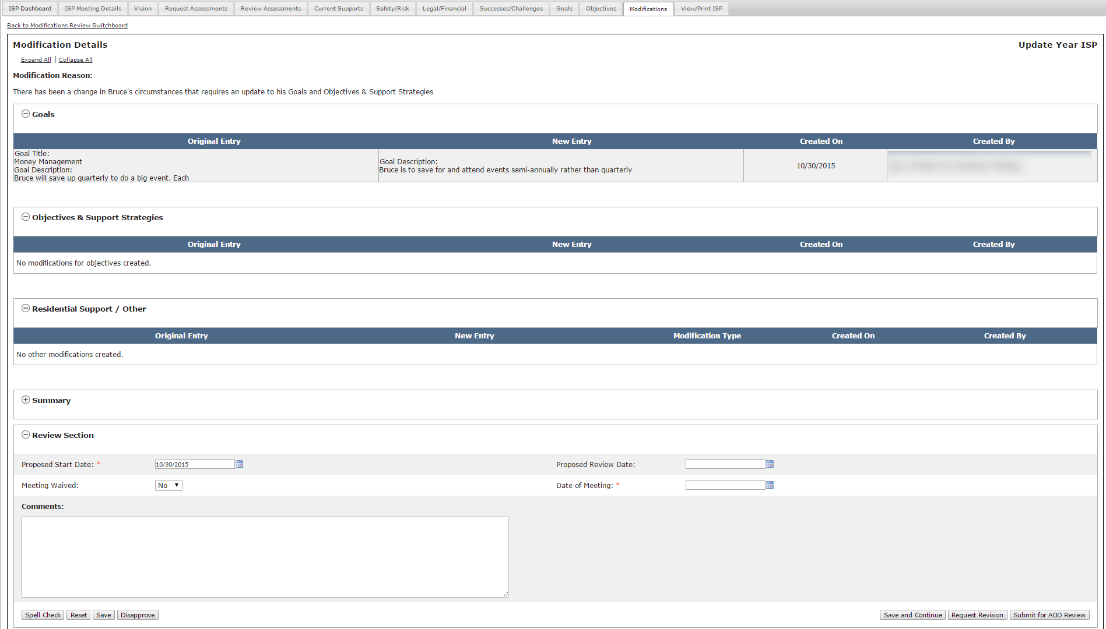
Scenario: Reviewing a Provider Initiated Modification
Step 1
SC
Receives Submission Alert
Step 2
SC
Review and Request Revision
Step 3
SC
Receive Re-Submission
Alert
Step 4
SC
Review and Submit to AOD
Step 5
AOD
Review and Approve
Step 6
Print Modification
Step 2: SC Review and Request Revision
Review the Modification Details screen.

Slide 66
Scenario: Reviewing a Provider Initiated Modification
Step 1
SC
Receives Submission Alert
Step 2
SC
Review and Request Revision
Step 3
SC
Receive Re-Submission
Alert
Step 4
SC
Review and Submit to AOD
Step 5
AOD
Review and Approve
Step 6
Print Modification
Step 2: SC Review and Request Revision
There are three options – 1.) “Submit for AOD Review”, 2.) “Request Revision”, 3.) “Disapprove”

Slide 67
Scenario: Reviewing a Provider Initiated Modification
Step 1
SC
Receives Submission Alert
Step 2
SC
Review and Request Revision
Step 3
SC
Receive Re-Submission
Alert
Step 4
SC
Review and Submit to AOD
Step 5
AOD
Review and Approve
Step 6
Print Modification
Step 2: SC Review and Request Revision
If the Modification information is acceptable and ready for AOD review, click “Submit for AOD Review”

Slide 68
Scenario: Reviewing a Provider Initiated Modification
Step 1
SC
Receives Submission Alert
Step 2
SC
Review and Request Revision
Step 3
SC
Receive Re-Submission
Alert
Step 4
SC
Review and Submit to AOD
Step 5
AOD
Review and Approve
Step 6
Print Modification
Step 2: SC Review and Request Revision
If this option is chosen, Providers will receive an alert indicating that the modification has been accepted but they still must wait for approval by the AOD.
Provider Alert | Reviewer
“Service Coordinator has accepted proposed Modification” | Service Coordinator Service Coordinator Supervisor
“AOD has approved your proposed Modification” | Area Office Director

Slide 69
Scenario: Reviewing a Provider Initiated Modification
Step 1
SC
Receives Submission Alert
Step 2
SC
Review and Request Revision
Step 3
SC
Receive Re-Submission
Alert
Step 4
SC
Review and Submit to AOD
Step 5
AOD
Review and Approve
Step 6
Print Modification
Step 2: SC Review and Request Revision
If the Modification was submitted in error or is not required, click “Disapprove” and enter comments to explain why the Modification has been disapproved.

Slide 70
Scenario: Reviewing a Provider Initiated Modification
Step 1
SC
Receives Submission Alert
Step 2
SC
Review and Request Revision
Step 3
SC
Receive Re-Submission
Alert
Step 4
SC
Review and Submit to AOD
Step 5
AOD
Review and Approve
Step 6
Print Modification
Step 2: SC Review and Request Revision
If the Modification requires revision, enter explanatory comments and click “Request Revision.” If “Request Revision” is chosen, the Provider Supervisor will receive an alert. In this scenario, this option is chosen.

Slide 71
Scenario: Reviewing a Provider Initiated Modification
Step 1
SC
Receives Submission Alert
Step 2
SC
Review and Request Revision
Step 3
SC
Receive Re-Submission
Alert
Step 4
SC
Review and Submit to AOD
Step 5
AOD
Review and Approve
Step 6
Print Modification
Step 3: SC Receive Submission Alert
Once the Provider completes revisions and submits to DDS, the SC receives an Alert.
Click “Modification Submitted by.”

Slide 72
Scenario: Reviewing a Provider Initiated Modification
Step 1
SC
Receives Submission Alert
Step 2
SC
Review and Request Revision
Step 3
SC
Receive Re-Submission
Alert
Step 4
SC
Review and Submit to AOD
Step 5
AOD
Review and Approve
Step 6
Print Modification
Step 3: SC Receive Submission Alert
On the Modifications Review Switchboard, click “Submitted for DDS Review.”

Slide 73
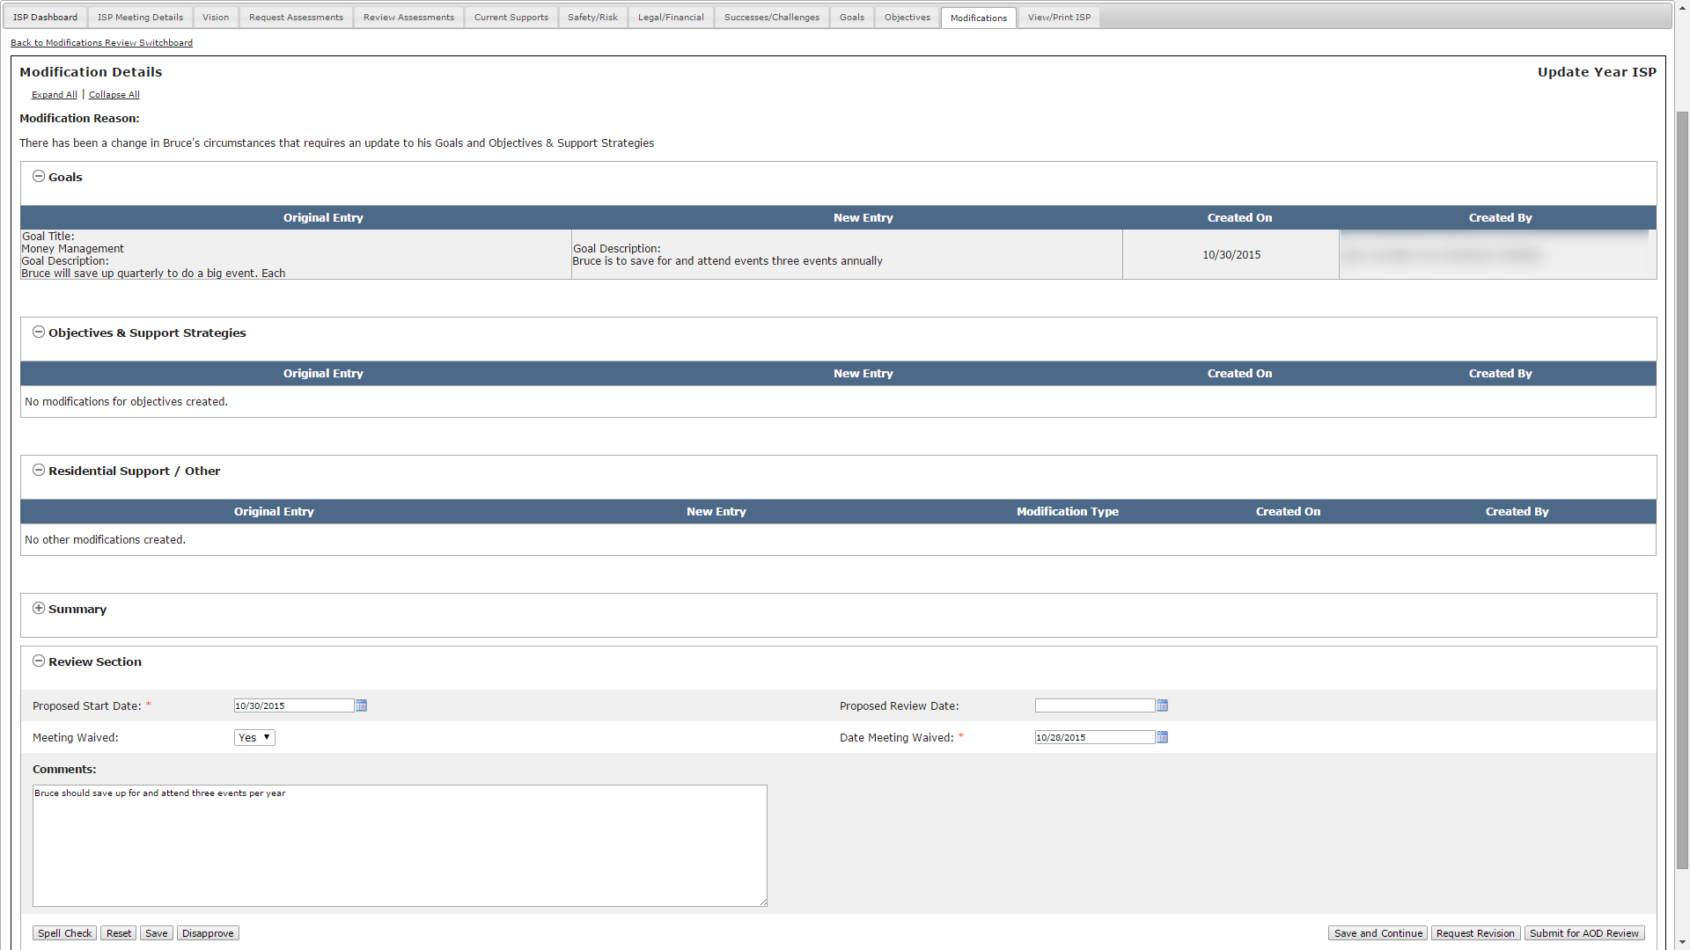
Scenario: Reviewing a Provider Initiated Modification
Step 1
SC
Receives Submission Alert
Step 2
SC
Review and Request Revision
Step 3
SC
Receive Re-Submission
Alert
Step 4
SC
Review and Submit to AOD
Step 5
AOD
Review and Approve
Step 6
Print Modification
Step 4: SC Review and Accept
Review the revised Modification

Slide 74
Scenario: Reviewing a Provider Initiated Modification
Step 1
SC
Receives Submission Alert
Step 2
SC
Review and Request Revision
Step 3
SC
Receive Re-Submission
Alert
Step 4
SC
Review and Submit to AOD
Step 5
AOD
Review and Approve
Step 6
Print Modification
Step 4: SC Review and Accept
If the revisions are acceptable, click “Submit for AOD Review.”

Slide 75
Scenario: Reviewing a Provider Initiated Modification
Step 1
SC
Receives Submission Alert
Step 2
SC
Review and Request Revision
Step 3
SC
Receive Re-Submission
Alert
Step 4
SC
Review and Submit to AOD
Step 5
AOD
Review and Approve
Step 6
Print Modification
Step 5: AOD Review and Approve
AOD receives an alert indicating that an SC has accepted a Modification for an individual.
AOD to click “A Modification has been accepted for an individual.”

Slide 76
Scenario: Reviewing a Provider Initiated Modification
Step 1
SC
Receives Submission Alert
Step 2
SC
Review and Request Revision
Step 3
SC
Receive Re-Submission
Alert
Step 4
SC
Review and Submit to AOD
Step 5
AOD
Review and Approve
Step 6
Print Modification
Step 5: AOD Review and Approve
The system will redirect to the Modifications Review Switchboard.
AOD to click “Submitted for AOD Review.”

Slide 77
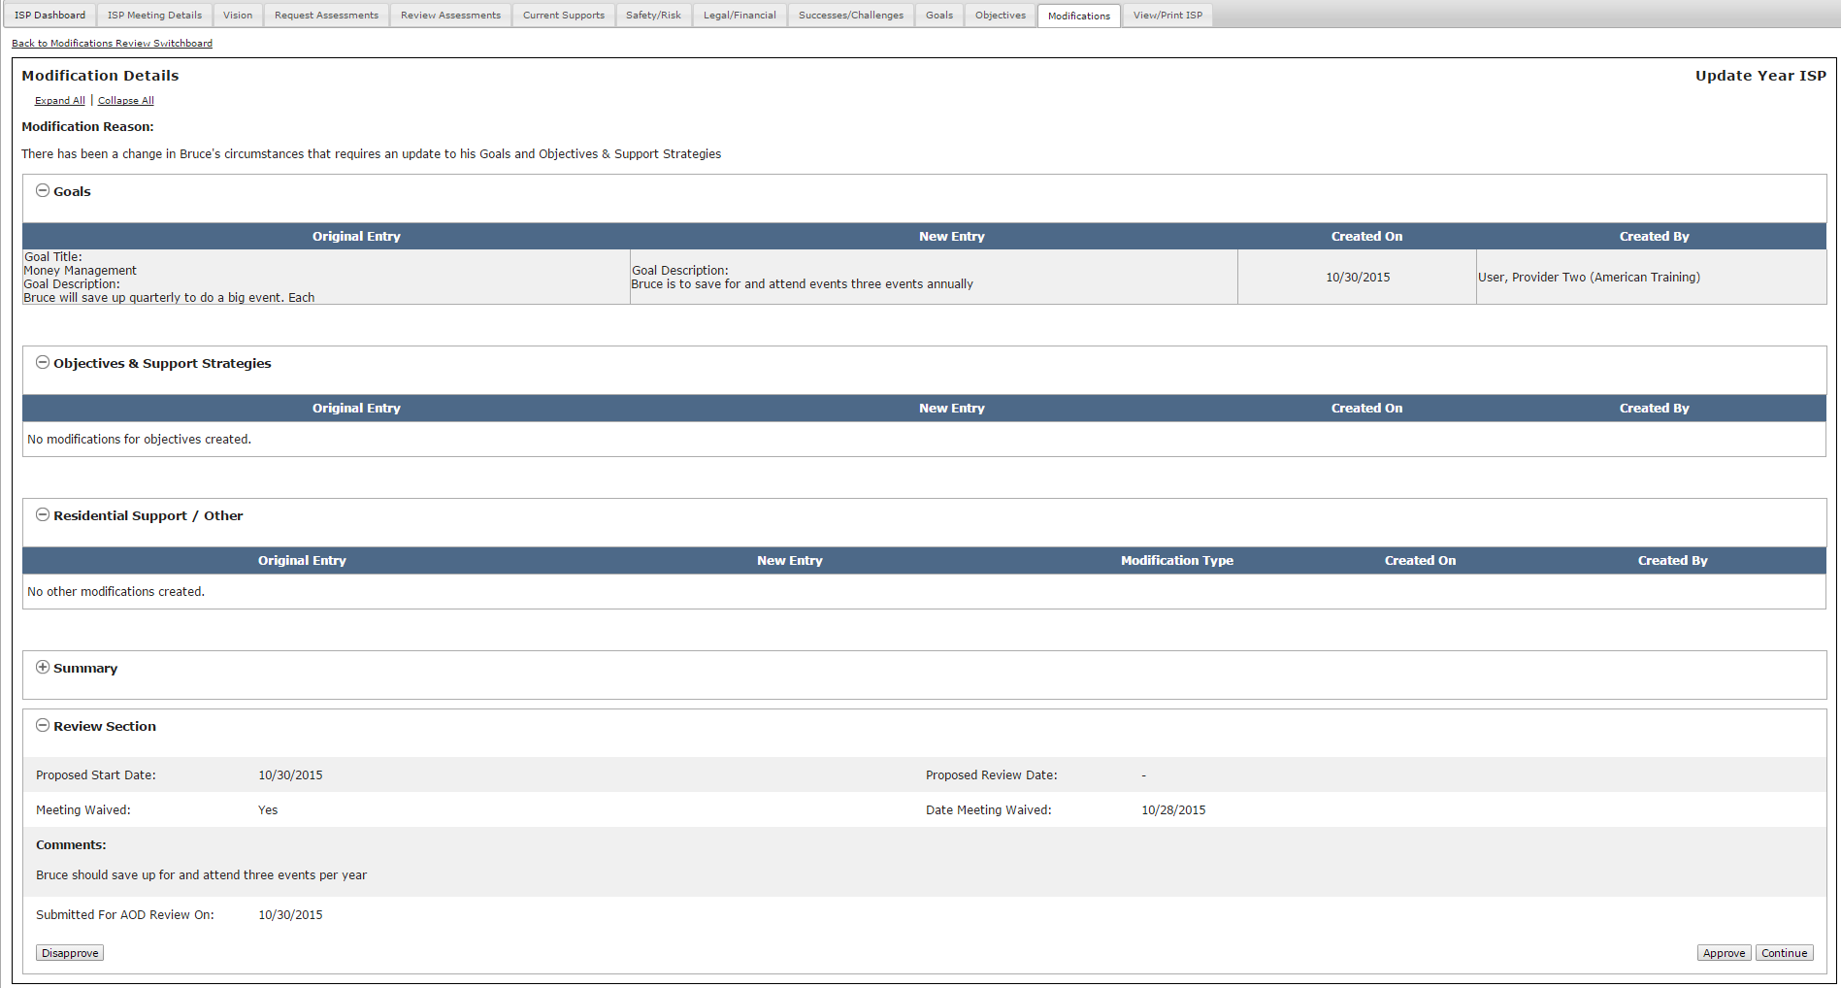
Scenario: Reviewing a Provider Initiated Modification
Step 1
SC
Receives Submission Alert
Step 2
SC
Review and Request Revision
Step 3
SC
Receive Re-Submission
Alert
Step 4
SC
Review and Submit to AOD
Step 5
AOD
Review and Approve
Step 6
Print Modification
Step 5: AOD Review and Approve
The system will redirect to the Modification Details Screen. AOD to review the content

Slide 78
Scenario: Reviewing a Provider Initiated Modification
Step 1
SC
Receives Submission Alert
Step 2
SC
Review and Request Revision
Step 3
SC
Receive Re-Submission
Alert
Step 4
SC
Review and Submit to AOD
Step 5
AOD
Review and Approve
Step 6
Print Modification
Step 5: AOD Review and Approve
Once the screen has been reviewed, the AOD has two options - “Approve” or “Disapprove.”

Slide 79
Scenario: Reviewing a Provider Initiated Modification
Step 1
SC
Receives Submission Alert
Step 2
SC
Review and Request Revision
Step 3
SC
Receive Re-Submission
Alert
Step 4
SC
Review and Submit to AOD
Step 5
AOD
Review and Approve
Step 6
Print Modification
Step 5: AOD Review and Approve
Option 1: Disapprove
In an offline discussion with the SC, the AOD will explain the reason that the Modification has not been approved. The AOD will either indicate that the Modification is not required altogether or that it requires revision. The reason will determine the next steps.
If the reason is that the Modification is not required altogether, the AOD will disapprove the Modification and no action is required the SC.
If the reason is that revision of the Modification is required, the AOD will neither disapprove nor approve the Modification and inform the SC who will request revisions from the Provider.

Slide 80
Scenario: Reviewing a Provider Initiated Modification
Step 1
SC
Receives Submission Alert
Step 2
SC
Review and Request Revision
Step 3
SC
Receive Re-Submission
Alert
Step 4
SC
Review and Submit to AOD
Step 5
AOD
Review and Approve
Step 6
Print Modification
Step 5: AOD Review and Approve
Option 2: Approve
If AOD selects “Approve,” the system will redirect to the Modifications Review Switchboard. The status of the Modification will read “Approved by AOD.”
In this scenario, the AOD approves the Modification.
.

Slide 81
Scenario: Reviewing a Provider Initiated Modification
Step 1
SC
Receives Submission Alert
Step 2
SC
Review and Request Revision
Step 3
SC
Receive Re-Submission
Alert
Step 4
SC
Review and Submit to AOD
Step 5
AOD
Review and Approve
Step 6
Print Modification
Step 6: Print Modification
SC or AOD click “View/Print ISP” tab.

Slide 82
Scenario: Reviewing a Provider Initiated Modification
Step 1
SC
Receives Submission Alert
Step 2
SC
Review and Request Revision
Step 3
SC
Receive Re-Submission
Alert
Step 4
SC
Review and Submit to AOD
Step 5
AOD
Review and Approve
Step 6
Print Modification
Step 6: Print Modification
The system will display the View / Print screen. Modifications will appear as an option.
SC or AOD click next to Modifications to expand.

Slide 83
Scenario: Reviewing a Provider Initiated Modification
Step 1
SC
Receives Submission Alert
Step 2
SC
Review and Request Revision
Step 3
SC
Receive Re-Submission
Alert
Step 4
SC
Review and Submit to AOD
Step 5
AOD
Review and Approve
Step 6
Print Modification
Step 6: Print Modification
SC or AOD select either the Word or PDF icon next to the Modification of choice. The document will print with a draft watermark until it has been approved.

Slide 84
Notes and Next Steps
The Area Office Director is not able to approve part of a modification. If the Area Office Director decides to click “Approve,” the entire Modification is approved, including all the elements included in it.
Once a Modification has been approved, the modified information will display in the individual’s plan.
All modified information will display with an asterisk on the system. For example, if an existing goal is modified, an asterisk displays next to the goal on the Goal tab for the individual.
NOTE: An new objective that is added as part of a Modification does not follow the approval process that objectives usually require in a typical ISP year. Rather, the approval of the Modification is recognized as an implicit approval of the objective and its status display as approved. Once approved, the objective will appear on the Objectives and Support Strategies Review Switchboard and, by default, the check mark will be selected in the Include in ISP? Column.
NOTE: Once a Modification for a newly added objective is submitted and approved, Progress Summaries will be triggered for the objective.

Slide 85
Review Process Management
The Review Process Management table now includes a “Modification” column, which indicates the status of any modifications associated with an individual’s ISP.
If no modifications have been submitted for an individual, the text in the column will read “Not Applicable.”

Slide 86
Chapter 6 Summary
This Chapter covered:
Overview of Modifications
Scenario: Initiating a Modification
Scenario: Reviewing a Modification

