Slide 1
Department of Developmental Services
Massachusetts Rehabilitation Commission
Individual Support Plan (ISP) Module Training
Release 7.7 – DDS Staff

Slide 2
Chapter 7: Additional Functionality and Conclusion
Chapter 1
Chapter 2
Chapter 3
Chapter 4
Chapter 5
Chapter 6
Chapter 7

Slide 3
Chapter 7 Overview
This Chapter will cover:
Scenario: Auto Save Functionality
Additional Enhancements
Training Summary and Conclusion

Slide 4
Scenario: Auto Save Functionality

Slide 5
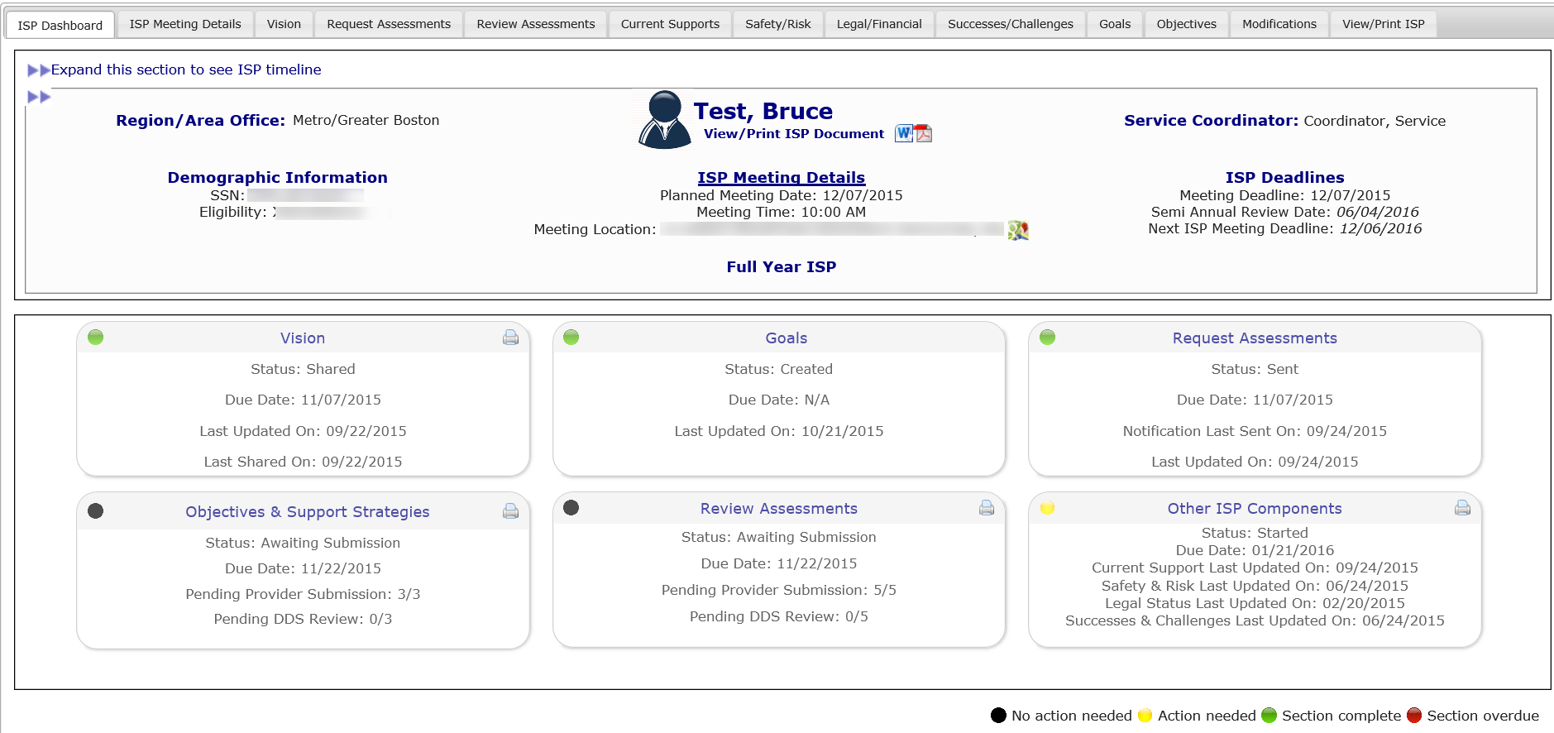
Scenario: Auto Save Functionality
Step 1
Navigate to ISP Dashboard
Step 2
Click
“Vision”
Step 3
Enter information into textbox
Step 4
Auto Save Runs
Step 5
Revisit “Vision”
Step 1: Navigate to ISP Dashboard
Auto Save Functionality is enabled for Service Coordinators, Service Coordinator Supervisors and Area Office Director roles on the Vision page and the Other ISP Components pages (Current Supports, Safety/Risk, Legal/Financial, Successes/Challenges). In this scenario, we’ll demonstrate the functionality in Vision.
Navigate to the ISP Dashboard.

Slide 6
Scenario: Auto Save Functionality
Step 1
Navigate to ISP Dashboard
Step 2
Click
“Vision”
Step 3
Enter information into textbox
Step 4
Auto Save Runs
Step 5
Revisit “Vision”
Step 2: Click on the “Vision” Tab
Click on the “Vision” tab.

Slide 7
Scenario: Auto Save Functionality
Step 1
Navigate to ISP Dashboard
Step 2
Click
“Vision”
Step 3
Enter information into textbox
Step 4
Auto Save Runs
Step 5
Revisit “Vision”
Step 3: Enter Information Into Textbox
Enter relevant information into the textbox. Auto Save will be initiated if you do not perform any action on the screen for 15 minutes.

Slide 8
Scenario: Auto Save Functionality
Step 1
Navigate to ISP Dashboard
Step 2
Click
“Vision”
Step 3
Enter information into textbox
Step 4
Auto Save Runs
Step 5
Revisit “Vision”
Step 4: Auto Save Runs
After remaining idle for 15 minutes, the system will automatically save the contents of the textbox. The system will also indicate that this action has occurred by displaying the following message on the screen:

Slide 9
Scenario: Auto Save Functionality
Step 1
Navigate to ISP Dashboard
Step 2
Click
“Vision”
Step 3
Enter information into textbox
Step 4
Auto Save Runs
Step 5
Revisit “Vision”
Step 5: Revisit Vision Page
If you are logged out of the system due to inactivity or if you navigate to a different section of HCSIS, the system automatically retains the AutoSaved information. At a later time, to view the automatically saved information, navigate back to the Vision tab. The screen will display the message below.

Slide 10
Scenario: Auto Save Functionality
Step 1
Navigate to ISP Dashboard
Step 2
Click
“Vision”
Step 3
Enter information into textbox
Step 4
Auto Save Runs
Step 5
Revisit “Vision”
Step 5: Revisit Other ISP Components page
As the message indicates, the text that has been auto-saved loads on the screen and is displayed in the text boxes.

Slide 11
Scenario: Auto Save Functionality
Step 1
Navigate to ISP Dashboard
Step 2
Click
“Vision”
Step 3
Enter information into textbox
Step 4
Auto Save Runs
Step 5
Revisit “Vision”
Step 5: Revisit Other ISP Components page
An icon displays next to the text box. If you hover over the icon, the text that was last manually saved by the user will display.

Slide 12
Scenario: Auto Save Functionality
Step 1
Navigate to ISP Dashboard
Step 2
Click
“Vision”
Step 3
Enter information into textbox
Step 4
Auto Save Runs
Step 5
Revisit “Vision”
Step 5: Revisit Other ISP Components page
Compare the auto-saved text with the manually saved text and determine which text to retain.

Slide 13
Scenario: Auto Save Functionality
Step 1
Navigate to ISP Dashboard
Step 2
Click
“Vision”
Step 3
Enter information into textbox
Step 4
Auto Save Runs
Step 5
Revisit “Vision”
Step 5: Revisit Other ISP Components page
If you would like to remove the auto saved information, click “Reset.” If you would like to retain the auto saved information, click “Save.”

Slide 14
Notes and Next Steps
NOTE: Auto Save functionality is operational in the Vision and Other ISP Components. This functionality has been added to these sections of the ISP document because these sections require a large amount of text. Auto Save is not enabled for other components of the ISP document, such as Goals and Objectives & Support Strategies.

Slide 15
Additional Enhancements

Slide 16
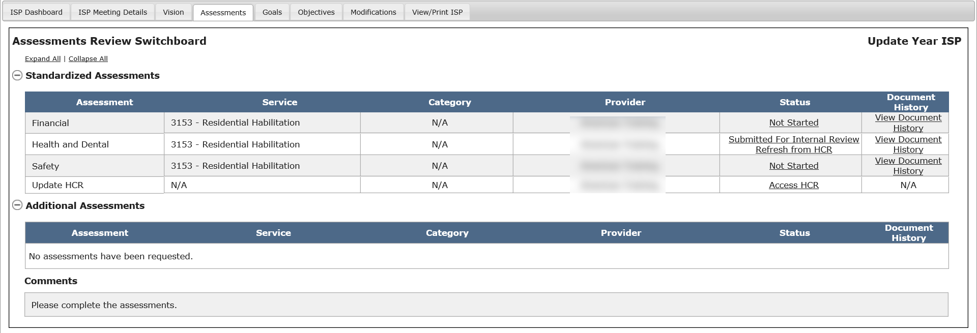
Other Enhancements
Health Care Record and Health & Dental Assessment – Date Format
Previous Functionality | New Functionality
Providers can only enter the year – “yyyy” format – for dates for physical and medical examination dates in the Health Care Record and, after the record has been refreshed, the dates populate in the Health and Dental Assessment. | The Health Care Record has been enhanced to now allow the provider to enter physical and medical examination dates in “mm/dd/yyyy” format. Once the Provider has entered the date in the new format in the HCR and clicked the “Refresh from HCR” button on the Assessments Review Switchboard, the new date format for physical and medical examinations will appear on the H&D assessment.
Provider View of Assessments Review Switchboard

Slide 17
Other Enhancements
Below is a list that briefly describes how the new, smaller enhancements will affect HCSIS:
Topic | Previous Functionality | New Functionality
RICCI Class Member ISP Submission | The ISP process for RICCI class members had been a paper process | It is now possible to complete the ISP Process for all RICCI class members on HCSIS
Ticket Response Time | Response time to complete requests for data fixes may require one to two weeks. | HCSIS Business Analysts now have a utility that enables them to have a faster response time when responding to requests related to data fixes, such as deleting mandatory assessments when a service has ended prior to an ISP.

Slide 18
Other Enhancements
Below is a list that briefly describes how the new, smaller enhancements will affect HCSIS:
Topic | Previous Functionality | New Functionality
Access After Caseload Change | If there is a change in caseload assignment in MEDITECH, the Service Coordinator who has been reassigned no longer has access to the ISP documents for the individuals previously on his/her caseload. | Under the new functionality, if there is a change in caseload assignment, the Service Coordinator who has been reassigned retains access to the latest approved ISP document of the individual.
Provider Access to Plans | When a Provider agency stops providing services to an individual, they would no longer have access to the individual in HCSIS. They would be unable to access the individuals current or previous plan. | If and when a Provider agency stops providing services to an individual, the agency will retain read-only access to the latest ISP document which the Provider had been involved in.
Vision Page Character Limits | The “Persons contributed to create Vision” text box on the Vision page currently has a 50 character limit. | Under the new functionality, the text box will be changed to accept up to 200 characters.

Slide 19
Future Enhancements
Below is a list that briefly describes requests for enhancements that will be deployed in a future release:
Access to Historical ISP Documents
This enhancement will enable Providers, Area Directors, and Service Coordinators to access historical sections of the ISP document regardless of whether the year selection status has been made by the Service Coordinator
Document Upload to HCSIS
Additional Assessments
Supporting Documentation

Slide 20
Chapter 7 Summary
This Chapter covered:
Scenario: Auto Save Functionality for Other ISP Components
Other Enhancements

Slide 21
Training Conclusion and Next Steps

Slide 22
Training Summary
Chapter 1: Overview of the ISP Module
Chapter 2: Year Selection
Chapter 3: Progress Summaries
Chapter 4: Progress Summary Report
Chapter 5: Area Director Approval of the ISP
Chapter 6: Modifications
Chapter 7: Additional Functionality and Conclusion

Slide 23
Additional References
Additional references are accessible on the ISP Assessments References page. To access the page, click the second level menu tab.

Slide 24
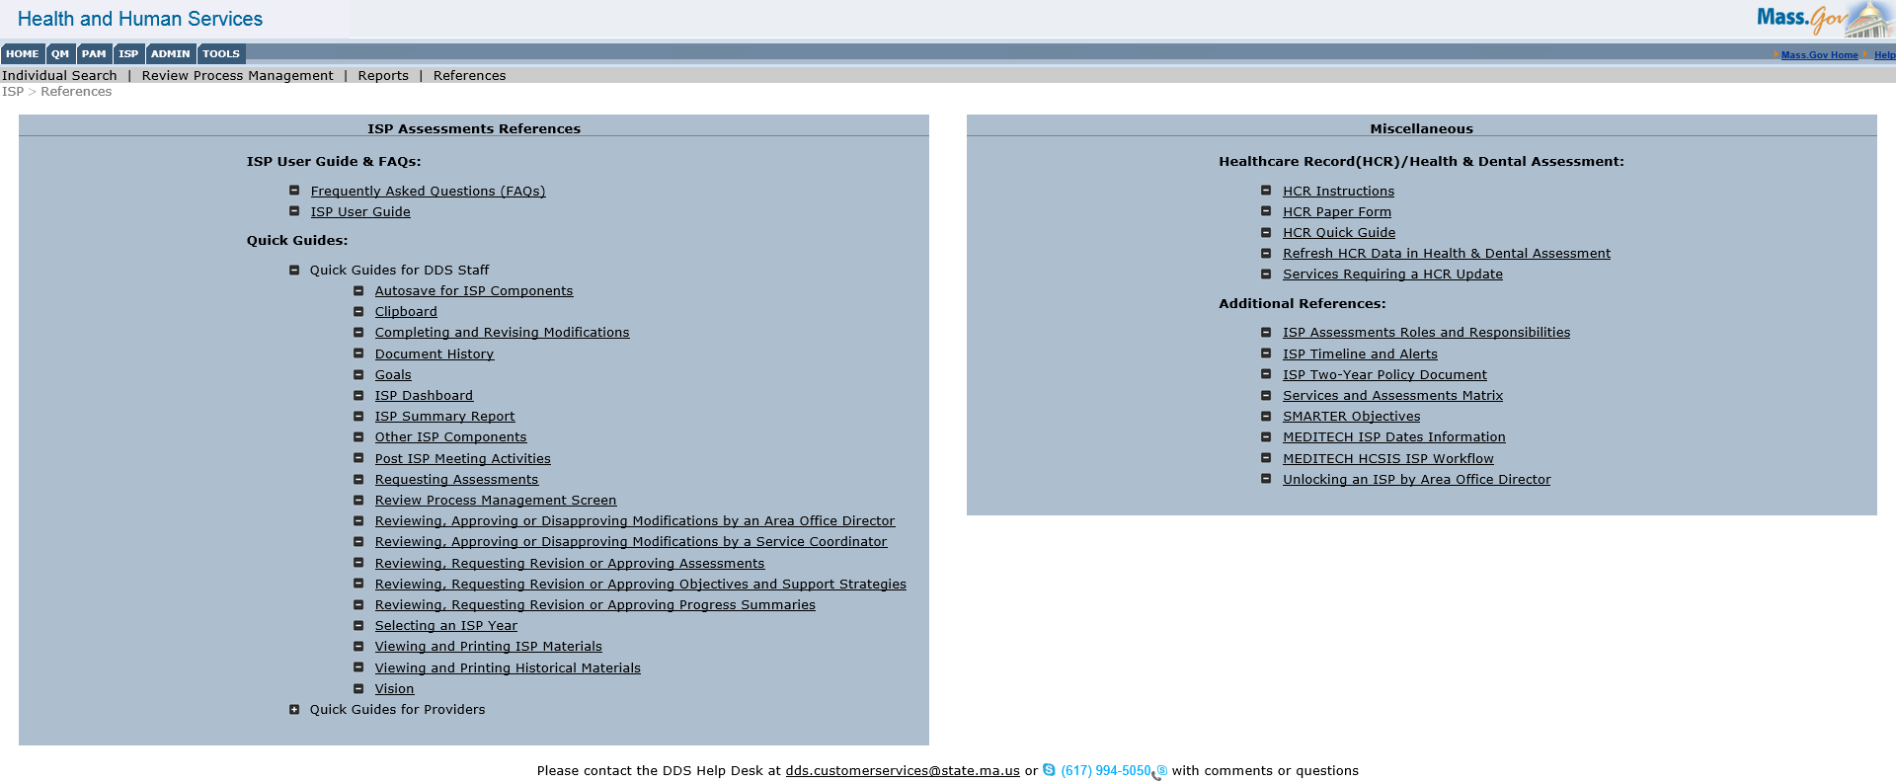
Additional References
The References page provides links to FAQs, ISP User Guide, Quick Guides, information on relationship between HealthCare Record / Health & Health and Dental Assessments, and additional references relating to the ISP Module. This is the expanded view of the ISP Module references. This shows the various Quick Guides for DDS Staff.

Slide 25
Additional References
Quick Guides on the new enhancements are available to you on the reference page.

Slide 26
Additional References
One reference is the ISP Timeline and Alerts document which identifies all of the alerts that the system generates.

Slide 27
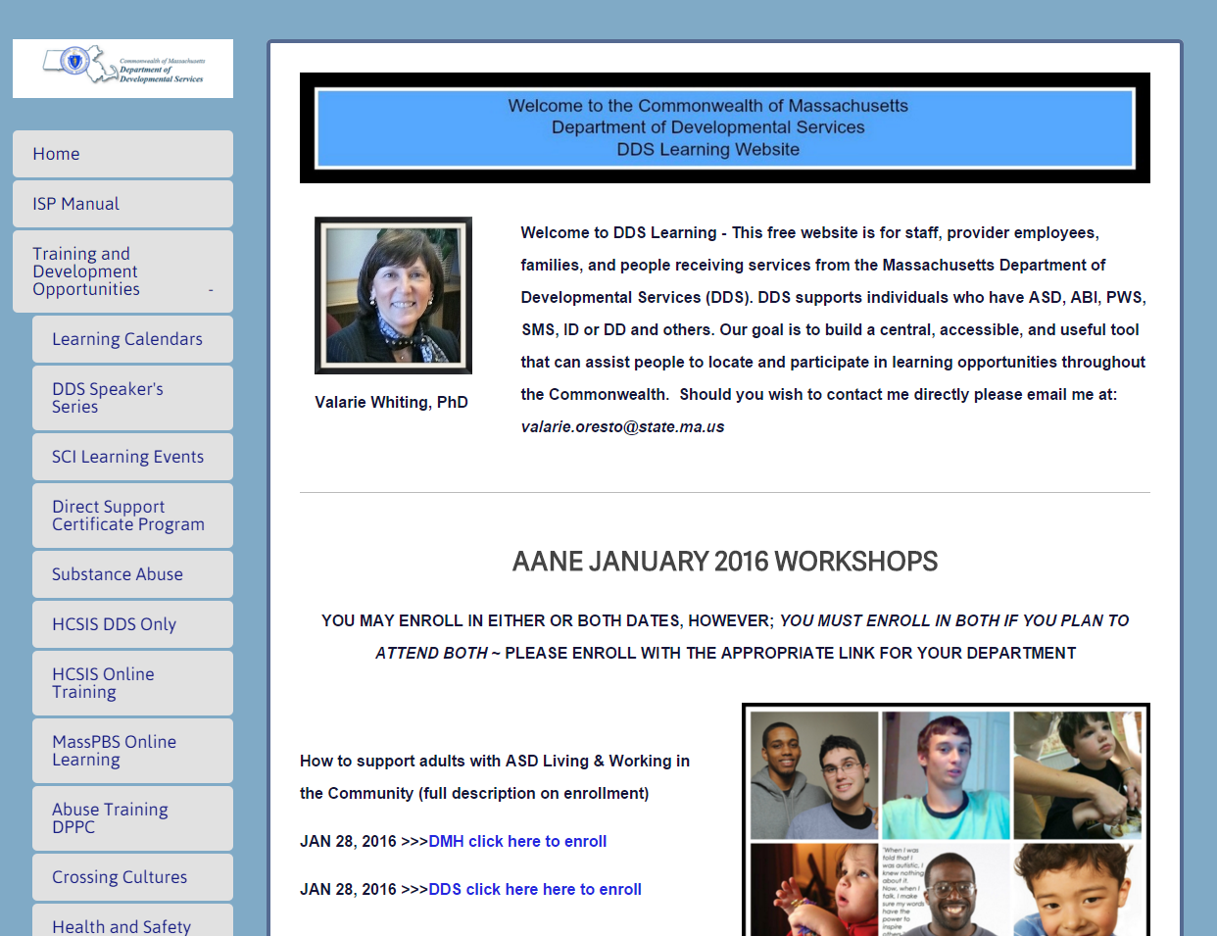
Additional References
Additional training content is available to you on DDSLearning.com. The content on the website includes video reference material. Be sure to use Google Chrome when accessing this website.
1. Click “Training and Development Opportunities”
2. Click “HCSIS Online Training”

Slide 28
Key Considerations
The ISP module enhancements will be accessible starting February 8th, 2016.
Post go-live webinars and Area Office visits will be conducted in the few months following the go-live date to address outstanding questions related to the changes.
Training materials will be available to you on the DDS website at mass.gov/dds and also at DDSLearning.com. A recording of this training session will be posted on DDSLearning.com as well.
IMPORTANT NOTE: On February 8th, the Progress Summary process will be activated. If a Progress Summary is due on or after March 9th – which is 30 days after the go-live – Providers will be required to complete the Progress Summary in the system and will receive alerts associated with the Progress Summary.
February 8th | PS due < 30 days after go-live | PS due >= 30 days after go-live
Go-live | Complete Paper Form | Complete form in HCSIS

Slide 29
Next Steps
DDS is currently working on additional video training materials. To access existing video references, please visit DDSLearning.com. Be sure to use Google Chrome when accessing this website.
If you have any additional questions, feel free to contact the DDS Help Desk:
‒ 617-994-5050**
dds.customerservices@state.ma.us
Hours of operation: 7AM – 7PM M-F
**Please note that, as of 6/1/2015, the help desk phone number was changed to the above.

